Slide 1
Creation and Optimization of a State Vector Quantum Simulator
Santo, Shannah and Viktor
Initial presentation for the Praktikum of Quantum Computing
Task assigned by: Prof. Dr. Kranzlmüller
Supervised by: F. Krötz, K. Staudacher, X.To
Date of presentation: 11th of October 2024

Slide 2
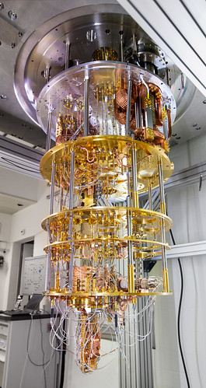
Introduction
Quantum simulator efficiency:
Allow us to know if we achieve quantum supremacy.
Minimize problem size to a magnitude computable by classical computers.
Goal: create a simulator that can generate an output in a minimum amount of time for a specific circuit by reducing it to the minimum problem size!
This Photo by Unknown Author is licensed under CC BY-ND

Slide 3
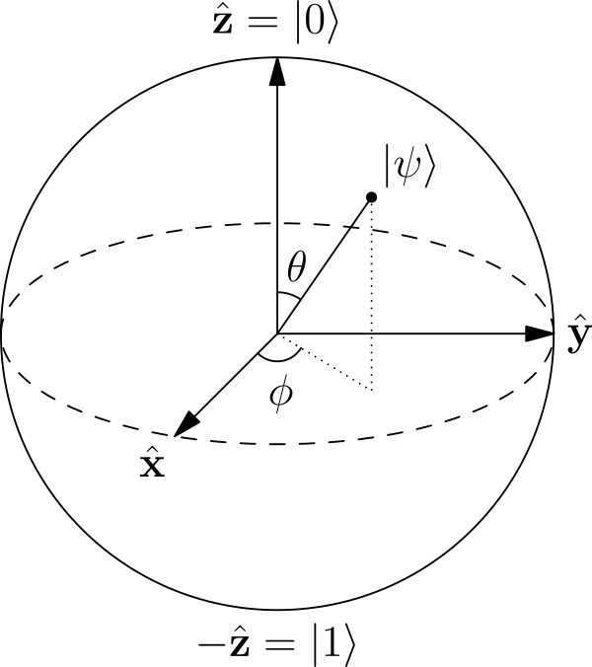
Simulate State vectors
Why this choice?
Advantages:
Very efficient and straightforward for small circuits.
High-fidelity simulations for pure states.
Lot of room for optimizations.
Disadvantages:
Inefficient for mixed states, systems with noise and decoherence.
Create very big matrices (due to multiple Kronecker products) and uses a lot of memory. Exponential Memory Growth.
Goal: create a simulator that can generate an output in a minimum amount of time for a specific circuit by reducing it to the minimum problem size!
This Photo by Unknown Author is licensed under CC BY-NC-ND

Slide 4
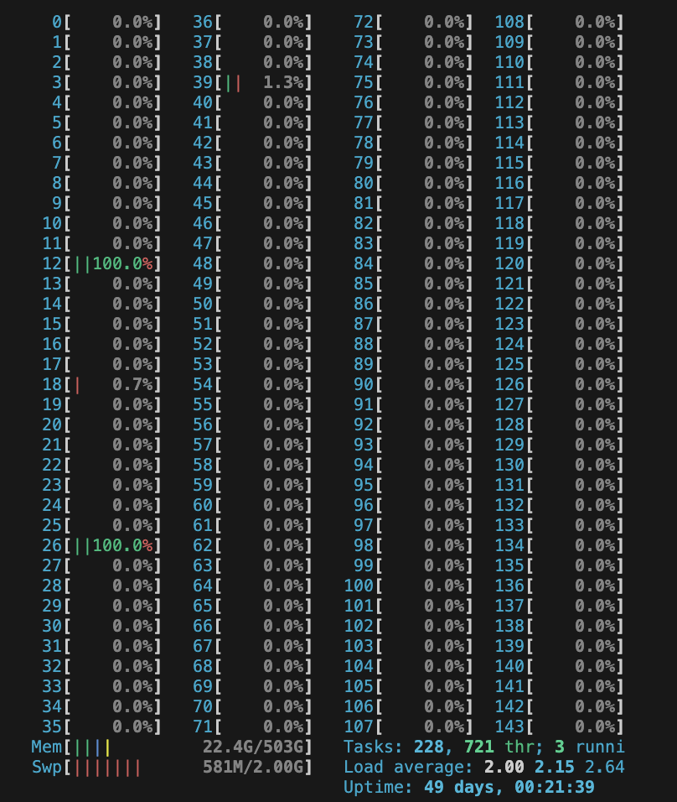
Cpu architecture
Quantum simulator on CPUs:
Given the many cores of ice1, the computation are multiprocessed (not only separated by threads, but by core)
Each computation of Kronecker or tensor product is computed by chunks instead of being fully fed in the operator.
Disadvantage: The RTT between each core is high and leads to lower performances for tensor product between small matrices.
Result: The computations can be parallelized but a good ratio is to be found when the computations involve matrices of heterogeneous sizes.
This screenshot by Shannah is licensed under CC BY-ND

Slide 5
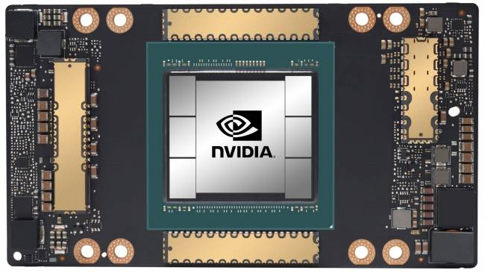
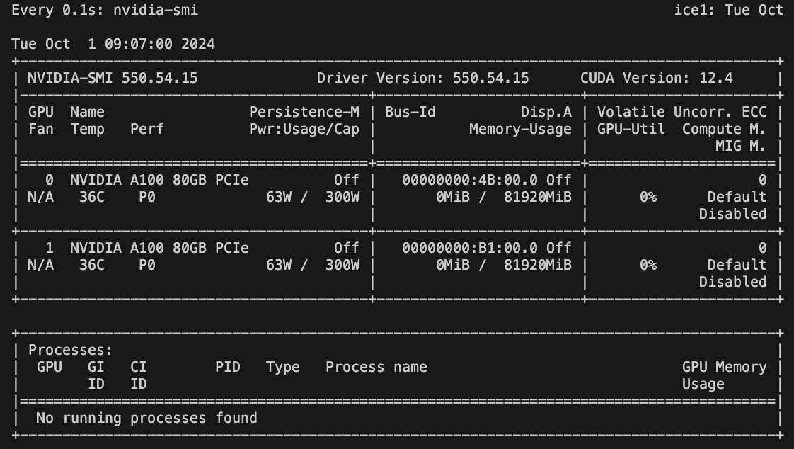
GPU architecture
Quantum simulator on GPUs:
Given the two GPUs of ice1, the computation can be ran on the accelerator device.
Allow similar computation to be executed very efficiently into each warp
Disadvantage: Computation are not using the full GPU as later results depends on earlier ones.
Result: RTT between host and device too high for small matrices sizes.
This Photo by Unknown Author is licensed under CC BY-ND
This screenshot by Shannah is licensed under CC BY-ND

Slide 6
Hints
# Cheat sheet for presentations
Speak naturally, do not recite or read off your text.
Use the template
Time management (Exhaust the time limit, but do not exceed it.)
Consider the readability of the slides (e.g. sizes and colors).
No „wall of text" on the slides
No table of contents slide
No „Thank you“ slide
Online-Presentations: Please choose only slide transition- or animation effects that are perceived as instantaneous.
Do a trial presentation with your supervisor!

Slide 7
Example for 3-column Table
1472
18
51.831
Founded in 1472
LMU’s 18 faculties offer a comprehensive and diverse spectrum across all areas of knowledge:
Law, economics and social sciences
Humanities and cultural studies
Medicine
Natural sciences
students from 140 countries
19% come from abroad
Winter Semester 2021/22

Slide 8
Thank you
You are Welcome.

