Slide 1
Minor Project Presentation
Friends Recommendation System

Slide 2
Made by:- Samarth Purandar – 20U02020 Himanshu Nageshwar – 20U02057 Project Supervisor:- Dr. Nikhil Singh Github link for Source code - https://github.com/SH3R1FF/Friends-Recommendation-System

Slide 3
Introduction A recommender system or a recommendation system is a subclass of information filtering system that seeks to predict the "rating" or "preference" that a user would give to an item.
CONTENT BASED FILTERING:
Idea: If you like an item then you will also like a “similar” item
Based on similarity of the items being recommended
It generally works well when it's easy to determine the context/properties of each item. For instance, when we are recommending the same kind of item like a movie recommendation or song recommendation.

Slide 4
COLLABORATIVE FILTERINIG:
Idea: If a person A likes item 1, 2, 3 and B like 2,3,4 then they have similar interests and A should like item 4 and B should like item 1.
This algorithm is entirely based on the past behaviour and not on the context. This makes it one of the most commonly used algorithm as it is not dependent on any additional information.
For instance: product recommendations by e-commerce player like Amazon and merchant recommendations by banks like American Express. User-User Collaborative filtering, tem-ltem Collaborative filtering and Other simpler algorithms

Slide 5
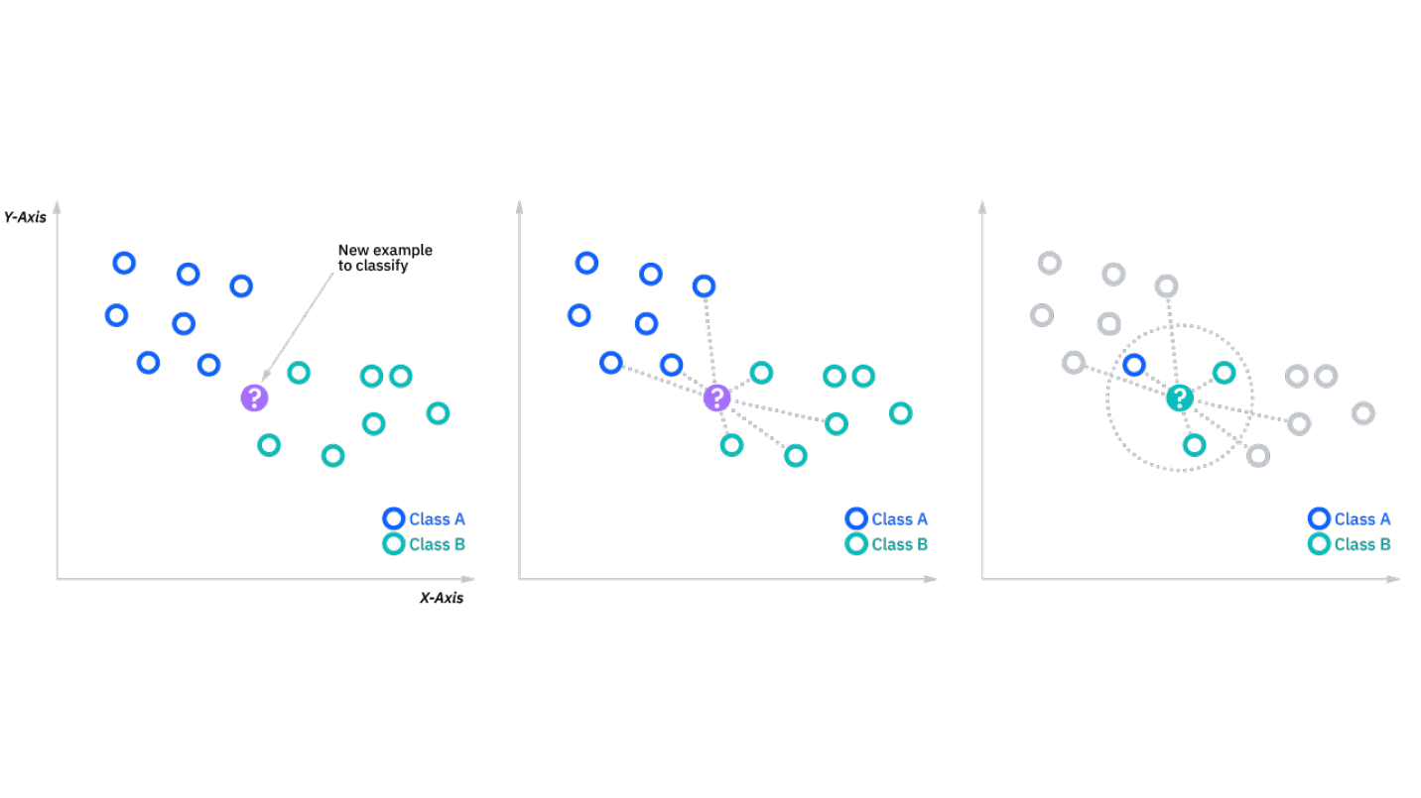
Algorithm Used : K – Nearest Neighbours Algorithm
The k-nearest neighbours algorithm, also known as KNN or k-NN, is a non-parametric, supervised learning classifier, which uses proximity to make classifications or predictions about the grouping of an individual data point. While it can be used for either regression or classification problems, it is typically used as a classification algorithm, working off the assumption that similar points can be found near one another.

Slide 6
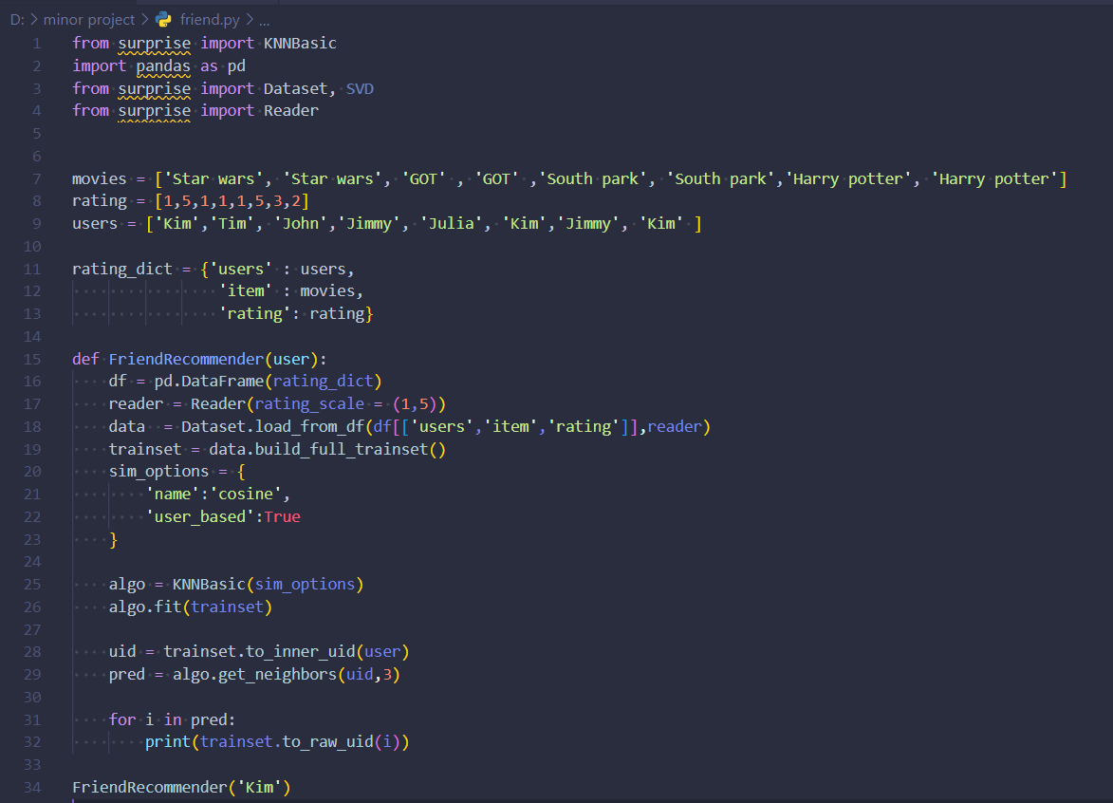
Source Code

Slide 7
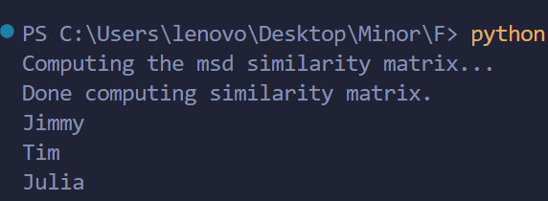
Output

Slide 8
Thank You

