Slide 1

Basic Details of the Team and Problem Statement
Ministry/Organization Name/Student Innovation: Ministry of power
PS Code: SIH1301
Problem Statement Title: Language translator tool to convert English to Hindi (official Language) which can be used by all the government organizations websites officially.
Team Name: S-HAWKZ
Team Leader Name: SHAIK MAHAMMAD THOFIQ
Institute Code (AISHE): U-0474
Institute Name: Sathyabama Institute of Science & Technology
Theme Name: Smart Automation

Slide 2
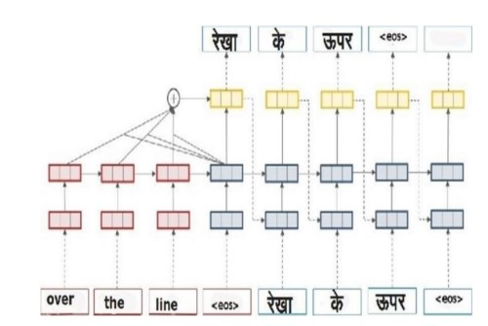
Idea/Approach Details
DESCRIPTION OF IDEA:
Neural Machine Translation is a cutting-edge technology that employs artificial neural networks to automatically translate text from English to Hindi.
It has gained immense importance due to the widespread use of these languages, particularly in India
NMT systems, powered by deep learning algorithms, have revolutionized the translation process by providing fast, accurate, and scalable translations
These systems analyze vast bilingual datasets to understand the linguistic patterns and nuances of both English and Hindi.
TECHNOLOGY STACK:
Deep Learning Frameworks
Open Source NMT Libraries
Neural Network Architectures - Seq2Seq,BERT
Data Preparation Tools - Tokenization,Cleaning
Word Embeddings
GPU Acceleration
Language Resources
Continuous Training and Fine-tuning

Slide 3
Idea/Approach Details
USE CASES:
DEPENDENCIES:
Cross-Cultural Communication
Content Localization
Multilingual Customer Support
Education and E-Learning
Research and Knowledge Sharing
Healthcare and Medical Translations
Content Creation
Government and Public Services
Humanitarian Aid and NGOs
High-Quality Bilingual Data
Linguistic Resources
Text Preprocessing Tools
Parallel Data Annotation
Hardware Resources - Adequate access to GPUs, TPUs
Neural Network Frameworks - TensorFlow or PyTorch
Pre-trained Embeddings
Continuous Learning and Fine-tuning
User Interface and Integration

Slide 4
Team Member Details
Team Leader Name: SHAIK MAHAMMAD THOFIQ
Branch : BE Stream : CSE IOT Year: III
Team Member 1 Name: T LOHITH
Branch : BE Stream : CSE IOT Year: III
Team Member 2 Name: R NIRANJAN GOUD
Branch : BE Stream : CSE IOT Year: III
Team Member 3 Name: P SATHYA NARAYANA
Branch : BE Stream : CSE IOT Year: III
Team Member 4 Name: S MAHESH KUMAR
Branch : BE Stream : CSE IOT Year: III
Team Member 5 Name: HASTHA
Branch : BE Stream : CSE AI/ML Year: III
Team Mentor 1 Name: Dr.D.Menaka
Category : Academic Expertise : AI, IOT, Data Science Domain Experience (5 years):
Team Mentor 2 Name: Dr.T.Naresh Kumar
Category : Academic Expertise : AI/ML/Robotics Domain Experience (11 years):

