Slide 1

Customer Shopping Behaviour Analysis
Uncovering spending patterns, customer segments, and product preferences from 3,900 transactions to guide strategic business decisions.

Slide 2
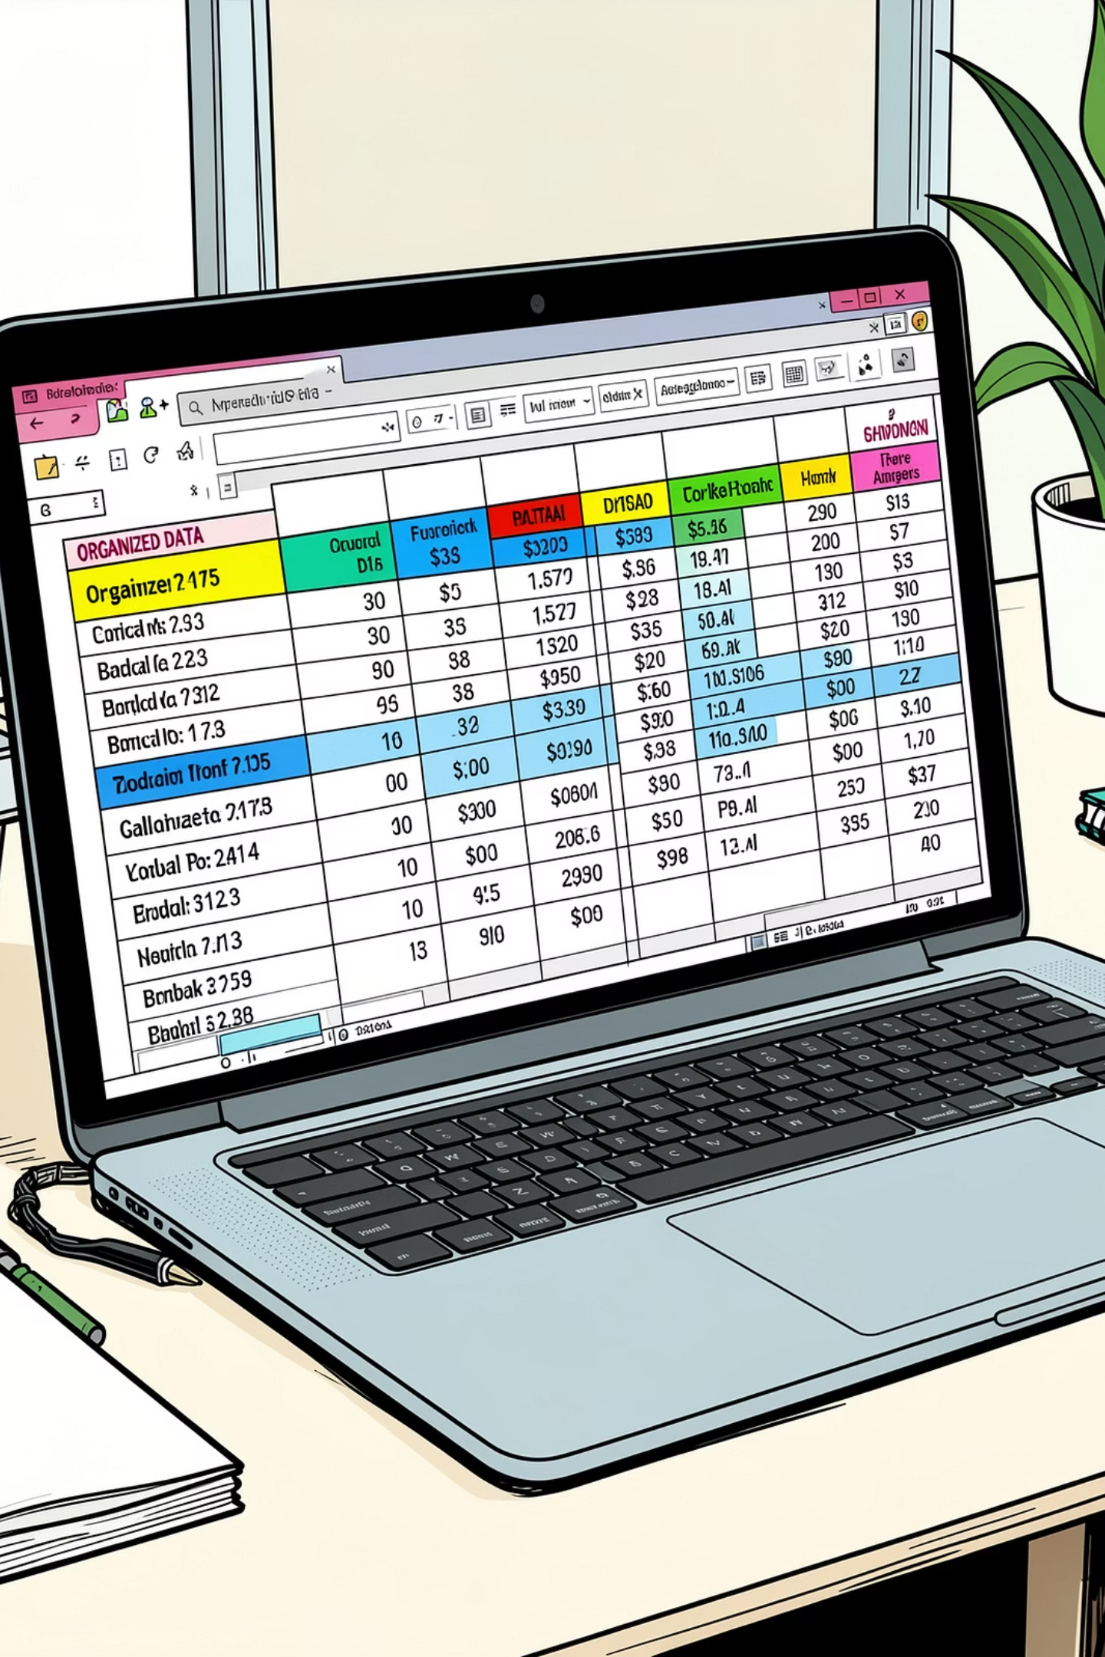
Dataset Summary
3,900 Rows
18 Columns
Transactional purchase records across multiple product categories
Demographics, purchase details, and shopping behaviour features
37 Missing Values
Only in the Review Rating column — imputed using category medians
Key features include Age, Gender, Location, Subscription Status, Purchase Amount, Discount Applied, Promo Code Used, and Frequency of Purchases.

Slide 3

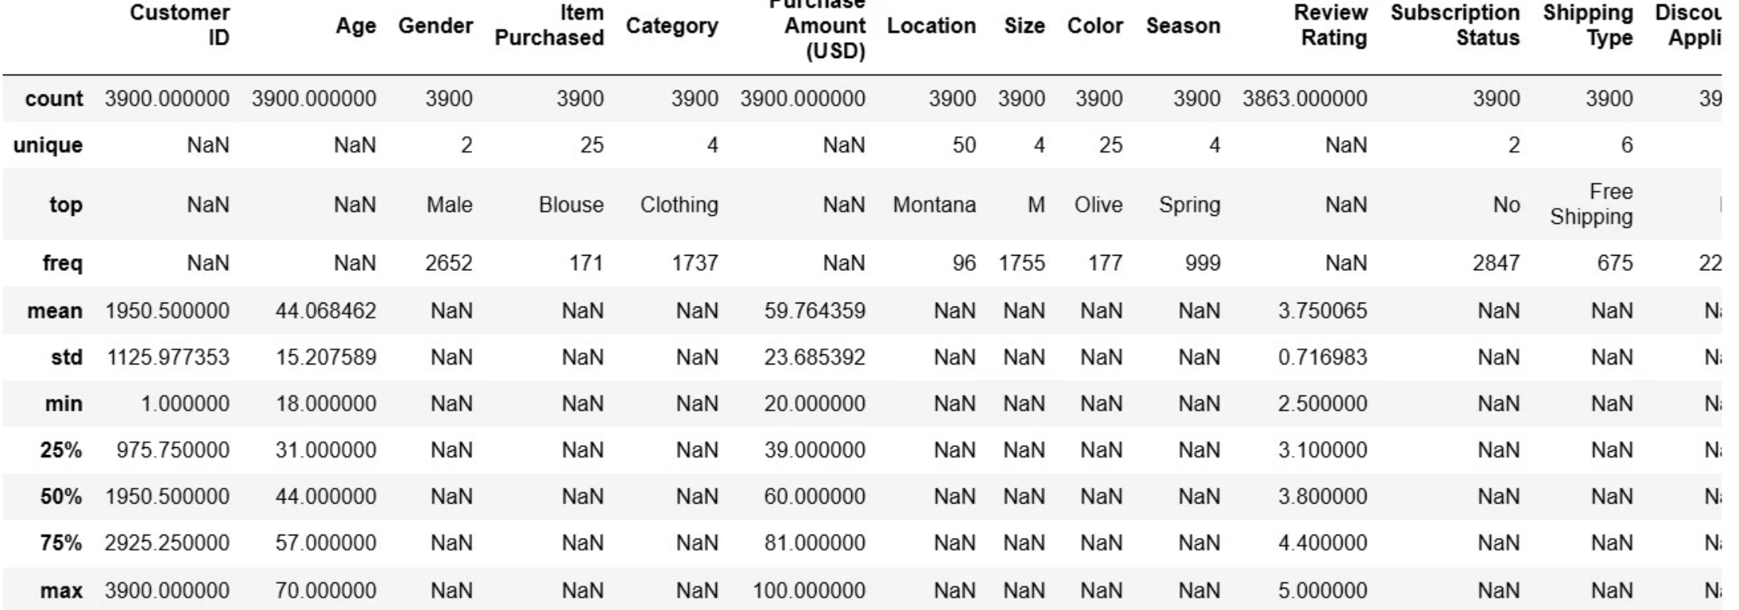
Exploratory Data Analysis in Python
Data Loading & Exploration
Imported via pandas; used df.info() and describe() for structure and summary stats
Missing Data & Standardization
Imputed Review rating using category medians; renamed columns to snake_case
Feature Engineering
Created age group bins and purchase_frequency_days; dropped redundant promo_code_used column

Slide 4
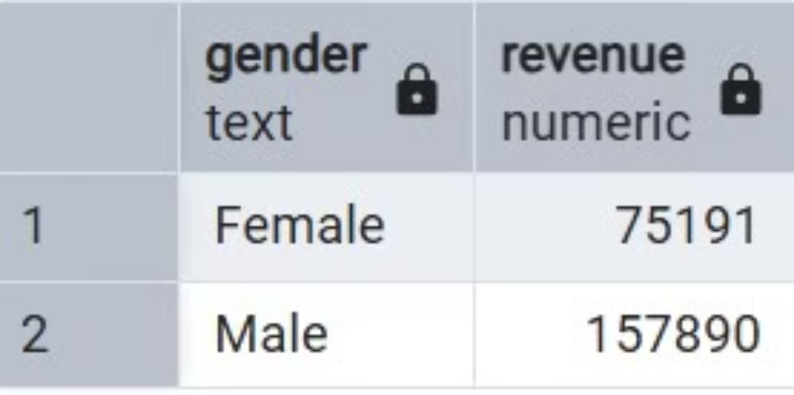
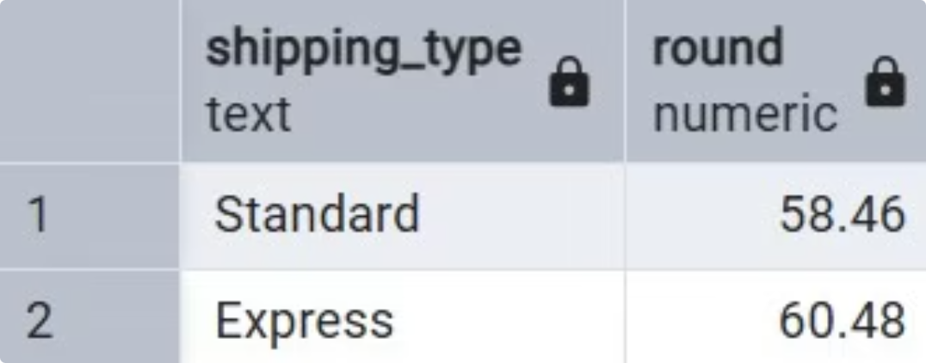
Revenue by Gender & Shipping Type
Revenue by Gender
Compared total revenue generated by male vs. female customers to identify which segment drives more revenue.
Shipping Type Comparison
Compared average purchase amounts between Standard and Express shipping. Express shipping customers tend to spend more per transaction.

Slide 5
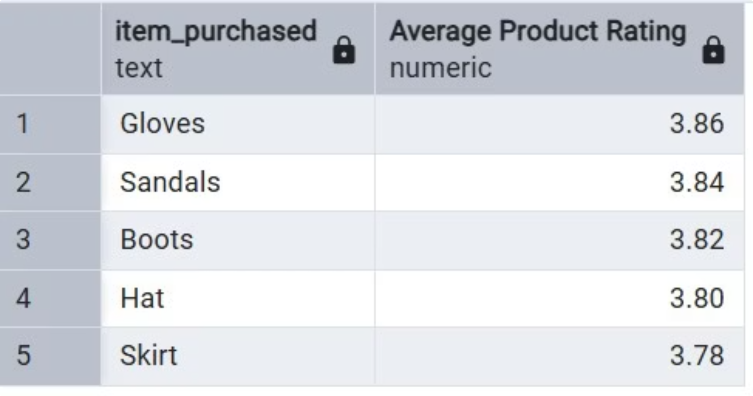
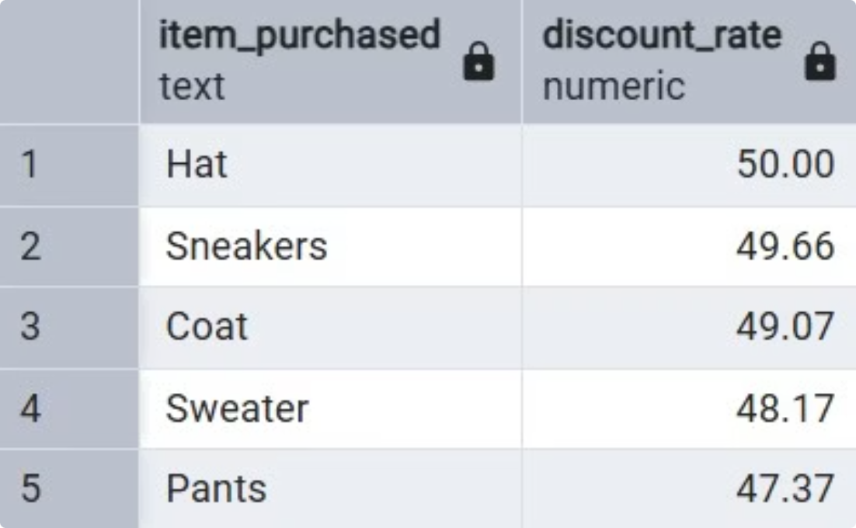
Top Products & Discount Behaviour
Top 5 Products by Rating
Discount-Dependent Products
Found products with the highest average review ratings to identify top-rated items.
Identified 5 products with the highest percentage of discounted purchases, revealing which items rely most on promotions.

Slide 6
High-Spending Discount Users
Key Finding
Identified customers who used discounts but still spent above the average purchase amount.
These customers represent a valuable segment — they respond to promotions yet maintain high spending, making them ideal targets for loyalty programs and exclusive subscriber benefits.

Slide 7
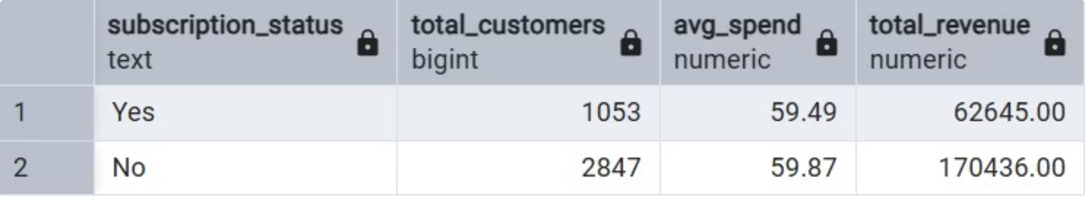
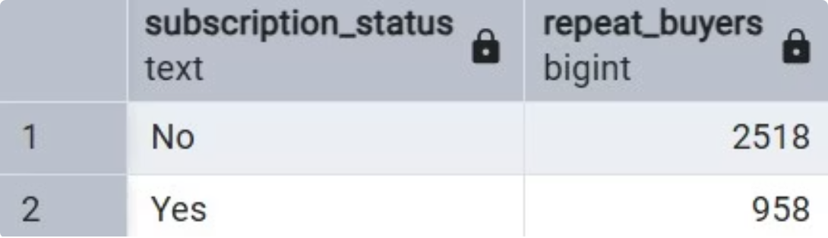
Subscribers vs. Non-Subscribers
Repeat Buyers & Subscriptions
Subscription Revenue Impact
Checked whether customers with >5 purchases are more likely to subscribe. Repeat buyers show a strong tendency toward subscription, confirming purchase frequency as a predictor of subscription likelihood.
Compared average spend and total revenue across subscription status. Subscribers contribute significantly more to total revenue and show higher average purchase amounts than non-subscribers.

Slide 8
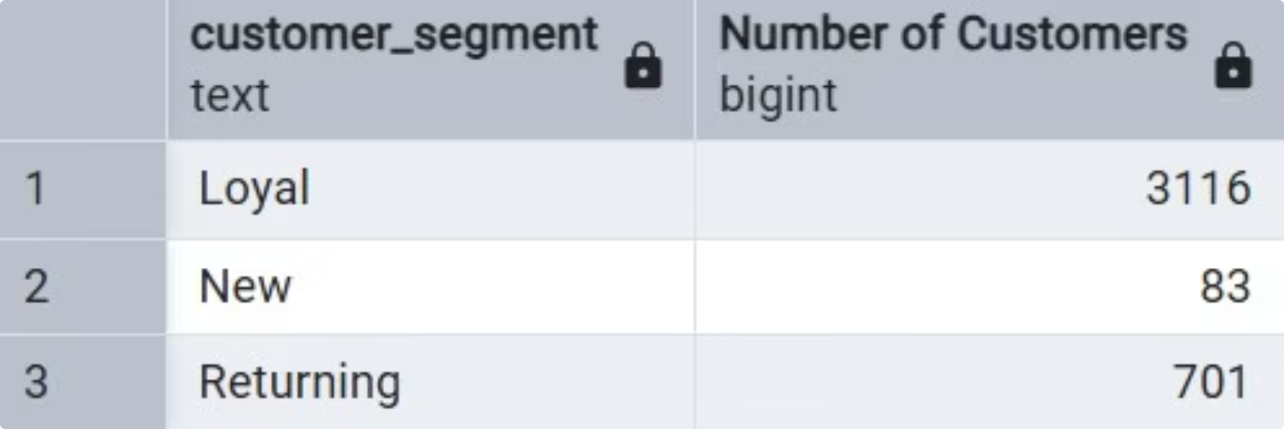
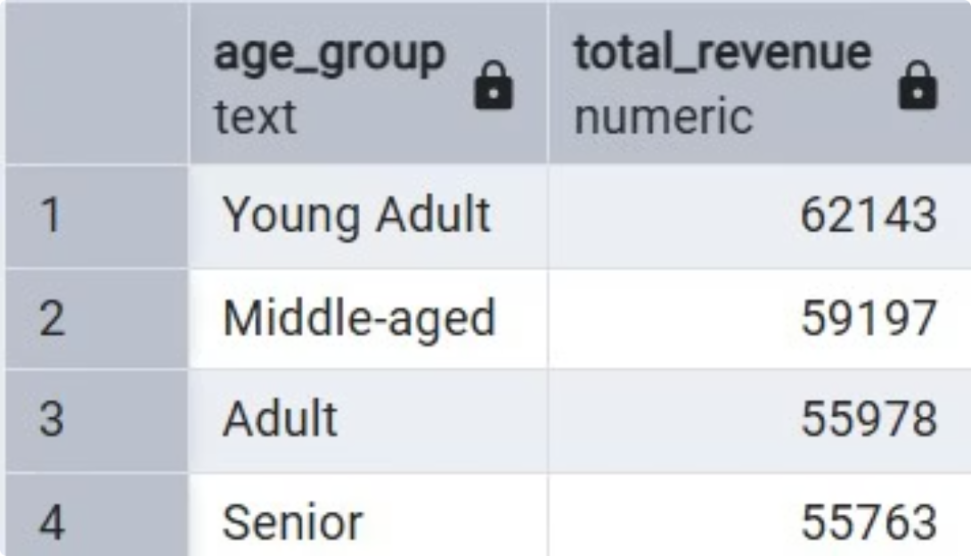
Customer Segmentation & Revenue by Age
Revenue by Age Group
Customer Segmentation
Calculated total revenue contribution of each age group. Certain age groups contribute disproportionately more to total revenue, guiding targeted marketing focus.
Classified customers into New, Regular, and Loyal segments based on purchase history, revealing the distribution of customer types across the dataset.

Slide 9
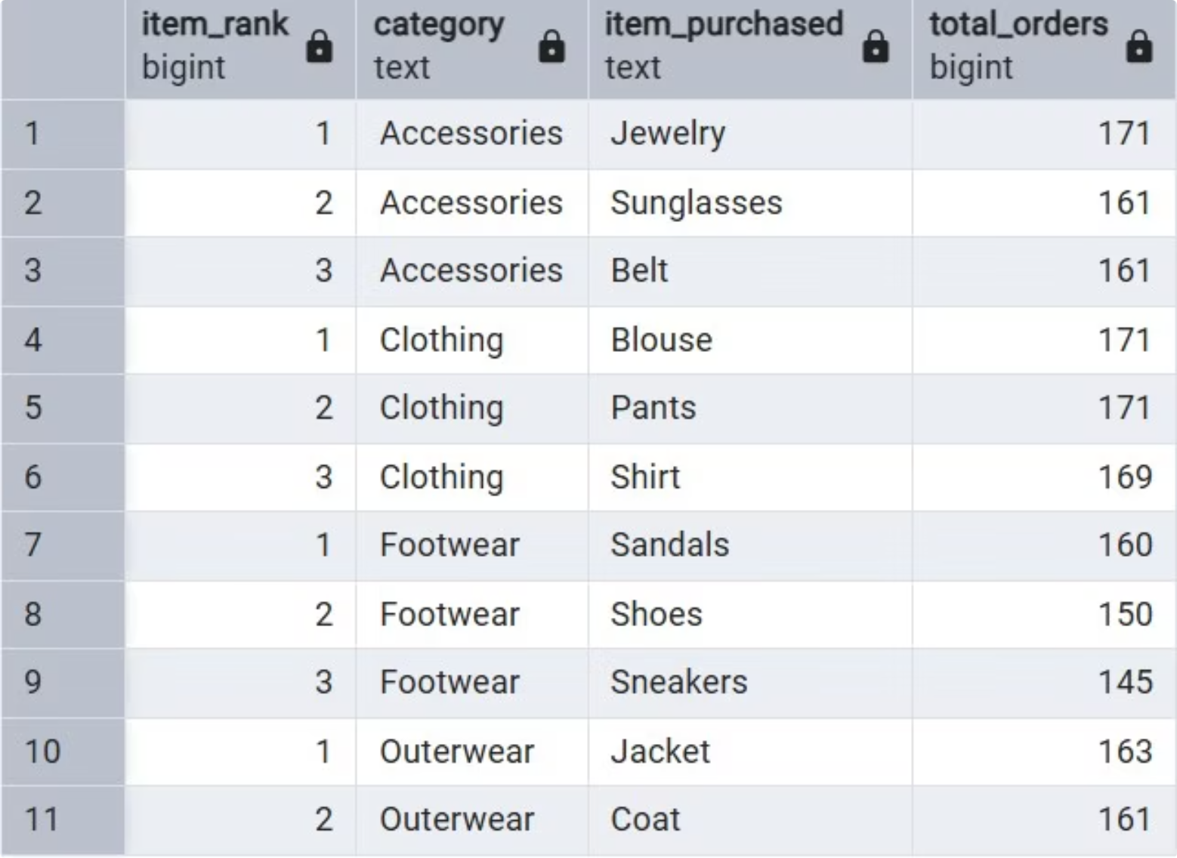
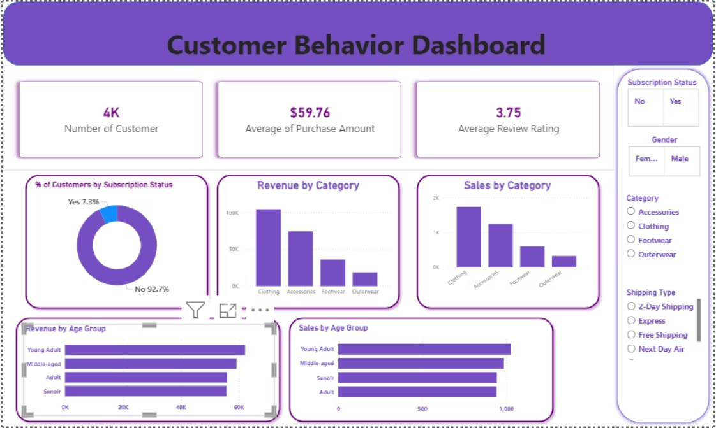
Top 3 Products per Category
Category Leaders
Listed the most purchased products within each category to identify best-sellers and inform product positioning in campaigns.
Power BI Dashboard
Built an interactive Power BI dashboard to present all insights visually, enabling stakeholders to explore revenue, segmentation, and product performance at a glance.

Slide 10





Business Recommendations
Boost Subscriptions
Loyalty Programs
Review Discount Policy
Promote exclusive benefits to convert high-frequency buyers into subscribers
Rward repeat buyers to advance them into the "Loyal" segment
Balance sales boosts with margin control on discount-dependent products
Targeted Marketing
Product Positioning
Focus on high-revenue age groups and express-shipping users
Highlight top-rated and best-selling products in campaigns

