Slide 1

Laravel HRMS: Transforming Human Resources
Welcome to an overview of our Human Resource Management System (HRMS), meticulously crafted with the robust Laravel framework. This presentation delves into the system's architecture, core functionalities, and the profound benefits it offers to HR professionals and technical stakeholders alike.

Slide 2
Streamlining Core HR Processes
1
2
Employee Management
Attendance Tracking
From onboarding to offboarding, manage employee lifecycles efficiently.
Automate time and attendance records, reducing manual errors and disputes.
3
4
Leave Management
Payroll Processing
Simplify leave requests, approvals, and balance tracking with intuitive workflows.
Integrate payroll calculations for accurate and timely compensation.
The HRMS is designed to automate and streamline fundamental HR operations, significantly boosting departmental efficiency and accuracy across the board.

Slide 3
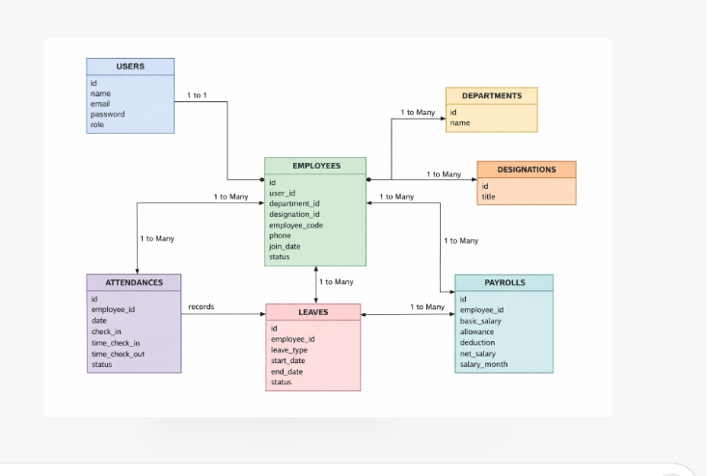
Technology Stack: Laravel Ecosystem
Our HRMS leverages the full power of the Laravel ecosystem, ensuring a modern, robust, and secure application. This approach provides a solid foundation for present and future needs.
Framework
Laravel (PHP)
Database
MySQL (or PostgreSQL)
Frontend
Vue.js / Blade Templates
Deployment
Docker (containerised environment)
Version Control
Git

Slide 4
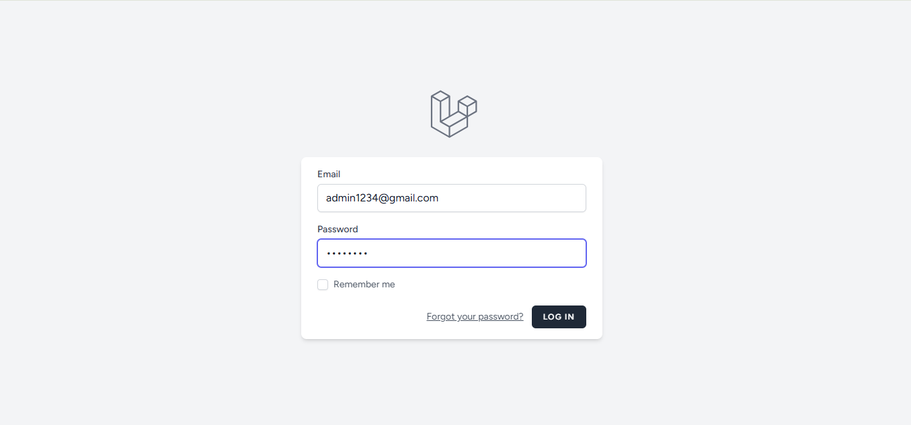
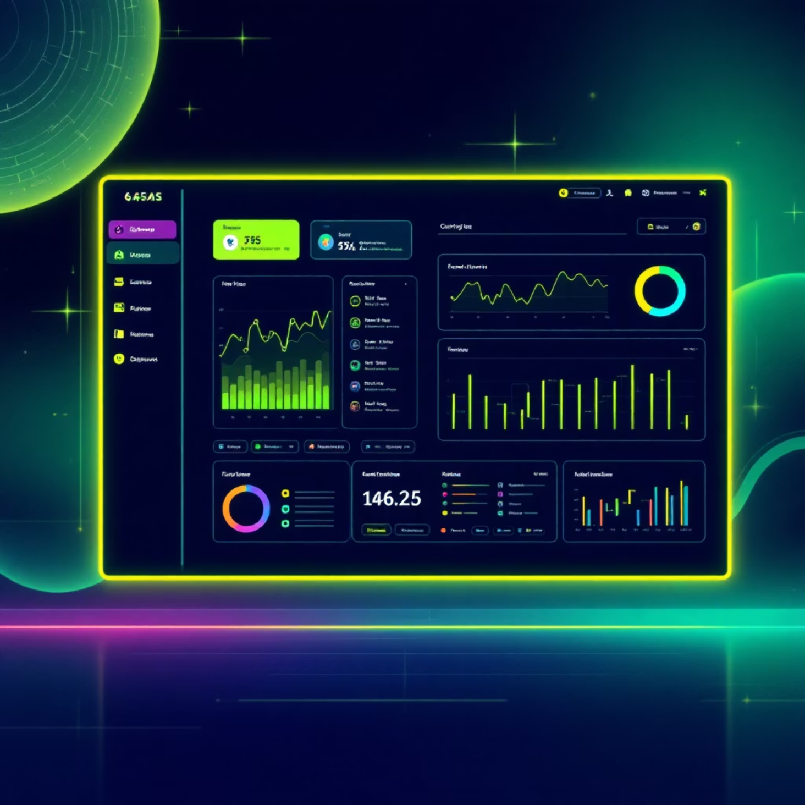
User Experience: Intuitive & Accessible
The user interface has been designed with a focus on intuitiveness and ease of use, ensuring that HR professionals can quickly adapt and efficiently manage their tasks.
Clean, modern design
Responsive across devices
Customisable dashboards
Accessible for all users
A well-designed user experience is paramount to the successful adoption and daily use of any HRMS.

Slide 5
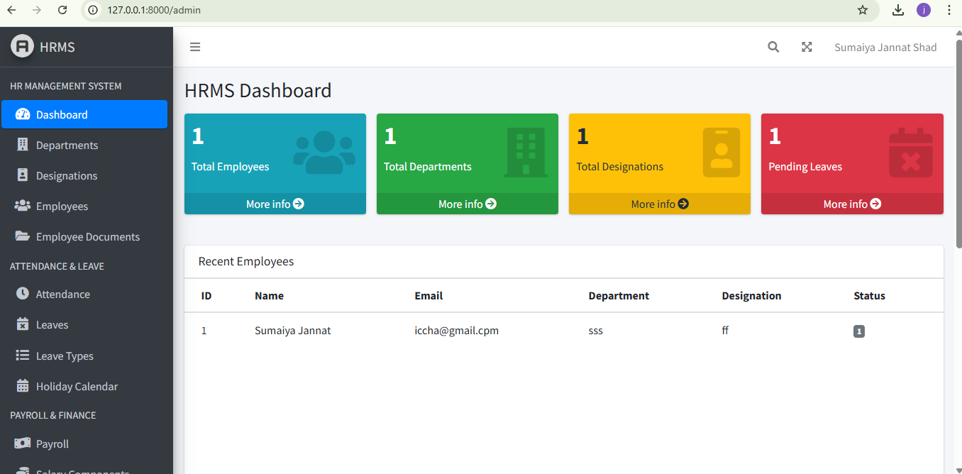

Security Measures in Place
Role-Based Access Control
Data Encryption
All sensitive data is encrypted both in transit and at rest, protecting against breaches.
Ensuring users only access data relevant to their specific roles and permissions.
Regular Security Audits
Continuous monitoring and auditing to identify and mitigate potential vulnerabilities.
Security is not an afterthought; it is woven into the very fabric of our HRMS, providing peace of mind for both HR and technical teams.

Slide 6
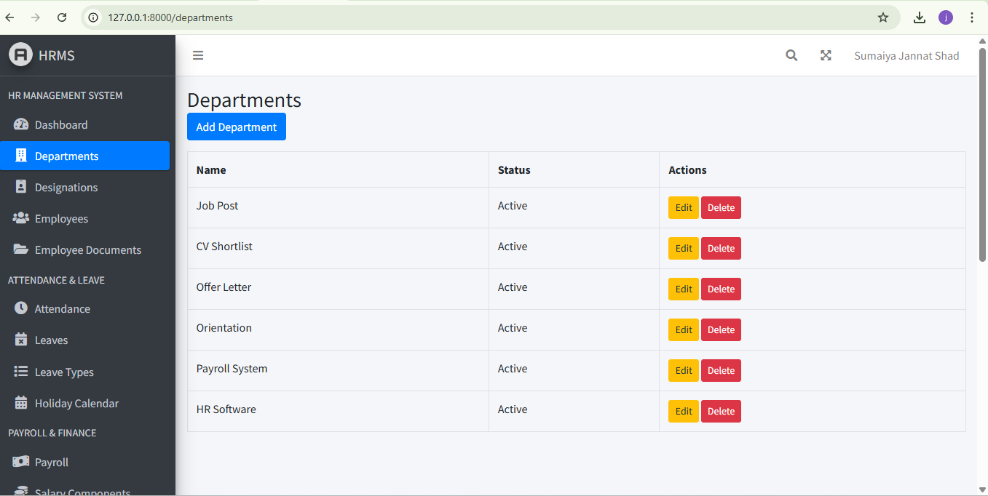


Scalability for Future Growth
Enterprise
Mid-Market
Growing Team
Startup
The Laravel HRMS is engineered for scalability, ensuring it can evolve and adapt as your organization grows. Whether you're a small startup or a large enterprise, the system is designed to meet your changing needs.
Horizontal and vertical scaling options
Optimised database performance
Modular architecture for feature expansion

Slide 7
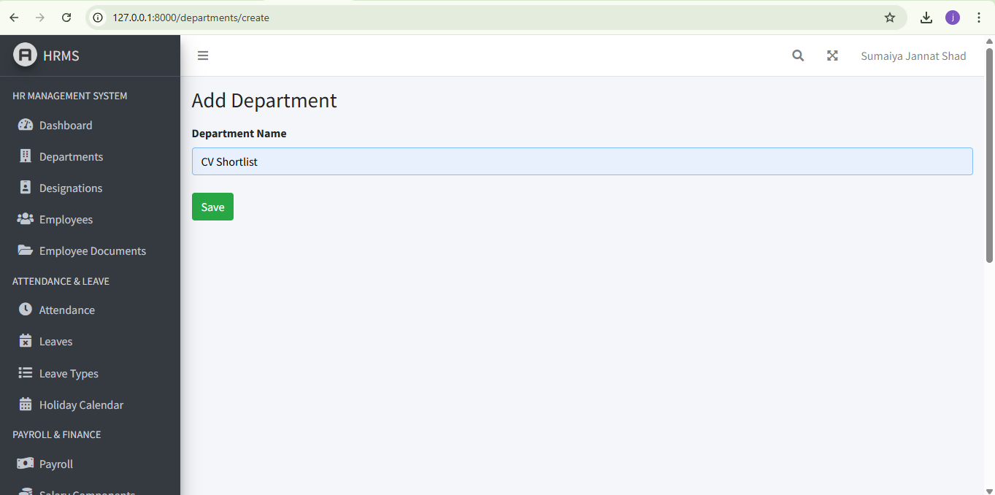

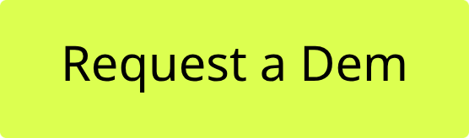

Key Takeaways & Next Steps
Modern Solution
Efficient Operations
A cutting-edge HRMS built on the robust Laravel framework.
Streamlines HR processes, reducing manual effort and errors.
Secure & Scalable
Ensures data integrity and grows with your organization.
We invite you to experience the future of HR management. For a detailed demonstration or to discuss how our Laravel HRMS can benefit your organization, please contact us.

Slide 8
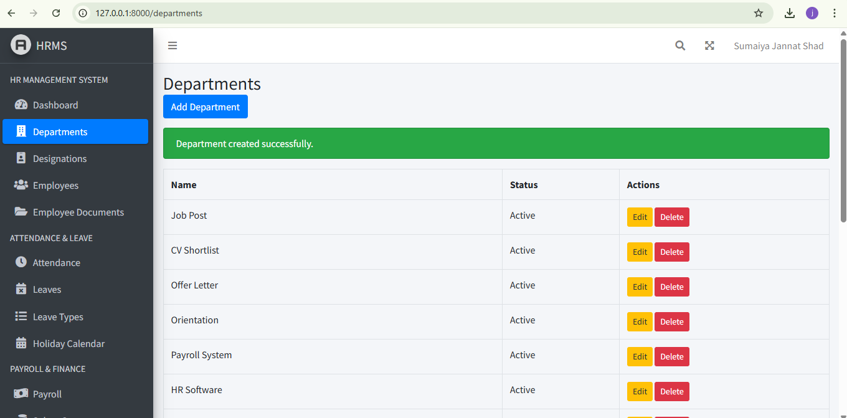

Slide 9
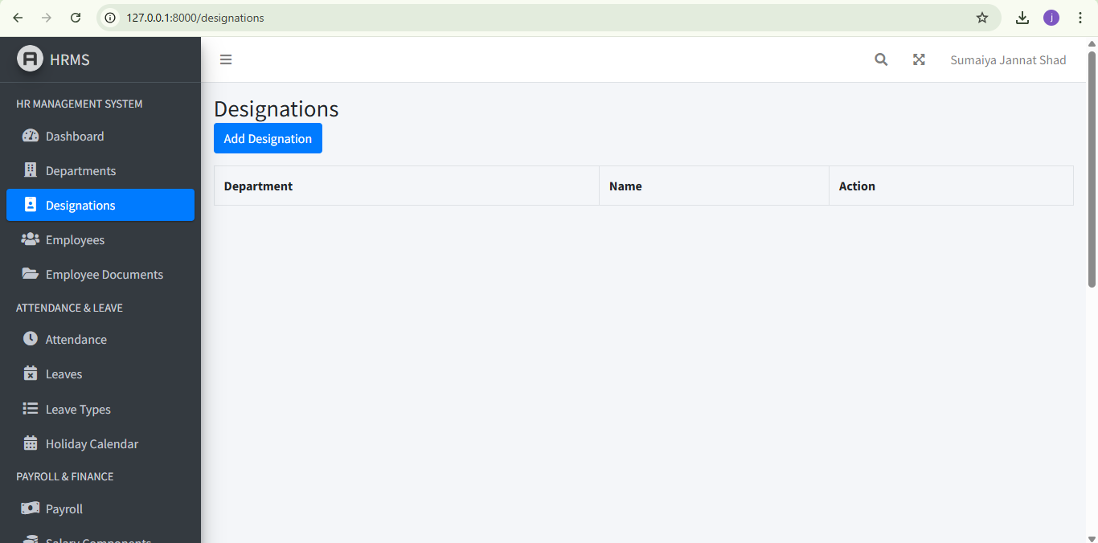

Slide 10
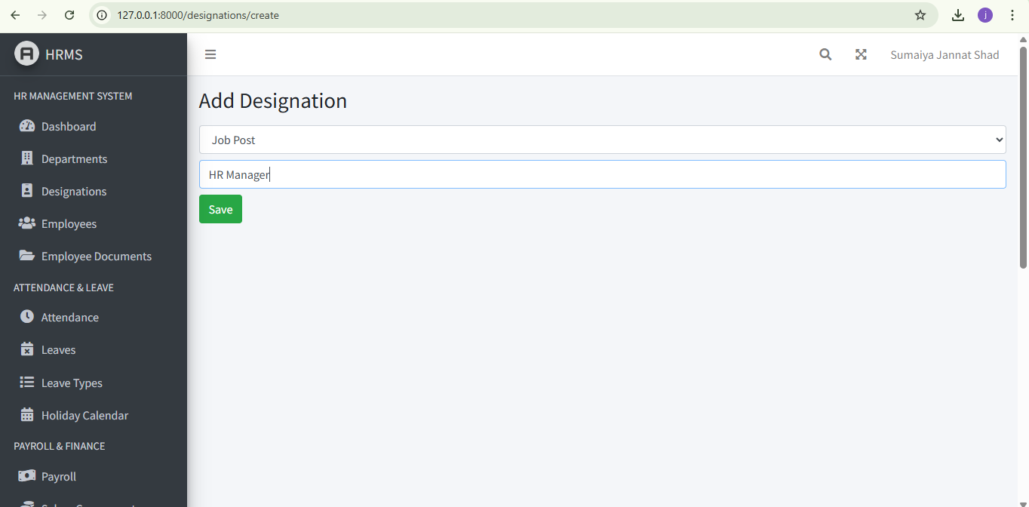

Slide 11
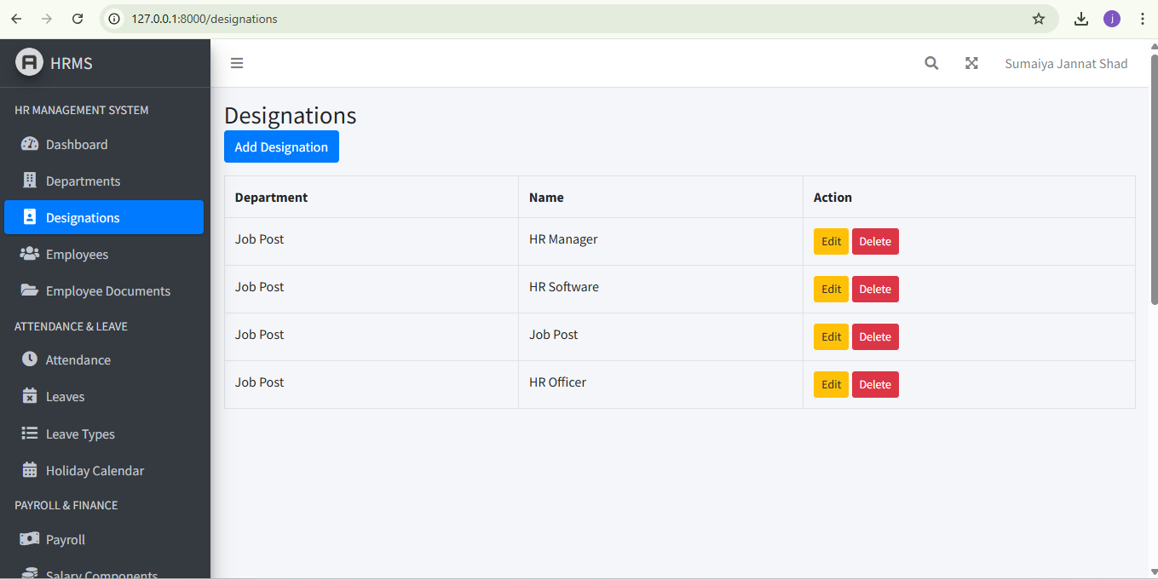

Slide 12
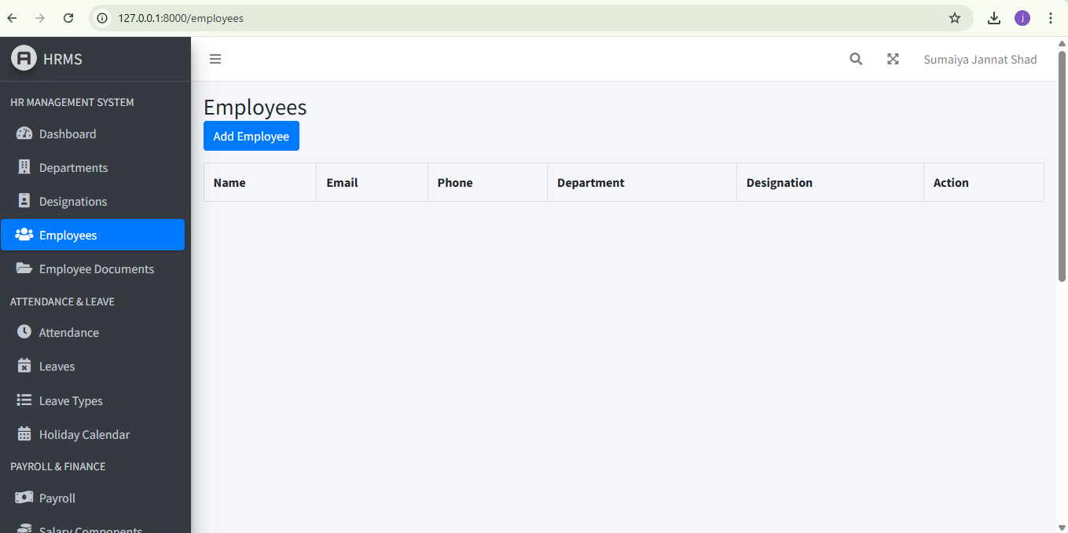

Slide 13
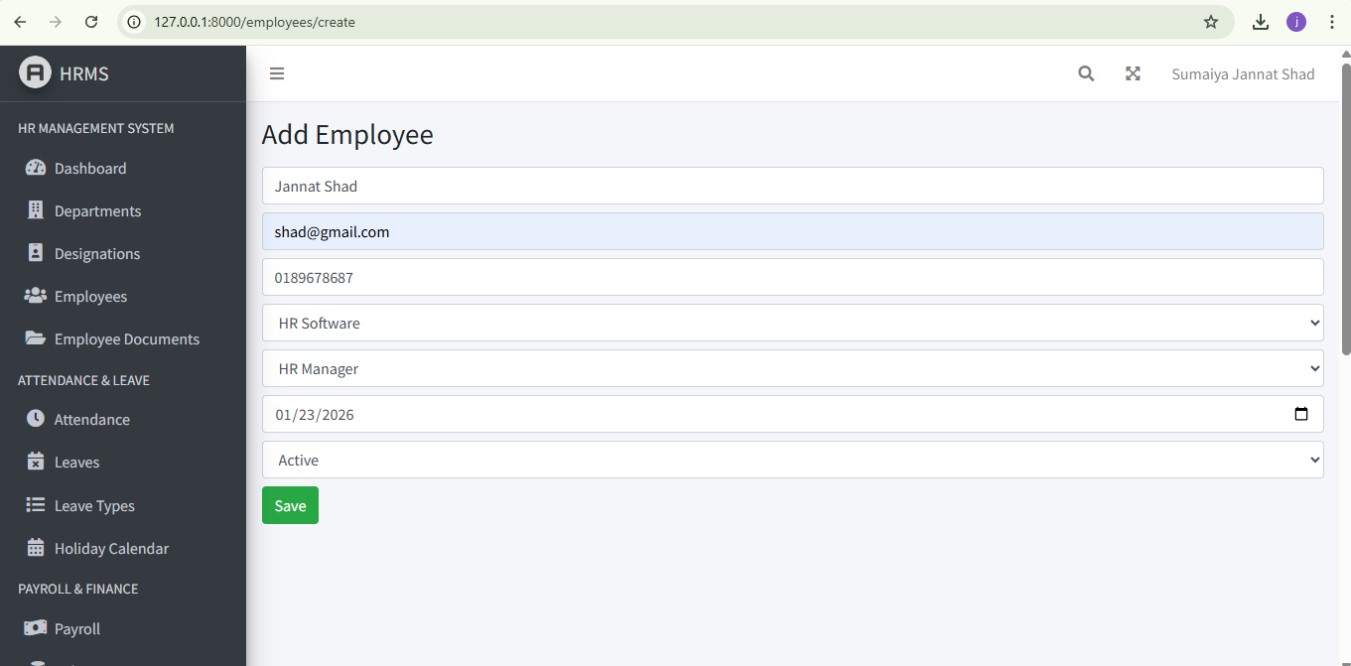

Slide 14
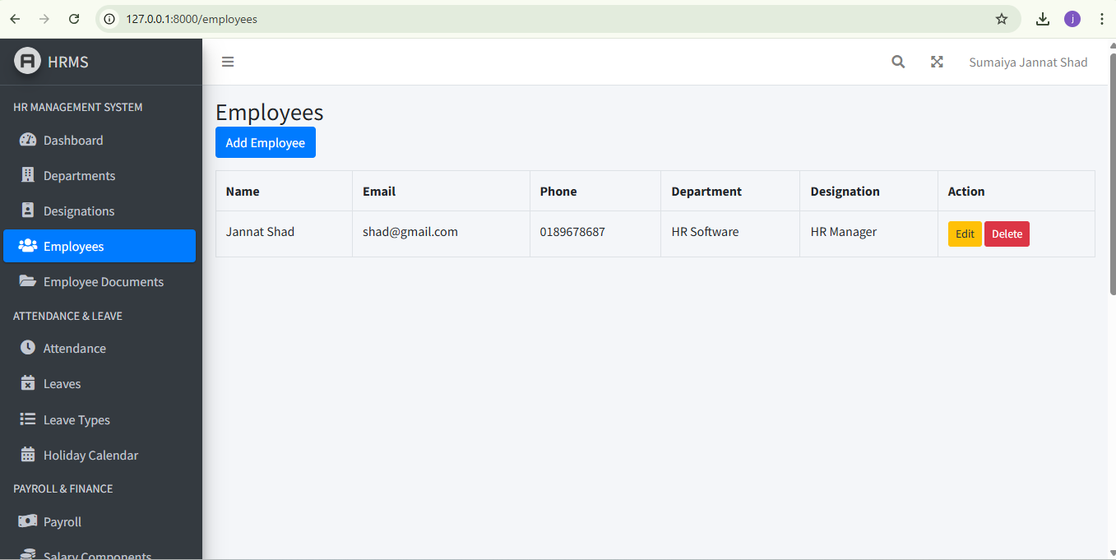

Slide 15
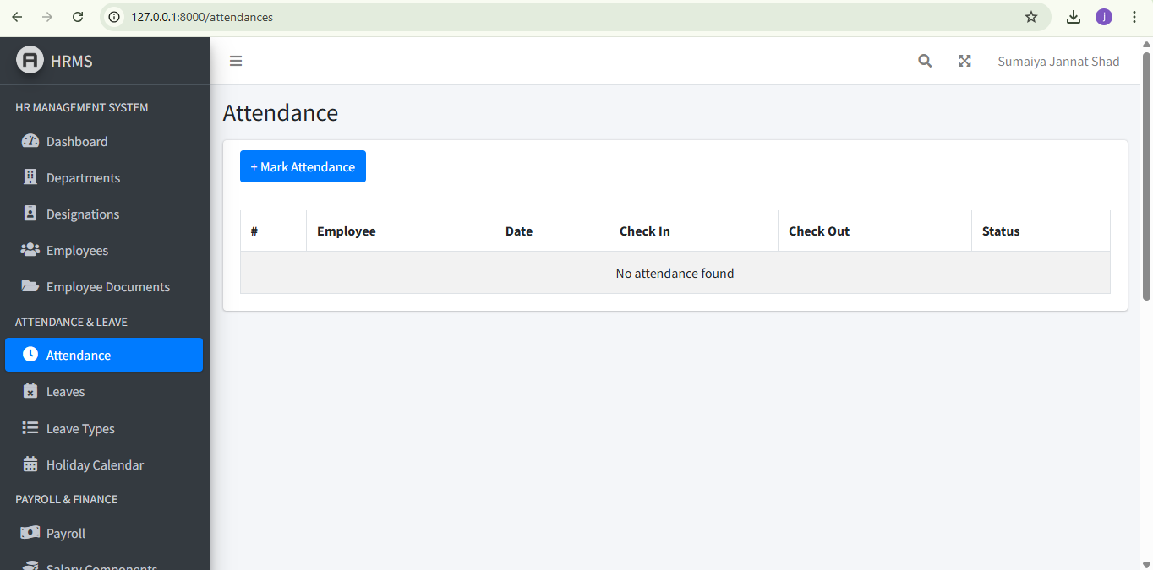

Slide 16
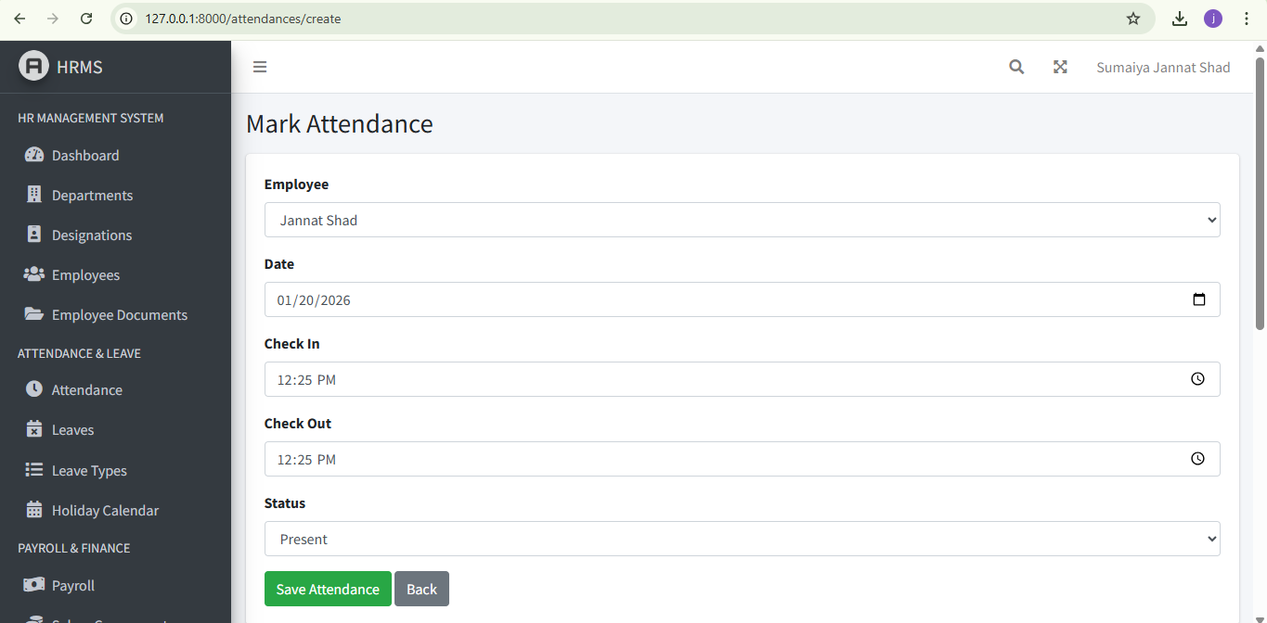

Slide 17
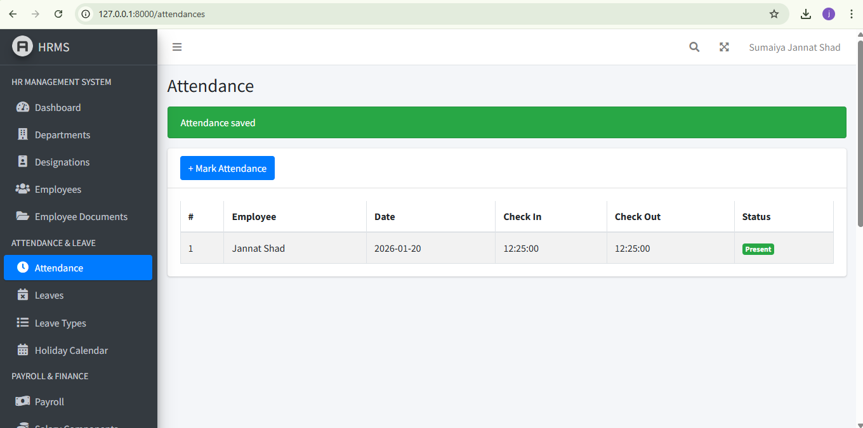

Slide 18
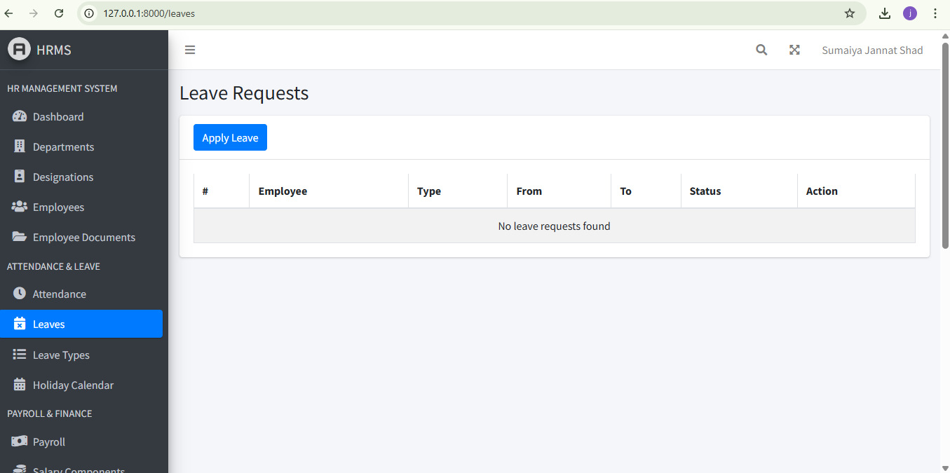

Slide 19
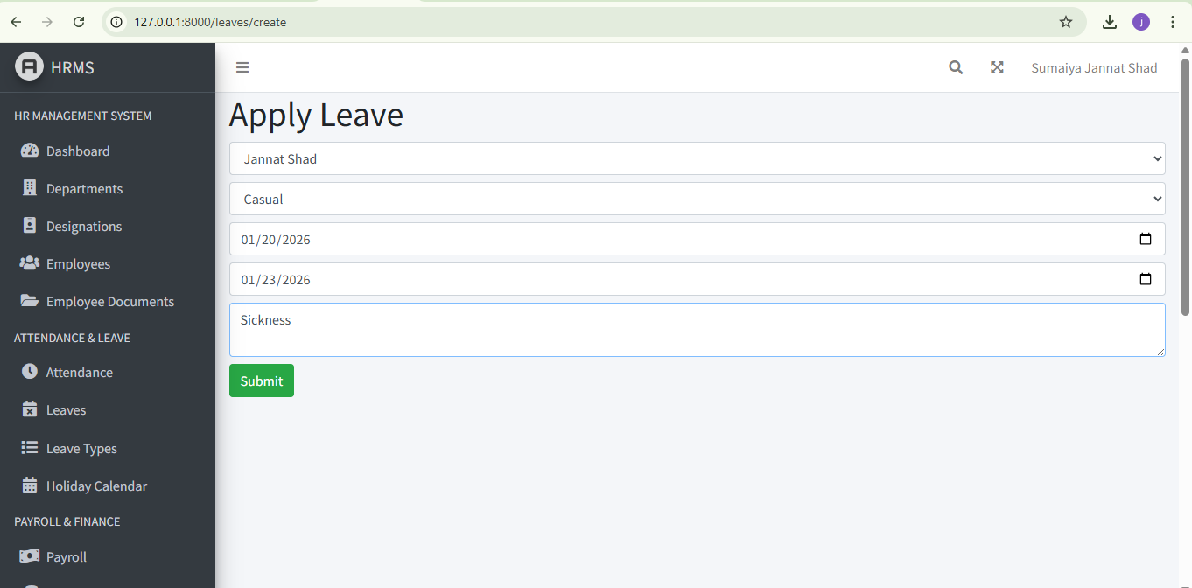

Slide 20
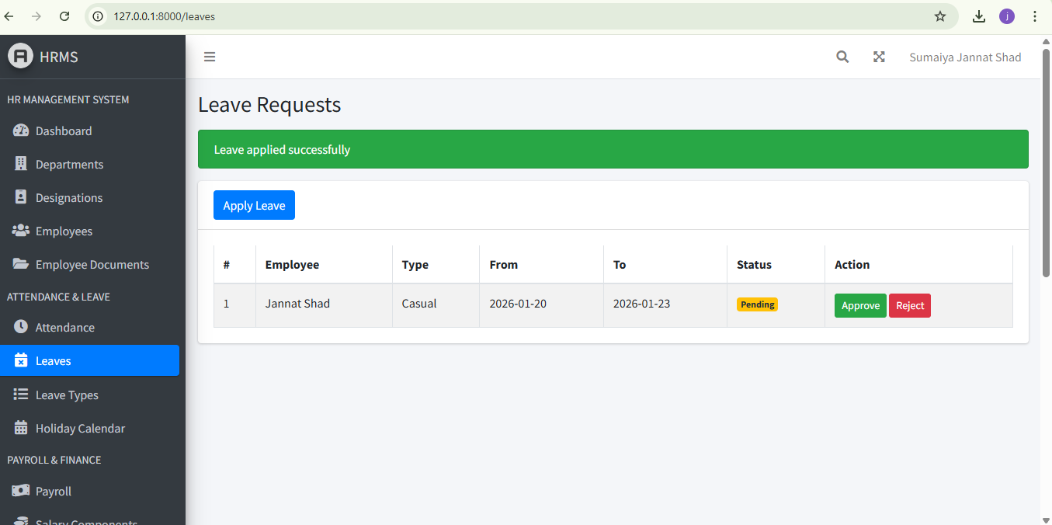

Slide 21


Slide 22
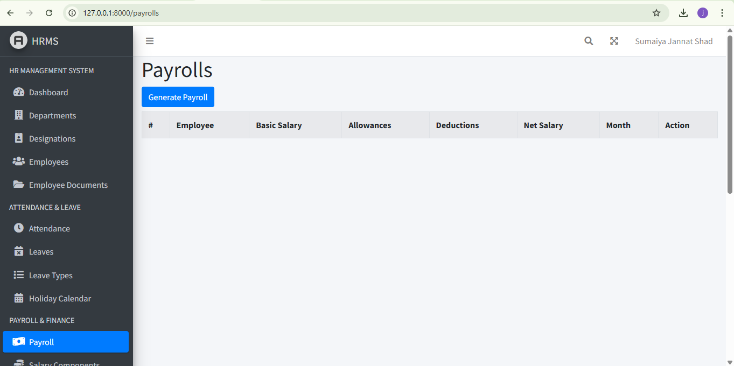

Slide 23
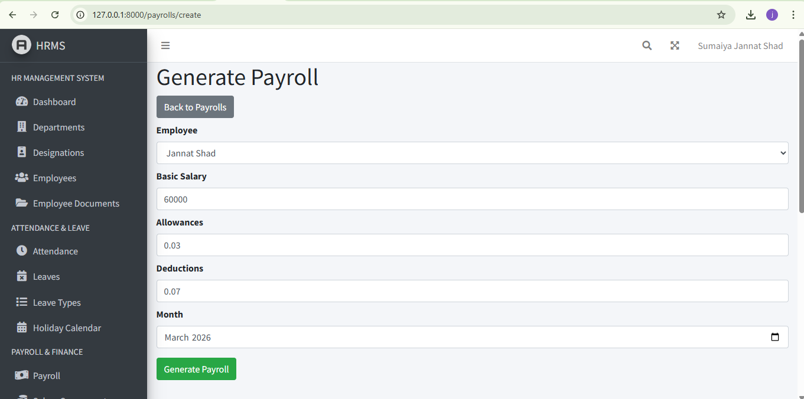

Slide 24
