Slide 1

Analysis of Super Store
Name:- SHADAAB NADEEM KAZI AICTE ID:- STU66f7ab9f450811727507359 College:- Vishwakarma Institute of technology Branch:- Mechanical

Slide 2

PROBLEM STATEMENT
How do different customer segments contribute to overall sales?
Which regions show the strongest/weakest performance?
To analyze sales trends and analyzing profitability.

Slide 3
Project Description The dataset contains sales information from a superstore, including details on shipping, customer segments, locations, product categories, and financial metrics. To proceed, we need to identify sales trends, analyzing profitability, or understanding customer behavior.

Slide 4

WHO ARE THE END USERS?
Sales and Marketing teams
Distributors
CXOs

Slide 5

Technology Used
Python (pandas, NumPy, etc.)
Vscode
Julius AI
Copilot

Slide 6
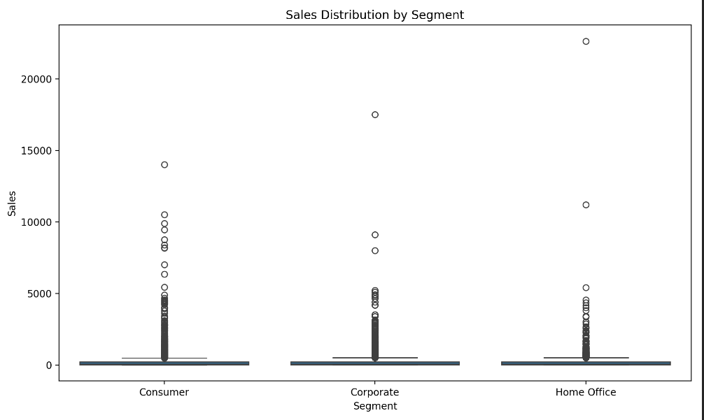
RESULTS
Consumer and Home Office segments: High variability in sales indicating fluctuating demand and diverse preferences.
Corporate segment: Consistent sales, suggesting stable demand and possible long-term contracts.
Strategy:
Focus on Corporate to stabilize overall sales.
Target Consumer and Home Office with strategic marketing to convert variability into consistent high sales.

Slide 7
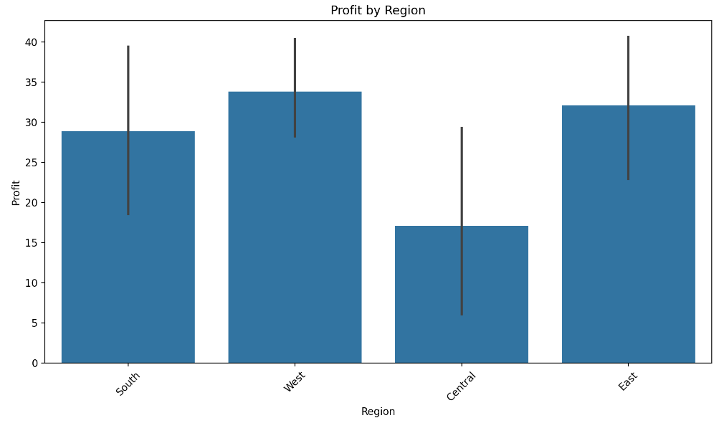
RESULTS
West region:
Highest profit
Consistent profit levels (low variability)
East region:
Second highest profit
Consistent profit levels (low variability)
South region:
Moderate profit
Higher variability in profit
Central region:
Lowest profit
Higher variability in profit
Strategic Focus:
Maximize profits by focusing on the West region
Improve performance in the Central region

Slide 8
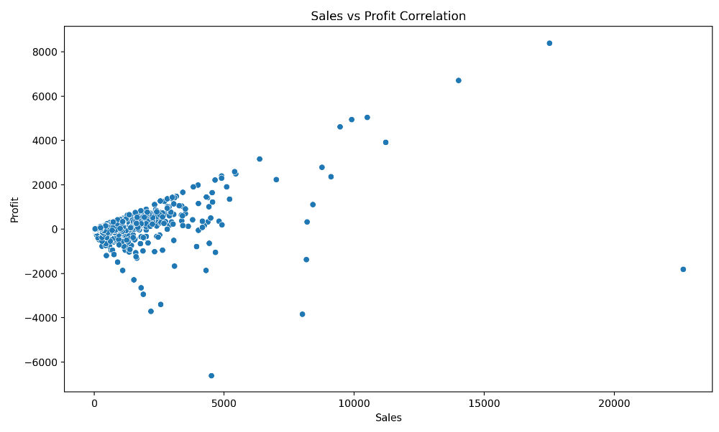
RESULTS
Positive Correlation: There is a general trend where higher sales are associated with higher profits, indicating a positive correlation between sales and profit.
High Variability: Some data points show high sales with low or negative profits, suggesting variability in profitability despite high sales.
Concentration of Data: Most data points are concentrated in the lower sales and higher profit area, indicating that many instances of lower sales still result in significant profits.
Outliers: There are outliers with high sales but low profits, which may need further investigation to understand the underlying causes.

Slide 9
Thank you
.
.

