Slide 1
TSMMIS
Teacher-Student Multi-Modal Instance Similarity
Self-Supervised Few-Shot Steel Surface Defect Recognition
Implemented in MATLAB | NEU-CLS Dataset | ResNet-18 Backbone

Slide 2
Presentation Outline
01
Introduction & Problem Statement
08
Prototype Self-Training Adaptation
02
Dataset – NEU-CLS Steel Surface Defects
09
Hyperparameters
03
System Architecture & Pipeline
10
Experimental Results
04
Data Preprocessing & Augmentation
11
t-SNE Feature Visualization
05
Self-Supervised Pretraining
12
Project Structure
06
Loss Functions (Contrastive + MMIS)
13
Conclusion
07
Few-Shot Classification

Slide 3
1
Introduction & Problem Statement
THE PROBLEM
OUR SOLUTION: TSMMIS
▸ Steel manufacturing requires rigorous surface quality inspection
▸ Manual inspection is slow, subjective, and error-prone
▸ Deep learning needs thousands of labeled images per defect class
▸ Labeling steel defect images is expensive and requires domain experts
▸ In real-world scenarios, only 1-4 labeled samples per class are available
▸ Self-supervised contrastive learning from unlabeled images
▸ Teacher-Student framework for robust feature learning
▸ Multi-Modal Instance Similarity (MMIS) regularization
▸ Few-shot classification with only 1-4 labeled examples per class
▸ Prototype-based classifier with self-training adaptation
▸ Achieves up to 95.75% accuracy with just 4 labeled samples/class

Slide 4
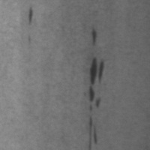
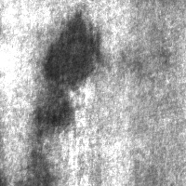
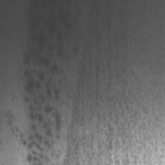
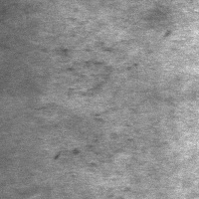
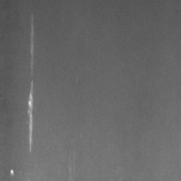
2
Dataset – NEU-CLS Steel Surface Defects
Northeastern University Classification Dataset | 6 defect classes | 1,440 grayscale images | 200x200 pixels
Crakling
Inclusion
Patches
Pitted Surface
Rolled-in Scale
Scratches
Class | Abbreviation | Train (60%) | Test (40%) | Total
Crakling | cra | 144 | 96 | 240
Inclusion | in | 144 | 96 | 240
Patches | pa | 144 | 96 | 240
Pitted Surface | ps | 144 | 96 | 240
Rolled-in Scale | rs | 144 | 96 | 240
Scratches | sc | 144 | 96 | 240
TOTAL | --- | 864 | 576 | 1,440

Slide 5
3
System Architecture & Pipeline
1
2
3
4
5
6
Data Preparation
Model Init
Self-Supervised Pretraining
Few-Shot Evaluation
Prototype Adaptation
Results & Visualization
▶
▶
▶
▶
▶
Load NEU-CLS
ResNet-18
PCA projection
N=1,2,3,4 shots
Self-training
Accuracy table
60/40 split
ImageNet pretrained
K-means clustering
100 random trials
Confidence margin
t-SNE embedding
Augmentation
512-dim features
300-epoch refinement
Prototype classifier
Unlabeled fusion
Scatter plot
Pipeline is orchestrated by main_TSMMIS.m (683 lines) which calls modular components: DataLoader.m | ResNet18Encoder.m | ContrastiveLoss.m | MMISLoss.m | TSMMISTrainer.m | TSMMISEvaluator.m

Slide 6
4
Data Preprocessing & Augmentation
PREPROCESSING
DATA AUGMENTATION (Multi-Crop)
▸ Images resized from 200x200 to 224x224 pixels
▸ Per-class folder scanning (JPG/PNG/BMP supported)
▸ Random 60/40 train-test split per class
▸ From 144 train images: 4 reserved few-shot + 140 unlabeled
▸ Full training pool used for N-shot sampling
▸ K = 5 multi-crop views per image
▸ Crop ratio range: [0.1, 1.0]
▸ Random horizontal & vertical flipping
▸ Color jitter: brightness +/-20%, contrast +/-20%
▸ Random grayscale conversion (20% probability)
▸ Gaussian blur (30% probability)
Raw Image (200x200) --> Resize (224x224) --> Multi-Crop (K=5) --> Augment (flip, jitter, blur) --> Feature Extraction
Implemented in: utils/DataLoader.m (284 lines)

Slide 7
5
Self-Supervised Pretraining
Step 1
Step 2
Step 3
Step 4
Step 5
Feature Extraction
L2 Normalization
PCA Projection
K-Means Init
Prototype Refinement
Extract 512-dim features from
▶
Row-wise L2 normalization
▶
Project to 256 dimensions
▶
Initialize 6 cluster centers
▶
300 epochs: cosine similarity
all unlabeled images using
of all feature vectors
with centering and whitening
with 5 replicates
assignment + mean re-computation
ResNet-18 encoder (batch=32)
then L2-normalize
for robust seeding
Track loss = mean(1 - maxSim)
OUTPUT: Learned Transform
{ mu (mean), coeff (PCA matrix), prototypeCenters (6 class prototypes), explainedVariance }
Pretraining uses no labels -- learns structure from unlabeled data alone

Slide 8
6
Loss Functions
Contrastive Loss L_t&s
MMIS Regularization L_MMIS
Teacher-Student Cross-View Contrastive Loss
Multi-Modal Instance Similarity Loss
sim_ps_yk = (P_s . Y_k^T) / tau
M_k = norm(Y_k) . norm(Y_{k+1})^T
sim_pk_ys = (P_k . Y_s^T) / tau
pseudo_labels = argmax(M_k, dim=2)
ce_k = CrossEntropy(M_k, pseudo_labels)
L_t&s = [ CE(sim_ps_yk, labels)
L_MMIS = mean(-ce_k) over K-1 pairs
+ CE(sim_pk_ys, labels) ] / (2K)
L_total = lambda * epoch * L_MMIS
▸ P_s = predictor output from main view
▸ Y_k = encoder outputs from K multi-crop views
▸ Y_s = main view features (detached for gradient)
▸ tau = 0.1 (temperature parameter)
▸ Cross-entropy with softmax over similarity rows
▸ Adjacent multi-crop pair similarity matrices
▸ Pseudo-labels via per-row argmax
▸ Negative cross-entropy encourages diversity
▸ lambda = 0.001 (MMIS weight)
▸ Epoch-scaled: grows importance during training
Implemented in: training/ContrastiveLoss.m (99 lines) | training/MMISLoss.m (141 lines)

Slide 9
7
Few-Shot Classification
Prototype Classifier
Evaluation Protocol
prototype_c = L2_norm( mean(
▸ Label counts tested: N = 1, 2, 3, 4 per class
▸ 100 random trials per label-count setting
▸ Each trial: random N-shot sampling from train pool
▸ Compute per-class prototype from support features
▸ Adapt prototypes with unlabeled data (self-training)
▸ Predict on test set using combined similarity scoring
▸ Record accuracy; report mean +/- std across 100 trials
▸ Blend ratio: 75% prototype + 25% nearest-instance
support_features where label = c ) )
proto_sim = features . prototypes^T
support_sim = max( features .
support_features_c^T ) per class c
combined = 0.75 * proto_sim
+ 0.25 * support_sim
prediction = argmax( combined )

Slide 10
8
Prototype Self-Training Adaptation
Leveraging unlabeled data to refine class prototypes through confident pseudo-label predictions
ALGORITHM: Self-Training Adaptation
FOR
iter = 1 to 2:
1.
Compute similarity = unlabeled_features . prototypes^T
2.
Sort similarity scores: get top-1 and top-2 per sample
3.
Calculate confidence margin = top1_score - top2_score
4.
IF margin >= 0.08 (high confidence):
pseudo_label = argmax(similarity)
5.
Update prototype for each class c:
prototype_c = L2_norm( 0.70 * prototype_c + 0.30 * mean(confident_unlabeled_c) )
END
Key Parameters: Iterations = 2 | Confidence Margin Threshold = 0.08 | Adaptation Blend = 0.70/0.30

Slide 11
9
Hyperparameters
Parameter | Value | Description
Image Size | 224 x 224 | Input resolution after resize
K (Multi-Crop Views) | 5 | Number of augmented views per image
Crop Ratio Range | [0.1, 1.0] | Min/max crop scale factor
Train/Test Split | 60% / 40% | Per-class data division
Pretrain Epochs | 300 | Prototype refinement iterations
Batch Size | 64 | Training batch size
Learning Rate | 0.003 | SGD learning rate
SGD Momentum | 0.9 | Optimizer momentum
Weight Decay | 1e-4 | L2 regularization
Lambda (MMIS) | 0.001 | MMIS loss weight
Tau (Temperature) | 0.1 | Contrastive loss temperature
PCA Dimension | 256 | Projected feature dimension
Few-Shot Runs | 100 | Random trials per setting
Label Counts | [1, 2, 3, 4] | Shots per class tested
Self-Train Iterations | 2 | Adaptation loop count
Confidence Margin | 0.08 | Pseudo-label threshold
Proto/Support Blend | 0.75 / 0.25 | Combined similarity weights
Adaptation Blend | 0.70 / 0.30 | Old/new prototype weights

Slide 12
10
Experimental Results
Few-Shot Classification Accuracy on NEU-CLS Test Set (576 images, 100 random trials per setting)
Setting | Labels/Class | Mean Accuracy | Std Dev | Interpretation
1-shot | 1 | 88.13% | 4.68% | Strong baseline from 1 example
2-shot | 2 | 93.11% | 2.64% | +4.98% gain; variance halved
3-shot | 3 | 94.86% | 1.85% | Approaching saturation
4-shot | 4 | 95.75% | 1.51% | Near-supervised performance
88.13%
95.75%
+7.62%
1.51%
1-shot accuracy
4-shot accuracy
Improvement 1->4 shot
Lowest std dev (4-shot)
Key Insight: Accuracy improves and variance decreases as more labeled support samples are provided per class. Self-supervised pretraining enables strong generalization even from a single labeled example.

Slide 13
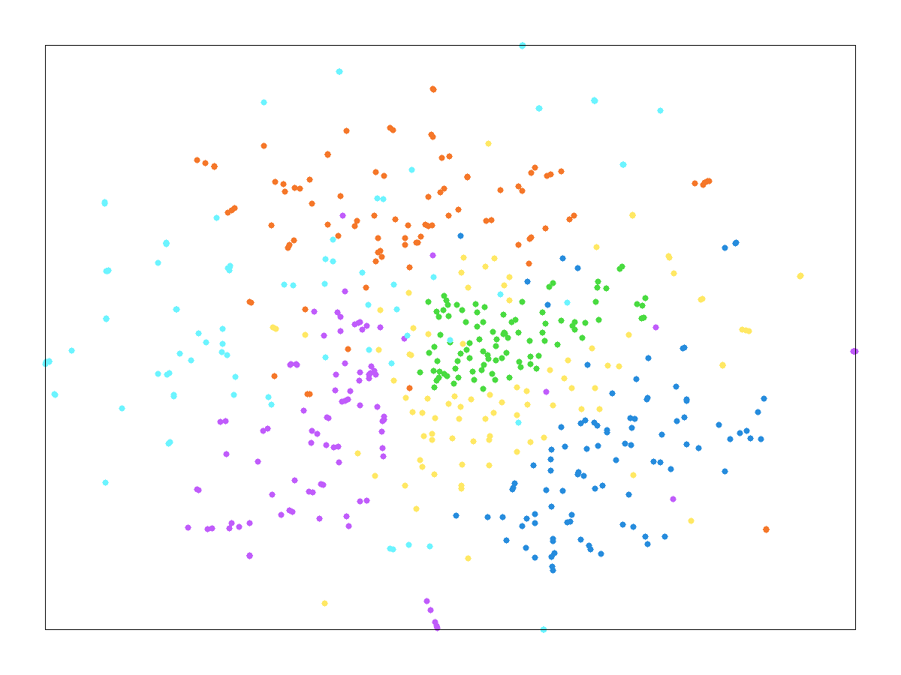
11
t-SNE Feature Visualization
2D t-SNE projection of learned test features showing class cluster separation
Parameters: perplexity=30 | Standardized features | Fallback: PCA if t-SNE unavailable

Slide 14
12
Project Structure
File / Folder | Lines | Role
main_TSMMIS.m | 683 | End-to-end orchestrator: config, data, train, eval, visualize
utils/DataLoader.m | 284 | Data loading, train/test split, multicrop, augmentation
utils/TSMMISConfig.m | 100 | Configuration value-object with all hyperparameters
models/ResNet18Encoder.m | 221 | ResNet-18 architecture: conv + 4 residual stages + GAP + FC
models/pretrained_encoder.mat | --- | Saved pretrained model weights
training/ContrastiveLoss.m | 99 | L_t&s: cross-view contrastive loss implementation
training/MMISLoss.m | 141 | L_MMIS: multi-modal instance similarity regularization
training/TSMMISTrainer.m | 262 | OOP training loop with initialize/train/step methods
training/trainTSMMIS_GPU.m | 181 | GPU-accelerated training with batch processing
evaluation/FineTuner.m | 297 | Few-shot fine-tuning (SVM linear eval + full fine-tune)
evaluation/TSMMISEvaluator.m | 285 | Evaluator class with t-SNE visualization
evaluation/results/ | --- | Output: evaluation_results.mat, tsne_embedding.mat, tsne_visualization.png
data/NEU-CLS/ | --- | 6 class folders x 240 images = 1,440 JPG files

Slide 15
13
Conclusion
KEY ACHIEVEMENTS
TECHNICAL CONTRIBUTIONS
▸ 95.75% accuracy with only 4 labeled samples per class
▸ 88.13% accuracy with a single labeled sample per class
▸ Self-supervised learning eliminates need for large labeled datasets
▸ Prototype self-training leverages unlabeled data effectively
▸ Teacher-Student contrastive learning framework
▸ Multi-Modal Instance Similarity (MMIS) regularization
▸ Combined prototype + instance similarity scoring (75/25)
▸ Confidence-based prototype adaptation from unlabeled data
PRACTICAL IMPACT
▸ Enables automated steel surface defect detection in manufacturing environments with minimal labeling effort
▸ Reduces dependency on domain experts for annotation -- only 1-4 labeled examples needed per defect type
▸ Modular MATLAB implementation allows easy extension to new defect types or other industrial inspection tasks
▸ Robust evaluation protocol (100 trials) ensures reliable and reproducible performance estimates

Slide 16
Thank You
TSMMIS: Self-Supervised Few-Shot Steel Surface Defect Recognition
Questions & Discussion

