Slide 1
Vehicle Make and model Classification using Convolutional Neural Networks
Group 04
Rajitha Meka
Syed Hasib Akhter Faruqui

Slide 2
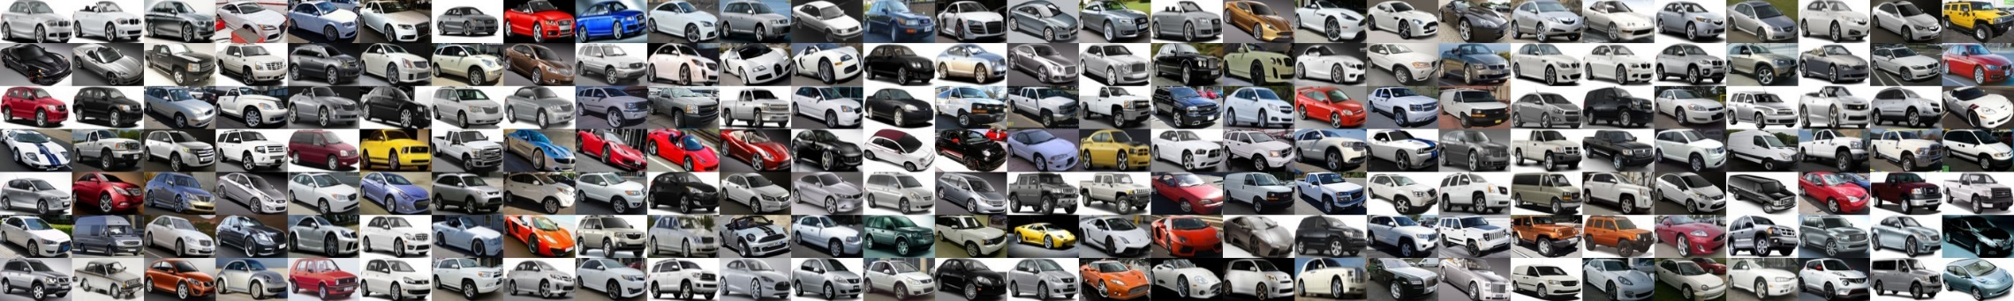
Project definition
Dataset:
Stanford cars dataset.
Images – 16,185
Classes -196

Slide 3
Project definition
Objective:
Classification of make and model of cars using AlexNet [1].
Challenges:
Pre-processing the dataset
Fine grained image categorization
Notes:
Black and white images
Crop and Resize images
Create accumulated data

Slide 4
Previous work
Image Classification of Vehicle Make and Model using Convolutional neural networks and Transfer Learning :
2 baselines – SVM, and 1 layer CNN
CaffeNet, VGGNet, GoogleNet
Accuracy – 95.1% (GoogleNet, fully-trained, Top 5 accuracy)
Accuracy – 94.2% (VGGNet, Top 5 accuracy)
Accuracy – 41.7% (CaffeNet, fully trained, Top 1 accuracy)
Notes:
Pre-initializing with ImageNet trained weights

Slide 5
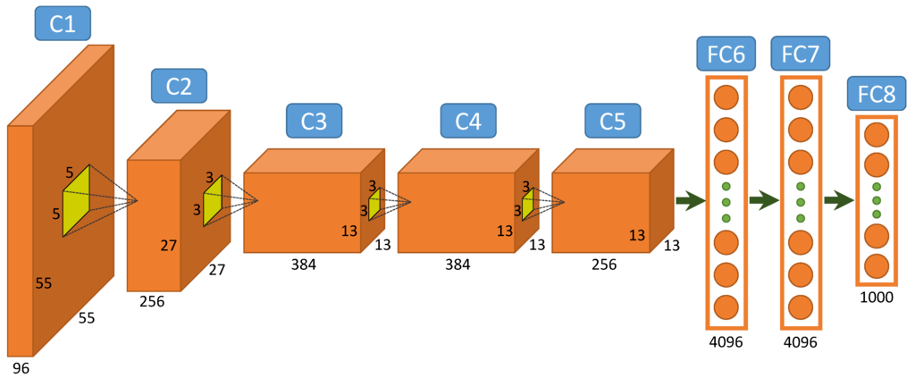
Architecture
AlexNet:
196
Fig: Structure of AlexNet

Slide 6
Reference
[1] Krause, Jonathan, et al. "3d object representations for fine-grained categorization." Proceedings of the IEEE International Conference on Computer Vision Workshops. 2013.
[2] Krizhevsky, Alex, Ilya Sutskever, and Geoffrey E. Hinton. "Imagenet classification with deep convolutional neural networks." Advances in neural information processing systems. 2012.
[3] Krause, Jonathan, et al. "Collecting a large-scale dataset of fine-grained cars." (2013).
[4] Liu, Derrick, and Yushi Wang. "Monza: Image Classification of Vehicle Make and Model Using Convolutional Neural Networks and Transfer Learning."
[5] Zhou, Yiren, et al. "Image-based Vehicle Analysis using Deep Neural Network: A Systematic Study." arXiv preprint arXiv:1601.01145 (2016).

