Slide 1
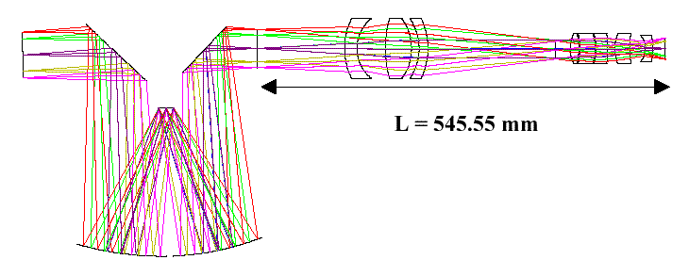
Optics
www.sliderbase.com
Mirrors and Lenses
Notes:
Optics
Mirrors and Lenses
www.sliderbase.com
Optics
Mirrors and Lenses
www.sliderbase.com
Optics
Mirrors and Lenses
www.sliderbase.com
Optics
Mirrors and Lenses
www.sliderbase.com
Optics
Mirrors and Lenses
www.sliderbase.com

Slide 2
Reflection
www.sliderbase.com
We describe the path of light as straight-line rays
Reflection off a flat surface follows a simple rule:
  angle in (incidence) equals angle out (reflection)
  angles measured from surface “normal” (perpendicular)
surface normal
same
angle
exit ray
reflected ray
incident ray
Notes:
Reflection
We describe the path of light as straight-line rays
Reflection off a flat surface follows a simple rule:
angle in (incidence) equals angle out (reflection)
angles measured from surface “normal” (perpendicular)
incident ray
exit ray
reflected ray
www.sliderbase.com
Reflection
We describe the path of light as straight-line rays
Reflection off a flat surface follows a simple rule:
angle in (incidence) equals angle out (reflection)
angles measured from surface “normal” (perpendicular)
incident ray
exit ray
reflected ray
www.sliderbase.com
Reflection
We describe the path of light as straight-line rays
Reflection off a flat surface follows a simple rule:
angle in (incidence) equals angle out (reflection)
angles measured from surface “normal” (perpendicular)
incident ray
exit ray
reflected ray
www.sliderbase.com
Reflection
We describe the path of light as straight-line rays
Reflection off a flat surface follows a simple rule:
angle in (incidence) equals angle out (reflection)
angles measured from surface “normal” (perpendicular)
incident ray
exit ray
reflected ray
www.sliderbase.com
Reflection
We describe the path of light as straight-line rays
Reflection off a flat surface follows a simple rule:
angle in (incidence) equals angle out (reflection)
angles measured from surface “normal” (perpendicular)
incident ray
exit ray
reflected ray
www.sliderbase.com

Slide 3
Reflection Vocabulary
Real Image –
  Image is made from “real” light rays that converge at a real focal point so the image is REAL
  Can be projected onto a screen because light actually passes through the point where the image appears
  Always inverted
www.sliderbase.com
Notes:
Reflection Vocabulary
Real Image –
Image is made from “real” light rays that converge at a real focal point so the image is REAL
Can be projected onto a screen because light actually passes through the point where the image appears
Always inverted
www.sliderbase.com
Reflection Vocabulary
Real Image –
Image is made from “real” light rays that converge at a real focal point so the image is REAL
Can be projected onto a screen because light actually passes through the point where the image appears
Always inverted
www.sliderbase.com

Slide 4
Reflection Vocabulary
Virtual Image–
  “Not Real” because it cannot be projected
  Image only seems to be there!
www.sliderbase.com
Notes:
Reflection Vocabulary
Virtual Image–
“Not Real” because it cannot be projected
Image only seems to be there!
www.sliderbase.com
Reflection Vocabulary
Virtual Image–
“Not Real” because it cannot be projected
Image only seems to be there!
www.sliderbase.com

Slide 5
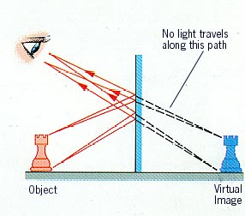
Virtual Images in Plane Mirrors
www.sliderbase.com
If light energy doesn't flow from the image, the image is "virtual". | Rays seem to come from behind the mirror, but, of course, they don't. It is virtually as if the rays were coming from behind the mirror. "Virtually": the same as if As far as the eye-brain system is concerned, the effect is the same as would occur if the mirror were absent and the chess piece were actually located at the spot labeled "virtual image".
Notes:
Virtual Images in Plane Mirrors
www.sliderbase.com
Virtual Images in Plane Mirrors
www.sliderbase.com
Virtual Images in Plane Mirrors
www.sliderbase.com
Virtual Images in Plane Mirrors
www.sliderbase.com
Virtual Images in Plane Mirrors
www.sliderbase.com

Slide 6
Hall Mirror
www.sliderbase.com
Useful to think in terms of images
“real” you
mirror only
needs to be half as
high as you are tall. Your
image will be twice as far from you
as the mirror.
“image” you
Notes:
Hall Mirror
Useful to think in terms of images
mirror only
needs to be half as
high as you are tall. Your
image will be twice as far from you
as the mirror.
www.sliderbase.com
Hall Mirror
Useful to think in terms of images
mirror only
needs to be half as
high as you are tall. Your
image will be twice as far from you
as the mirror.
www.sliderbase.com
Hall Mirror
Useful to think in terms of images
mirror only
needs to be half as
high as you are tall. Your
image will be twice as far from you
as the mirror.
www.sliderbase.com
Hall Mirror
Useful to think in terms of images
mirror only
needs to be half as
high as you are tall. Your
image will be twice as far from you
as the mirror.
www.sliderbase.com
Hall Mirror
Useful to think in terms of images
mirror only
needs to be half as
high as you are tall. Your
image will be twice as far from you
as the mirror.
www.sliderbase.com

Slide 7

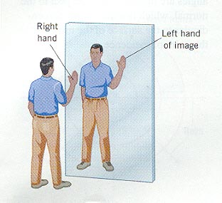
LEFT- RIGHT REVERSAL
www.sliderbase.com
Notes:
LEFT- RIGHT REVERSAL
AMBULANCE
www.sliderbase.com
LEFT- RIGHT REVERSAL
AMBULANCE
www.sliderbase.com

Slide 8
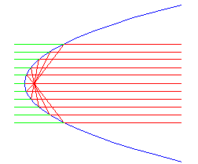
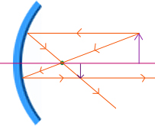
Curved mirrors
www.sliderbase.com
What if the mirror isn’t flat?
  light still follows the same rules, with local surface normal
Parabolic mirrors have exact focus
  used in telescopes, backyard satellite dishes, etc.
  also forms virtual image
Notes:
Curved mirrors
What if the mirror isn’t flat?
light still follows the same rules, with local surface normal
Parabolic mirrors have exact focus
used in telescopes, backyard satellite dishes, etc.
also forms virtual image
www.sliderbase.com
Curved mirrors
What if the mirror isn’t flat?
light still follows the same rules, with local surface normal
Parabolic mirrors have exact focus
used in telescopes, backyard satellite dishes, etc.
also forms virtual image
www.sliderbase.com
Curved mirrors
What if the mirror isn’t flat?
light still follows the same rules, with local surface normal
Parabolic mirrors have exact focus
used in telescopes, backyard satellite dishes, etc.
also forms virtual image
www.sliderbase.com
Curved mirrors
What if the mirror isn’t flat?
light still follows the same rules, with local surface normal
Parabolic mirrors have exact focus
used in telescopes, backyard satellite dishes, etc.
also forms virtual image
www.sliderbase.com
Curved mirrors
What if the mirror isn’t flat?
light still follows the same rules, with local surface normal
Parabolic mirrors have exact focus
used in telescopes, backyard satellite dishes, etc.
also forms virtual image
www.sliderbase.com

Slide 9


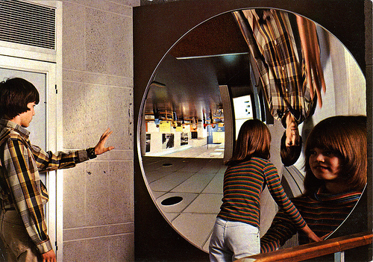
Concave Mirrors
View kacleaveland's map
"Have you ever approached a giant concave mirror? See your upside-down image suspended in mid-air. Walk through the image to see a new reflection, right-side-up and greatly magnified. In the background you see reflected a room full of visitors enjoying other
Taken in a place with no name (See more photos or videos here)
    Curves inward
    May be real or virtual image
www.sliderbase.com
Notes:
Concave Mirrors
Curves inward
May be real or virtual image
View kacleaveland's map
Taken in a place with no name (See more photos or videos here)
"Have you ever approached a giant concave mirror? See your upside-down image suspended in mid-air. Walk through the image to see a new reflection, right-side-up and greatly magnified. In the background you see reflected a room full of visitors enjoying other
www.sliderbase.com
Concave Mirrors
Curves inward
May be real or virtual image
View kacleaveland's map
Taken in a place with no name (See more photos or videos here)
"Have you ever approached a giant concave mirror? See your upside-down image suspended in mid-air. Walk through the image to see a new reflection, right-side-up and greatly magnified. In the background you see reflected a room full of visitors enjoying other
www.sliderbase.com

Slide 10
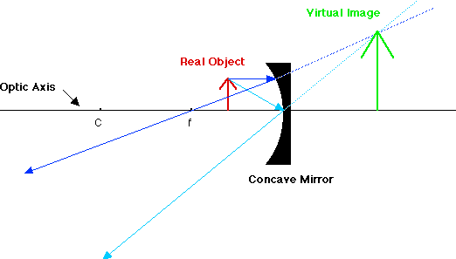
For a real object between f and the mirror, a virtual image is formed behind the mirror. The image is upright and larger than the object.
For a real object between f and the mirror, a virtual image is formed behind the mirror. The position of the image is found by tracing the reflected rays back behind the mirror to where they meet. The image is upright and larger than the object.
www.sliderbase.com
Notes:
For a real object between f and the mirror, a virtual image is formed behind the mirror. The image is upright and larger than the object.
For a real object between f and the mirror, a virtual image is formed behind the mirror. The position of the image is found by tracing the reflected rays back behind the mirror to where they meet. The image is upright and larger than the object.
www.sliderbase.com
For a real object between f and the mirror, a virtual image is formed behind the mirror. The image is upright and larger than the object.
For a real object between f and the mirror, a virtual image is formed behind the mirror. The position of the image is found by tracing the reflected rays back behind the mirror to where they meet. The image is upright and larger than the object.
www.sliderbase.com
For a real object between f and the mirror, a virtual image is formed behind the mirror. The image is upright and larger than the object.
For a real object between f and the mirror, a virtual image is formed behind the mirror. The position of the image is found by tracing the reflected rays back behind the mirror to where they meet. The image is upright and larger than the object.
www.sliderbase.com
For a real object between f and the mirror, a virtual image is formed behind the mirror. The image is upright and larger than the object.
For a real object between f and the mirror, a virtual image is formed behind the mirror. The position of the image is found by tracing the reflected rays back behind the mirror to where they meet. The image is upright and larger than the object.
www.sliderbase.com
For a real object between f and the mirror, a virtual image is formed behind the mirror. The image is upright and larger than the object.
For a real object between f and the mirror, a virtual image is formed behind the mirror. The position of the image is found by tracing the reflected rays back behind the mirror to where they meet. The image is upright and larger than the object.
www.sliderbase.com

Slide 11
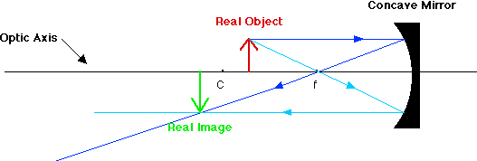
For a real object between f and the mirror, a virtual image is formed behind the mirror. The position of the image is found by tracing the reflected rays back behind the mirror to where they meet. The image is upright and larger than the object.
For a real object close to the mirror but outside of the center of curvature, the real image is formed between C and f. The image is inverted and smaller than the object.
For a real object between C and f, a real image is formed outside of C. The image is inverted and larger than the object.
www.sliderbase.com
For a real object between C and f, a real image is formed outside of C. The image is inverted and larger than the object.
Notes:
For a real object between f and the mirror, a virtual image is formed behind the mirror. The position of the image is found by tracing the reflected rays back behind the mirror to where they meet. The image is upright and larger than the object.
For a real object close to the mirror but outside of the center of curvature, the real image is formed between C and f. The image is inverted and smaller than the object.
For a real object between C and f, a real image is formed outside of C. The image is inverted and larger than the object.
For a real object between C and f, a real image is formed outside of C. The image is inverted and larger than the object.
www.sliderbase.com
For a real object between f and the mirror, a virtual image is formed behind the mirror. The position of the image is found by tracing the reflected rays back behind the mirror to where they meet. The image is upright and larger than the object.
For a real object close to the mirror but outside of the center of curvature, the real image is formed between C and f. The image is inverted and smaller than the object.
For a real object between C and f, a real image is formed outside of C. The image is inverted and larger than the object.
For a real object between C and f, a real image is formed outside of C. The image is inverted and larger than the object.
www.sliderbase.com
For a real object between f and the mirror, a virtual image is formed behind the mirror. The position of the image is found by tracing the reflected rays back behind the mirror to where they meet. The image is upright and larger than the object.
For a real object close to the mirror but outside of the center of curvature, the real image is formed between C and f. The image is inverted and smaller than the object.
For a real object between C and f, a real image is formed outside of C. The image is inverted and larger than the object.
For a real object between C and f, a real image is formed outside of C. The image is inverted and larger than the object.
www.sliderbase.com
For a real object between f and the mirror, a virtual image is formed behind the mirror. The position of the image is found by tracing the reflected rays back behind the mirror to where they meet. The image is upright and larger than the object.
For a real object close to the mirror but outside of the center of curvature, the real image is formed between C and f. The image is inverted and smaller than the object.
For a real object between C and f, a real image is formed outside of C. The image is inverted and larger than the object.
For a real object between C and f, a real image is formed outside of C. The image is inverted and larger than the object.
www.sliderbase.com
For a real object between f and the mirror, a virtual image is formed behind the mirror. The position of the image is found by tracing the reflected rays back behind the mirror to where they meet. The image is upright and larger than the object.
For a real object close to the mirror but outside of the center of curvature, the real image is formed between C and f. The image is inverted and smaller than the object.
For a real object between C and f, a real image is formed outside of C. The image is inverted and larger than the object.
For a real object between C and f, a real image is formed outside of C. The image is inverted and larger than the object.
www.sliderbase.com

Slide 12
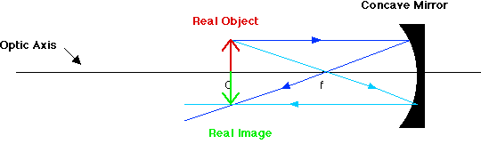
For a real object between f and the mirror, a virtual image is formed behind the mirror. The position of the image is found by tracing the reflected rays back behind the mirror to where they meet. The image is upright and larger than the object.
For a real object close to the mirror but outside of the center of curvature, the real image is formed between C and f. The image is inverted and smaller than the object.
For a real object between C and f, a real image is formed outside of C. The image is inverted and larger than the object.
For a real object at C, the real image is formed at C. The image is inverted and the same size as the object.
www.sliderbase.com
For a real object at C, the real image is formed at C. The image is inverted and the same size as the object.
Notes:
For a real object between f and the mirror, a virtual image is formed behind the mirror. The position of the image is found by tracing the reflected rays back behind the mirror to where they meet. The image is upright and larger than the object.
For a real object close to the mirror but outside of the center of curvature, the real image is formed between C and f. The image is inverted and smaller than the object.
For a real object between C and f, a real image is formed outside of C. The image is inverted and larger than the object.
For a real object at C, the real image is formed at C. The image is inverted and the same size as the object.
For a real object at C, the real image is formed at C. The image is inverted and the same size as the object.
www.sliderbase.com
For a real object between f and the mirror, a virtual image is formed behind the mirror. The position of the image is found by tracing the reflected rays back behind the mirror to where they meet. The image is upright and larger than the object.
For a real object close to the mirror but outside of the center of curvature, the real image is formed between C and f. The image is inverted and smaller than the object.
For a real object between C and f, a real image is formed outside of C. The image is inverted and larger than the object.
For a real object at C, the real image is formed at C. The image is inverted and the same size as the object.
For a real object at C, the real image is formed at C. The image is inverted and the same size as the object.
www.sliderbase.com
For a real object between f and the mirror, a virtual image is formed behind the mirror. The position of the image is found by tracing the reflected rays back behind the mirror to where they meet. The image is upright and larger than the object.
For a real object close to the mirror but outside of the center of curvature, the real image is formed between C and f. The image is inverted and smaller than the object.
For a real object between C and f, a real image is formed outside of C. The image is inverted and larger than the object.
For a real object at C, the real image is formed at C. The image is inverted and the same size as the object.
For a real object at C, the real image is formed at C. The image is inverted and the same size as the object.
www.sliderbase.com
For a real object between f and the mirror, a virtual image is formed behind the mirror. The position of the image is found by tracing the reflected rays back behind the mirror to where they meet. The image is upright and larger than the object.
For a real object close to the mirror but outside of the center of curvature, the real image is formed between C and f. The image is inverted and smaller than the object.
For a real object between C and f, a real image is formed outside of C. The image is inverted and larger than the object.
For a real object at C, the real image is formed at C. The image is inverted and the same size as the object.
For a real object at C, the real image is formed at C. The image is inverted and the same size as the object.
www.sliderbase.com
For a real object between f and the mirror, a virtual image is formed behind the mirror. The position of the image is found by tracing the reflected rays back behind the mirror to where they meet. The image is upright and larger than the object.
For a real object close to the mirror but outside of the center of curvature, the real image is formed between C and f. The image is inverted and smaller than the object.
For a real object between C and f, a real image is formed outside of C. The image is inverted and larger than the object.
For a real object at C, the real image is formed at C. The image is inverted and the same size as the object.
For a real object at C, the real image is formed at C. The image is inverted and the same size as the object.
www.sliderbase.com

Slide 13
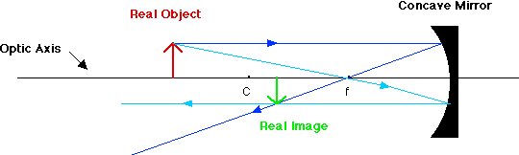
For a real object between f and the mirror, a virtual image is formed behind the mirror. The position of the image is found by tracing the reflected rays back behind the mirror to where they meet. The image is upright and larger than the object.
For a real object close to the mirror but outside of the center of curvature, the real image is formed between C and f. The image is inverted and smaller than the object.
www.sliderbase.com
For a real object close to the mirror but outside of the center of curvature, the real image is formed between C and f. The image is inverted and smaller than the object.
Notes:
For a real object between f and the mirror, a virtual image is formed behind the mirror. The position of the image is found by tracing the reflected rays back behind the mirror to where they meet. The image is upright and larger than the object.
For a real object close to the mirror but outside of the center of curvature, the real image is formed between C and f. The image is inverted and smaller than the object.
For a real object close to the mirror but outside of the center of curvature, the real image is formed between C and f. The image is inverted and smaller than the object.
www.sliderbase.com
For a real object between f and the mirror, a virtual image is formed behind the mirror. The position of the image is found by tracing the reflected rays back behind the mirror to where they meet. The image is upright and larger than the object.
For a real object close to the mirror but outside of the center of curvature, the real image is formed between C and f. The image is inverted and smaller than the object.
For a real object close to the mirror but outside of the center of curvature, the real image is formed between C and f. The image is inverted and smaller than the object.
www.sliderbase.com
For a real object between f and the mirror, a virtual image is formed behind the mirror. The position of the image is found by tracing the reflected rays back behind the mirror to where they meet. The image is upright and larger than the object.
For a real object close to the mirror but outside of the center of curvature, the real image is formed between C and f. The image is inverted and smaller than the object.
For a real object close to the mirror but outside of the center of curvature, the real image is formed between C and f. The image is inverted and smaller than the object.
www.sliderbase.com
For a real object between f and the mirror, a virtual image is formed behind the mirror. The position of the image is found by tracing the reflected rays back behind the mirror to where they meet. The image is upright and larger than the object.
For a real object close to the mirror but outside of the center of curvature, the real image is formed between C and f. The image is inverted and smaller than the object.
For a real object close to the mirror but outside of the center of curvature, the real image is formed between C and f. The image is inverted and smaller than the object.
www.sliderbase.com
For a real object between f and the mirror, a virtual image is formed behind the mirror. The position of the image is found by tracing the reflected rays back behind the mirror to where they meet. The image is upright and larger than the object.
For a real object close to the mirror but outside of the center of curvature, the real image is formed between C and f. The image is inverted and smaller than the object.
For a real object close to the mirror but outside of the center of curvature, the real image is formed between C and f. The image is inverted and smaller than the object.
www.sliderbase.com

Slide 14
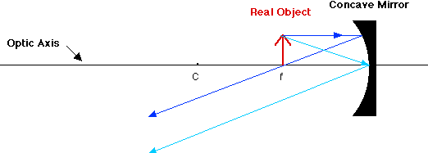
For a real object at f, no image is formed. The reflected rays are parallel and never converge.
www.sliderbase.com
What size image is formed if the real object is placed at the focal point f?
For a real object at f, no image is formed. The reflected rays are parallel and never converge.
Notes:
For a real object at f, no image is formed. The reflected rays are parallel and never converge.
For a real object at f, no image is formed. The reflected rays are parallel and never converge.
What size image is formed if the real object is placed at the focal point f?
www.sliderbase.com
For a real object at f, no image is formed. The reflected rays are parallel and never converge.
For a real object at f, no image is formed. The reflected rays are parallel and never converge.
What size image is formed if the real object is placed at the focal point f?
www.sliderbase.com
For a real object at f, no image is formed. The reflected rays are parallel and never converge.
For a real object at f, no image is formed. The reflected rays are parallel and never converge.
What size image is formed if the real object is placed at the focal point f?
www.sliderbase.com
For a real object at f, no image is formed. The reflected rays are parallel and never converge.
For a real object at f, no image is formed. The reflected rays are parallel and never converge.
What size image is formed if the real object is placed at the focal point f?
www.sliderbase.com
For a real object at f, no image is formed. The reflected rays are parallel and never converge.
For a real object at f, no image is formed. The reflected rays are parallel and never converge.
What size image is formed if the real object is placed at the focal point f?
www.sliderbase.com

Slide 15
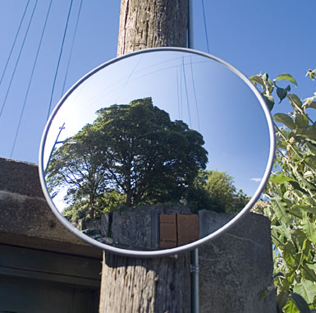

Convex Mirrors
    Curves outward
    Reduces images
    Virtual images
  Use: Rear view mirrors, store security…
CAUTION! Objects are closer than they appear!
www.sliderbase.com
Notes:
Convex Mirrors
Curves outward
Reduces images
Virtual images
Use: Rear view mirrors, store security…
CAUTION! Objects are closer than they appear!
www.sliderbase.com
Convex Mirrors
Curves outward
Reduces images
Virtual images
Use: Rear view mirrors, store security…
CAUTION! Objects are closer than they appear!
www.sliderbase.com

Slide 16
Refraction
www.sliderbase.com
Light also goes through some things
  glass, water, eyeball, air
The presence of material slows light’s progress
  interactions with electrical properties of atoms
The “light slowing factor” is called the index of refraction
  glass has n = 1.52, meaning that light travels about 1.5 times slower in glass than in vacuum
  water has n = 1.33
  air has n = 1.00028
  vacuum is n = 1.00000 (speed of light at full capacity)
Notes:
Refraction
Light also goes through some things
glass, water, eyeball, air
The presence of material slows light’s progress
interactions with electrical properties of atoms
The “light slowing factor” is called the index of refraction
glass has n = 1.52, meaning that light travels about 1.5 times slower in glass than in vacuum
water has n = 1.33
air has n = 1.00028
vacuum is n = 1.00000 (speed of light at full capacity)
www.sliderbase.com
Refraction
Light also goes through some things
glass, water, eyeball, air
The presence of material slows light’s progress
interactions with electrical properties of atoms
The “light slowing factor” is called the index of refraction
glass has n = 1.52, meaning that light travels about 1.5 times slower in glass than in vacuum
water has n = 1.33
air has n = 1.00028
vacuum is n = 1.00000 (speed of light at full capacity)
www.sliderbase.com
Refraction
Light also goes through some things
glass, water, eyeball, air
The presence of material slows light’s progress
interactions with electrical properties of atoms
The “light slowing factor” is called the index of refraction
glass has n = 1.52, meaning that light travels about 1.5 times slower in glass than in vacuum
water has n = 1.33
air has n = 1.00028
vacuum is n = 1.00000 (speed of light at full capacity)
www.sliderbase.com
Refraction
Light also goes through some things
glass, water, eyeball, air
The presence of material slows light’s progress
interactions with electrical properties of atoms
The “light slowing factor” is called the index of refraction
glass has n = 1.52, meaning that light travels about 1.5 times slower in glass than in vacuum
water has n = 1.33
air has n = 1.00028
vacuum is n = 1.00000 (speed of light at full capacity)
www.sliderbase.com
Refraction
Light also goes through some things
glass, water, eyeball, air
The presence of material slows light’s progress
interactions with electrical properties of atoms
The “light slowing factor” is called the index of refraction
glass has n = 1.52, meaning that light travels about 1.5 times slower in glass than in vacuum
water has n = 1.33
air has n = 1.00028
vacuum is n = 1.00000 (speed of light at full capacity)
www.sliderbase.com

Slide 17
Refraction at a plane surface
www.sliderbase.com
Light bends at interface between refractive indices
  bends more the larger the difference in refractive index
A
n₁ = 1.0
n₂ = 1.5
B
Notes:
Refraction at a plane surface
Light bends at interface between refractive indices
bends more the larger the difference in refractive index
www.sliderbase.com
Refraction at a plane surface
Light bends at interface between refractive indices
bends more the larger the difference in refractive index
www.sliderbase.com
Refraction at a plane surface
Light bends at interface between refractive indices
bends more the larger the difference in refractive index
www.sliderbase.com
Refraction at a plane surface
Light bends at interface between refractive indices
bends more the larger the difference in refractive index
www.sliderbase.com
Refraction at a plane surface
Light bends at interface between refractive indices
bends more the larger the difference in refractive index
www.sliderbase.com

Slide 18
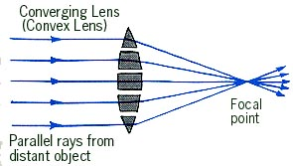
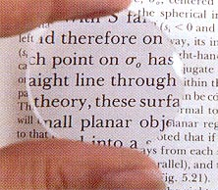
Convex Lenses
Thicker in the center than edges.
  Lens that converges (brings together) light rays.
  Forms real images and virtual images depending on position of the object
The Magnifier
www.sliderbase.com
Notes:
Convex Lenses
Thicker in the center than edges.
Lens that converges (brings together) light rays.
Forms real images and virtual images depending on position of the object
The Magnifier
www.sliderbase.com
Convex Lenses
Thicker in the center than edges.
Lens that converges (brings together) light rays.
Forms real images and virtual images depending on position of the object
The Magnifier
www.sliderbase.com

Slide 19
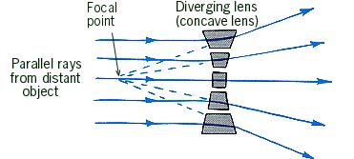
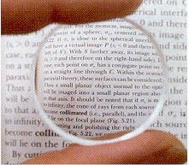
Concave Lenses
Lenses that are thicker at the edges and thinner in the center.
  Diverges light rays
  All images are
  erect and reduced.
The De-Magnifier
www.sliderbase.com
Notes:
Concave Lenses
Lenses that are thicker at the edges and thinner in the center.
Diverges light rays
All images are
erect and reduced.
The De-Magnifier
www.sliderbase.com
Concave Lenses
Lenses that are thicker at the edges and thinner in the center.
Diverges light rays
All images are
erect and reduced.
The De-Magnifier
www.sliderbase.com

Slide 20

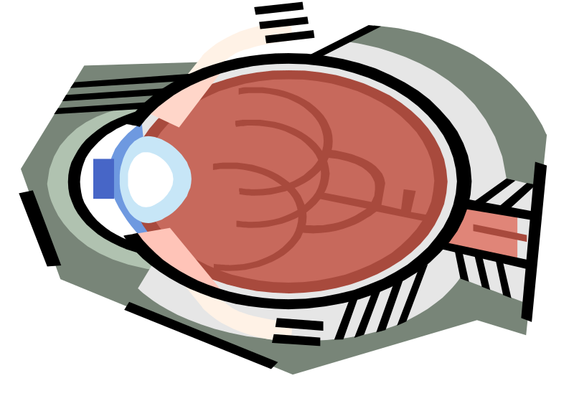
How You See
Near Sighted – Eyeball is too long and image focuses in front of the retina
    Near Sightedness – Concave lenses expand focal length
Far Sighted – Eyeball is too short so image is focused behind the retina.
    Far Sightedness – Convex lense shortens the focal length.
www.sliderbase.com
Notes:
How You See
Near Sighted – Eyeball is too long and image focuses in front of the retina
Near Sightedness – Concave lenses expand focal length
Far Sighted – Eyeball is too short so image is focused behind the retina.
Far Sightedness – Convex lense shortens the focal length.
www.sliderbase.com
How You See
Near Sighted – Eyeball is too long and image focuses in front of the retina
Near Sightedness – Concave lenses expand focal length
Far Sighted – Eyeball is too short so image is focused behind the retina.
Far Sightedness – Convex lense shortens the focal length.
www.sliderbase.com

Slide 21


Cameras, in brief
www.sliderbase.com
object
pinhole
image at
film plane
In a pinhole camera, the hole is so small that light hitting any particular point
on the film plane must have come from a particular direction outside the camera
object
image at
film plane
lens
In a camera with a lens, the same applies: that a point on the film plane
more-or-less corresponds to a direction outside the camera. Lenses have
the important advantage of collecting more light than the pinhole admits
Notes:
Cameras, in brief
In a pinhole camera, the hole is so small that light hitting any particular point
on the film plane must have come from a particular direction outside the camera
In a camera with a lens, the same applies: that a point on the film plane
more-or-less corresponds to a direction outside the camera. Lenses have
the important advantage of collecting more light than the pinhole admits
www.sliderbase.com
Cameras, in brief
In a pinhole camera, the hole is so small that light hitting any particular point
on the film plane must have come from a particular direction outside the camera
In a camera with a lens, the same applies: that a point on the film plane
more-or-less corresponds to a direction outside the camera. Lenses have
the important advantage of collecting more light than the pinhole admits
www.sliderbase.com
Cameras, in brief
In a pinhole camera, the hole is so small that light hitting any particular point
on the film plane must have come from a particular direction outside the camera
In a camera with a lens, the same applies: that a point on the film plane
more-or-less corresponds to a direction outside the camera. Lenses have
the important advantage of collecting more light than the pinhole admits
www.sliderbase.com
Cameras, in brief
In a pinhole camera, the hole is so small that light hitting any particular point
on the film plane must have come from a particular direction outside the camera
In a camera with a lens, the same applies: that a point on the film plane
more-or-less corresponds to a direction outside the camera. Lenses have
the important advantage of collecting more light than the pinhole admits
www.sliderbase.com
Cameras, in brief
In a pinhole camera, the hole is so small that light hitting any particular point
on the film plane must have come from a particular direction outside the camera
In a camera with a lens, the same applies: that a point on the film plane
more-or-less corresponds to a direction outside the camera. Lenses have
the important advantage of collecting more light than the pinhole admits
www.sliderbase.com

