Slide 1
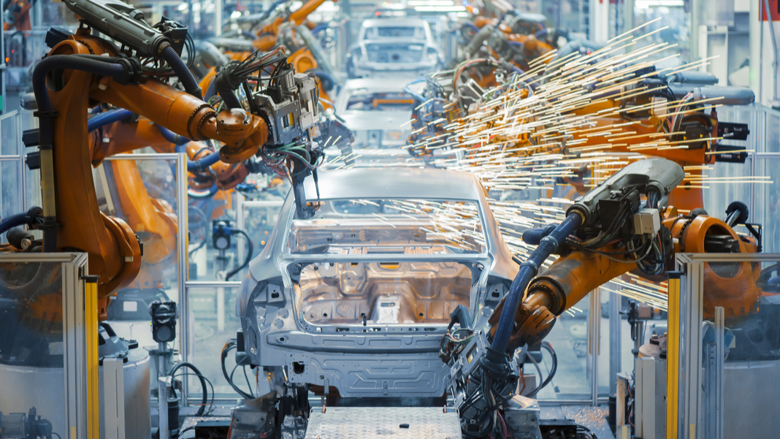
Explainable AI in Manufacturing
This Photo by Unknown Author is licensed under CC BY-ND

Slide 2
Introduction
Manufacturing companies traditionally use reactive maintenance approaches, which can result in downtime and maintenance costs.
Predictive maintenance is a proactive approach that uses machine learning algorithms to predict when equipment failures are likely to occur.
Predictive maintenance can reduce downtime and maintenance costs, and improve overall equipment effectiveness (OEE).
The use of machine learning algorithms in manufacturing can raise concerns about the trustworthiness of predictions.
Explainable AI can help build trust in machine learning models by providing insights into how they make their predictions.
This presentation will discuss the importance of explainable AI in manufacturing and how it can be used in a case study on predictive maintenance.

Slide 3
Explainable AI
Explainable AI refers to the ability to understand and explain how machine learning models make predictions.
It is important for manufacturing companies to have explainable AI because it can build trust in AI models and allow for informed decision-making.
With explainable AI, companies can understand the factors that are driving predictions and make necessary adjustments to improve accuracy.
Explainable AI can also help with compliance and regulatory requirements by providing transparent decision-making processes.
There are various techniques for implementing explainable AI, such as feature importance analysis, partial dependence plots, and LIME (Local Interpretable Model-Agnostic Explanations).
Explainable AI is crucial for applications such as predictive maintenance because it can help technicians understand why a piece of equipment is predicted to fail and take appropriate action to prevent it.

Slide 4
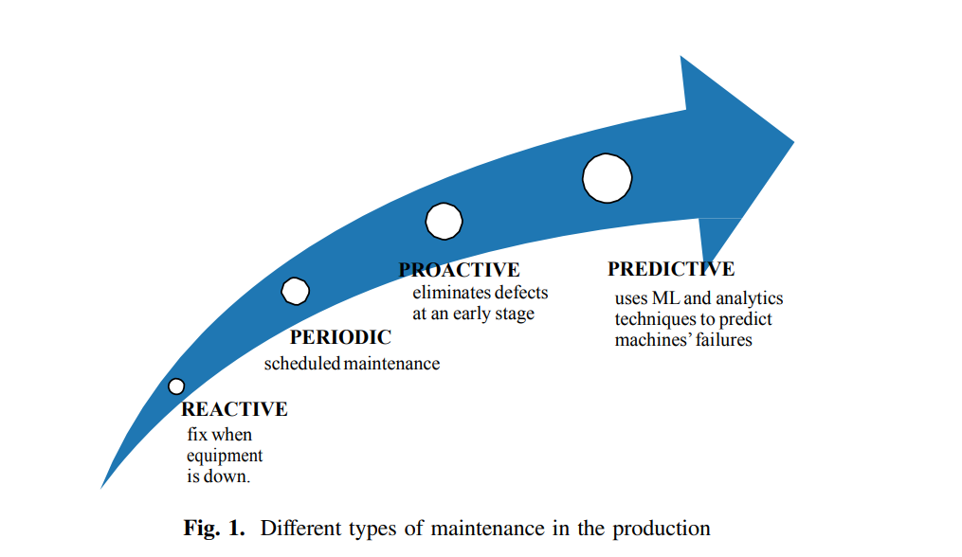
Predictive Maintenance
Predictive maintenance is a proactive maintenance strategy that uses data analysis and machine learning algorithms to predict when equipment failure is likely to occur.
This approach can help manufacturing companies reduce downtime, lower maintenance costs, and improve overall equipment effectiveness (OEE).
Predictive maintenance differs from traditional maintenance approaches (reactive, preventive) because it uses data to predict when maintenance is necessary instead of waiting for equipment to fail.
Predictive maintenance requires a large amount of data to be effective, such as sensor data, maintenance logs, and equipment performance data.

Slide 5
Advantages of PdM
Reduce the operational risk of mission-critical equipment.
Control cost of maintenance by enabling just-in-time maintenance operations.
Discover patterns connected to various maintenance problems.
Provide Key Performance Indicators.

Slide 6
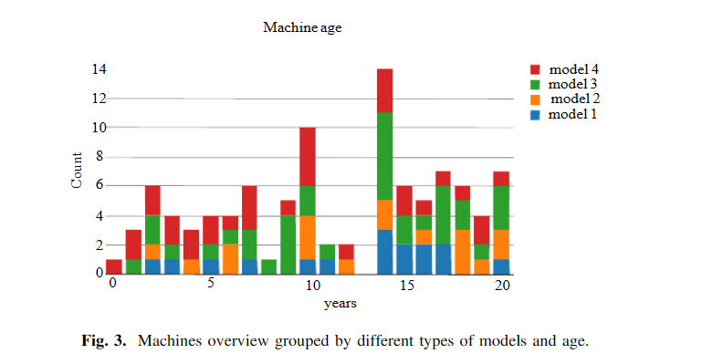
Data Preparation for Failure Prediction
Data collected from Azure blob storage
Telemetry: Collects historical machine behavior data (voltage, vibration, etc.)
Machines: Descriptive information about the machines. The information includes: model type, and machine age

Slide 7
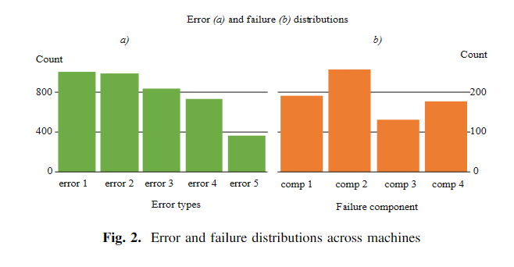
Errors: Data about warnings and errors in the machines
Maintenance data: Data about replacement and maintenance for the machines
Failures: Data when a machine stops due to component failure

Slide 8
Feature Engineering:
Created lagged telemetry data to capture time-series patterns.
Calculated rolling mean and standard deviation over lag windows.
Merged lag features into one data frame.
Aggregated categorical error values to capture different error types.
Incorporated component replacement frequency and time since last replacement.
Utilized machine information such as type and age.
Label Construction:
Defined label as probability of machine failure in next 24 hours due to component failure.
Created column indicating machine failure status:
"none": No failure in next 24 hours.
"comp1" to "comp4": Failure due to specific components.

Slide 9
ML Model
DART Booster: A boosting algorithm utilized for hyper-parameter tuning in LightGBM3, a gradient boosting framework.
LightGBM3: A powerful gradient boosting framework that employs tree-based learning algorithms for efficient model training.
DART (Dropouts meet Multiple Additive Regression Trees): An optimization technique integrated into boosting algorithms, enhancing model performance.
Hyper-Parameter Tuning: The process of fine-tuning algorithm settings to optimize model accuracy and reliability.

Slide 10
In the scope of XAI
Feature Importance: Fine-tuning the hyper-parameters helps identify and prioritize important features, enhancing the interpretability of the model by highlighting the factors that contribute significantly to predictions.
Model Simplicity: By removing irrelevant or redundant features, the tuning process simplifies the model, making it easier to understand and explain to non-technical stakeholders.
Human-Readable Outputs: LightGBM3 provides visualizations and reports that aid in explaining the model's predictions, such as feature importance plots and decision trees, improving interpretability and facilitating communication with stakeholders.

Slide 11
Benefits of DART Booster Hyper-Parameter Tuning:
Improved model accuracy and reliability through optimal parameter configuration.
Enhanced generalization and robustness, particularly beneficial for small data sets.
Implementation of DART Booster with LightGBM3 in Predictive Maintenance (PdM):
Selected as the boosting algorithm for building a multi-class classification model to predict machine failures.
Specifically designed to handle the prediction of five potential failure types: comp1, comp2, comp3, comp4, or none.
Promising results obtained during the model evaluation phase, indicating the effectiveness of the approach.
Future Directions:
Further exploration of hyper-parameter optimization to maximize model performance.
Validation of the trained model using real-world manufacturing data to ensure its practical applicability.
DART Booster Hyper-Parameter Tuning with LightGBM3 provides a robust and efficient solution for accurate Predictive Maintenance models in manufacturing settings.

Slide 12
Preliminary Results and ML Model Evaluation:
Utilized the DART Booster hyper-parameter tuning with LightGBM3
LightGBM3 is a gradient boosting framework using tree-based learning algorithm
Evaluated the trained model using the training data set Analyzed 5 data sets with telemetry, errors, maintenance, and failure information for 100 machines
Transformed and analyzed the data to create the final data set for PdM model building
Generated the label column to describe machine failure in the next 24 hours: comp1, comp2, comp3, comp4, or none

Slide 13
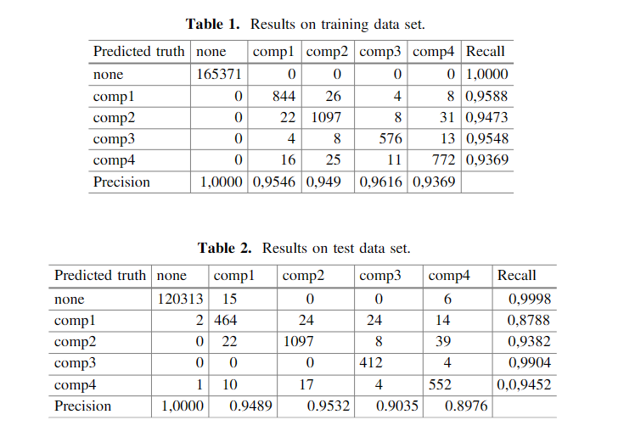
Results :
The model accurately predicts values from the training data set in most cases
Evaluated the model's performance on unknown data entries using the test data (Table 2)
Overall accuracy of 99% and 95% average per class accuracy, showing promising results for the experimental case
Note: Table 1 and Table 2 are not provided in the given information, so they are not included in the slide.

Slide 14
Conclusion
The experimental case study demonstrated the potential of explainable AI in Predictive Maintenance (PdM) within the manufacturing field.
Reliable prediction models and visualizations provided by explainable AI contribute to avoiding unnecessary costs associated with unscheduled downtime caused by machine errors or tool failures.
Despite being based on a generic data set, the presented concept showed high maturity and yielded promising results.
Future steps involve engaging the trained model with real-world manufacturing data, including data from different manufacturers, to validate and enhance the reliability of the results.
Explainable AI holds significant promise in manufacturing and PdM, empowering manufacturers to proactively identify and address potential issues, optimize production efficiency, and prevent costly disruptions.

