Slide 1
CAMPUS RECRUITMENT SYSTEM
DESIGNED AND PRESENTED BY :
GROUP-1
KSHITIJ SHARMA
KUNDAN KUMAR
KUMAR SHIVAM RANJAN

Slide 2



CONTENTS
LANDING PAGE
STUDENT LOGIN
COMPANY LOGIN
ADMIN
ABOUT

Slide 3


HOME PAGE:

Slide 4
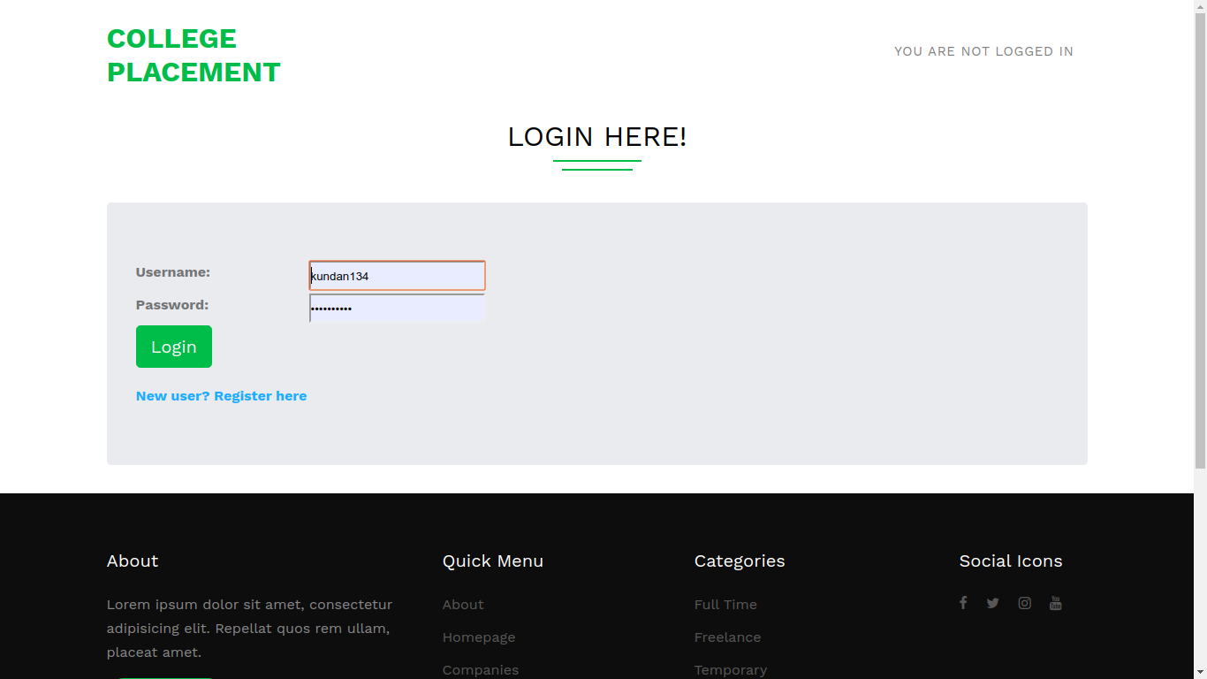
STUDENT LOGIN:

Slide 5
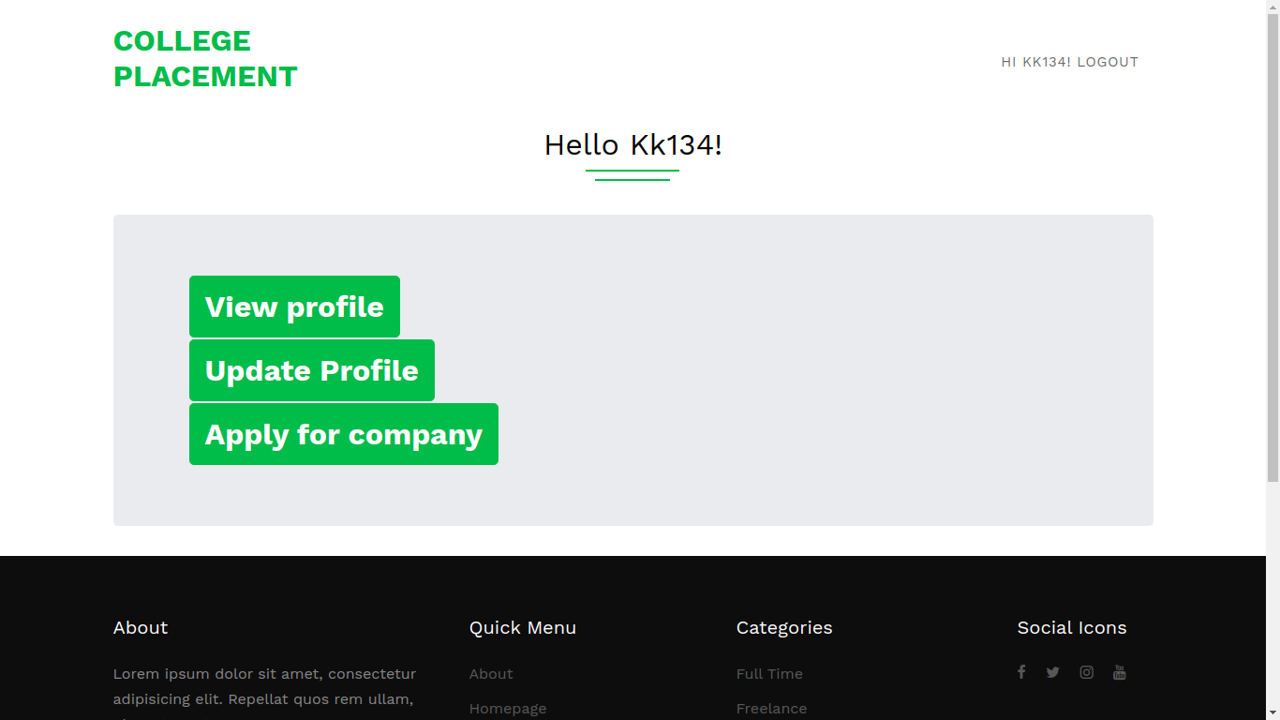
STUDENT DASHBOARD:

Slide 6
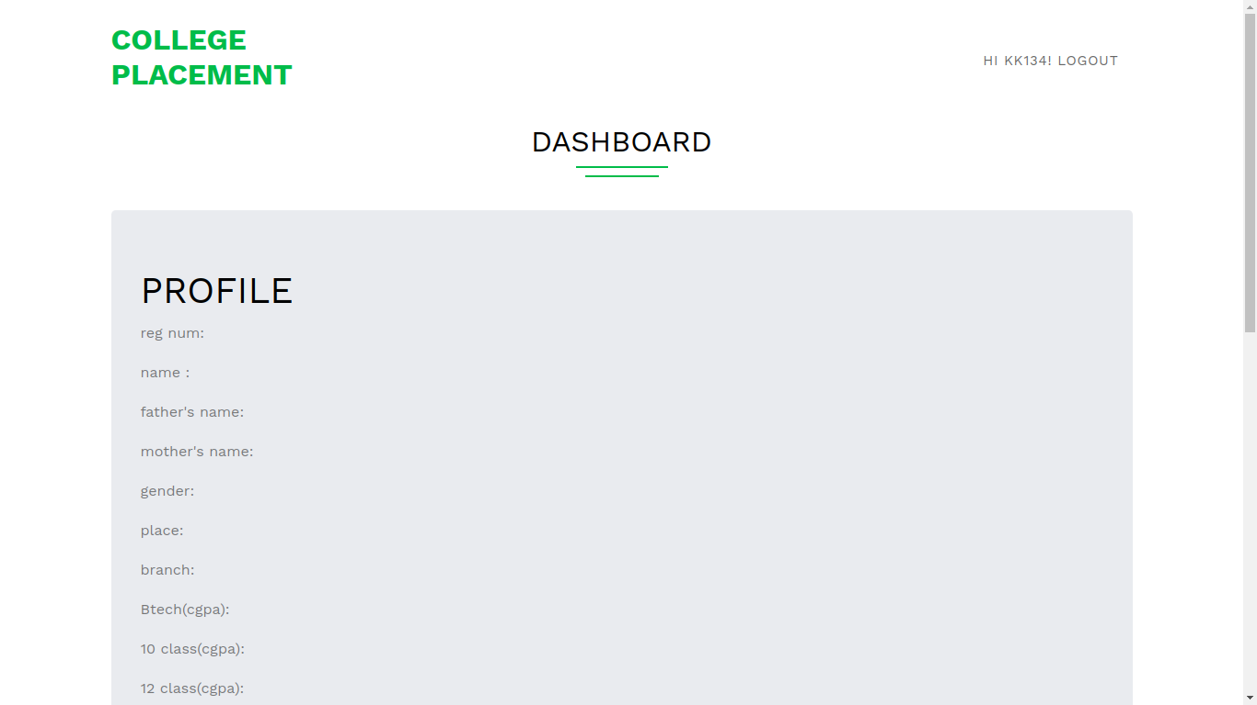
STUDENT DETAILS:

Slide 7
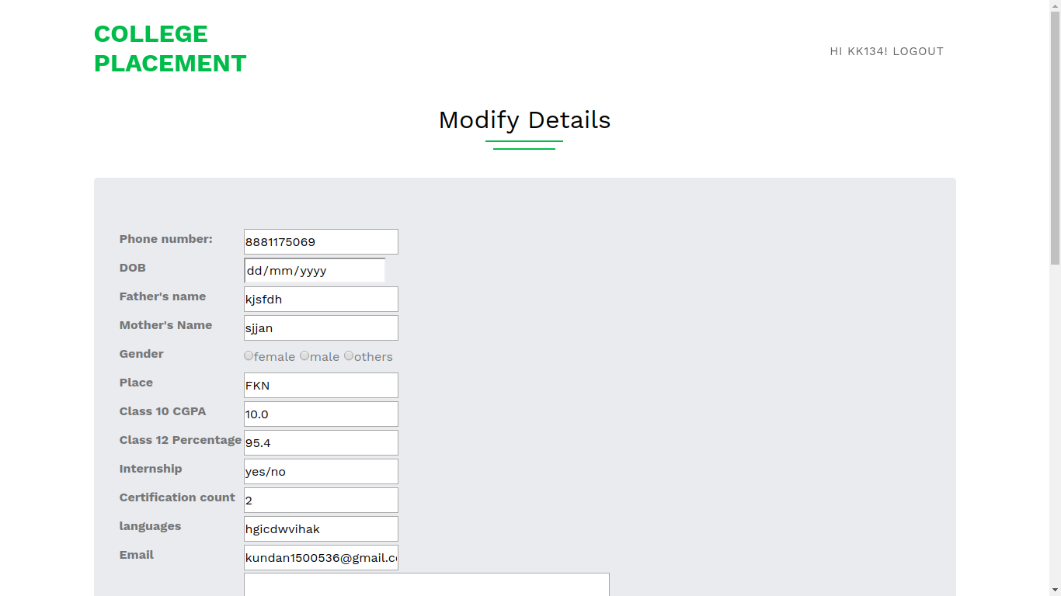
MODIFY DETAILS:

Slide 8
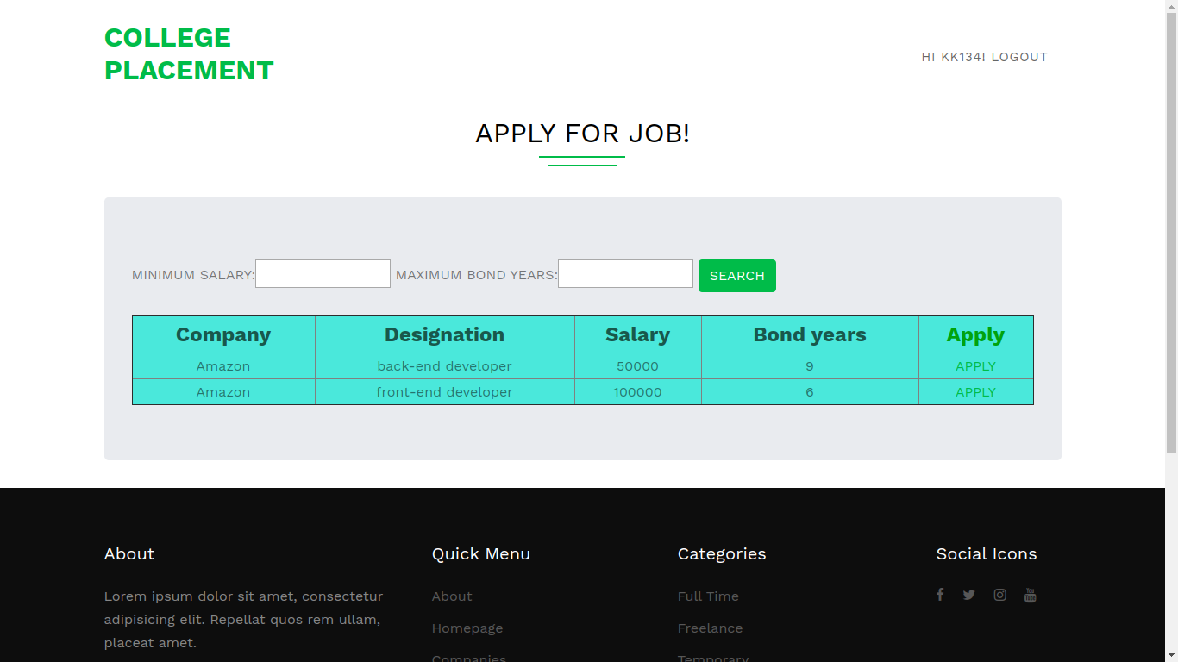
APPLY FOR A JOB:

Slide 9
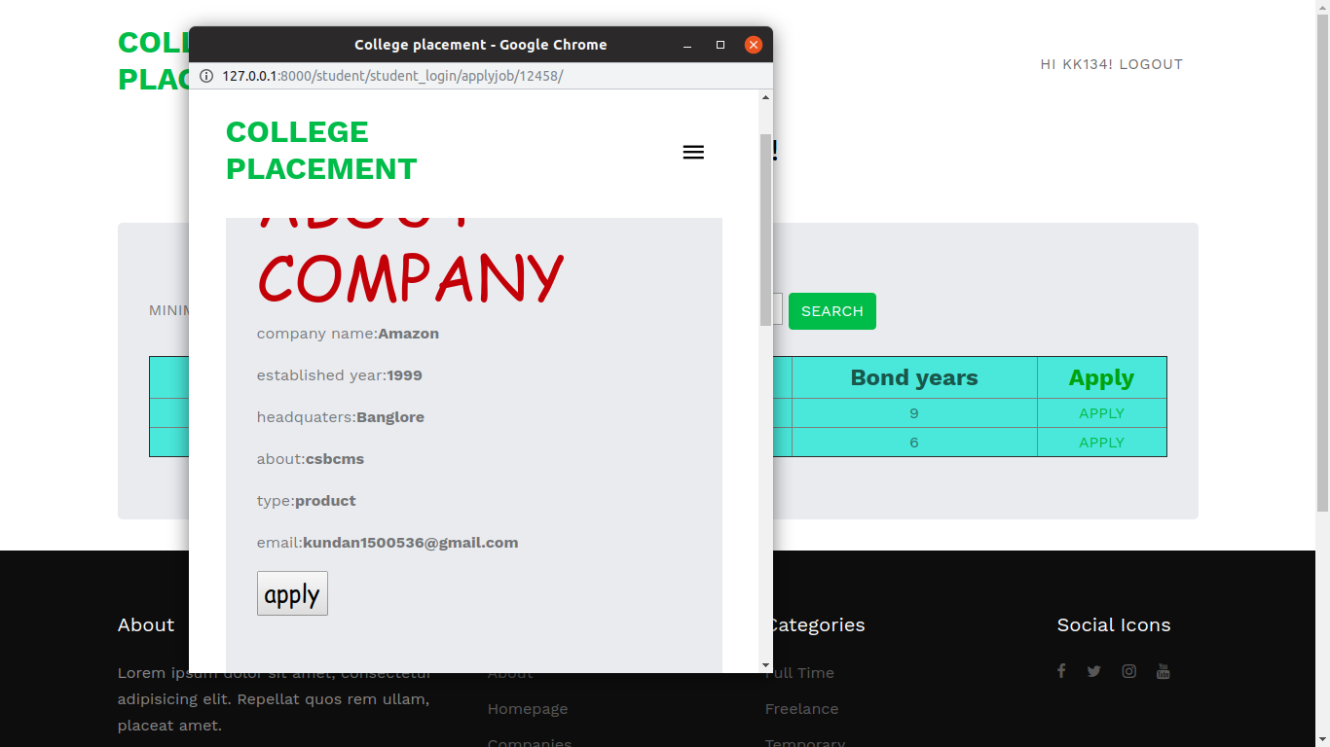
POPUP FOR APPLY:

Slide 10
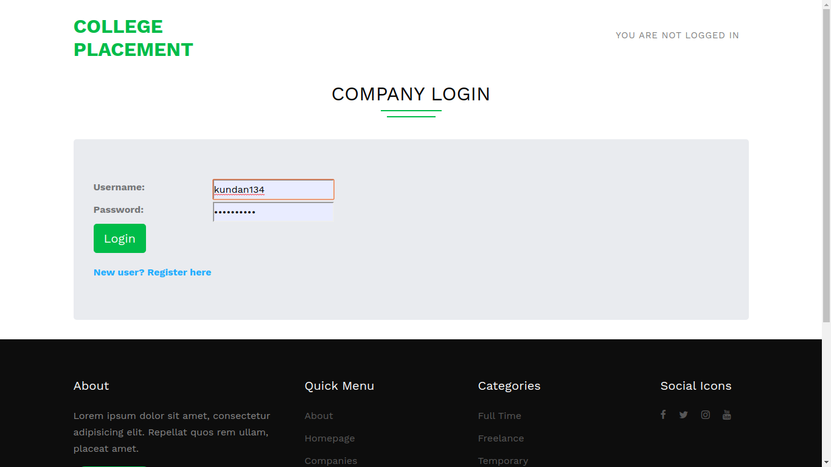
COMPANY LOGIN:

Slide 11
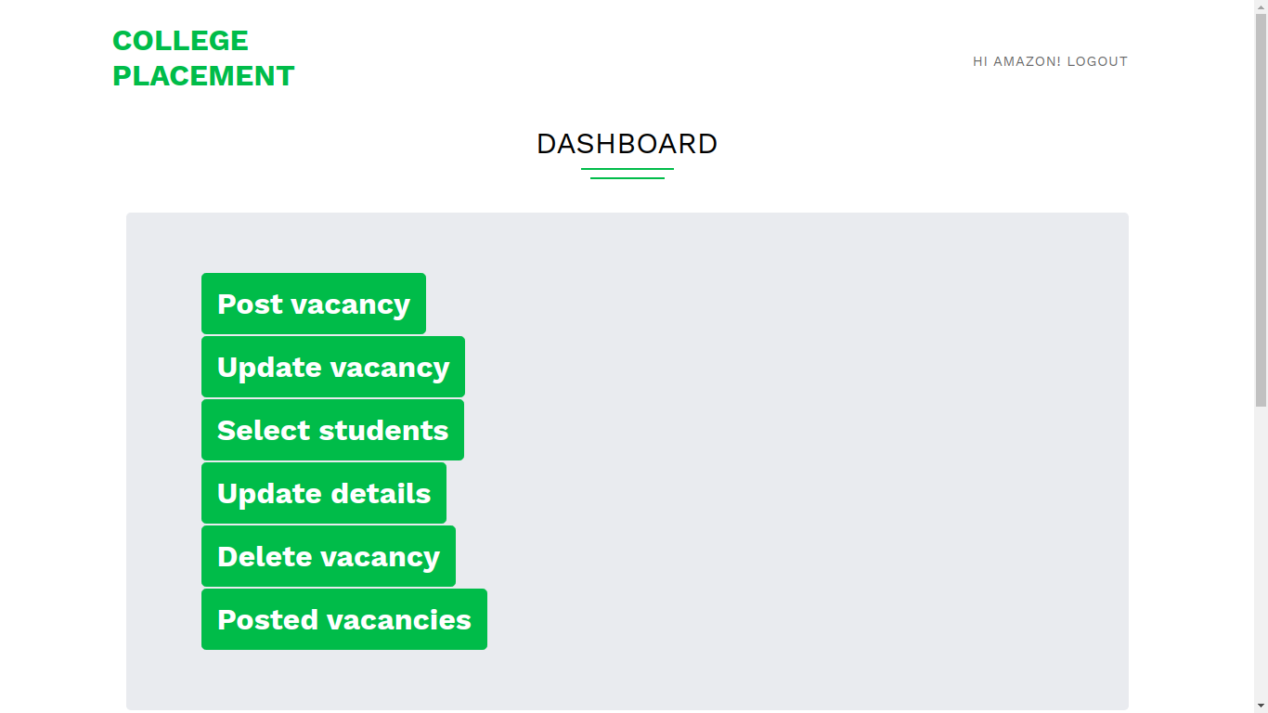
DASHBOARD:

Slide 12
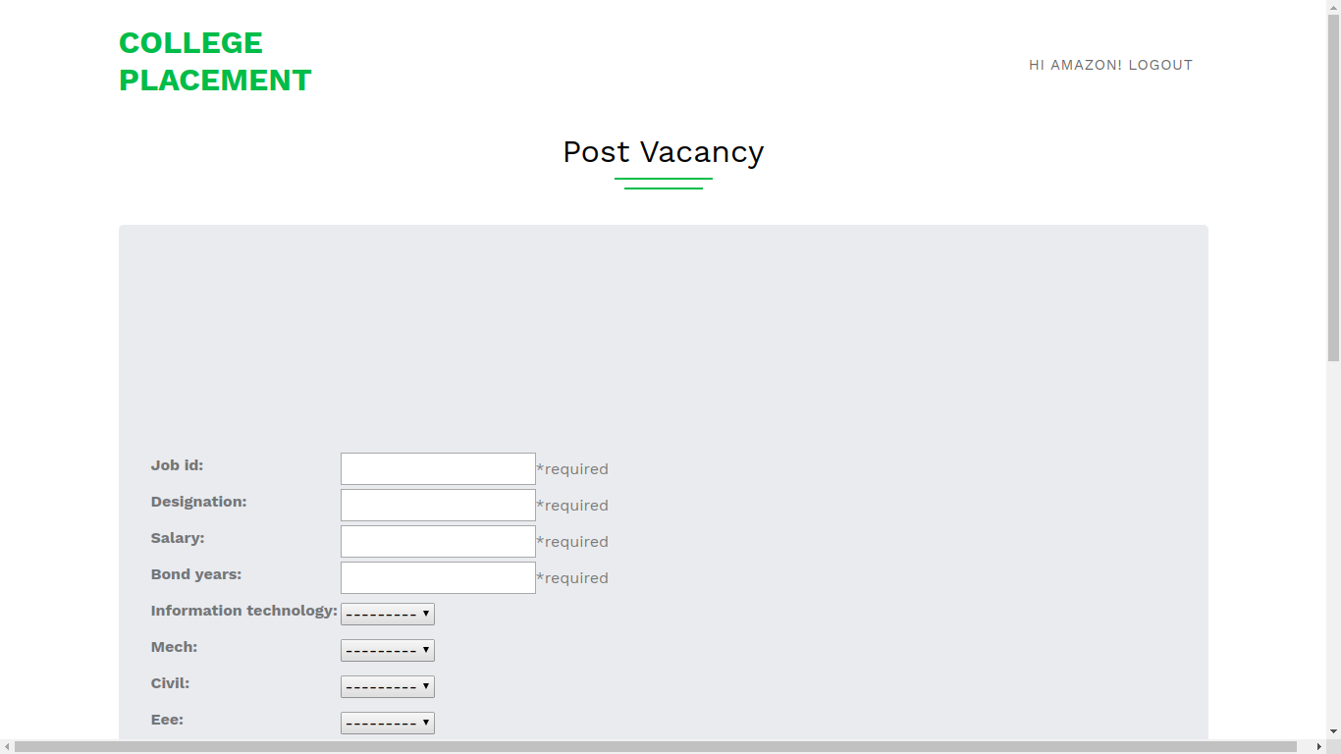
POST NEW VACANCIES:

Slide 13
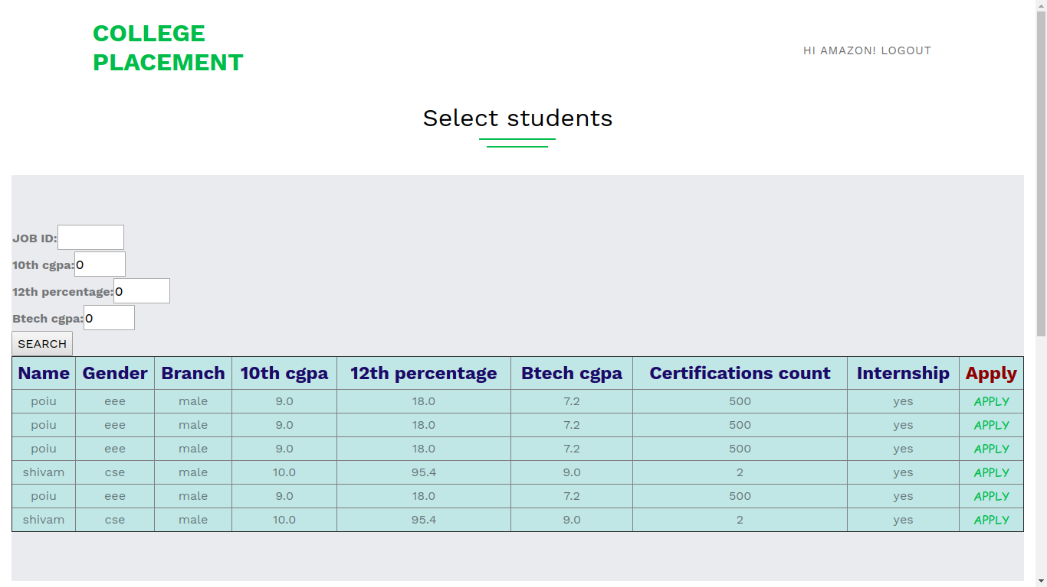
SELECT STUDENTS WHO APPLIED:

Slide 14
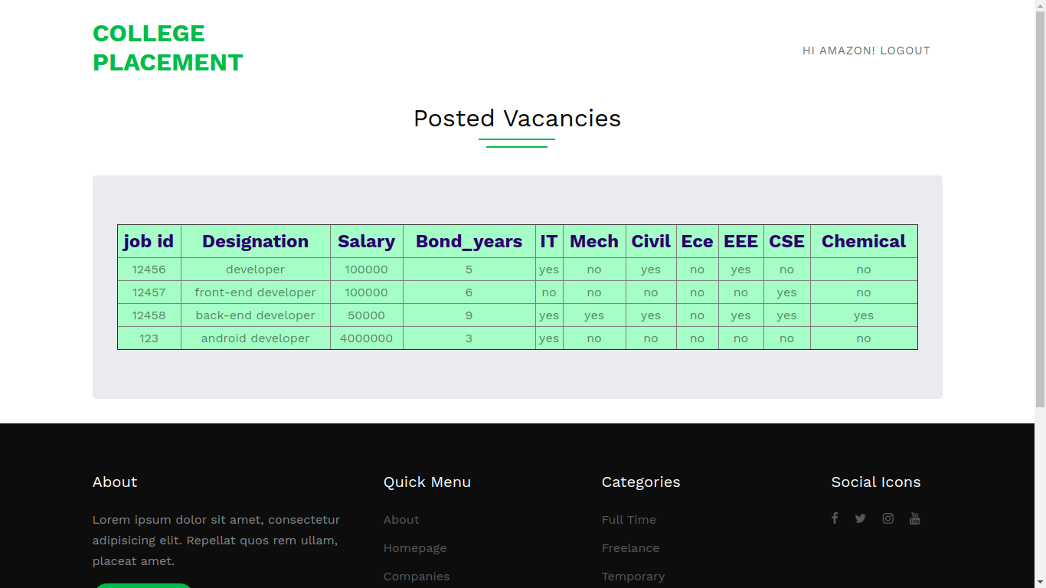
POSTED VACANCIES:

Slide 15
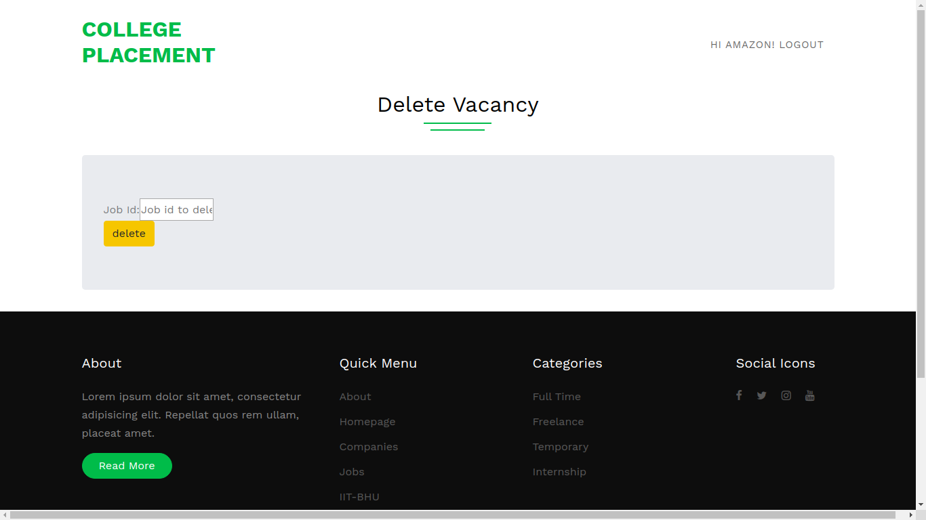
DELETE A VACANCY:

Slide 16

**THANK YOU**

