Slide 1



BALLARI INSTITUTE OF TECHNOLOGY & MANAGEMENT
Autonomous Institute under VTU, Ballari-Hospet Road, Allipur, Ballari-583 104 Karnataka ,India
Department of Artificial Intelligence & Machine Learning
Crepston Project Presentation
on
“Sentiment Analysis of Text Reviews using NLP and Machine Learning”
Presented by
SHAIK MOHAMMED NAWAZ 3BR23AI144
SHAIK REHAN 3BR23AI145
SYED ABDUL NAJEEB 3BR23AI160
K ISMAIL ZABIULLA 3BR24AI403
Under the Guidance of
Mr. May Raju
Assistant Professor
Dept. of AIML
Dr. B.M Vidyavathi
Head of the Department
Dept. of AIML

Slide 2
INTRODUCTION
Natural Language Processing (NLP) is a field of Artificial Intelligence that enables computers to understand and process human language. It is widely used in applications such as sentiment analysis, chatbots, and recommendation systems. Sentiment analysis, in particular, helps identify user opinions from textual data and is highly useful for analyzing customer feedback and reviews.

Slide 3
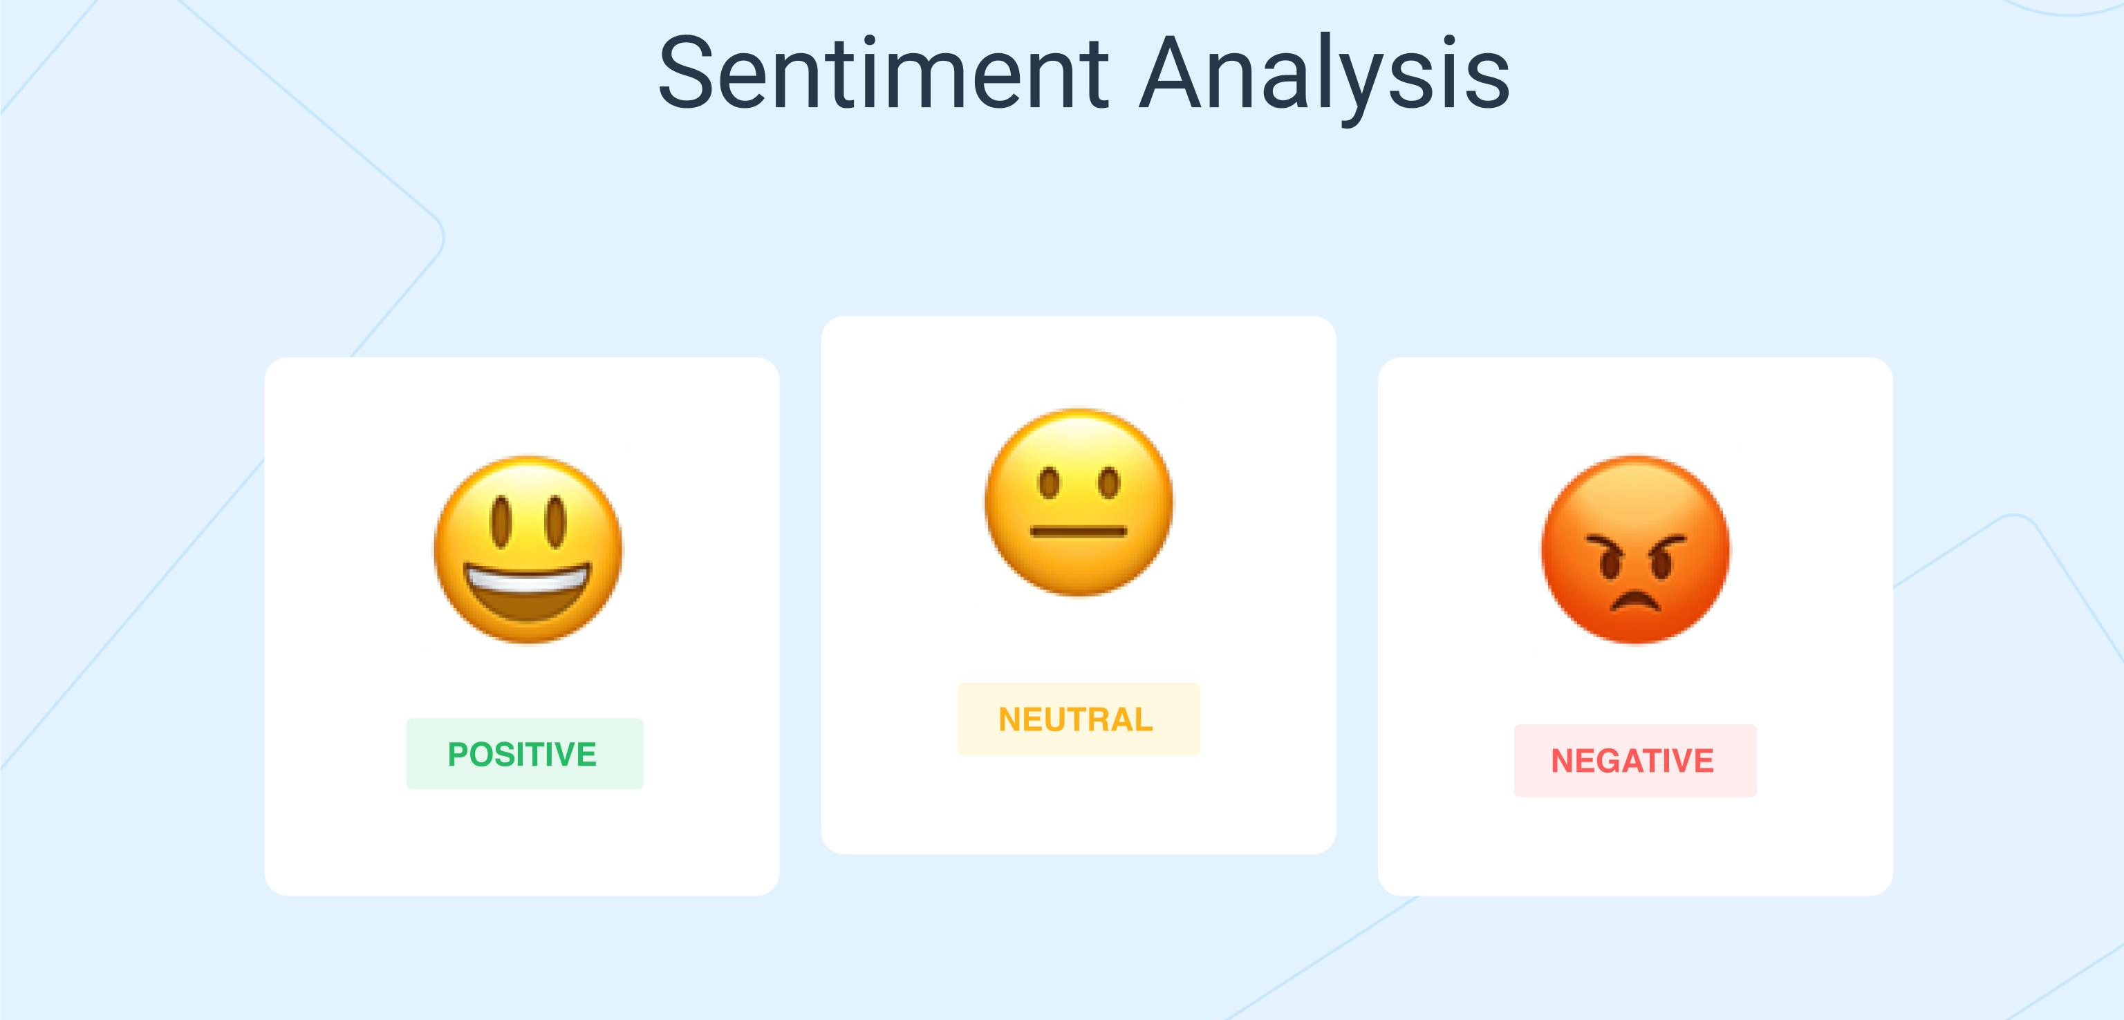
PROBLEM STATEMENT
A large amount of textual review data is generated daily, making it difficult to manually analyze user opinions. Therefore, there is a need for an automated system that can classify sentiment effectively. The reviews must be categorized into three sentiment classes: positive, neutral, and negative. The objective is to build a model that can accurately predict the sentiment of a review based on its text.

Slide 4


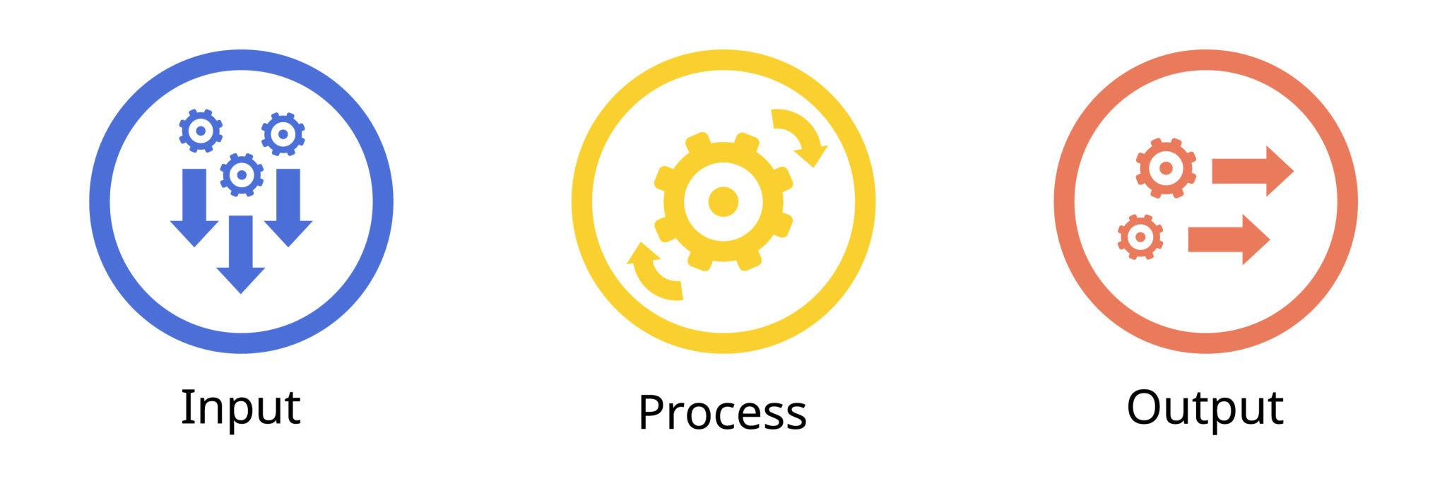
OBJECTIVES
Clean and preprocess the review text
Identify sentiment of each review (Positive, Neutral, Negative)
Build models to classify sentiment
Evaluate model performance

Slide 5
Dataset Description
The dataset used in this project consists of user-generated reviews along with corresponding ratings ranging from 1 to 5. The review text is unstructured in nature and requires preprocessing before analysis. These ratings are used to categorize the sentiment of each review as positive, neutral, or negative. The dataset serves as the foundation for performing sentiment analysis using NLP techniques and machine learning models.

Slide 6
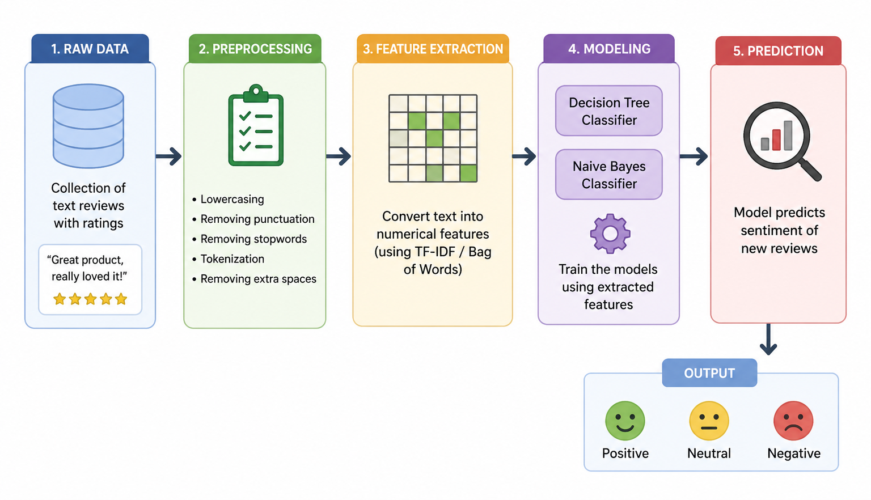
SYSTEM WORKFLOW

Slide 7
DATA PREPROCESSING
Data preprocessing is an important step in NLP where raw text is cleaned and prepared for analysis. In this project, preprocessing includes converting text to lowercase, removing punctuation and stopwords, and performing tokenization. These steps help in reducing noise and improving the quality of the data for better model performance.

Slide 8
VADER Sentiment Scoring
VADER (Valence Aware Dictionary and sEntiment Reasoner) is a rule-based sentiment analysis tool available in the NLTK library.
It is used to determine the sentiment of text by calculating polarity scores using the polarity_scores() method.
It provides four types of scores: positive, negative, neutral, and compound.
The compound score represents the overall sentiment of the text and is used to classify reviews effectively.

Slide 9
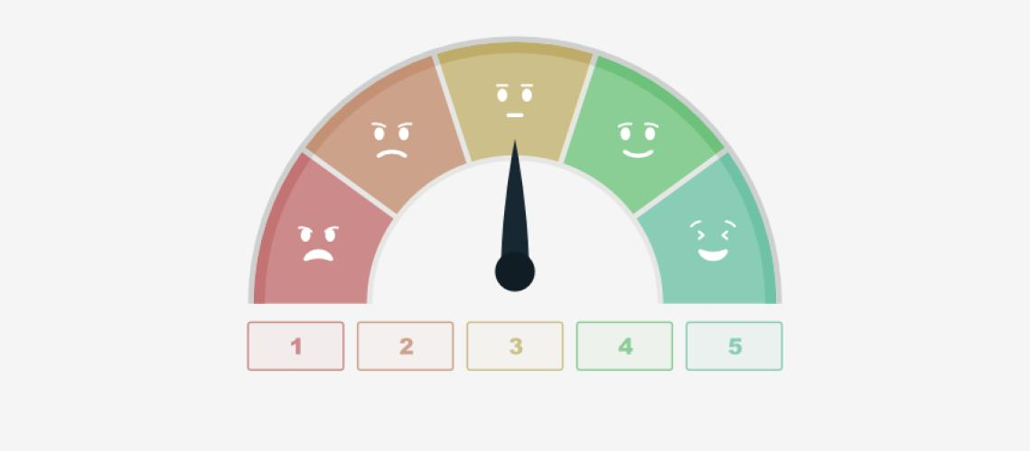
LABEL TRANSFORMATION
Ratings converted into sentiment categories
Mapping applied:
1 ≤ Rating < 3 → Negative
Rating = 3 → Neutral
Rating > 3 → Positive
Converts numerical ratings into class labels
Used for training ML models

Slide 10
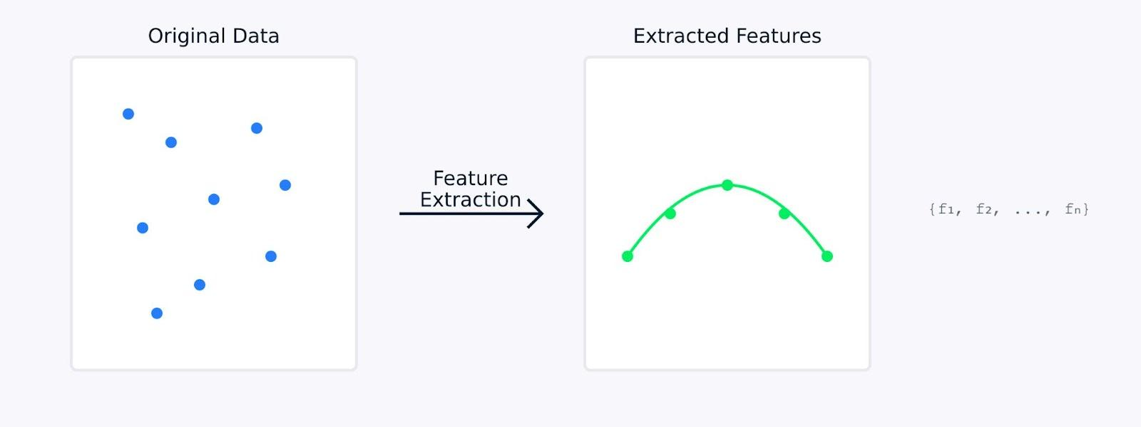
FEATURE EXTRACTION
Text data cannot be used directly by ML models
Convert text into numerical form
Used techniques:
Bag of Words (BoW)
TF-IDF
Represents text as vectors
Helps models understand word importance

Slide 11
DECISION TREE MODEL
Decision Tree is a supervised machine learning algorithm used for classification tasks. It works by creating a tree-like structure where the data is split based on different features. Each branch represents a decision, and the final output represents the predicted class. In this project, the Decision Tree model is used to classify reviews into positive, neutral, or negative sentiments.

Slide 12
NAIVE BAYES MODEL
Naive Bayes is a probabilistic machine learning algorithm based on Bayes’ theorem. It assumes that the features are independent of each other and is widely used for text classification tasks. In this project, the Naive Bayes model is applied to classify reviews into positive, neutral, or negative sentiment categories.

Slide 13
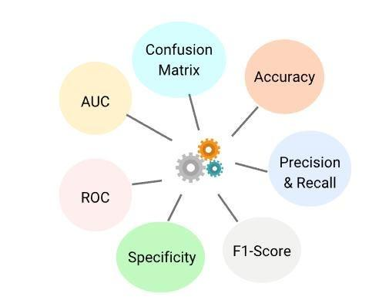
RESULTS & MODEL COMPARISON
Both Decision Tree and Naive Bayes models were trained and evaluated on the dataset using accuracy as the performance metric. The Naive Bayes model performed better for text classification tasks, while the Decision Tree model provided better interpretability. The final model selection was based on overall performance.

Slide 14
CONCLUSION
In this project, sentiment analysis was successfully performed on textual review data using NLP techniques. After preprocessing and applying VADER sentiment scoring, the ratings were converted into sentiment categories. Machine learning models such as Decision Tree and Naive Bayes were built and evaluated, with Naive Bayes showing better performance for text classification.

Slide 15
REFERENCES
[1] C. J. Hutto and E. Gilbert, “VADER: A Parsimonious Rule-based Model for Sentiment Analysis of Social Media Text,” Proc. Int. AAAI Conf. Weblogs Social Media (ICWSM), 2014.
[2] S. Bird, E. Klein and E. Loper, Natural Language Processing with Python. Sebastopol, CA, USA: O’Reilly Media, 2009.
[3] F. Pedregosa et al., “Scikit-learn: Machine Learning in Python,” J. Mach. Learn. Res., vol. 12, pp. 2825–2830, 2011.
[4] C. D. Manning, P. Raghavan and H. Schütze, Introduction to Information Retrieval. Cambridge, U.K.: Cambridge University Press, 2008.

Slide 16


