Slide 1

BMAT202L · BMAT202P | SLOT F1
Can Statistics Detect Fake Data?
Identifying anomalies and outliers in real datasets using Benford’s Law and Chi-Square Goodness-of-Fit
Shaik Sameer — 24BDS1154
Joshita Chowdary — 24BRS1313
Faculty: Dr. Tharasi Dilleswar
VIT Chennai
Probability and Statistics Lab
Notes:
Introduce yourselves and the project in one breath: 'We asked whether plain statistics can help spot numbers that look made up.' Mention the course (Probability and Statistics, theory and lab), Dr. Tharasi Dilleswar, and slot F1. Keep this under 20 seconds. Next slide: why this problem is worth caring about.

Slide 2
Nobody can eyeball a million numbers
1
Big tables hide oddities
Thousands of country-year values scroll past; a person checking by hand will miss patterns.
WHY DIGITS?
Real-world numbers follow quiet patterns. Made-up ones often don’t.
2
Invented numbers leak habits
People favour round values and certain leading digits, and that can leave a trace.
3
Statistics gives us a first filter
Test the digits, then take a closer look only where they disagree with what we expect.
IN PLAIN WORDS
We screen; we don’t accuse. An odd pattern says “look here”, never “this is fraud”.
Notes:
Make this concrete. Imagine being handed a spreadsheet with tens of thousands of numbers and asked 'does anything look off?' You can't do that by eye. Real numbers tend to follow a quiet digit pattern, and people inventing numbers often don't reproduce it. That makes digits a cheap first filter. Stress the sticky note: we flag, we don't convict. Next: the exact question we asked.

Slide 3
What we set out to ask
OUR RESEARCH QUESTION
Can Benford’s Law and a chi-square goodness-of-fit test flag unusual patterns in real datasets, and how well do they catch known alterations?
1
1
2
2
3
3
4
4
Screen real data
Check suitability first
Plant known errors
Build it to be reused
Test World Bank indicators against the expected first-digit pattern.
Ask whether Benford’s Law is a fair yardstick before testing.
Alter synthetic data in controlled ways and see what gets caught.
A reproducible R pipeline plus an interactive Shiny dashboard.
The goal is to find unusual statistical patterns, not to prove fraud automatically.
Notes:
Read the question out loud, slowly. Then walk the four objectives left to right: screen real data, check suitability, test with planted errors, and package it as something reusable. Close on the italic line: this project finds unusual patterns, it does not automatically prove fraud. (Check that the wording of the question matches your report.) Next: the real dataset.

Slide 4
Where the numbers come from
REAL DATA
Latest-year cross-section
World Bank WDI
Each country appears once, so observations are independent. This is the cleanest view for a chi-square test.
Country-by-year development indicators
Example indicator assessed: AG.LND.TOTL.K2 (land area, km²)
PREPARATION
Pooled country-years
1 Select indicators
2 Clean the values
3 Reshape into country-year rows
The same country repeats across years, so observations are not independent. Treat these p-values with extra caution.
Row counts: fill from report
Notes:
Our main real dataset is the World Bank's World Development Indicators: indicators for every country, year by year. Explain that we prepared it in three simple steps. The important point on the right: we look at the data in two ways. In the latest-year view each country appears once, so the observations are independent. In the pooled view the same country shows up again and again, so the independence assumption behind chi-square is weaker. Fill in the exact row counts from your report before presenting. Next: the end-to-end method.

Slide 5
From raw table to a careful verdict
1
1
2
2
3
3
4
4
Data selection
Clean and reshape
Exploratory analysis
Suitability check
Pick WDI indicators
Tidy country-year rows
Look before testing
Is Benford a fair yardstick?
5
5
6
6
7
7
8
Digit extraction
Statistical testing
Anomaly flagging
Interpretation
Pull each leading digit
Chi-square, MAD, residuals
Adjusted p-values and effect
A reason to look, not proof
Notes:
This is the whole story on one slide, read left to right and then the second row. The step to emphasise is number four: before any test, we ask whether the indicator is even suited to Benford's Law. Many numbers (for example tightly bounded ones) simply aren't. Steps five to seven are the statistics, and step eight is the human part: reading the flags sensibly. Next: what Benford's Law actually expects.

Slide 6
What does “normal” look like?
EXPECTED SHARE OF DIGIT d
P(d) = log₁₀(1 + 1/d)
for d = 1, 2, …, 9
IN PLAIN WORDS
About 3 in 10 numbers start with a 1. Fewer than 1 in 20 start with a 9.
Expected first-digit frequencies under Benford’s Law (theoretical values).
Notes:
Show the shape first, then the formula. For many real-world datasets that spread across several orders of magnitude, the number 1 leads about 30 percent of the time and 9 only about 4.6 percent. That uneven staircase is our yardstick. Say clearly: it only works for suitable data, which is why we test suitability before we trust any result. Next: the statistical tools we use to compare real digit counts against this curve.

Slide 7
The toolkit, in plain English
1
Chi-square goodness-of-fit
MAD and conformity bands
Residuals and effect size
1
2
2
3
3
Are the observed digit counts too far from the expected ones to be down to chance?
How big is the gap, whatever the sample size? Nigrini bands: close ≤ 0.006, acceptable ≤ 0.012, marginal ≤ 0.015, beyond that nonconforming.
Which digits are off, in which direction, and is the departure large enough to matter?
4
Multiple-testing correction
Suitability and validity checks
4
5
5
We test many indicators at once, so p-values are adjusted to limit false alarms.
Does the data span enough magnitudes for Benford’s Law to be a fair benchmark at all?
Notes:
One idea per card. Chi-square asks 'is the gap bigger than chance?'. The weakness: with very large samples even tiny gaps look significant, which is why we also use MAD, which measures the size of the gap itself, and effect size. Residuals tell us which digits drive a flag. Because we test many indicators, we adjust p-values. And suitability comes first, because a clean test on an unsuitable dataset is still meaningless. Keep formulas off the slide; explain purpose only. Next: how this is all built in R and Shiny.

Slide 8
How it is built
World Bank WDI
R processing and statistical functions
Shiny interactive dashboard
Real indicators
app.R
R/benford.R
Synthetic test data
Analysis pipeline
Generated outputs
scripts/run_all.R
Known alterations
CSV tables · PNG figures · HTML / Word reports
NO MACHINE LEARNING
No model is trained here. It’s classical statistics, written in R.
Automated test suite
Checks the pipeline and the dashboard
Notes:
Walk the picture left to right. Two kinds of input: real World Bank data and synthetic data we create ourselves. Both flow through the R functions and the analysis pipeline. Out the other side come CSV tables, figures and reports, and the Shiny dashboard lets anyone explore the same analysis interactively. Underneath it all is an automated test suite. Be explicit: there is no machine learning or AI model here, only classical statistical tests. Next: the dashboard itself.

Slide 9
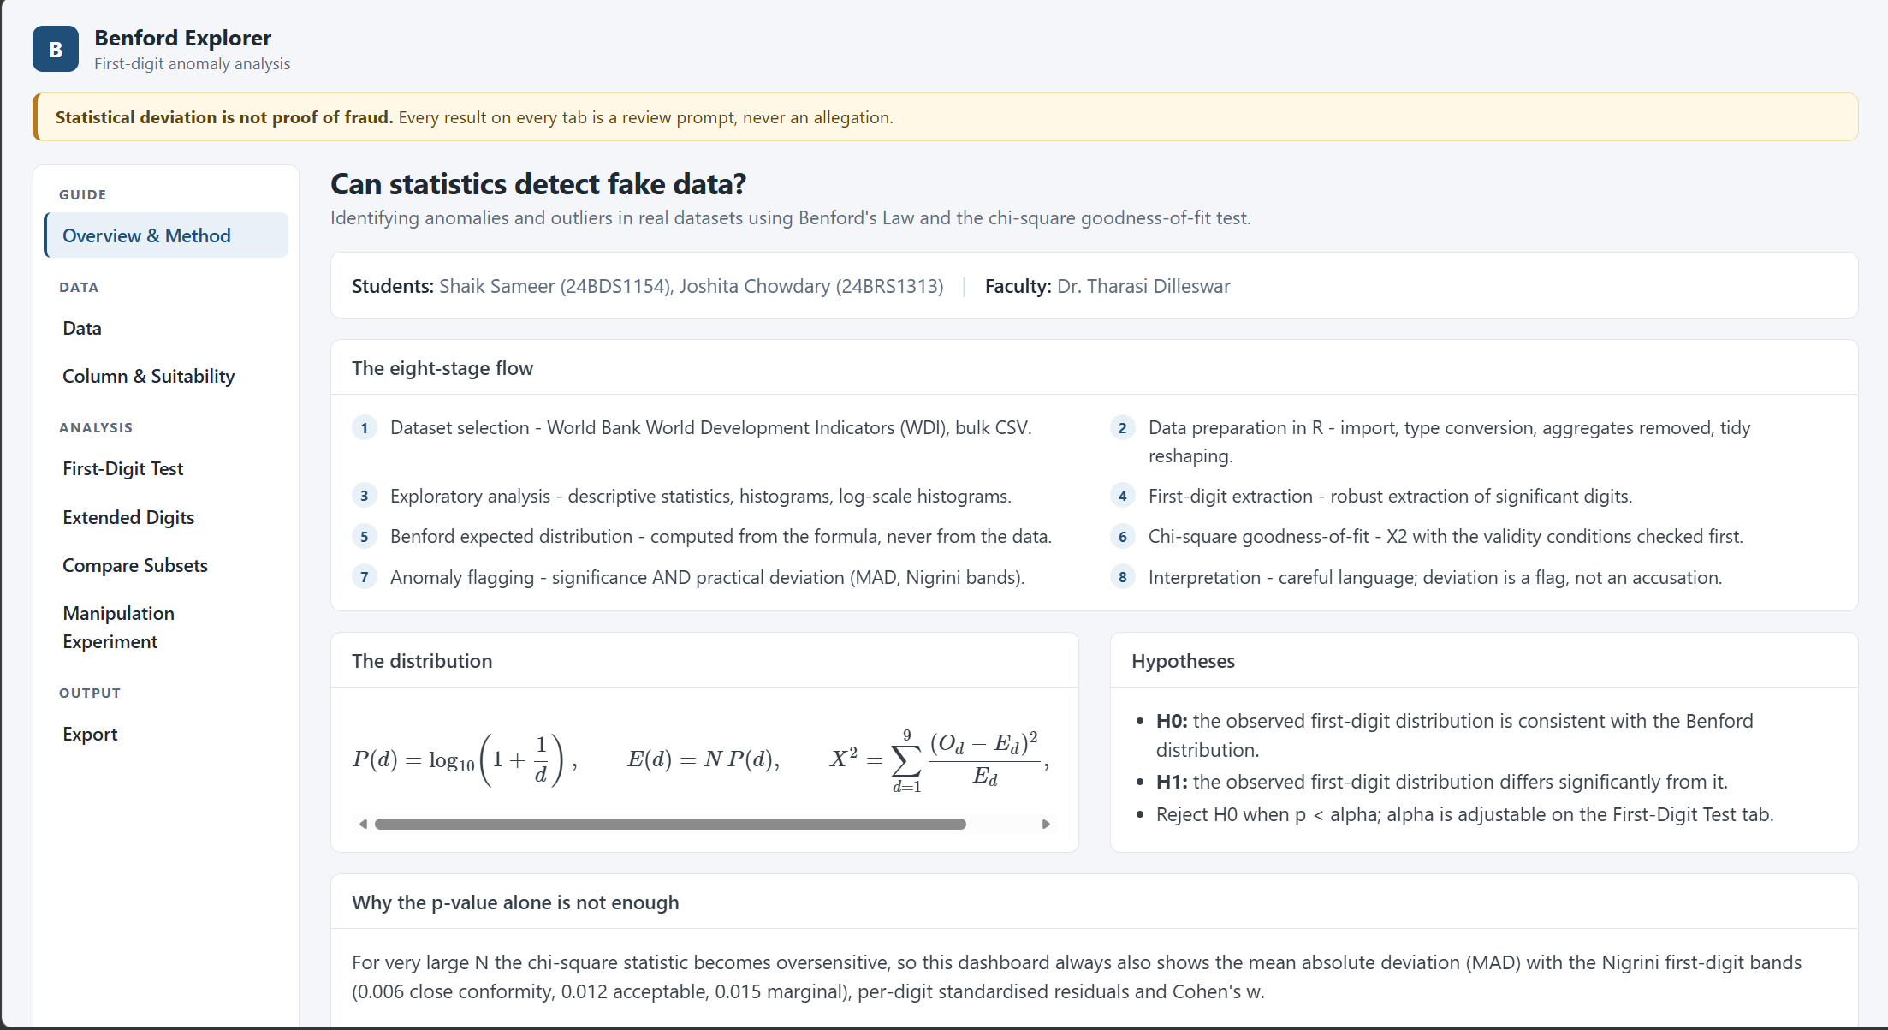
The dashboard, hands-on
1
Choose the data
Pick an indicator and view.
2
Check suitability
Insert your real dashboard screenshot
See whether Benford’s Law fits.
Data interface · Suitability assessment · First-digit results
3
Read the digits
Compare observed with expected.
Notes:
Use a genuine screenshot from your dashboard here, and number the three regions to match the callouts: where users choose data, where suitability is shown, and where the first-digit results appear. If you can, do a short live demo instead. Make sure the suitability label shown for land area matches the final corrected result (see the open issue on the next slide). Next: what the real-data results show.

Slide 10
What the real data says
Indicator | n | Raw p | Adj. p | MAD | Reading
AG.LND.TOTL.K2 (land area) | — | — | — | — | Suitability disputed
[indicator] | — | — | — | — | [reading]
[indicator] | — | — | — | — | [reading]
[indicator] | — | — | — | — | [reading]
[indicator] | — | — | — | — | [reading]
OPEN ISSUE
Is land area suitable?
The report questions it, but the dashboard labels it suitable. Check suitability_summary.csv and the code before presenting.
Don’t mix independent latest-year results with pooled, repeated country-years.
Fill from chi_square_results.csv
Show significant and non-significant results alike. Keep raw and adjusted p-values separate, and say which view (latest-year or pooled) each row uses.
Notes:
Fill this table from outputs/tables/chi_square_results.csv, suitability_summary.csv and anomaly_flags.csv, not from memory. Present the findings honestly: some indicators will conform, some will not, and one is flagged as unsuitable. Explain the difference between a statistically significant result and a practically large one (MAD). RESOLVE THE LAND-AREA CONTRADICTION BEFORE YOU PRESENT: the report questions its suitability while the dashboard says it is suitable. Decide which is right from the CSV and the code, then update the report, dashboard and this slide so they agree. Also say clearly which results use the independent latest-year cross-section and which use pooled, repeated country-years. Next: testing the method on data where we know the truth.

Slide 11
Planting known errors to see if we catch them
1
Round-number substitution
Leading-digit bias
Partial multiplicative change
1
2
2
3
3
Some values are replaced by rounded versions.
Leading digits are nudged toward favoured numbers.
A share of values is scaled up or down.
SYNTHETIC DATA
READ IT STRAIGHT
Say which changes were caught easily and which slipped through.
Insert detection-rate chart
From the experiment outputs
Notes:
Because real data has no ground truth, we create synthetic data and alter it in three known ways: swapping in round numbers, biasing the leading digits, and multiplying only part of the values. Then we measure how often the method notices. Use only the real detection rates from your experiment output, and be candid about the harder cases: subtle or partial changes are naturally harder to detect. Label everything on this slide as synthetic. Next: how we checked our own code.

Slide 12
How we checked our own work
Reported by the development tool
Independently re-run by us
—
—
tests passed
tests passed
Fill from logs
Fill from logs
Automated test suite
Pipeline verification
Dashboard testing
Result: add from logs
Result: add from logs
Result: add from logs
Notes:
Be strictly honest here. There is a difference between 'the development tool reported these tests as passing' and 'we re-ran them ourselves and saw them pass'. Show both columns, and only fill in numbers you can support from logs. Then name the three layers of checking: the automated test suite, the pipeline verification, and dashboard testing. Do not claim a test passed unless a log shows it. Next: limits, conclusion and future work.

Slide 13
What we can, and can’t, conclude
Limitations
Conclusion
PROPOSED, NOT BUILT
Data must span several magnitudes
Rounded or bounded data distort digits
Many tests need p-value adjustment
Huge samples flag tiny gaps
Country-years aren’t independent
A flag is a lead, not proof
Benford’s Law plus chi-square gives a transparent first-pass screen. With suitability checks and effect sizes, it points to where to look, and says plainly when it can’t judge.
Future work
Better-suited datasets
Stronger validation
Improved visualisation
Notes:
Start with limitations, because it shows you understand the method: suitability, rounding and bounds, multiple testing, large-sample sensitivity, and non-independent country-year rows. Then the conclusion: a transparent screening tool, not a lie detector. Future work is clearly labelled proposed, not completed: better-suited datasets, stronger validation, improved visualisation. If the land-area inconsistency is still unresolved, say so here rather than hiding it. Next: references and questions.

Slide 14

References
Benford, F. (1938). The law of anomalous numbers. Proceedings of the American Philosophical Society, 78(4), 551–572.
Newcomb, S. (1881). Note on the frequency of use of the different digits in natural numbers. American Journal of Mathematics, 4(1), 39–40.
Nigrini, M. J. (2012). Benford’s Law: Applications for Forensic Accounting, Auditing, and Fraud Detection. Wiley.
Pearson, K. (1900). On the criterion that a given system of deviations from the probable in the case of a correlated system of variables is such that it can be reasonably supposed to have arisen from random sampling. Philosophical Magazine, 50(302), 157–175.
World Bank. World Development Indicators (WDI). data.worldbank.org
Thank you
QUESTIONS?
Notes:
Pause on the thank-you box and invite questions. Likely questions: why Benford's Law, why chi-square and MAD together, how you chose suitability rules, and what the synthetic experiment shows. Check this reference list against the one in your report and add or remove entries so it matches what you actually used (for example, any paper behind the MAD conformity bands).

