Slide 1
Employee Attrition Analysis at Green Destinations
Objective: Analyze employee attrition trends and factors affecting it.

Slide 2
Project Objective
Green Destinations, a travel agency, noticed increased employee attrition. The HR Director aims to analyze the attrition trends using data.

Slide 3
Attrition Rate Analysis
The attrition rate is calculated as the percentage of employees who have left.
Attrition Rate: 16.12%.

Slide 4
Analysis of Factors Influencing Attrition
Analyzed factors: Age, YearsAtCompany, and DailyRate (Income).
Employees who left tend to be slightly younger, have fewer years at the company, and lower income.

Slide 5
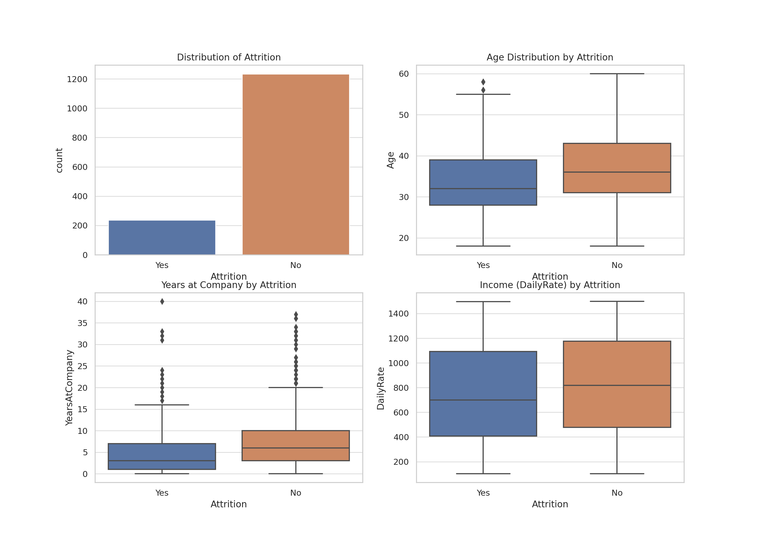
Visualizations

Slide 6
1. Employees who left tend to be younger and have fewer years at the company.
2. There is a slight difference in income between those who stayed and those who left.

