Slide 1

Sensing Temperature and Humidity
By Sharukh Shaik

Slide 2
Purpose
Measuring temperature
Measuring humidity

Slide 3
Applications
used in file management: paper products are extremely sensitive to temperature and humidity
are used in greenhouses: the growth of plants has extremely strict requirements on temperature and humidity.
used in computer room monitoring.
Are used in the field of medicine

Slide 4

Components
DHT 11 Sensor
ESP32
Mosquitto
Node-Red
Node Red Dashboard

Slide 5
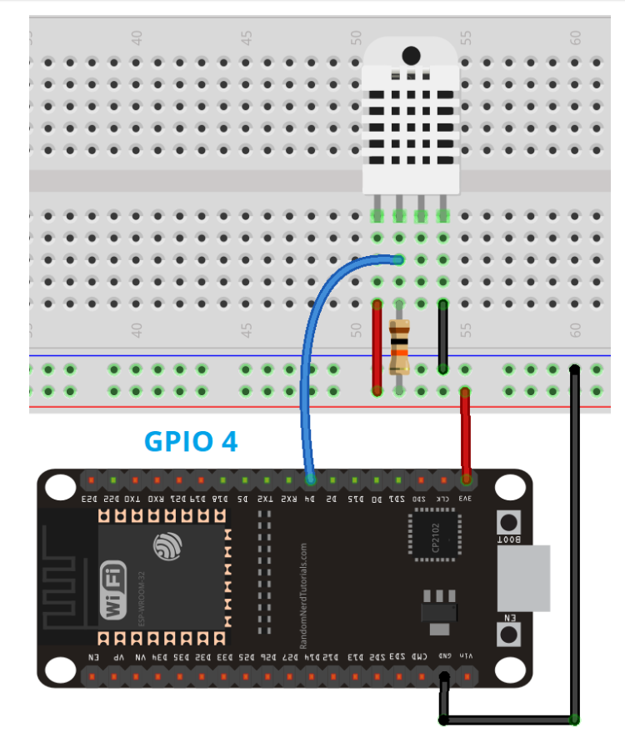
Circuit

Slide 6
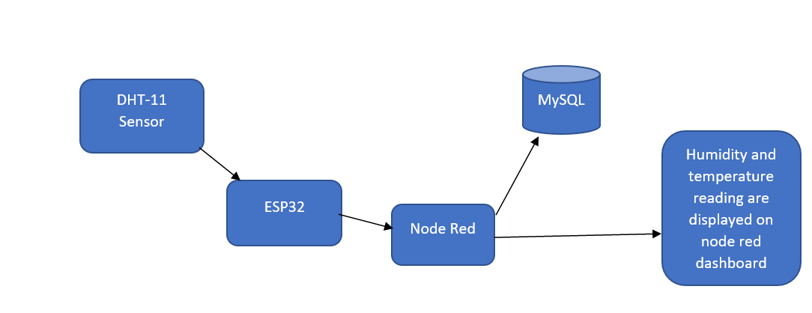
Architecture

Slide 7
References
https://www.researchgate.net/publication/336231656_IoT_based_Temperature_and_Humidity_Controlling_using_Arduino_and_Raspberry_Pi
https://www.linquip.com/blog/temperature-and-humidity-sensors-an-ultimate/
https://randomnerdtutorials.com/esp32-dht11-dht22-temperature-humidity-web-server-arduino-ide/
https://cdsentec.com/6-applications-of-temperature-humidity-sensor/
https://asairsensors.com/application-of-temperature-and-humidity-sensor-in-medical/

