Slide 2
Introduction to Extracting Text from Images And Documents using Computer Vision
Shaima Haque
https://docs.microsoft.com/en-us/learn/modules/read-text-images-documents-with-computer-vision-service/
MS Ambassador
Trisha Banerjee
MS Ambassador
Notes:
Link to published module on Learn: https://docs.microsoft.com/en-us/learn/modules/learn-pr/wwl-data-ai/classify-images-custom-vision/

Slide 3
Prerequisites
An Azure Account. You may get free credits from Azure for Students, or Azure Free Trial.
Python 3.6 or later installed.
Visual Studio Code.
Basic Knowledge of Python –
https://docs.microsoft.com/en-us/learn/modules/intro-to-python/
Basic Knowledge of APIs –
https://www.freecodecamp.org/news/what-is-an-api-in-english-please-b880a3214a82/

Slide 4
Learning objectives
Learn about Computer Vision service
Read Text from images with the OCR API and Read API
Develop an application in Python that can read printed and handwritten text

Slide 5
Agenda
Introduction
Quick intro to computer vision
Intro to OCR and Read API
Exercise – Create your first Custom Vision Resource
Milestone 1 - Create your first Cognitive Service Resource
Milestone 2 - Prepare to use Computer Vision SDK
Develop an application in Python that can read printed and handwritten text
Exercise – Create an application in Python that can read printed and handwritten text
Milestone 3 – Use the OCR API
Milestone 4 – Use the Read API
Milestone 5 – Test your Application
Knowledge Check
Summary
Next Steps
Notes:
https://forms.office.com/r/nucza8taj4

Slide 6
Introduction to Computer Vision

Slide 7

Computer vision is a branch of artificial intelligence (AI) that enables computers and systems to derive meaningful information from digital photos, videos, and other visual inputs and then act or recommend on that information. Computer vision is one of the core areas of artificial intelligence (AI), and focuses on creating solutions that enable AI applications to "see" the world and make sense of it.
To an AI application, an image is just an array of pixel values. These numeric values can be used as features to train machine learning models that make predictions about the image and its contents.
This Photo by Unknown Author is licensed under CC BY-NC

Slide 8
Applications of Computer Vision:
Image classification
Object detection
Object tracking
Content-based image retrieval

Slide 9
Introduction to OCR API

Slide 10
OCR API
An Optical Character Recognition(OCR) API helps you transcribe text from image files and PDF documents and receive the extracted data in a JSON/CSV/Excel or other file formats. OCR scans images of documents, invoices, receipts, recognizes and extracts text from them, and transcribes it into a format for interpretation by the machines. OCR APIs are built on OCR technology but what differentiates them is that they are trained to extract data from specific documents, and that’s why they are more accurate.

Slide 11
OCR API
The OCR API is an optical character recognition API that is optimized for reading small to medium amounts of printed text in .jpg, .png, .gif, and .bmp format images. It supports a wide range of languages and in addition to reading text in the image it can determine the orientation of each text region and return information about the rotation angle of the text in relation to the image.

Slide 12
OCR API
To use the OCR API, call the OCR REST function (or the equivalent SDK method) passing the image URL or binary image data, and specifying the language of the text to be detected, and optionally the detectOrientation parameter to return information about orientation of the text in the image.
The resulting JSON describes the text detected, broken down into regions of the image, and then further down into lines, and then individual words.

Slide 13
Introduction to Read API

Slide 14
Read API
The Read API uses an updated recognition model, takes an image or PDF document as the input and extracts text asynchronously.
It's optimized to extract text from text-heavy images and multi-page PDF documents with mixed languages. It supports extracting both printed and handwritten text in the same image or document.

Slide 15
Read API
The Read API uses a newer text recognition model than the OCR API, and performs better for larger images that contain a lot of text. It also supports text extraction from .pdf files, and can recognize both printed text and handwritten text in multiple languages.
The Read API uses an asynchronous operation model, in which a request to start text recognition is submitted; and the operation ID returned from the request can subsequently be used to check progress and retrieve results

Slide 16
Exercise
Create your first Custom Vision Resource
Milestone 1 – Create your first Cognitive Service Resource
Milestone 2 – Prepare to use Computer Vision SDK

Slide 17
Creating your first Cognitive Service Resource
Open the Azure portal: https://portal.azure.com, sign in using your Microsoft account which is associated with Azure subscription.
Select the +Create Resource button, search for Cognitive Services and create a Cognitive Services Resource.
Subscription: Your Azure subscription
Resource group: Choose or create a resource group (if you are using a restricted subscription, you may not have permission to create a new resource group - use the one provided)
Region: Choose any available region
Name: Enter a unique name
Pricing tier: Standard S0
Notes:
To train a classification model, you must upload images to your training resource and label them with the appropriate class labels. Then, you must train the model and evaluate the training results.
You can perform these tasks in the Custom Vision portal, One of the key considerations when using images for classification, is to ensure that you have sufficient images of the objects in question and those images should be of the object from many different angles.

Slide 18
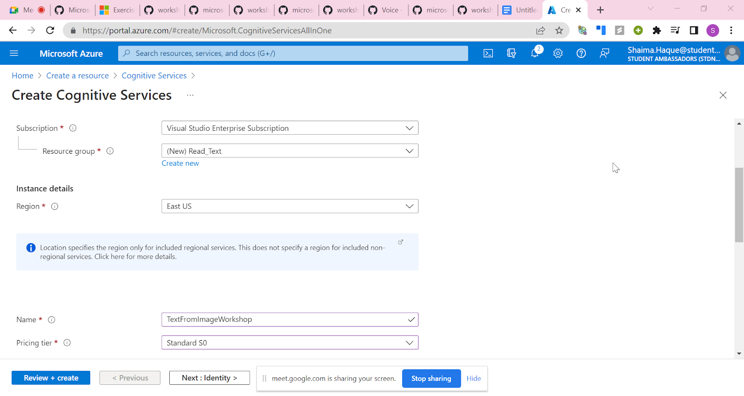
Creating your first Cognitive Service Resource
Notes:
To train a classification model, you must upload images to your training resource and label them with the appropriate class labels. Then, you must train the model and evaluate the training results.
You can perform these tasks in the Custom Vision portal, One of the key considerations when using images for classification, is to ensure that you have sufficient images of the objects in question and those images should be of the object from many different angles.

Slide 19
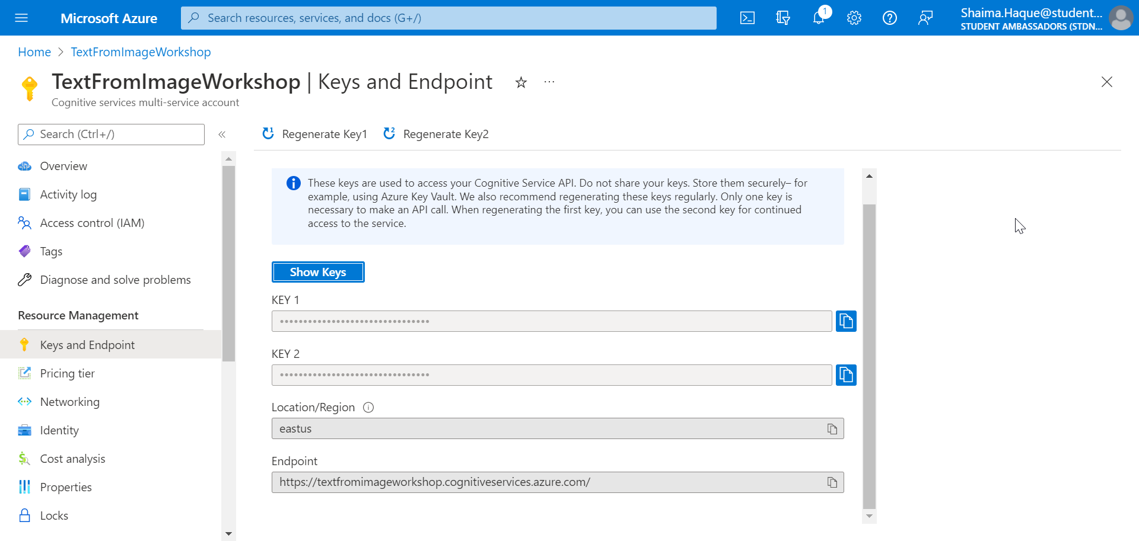
Creating your first Cognitive Service Resource
Click on Review+Create and wait for its deployment.
When the resource has been deployed, go to it and view its Keys and Endpoint page. You will need the endpoint and one of the keys from this page in the next procedure.
Notes:
To train a classification model, you must upload images to your training resource and label them with the appropriate class labels. Then, you must train the model and evaluate the training results.
You can perform these tasks in the Custom Vision portal, One of the key considerations when using images for classification, is to ensure that you have sufficient images of the objects in question and those images should be of the object from many different angles.

Slide 20
Prepare to use Computer Vision SDK
Clone the repository: https://github.com/SHAIMA-HAQUE/Intro-to-Extracting-Text-in-Images-and-Documents-using-Computer-Vision
(Code taken from https://github.com/MicrosoftLearning/AI-102-AIEngineer)
Navigate to workshop/Read_Text_from_Images_initial/ocr/read-text
We need to install the Computer Vision SDK package by running the command:
pip install azure-cognitiveservices-vision-computervision==0.7.0
Notes:
To train a classification model, you must upload images to your training resource and label them with the appropriate class labels. Then, you must train the model and evaluate the training results.
You can perform these tasks in the Custom Vision portal, One of the key considerations when using images for classification, is to ensure that you have sufficient images of the objects in question and those images should be of the object from many different angles.

Slide 21
Prepare to use Computer Vision SDK
Open read-text.py file in your text editor.
Add the lines below to import the namespaces you will need to use the Computer Vision SDK.
from azure.cognitiveservices.vision.computervision import ComputerVisionClient
from azure.cognitiveservices.vision.computervision.models import OperationStatusCodes
from msrest.authentication import CognitiveServicesCredentials

Slide 22
Prepare to use the Computer Vision SDK
In the code file for your client application, in the Main function, note that the code to load the configuration settings has been provided. Then find the comment Authenticate Computer Vision client. Then, under this comment, add the following language-specific code to create and authenticate a Computer Vision client object:
credential = CognitiveServicesCredentials(cog_key)
cv_client = ComputerVisionClient(cog_endpoint, credential)

Slide 23
Exercise
Create an application in Python that can read printed and handwritten text
Milestone 3 – Use the OCR API
Milestone 4 – Use the Read API
Milestone 5 – Test your Application

Slide 24
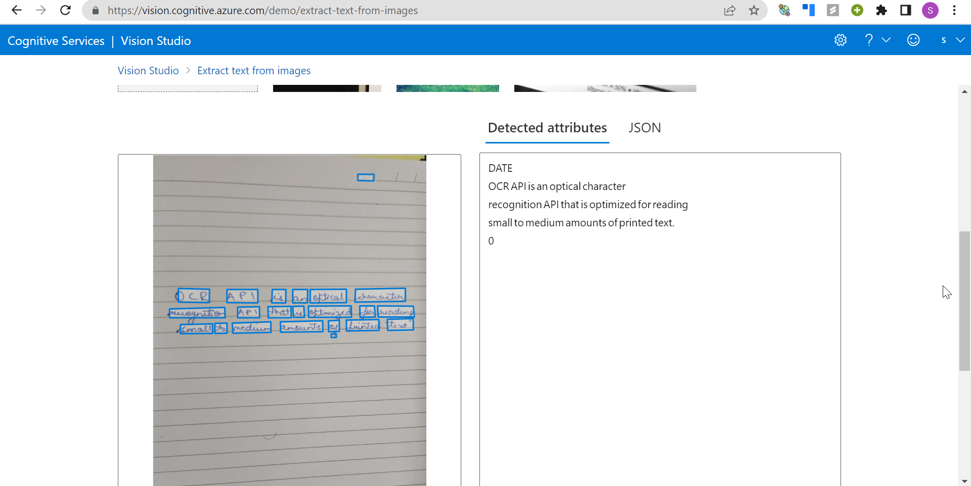
Using OCR and Read API
Before we start coding, let's see what the result should be like.
Go to https://vision.cognitive.azure.com/demo/extract-text-from-images
Sign in through your azure account. Choose your resource and upload an image which has text on it or choose one from the options given.
I had uploaded an image of my own handwriting, and the API could detect every word that was written in the paper including the word "DATE" in the upper right-hand corner.

Slide 25

Coding using OCR API

Slide 26
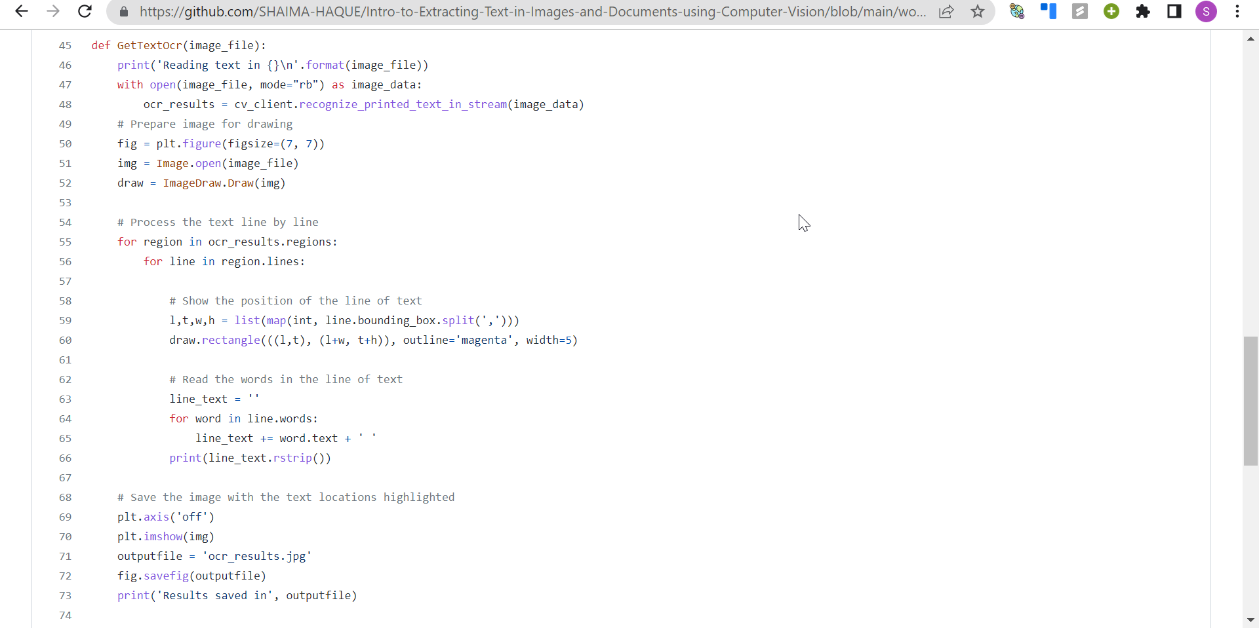
Final OCR Code Snippet

Slide 27
Coding using Read API

Slide 28
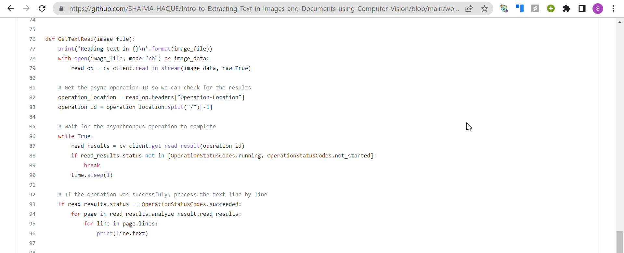
Final Read Code Snippet

Slide 29
Testing your Code
You might find some images already in the file path:
Intro-to-Extracting-Text-in-Images-and-Documents-using-Computer-Vision/workshop/Read_Text_from_Images_initial/ocr/read-text/
We can also upload your own images for testing.

Slide 30
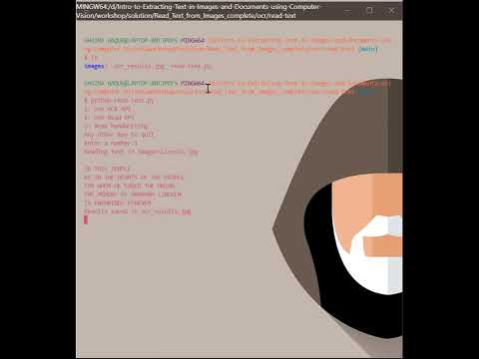
Testing Your Code

Slide 31
Knowledge check

Slide 32
Question 1
Which API would be best for this scenario? You need to read a large amount of text with high accuracy. Some of the text is handwritten in English and some of it is printed in multiple languages.
OCR API
Read API
Image Analysis API
Notes:
Explanation: Correct: When you create a Custom Vision resource, you can specify whether it is to be used for training, prediction, or both.

Slide 33
Question 1
Which API would be best for this scenario? You need to read a large amount of text with high accuracy. Some of the text is handwritten in English and some of it is printed in multiple languages.
OCR API
Read API
Image Analysis API
Notes:
Explanation: Correct: When you create a Custom Vision resource, you can specify whether it is to be used for training, prediction, or both.

Slide 34
Question 2
What is a difference between the response from the Read API versus the OCR API?
There's no difference between the response returned, the only difference is that the Read API can be us.
The OCR API results break down by region, line, then word, while the Read API results break down by page, then line, and then word.ed for handwritten text.
The OCR API results include bounding box coordinates for images and text, while the Read API results only include results for text.
Notes:
Explanation: Correct: Generally, adding more images to the project an retraining the model is likely to improve performance.

Slide 35
Question 2
What is a difference between the response from the Read API versus the OCR API?
There's no difference between the response returned, the only difference is that the Read API can be us.
The OCR API results break down by region, line, then word, while the Read API results break down by page, then line, and then word.ed for handwritten text.
The OCR API results include bounding box coordinates for images and text, while the Read API results only include results for text.
Notes:
Explanation: Correct: Generally, adding more images to the project an retraining the model is likely to improve performance.

Slide 36
Question 3
You have scanned a letter into PDF format and need to extract the text it contains. What should you do?
Use the Custom Vision service
Use the OCR API of the Computer Vision service
Use the Read API of the Computer Vision service.
Notes:
Explanation: You can configure and customize your apps in Power Apps Studio.

Slide 37
Summary
Notes:
Knowledge test: https://forms.office.com/r/YabQSUayJu

Slide 38
Summary
Congratulations on creating using OCR and Read APIs to extract text from documents and images!
In this workshop, you've learned how to:
Read text from images with the OCR API and Read API
Use the Computer Vision service with SDKs and the REST API
Develop an application that can read printed and handwritten text
Notes:
Congratulations on creating your first app with Power Apps!
In this module, you discovered what Power Apps can do for your business and the building blocks of creating your first app. You then created an app from data in a Microsoft Excel workbook.
Additionally, you learned that:

Slide 39
Next steps
If you want to learn more:
Microsoft Learning Path: Learn more about
Custom Vision,
Introduction to Computer Vision using Tensorflow
Introduction to Computer Vision using PyTorch
Notes:
It's a good idea at the end of a project to identify whether you still need the resources you created. Resources left running can cost you money.
If you are continuing on to other modules in this learning path you can keep your resources for use in other labs.
If you have finished learning, you can delete the resource group or individual resources from your Azure subscription

Slide 40
Thank you!
Let us know your feedback about this workshop!

