Slide 1

Inside Large Language Models
C28 – AI Immersion Series
Student Name: [Your Name] | Register Number: [Your ID] | Department: [Your Department] | Section: [Your Section]

Slide 2




What is an LLM?
Definition
A neural network trained on vast text data to predict and generate human-like language
Why It Matters
User Prompt
Powers AI assistants, code generation, content creation, and intelligent automation
Tokens
Model Processing
Response
How It Works
Converts your prompt into tokens → processes through layers → generates a response

Slide 3




LLM Platform Comparison
ChatGPT vs Gemini vs Claude — same prompt, three perspectives
ChatGPT
Gemini
Claude
Conversational, strong reasoning, broad world knowledge. Excels at nuanced explanation and coding assistance.
Multimodal-first with real-time data access and deep integration with Google services and Search.
Long context window, detailed analytical responses, and a strong focus on safety and helpfulness.
Hands-On Experiment: Insert the same test prompt into all three platforms. Compare tone, clarity, depth, accuracy, structure, and usefulness. Add screenshots and response analysis below.

Slide 4

Transformer Architecture
Core Components
Encoder
Processes and understands the full input sequence
Decoder
Generates the output token-by-token from encoded context
Input
Embedding
Tokenization
Self-Attention
Identifies relationships between words regardless of distance in the sentence
Stacked Layers
Multiple transformer blocks refine language understanding progressively

Slide 5
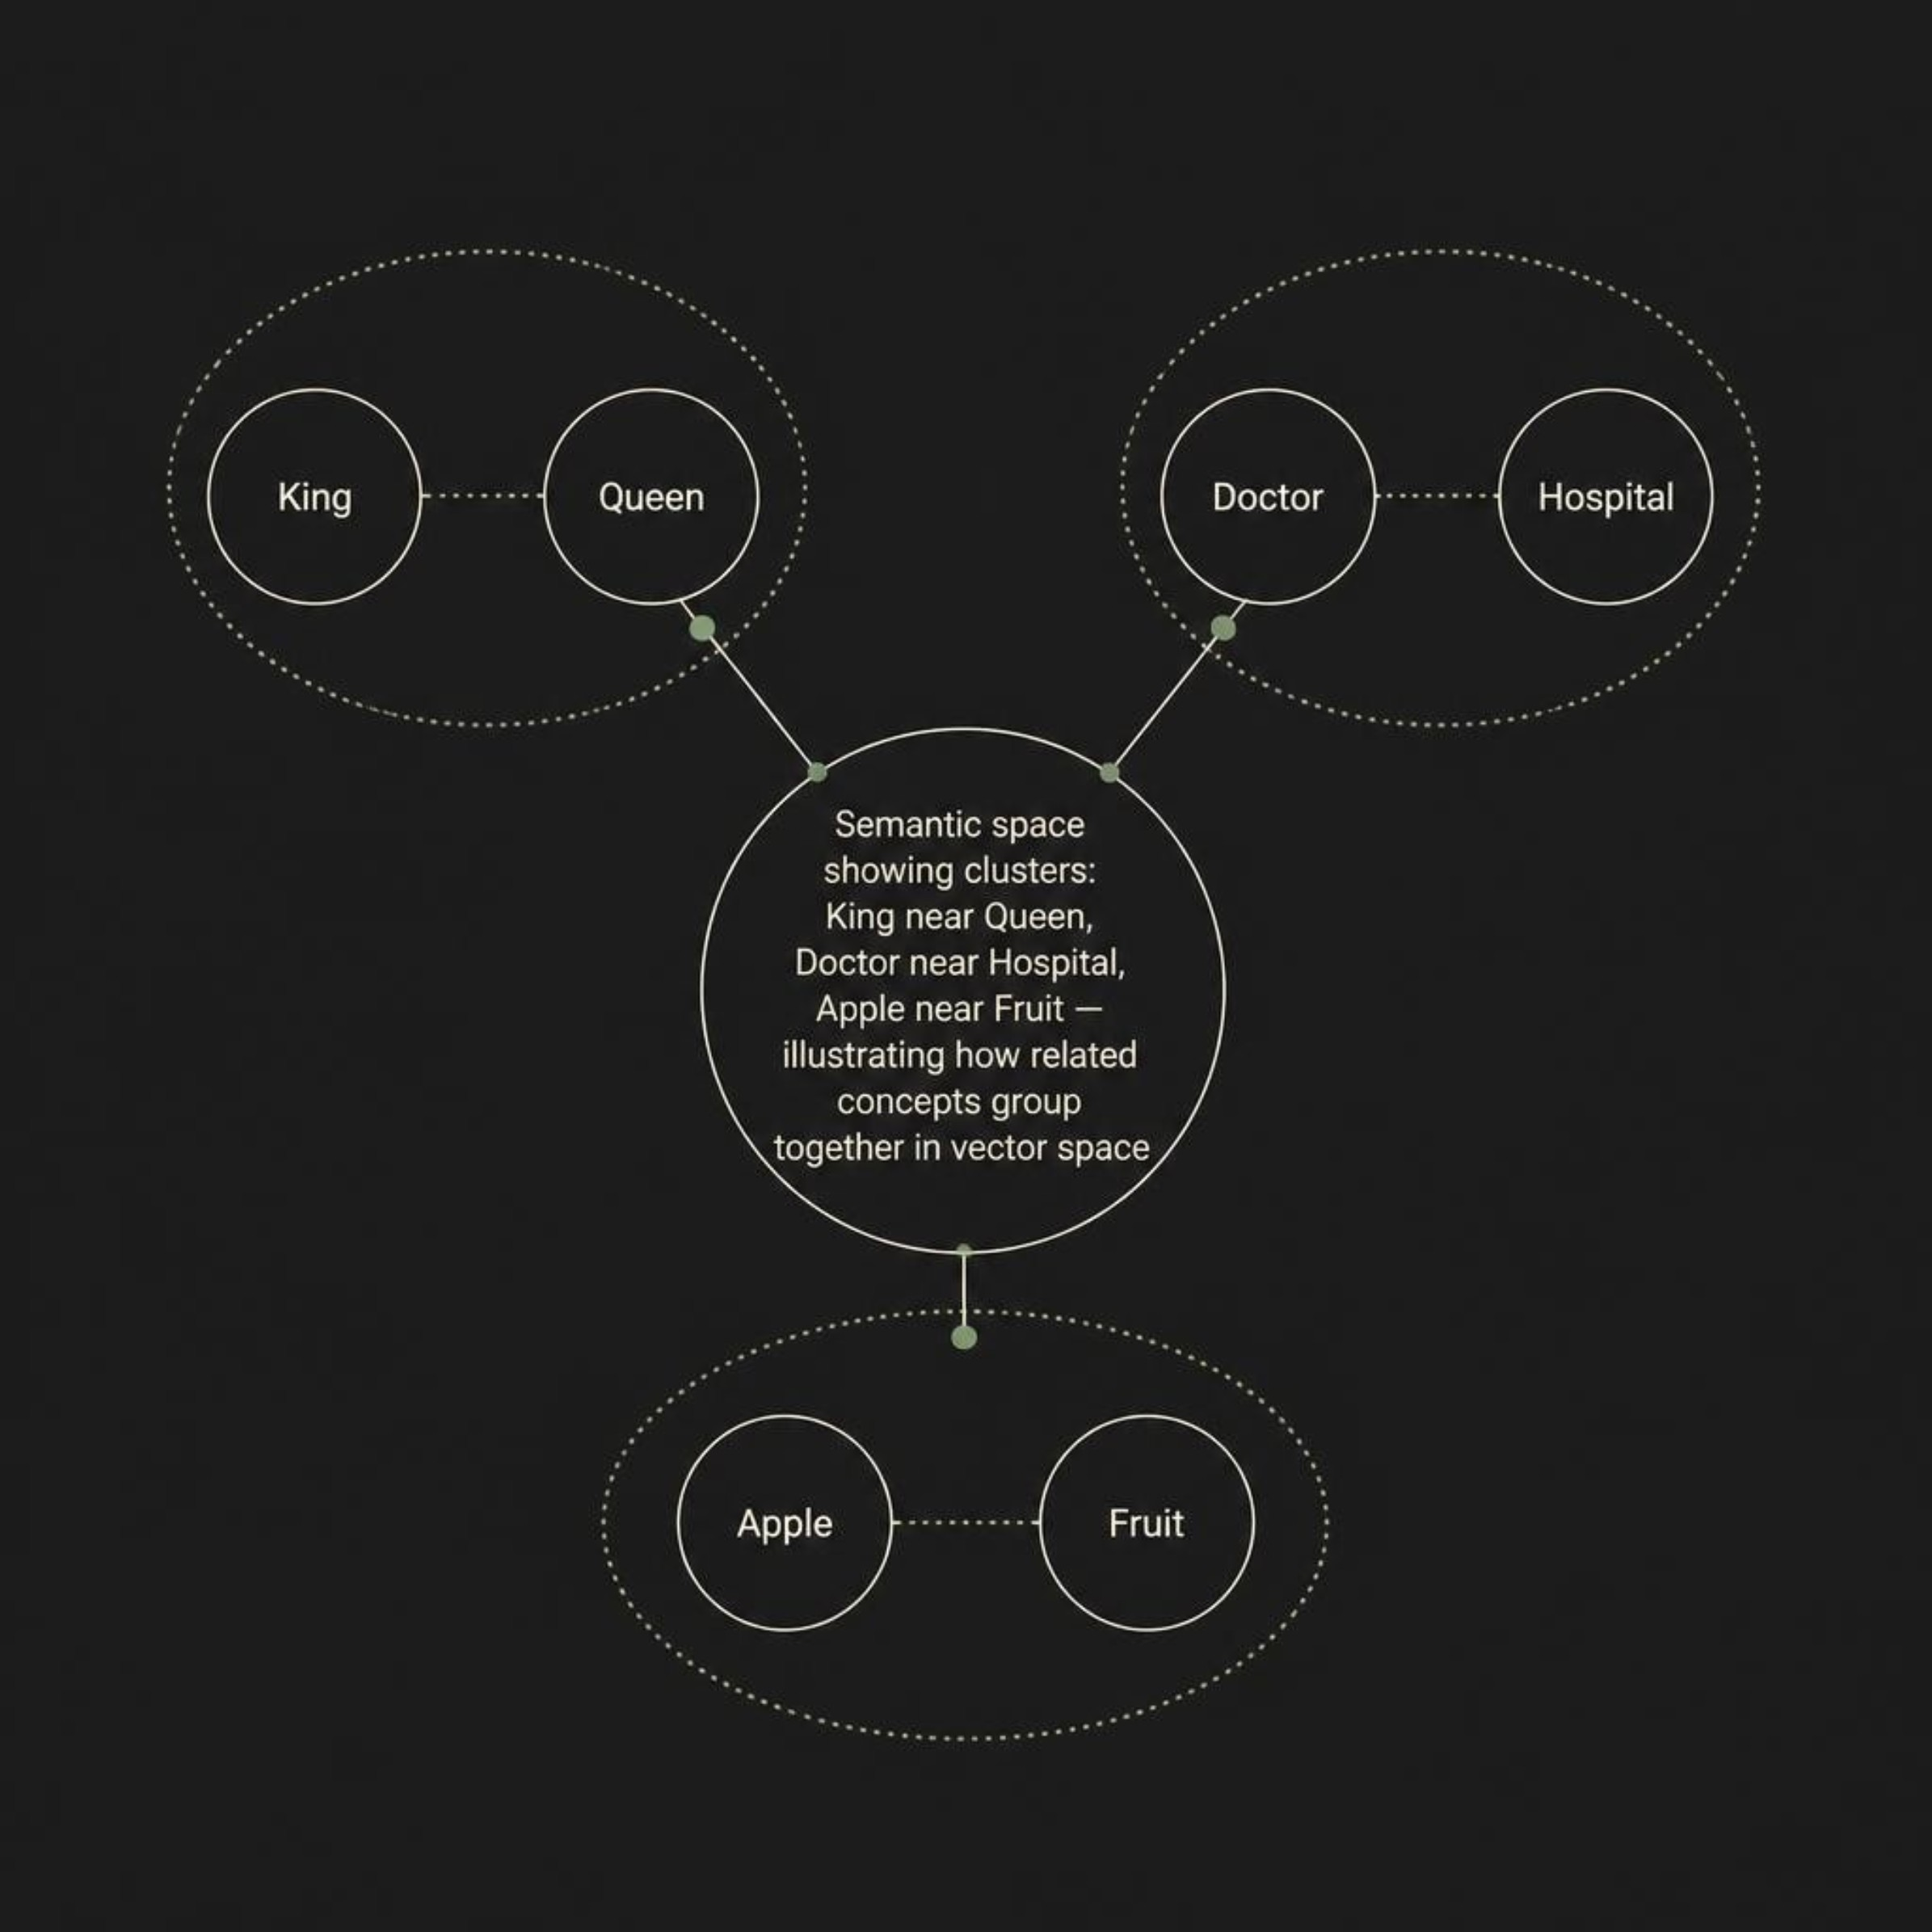
Tokens & Embeddings
Part B — Embeddings
Each token is mapped to a high-dimensional numerical vector capturing its meaning.
Part A — Tokenization
Text is broken into small processable units before the model can read it.
Example: "AI understands human language"
→ ["AI", " understands", " human", " language"]
Tokens can be words, subwords, or characters
Tokens determine processing cost, speed, and context limits

Slide 6



Attention Mechanism
How Attention Works
1
Query
What the current word is looking for in context
2
Key
What each other word offers as identifiable information
3
Value
Input
Q/K/V Compute
Attention Weights
Context Output
The actual content retrieved when a match is found
Classic example: "The bank executive sat by the river bank" — attention disambiguates both meanings of bank from surrounding context.

Slide 7




Prompt Engineering
The quality of your prompt directly determines the quality of the model's response.
Weak vs. Improved Prompts
Prompting Techniques
❌ Weak
✅ Improved
Zero-Shot
"Explain transformers" → Generic, surface-level response with no structure
"Explain transformer architecture to a first-year engineer in simple language. Include self-attention and one real-world example." → Focused, detailed, actionable response
Ask directly without any examples
Few-Shot
Provide sample input-output pairs before the question
Role Prompting
"Act as a teacher explaining to a student…"
Chain-of-Thought
"Think step-by-step…" for complex reasoning

Slide 8
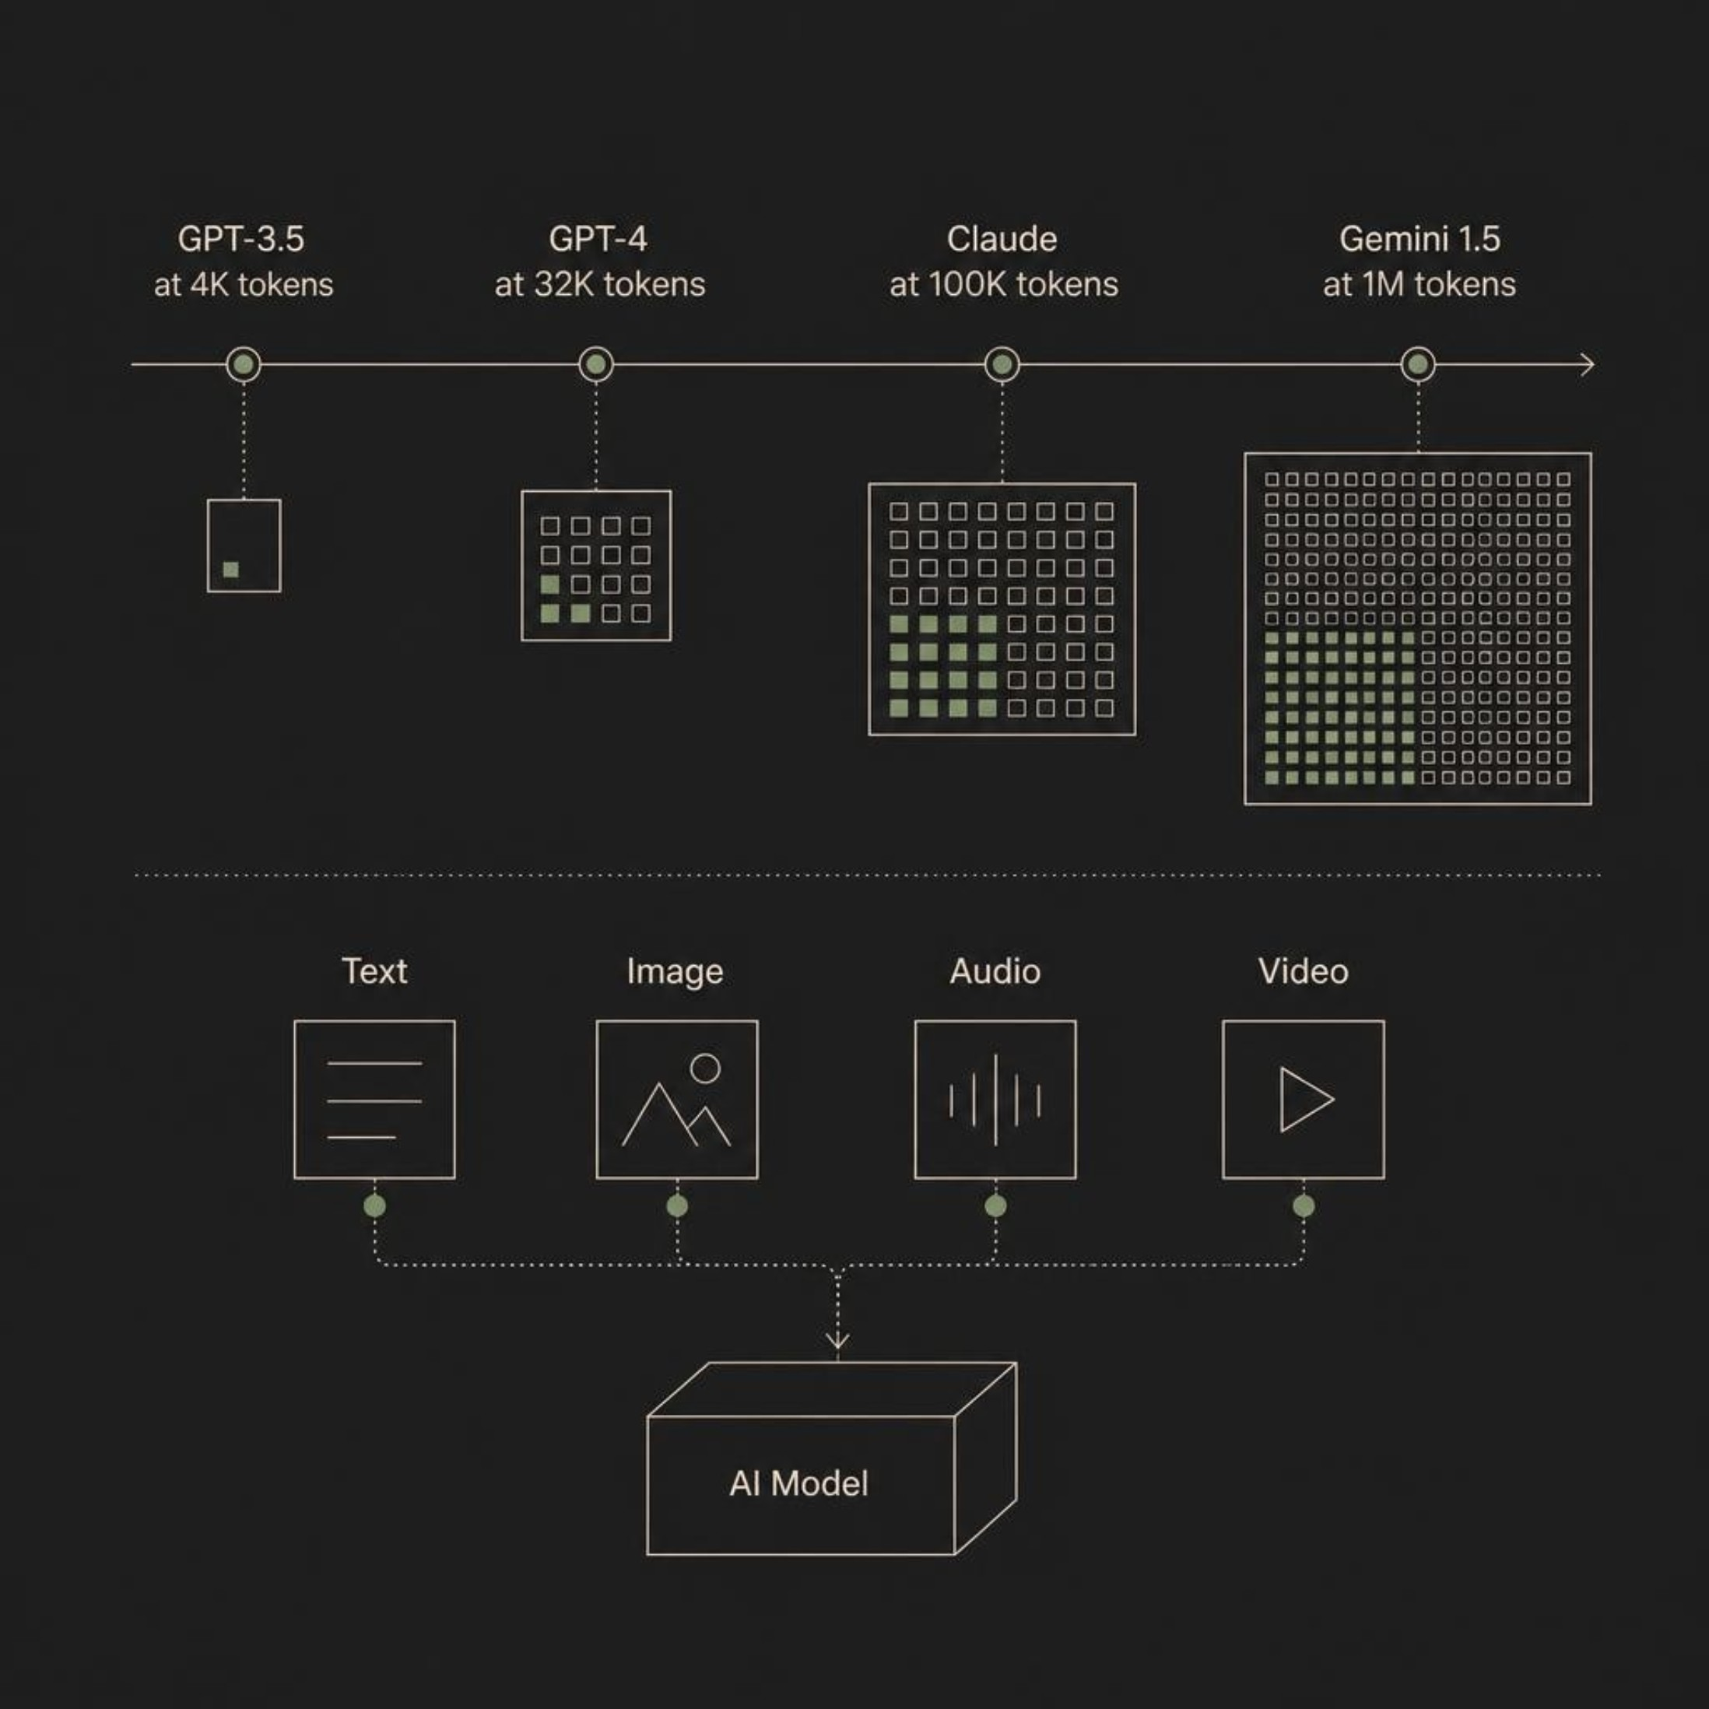
Context Window & Multimodal AI
Part A — Context Window
Definition: Maximum text the model can consider at one time
Older models: 2K–4K tokens; Newer models: 100K+ tokens
Challenge: Information beyond the window is truncated and "forgotten"
Part B — Multimodal AI
Capability: Process text, images, audio, and video simultaneously
Example: Upload an image → AI describes content, answers questions, extracts text
Impact: Enables richer understanding and more versatile real-world applications

Slide 9



Ethics & Responsible AI
1
Verify Information
AI can hallucinate facts confidently. Always fact-check outputs against credible sources before submission.
2
Attribute AI Assistance
Cite AI tools used in your academic work. Never present AI-generated content as entirely your own.
3
Use as a Learning Tool
AI accelerates exploration — not a shortcut to skip understanding. Engage deeply with the material.
4
Own Accountability
You are responsible for explaining and defending every element of your submitted work.
AI Assistance
Verify
Understand
Explain
Cite
Use AI tools as helpers, not sources
Fact-check outputs against reliable sources
Assess how and why the AI produced results
Document reasoning and limitations clearly
Attribute AI tools and source materials

Slide 10

Key Takeaways & References
Concepts Covered
References
01
OpenAI
Google DeepMind
LLM Platforms
ChatGPT Documentation — platform.openai.com
Gemini Official Resources — deepmind.google/gemini
ChatGPT, Gemini, and Claude — strengths and differences
Anthropic
Vaswani et al., 2017
02
Claude Documentation — anthropic.com/claude
"Attention is All You Need" — Foundational transformer paper
Transformer Architecture
Encoder, decoder, self-attention, stacked layers
Additional Sources
03
[Add further references consulted during your research]
Tokens & Embeddings
How language becomes numbers the model can process
04
Attention Mechanism
Query, Key, Value — contextual word understanding
05
Prompt Engineering
Zero-shot, few-shot, role prompting, chain-of-thought
06
Context Window & Multimodal AI
Token limits, memory, and multi-format input processing
07
Responsible AI
Verify, attribute, understand, and cite your AI use

