Slide 1

Payment Fraud Detection
Presented by
Shakthi.A
(1BM20CS144)
Under the guidance of
Prof . Saritha A N
Assistant Professor
Department of Computer Science and Engineering
BMS College and Engineering, Bengaluru

Slide 2
Introduction
2.1 Overview
Definition of Payment Fraud Detection
Detection of fraudulent activities in financial transactions.
Utilizes advanced technologies to identify and prevent unauthorized transactions.
Importance in the Digital Age
Rapid growth in overall transactions.
Increased vulnerability to various forms of cybercrime.
Necessity for robust security measures.

Slide 3

2.2 Motivation
Rising Instances of Fraud
Statistics on the increasing frequency of online payment fraud.
Impact on individuals, businesses, and the overall economy.
Financial Impact on Individuals and Businesses
Losses incurred due to fraudulent activities.
Importance of protecting personal and financial information.

Slide 4
2.3 Objectives
Enhancing Security in Transactions
Developing proactive measures to prevent fraud.
Strengthening the overall security infrastructure of online platforms.
Leveraging Machine Learning for Fraud Detection
Utilizing advanced analytics and machine learning algorithms.
Enhancing the efficiency and accuracy of fraud detection processes.

Slide 5
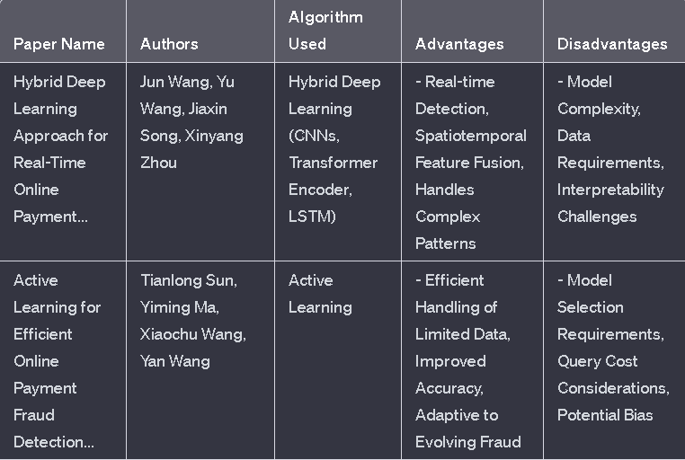
LITERATURE SURVEY

Slide 6
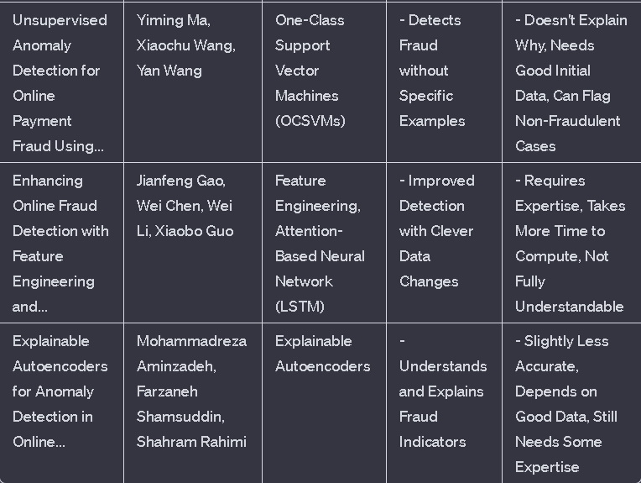

Slide 7
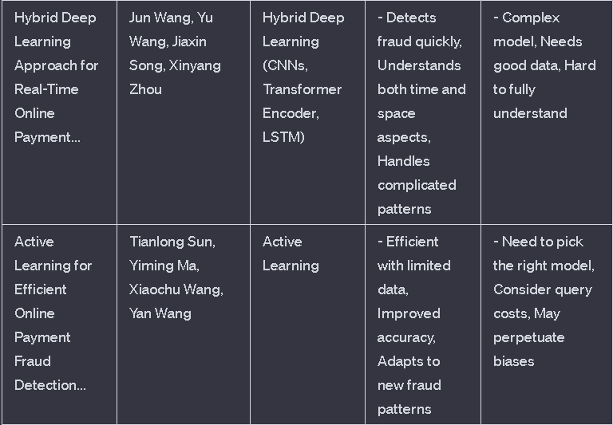

Slide 8
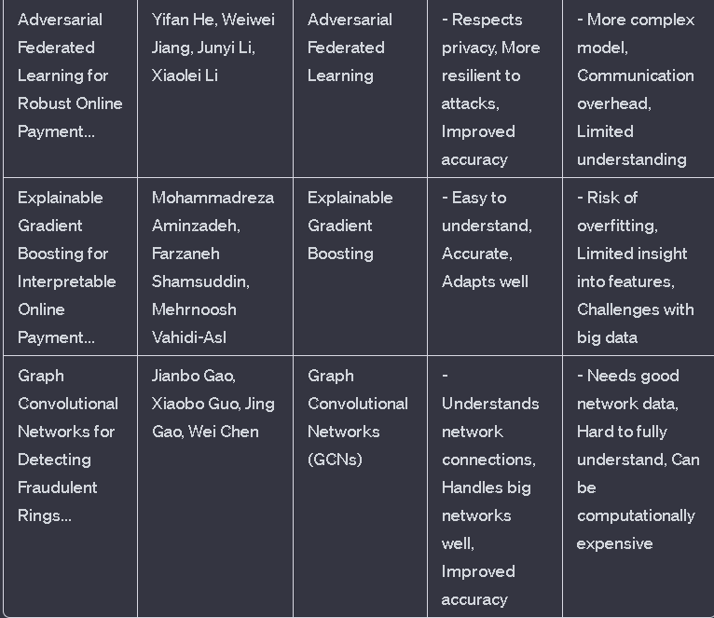

Slide 9
Methodology/Techniques or Algorithms used.
The libraries used are :
Pandas: This library helps to load the data frame in a 2D array format and has multiple functions to perform analysis tasks in one go.
Seaborn/Matplotlib: For data visualization.
Numpy: Numpy arrays are very fast and can perform large computations in a very short time.

Slide 10
Data Preprocessing
This step includes the following :
Encoding of Type column
Dropping irrelevant columns like nameOrig, nameDest
Data Splitting
ML MODEL
RandomForestClassifier : Random forest classifier creates a set of decision trees from a randomly selected subset of the training set. Then, it collects the votes from different decision trees to decide the final prediction.
TOOLS USED
Vscode with jupyter notebook extension

Slide 11
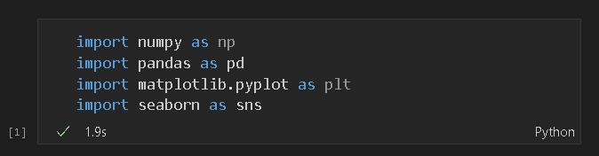
Modules implementation and results
MODULE 1 (IMPLEMENTATION OF DATASET)
Import modules

Slide 12
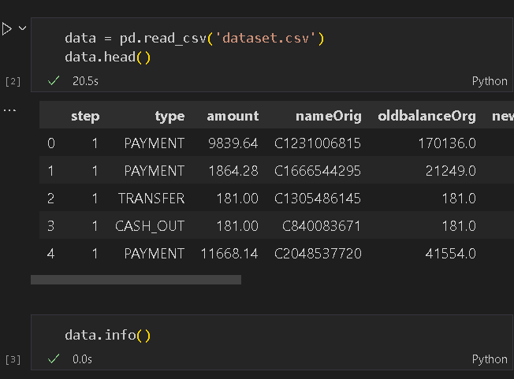
Read the dataset

Slide 13
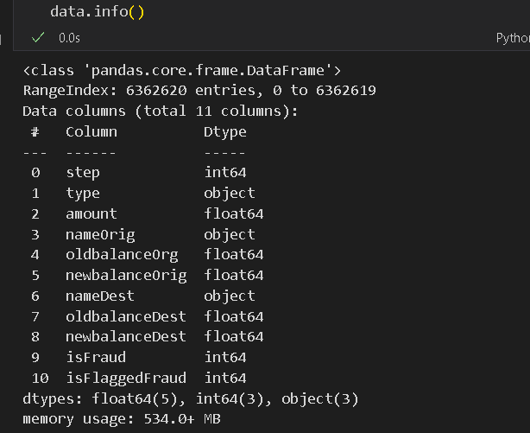
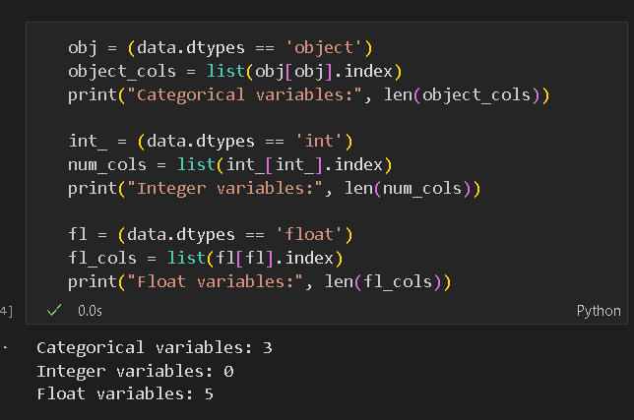
ANALYSE THE DATASET

Slide 14
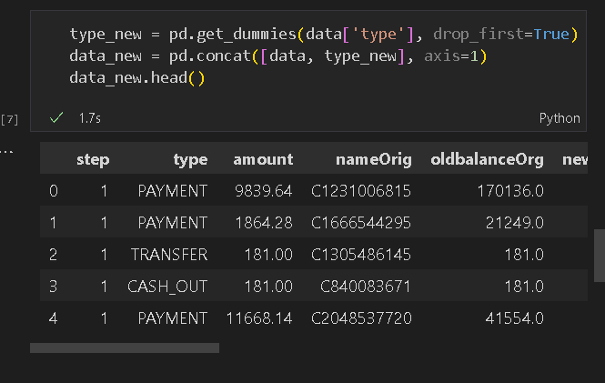
DATA PREPROCESSING
ENCODING OF TYPE COLUMN: CONVERTING CATEGORICAL DATA INTO NUMERICAL REPRESENTATION.

Slide 15
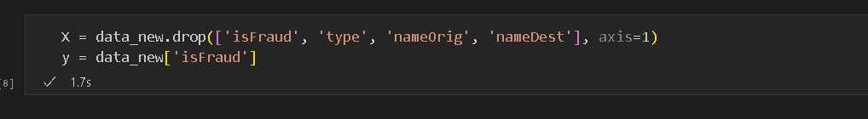
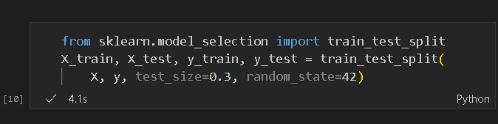
Dropping irrelevant columns like nameOrig, nameDest
DATA SPLITTING

Slide 16
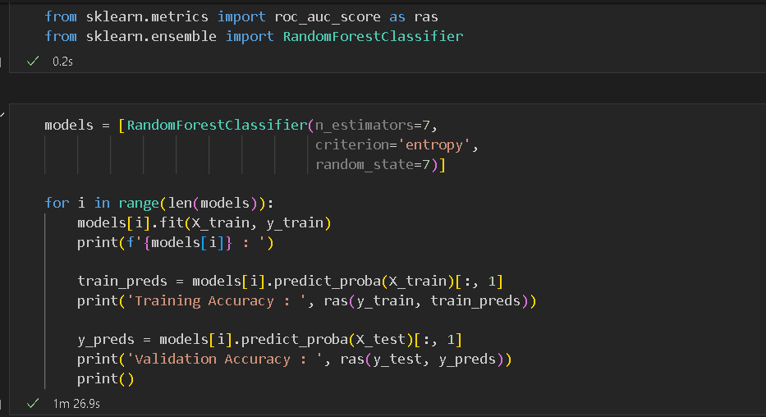
MODULE 2 (MODEL IMPLEMENTATION)
RANDOMFORESTCLASSIFIER

Slide 17
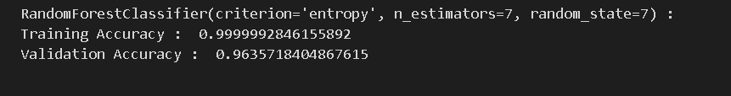
RESULT

Slide 18
REFERENCES
https://www.kaggle.com/datasets
[1] Fraud detection in Online Payment Transaction using Machine Learning Algorithms. (2022, November 1). IEEE Conference Publication | IEEE Xplore. https://ieeexplore.ieee.org/document/10125521/authors
[2] Fraud detection in Online Payment Transaction using Machine Learning Algorithms. (2022, November 1). IEEE Conference Publication | IEEE Xplore. https://ieeexplore.ieee.org/document/10125521/authors
[3] Protecting Contactless Credit Card Payments from Fraud through Ambient Authentication and Machine Learning. (2023, May 18). IEEE Conference Publication | IEEE Xplore. https://ieeexplore.ieee.org/document/10200022

Slide 19
[4] Extreme Gradient Boost Classifier based Credit Card Fraud Detection Model. (2023, March 17). IEEE Conference Publication | IEEE Xplore. https://ieeexplore.ieee.org/document/10110188
[5] Fraud Detection using Recurrent Neural Networks for Digital Wallet Security. (2023, September 13). IEEE Conference Publication | IEEE Xplore. https://ieeexplore.ieee.org/document/10286651
[6] Analyzing Credit Card Fraud Detection based on Machine Learning Models. (2022, June 1). IEEE Conference Publication | IEEE Xplore. https://ieeexplore.ieee.org/document/9795737
[7] Smart Acquiring Platform in Contactless Payments using Advanced Machine Learning : Security Controls using Device Recognition, Geo Fencing and Customer on File. (2023, May 5). IEEE Conference Publication | IEEE Xplore. https://ieeexplore.ieee.org/document/10179552

Slide 20
[8] Online Payment fraud detection model using machine learning techniques. (2023). IEEE Journals & Magazine | IEEE Xplore. https://ieeexplore.ieee.org/document/10341223
[9] Online Fraud Detection using Machine Learning. (2023, January 27). IEEE Conference Publication | IEEE Xplore. https://ieeexplore.ieee.org/document/10085493
[10] Fraud Detection in Online Payments using Machine Learning Techniques. (2023, May 17). IEEE Conference Publication | IEEE Xplore. https://ieeexplore.ieee.org/document/10142404

