Slide 1
Team Name 192.168.0.1
Problem Statement - 2
BREAST CANCER EARLY DETECTION & AWARENESS
A Akhil

Slide 2
Introduction
Why is Early Detection Important?
Breast cancer is the most common cancer among women, contributing to 15% of all cancer deaths worldwide.
Early detection significantly increases survival rates, but lack of awareness and delayed diagnosis remain major challenges.
Existing detection methods rely on radiologists and medical experts, leading to long waiting times and accessibility issues.
Key Challenges:
Late Diagnosis: Many cases are detected in advanced stages.
Limited Access: Rural areas lack specialized oncologists and diagnostic centers.
User Hesitation: Fear, lack of knowledge, and stigma prevent early testing.

Slide 3
Our Solution
Breast Cancer Early Detection & Awareness System
✔ AI-powered risk assessment using medical reports & X-rays.
✔ Guidance for diagnosed patients (next steps, specialist recommendations).
✔ Interactive chatbot answering only breast cancer-related queries.
✔ Runs completely on localhost (No external API/cloud dependency).

Slide 4
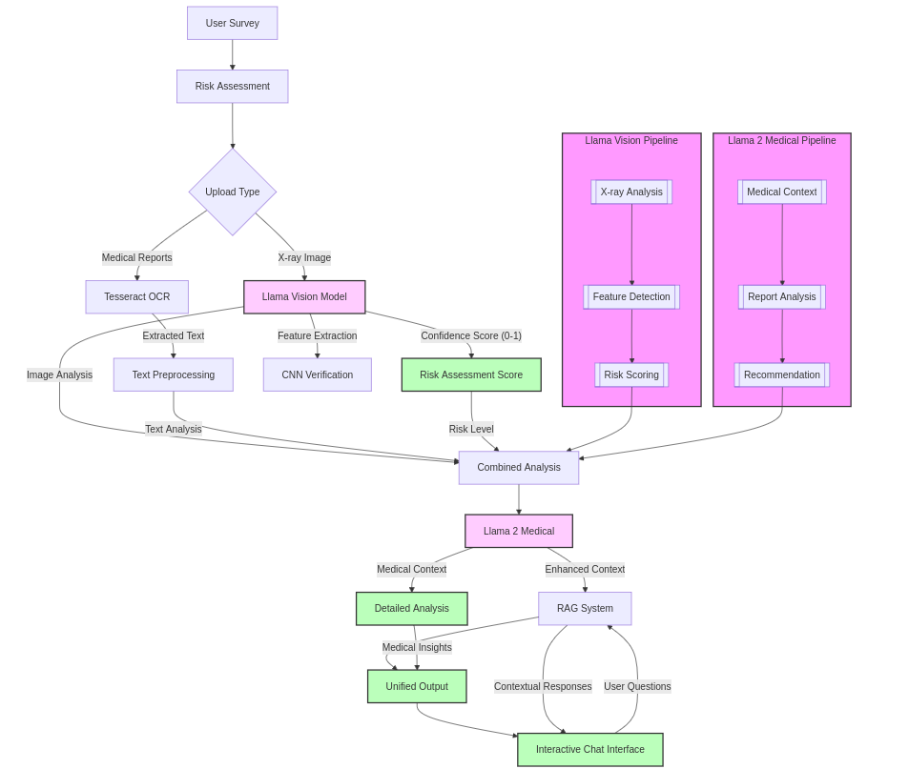
System Architecture

Slide 5
Core Components:
User Survey & Risk Assessment
Medical Report Upload (LLaMA 3.1: 70B fine-tuned model)
X-ray Analysis (LLaMA Vision Model - Fine-tuned on CBIS-DDSM dataset)
Risk Scoring & Combined Analysis
LLaMA 2 Medical Model (Fine-tuned on Polymed-QA, MMLU-medical-cot, Aloe-Beta-General-Collection)
Interactive Chat & Recommendations

Slide 6
Fine-Tuned Models Used
1. LLaMA Vision Model (for X-ray analysis)
  Fine-tuned on CBIS-DDSM: Breast Cancer Image Dataset
  Identifies tumor regions & classifies risk levels.
2. Convolutional Neural Network (CNN) Model (for X-ray feature extraction & classification)
  Custom CNN architecture trained on CBIS-DDSM for enhanced image classification.
  Extracts detailed tumor features to complement LLaMA Vision Model.
  Improves prediction accuracy by combining deep learning with LLM analysis.
3. LLaMA 3.1: 70B Model (for medical report analysis & chatbot)
Fine-tuned on:
  HPAI-BSC/Aloe-Beta-General-Collection
  HPAI-BSC/Polymed-QA
  HPAI-BSC/MMLU-medical-cot-llama31
Provides contextual medical recommendations based on extracted text.
Training is done on DGX A-100 40GB Vram

Slide 7
DEMO

Slide 8
Thank You!!!!

