Slide 1
PHISHING DETECTION
PIP104 PROFESSIONAL PRACTICE-II
VIVA-VOCE
Batch Number: CSE-G77
Roll Number | Student Name
20201CSE0495 | SHAMBHVI SAMRIDHI
20201CSE0480 | MUKTHI K
20201CSE0472 | MANYATHA RAJ
20201CSE0496 | VISHAL SRIVASTAVA
Under the Supervision of,
Ms. Sreelatha P.K
Associate Professor School of Computer Science Engineering & Information Science
Presidency University

Slide 2
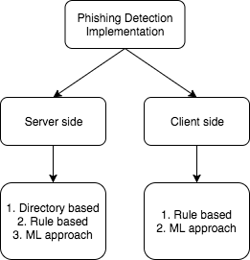
Introduction
PROBLEM DOMAIN
Phishing is the fraudulent attempt to obtain sensitive information such as usernames, passwords, and credit card details (and money), often for malicious reason.
Approaches to phishing detection :-

Slide 3
1. Directory Based Approach:-
Directory of all phishing websites
PhishTank
Google Safe Browsing API
Not effective as directory can’t keep the up to date record of all the continuously developed phishing websites.
Leaks browsing behaviour.
2. Rule Based Approach:-
Easier implementation on the client side.
Not more accurate as compared to the ML Based approach.
PhishDetector
PhishNet
Spoof Guard
Phishwish

Slide 4
3. Machine Learning Based Approach:-
Random Forest Classifier:- 97.36%
Ensemble model uses CART algorithm
Phishing validation and detection with low rate of false alarm.
Based on comparision of different ML techniques, random forest classifier seems to perform better .
To benifit an end user:-implement detection in a browser plugin. So that the user can be warned in real time as he browses a phishing site
Browser extensions have restrictions:-
Can be written only in JavaScript.
Have limited access to page URL and resources.
Existing plugins send the URL to a server, so that the classification can be done in the server and the result is returned to the plugin.

Slide 5
Our project aim to implement the plugin on a chrome browser plugin which can do the classification without an external server.
Advantages:-
Enables user privacy.
Rapid detection of phishing website in real time.
Can detect new phishing sites too.
Can interrupt the user incase of phishing
Reduces network latency.
Opportunities:-
Everyone conscious of privacy and security can use this plugin.
Non technical people who do business transactions are vulnerable to phishing and they are potential end users for this

Slide 6
Literature Review
A literature survey, also commonly referred to as a literature review, is a critical and systematic analysis of scholarly articles, books, dissertations, conference proceedings, and other sources relevant to a particular research topic or area of study.
Phishing in Online Banking.
A Literature Review on Phishing Attacks.
A Study of Phishing Attacks and Countermeasures.
Preventing Phishing Attacks: A Survey.
A Survey of Phishing Detection and Prevention Techniques.
A Machine Learning-Based Approach for Phishing Detection and Prevention.
A Survey of Phishing Detection and Email Address Verification.

Slide 7
Research Gaps Identified
Detecting phishing websites often include lookup in a directory of malicious sites.
Most of the phishing websites are short lived, the directory cannot always keep track of all, including new phishing websites.
So the problem of detecting phishing websites can be solved in a better way by machine learning techniques.
Based on a comparison of different ML techniques, the random forest classifier seems to perform better.
Only way for an end user to benefit from this is to implement detection in a browser plugin. So that the user can be warned in real time as he browses a phishing site.
Browser extensions have restrictions:-
they can be written only in javascript.
they have limited access to page URLs and resources.

Slide 8
Existing plugins send the URL to a server, so that the classification can be done in the server and the result is returned to the plugin.
Limitations:-
User privacy questioned.
Leads to network latency.
Plugin may fail to warn the user in real time.
As it is an important security problem and also considering the privacy aspects, we decided to implement this on a chrome browser plugin which can do the classification without an external server.
Advantages:-
Enables user privacy.
Rapid detection of phishing website in real time.
Can detect new phishing sites too.
Can interrupt the user incase of phishing
Reduces network latency.

Slide 9
Proposed Methodology
Reducing Phishing Attacks in Online/Mobile Wallets and Net Banking.
1. Phishing Threat Analysis: -
Data Collection:
Analysis
2. Literature Review: -
Identification of Key Studies
Summarization
3. User Education and Awareness Campaign:-
Content Development
Distribution

Slide 10
4. Technical Countermeasures: –
Implementation
Testing
5. Usability and User Experience Assessment: –
Usability Testing
Iterative Improvement
6. Effectiveness Evaluation: –
Simulated Phishing Attacks
Quantitative Analysis
7. User Feedback Integration: –
Feedback Collection
Feedback Analysis

Slide 11
8. Documentation and Reporting: –
Project Report
Recommendations
9. Dissemination: –
Stakeholder Engagement
10. Ethical Considerations: –
Data Privacy
Informed Consent

Slide 12
Objectives
Our objective is to design a plugin for the chrome browser which can do classification without using external server to make the detection of the phishing websites instant so that the user will be warned before entering any sensitive information on the phishing website.
Phishing Threat Analysis
Literature Review
User Education and Awareness
Usability and User Experience
Effectiveness Evaluation

Slide 13
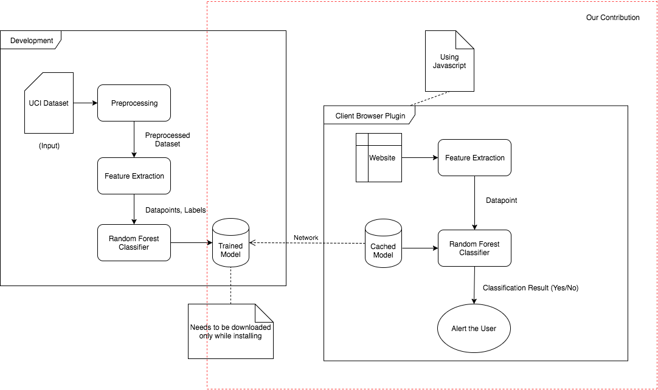
System Design & Implementation
System Architecture:-

Slide 14
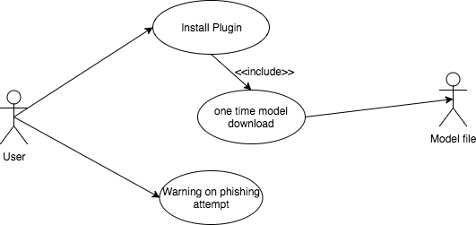
A Random Forest classifier - trained on phishing sites dataset using python scikit-learn.
A JSON format to represent the random forest classifier has been devised and the learned classifier is exported to the same.
A browser script has been implemented which uses the exported model JSON to classify the website being loaded in the active browser tab.
Use Case Diagram:-

Slide 15
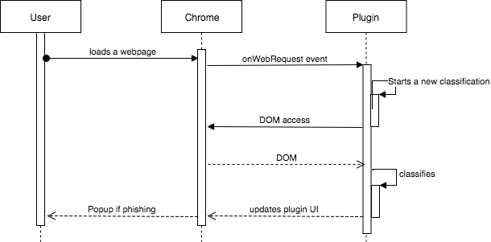
System Sequence Diagram:-

Slide 16
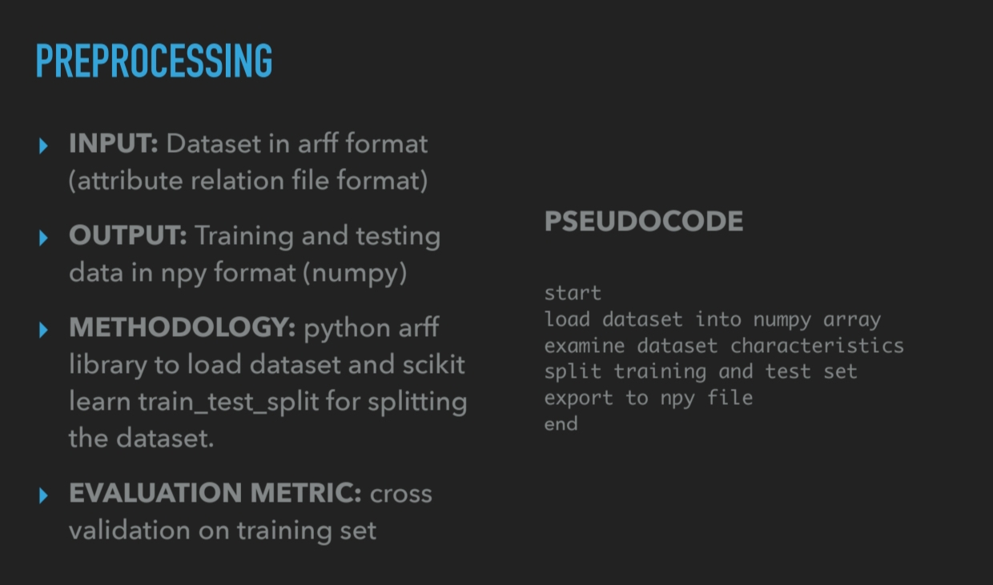

Slide 17
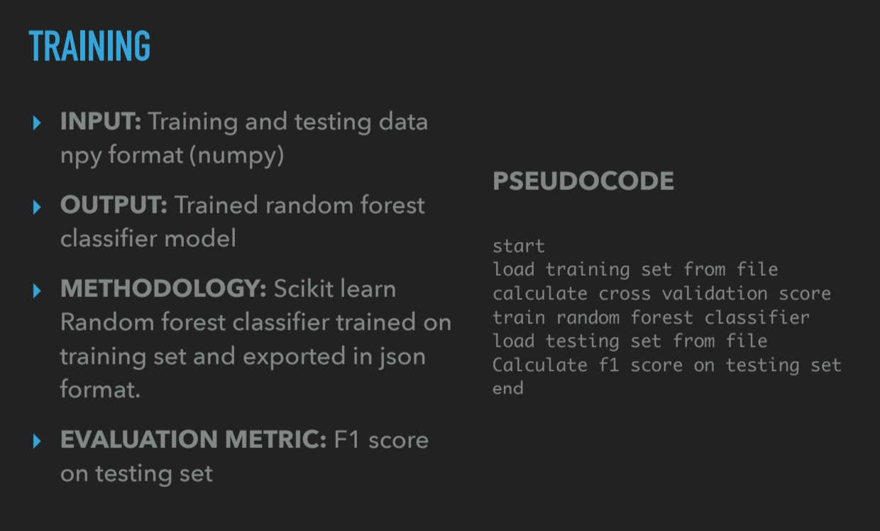

Slide 18
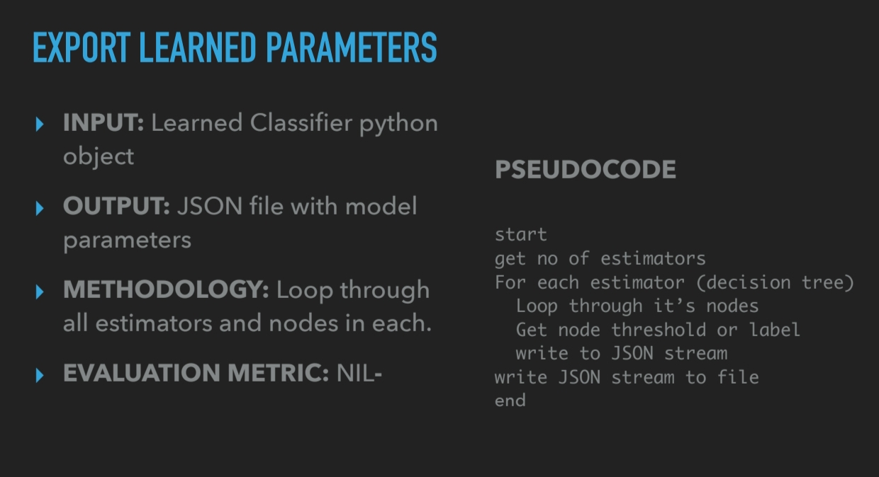

Slide 19
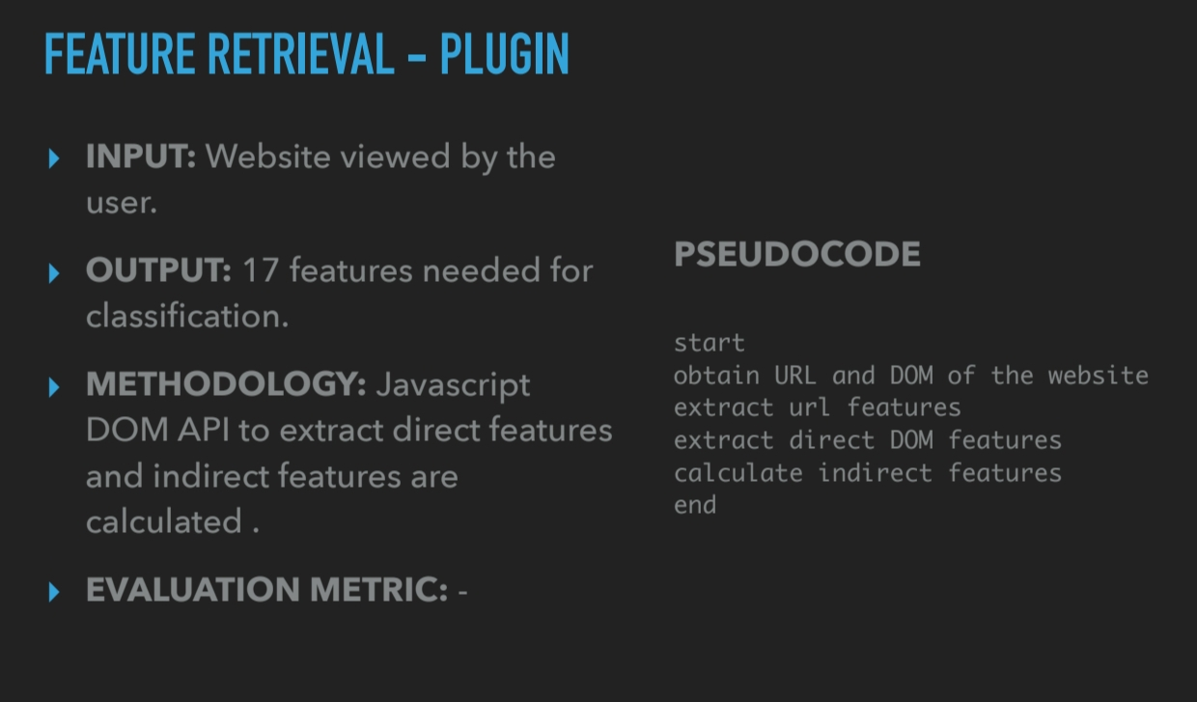

Slide 20
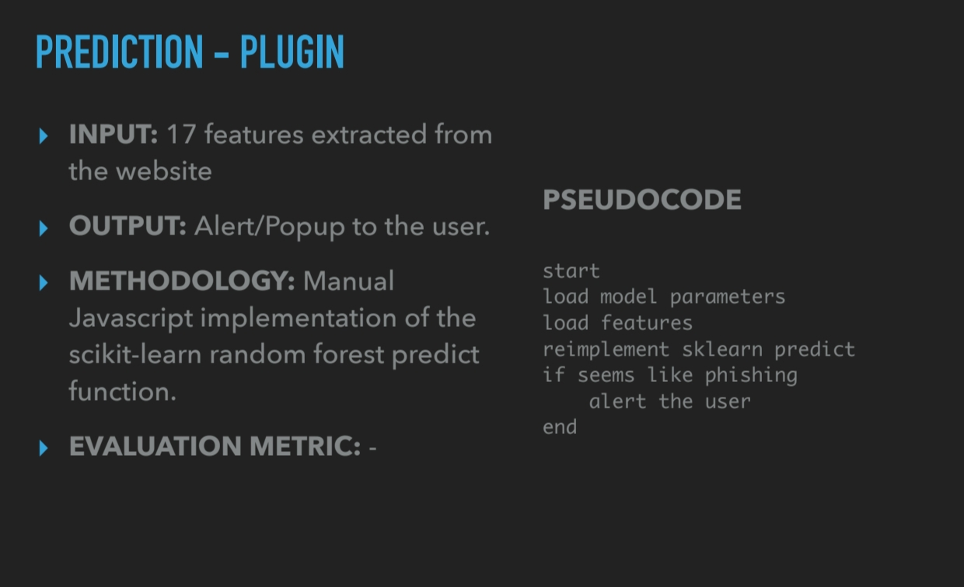

Slide 21
Modules Design:-
1. Preprocessing:
This module takes the downloaded dataset in arff format and the creates four new files listed as training features, training class labels, testing features, testing class labels.
2. Training: This module takes the four output files from preprocessor and gives a trained Random Forest object along with the cross validation score on the training set.
3. Exporting model: This module takes the learned Random Forest classifier object and the recursively generates its JSON representation which is written to file in disk.
4. Plugin Feature Extraction: This module takes a webpage as input and generates a feature vector with 17 encoded features.
5. Classification: This module takes the feature vector from feature extraction module and the JSON format from the Exporting model module and then gives a boolean output which denotes whether the webpage is legitimate or phishing.

Slide 22
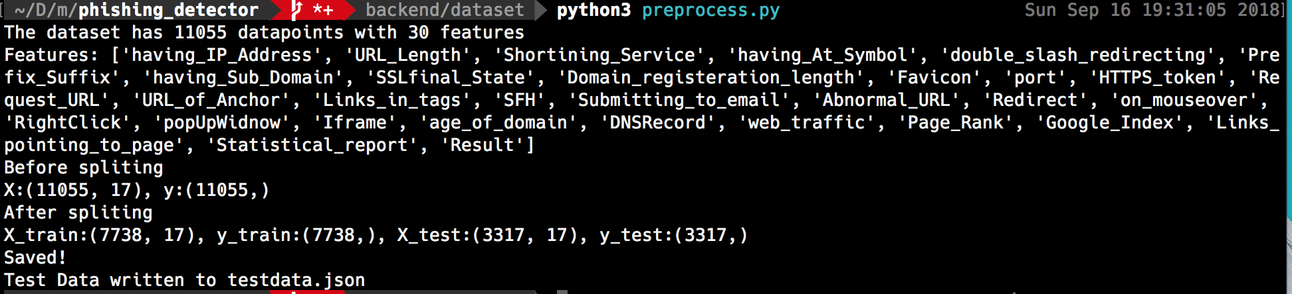
Outcomes / Results Obtained
The results of this module testing as well as the testing of the entire system are summarised below.
1. Preprocessing

Slide 23
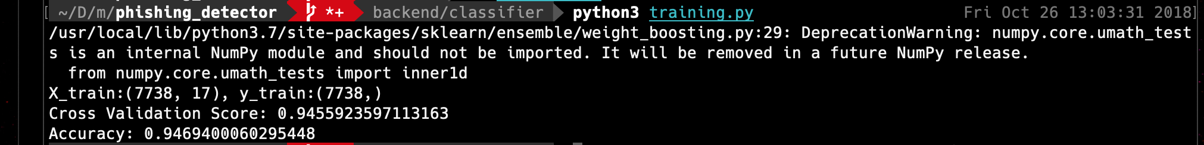
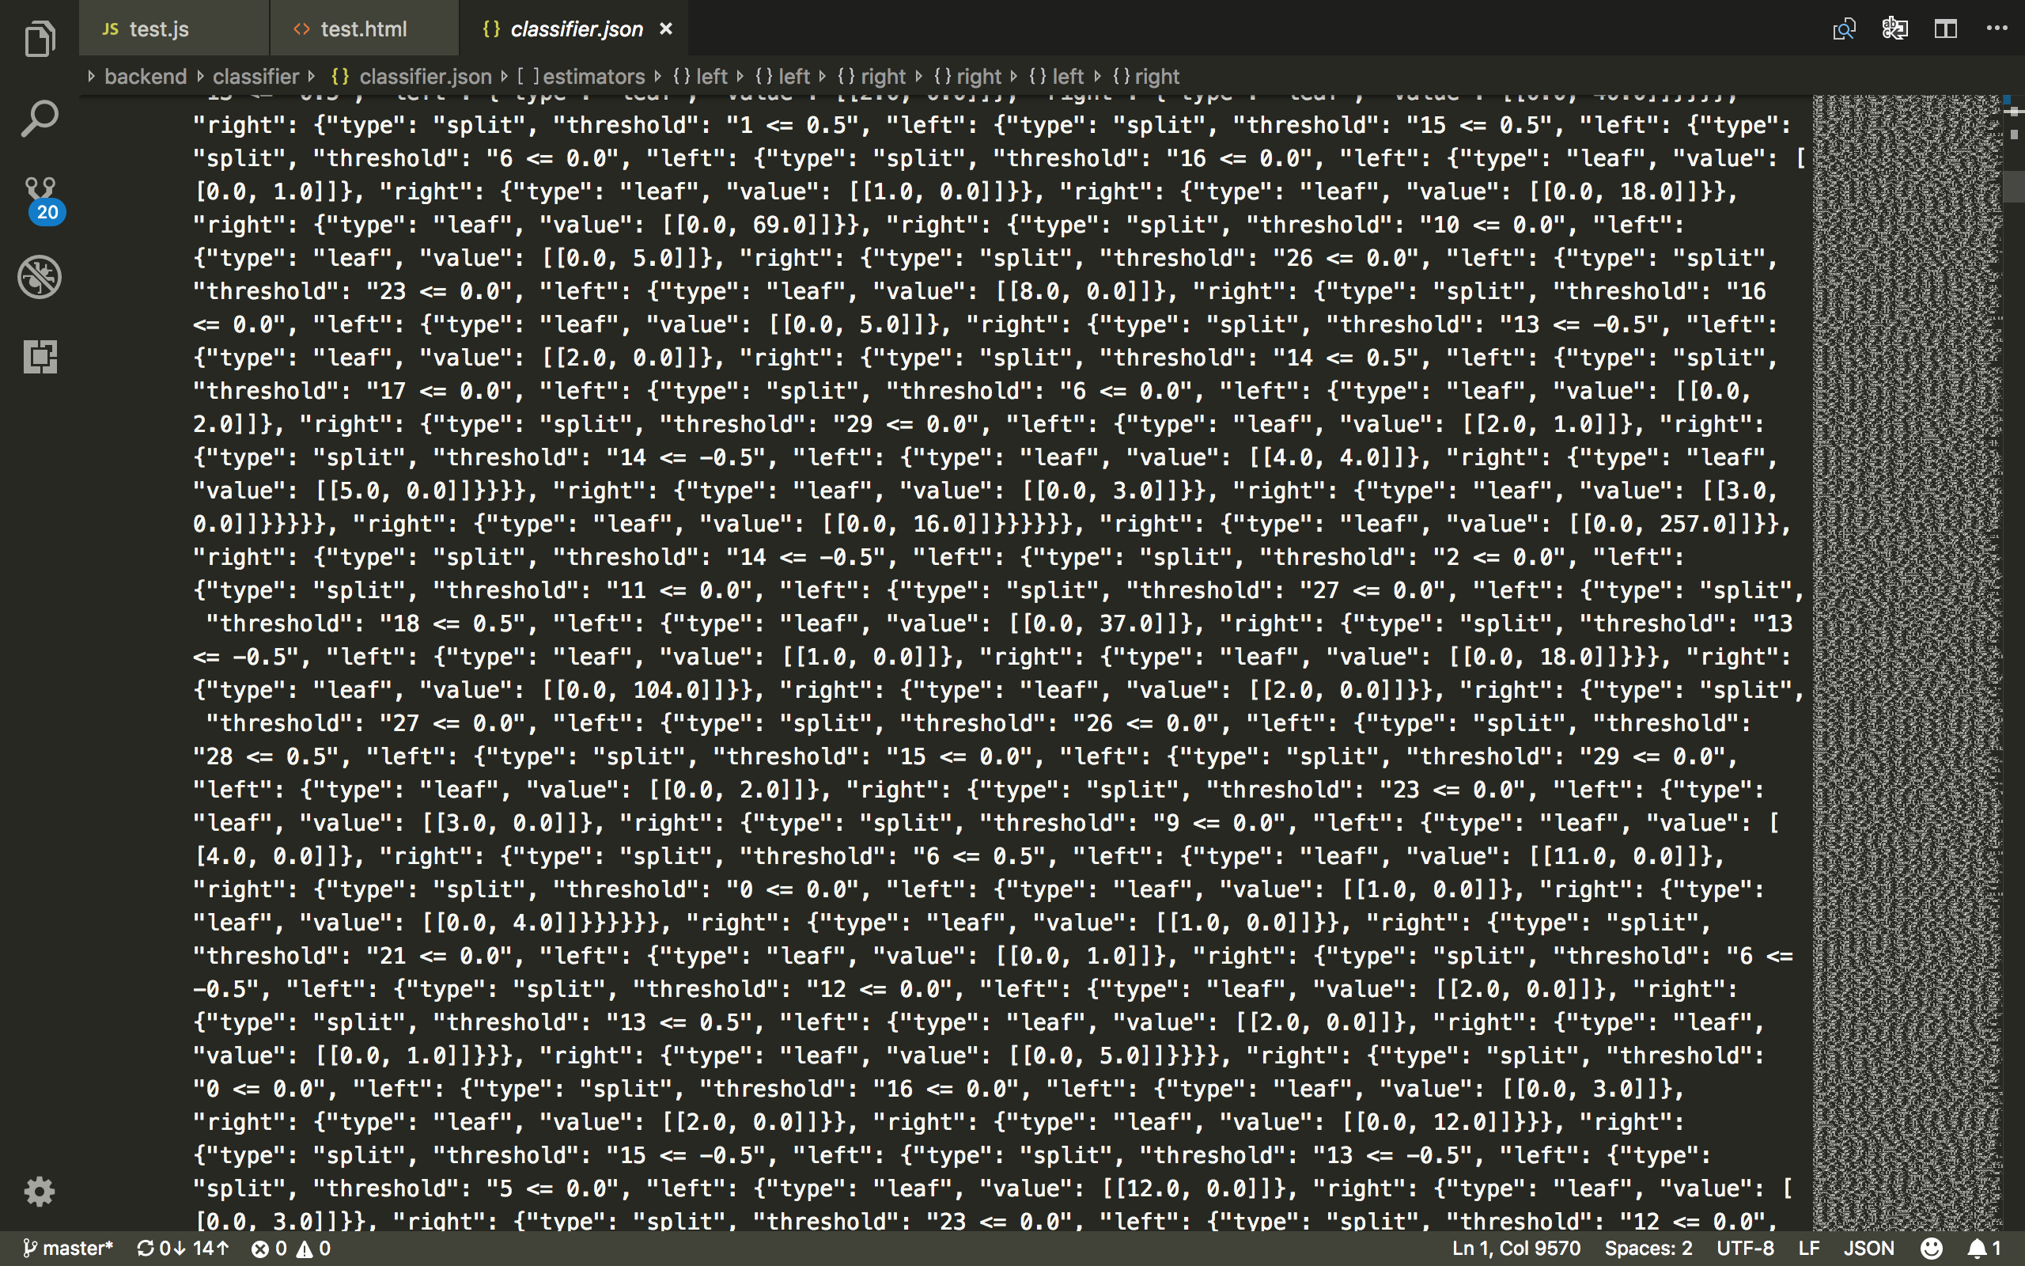
2. Training
3. Exporting model

Slide 24
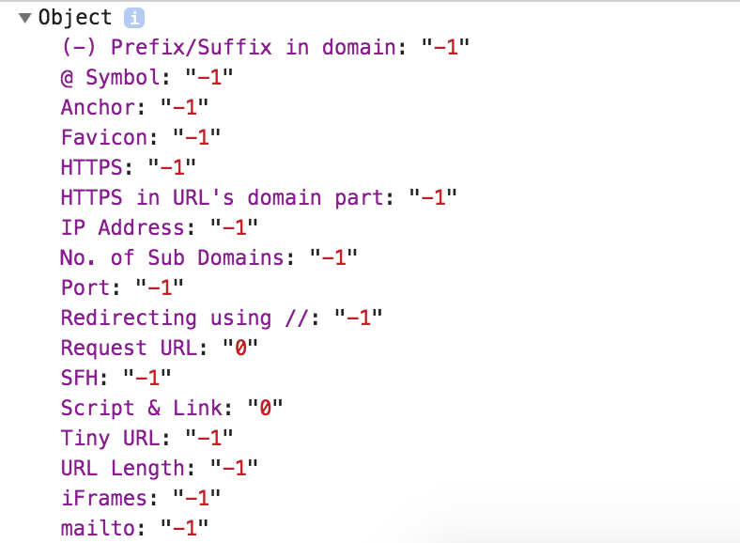
4. Plugin Feature Extraction

Slide 25
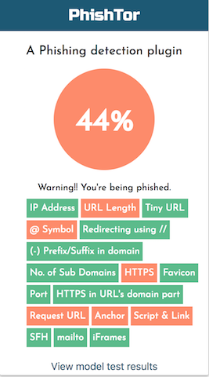
5. Classification

Slide 26
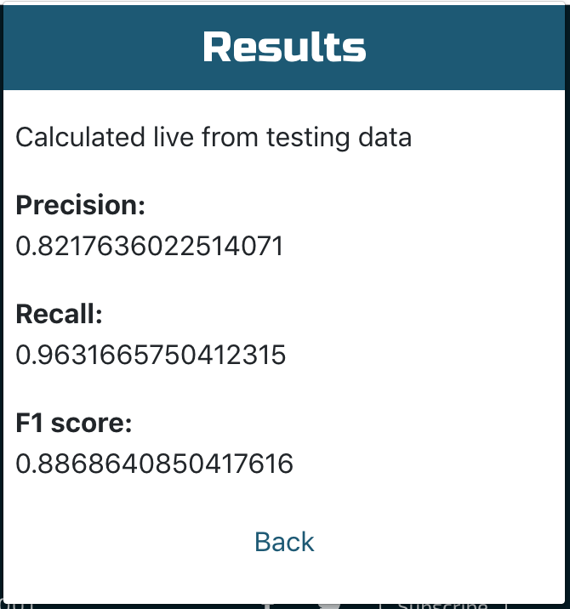
Performance Evaluation:
Cross Validation Score:

Slide 27
Conclusion
This is a phishing website detection system that focuses on client side implementation with rapid detection so that the users will be warned before getting phished. The main implementation is porting of Random Forest classifier to javascript. Similar works often use webpage features that are not feasible to extract on the client side and this results in the detection being dependent on the network. On the other side, this system uses only features that are possible to extract on the client side and thus it is able to provide rapid detection and better privacy. Although using lesser features results in mild drop in accuracy, it increases the usability of the system. This work has identified a subset of webpage feature that can be implemented on the client side without much effect in accuracy. The port from python to javascript and own implementation of Random Forest in javascript further helped in rapid detection as the JSON representation of the model and the classification script is designed with time complexity in mind. The plugin is able to detect the phishing even before the page loads completely. The F1 score calculated on the test set on the client side is 0.886

Slide 28
References
[1] A. Subasi, E. Molah, F. Almkallawi, and T. J. Chaudhery, “Intelligent phishing website detection using random forest classifier,” 2017 International Conference on Electrical and Computing Technologies and Applications (ICECTA), Nov. 2017.
[2] “UCI Machine Learning Repository: Phishing Websites Data Set,” [Online]. Available: https://archive.ics.uci.edu/ml/datasets/ phishing websites.
[3] J.-H. Li and S.-D. Wang, “PhishBox: An Approach for Phishing Validation and Detection,” 2017 IEEE 15th Intl Conf on Dependable, Autonomic and Secure Computing, 15th Intl Conf on Pervasive Intelligence and Computing, 3rd Intl Conf on Big Data Intelligence and Computing and Cyber Science and Technology Congress(DASC/PiCom/DataCom/CyberSciTech), 2017.
[4] A. A. Ahmed and N. A. Abdullah, “Real time detection of phishing websites,” 2016 IEEE 7th Annual Information Technology, Electronics and Mobile Communication Conference (IEMCON), 2016.

Slide 29
[5] R. Aravindhan, R. Shanmugalakshmi, K. Ramya, and S. C., “Certain investigation on web application security: Phishing detection and phishing target discovery,” 2016 3rd International Conference on Advanced Computing and Communication Systems (ICACCS), 2016. 35
[6] S. B. K.p, “Phishing Detection in Websites Using Neural Networks and Firefly,” International Journal Of Engineering And Computer Science, 2016.
[7] “An Efficient Approaches For Website Phishing Detection Using Supervised Machine Learning Technique,” International Journal of Advance Engineering and Research Development, vol. 2, no. 05, 2015.
[8] S. Gupta and A. Singhal, “Phishing URL detection by using artificial neural network with PSO,” 2017 2nd International Conference on Telecommunication and Networks (TEL-NET), 2017.
[9] Ammar ALmomani, G. B. B, Tat-Chee Wan, Altyeb Altaher, and Selvakumar Manickam, “Phishing Dynamic Evolving Neural Fuzzy Framework for ...,” Jan-2013. [Online]. Available: https://arxiv.org/ pdf/1302.0629

Slide 30

Thank You

