Slide 1
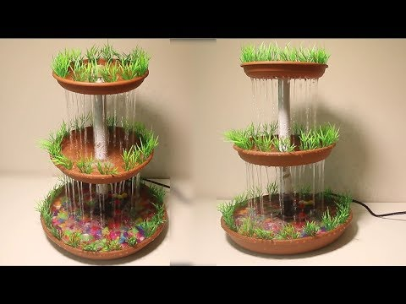
SMART WATER FOUNTAIN
BY….,
Sarmathi .N

Slide 2
PROBLEM STATEMENT :
When the water flow does not have any restrict , there is lose of water in household as well as environment .
The lack of fountains in a community can have a number of negative consequences for people, the environment, and the local economy.

Slide 3
Project statement
HARDWARE
First we start by using the Wio Node and a relay ,also going to a screen for feedback and text.Using the relay we can control the power supply.
SOFTWARE
The hardware is all connected ,its time to setup the software . We will use the Wio app by seeed.

Slide 4
design
STEP 1: Install Android/iOS App
STEP 2: Create your Account
STEP 3: Connect Wio Node to Internet
STEP 4: Virtually interconnect modules with Wio Node and update firmware
Here is where we add the 2 components
Relay
OLED

Slide 5
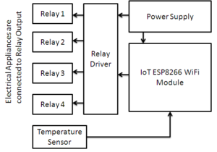
Block diagram

Slide 6


