Slide 1



Title: To develop a CNN model to classify images of plastic waste into different categories.
Subtitle: Waste Classification using CNN Model
**A Deep Learning Approach to Classify Organic and Recyclable Waste**
NAME: SHAMSHAD M
INTERNSHIP DETAILS:
Shell-Edunet Skills4Future AICTE Internship
AICTE Student ID: STU644001f3796eb1681916403
AICTE Internship ID: INTERNSHIP_1733138870674d99b64cb4b Date: 2025/02/08

Slide 2

Learning Objectives
Objective 1:
To classify waste into organic and recyclable categories using a Convolutional Neural Network (CNN).
What is Waste Classification?
Waste classification is the process of sorting waste into categories like organic (food scraps, garden waste) and recyclable (plastic, paper, metal). It’s essential for proper waste management and protecting the environment.
Why Use a CNN?
CNNs are deep learning models great for image tasks. They automatically learn features from images, making them perfect for identifying waste types based on how they look.
How Does It Work?
The CNN takes waste images as input, processes them through layers, and predicts if the waste is organic or recyclable. It learns by training on labeled images to recognize patterns for each category.
GOAL

Slide 3
Learning Objectives
Objective 2: To build a deep learning model with high accuracy for waste classification.
What Does High Accuracy Mean?
High accuracy means that the model correctly classifies a large percentage of the waste images into their respective categories (organic or recyclable). Achieving high accuracy is important to ensure the reliability of the waste classification system.
How to Achieve High Accuracy?
- Data Quality: Use a large, diverse, and well-labeled dataset of waste images.
- Model Architecture: Design a CNN with an appropriate number of layers and neurons to capture the complexity of the data.
- Training: Train the model using techniques like data augmentation, regularization, and optimization algorithms to prevent overfitting and improve generalization.
- Evaluation: Continuously evaluate the model's performance on a validation set and adjust hyperparameters as needed.

Slide 4
Learning Objectives
Objective 3: To visualize the model's performance using accuracy and loss plots.
Why Visualize Performance?
Visualizing the model's performance helps in understanding how well the model is learning and whether it is improving over time. It also helps in diagnosing issues like overfitting or underfitting.
- Accuracy Plots:
- What They Show: Accuracy plots display the model's accuracy on both the training and validation datasets over each epoch (iteration of training).
- What to Look For: Ideally, both training and validation accuracy should increase and stabilize at a high value. A large gap between training and validation accuracy may indicate overfitting.
- Loss Plots:
- What They Show: Loss plots display the model's loss (a measure of error) on both the training and validation datasets over each epoch.
- What to Look For: Both training and validation loss should decrease and stabilize at a low value. If the validation loss starts to increase while the training loss continues to decrease, it may indicate overfitting.

Slide 5
Learning Objectives
- How to Use These Plots:
- Diagnose Issues: Use the plots to identify if the model is overfitting (high training accuracy but low validation accuracy) or underfitting (low accuracy on both training and validation).
- Adjust Model: Based on the plots, you can adjust the model's architecture, learning rate, or regularization techniques to improve performance.
***********************************************
***************************************
*****************************
Summary:
1 - focuses on using CNNs to classify waste into organic and recyclable categories.
2 - aims to build a model with high accuracy, ensuring reliable waste classification.
3 - involves visualizing the model's performance through accuracy and loss plots to monitor and improve the model's learning process.
These objectives collectively aim to create an effective and reliable waste classification system using deep learning techniques.

Slide 6
Tools and Technology used
Here are the tools and technologies used in the Waste Management Using CNN Model project:
Tools:
Technologies:
Programming Language
•Python
Libraries & Frameworks
•TensorFlow/Keras – For building and training the CNN model
•OpenCV (cv2) – For image processing and manipulation
•NumPy – For numerical computations and array manipulations
•Pandas – For handling and structuring image-label data
•Matplotlib – For visualizing data, model accuracy, and loss
•tqdm – For progress tracking in loops
•Glob – For file handling and retrieving image paths
•Warnings – To suppress unnecessary warnings
Deep Learning Model
•Convolutional Neural Network (CNN) – For image classification
•ImageDataGenerator – For real-time data augmentation
Dataset Handling
•Image Preprocessing (Rescaling, Resizing, Color Conversion)
•Categorical Classification (Organic vs. Recyclable)
Training & Evaluation
•Binary Crossentropy Loss Function
•Adam Optimizer
•Accuracy as Performance Metric
•Data Visualization for Model Performance

Slide 7
Methodology
- Step 1: Dataset Collection (from KaggleHub)
The dataset used for this project was sourced from KaggleHub, containing labeled images of waste categorized as Organic and Recyclable. The dataset was divided into training and testing sets, ensuring a balanced distribution of both categories to facilitate accurate model learning.
- Step 2: Data Preprocessing (resizing, normalization)
To standardize the input, all images were resized to 224x224 pixels to maintain consistency in model training. Normalization (rescaling pixel values to the range [0,1]) was applied using ImageDataGenerator to improve training efficiency and prevent saturation of neuron activations.
- Step 3: Model Building (CNN architecture)
A Convolutional Neural Network (CNN) was designed with three convolutional layers, each followed by ReLU activation and MaxPooling to extract meaningful spatial features. The model was then flattened and connected to dense layers with dropout regularization to prevent overfitting, and the final output layer used sigmoid activation for binary classification.

Slide 8
Methodology
- Step 4: Model Training (15 epochs)
The CNN model was trained for 15 epochs using Adam optimizer and binary crossentropy loss function. The batch size was set to 32, and training was performed using augmented data to improve generalization. The model progressively learned to distinguish between organic and recyclable waste through iterative weight adjustments.
- Step 5: Model Evaluation (accuracy and loss plots)
After training, the model’s performance was evaluated using accuracy and loss plots. Training accuracy and validation accuracy were compared to check for underfitting or overfitting. Similarly, loss curves helped assess how well the model minimized classification errors over time.
- Step 6: Prediction on Test Images
To validate the model's real-world applicability, test images were passed through the trained CNN. Each image was preprocessed (resized and normalized), and the model predicted whether it was organic or recyclable waste. The results were displayed using Matplotlib, providing a visual confirmation of the classification.

Slide 9
Problem Statement
Problem:
Waste management is a pressing global challenge, with improper disposal leading to environmental pollution and health hazards. Traditional waste classification methods rely on manual sorting, which is time-consuming, inefficient, and prone to human errors. Inaccurate segregation of organic and recyclable waste often results in increased landfill waste and reduced recycling efficiency, contributing to environmental degradation. The need for a faster, automated, and more reliable waste classification system is essential to promote sustainable waste management.
Solution:
To address this issue, an AI-powered waste classification system using Convolutional Neural Networks (CNNs) is developed. The model automatically identifies and classifies waste into organic and recyclable categories based on image inputs. By leveraging deep learning techniques, the system enhances efficiency, accuracy, and scalability in waste segregation. This solution helps in reducing manual effort, improving recycling processes, and promoting a cleaner environment through better waste management strategies.

Slide 10
Solution:
Solution: AI-Based Waste Classification System
☑Automated Waste Classification – Uses CNN-based AI model to classify waste into organic and recyclable categories.
☑Improved Accuracy & Efficiency – Reduces human errors and enhances the speed of waste segregation compared to manual sorting.
☑ Environmental Impact – Promotes proper recycling and waste management, reducing landfill waste and environmental pollution.
☑Scalability & Adaptability – Can be integrated with smart waste management systems in municipalities, industries, and recycling plants.
☑User-Friendly & Cost-Effective – Minimizes manual labor costs while ensuring a sustainable, tech-driven approach to waste segregation.

Slide 11
Solution:
- Solution Overview:
- A CNN model was built using TensorFlow/Keras.
- The model was trained on a dataset of 22,564 images (organic and recyclable waste).
- Achieved a training accuracy of 98.61% and validation accuracy of 89.65%.
- Key Features:
- High accuracy in waste classification.
- Scalable and can be integrated into waste management systems.

Slide 12
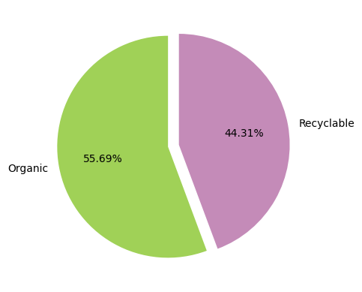
Screenshot of Output:
- Screenshot 1:
Pie chart showing the distribution of organic and recyclable waste in the dataset.
Pie Chart – Dataset Distribution
This chart represents the distribution of waste categories in the dataset.
The 55.69% of the data consists of organic waste, while 44.31% consists of recyclable waste.
The color-coded segmentation helps visualize the balance of categories in the dataset.
This distribution ensures the dataset is well-balanced for training an accurate CNN model.

Slide 13
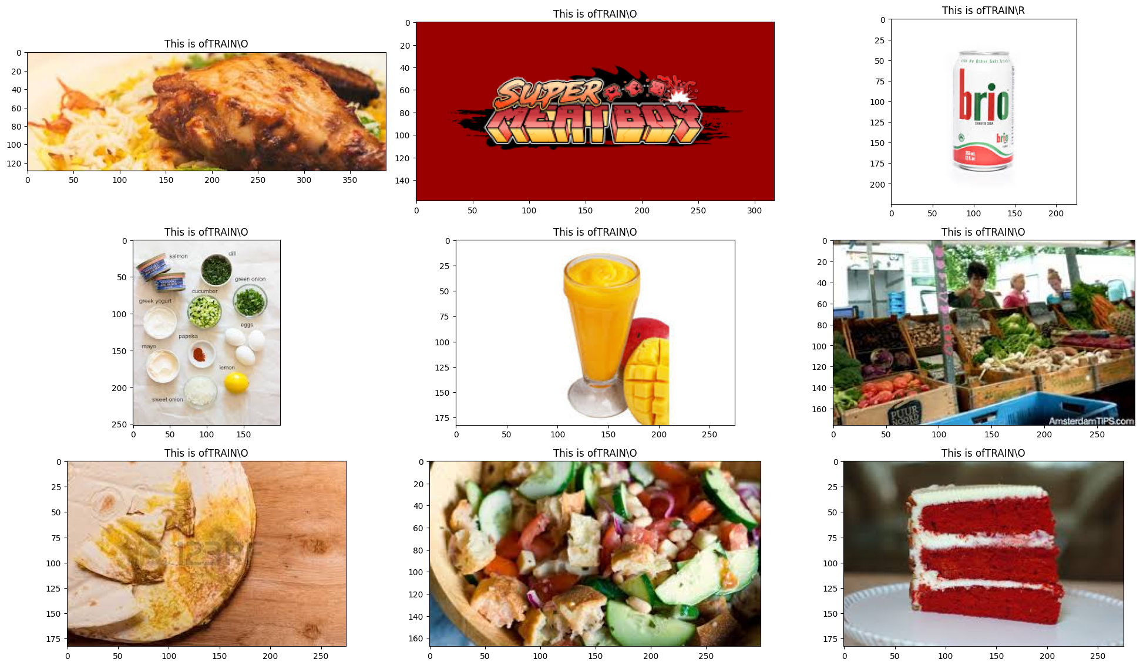
Screenshot of Output:
- Screenshot 2:
Sample images from the dataset (organic and recyclable waste).
Sample Images from the Dataset
This output displays a grid of images from the dataset, categorized into organic (O) and recyclable (R) waste.
Each image is labeled based on its category to verify dataset correctness.
Examples of organic waste: food items, vegetables, drinks.
Examples of recyclable waste: cans, plastic bottles.
This step helps ensure the model learns meaningful features from different types of waste.

Slide 14
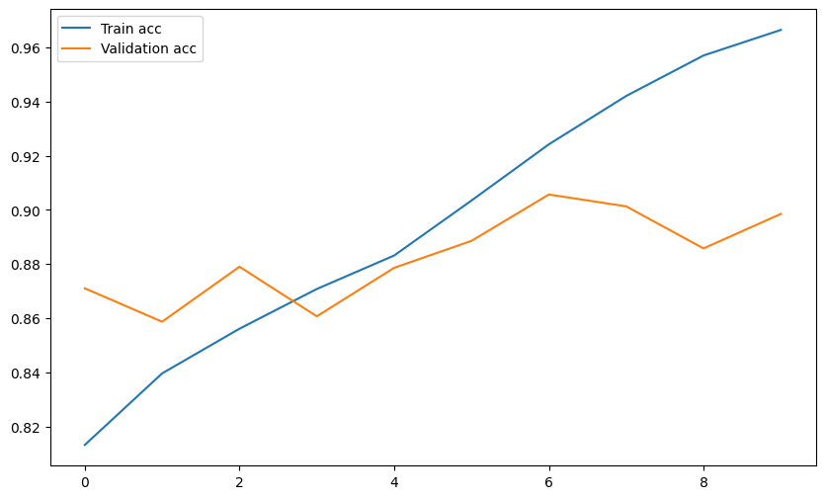
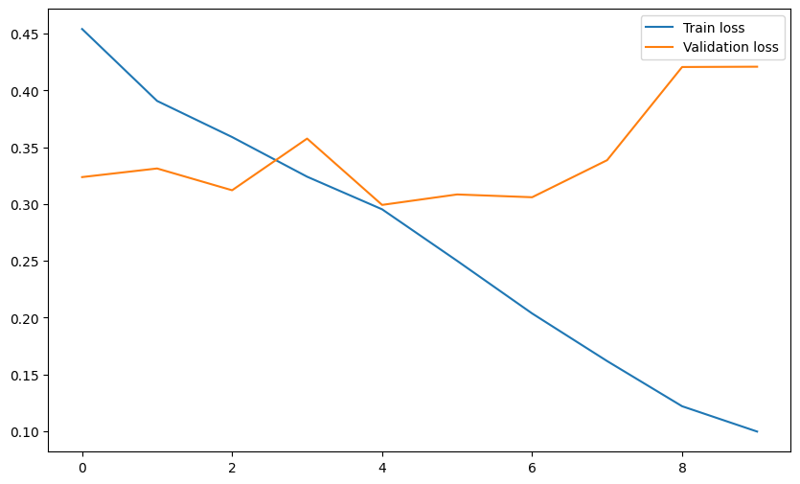
Screenshot of Output:
A. ACCURACY:
- Screenshot 3:
Accuracy and loss plots during training.
Training Accuracy & Loss Plots
The accuracy plot shows how the model improves over epochs, with training accuracy reaching nearly 96% and validation accuracy stabilizing.
The loss plot shows the reduction in error over time, but the validation loss slightly increases at later epochs, which may indicate some overfitting.
These graphs help in assessing the model’s learning curve and optimizing hyperparameters if needed.
B. LOSS:

Slide 15
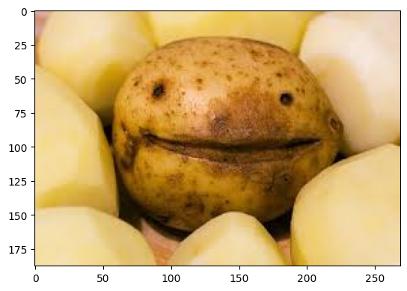
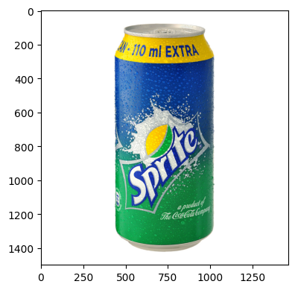
- Screenshot 4:
Prediction results on test images
(e.g., "The image shown is Organic Waste").
Predictions on Test Images
The model is tested on new waste images to classify them as organic or recyclable.
The predicted outputs are displayed alongside the images.
Example:
A potato image might be classified as organic waste.
A Sprite can is correctly classified as recyclable waste.
This step validates how well the trained CNN model generalizes to unseen data.

Slide 16
Conclusion:
Key Takeaways:
☑ The CNN model effectively classified waste into organic and recyclable categories based on image inputs. The model successfully learned distinguishing features, enabling accurate waste identification.
☑ The model achieved high accuracy, as seen from the training and validation results. However, minor overfitting was observed, which can be improved with data augmentation, regularization techniques, or hyperparameter tuning.
☑This AI-powered solution can be integrated into smart waste management systems to assist in automating waste segregation, reducing manual efforts, and improving recycling efficiency.

Slide 17
Conclusion:
Future Work:
🚀 Web Deployment:
To make the model more accessible, it can be deployed as a web application using Streamlit or Flask, allowing users to upload waste images for instant classification.
📈 Dataset Expansion:
The current dataset includes only organic and recyclable waste. Expanding it to include more waste categories like plastic, metal, glass, and hazardous waste can improve real-world applicability.
🛠 Model Optimization:
Future improvements can focus on transfer learning with pre-trained models (ResNet, VGG16), fine-tuning CNN layers, and using more advanced architectures for better accuracy.
♻ Integration with IoT & Edge Devices:
The model can be embedded into smart bins with cameras to automate waste sorting in urban waste management and industrial recycling plants.

Slide 18
CONCLUSION
Real-World Applications & Impact 🌍 ♻️
How This Project Can Make a Difference:
✅ Smart Waste Bins: Implement the model in AI-powered bins that automatically classify and separate waste in public places, offices, and households.
✅ Recycling Centers & Waste Management Plants: The AI system can assist in automating waste sorting at municipal waste plants, improving efficiency and reducing manual labor.
✅ Sustainability & Environmental Benefits: Proper waste classification leads to better recycling, reduces landfill waste, and helps in environmental conservation.
✅ Smart City Integration: The model can be integrated into smart city waste management systems to enhance urban waste handling and reduce pollution.
🚀 Future Vision: With continuous improvements, this project can evolve into a fully automated waste sorting system that contributes to global sustainability efforts.

Slide 19
💡 "Small actions, big impact – AI for a cleaner planet!" 🌍 ♻️
📌 Project By : Shamshad Mutala
📌 Mentorship/Team (if applicable) : Raghunandan M S
🔗 For Questions & Discussions : Gmail ID , Linked in
Let's innovate for a sustainable future!
THANK YOU!! 🙏

