Slide 1
Chat Application
蔡杰超 2230026003
张哲睿 2230026218
单佳影 2230026230
丁书萱 2230026232

Slide 2
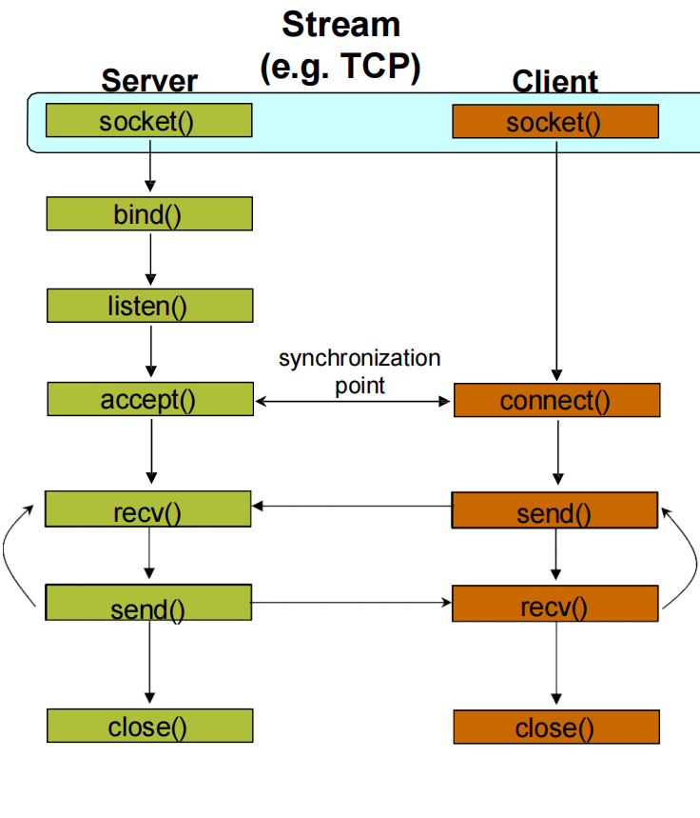

Client-Server Communication

Slide 4


Slide 5
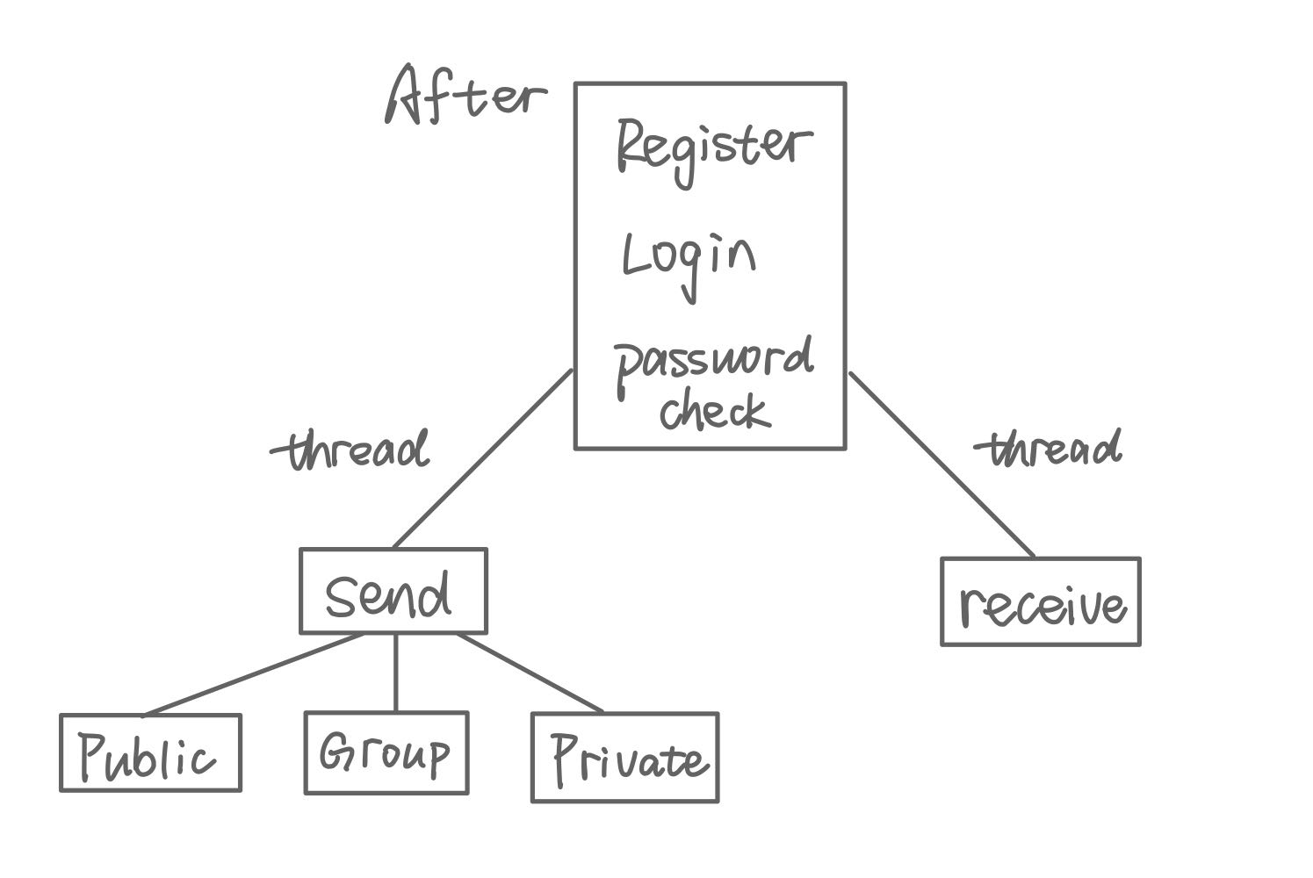
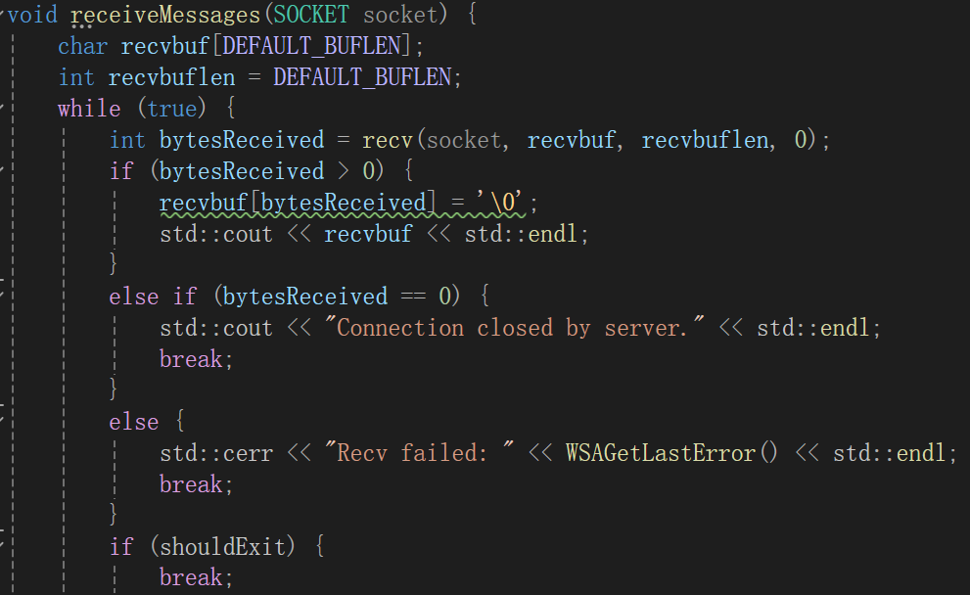
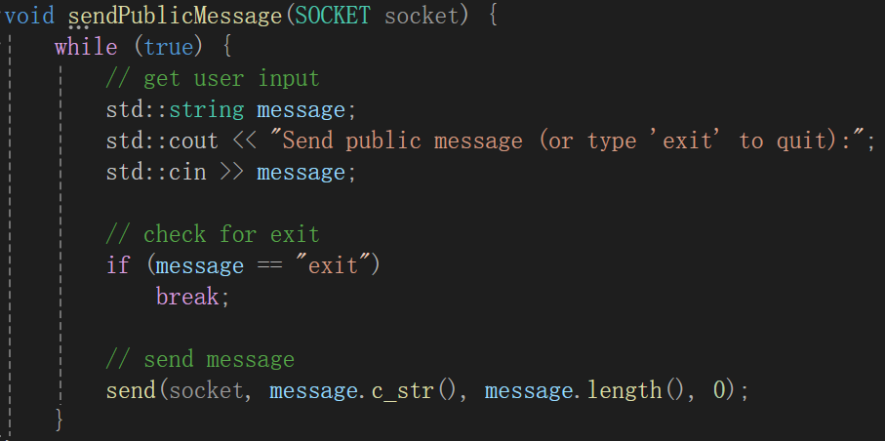
Client

Slide 6
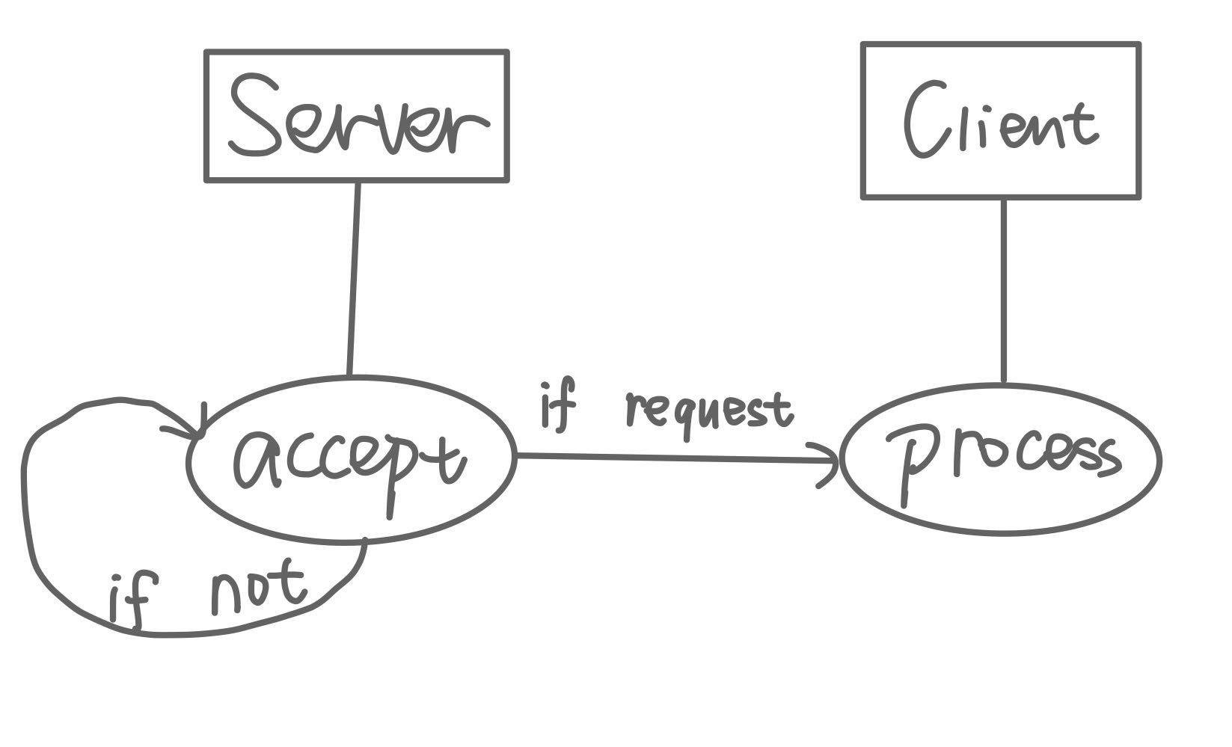


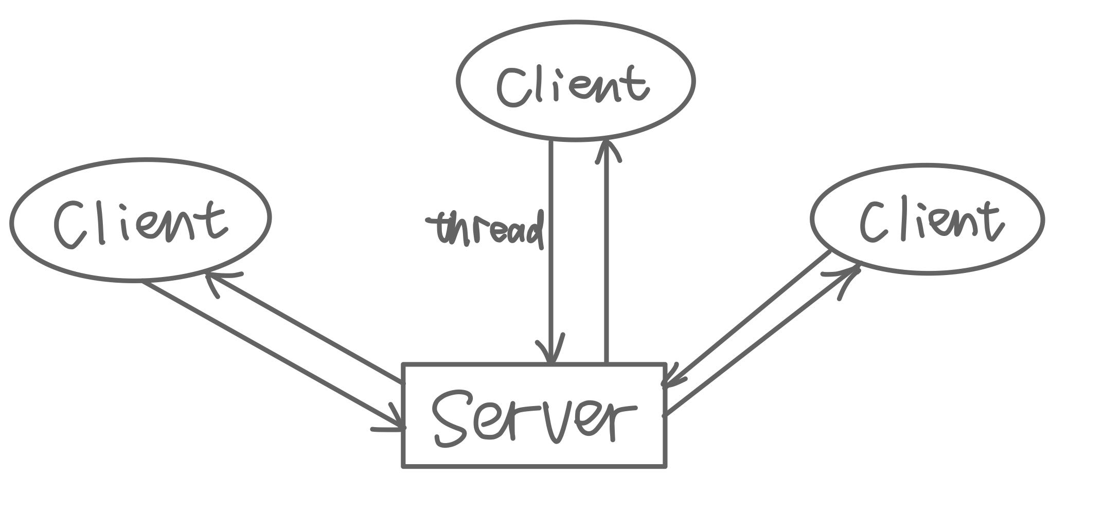
Server.cpp
Client.cpp

Slide 7
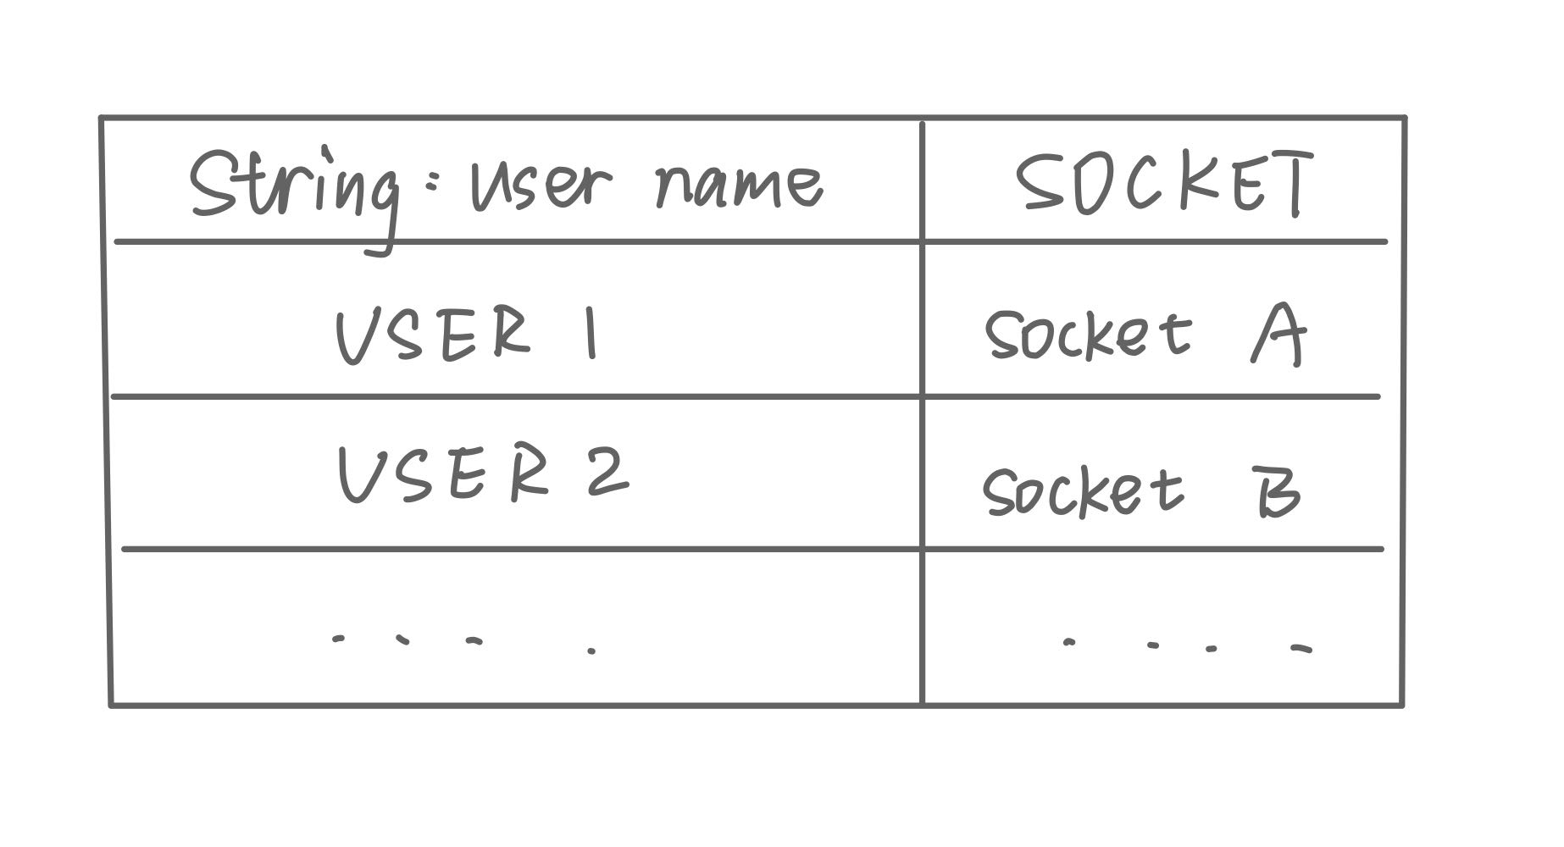


How to find Socket and send any type message
Automatic update thread
Map:
Group:
After login MAP it

Slide 8
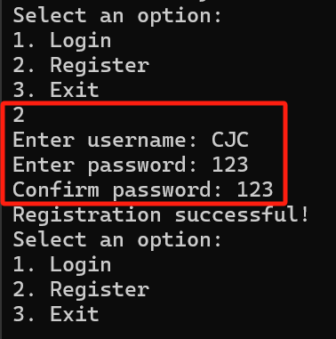
Register&Password Check

Slide 9
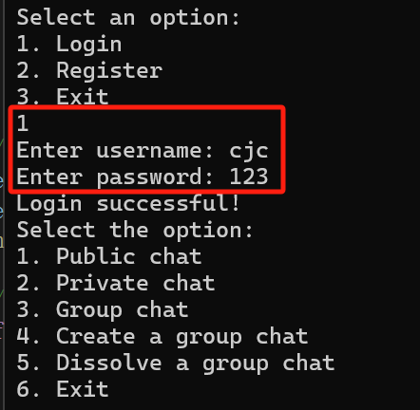
Login

Slide 10
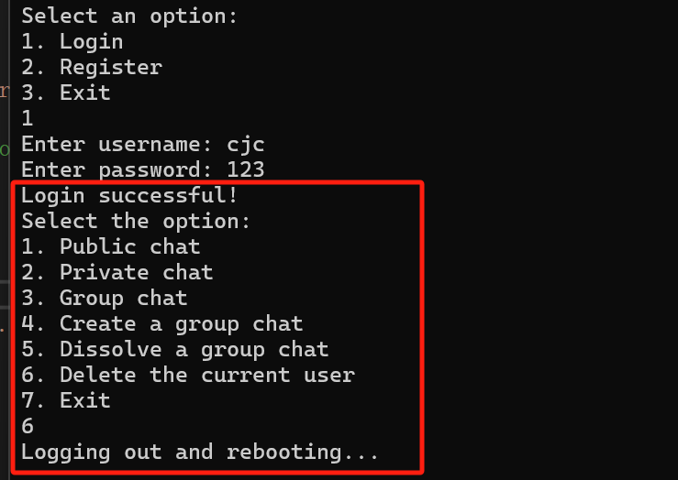
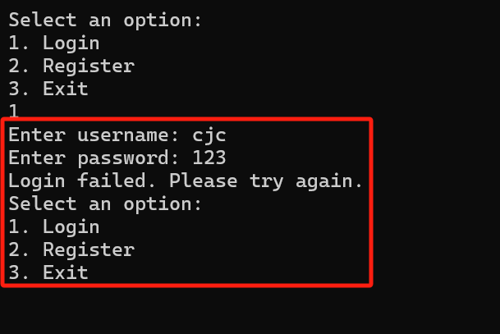
Delete User

Slide 11

Public Chat

Slide 12
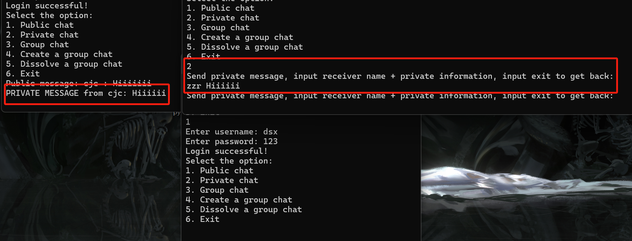
Private Chat
No Private Chat displayed

Slide 13
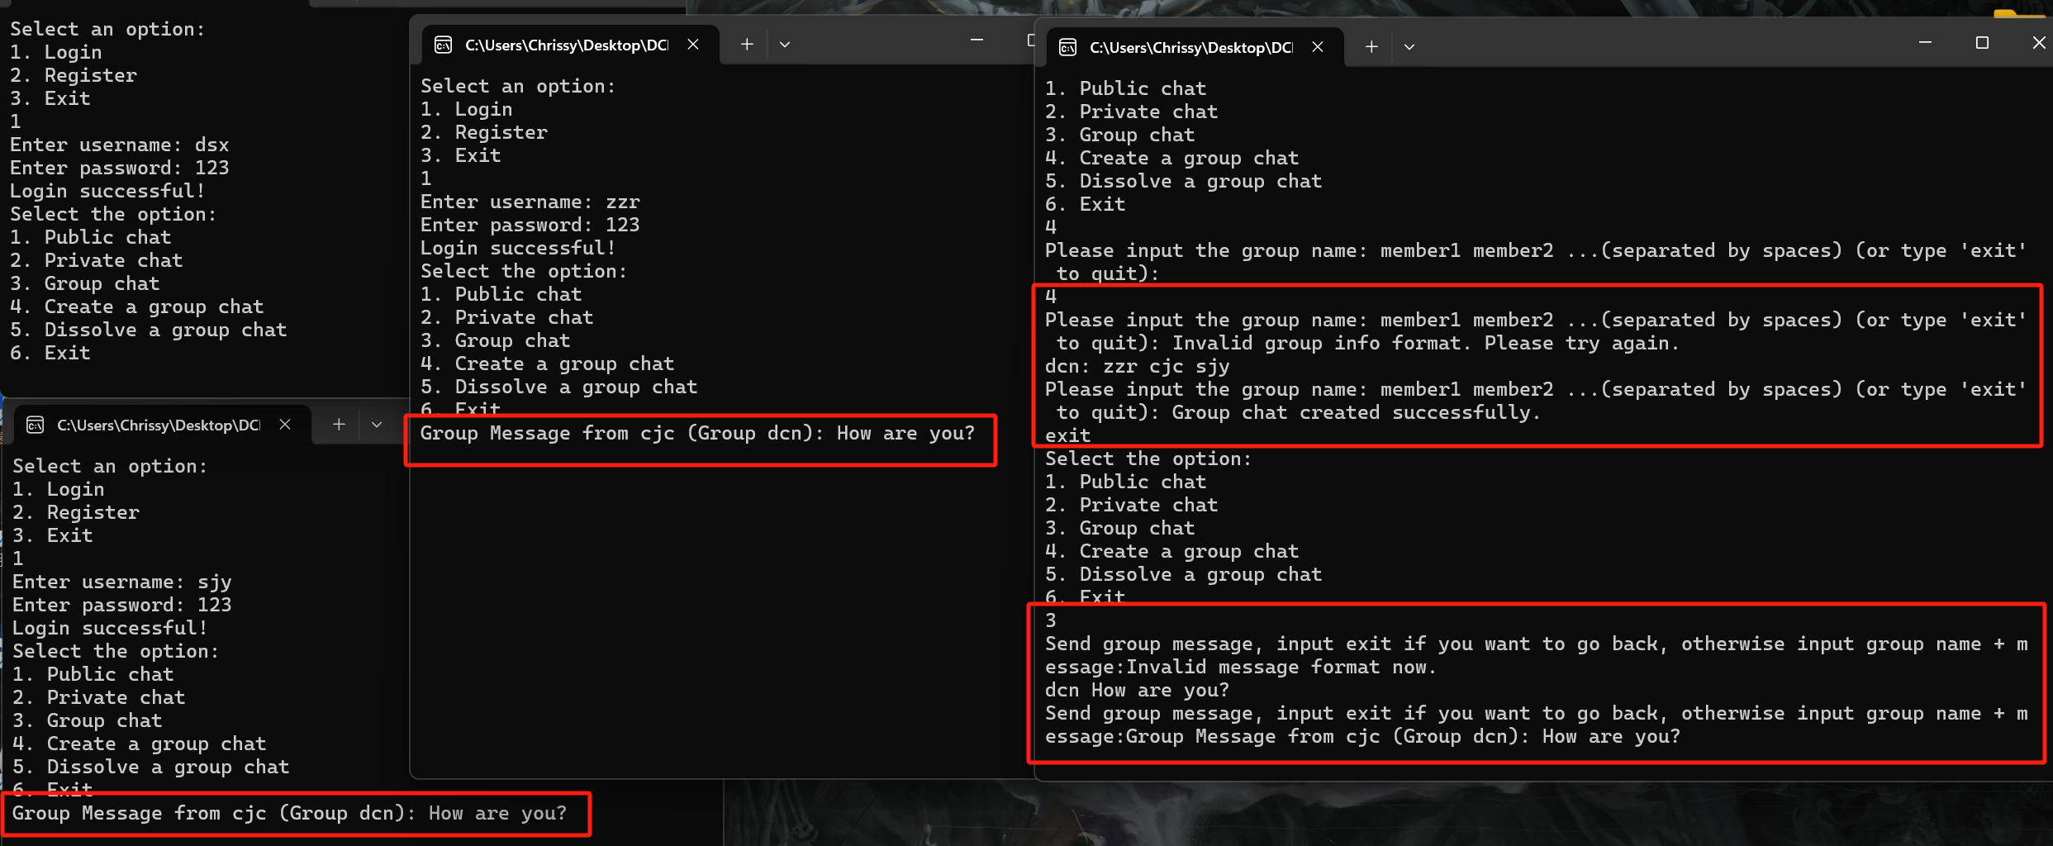
Group Chat
No Group Chat displayed

Slide 14
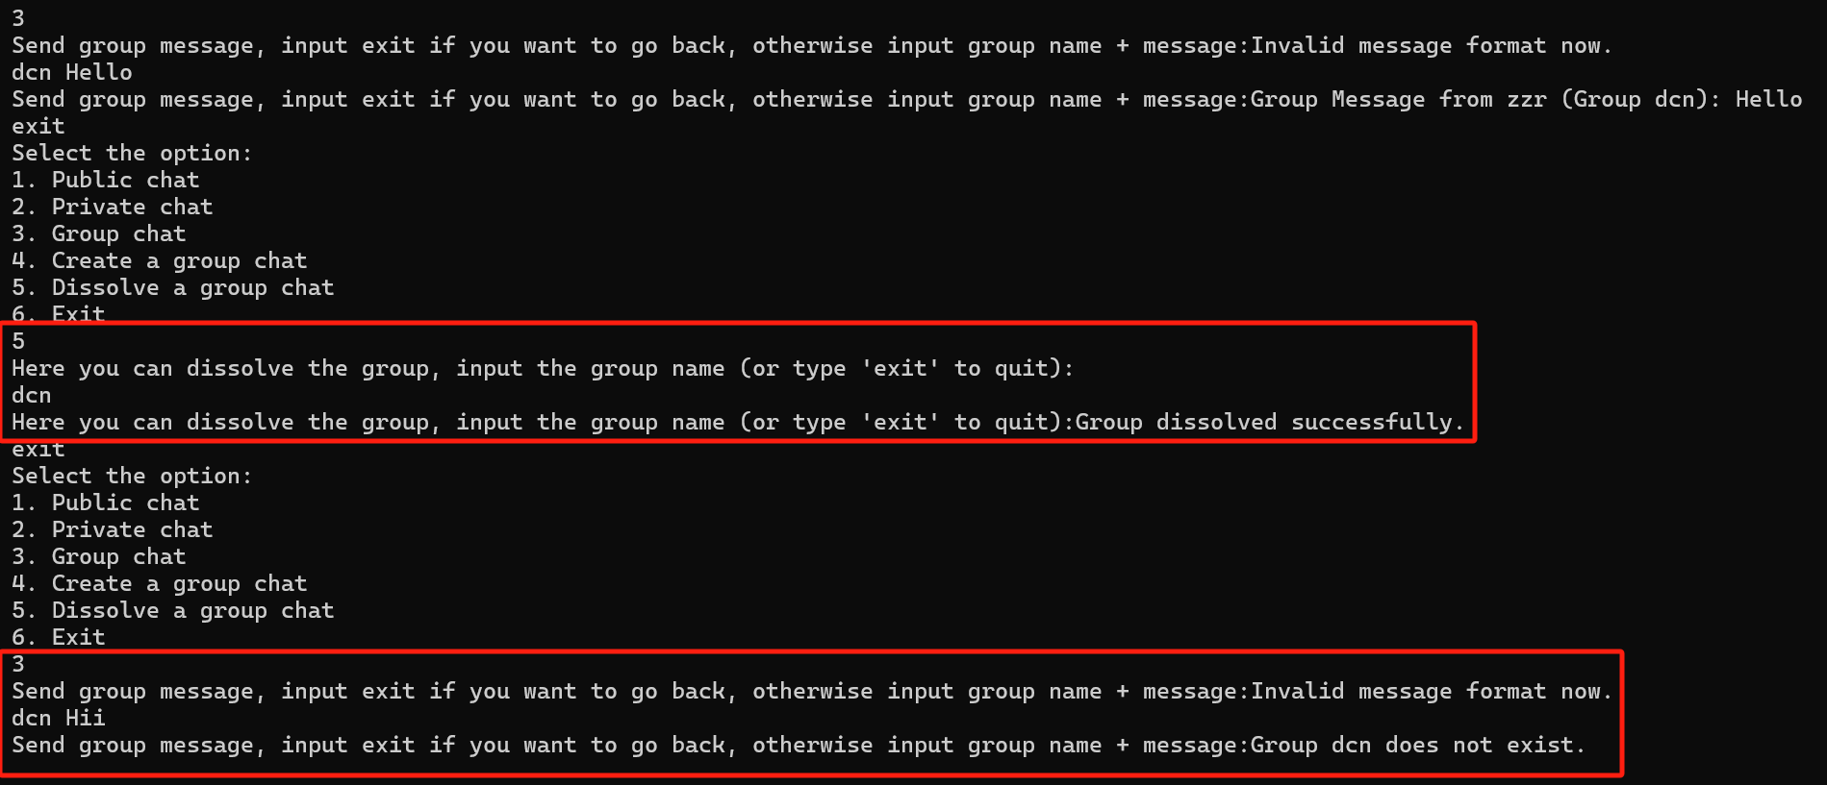
Dissolve a Group Chat

Slide 15
Demonstration

