Slide 1
Problem Statement

Slide 2
Approach and Methodology
Step 1: Understand the Dataset
Load the Data:
Import the necessary libraries (e.g., pandas, numpy, matplotlib, seaborn).
Load the dataset into a pandas DataFrame.
Display the first few rows to get an initial understanding of the data.
Inspect Data Structure:
Check the data types of each column.
Get summary statistics using df.describe() for numerical columns and df.info() for a concise summary.
Step 2: Data Cleaning
Handle Missing Values:
Identify columns with missing values and their proportion.
Decide on strategies to handle missing values (e.g., imputation, removal).
Handle Outliers:
Use box plots or z-scores to detect outliers.
Decide whether to remove, transform, or cap outliers.
Correct Data Types:
Ensure categorical variables are correctly set as 'category' type.
Convert date columns to datetime type if necessary.

Slide 3
Step 3: Univariate Analysis
Numerical Variables:
Plot histograms and box plots to understand the distribution.
Categorical Variables:
Plot bar charts to visualize the frequency distribution.
Calculate the mode and count the unique categories.
Step 4: Bivariate Analysis
Numerical vs. Numerical:
Use scatter plots and correlation matrices (heatmaps) to identify relationships.
Categorical vs. Numerical:
Use box plots, violin plots, and bar plots to compare numerical data across categories.
Categorical vs. Categorical:
Use count plots, stacked bar charts, and contingency tables.
Step 5: Multivariate Analysis
Heatmaps:
Create heatmaps to show correlation between numerical variables.

Slide 4
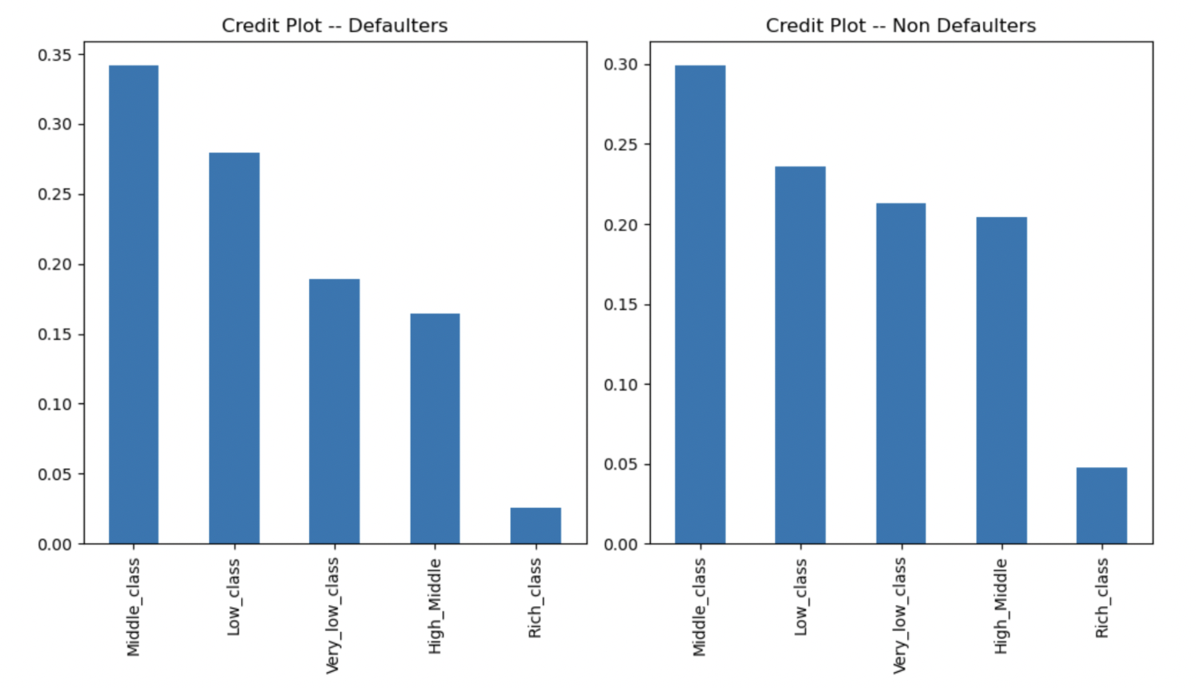
Univariate Analysis
We can infer that Middle class and Low class peoples are more likely to default compared to very low class and high middle class.

Slide 5
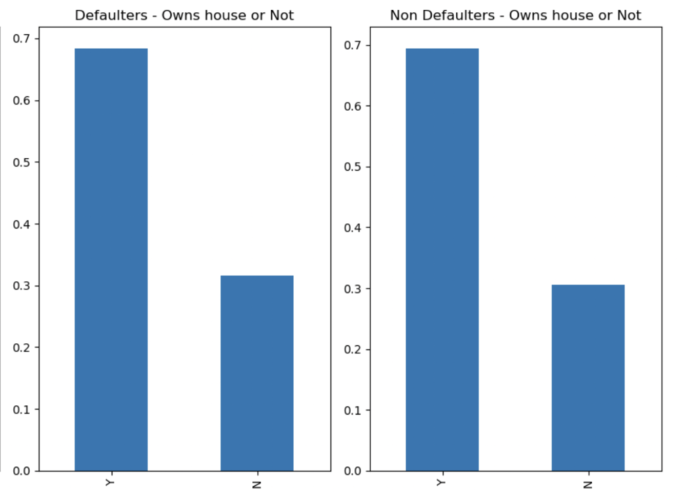
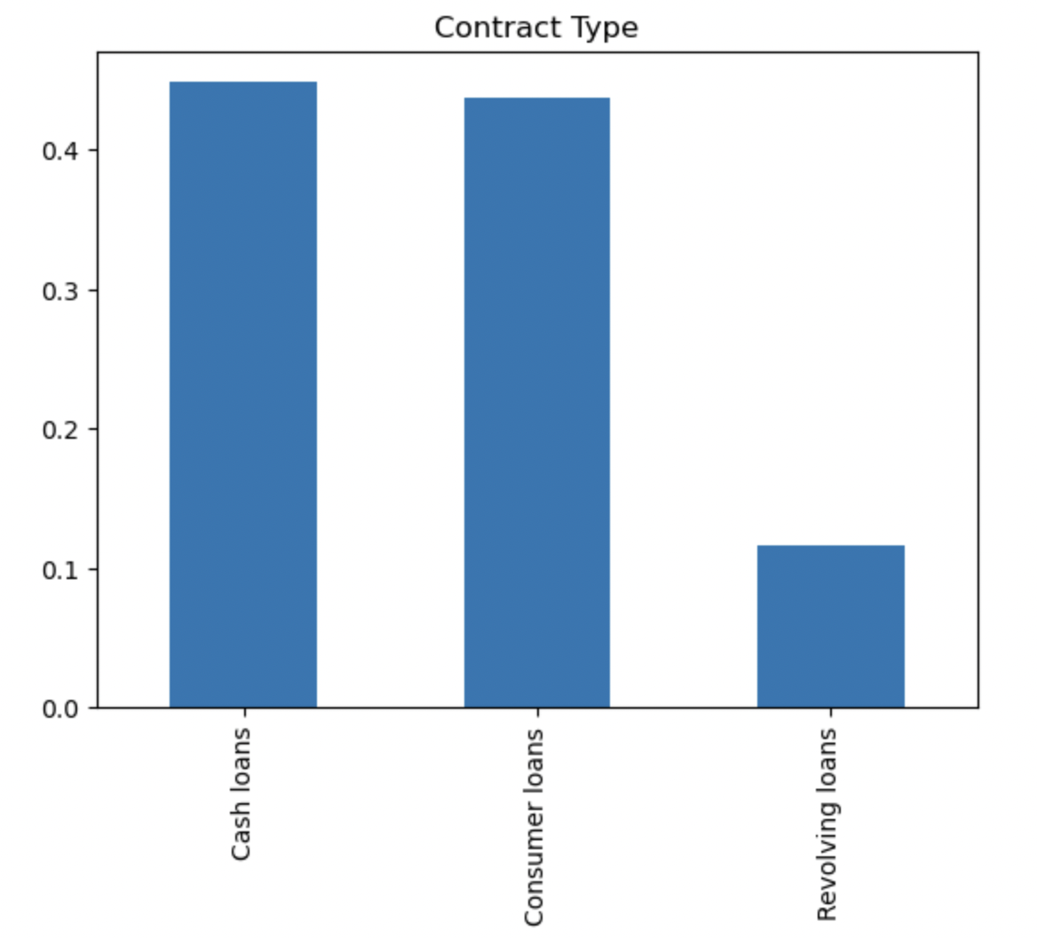
Total :
Y - 0.69 * 307508 = 212181
N - 0.31 * 307508 = 95327
Defaulters:
Y - 0.68 * 24825 = 16881
N - 0.32 * 24825 = 7944
Non Defaulters:
Y - 0.69 * 282683 = 195051
N - 0.31 * 282683 = 87632
we can conclude that the people who owns the houses are more likely to take loan and the default rate for people who doesn't own house(8.3%) is higher than the default rate for people who owns the house(7.9%)
Approximately 43% and 44% the loans taken are Cash loans and consumer loans

Slide 6
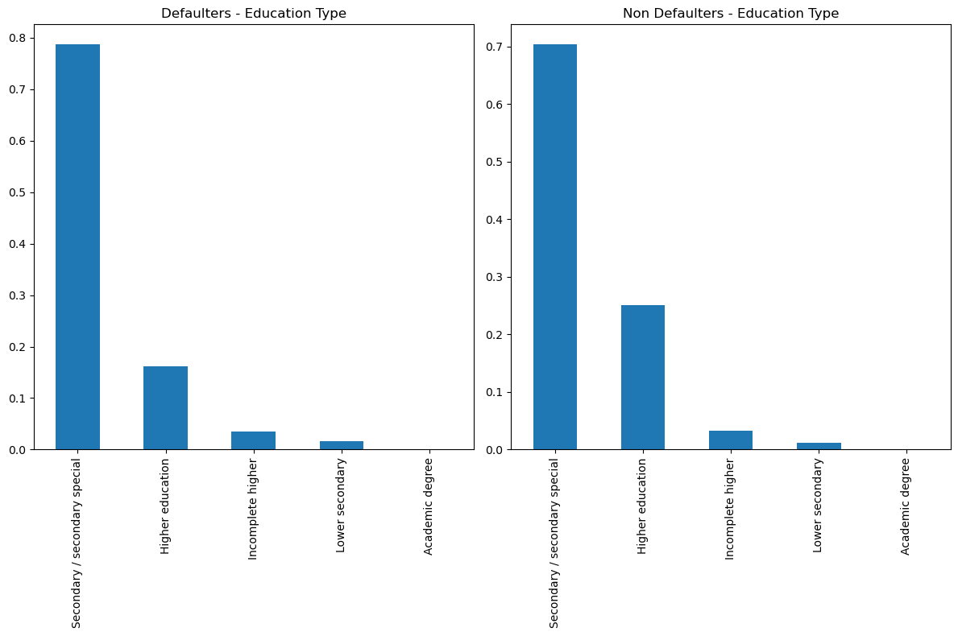
We can conclude that the people who's education type is 'Secondary/secondary special' is more likely to take a loan
We can infer that people who's education type is 'Secondary/secondary special' has higher default rate(8.79%)

Slide 7
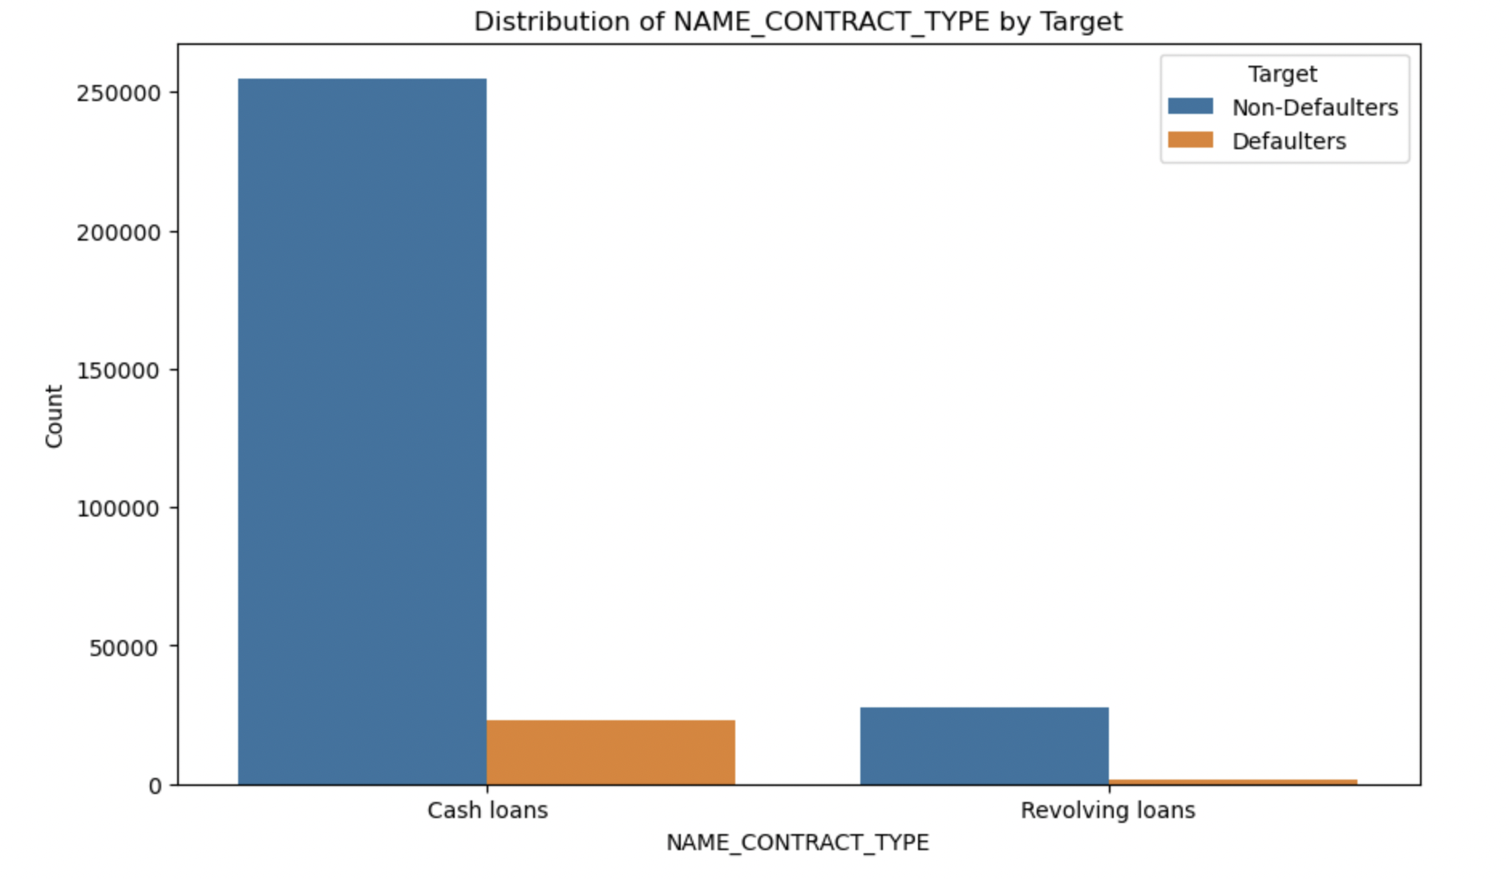
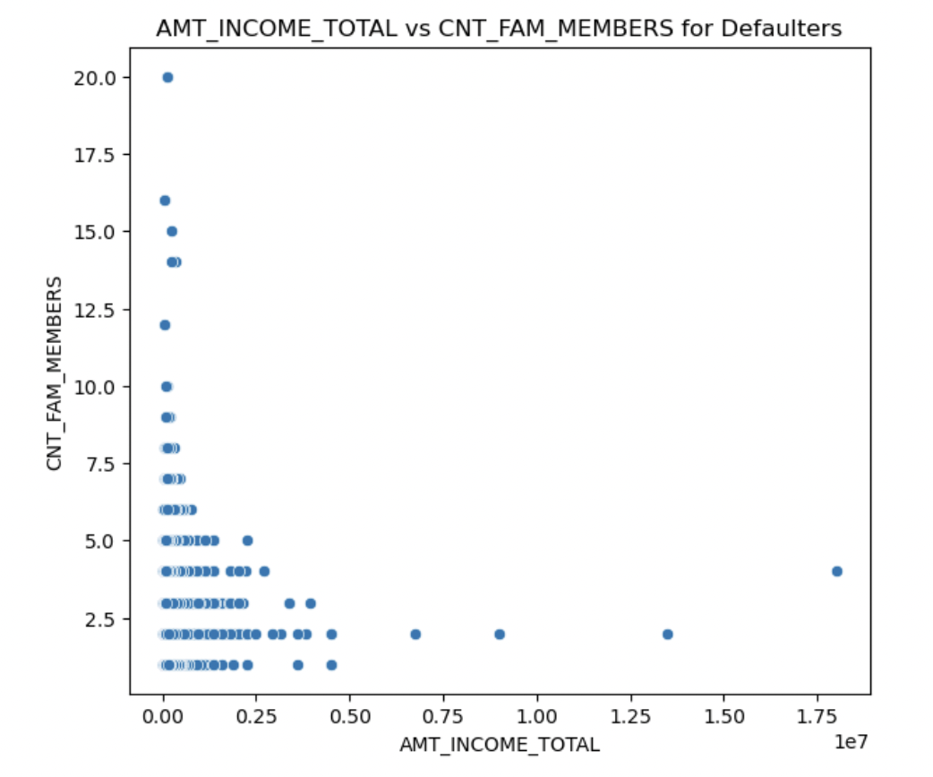
Bivariate Analysis
We can gain insights that default rate of people taking cash loans is higher. People taking cash loans is much higher than the people taking Revolving loans
We can infer that the person with minimum annual income and family count upto 5 tends to default more compared to people with higher income. This insight can be gained by looking at the concentration level on the left side of Defaulters plot

Slide 8
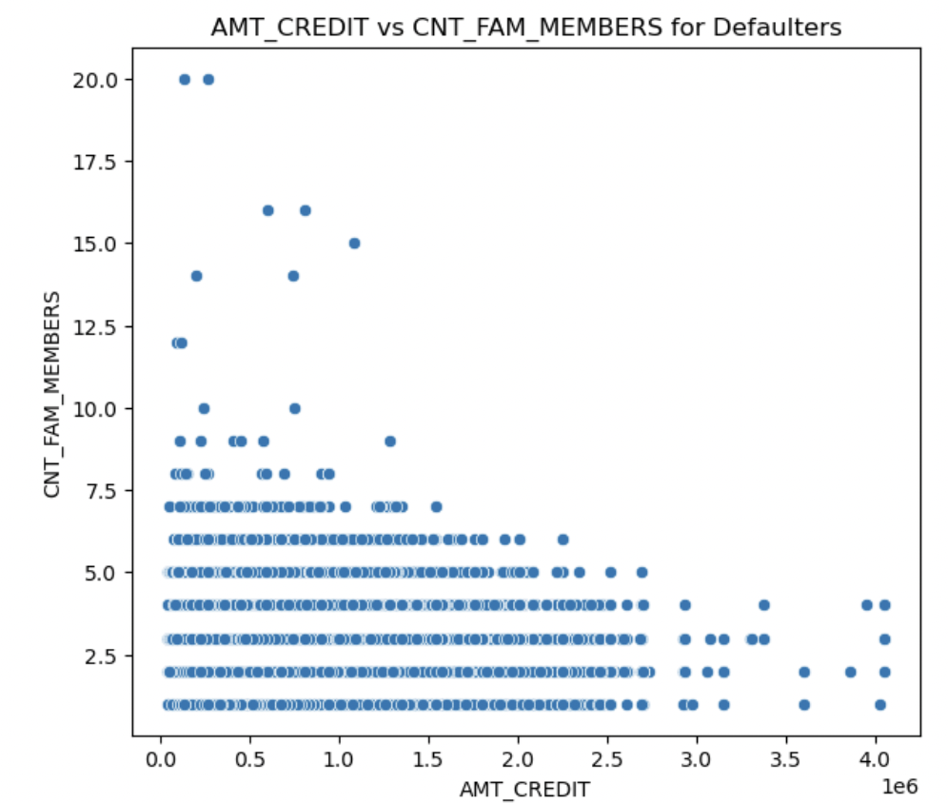
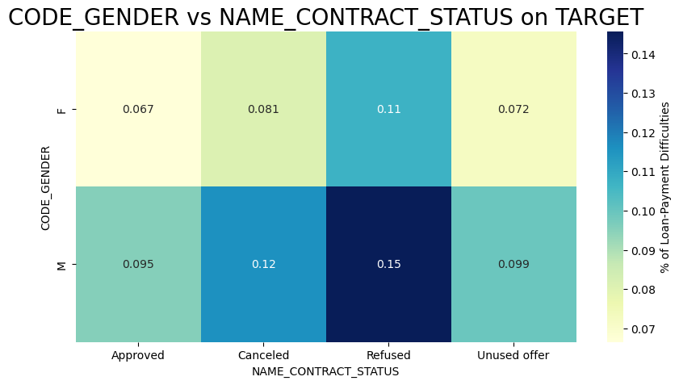
Most loans are concentrated in the lower credit amount range, regardless of family size.
Larger family sizes (beyond 10 members) are more frequently associated with defaulters, suggesting that larger families might have higher financial stress leading to defaults.
We can infer that most of the application Canceled and refused belongs to Male
From this we can conclude that Males have more default rate than females

Slide 9
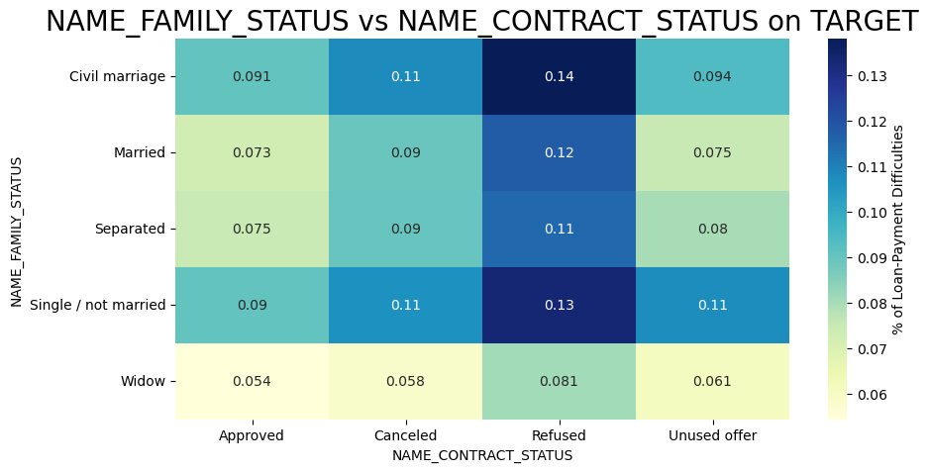
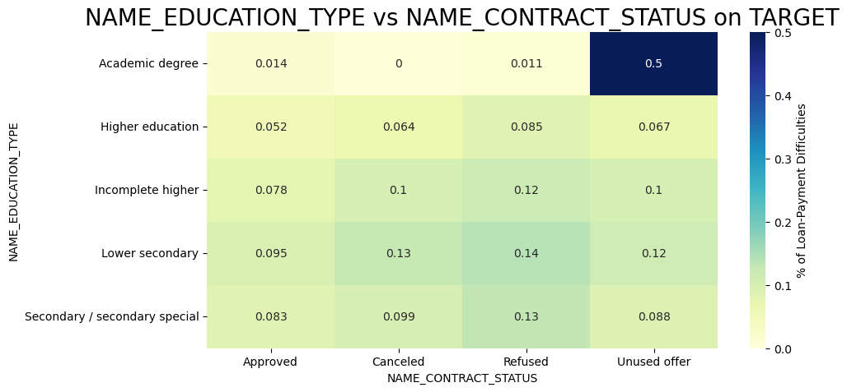
We can visualize that the percentage of Defaulters is high for Civil marriage and Single/not married
Academic Degree Holder tends to have more unused offers
people with Lower secondary and Incomplete higher has more difficulties in repaying the loans

Slide 10
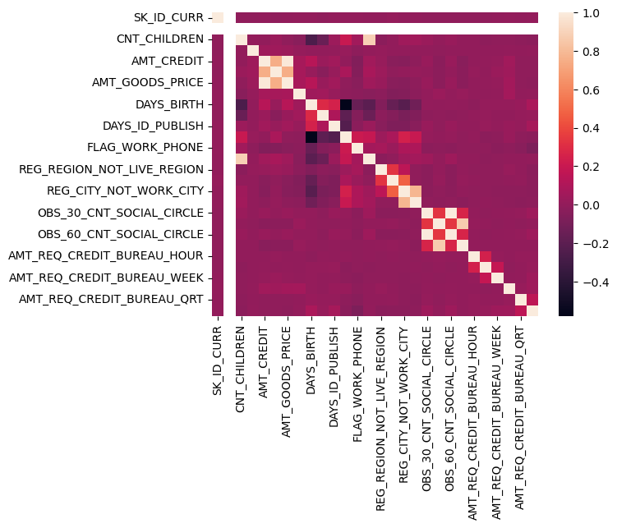
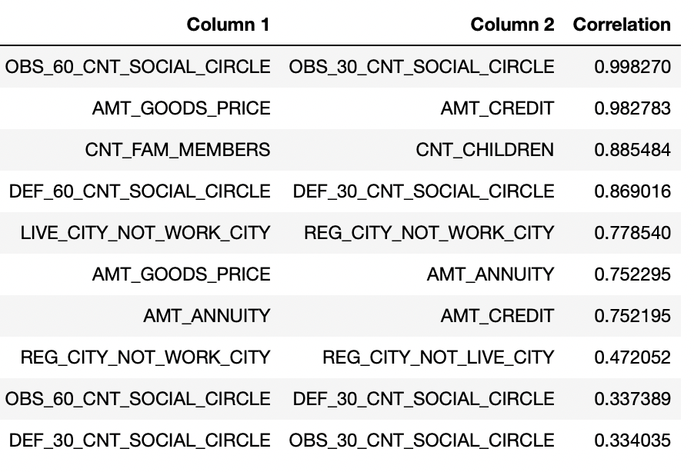
Multivariate Analysis
Top 10 correlations

Slide 11
Recommendation or conclusion
Socioeconomic Class and Default Risk:
Conclusion: Middle and low-class individuals exhibit a higher likelihood of loan default.
Home Ownership and Loan Default Rate:
Conclusion: Non-homeowners have a higher default rate (8.3%) compared to homeowners (7.9%), despite homeowners being more likely to take loans.
Loan Types and Default Rates:
Conclusion: Cash loans have a notably higher default rate compared to other loan types.
Education Level and Loan Behavior:
Conclusion: Individuals with 'Secondary/secondary special' education are the most likely to take loans and have the highest default rate (8.79%).
Income and Family Size:
Conclusion: Individuals with lower annual incomes and family sizes up to 5 members tend to default more. Larger family sizes (beyond 10 members) are also associated with higher default rates, indicating financial stress.

Slide 12
Loan Amount Distribution:
Conclusion: Most loans are concentrated in the lower credit amount range, irrespective of family size.
Gender and Loan Applications:
Conclusion: Males are more likely to have their loan applications canceled or refused and have a higher default rate compared to females.
Marital Status and Default Rates:
Conclusion: Individuals in civil marriages and those who are single/not married have a higher percentage of defaults.
Academic Background and Loan Performance:
Conclusion: People with lower secondary and incomplete higher education levels face more difficulties in repaying loans, while academic degree holders tend to have more unused offers.

