Slide 1
Metropolitan Bus Express
Real Time Traffic Suggesting App

Slide 2
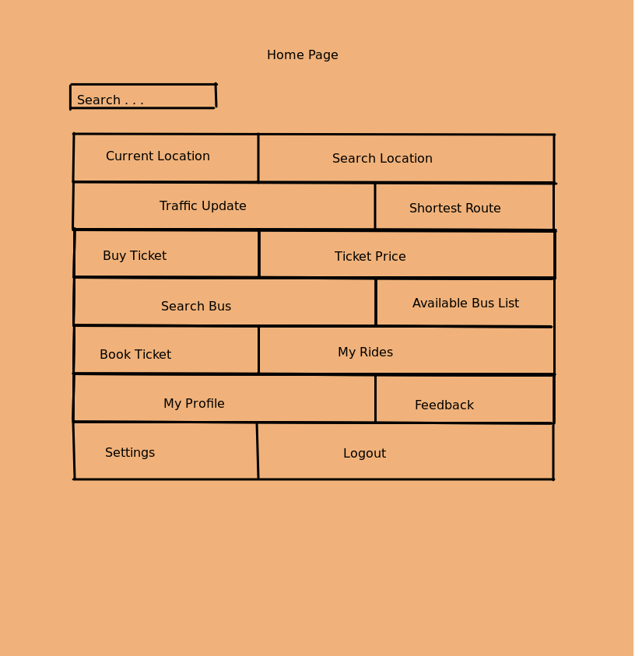
Introduction
Dhaka is the most densely populated city among all the cities of Bangladesh. Since inside the city to move from one place to another is very usual, for this purpose as well as being the cheapest way to travel the city buses are most popular. But most of the time general people who are new in the city as passengers face some difficulties when travelling in the city buses. The purpose of this document is to build a mobile application to give information of local city buses to ease the journey.

Slide 3
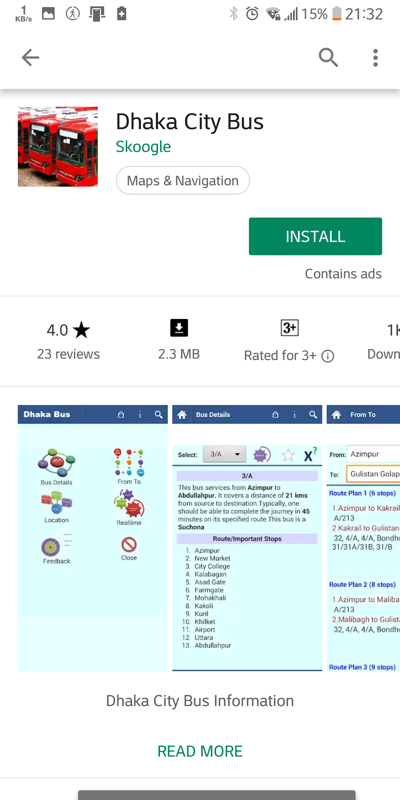

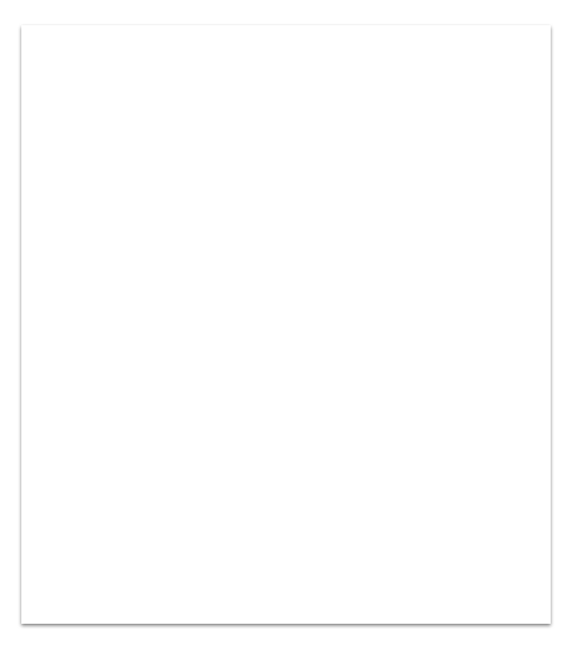
Current Product:
Here is one existing product example.
Tip
If one example isn’t sufficient to help people understand the breadth of your idea, pick a couple of examples.
Source
In playstore Dhaka city bus
Story for illustration purposes only

Slide 4
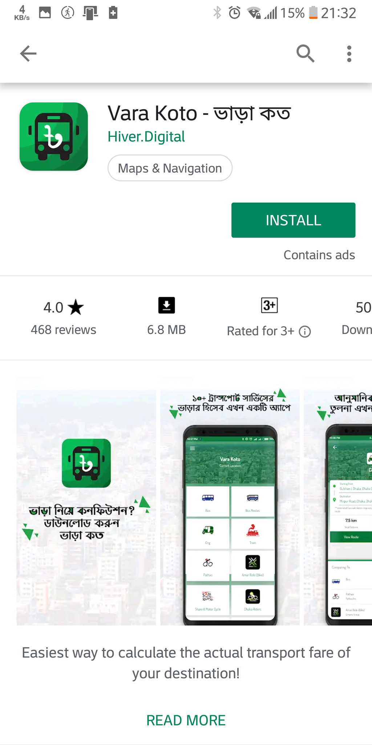
Current Product:
Another existing product example.
Tip
If one example isn’t sufficient to help people understand the breadth of your idea, pick a couple of examples.
Source
In playstore Vara Koto
Story for illustration purposes only

Slide 5
What improvement ?
We are offering a complete solution for all this hassle.
Allows the users to create their accounts .
Viewing available buses for particular route.
Bus Type.
Bus Fare.
Real-time road condition.
Save used route.
Location sharing.

Slide 6
What improvement ?
Well-designed
Time to time information update

Slide 7
Functional Requirements.
The user shall be signed in to use the system .
User shall be triggered to bus information page after choosing route.
User shall get promotional offers with pop up notification at any time .
The server shall turn on private mode in the time of online payment gateway.
User shall use map service.
User shall get traffic update.
The system shall record user history.
System shall store information in database.

Slide 8
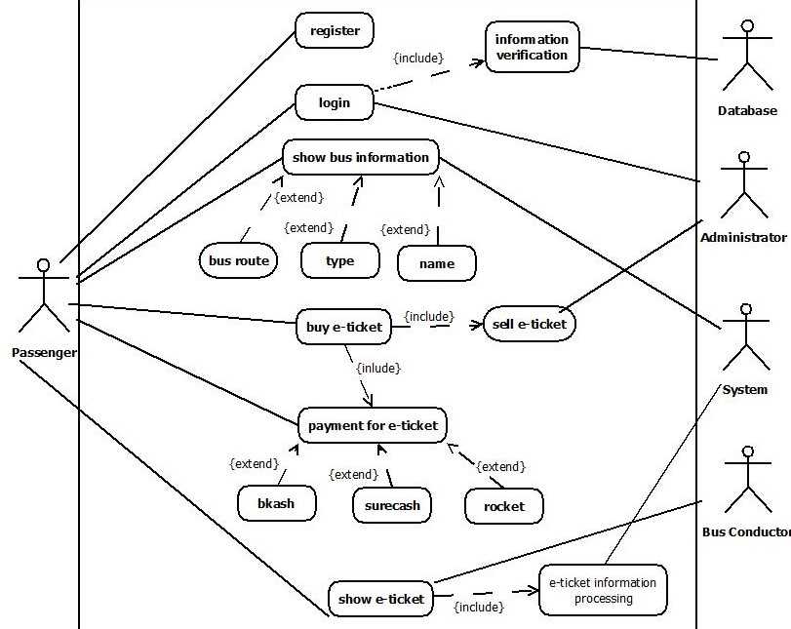
Use Case

Slide 9
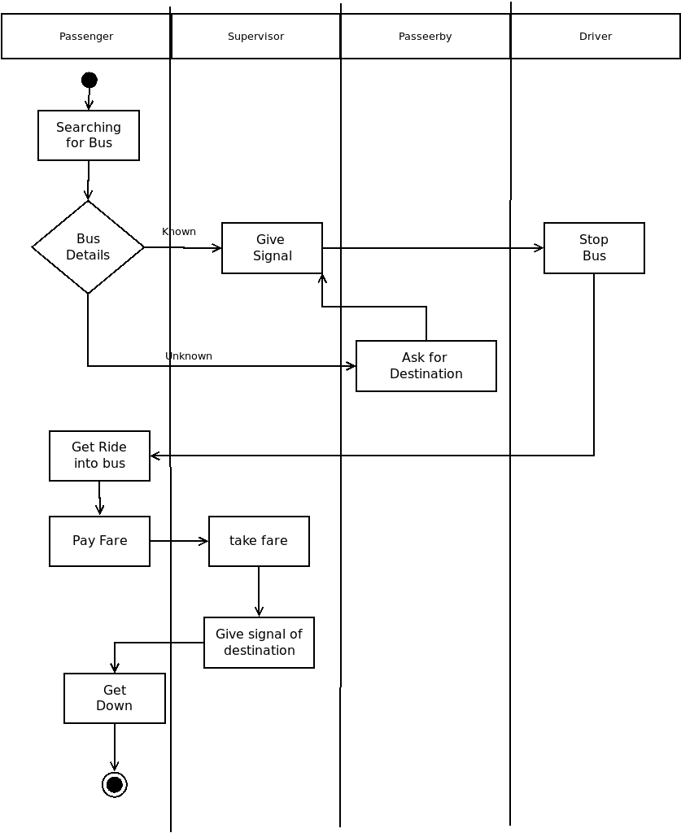
As-Is

Slide 10
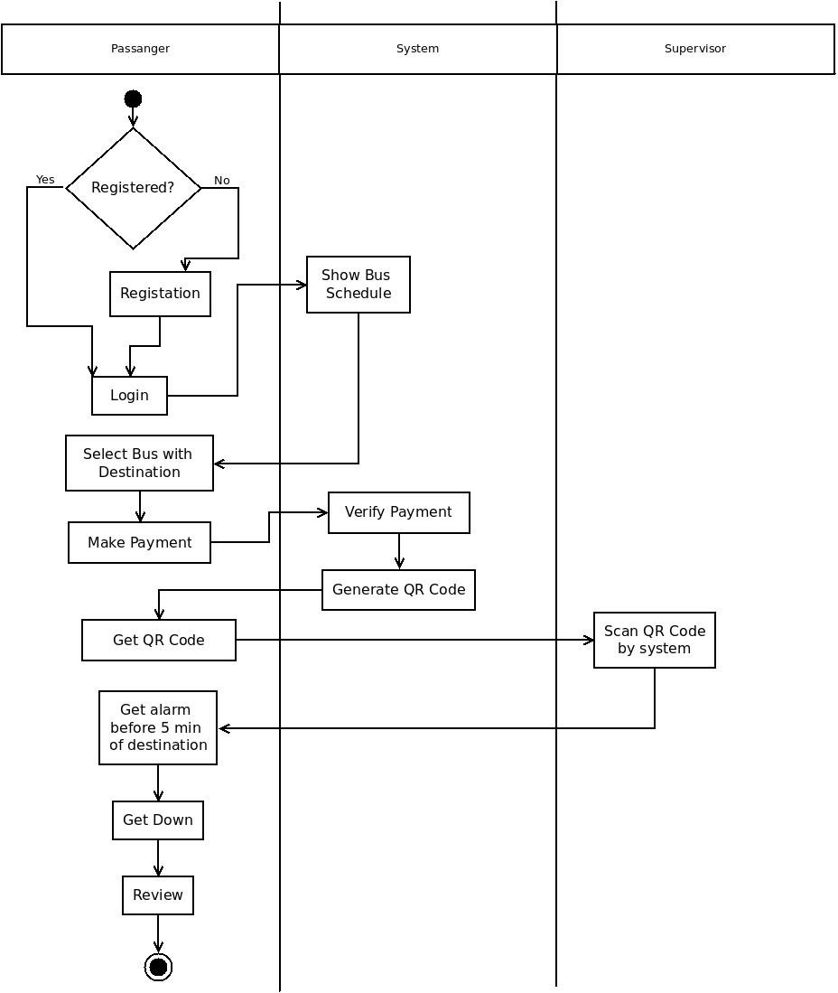
To-Be

Slide 11
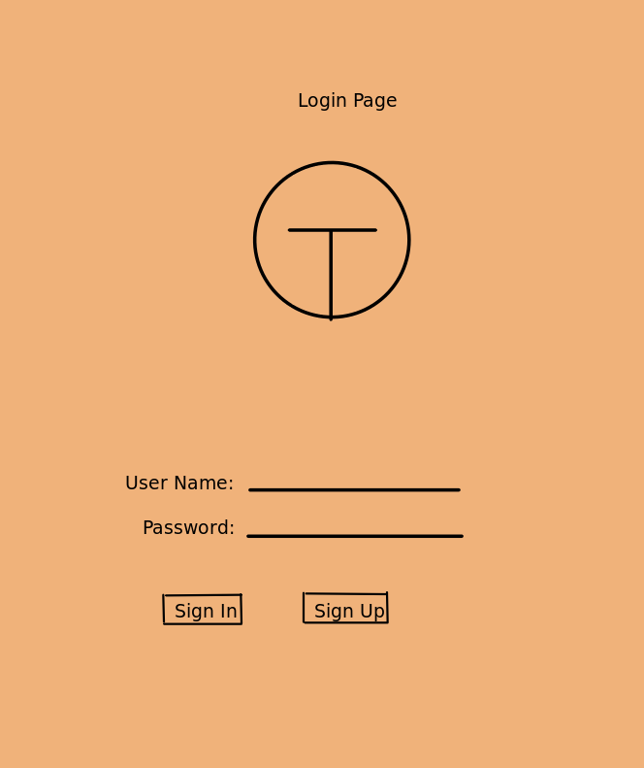
Prototypes
Login

Slide 12
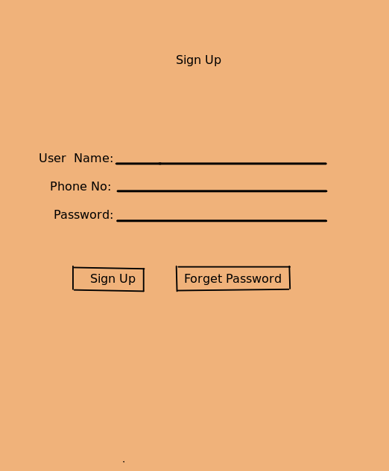
Prototypes
SignUp

Slide 13
Prototypes
HomePage

Slide 14
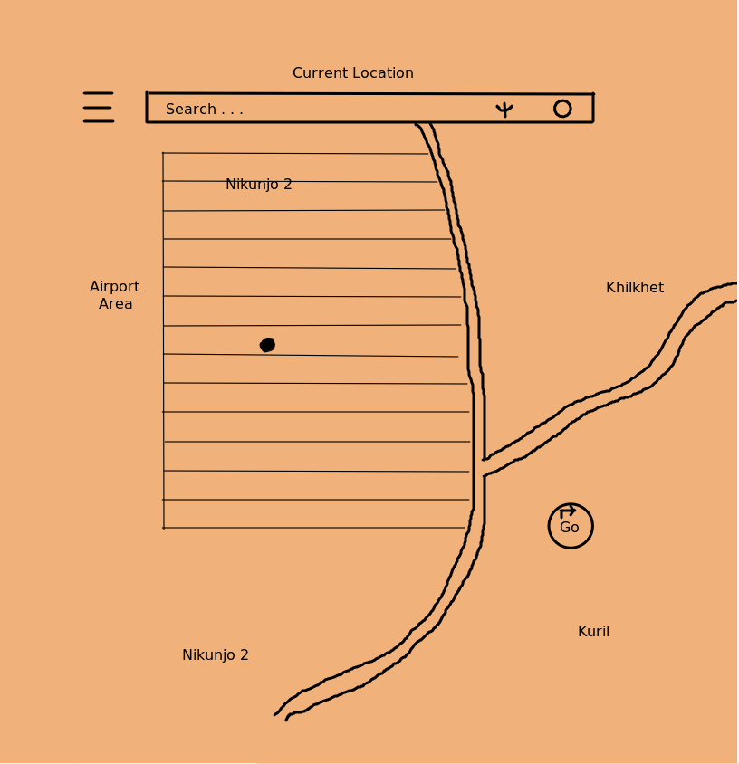
Prototypes
My Location

Slide 15
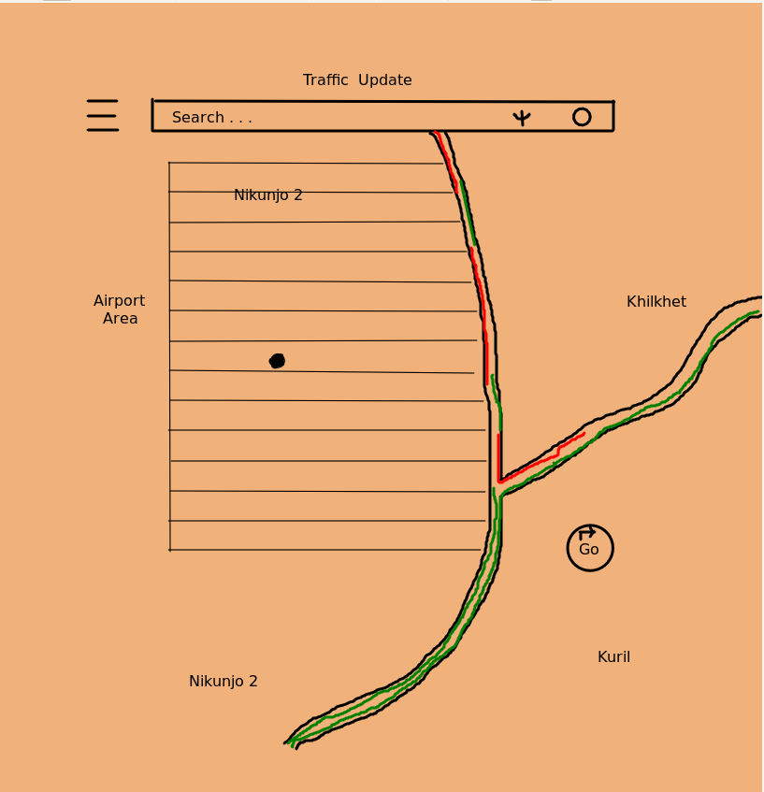
Prototypes
Traffic Update

Slide 16
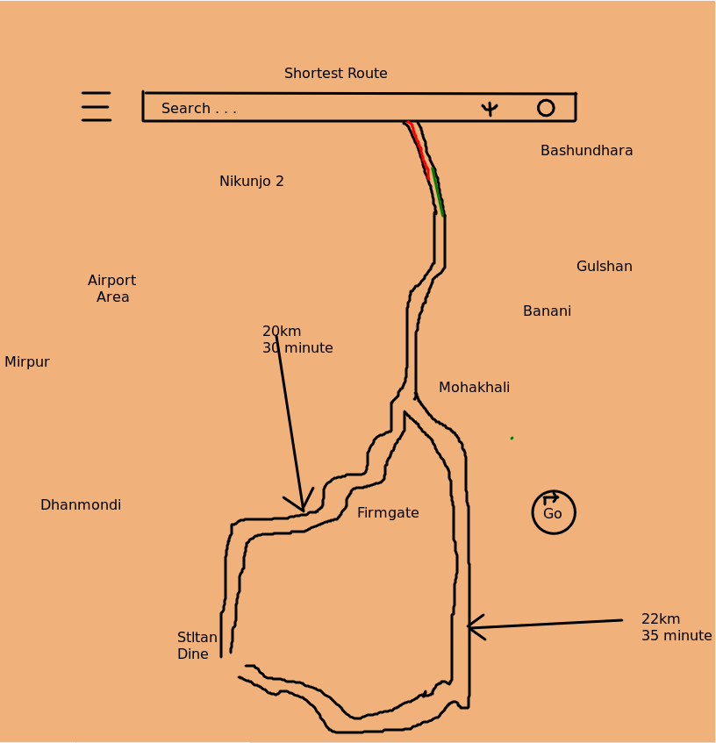
Prototypes
Shortest Route

Slide 17
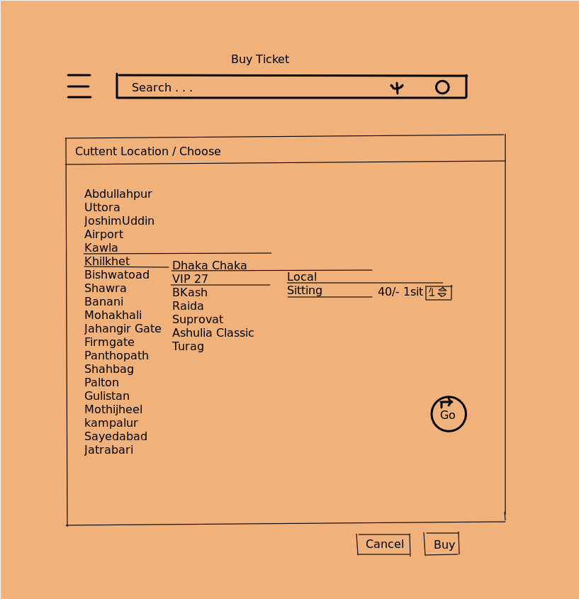
Prototypes
Buy Ticket

Slide 18
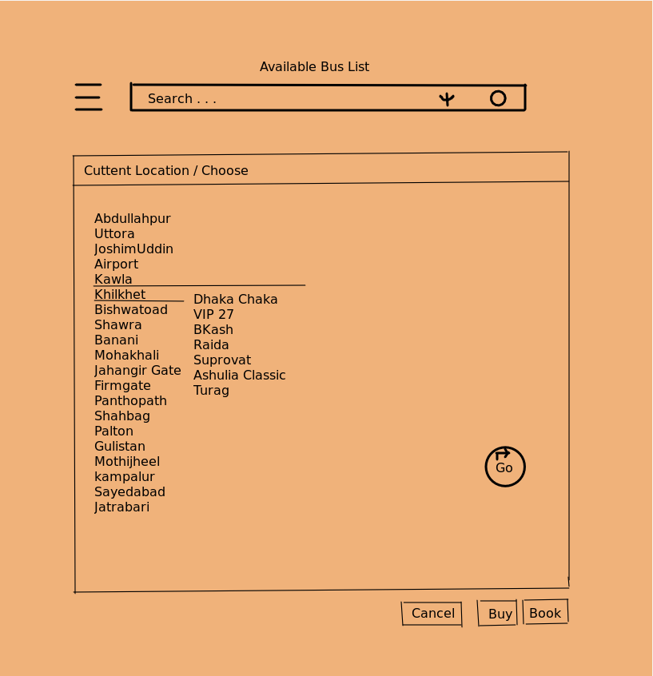
Prototypes
Available Bus

Slide 19
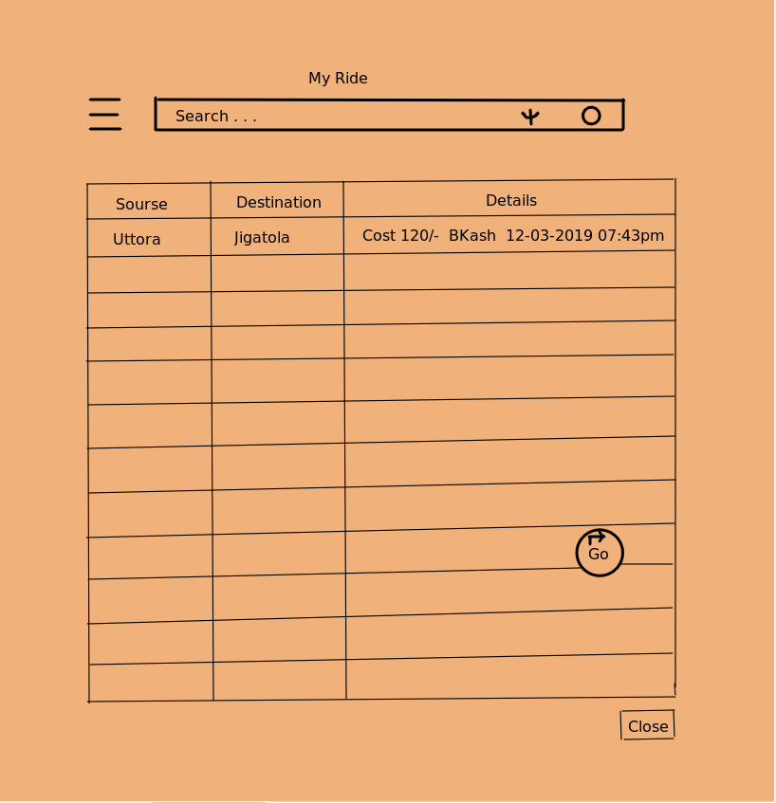
Prototypes
My Rides

Slide 20
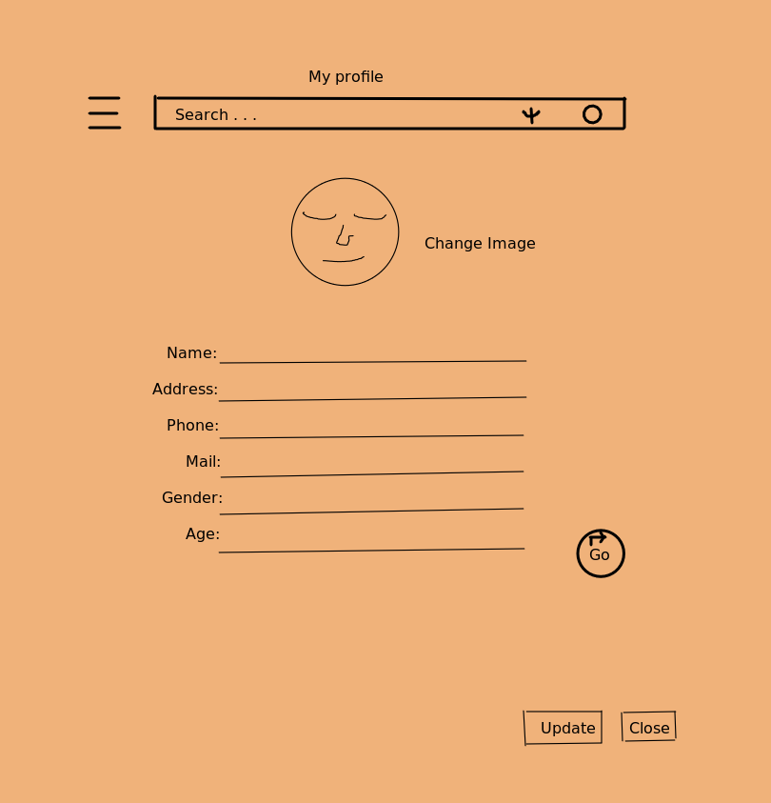
Prototypes
My Profile

Slide 21
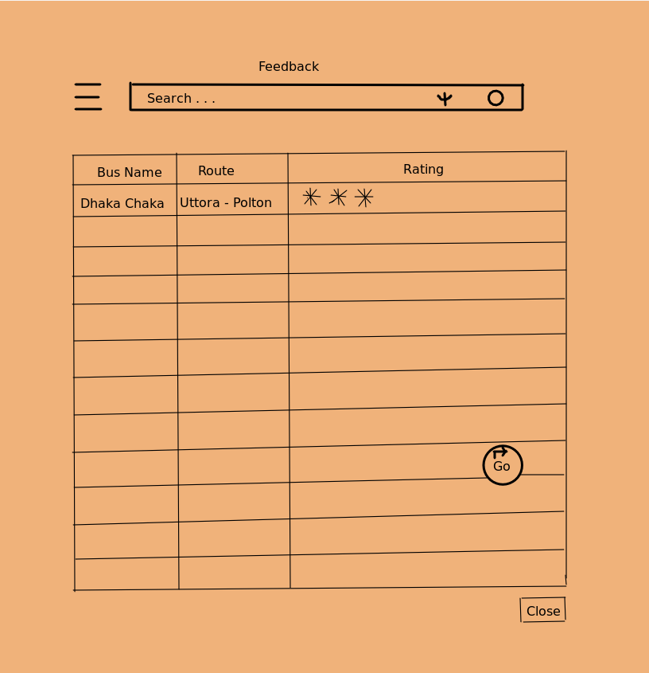
Prototypes
Feedback

Slide 22
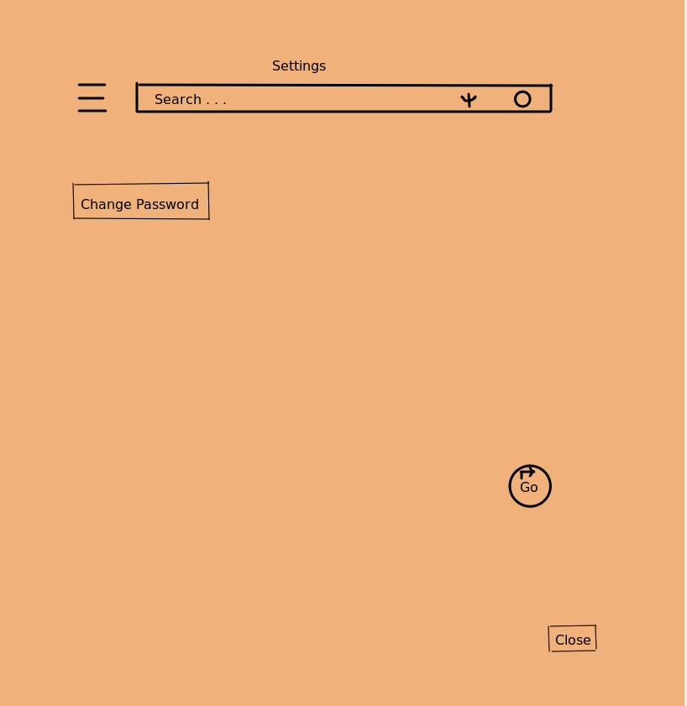
Prototypes
Settings

Slide 23
Conclusion
In summary, as most of the people use smartphone now we believe that our product will be helpful for new people in the city as well as regular people.We also believe that our E-Ticket concept will take forward our govt. vision of Digital Bangladesh.

