Slide 1

ML Regression / Prediction Model Project on
Clustering Student Profiles on Social Media for Enhanced Engagement Strategies
MCP Program - Case Study
Author: Shanker prasad v
contact: shankerprasad072@gmail.com

Slide 2
Introduction
Overview of the Problem:
Importance of understanding student engagement on social media.
Need for targeted strategies to enhance interaction and community building.
Objective:
Cluster student profiles based on social media activity, interests, and demographics
The goal is to cluster student profiles based on their social media activity, interests, and demographics to identify distinct groups for targeted engagement strategies, content recommendations, and community-building efforts..
Dataset Overview
Source: Kaggle (Students Social Network Profile Clustering)
Link: https://www.kaggle.com/datasets/zabihullah18/students-social-networ k-profile-clustering
Description:
Contains data on students’ social media profiles, including demographics, interests, and activity metrics.

Slide 3
Data Exploration
-Importing libraries
-Loading the Data
Brief overview of how to load and explore data using Pandas.
Data Preprocessing
Cleaning the Data:
Handling missing values and duplicates.
Feature Selection:
Identifying relevant features for clustering (e.g., activity level, interests).
Normalization:
Standardizing numerical features to ensure equal weighting in clustering.

Slide 4
Step by step process
-Let's have a look at the number of male, female and missing values
-One way to deal with these missing values would be to fill the missing values with the average age of each graduation year
-Now fill the missing values for each graduation year with the mean that we got as above
Feature Engineering
-Convert object variable to numeric
-Checking the transformed values
-Building the K-means model
-Creating a function with KMeans to plot "The Elbow Curve"

Slide 5
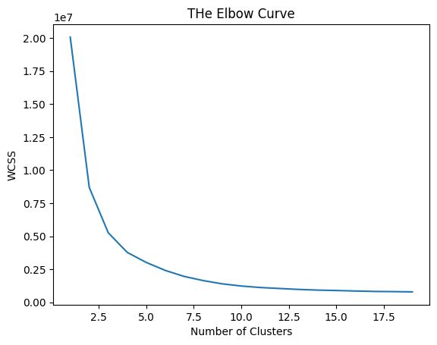

Slide 6
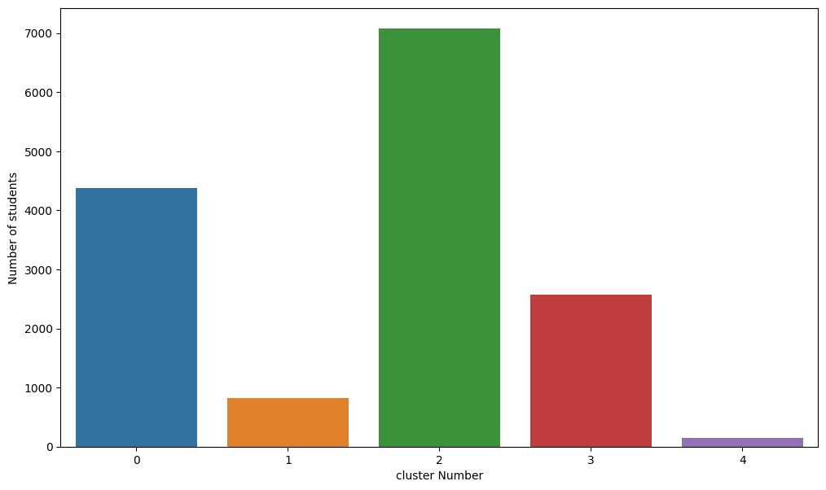

Slide 7
Clustering process
-Calculate the mean age for each cluster
-Calculate the percentage of females in each cluster
-Calculate the average number of friends in each cluster
Result
- Clusters 1, 2, and 3 have a higher percentage of females compared to the overall population. Products related to fashion, beauty, socializing, or lifestyle may resonate more with these clusters.
- Clusters 0 and 4 have a higher percentage of males Products related to sports, technology, gaming, or adventure may appeal more to these clusters.
- Clusters 2 and 3 show a higher interest in shopping
- Collaborate with sports brands or organize sports-related events and activities to appeal to clusters showing a strong interest in sports (e.g., Clusters 3 and 4).

Slide 8
Kaggle link: https://www.kaggle.com/code/shankerprasad/student-on-social-media-clustering-project-3-3
Explanation link: https://youtu.be/0A88RfdDGDc?si=yLWhQD9AksQmkcPU

Slide 9
THANKYOU

