Slide 1


Department of Artificial Intelligence and Data Science
CROPMASTER An AI-Driven Smart Farming Bot
Dr. P. Indira Priya M.E., Ph.D.,
Professor
Department of AI&DS
Jayanesh D 221801020
Shanmugashree M 221801049

Slide 2
Problem Statement and Motivation
How can we create an advanced agricultural bot to address challenges faced by small-scale farmers? This involves enhancing crop management through real-time soil testing with the aim of doubling agricultural output and income.
The motivation behind this project is to bridge the technological gap for small-scale farmers.
Optimize resource use through real-time soil testing
Enhance economic viability by significantly increasing agricultural output and income.

Slide 3
Objectives
Enhance soil health and crop yield predictions using data-driven insights from the Guassian Naïve Bayes Algorithm.
Provide actionable farming recommendations through a user-friendly app to help small-scale farmers make informed decisions.
Develop a scalable and adaptable system that improves with new data and feedback, suitable for diverse farming conditions.

Slide 4
Abstract
India is a predominantly agricultural country, with agriculture playing an important part in the Indian economy and people’s lives.
An innovative agricultural bot is designed to revolutionize small-scale farming by integrating advanced technology.
Key features include real-time soil analysis, crop recommendation via machine learning for precise interventions.
Artificial Intelligence has the potential to drastically revolutionize the agriculture industry by increasing efficiency, minimizing waste, and raising crop yield.

Slide 5
Introduction and Overview of the Project
CropMaster aims to create an advanced agricultural bot that leverages existing soil and crop yield data to optimize crop management for small-scale farmers.
By using the Guassian Naïve Bayes algorithm, the system predicts soil health and provides tailored recommendations for irrigation, fertilization, and crop selection.
Farmers can access these insights through a user-friendly interface, making advanced agricultural tools easily accessible and actionable
The system is designed to be scalable and adaptable, continuously improving with new data and feedback, ensuring it remains effective across different regions and farming conditions.

Slide 6
Literature Survey
S.No | Author Name | Paper Title | Description | Journal | Volume/ Year
1. | C. Bhuvaneswari, H.S. Pokhariya, Pallavi Yarde, Natrayan L, V. Vekariya and Harshal Patil | Implementing AI-Powered Chatbots in Agriculture for Optimization and Efficiency | The Chatbot help farmers select crops that are suited for cultivation and evaluate the health of their crops GNB & SVM are used for crop suggestions and VGG-16 transfer learning model for disease prediction | IEEE Xplore | 2024
2. | Ajay Agarwal, Sartaj Ahmad and Adesh Pandey | Crop Recommendation Based on Soil Properties: A Comprehensive Analysis | Machine learning-based crop recommendations using soil properties by XG-Boost algorithm | IEEE Xplore | 2023

Slide 7
Literature Survey
S.No | Author Name | Paper Title | Description | Journal | Volume/ Year
3. | Gaurav Chauhan and Alka Chaudhary | Crop Recommendation System using Machine Learning Algorithms | Predict the most suitable crops for various soil types based on several factors by Random Forest & Decision Tree Algorithm. | IEEE Xplore | 2023
4. | Neelam Chandolikar and Chirag Dale | Agriculture Assistant Chatbot Using Artificial Neural Network | A chatbot with expert agricultural advice and predictive insights by using Gaussian Naïve Bayes Algorithm | IEEE Xplore | 2022

Slide 8
Existing System
Traditional methods involve periodic soil sampling and laboratory analysis, which are time-consuming and lack real-time data.
Farmers use limited or outdated tools for decision-making, relying on general recommendations rather than real-time, data-driven insights.
Data is often collected manually and in an unstructured manner, making it difficult to analyze and integrate for comprehensive crop management.
Current systems lack integration between different agricultural processes, leading to inefficiencies and suboptimal resource utilization.

Slide 9
Drawback of Existing System
Delayed Soil Insights: Soil testing is infrequent and relies on laboratory results, providing data that is not real-time.
Outdated Decision-Making Tools: Existing tools provide general advice rather than actionable, real-time insights based on current data.
Fragmented Data Collection: Data is often collected manually and in an unstructured manner, hindering comprehensive analysis and integration.
Lack of System Integration: Agricultural processes are not well-integrated, resulting in inefficiencies and suboptimal use of resources.

Slide 10
Proposed System
Efficient Predictions: Uses existing data to train a model, predicting soil health and best practices without real-time sensors.
Flexible and Scalable: Adaptable to different regions, farming conditions, and evolving needs, making it ideal for small-scale farmers.
Easy-to-Use: Farmers can access these insights through a simple website, ensuring the system is both efficient and user-friendly, even for those with limited technical skills.
Efficiency: By leveraging the most suitable algorithm, the system maximizes efficiency in processing and analyzing data, leading to faster and more reliable insights for farmers.
Continuous Improvement: Learns from new data and feedback, enhancing efficiency and flexibility over time.

Slide 11
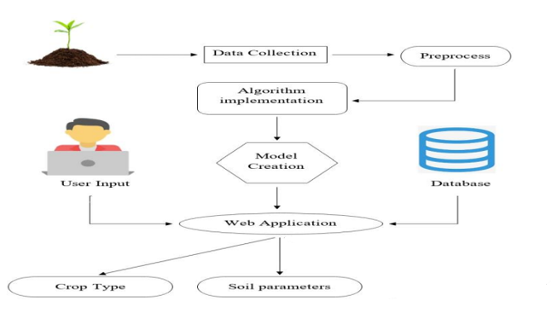
System Architecture

Slide 12
List Of Modules
Data Collection and Preprocessing Module
Model Building & Evaluation Module
Model Performance
Prediction and Recommendation Module
Data visualization
User Interface Module

Slide 13
Module: Preprocessing
Step 1: Check for missing values in the dataset using .isnull().sum().
Step 2: Separate features (X) and target (y) by dropping the 'label' column.
Step 3: Apply MinMaxScaler to scale the features to a range between 0 and 1 for normalization.
Step 4 :Save the scaler object using pickle for consistency in future predictions.
Step 5: Convert the scaled features back into a DataFrame to retain column name
Step 6: Split the data into training and testing sets.
Step 7: Print the shapes of training and testing sets to verify the split

Slide 14
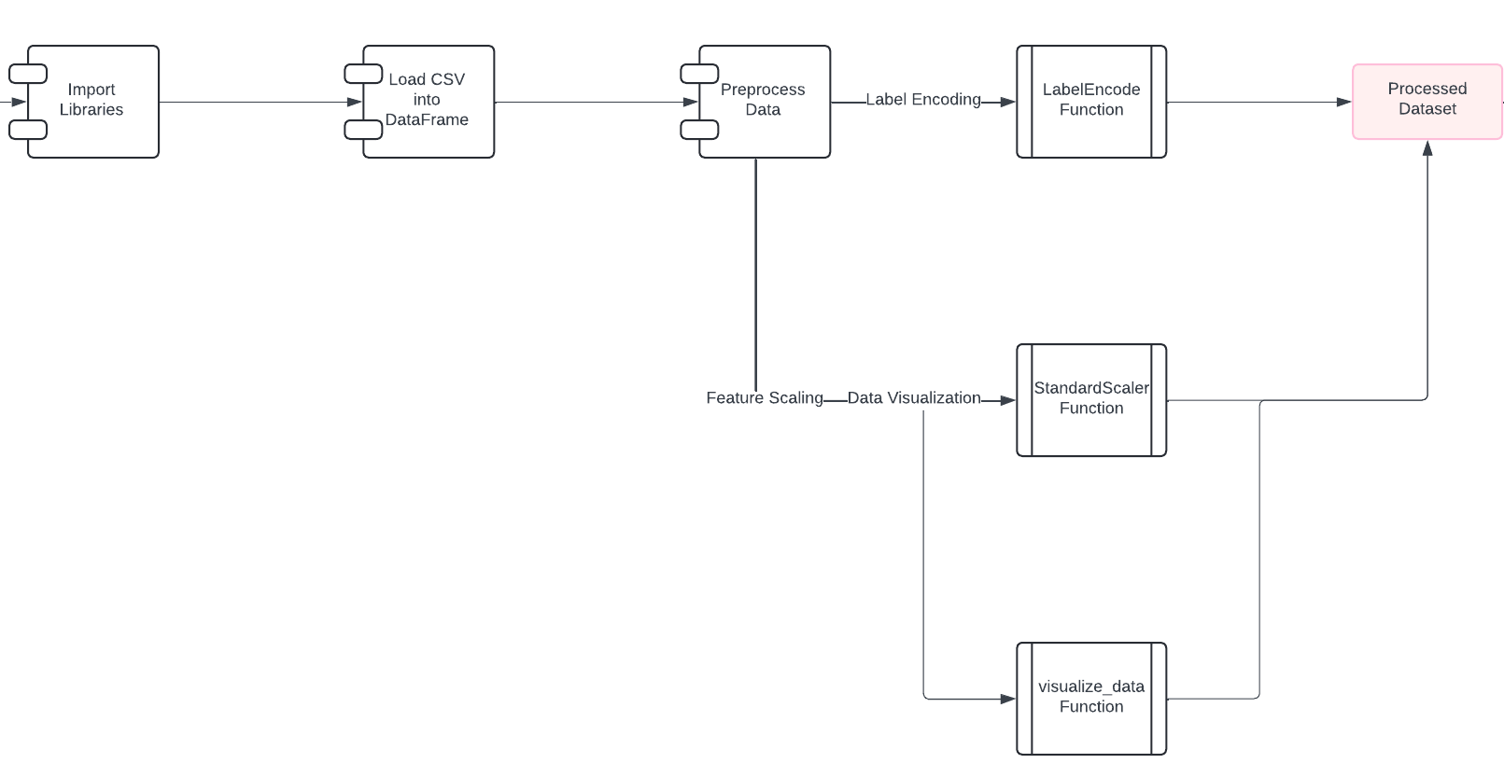
Data Flow Diagram

Slide 15
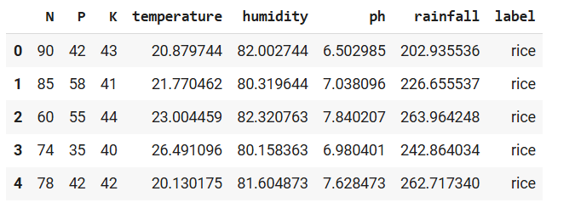
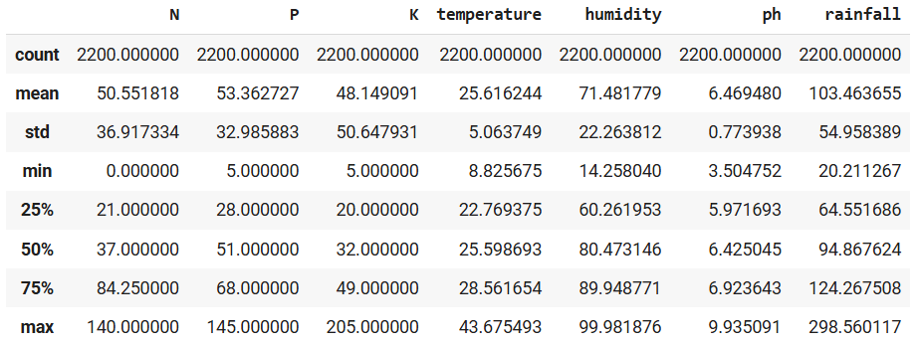
Output
Head of the dataset
Description of the dataset
Second Review

Slide 16
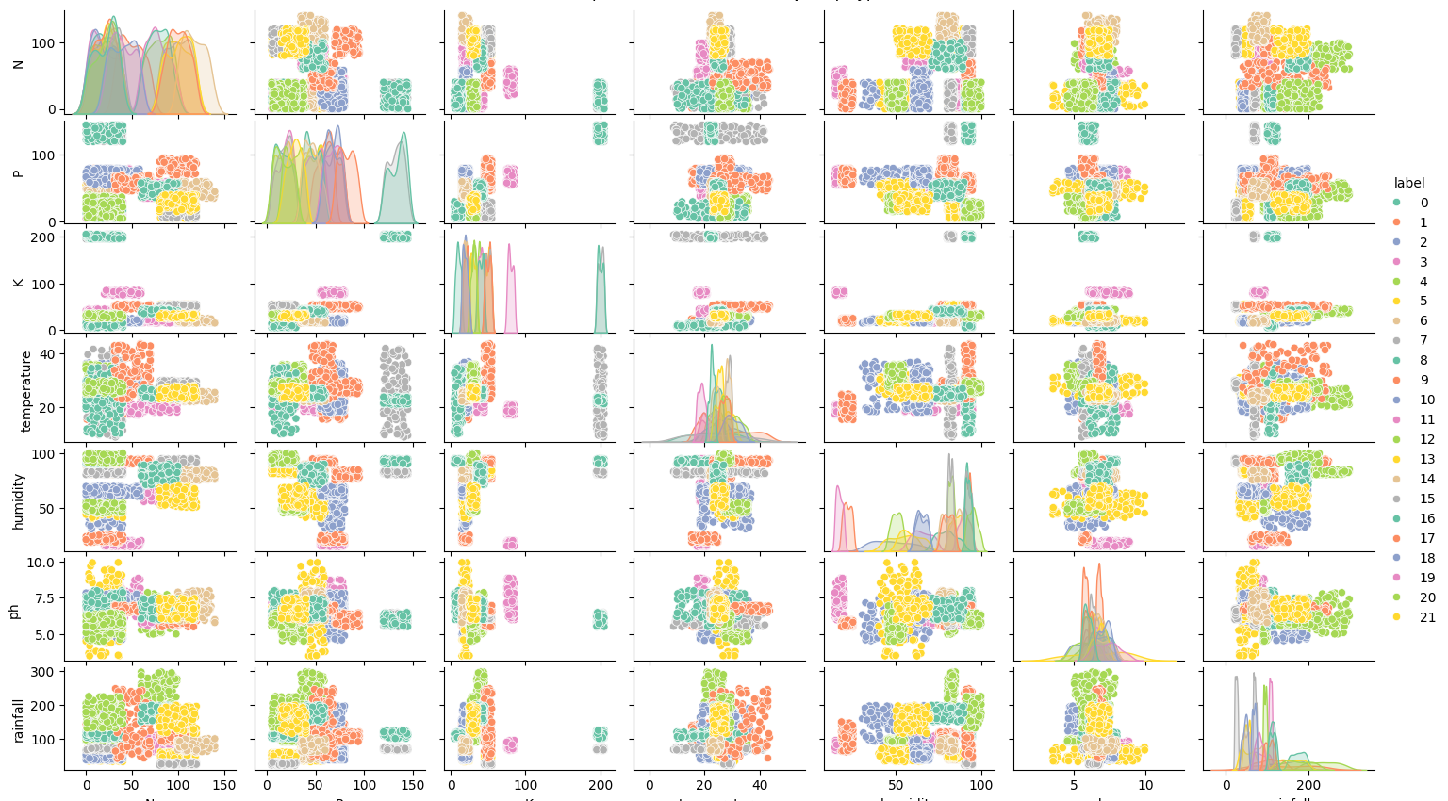
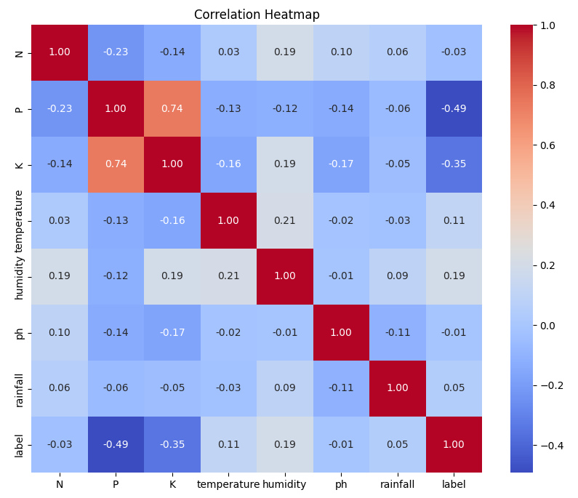
Output

Slide 17
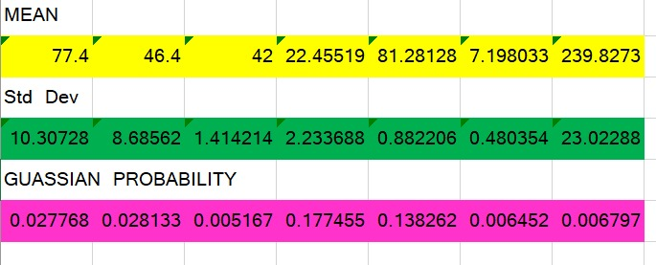
Calculation Using Excel

Slide 18
Module: Model Building & Evaluation
Step 1: Define a function crop_recommendation that trains a model, predicts on test data, calculates accuracy and classification metrics, and stores results
Step 2:Initialize the Logistic Regression model with specified hyperparameters, train it using crop_recommendation, and save the model with pickle
Step 3:Initialize the Decision Tree model, train it with crop_recommendation, and save the model.
Step 4 :Repeat step 3 for each model: Random Forest, Support Vector Machine, K-Nearest Neighbors, Naive Bayes, Linear Discriminant Analysis, Bagging Classifier, and Gradient Boosting Classifier.
Step 5: Display all model accuracies in a bar plot, identify and print the model with the highest accuracy score.

Slide 19
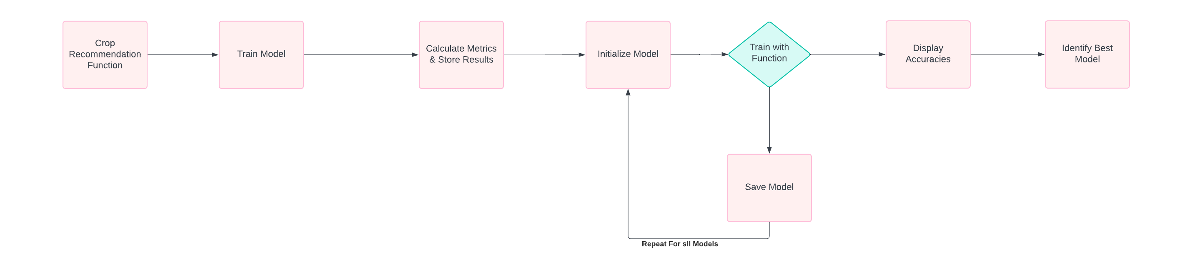
Data Flow Diagram

Slide 20
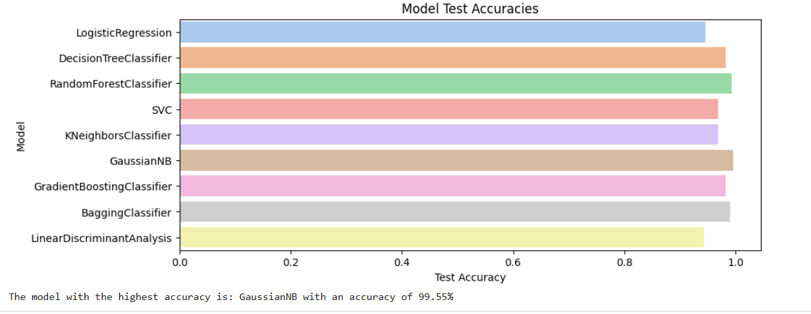
Output

Slide 21
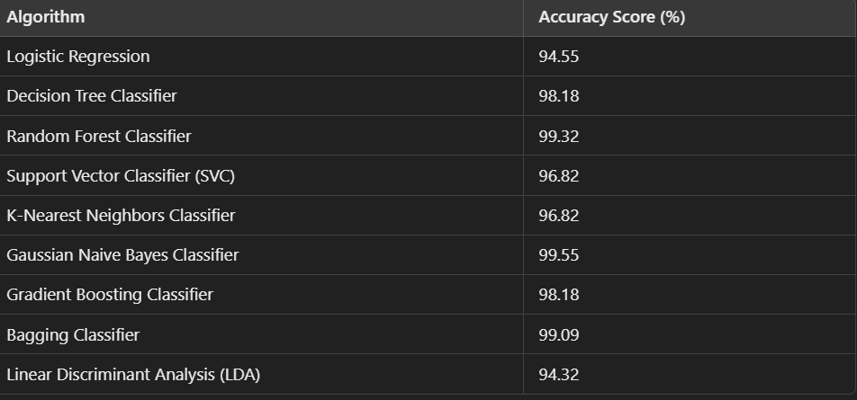
Model Performance

Slide 22

Guassian Naïve Bayes Algorithm
Gaussian Naive Bayes (NB) is chosen for crop recommendation because it is particularly effective with high-dimensional data and handles continuous features well, making it suitable for agricultural datasets with varied environmental conditions. Gaussian NB assumes that features follow a Gaussian (normal) distribution, which aligns with many natural datasets and allows the model to make fast and reliable predictions. Its simplicity and low computational requirements also make it efficient for real-time recommendations, providing high accuracy without extensive training time or resource demands.
The formula for calculating posterior probability:

Slide 23
Module: Prediction & Recommendation
Step 1: Load the pre-trained Naive Bayes model from the saved .pkl file using pickle.
Step 2: Load the MinMaxScaler from the saved .pkl file to ensure the new data aligns with the training data scale.
Step 3: Define new input data in the same feature order and format as the training set
Step 4 :Use the scaler to transform the new data, scaling it to the appropriate range
Step 5:Predict the crop recommendation by passing the scaled data into the loaded Naive Bayes model.
Step 6: Print the predicted crop as the recommended crop for the input conditions.

Slide 24
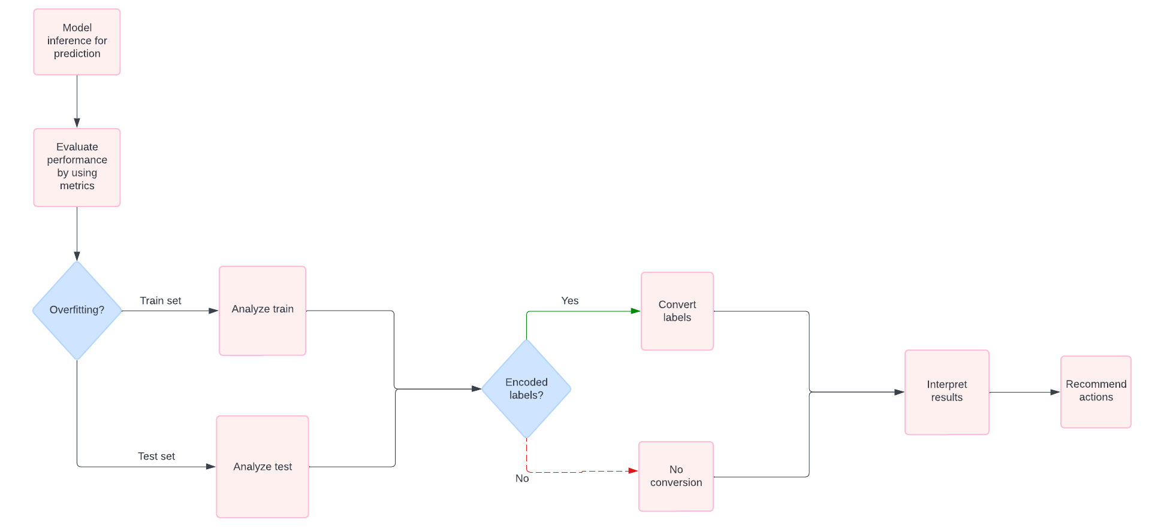
Data Flow Diagram

Slide 25
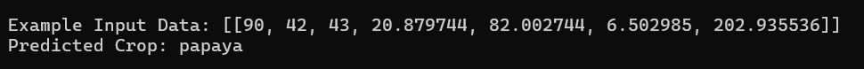
Output

Slide 26
References
"Implementing AI-Powered Chatbots in Agriculture for Optimization and Efficiency" by C. Bhuvaneswari, Hemant Singh Pokhariya, Pallavi Yarde, Vipul Vekariya, and Harshal Patil, Natrayan L, IEEE Xplore, 2024.
"Crop Recommendation Based on Soil Properties: A Comprehensive Analysis" by Ajay Agarwal, Sartaj Ahmad and Adesh Pandey, IEEE Xplore, 2023.
"Crop Recommendation System using Machine Learning Algorithms" by Gaurav Chauhan and Alka Chaudhary, IEEE Xplore, 2023.
"Integrated Fertilizer Recommendation and Crop Management System for Farmers“ by Shanmugapriya M, Saikrishnan S, Arun Depak K, Adithyaa Jagannathan Sudhakar, IEEE Xplore, 2023.
"Agriculture Assistant Chatbot Using Artificial Neural Network" by Neelam Chandolikar and Chirag Dale, IEEE Xplore, 2022.

Slide 27
Thank You!

