Slide 1

WIPRO NGA Program – Java & Selenium Testing – Batch No : 6
Capstone Project -17th - 25th March 2025
Project Title Here - Automated Tests using Java and Selenium for the website “LetsKodeit.com”
Presented by - Shanmukh Nakkella
www.rpsconsulting.in

Slide 2

TABLE OF CONTENTS :
Introduction
Application
Testing Process
Major Functionalities Automated
Feature File
Project Structure
Screenshots
Conclusion
2025 - RPS Consulting all rights reserved

Slide 3
INTRODUCATION :
Objective: Automate testing of website functionalities using Java, Selenium and Cucumber.
Technologies: Selenium WebDriver, Cucumber, TestNG, Maven, Jenkins, Git.
Features:
UI testing with Selenium WebDriver
Behaviour-Driven Development (BDD) with Cucumber
Cross-browser testing
Maven-Git integration with Jenkins
Comprehensive test cases for key pages and functionalities
Detailed reporting with Extent Report
Design:
Hybrid framework with Page Object Model (POM)
Reusable functions
Data-driven testing
Best practices in locator strategies and exception handling
2025 - RPS Consulting all rights reserved

Slide 4

APPLICATION -
2025 - RPS Consulting all rights reserved

Slide 5
APPLICATION OVERVIEW - https://www.letskodeit.com
This website is a practice platform designed to help learners test and improve their skills in web technologies, with a strong focus on UI elements and interactions. It offers a hands-on environment where users can experiment with components like radio buttons, checkboxes, dropdowns, and alerts.
Key Features :
Interactive Practice Page: Includes various UI elements (e.g., radio buttons, checkboxes, dropdowns, alerts) for real-time practice and learning.
Educational Resources: Offers courses, tutorials, and interview preparation materials to support structured learning.
User-Friendly Interface: Features sections like Home, All Courses, Interview, Support, and Blog for seamless navigation.
User Authentication: Supports registration, login, and password recovery for a personalized experience.
2025 - RPS Consulting all rights reserved

Slide 6
TESTING PROCESS -
Testing Process - Planning and Setup:
Planning: Defined the testing scope and identified key areas. Selected tools such as Selenium, Cucumber, TestNG, Maven, Jenkins, and Git.
Setup: Configured the test environment with Java, Selenium, TestNG, Cucumber, and Maven. Enabled cross-browser testing and integrated with Jenkins.
Design: Created test cases using the Page Object Model (POM) and Behavior-Driven Development (BDD) for key functionalities.
Test Planning
Test Environment Setup
Test Design
2025 - RPS Consulting all rights reserved

Slide 7
TESTING PROCESS -
Testing Process - Execution and Maintenance :
Execution: Ran tests with TestNG, incorporating data-driven testing, assertions, and exception handling.
Reporting: Generated detailed reports with Extent Report and analyzed them for defects and coverage.
Maintenance: Followed best practices for efficient locators, code reusability, synchronization, and regular updates.
Test Execution
Test Reporting
Test Maintenance
2025 - RPS Consulting all rights reserved

Slide 8
MAJOR FUNCTIONALITIES TESTED -
Home Page
Shopping Cart:
Reporting & Logging:
User Authentication
Verified page title and the presence of key sections like Home, All Courses, Interview, Support, and Blog.
All Courses Page
Verified user registration, login, and forgot password functionality.
Practice Page
Tested category filter, course search functionality, and search button validation.
Automated interactions with radio buttons, checkboxes, dropdowns, and alert handling, etc..
Automated adding, removing items, and proceeding to checkout.
Generated Extent Reports and captured screenshots for failed steps.
2025 - RPS Consulting all rights reserved

Slide 9
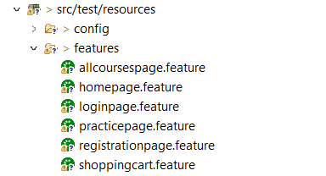
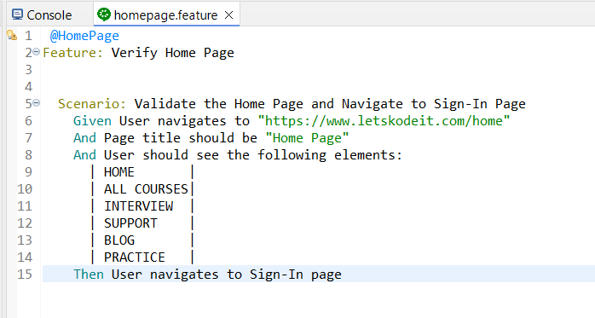
FEATURE FILES -
The feature files created in Cucumber defined test scenarios using Gherkin syntax (Given, When, Then) to automate UI testing. It outlined application behavior in a structured and readable format for BDD. Each scenario covered a specific functionality, using Given for preconditions, When for user actions, and Then for expected outcomes. This approach helped me ensure clarity, maintainability, and alignment between business requirements and automated tests.
2025 - RPS Consulting all rights reserved

Slide 10
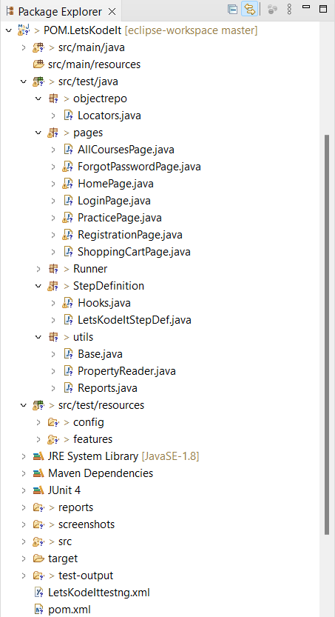
PROJECT STRUCTURE -
src/test/java – Contained the automation framework, including the Page Object Model (POM) classes,test scripts and step definitions for Cucumber.
src/test/resources – Included feature files, test data Properties and configurations.
utils/ – Held WebDriver executables for Chrome and Firefox.
reports/ – Generated Extent reports for test execution results.
pom.xml – Managed dependencies (Selenium, Cucumber, TestNG, Apache POI) and test execution configurations and plugins.
2025 - RPS Consulting all rights reserved

Slide 11
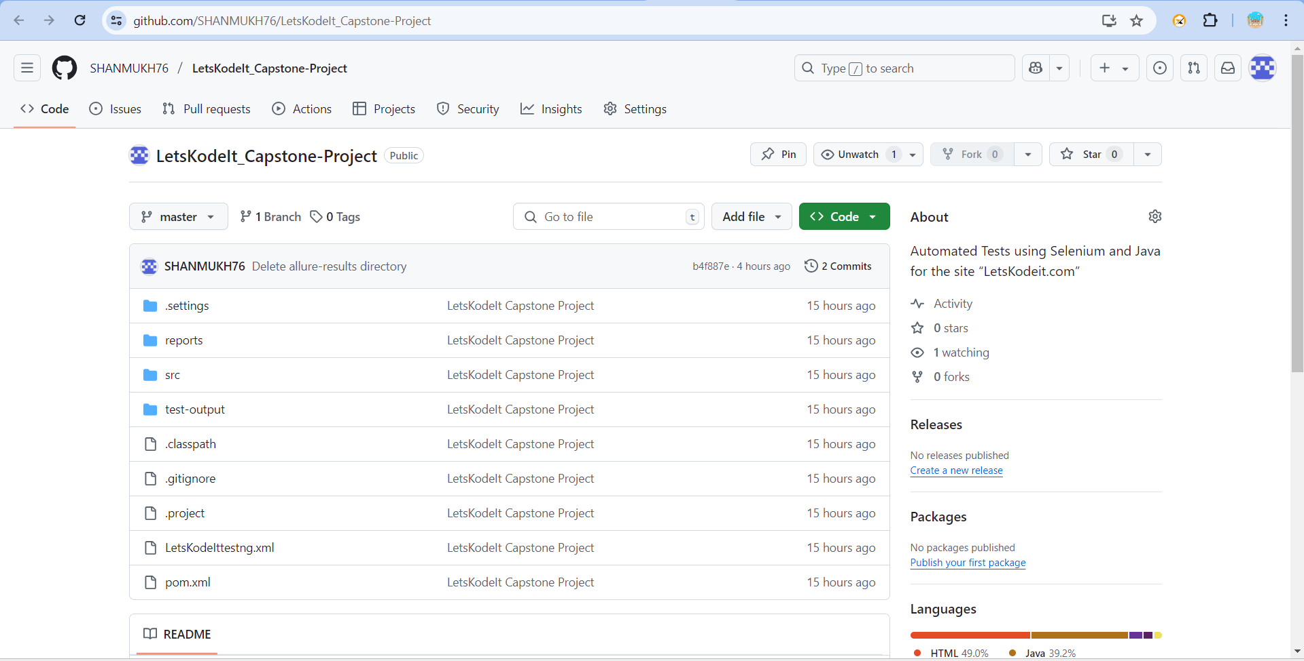
SCREENSHOTS :
Git Project Repository : https://github.com/SHANMUKH76/LetsKodeIt_Capstone-Project
2025 - RPS Consulting all rights reserved

Slide 12
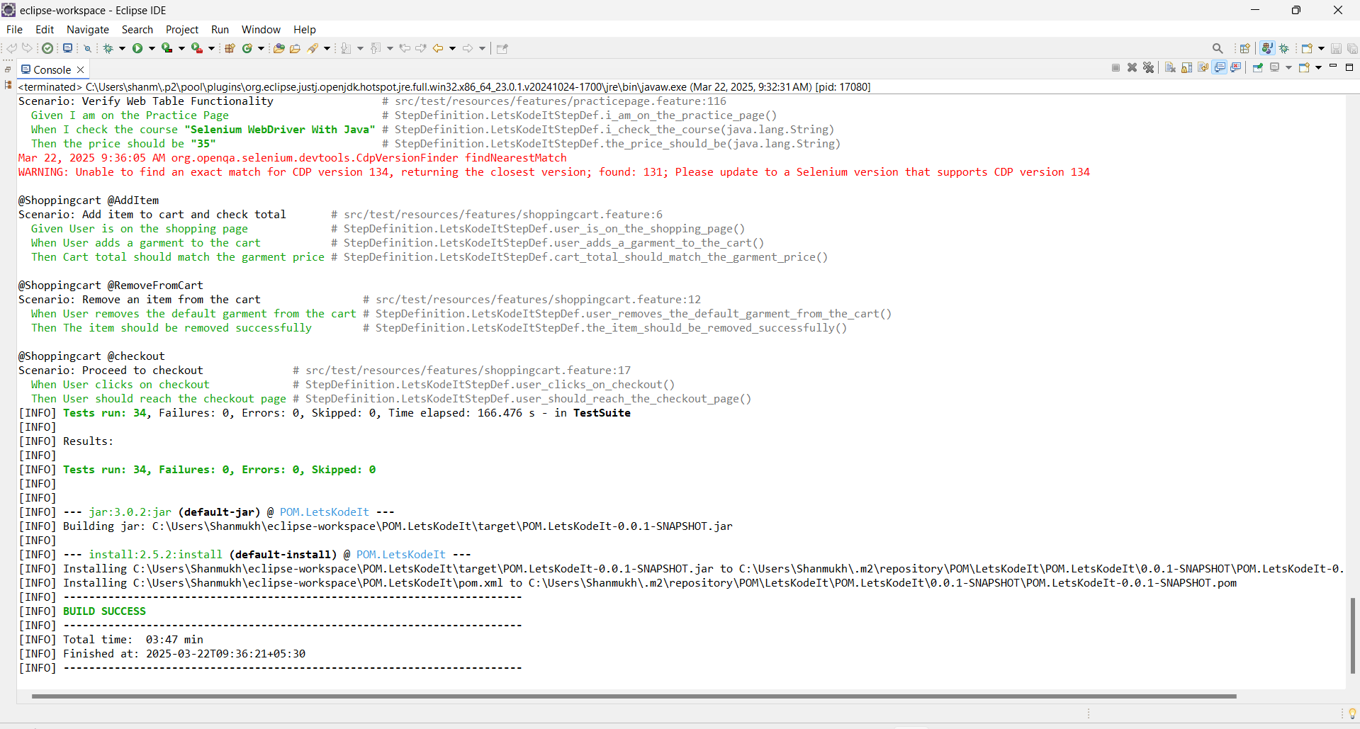
SCREENSHOTS OF EXECUTION :
CONSOLE OUTPUT (ECLIPSE) :
2025 - RPS Consulting all rights reserved

Slide 13
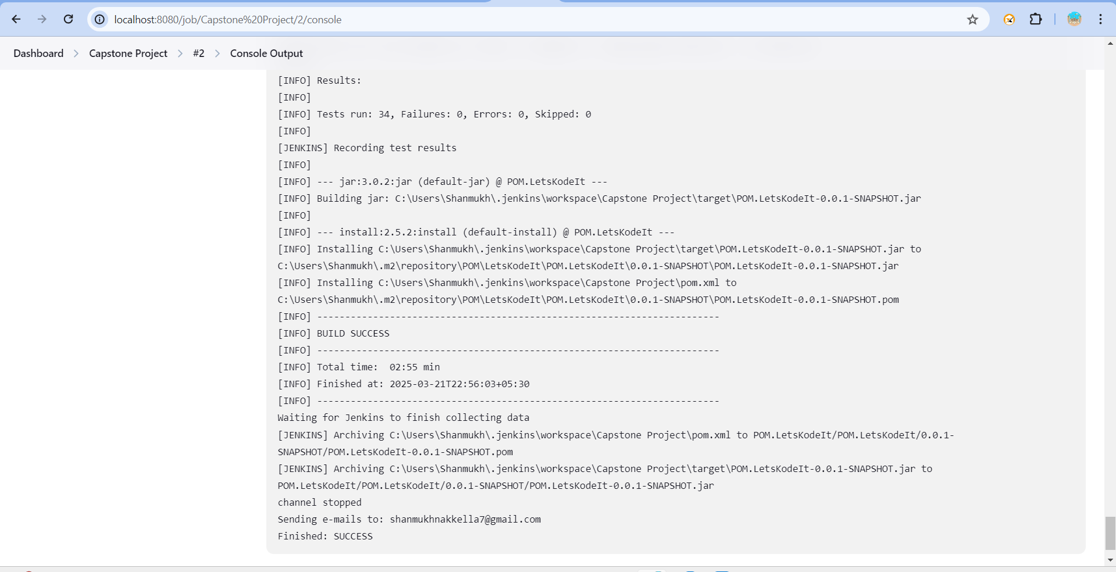
SCREENSHOTS OF EXECUTION :
CONSOLE OUTPUT (JENKINS)
2025 - RPS Consulting all rights reserved

Slide 14
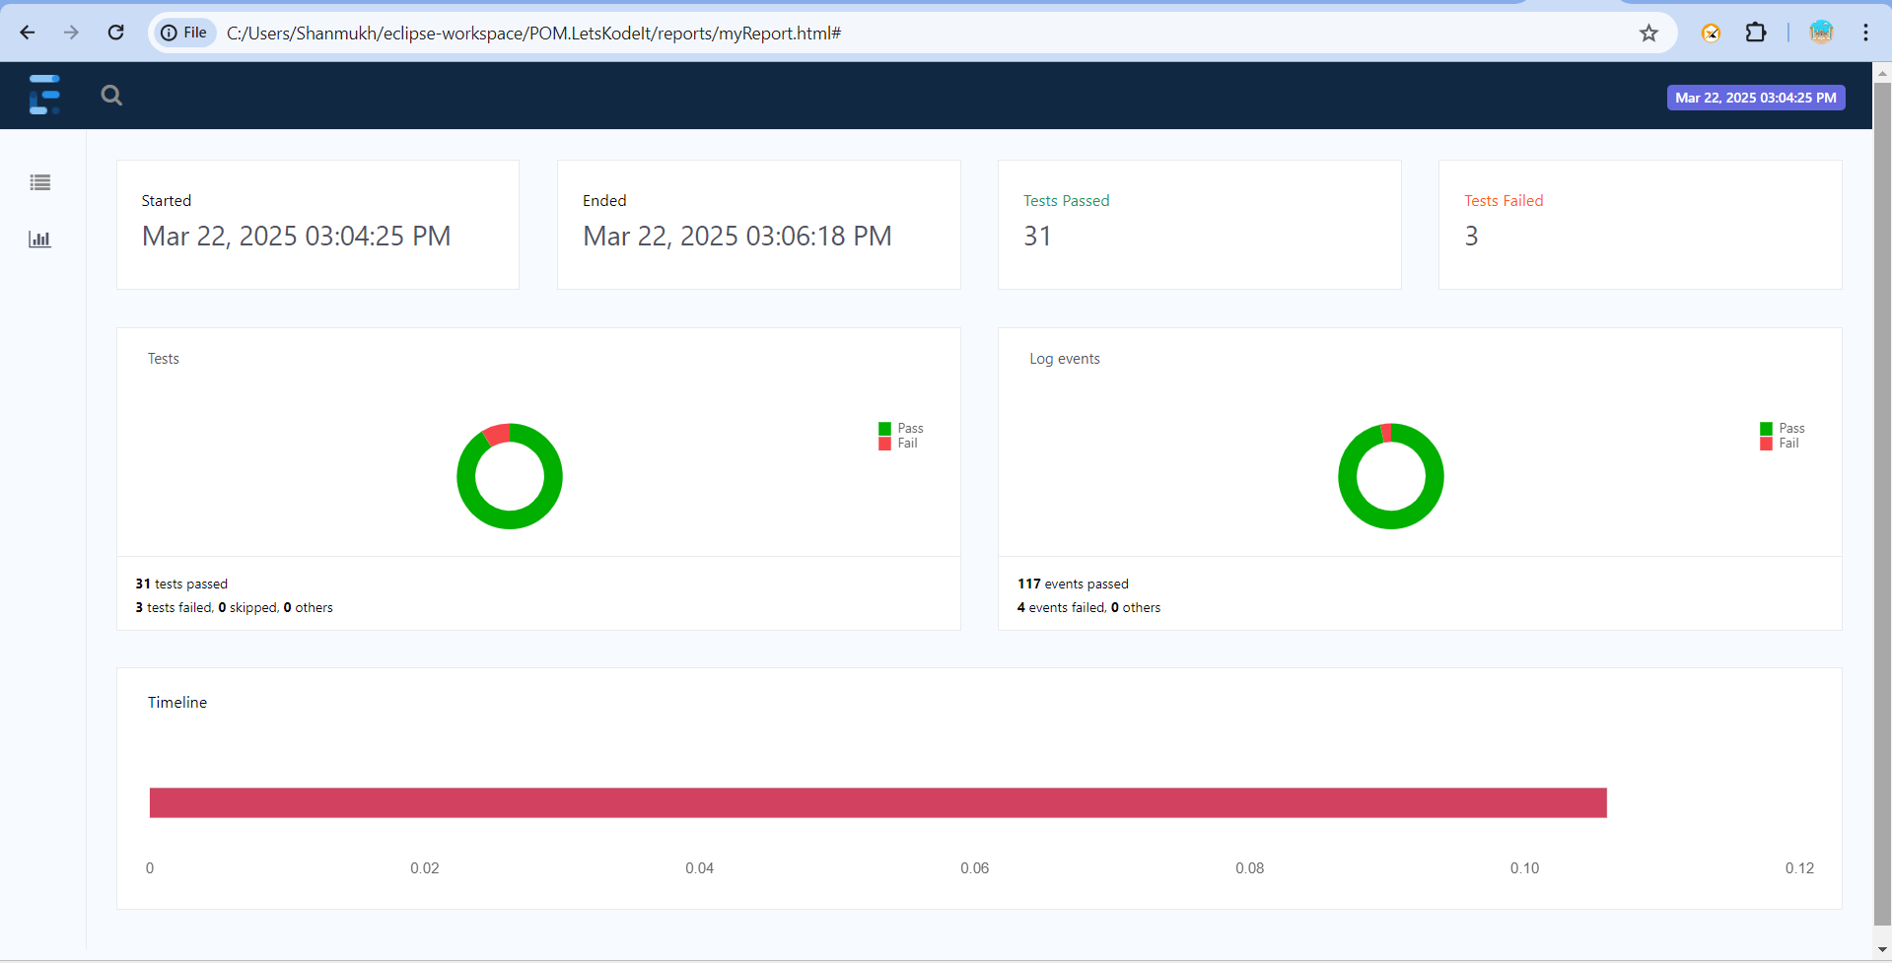
REPORT SCREENSHOT -
EXTENT REPORT :
2025 - RPS Consulting all rights reserved

Slide 15
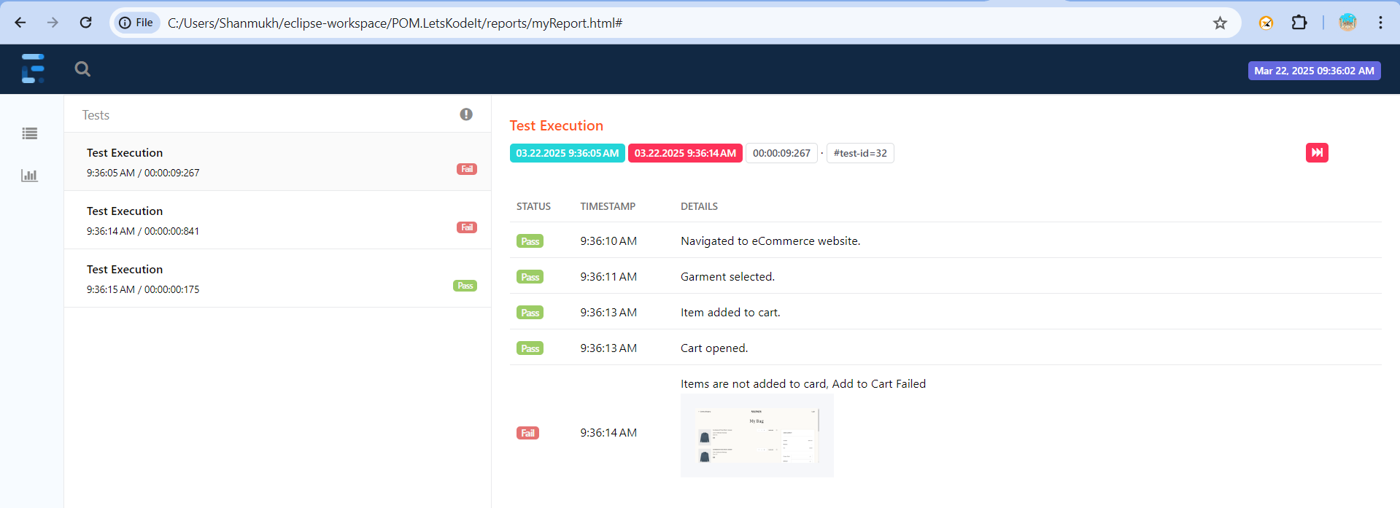
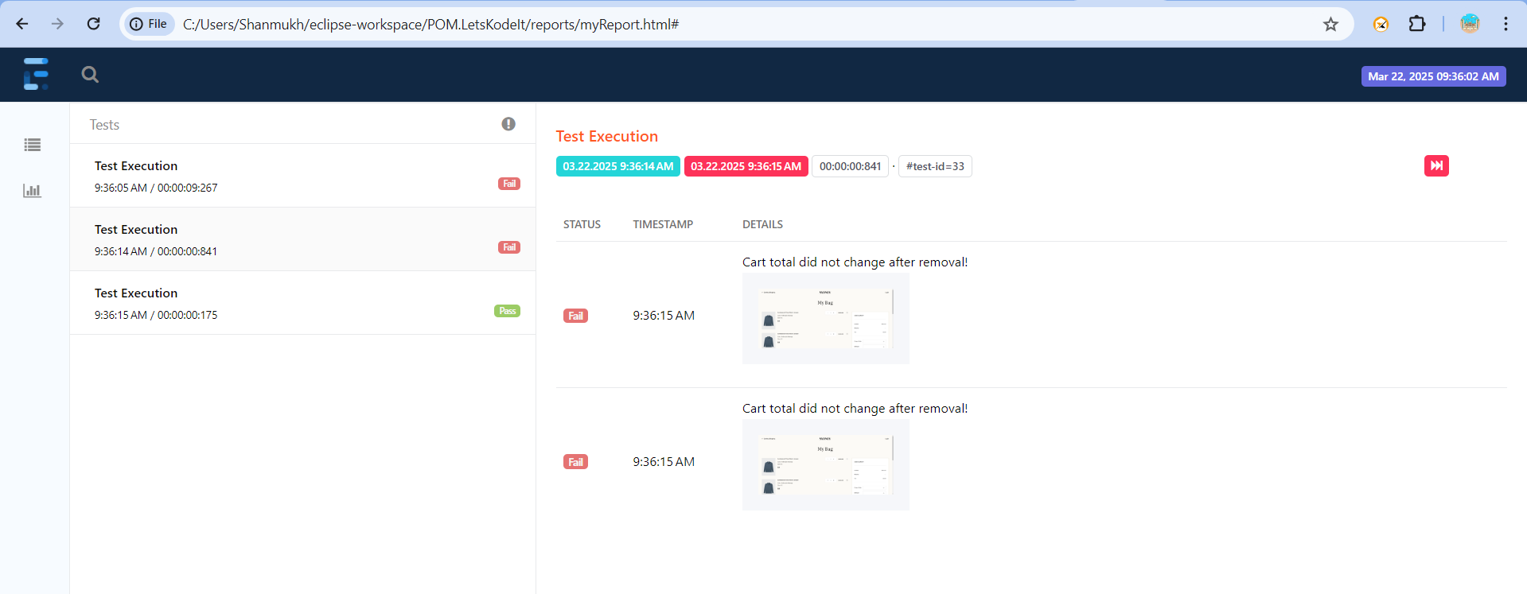
REPORT SCREENSHOTS :
EXTENT REPORTS - FAILED TEST CASES AND THEIR CAPTURED SCREENSHOTS IN THE REPORT :
2025 - RPS Consulting all rights reserved

Slide 16
CONCLUSION :
The project successfully automated testing for the website “letskodeit.com” using Java, Selenium, Cucumber, and TestNG, ensuring seamless functionality across key features.
A Hybrid Framework was implemented, combining Page Object Model (POM) and Data-Driven Testing for better maintainability and reusability and Maven-based project structure for streamlined dependency management and test execution.
Jenkins was integrated using Git and Maven, with SMTP configuration to send email notifications upon successful or unsuccessful builds.
During testing, two bugs were identified in the shopping cart functionality—issues with adding and removing items.
Detailed Extent Reports were generated, documenting test execution results.
The project not only validated website reliability but also demonstrated the effectiveness of an automation framework in identifying and reporting defects efficiently.
2025 - RPS Consulting all rights reserved

