Slide 1

Enhanced Image Processing Techniques for Accurate Feature Extraction in Gastrointestinal Disease Detection
Batch Members :
N.SHANMUKHA SAI(21603107)
E.AARTHI(21603116)
Department of ECE
VISTAS
Supervisor:
DR.MADONA B SAHAAI
Assistant professor
Department of ECE
VISTAS

Slide 2

ABSTRACT
Gastrointestinal (GI) diseases like ulcers, polyps, and GI bleeding are detected through endoscopic imaging, where a fiberoptic endoscope captures images of affected areas. This project aims to enhance diagnostic accuracy using image processing techniques that remove noise and improve feature extraction.
Our project focuses on enhancing endoscopic image accuracy to classify four conditions: Polyp Cells Detection, GI Bleeding Identification, Normal Stage, and Ulcer Abnormal Stage. Using advanced image processing techniques, we aim to improve diagnostic precision and reliably identify each of these conditions.
Accuracy is driven by the training process, parameters like epochs, batchSize, learning rate,loss function,precision and recall.
Disease Identification parameters:Contrast, Correlation, Energy, Mean, Variance, Standard Deviation, Kurtosis, Skewness, Entropy, RMS. these features help the model to identify and differentiate between diseased and non-diseased samples.

Slide 3
INTRODUCTION:
Gastric cancer (also known as stomach cancer) is a type of cancer that develops in the lining of the stomach. It is one of the most common cancers worldwide, though its incidence varies by region.
In recent years, image processing has become an indispensable tool in various fields, from healthcare and forensics to security and automation. With advancements in machine learning and computer vision, we can now analyze images with remarkable precision, revealing insights hidden to the human eye. This project aims to harness these capabilities for a specialized application by processing images through a series of transformation and enhancement steps. Starting with noise reduction and edge sharpening, the approach moves through segmentation and feature extraction to classify critical patterns accurately.

Slide 4
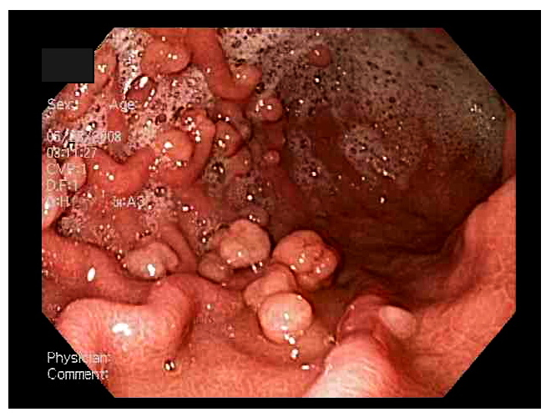
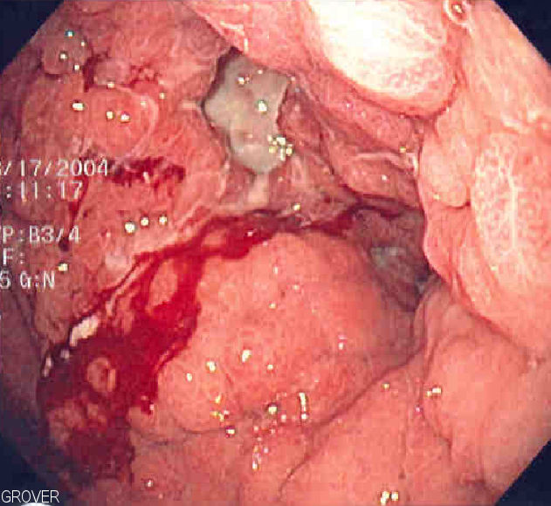
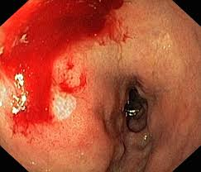
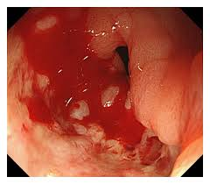
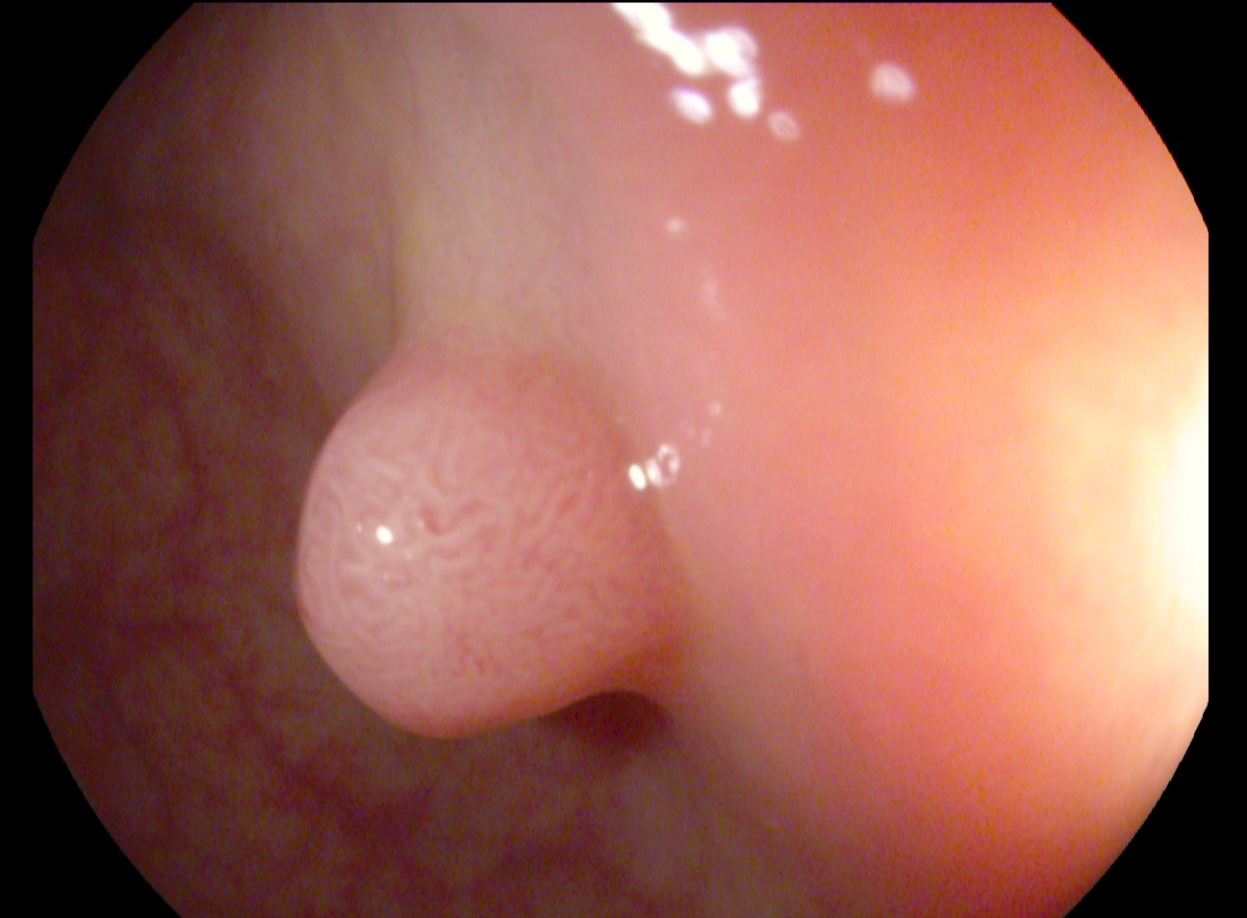
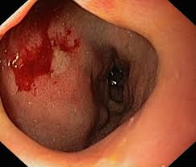
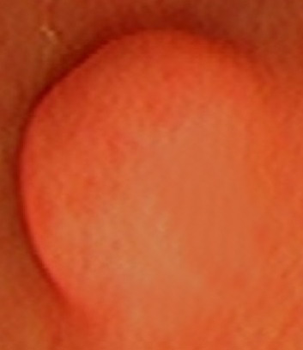
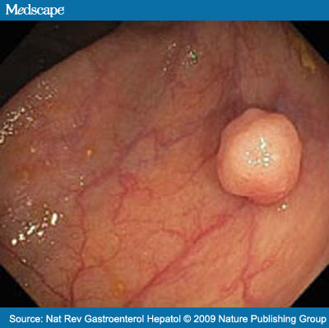
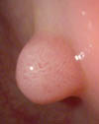
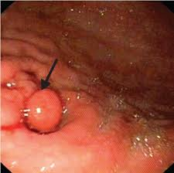
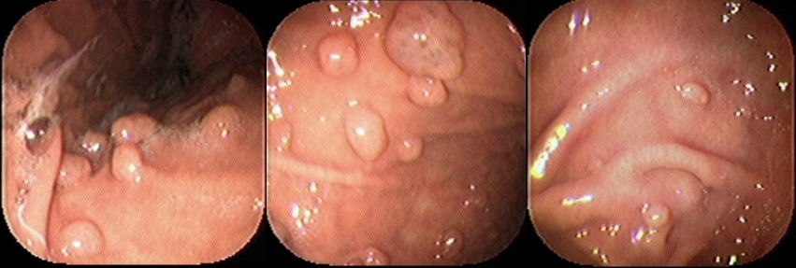
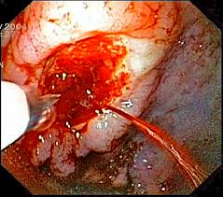
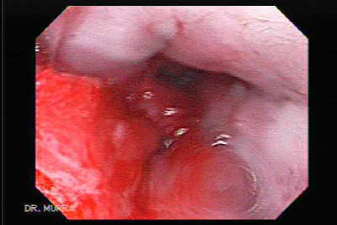
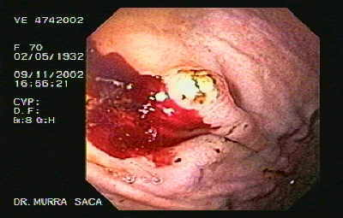

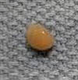
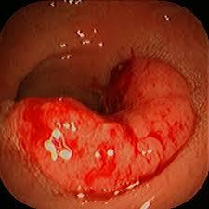

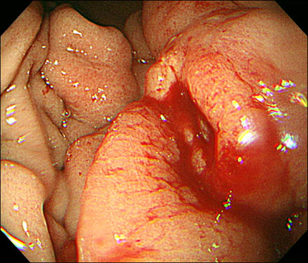
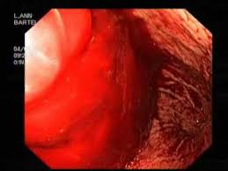
DATASET SAMPLE IMAGES
ENDOSCOPIC IMAGES (OPTICAL)

Slide 5
EXISTING METHOD:
Methodology:Utilizes MATLAB algorithms to enhance image quality, remove noise, and eliminate artifacts like reflected flash spots.
Filters used:Weighted Guided Filter (WGF),InpaintExemplar function (2 filters).
Algorithms used:YOLOv5 ,Histogram Equalization,Saliency Weightmap(3 algorithms).
Drawbacks:
Manual Annotation: Time-consuming and prone to human error.
Limited Dataset Generalization: The model may not generalize well across diverse datasets.
Artifact Handling: While noise and reflections are reduced, some artifacts still affect image quality and analysis.
Dependency on Expert Intervention

Slide 6
PROPOSED SYSTEM
Methodology:The methodology begins with image acquisition, followed by contrast enhancement using histogram stretching and RGB-to-grayscale conversion for simplified processing. To reduce noise, Gaussian and median filters are applied, and edges are detected with the Canny method. The image is converted to HSV color space to analyze individual channels, then enhanced through morphological operations. K-means clustering is applied for color-based segmentation, grouping pixels by clusters.Key features are extracted with Discrete Wavelet Transform (DWT), and Principal Component Analysis (PCA). Finally, a Convolutional Neural Network (CNN) classifier uses these features for pattern recognition and prediction.
Algorithms used:RGB extraction,Converting to grayscale,Smooth filter,Binary mask,Histogram Statistics.
Filters used:Gaussian Filter,Median Filter
Technique used:Segmentation, Algorithm:k-means clustering.

Slide 7
ADVANTAGES
Automating Feature Extraction: Instead of relying heavily on manual marking, It will employ advanced algorithms to automate the detection and extraction of significant features from endoscopic images, reducing human error and time consumption.
Improved Noise Removal: The system will integrate advanced noise removal techniques to ensure that even the finest details of the medical images are preserved, leading to higher accuracy in diagnosis.
Enhanced Detection Algorithms: Introduce improved detection algorithms, offering more precise differentiation between cancerous and non-cancerous areas. This could include better handling of specular reflections and minimizing artifacts that affect image clarity.
Real-time Processing: The system will focus on improving the speed of image analysis and feature extraction, making it more suitable for real-time medical applications.
Broader Dataset Integration: By using a more diverse and comprehensive dataset,The system will aim to provide better generalization across different cases, making it more reliable in clinical settings.

Slide 8
Disease Identification Features and their Ranges
METRICS/CONDITIONS | POLYPS | GI BLEEDING | ULCER | NORMAL
CONTRAST | 0.1922-0.3420 | 0.2105-0.2956 | 0.1980-0.4235 | 0.2130-0.3026
CORRELATION | 0.0735-0.1799 | 0.0648-0.1702 | 0.0381-0.1850 | 0.0323-0.1664
ENERGY | 0.7222-0.8265 | 0.7407-0.8045 | 0.7364-0.8512 | 0.7356-0.8042
MEAN | 0.0014-0.0057 | 0.0020-0.0058 | 0.0019-0.0064 | 0.0015-0.0052
STANDARD DEVIATION | 0.0896-0.0898 | 0.0896-0.0898 | 0.0896-0.0898 | 0.0897-0.0898
ENTROPY | 2.3894-3.7168 | 2.8284-3.6029 | 2.3247-3.6861 | 2.9682-3.7423
RMS | 0.0898 | 0.0898 | 0.0898 | 0.0898
VARIANCE | 0.0080-0.0081 | 0.0080-0.0081 | 0.0080-0.0081 | 0.0080
KURTOSIS | 4.1223- | 6.2727-13.8553 | 5.5237-28.4905 | 5.2114-12.1648
SKEWNESS | 0.3358-1.9725 | 0.3326-1.1057 | 0.3927-2.6899 | 0.4322-1.2595

Slide 9
LITREATURE SURVEY:

Slide 10
S.NO | TITLE | YEAR | AUTHOR | EXPLANATION | ADVANTAGES | DISADVANTAGES
1 | Error feedback sampling for CNN training in upper gastrointestinal diseases classification | 2019 | Qi Wang | With the continuous development of deep learning technology, the application scope of convolutional neural network (CNN) in image recognition is expanding. The classification of medical images has become a new application field of CNN. How to quickly train the CNN with high accuracy has become an important problem in the process of training. | Efficient Training Enhanced Generalization | Error Propagation Complex Implementation

Slide 11
S.NO | TITLE | YEAR | AUTHOR | EXPLANATION | ADVANTAGES | DISADVANTAGES
2 | AFA-RN: An Abnormal Feature Attention Relation Network for Multi-class Disease Classification in gastrointestinal endoscopic images | 2021 | Qingmin Liao | Gastrointestinal diseases pose a great threat to human health. Early detection and treatment will significantly reduce the fatality rate. At present, wireless capsule endoscopy (WCE) is widely used in the clinical examination of gastrointestinal diseases. Each examination will produce tens of thousands of WCE images, only a small part of which are images with diseases | Efficient use of data Reduced manual effort | complexity Data imbalance challenges

Slide 12
S.NO | TITLE | YEAR | AUTHOR | EXPLANATION | ADVANTAGES | DISADVANTAGES
3) | Review on the Applications of Deep Learning in the Analysis of Gastrointestinal Endoscopy Images | 2018 | Wenju Du | This review focuses on the applications of DL methods in the analysis of GI images. We summarized and compared the latest published literature related to the common clinical GI diseases and covers the key applications of DL in GI image detection, classification, segmentation, recognition, location, and other tasks. At the end, we give a discussion on the challenges and the research directions of GI image analysis based on DL in the future. | Feature Extraction Adaptable | Need for Large Labeled Datasets Overfitting Risk

Slide 13
S.NO | TITLE | YEAR | AUTHOR | EXPLANATION | ADVANTAGES | DISADVANTAGES
4) | Deep Learning for Detecting Diseases in Gastrointestinal Biopsy Images | 2021 | Aman Srivastava | Machine learning and computer vision have found applications in medical science and, recently, pathology. In particular, deep learning methods for medical diagnostic imaging can reduce delays in diagnosis and give improved accuracy rates over other analysis techniques. This paper focuses on methods with applicability to automated diagnosis of images obtained from gastrointestinal biopsies. | scalability reduce diagnostic time | Data dependency Regulatory and etical concerns

Slide 14
S.NO | TITLE | YEAR | AUTHOR | EXPLANATION | ADVANTAGES | DISADVANTAGES
5) | Transfer Learning with Convolutional Neural Network for Gastrointestinal Diseases Detection using Endoscopic Images | 2020 | Karen Sanchez | Automated and accurate classification of pathologies on endoscopic images is a current challenge for Gastroenterology. This paper presents an approach to assist medical diagnosis processes of diseases and anomalies in the gastrointestinal tract based on the classification of features extracted from endoscopic images with a convolutional neural network and transfer learning type fine-tuning. The proposed strategy was evaluated on real endoscopic images from the Kvasir dataset. | Efficient Use of Data Generalization Capability | Dependence on Pre-Trained Models Computational complexity

Slide 15
S.NO | TITLE | YEAR | AUTHOR | EXPLANATION AND DRAWBACKS | ADVANTAGES | DISADVANTAGES
6) | Hierarchical Deep Convolutional Neural Networks for Multi-category Diagnosis of Gastrointestinal Disorders on Histopathological Images | 2021 | Lubaina Ehsan | Addressing this problem with a flat model which assumes all classes (parts of the gut and their diseases) are equally difficult to distinguish leads to an inadequate assessment of each class. Since hierarchical model restricts classification error to each sub-class, it leads to a more informative model compared to a flat model. In this paper we propose to apply hierarchical classification of biopsy images from different parts of the GI tract and the receptive diseases within each. | Reduced misclassification informative predictions | computational overhead limited flexibility in new class addition.

Slide 16
S.NO | TITLE | YEAR | AUTHOR | EXPLANATION | ADVANTAGES | DISADVANTAGES
7) | Least Square Saliency Transformation of Capsule Endoscopy Images for PDF Model Based Multiple Gastrointestinal Disease Classification | 2020 | Amit Kumar Kundu | Wireless capsule endoscopy (WCE) is an effective video technology to diagnose gastrointestinal (GI) diseases, such as bleeding, ulcer, and tumor. In order to avoid a tedious manual review process of long duration WCE video recordings, automatic disease detection schemes have received significant attention from the researchers | Enhanced Feature Extraction Better Generalization | Increased Model Complexity Limited Applicability

Slide 17
BLOCK DIAGRAM
Input Image
RGB to Gray Conversion
Gaussian Filter
Median Filter
Segmentation
(k-means clustering)
Enhancement
High Saturation Value
Edge Detection
Feature Extraction
Trained data
CNN classification
Disease identification output.

Slide 18
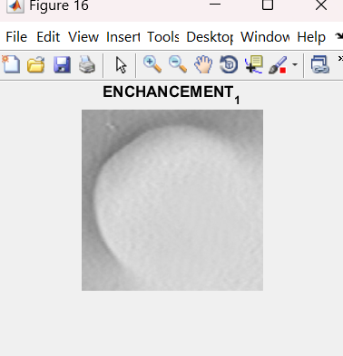
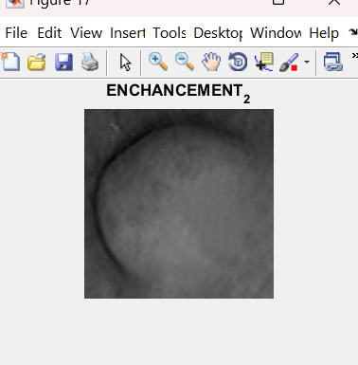
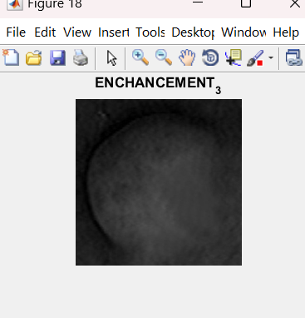
Enhancements output
Red band Enhanced
Green Band Enhanced
Blue Band Enhanced

Slide 19
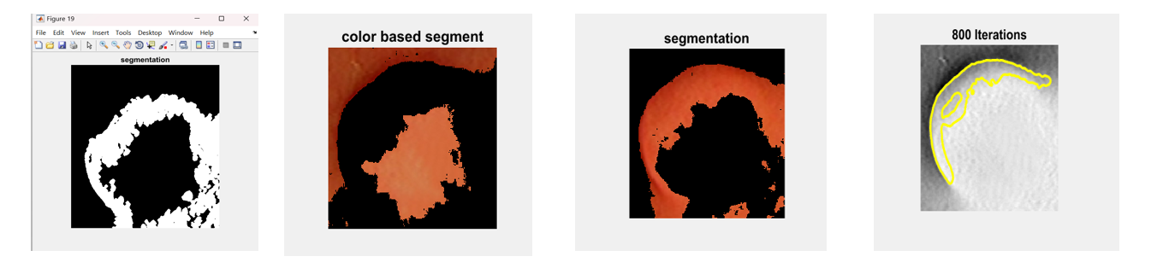
Segmentation output:
Segmentation: Dividing an image into regions to make analysis easier.
Color-Based Segmentation: Separating image parts based on color to highlight specific features.
Iterations : Repeated steps to improve model accuracy by adjusting weights based on training data.

Slide 20
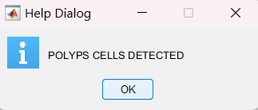
Disease Identification Results:
the disease identified is displayed in a help dialog box , as they match the features of particular disease from training dataset.
using enhanced image processing techniques it enhanced the images and performed segmentation,extracted the features from training dataset and classified using CNN algorithm as it is the best choice for classification tasks.
Model Accuracy is 99.2 %
Achieved after completeing 800 iterations

Slide 21
SYSTEM AND SOFTWARE REQUIREMENTS
Windows 7 (or) higher
64 bit operating system
Disk Space
2 GB for MATLAB only,
4–8 GB for a typical installation.
Minimum 2GB RAM needed
No specific graphic cards required
SOFTWARE USED: MATLAB 2016a
TOOL BOX : Image Processing Tool Box

Slide 22
APPLICATIONS
Early Detection of Gastrointestinal Diseases
Clinical Diagnostics
Medical Image Processing(MRI and CT scans)
Research and Development
Remote Diagnosis

Slide 23
CONCLUSION
This project presents an advanced image processing system to improve the detection of gastrointestinal diseases using endoscopic images. By enhancing image quality and leveraging CNN models, the system provides accurate classification of diseases such as polyps and ulcers and intestinal beeding.
The use of deep learning and noise reduction techniques ensures high precision, enabling early detection and diagnosis. This approach can significantly improve clinical outcomes and support medical professionals in making informed decisions.

Slide 24
THANK YOU

