Slide 1
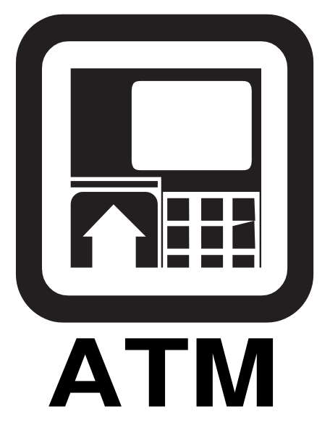

Automatic teller machine
Presented By:
Sonu Kumar
Shanny Kumar Singh
Suyash Chaturvedi
Sumitted to
Dr. A.Ranjith Kumar

Slide 2
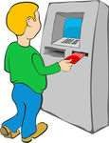
What is an ATM ??
An automated teller machine (ATM) is a computerized telecommunications device that provides the customers of a financial institution / bank with access to financial transactions in a public space without the need for a human clerk or bank teller round the clock (24 hrs a day)
Banks have been deploying ATMs to increase their reach.

Slide 3
ATM security
On most modern ATMs, the customer is identified by inserting a plastic ATM card with a magnetic stripe or a plastic smartcard with a chip, that contains a unique card number and some security information.
Security is provided by the customer entering a personal identification number (PIN).

Slide 4
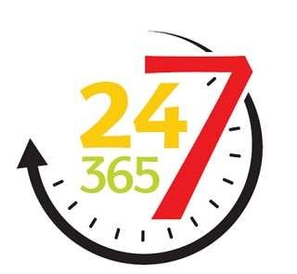
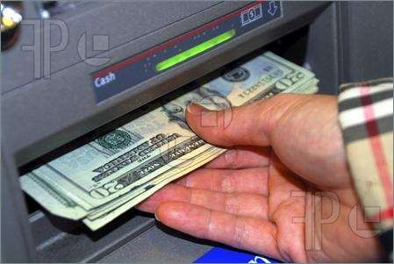

Functions of ATM
24-hour access to cash
View Account Balances & Mini-statements
Transfer Funds between accounts
Pay your utility bills
Deposit cash

Slide 5
HISTORY OF ATM
The first Automated Teller Machine (ATM) was introduced in the year 1967 by Barclays Bank in Enfield Town in North London.
The main objective of introducing the ATM was reducing customer’s time, lesser bank distribution cost and enhancing the efficiency of banking institutes.
The first person to use the machine was Reg Varney of "On the Buses" fame, a British Television programme from the 1960s
The idea of a PIN stored on the card was developed by the British engineer John
Rose in 1965.

Slide 6
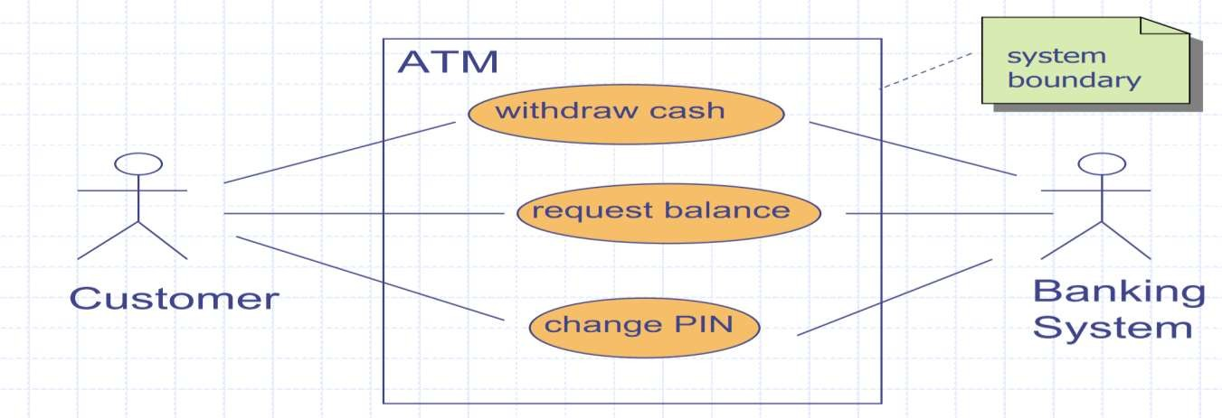
How does it come together?
User Case Diagram
6

Slide 7
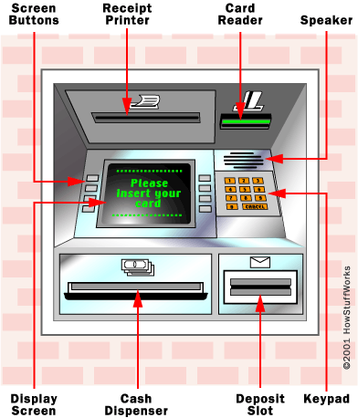
Structure of ATM
Card reader
Keypad
Speaker
Display screen
Receipt printer
Cash dispenser

Slide 8
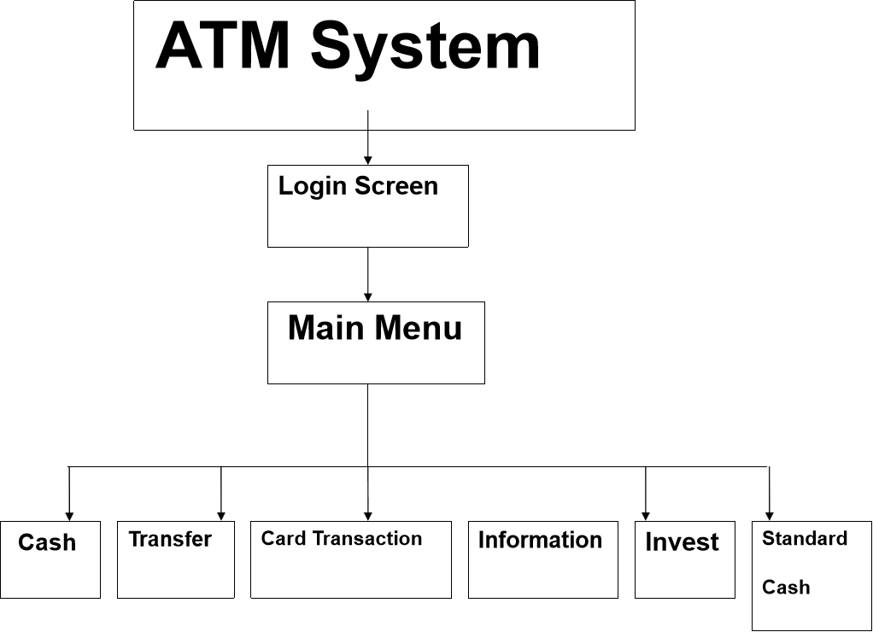
ARICTECTURE OF ATM SYSTEM

Slide 9
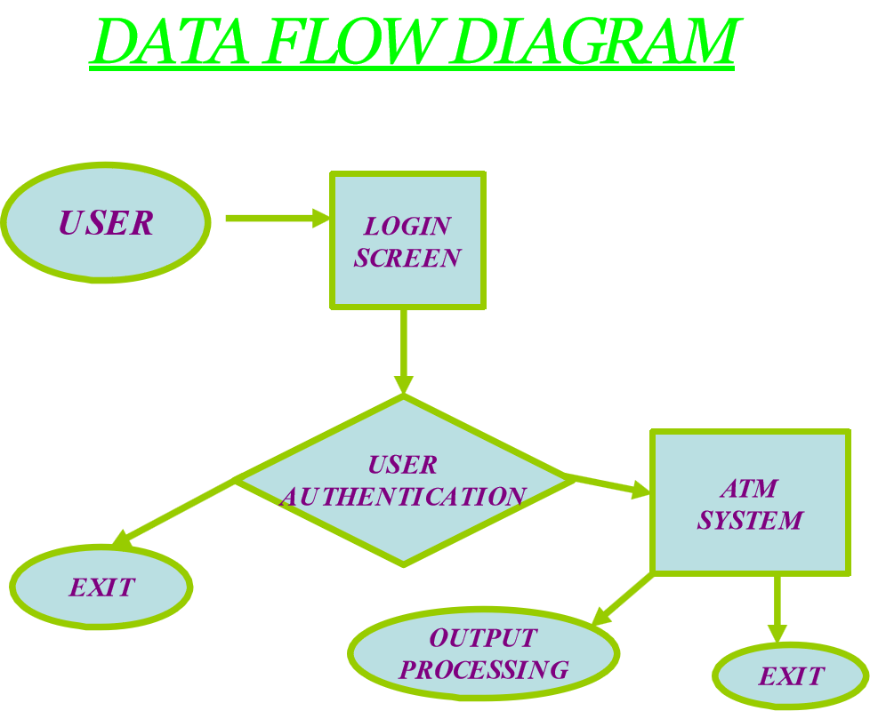

Slide 10
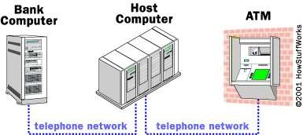
How Do ATMs Work?
An ATM is simply a data terminal with two input and four output devices. Like any other data terminal, the ATM has to connect to, and communicate through, a host processor

Slide 11
ABSTRACT
The ATM System is the project which is used to access their bank accounts in order to make cash withdrawals. Whenever the user need to make cash withdraws, they can enter their PIN number (personal identification number) , Once their withdrawn was successful, the amount will be debited in their account.
The ATM will service one customer at a time. A customer will be required to enter ATM personal identification number (PIN). he customer will then be able to perform one or more transactions. Also customer must be able to make a balance inquiry

Slide 12
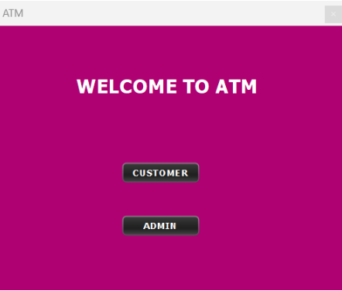
Outputs
main window

Slide 13
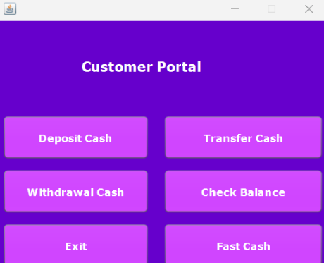
Customer window

Slide 14
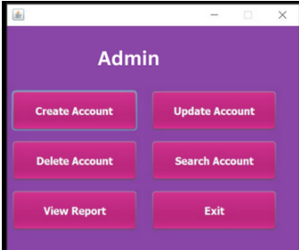
Admin window

Slide 15
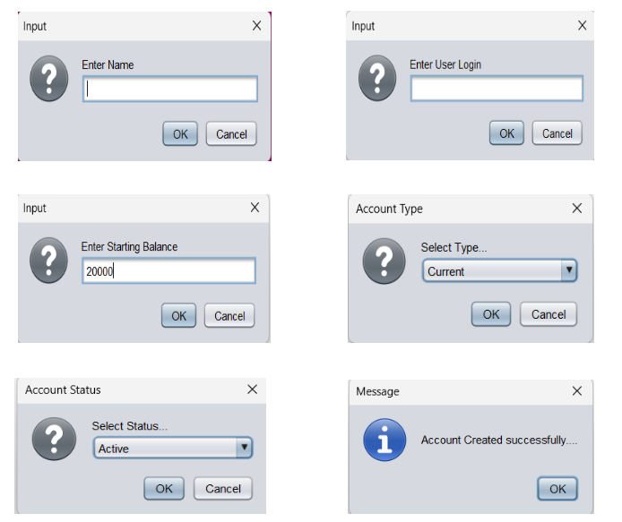
Create account

Slide 16
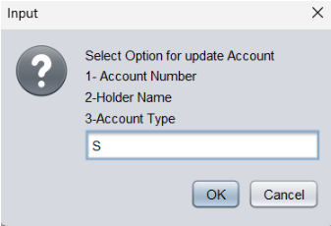
Update account

Slide 17
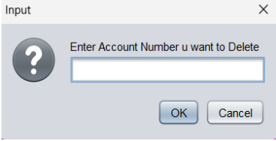
Delete account

Slide 18
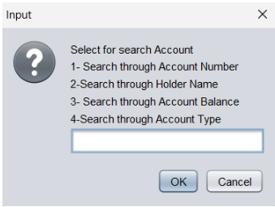
Searching account

Slide 19
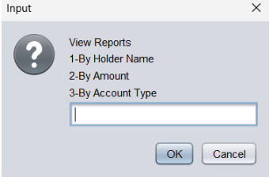
View report

Slide 20
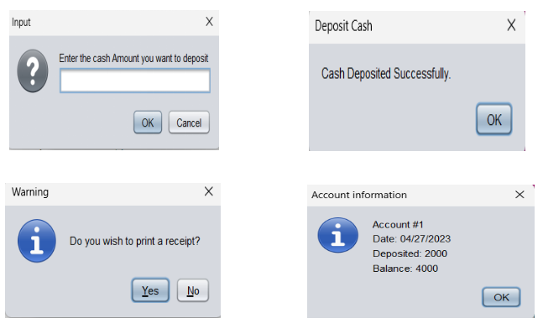
Deposit cash

Slide 21
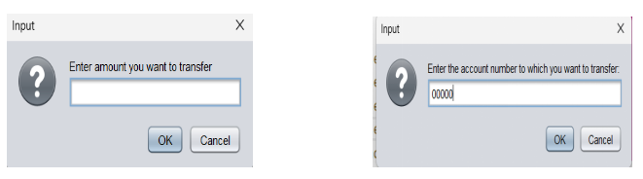
Transfer cash

Slide 22
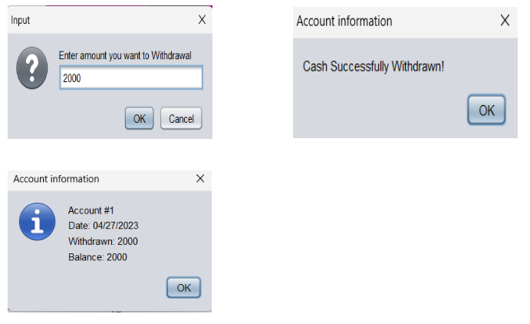
Withdrawal cash

Slide 23
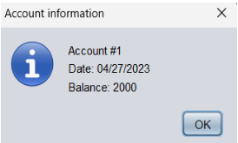
Check balance

Slide 24
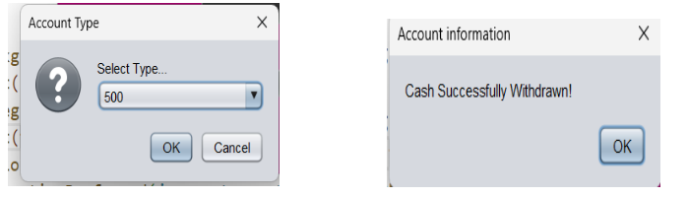
Fast cash

Slide 25
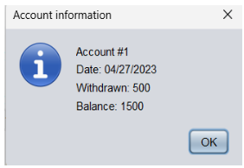

Slide 26
Conclusion
The project on “ ATM SYSTEM "has been developed as the
best flexible and efficient project within the available resources
and time.
• Care has been taken at each step to make it more user
friendly so that users can add new features where ever necessary
while using this automated system. It May be Enhanced for
Requirement of User.

Slide 27


