Slide 1
Introduction to Data Structures

Slide 2
Elementary Data Organization
Data are simply values or sets of values.
Collection of data are frequently organized into a hierarchy of fields, records and files.
This organization of data may not complex enough to maintain and efficiently process certain collections of data.
For this reason, data are organized into more complex type of structures called Data Structures.

Slide 3
Data Structures
Data Structures
The logical or mathematical model of a particular organization of data is called a data structure.
Choice of Data Structures
The choice of data structures depends on two considerations:
  It must be rich enough in structure to mirror the actual relationships of data in the real world.
  The structure should be simple enough that one can effectively process data when necessary.

Slide 4
Classification of Data Structure
1. Primitive
Ex.: Integer, Real, Character, Boolean.
2. Non-Primitive
  Linear Data Structure
Ex.: Arrays, Linked Lists, Stacks, Queues
  Nonlinear Data Structure
Ex.: Trees, Graphs
Array
A
B
C
D
E
F
A
Tree
B
C
D
E
F

Slide 5
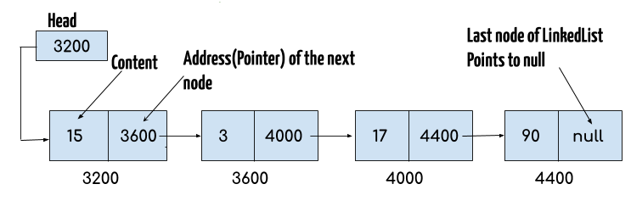
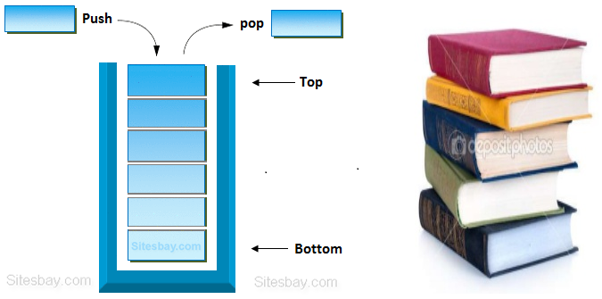
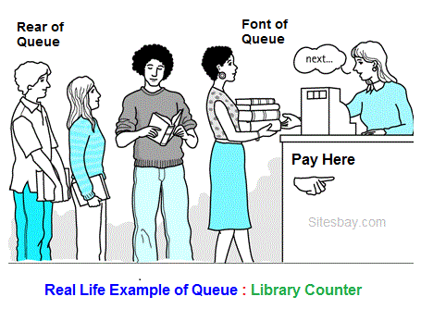
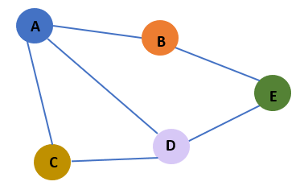
Linked List
Stack
Queue
Graph

Slide 6
Data Structure Operations
Traversing: Accessing each record exactly once so that certain items in the record may be processed.
2. Searching: Finding the location of the record with a given key value.
3. Inserting: Adding a new record to the structure.
4. Deleting: Removing a record from the structure.
5. Sorting: Arranging the records in some logical order.
6. Merging: Combing the records in two different sorted files into a single sorted file.

Slide 7
Algorithmic Notation
Identifying Number
Steps, Control, Exit
Comments
Variable Names
Assignment Statement
Input and Output
Procedure

Slide 8
Algorithms
It is a well-defined set of instructions used to solve a particular problem.
Example:
Write an algorithm for finding the location of the largest element of an array Data.
Largest-Item (Data, N, Loc)
1. set k:=1, Loc:=1 and Max:=Data[1]
2. while k<=N repeat steps 3, 4
3. If Max < Data[k] then Set Loc:=k and Max:=Data[k]
4. Set k:=k+1
5. write: Max and Loc
6. exit

Slide 9
Complexity of Algorithms
The complexity of an algorithm M is the function f(n) which gives the running time and/or storage space requirement of the algorithm in terms of the size n of the input data.
Measures of complexity
  Time Complexity- Time is measured by counting the number of key operations(number of comparisons)-in searching and sorted algorithms.
  Space Complexity- The space is measured by counting the maximum of memory needed by the algorithm

Slide 10
Linear Search
A linear array DATA with N elements and a specific ITEM of information are given. This algorithm finds the location LOC of ITEM in the array DATA or sets LOC: =0.
1. [Initialize] Set K: =1 and LOC: =0.
2. Repeat Steps 3 and 4 while LOC=0 and K<=N.
3. If ITEM=DATA [K], then: Set LOC: =K.
4. Set K: =K+1. [Increments counter]
[End of step 2 loop.]
5. [Successful.]
If LOC=0, then:
Write: ITEM is not in the array DATA
Else:
Write: LOC is the location of ITEM.
[End of If Structure.]
6. Exit.

Slide 11
Best Case : When Item does appear in first Position in DATA.
Worst Case : When Item is the last element in array DATA or is not there at all.
        C(n) = n
Average Case : When Item does appear in DATA at any position in array.
    Number of Comparison can be any of number 1,2,3,…n
    Each number occur with probability p= 1/n.
    C(n) = 1. 1/n + 2. 1/n+ ……. + n. 1/n
    = (1+2+3+….+n). 1/n
    = (n(n+1)/2) . 1/n
    = n+1/n

Slide 12
String Processing
Introduction
Basic Terminology
  Character Set
    Alphabet
    Digits
    Special Characters
  String
    Empty String or Null String
    Concatenation

Slide 13
Storing String
Strings are stored in three types of structures:
  Fixed-length Structures
  Variable-length Structures with fixed maximum
  Linked Structures.

Slide 14
Record-Oriented Fixed-length Structures
In Fixed-length storage each line of print is viewed as a record, where all records have the same length.
Each record accommodates the same number of character.

Slide 15
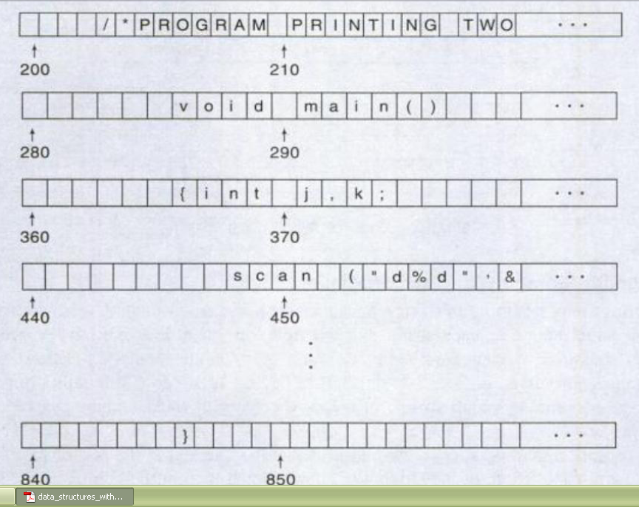
Fixed Length Storage

Slide 16
Disadvantages of Fixed-length Structures
Time is wasted reading an entire record if most of the storage consists of inessential blank spaces.
Certain records may require more space than available.
Correction-entire record change

Slide 17
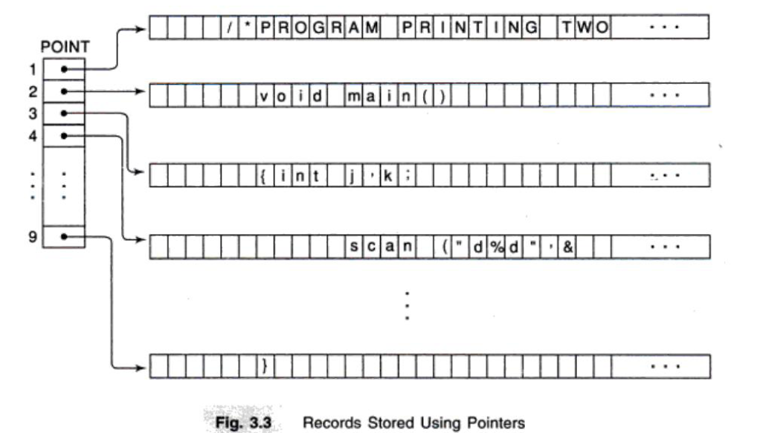

Slide 18
Variable-length Structures with fixed maximum
  One can use a marker, such as two dollar signs ($$), to signal the end of the string.
  One can list the length of the string- as an additional item in the pointer array.

Slide 19
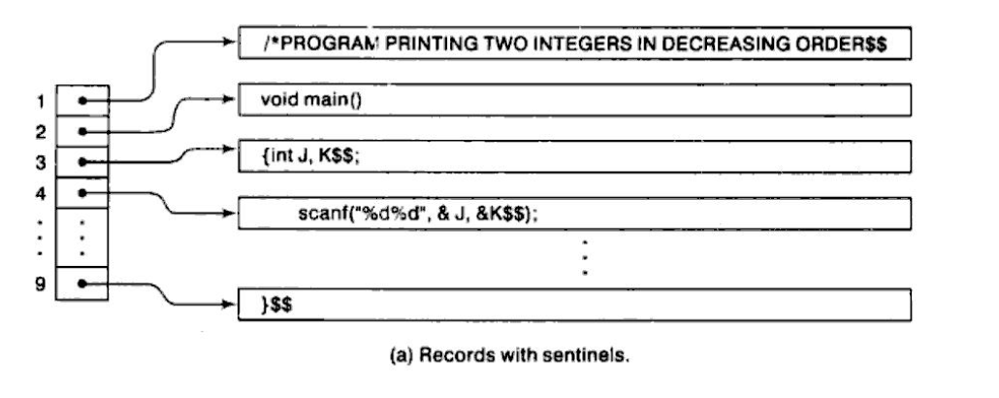
Variable Length Storage

Slide 20
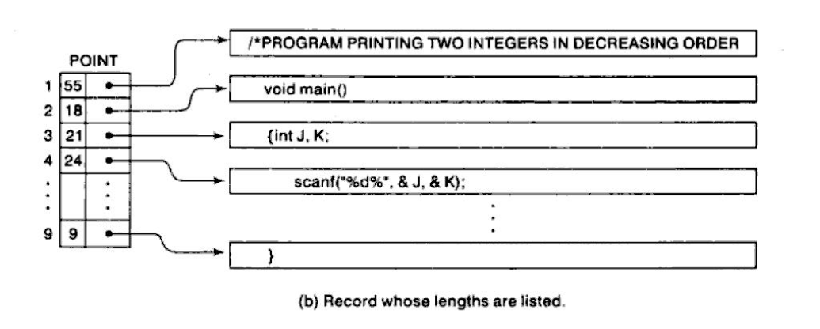

Slide 21
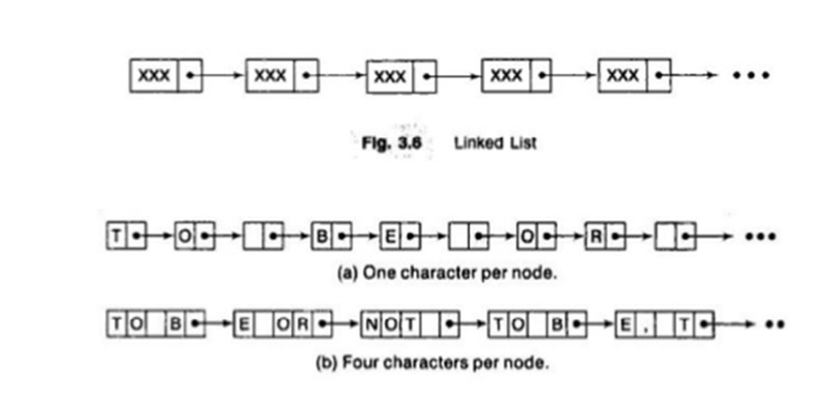
Linked Storage

Slide 22
Character Data Type
Constant- Many programming languages denote string constants by placing the string in either single or double quotation marks.
  Eg-”THE END”
-String constants of the length 7.
Variables-
Static –length is defined before the program is executed
Dynamic – change during the execution of the program
Semistatic -length does not exceed a maximum value determined by the program

Slide 23
String Operation
String may be viewed simply as a sequence or linear array of character.
String = ‘TO BE OR NOT TO BE’
  Array = [4,6,8,9,10]
Substring
  SUBSTRING ( string, initial, length)
  String =‘TO BE OR NOT TO BE’
  Ex.- SUBSTRING( String, 4, 7)= ‘BE OR N’

Slide 24
Indexing - Finding the position where string pattern P first appear in given string text T.
  INDEX(text, pattern)
  Text - ‘TO BE OR NOT TO BE’
  Ex. - INDEX(Text, ‘BE’) = 4
Concatenation-
S1 || S2
S1 = ‘ABC’
S2 = ‘DEF’
S1 || S2 = ‘ABCDEF’
Length – LENGTH(String)
  String – ‘ABC’
LENGTH(String) = 3

Slide 25
Word Processing
Insertion
  INSERT(text, position, string)
  Ex.- INSERT(‘ABCD’, 3, ‘XYZ’) = ‘ABXYZCD’
Deletion
  DELETE(text, position, length)
  Ex.- DELETE (‘ABCD’, 3, 1) = ‘ABD’
Replacement
  REPLACE(text, pattern1, pattern2)
  Ex.- REPLACE (‘ABCD’, ‘BC’, ‘XY’) = ‘AXYD’

