Slide 1
Unit-2

Slide 2
Contents
Linear arrays and their representation in memory, traversing linear arrays, inserting & deleting operations, Bubble sort, Linear search and Binary search algorithms. Multidimensional arrays, Pointer arrays. Record structures and their memory representation. Matrices.

Slide 3
Linear Array
Linear Array is a list of finite number n of homogeneous data elements such that.
The elements are referenced respectively by an index set consisting of n consecutive numbers.
The elements are stored respectively in successive memory locations.
The number n of element is called length or size of array.
Length = UB – LB + 1
UB – largest index ( upper bound )
LB – smallest index ( lower bound )
The element of an array may be denoted by subscript notation or by bracket notation.
A1, A2, A3…. An OR A[1], A[2], A[3]……A[n]

Slide 4
Representation of Linear Array in Memory
LA be a linear array in the memory of computer.
LOC ( LA[K])= address of the element LA[K] of array LA.
1000
1001
1002
1003
1004
1005
Computer Memory

Slide 5
The Computer Calculate the address of any element of LA
LOC ( LA[K])= Base( LA ) + w( K – Lower Bound)
W is the number of words per memory cell in memory.
Ex. Consider the array AUTO which records the number of vehicle sold each year from 1932 to 1984. that is
Base(AUTO) = 200 and w= 4
then find out the address of the array
element for the year K = 1965
200 |  | AUTO[1932]
201
202
203
204 |  | AUTO[1933]
205
206
207
208 |  | AUTO[1934]
209
210
211

Slide 6
Traversing a Linear Array
We want to print the contents of each element of LA
We want to count the number of elements of LA with given properties.
Traversing-Visiting each element of LA exactly once.

Slide 7
Traversing a Linear Array
Here LA is a linear array with lower bound LB and upper bound UB. This algorithm traverses LA applying an operation PROCESS to each element of LA.
1. [Initialize Counter.] Set K: =LB.
2. Repeat Steps 3 and 4 while K<=UB.
3. [Visit element.] Apply PROCESS to LA[K].
4. [Increase Counter.] Set K:=K+1.
[End of step 2 loop.]
5. Exit.

Slide 8
Traversing a Linear Array
Here LA is a linear array with lower bound LB and upper bound UB. This algorithm traverses LA applying an operation PROCESS to each element of LA.
1. Repeat for K:=LB to UB.
[Visit element.]
Apply PROCESS to LA[K].
[End of step 2 loop.]
2. Exit.

Slide 9
Inserting and Deleting
Inserting-
Inserting an element at the END of a linear array.
Insert an element in the MIDDLE of a linear array.

Slide 10
Inserting into a Linear Array
INSERT (LA, N, K, ITEM)
Here LA is a linear array with N elements and K is a positive integer such that K<=N. This algorithm inserts an element ITEM into the K^{th} position in LA.
1. [Initialize Counter.] Set J: =N.
2. Repeat Steps 3 and 4 while J>=K.
3. [Move J^{th} element downward.] Set LA [J+1]:= LA [J].
4. [Decrease counter.] Set J: =J-1.
[End of Step 2 loop.]
5. [Insert element.] Set LA [K]:=ITEM.
6. [Reset N.] Set N: =N+1.
7. Exit.

Slide 11
Deleting-
Deleting an element at the “end” of an array presents no difficulties.
But deleting an element somewhere in the middle of the array would require that each subsequent element be moved one location upward in order to “fill up” the array.

Slide 12
Deleting from a Linear Array
DELETE (LA, N, K, ITEM)
Here LA is a linear array with N elements and K is a positive integer such that K<=N. This algorithm deletes the Kth elements from LA.
1. Set ITEM: =LA [K].
2. Repeat for J=K to N-1:
[Move J + 1st element upward.] Set LA [J]:=LA [J+1].
[End of loop.]
3. [Reset the number N of elements in LA.] Set N: =N-1.
4. Exit.

Slide 13
Sorting : Bubble Sort
Let A be the list of n numbers. Sorting A refers to the operation of rearranging the elements of A. i.e…
A[1] < A[2] < A[3] < ….. < A[N]
Bubble Sort Animation in PowerPoint.mp4

Slide 14
Bubble Sort
BUBBLE SORT (DATA, N)
Here DATA is an array with N elements. This algorithm sorts the elements in DATA.
1. Repeat Steps 2 and 3 for K=1 to N-1.
2. Set PTR: =1. [Initializes pass pointer PTR]
3. Repeat while PTR<=N-K: [Executes pass.]
(a)If DATA [PTR]>DATA [PTR+1], then:
Interchanges DATA [PTR] and DATA [PTR+1]
[End of If structure.]
(b)Set PTR:=PTR+1
[End of inner loop.]
[End Step1 of outer loop.]
4. Exit.

Slide 15
Searching: Linear Search
DATA is linear array with N elements, and ITEM is given item of information. This algorithm finds the LOC of ITEM in DATA or Set LOC =0 if Unsuccessful.
1. [Insert ITEM at the end of DATA] set DATA[N+1] := ITEM
2. [Initialize counter] set LOC := 1
3. [Search for ITEM]
Repeat while DATA[LOC] != ITEM:
Set LOC := LOC+1
[End of loop]
4. [Successful?] if LOC = N+1, then: set LOC := 0
5. Exit

Slide 16
BEG=MID+1 END=MID-1 MID=
11 | 22 | 33 | 44 | 55 |  | 44
1 | 2 | 3 | 4 | 5

Slide 17
Binary Search
Binary Search (DATA, LB, UB, ITEM, LOC):
Here DATA is a sorted array with lower bound LB and upper bound UB and ITEM is a given item of information. The variables BEG, END and MID denote, respectively, the beginning, end and middle locations of a segment of elements of DATA. This algorithm finds the location LOC of ITEM in DATA or sets LOC=NULL.

Slide 18
1.[Initialize segment variables.]
Set BEG: = LB, END: =UB and MID=INT((BEG+END)/2).
2. Repeat Steps 3 and 4 while BEG<=END and
DATA [MID]! =ITEM.
3. If ITEM< DATA[MID], then:
Set END: =MID-1
Else:
Set BEG: = MID+1.
[End of If statement.]
4. Set MID: = INT ((BEG+END)/2).
[End of Step 2 loop].
5. If DATA[MID] = ITEM, then:
Set LOC: = MID.
Else:
Set LOC: =NULL.
[End of If structure.]
6. Exit.

Slide 19
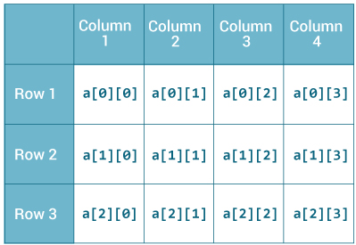
Multidimensional Array
Two-Dimensional Array
A two-dimension m x n array, A is it collection of m.n data elements such that each elements is specified by pair of integers (such as J,K) called subscripts, with the property that,
1<= J <= m , 1<= K <= n

Slide 20
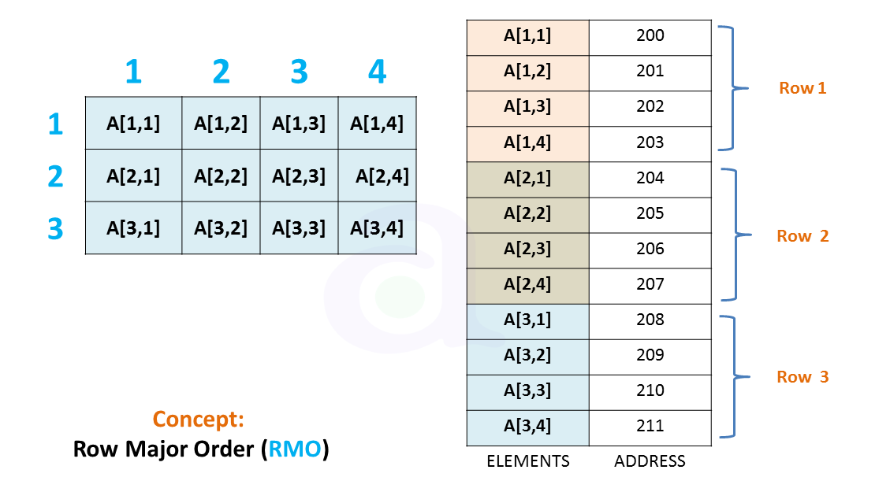
Representation of Two-Dimensional Array in Memory
LOC(A[J,K]) = Base( A ) + w[N(J-1)+(K-1)]

Slide 21
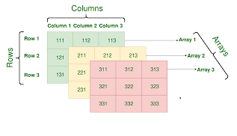
General Multidimensional Arrays

Slide 22
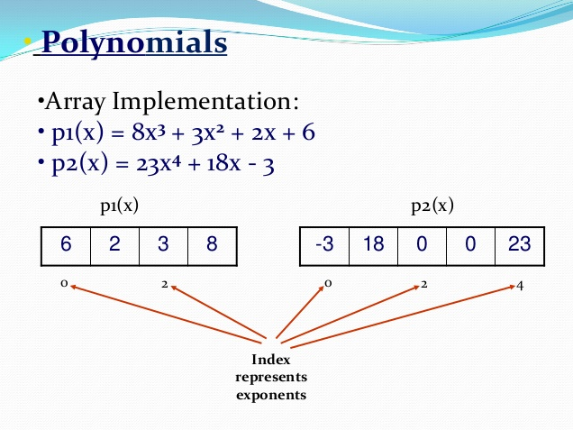

Slide 23
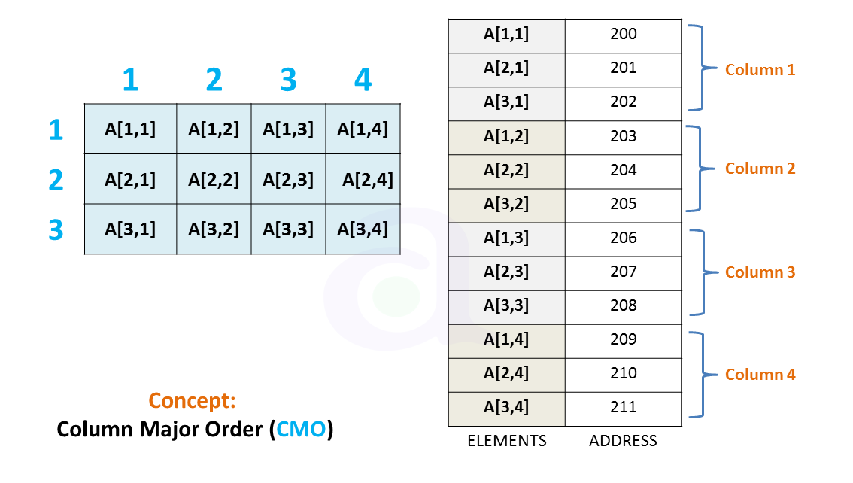
LOC(A[J,K]) = Base( A ) + w[M(K-1)+(J-1)]

Slide 24
Pointer, Pointer Array
Let DATA be an array.
A variable P is called a pointer if P points to an element in DATA i.e. if P contains the address of an element in DATA.
An array PTR is called pointer array if each element of PTR is a pointer.

Slide 25
Records; Record Structure
A Record may be collection of nonhomogeneous data i.e. the data item in a record may have different data type.
The data items in a record are indexed by attribute names.
Indexing Item in Record – Qualification is indicated by using decimal point to separate group items from sub items.

Slide 26
LINKED LIST
Linked lists: Memory Representation of Linked List, traversing a linked list, searching a linked list. Memory allocation & garbage collection. Insertion & deletion operations on linked lists. Header linked lists, Two- way linked lists.

Slide 27
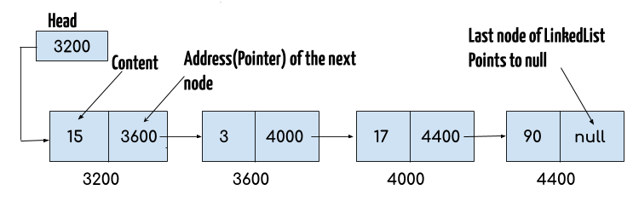
Linked List

Slide 28
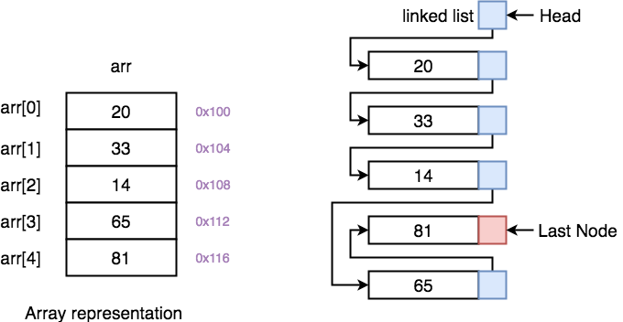

Slide 29
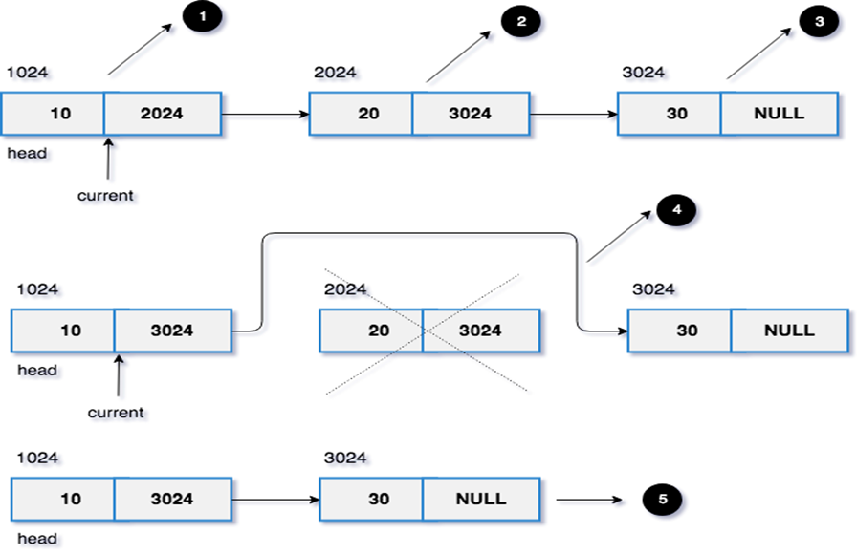

Slide 30
Two-way lists
A two-way list is a linear collection of data elements, called nodes, where each node N is divided into three parts:
Information field
Forward Link which points to the next node
Backward Link which points to the previous node
The starting address or the address of first node is stored in START / FIRST pointer .
Another pointer can be used to traverse list from end. This pointer is called END or LAST.

Slide 31
• Every node (except the last node) contains the address of the next node, and every node (except the first node) contains the address of the previous node.
• A two-way list (doubly linked list) can be traversed in either direction.

Slide 32
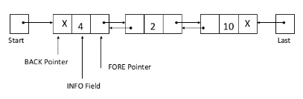
Representation of Two-way lists

Slide 33
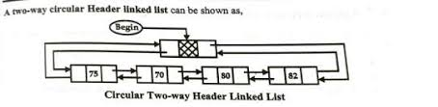
Two way Header List

Slide 34
HEADER LINKED LISTS
A header linked list which always contain a special node called header node at the beginning of the list.
There are two kinds of widely used header lists:
Grounded header list is a header list where the last node contains null pointer
Circular header list is a header list where the last node points back to the header node

Slide 35
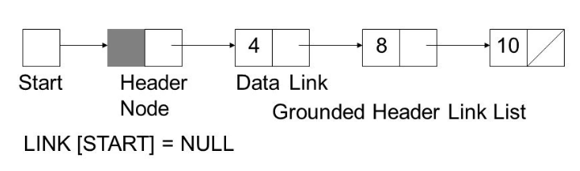
Grounded Header Linked List
A grounded header list is a header list where the last node contains the null pointer.
The term “grounded” comes from the fact that many texts use the electrical ground symbol to indicate the null pointer. Header Node Start Figure: Grounded Header Link List

Slide 36
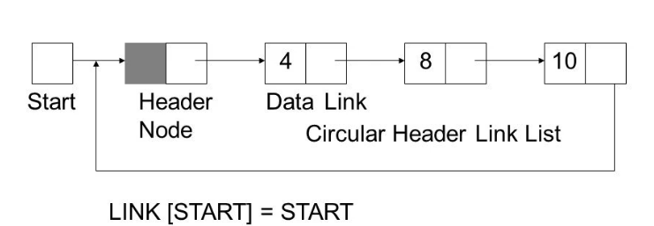
Circular Header Linked List
A circular header linked list is a header list where the last node points back to the header node.
START always points to the header node.
LINK[START] = NULL means grounded header list is empty.
LINK[START] = START indicates that a circular header list is empty. Header Node Figure: Circular Header Link List Start

