Slide 1
Unit-I Introduction to Data Structures

Slide 2
Definition
Data structure: Collection of data
Data structure is a specialized format for organizing and storing data in memory that considers not only the elements stored but also their relationship to each other.

Slide 3
Classification of Data Structure
Data structure are normally divided into two broad categories:
Primitive Data Structure
Non-Primitive Data Structure

Slide 4
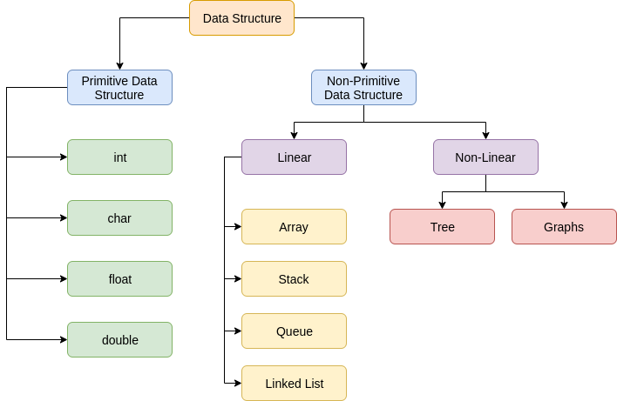
Classification of Data Structure

Slide 5
Primitive Data Structure
There are basic structures and directly operated upon by the machine instructions.
Data structures are directly operated upon the machine-level instructions .
Integer, Floating-point number, Character constants, string constants, pointers etc, fall in this category.

Slide 6
Primitive Data Structure
The most commonly used operation on data structure are broadly categorized into following types:
Create
Selection
Updating
Destroy or Delete

Slide 7
Non-Primitive Data Structure
There are more sophisticated Data structures.
The Data structures that are derived from the primitive data structures are called Non-primitive data structure.
The non-primitive data structures emphasize on structuring of a group of homogeneous (same type) or heterogeneous (different type) data items.

Slide 8
Non-Primitive Data Structure
Linear Data structures:
The data structure in which elements are in a sequence and form a linear series.
Linear data structures are very easy to implement, since the memory of the computer is also organized in a linear fashion.
Some commonly used linear data structures are Stack, Queue and Linked
Lists.
Non-Linear Data structures:
Non-Linear data structure may exhibit either a hierarchical relationship or parent child relationship.
The data elements are not arrang ed in a sequential structure. The different non-linear data structures are trees and graphs.

Slide 9
Non-Primitive Data Structure
The most commonly used operation on data structure are broadly categorized into following types:
Traversal
Insertion
Selection Searching Sorting
Merging
Destroy or Delete

Slide 10
Description of various
Data Structures : Arrays
An array is defined as a set of finite number of homogeneous elements or same data items.
It means an array can contain one type of data only , either all integer, all float-point number or all character.

Slide 11
Arrays
Simply, declaration of array is as follows:
int arr [10]
Where int specifies the data type or type of elements arrays stores.
“arr” is the name of array & the number specified inside the square brackets is the number of elements an array can store, this is also called sized or length of array.

Slide 12
Arrays types
Single Dimension Array
Array with one subscript
Two Dimension Array
Array with two subscripts
(Rows and Column)
Multi - Dimension Array
Array with Multiple subscripts

Slide 13
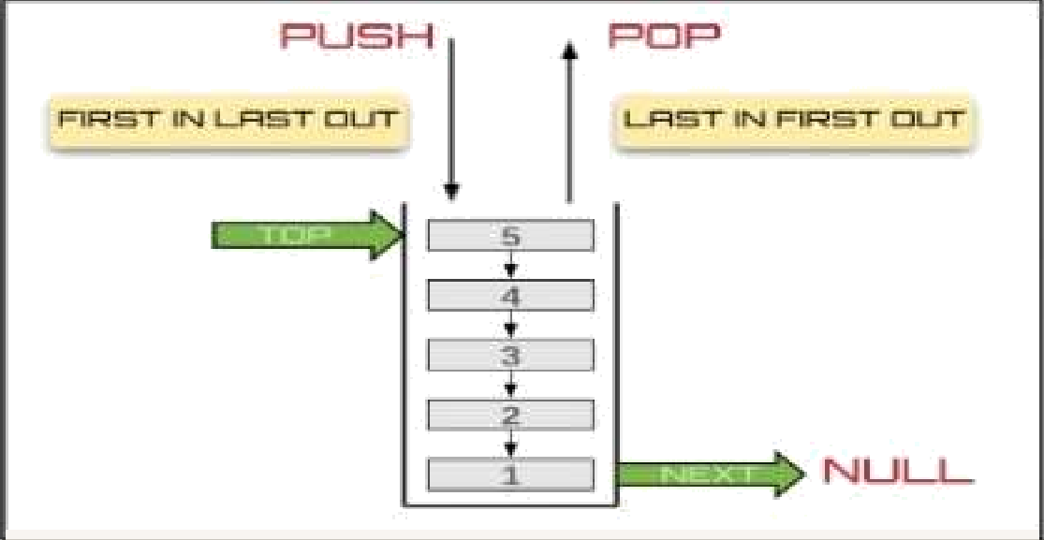
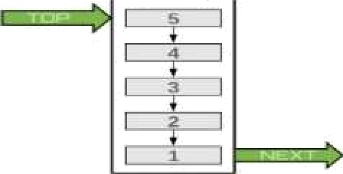
StAck
Stack is a linear data structure which follows a particular order in which the operations are performed.
Insertion of element into stack is called PUSH and
deletion of element from stack is called POP.
The order may be LIFO(Last In First Out) or FILO(First In Last Out).

Slide 14
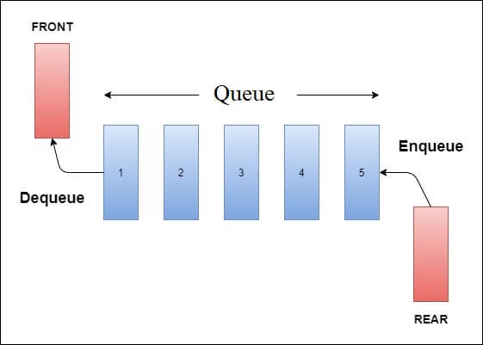
Queue
A queue is an ordered collection of items where an item is inserted at one end called the “rear and an existing item is removed at the other end, called the ’front”.
Queue is also called as FIFO list i.e. First-In First-Out.

Slide 15
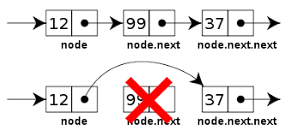
Linked Lists
A lists (Linear linked list) can be defined as a
collection of variable number of data items
called nodes.
Lists are the most commonly used non- primitive data structures.
Each nodes is divided into two parts: The first part contains the informationof the element.
The second part contains the memory address of
the next node in the list. Also called Link part.

Slide 16
Graph
An edge connects a pair of vertices and many have weight such as length, cost and another measuring instrument for according the graph.
Vertices on the graph are shown as point or circles and edges are drawn as arcs or line segment.

Slide 17
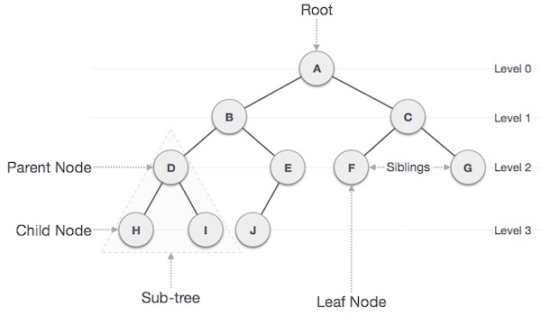
Trees
A Tree is a hierarchical data structure defined as a collection of nodes.
Nodes represent value and nodes are connected by edges.
The tree has one node called root.

Slide 18
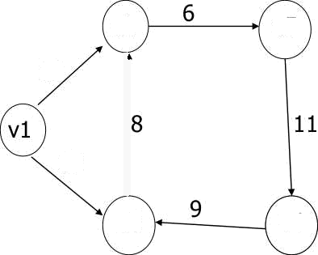
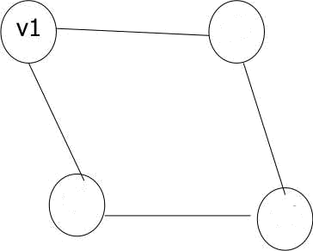

Graph
Example of graph:
v2
V5
v3
10
15
v2
v3
v4
v4
[a] Directed
Weighted Graph
Undirected Graph

