Slide 1
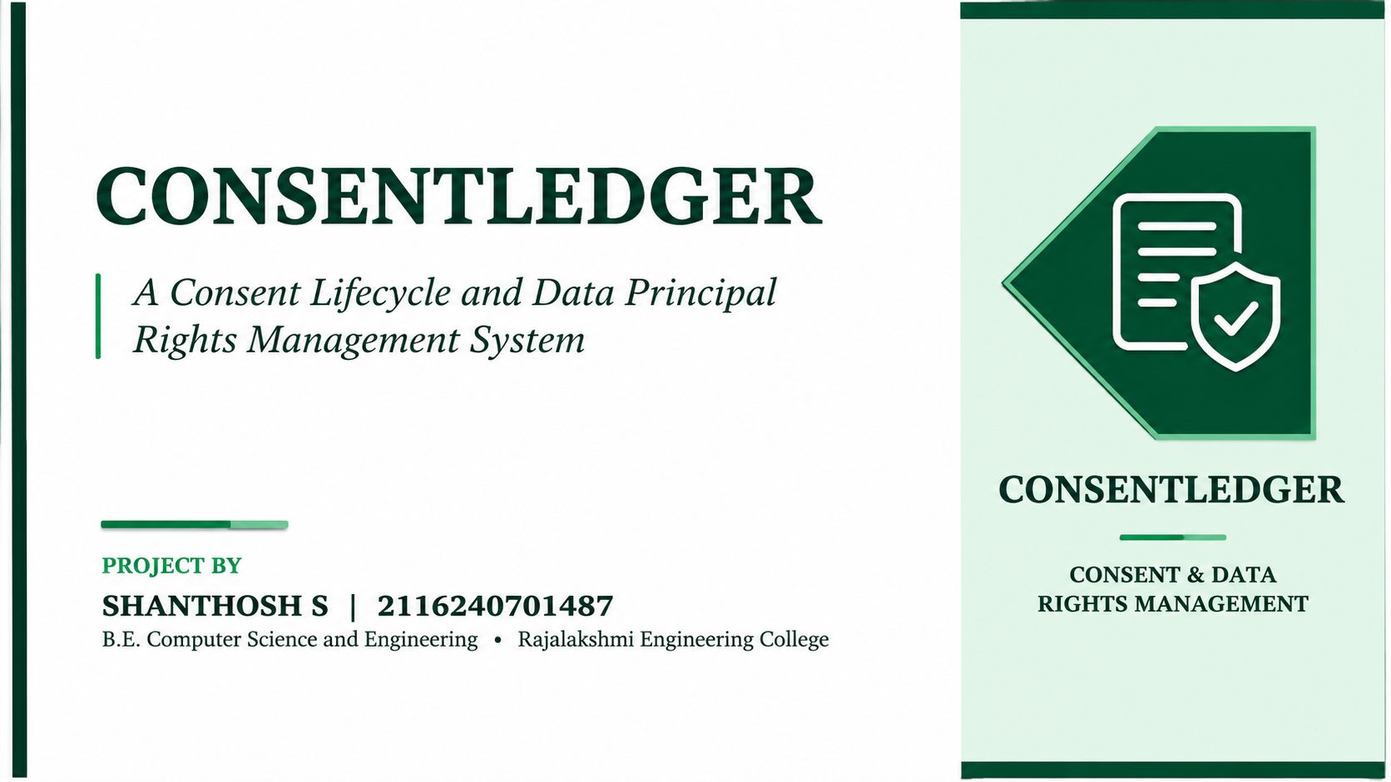

Slide 2
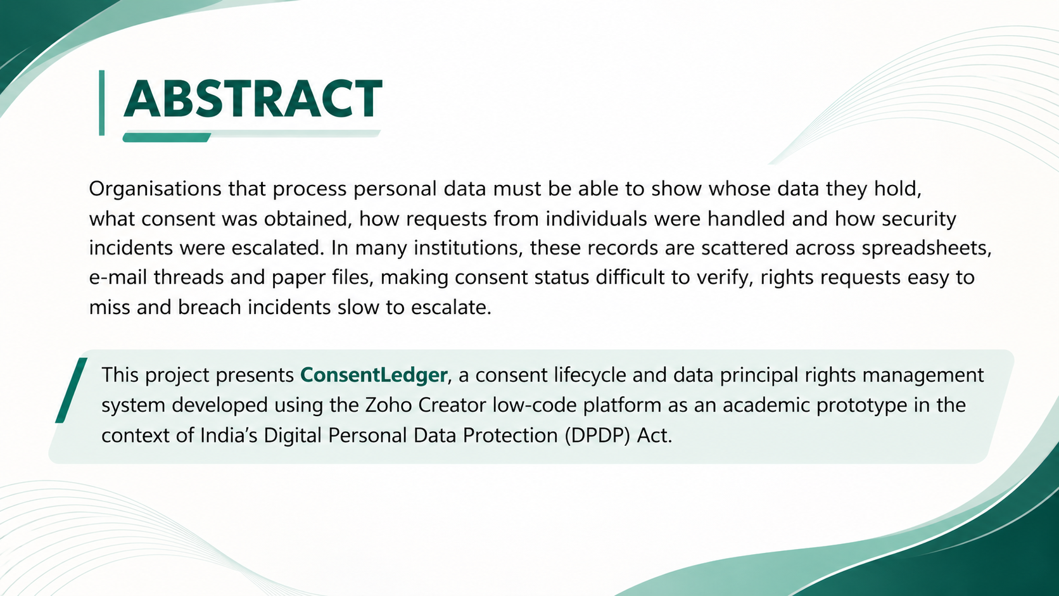

Slide 3
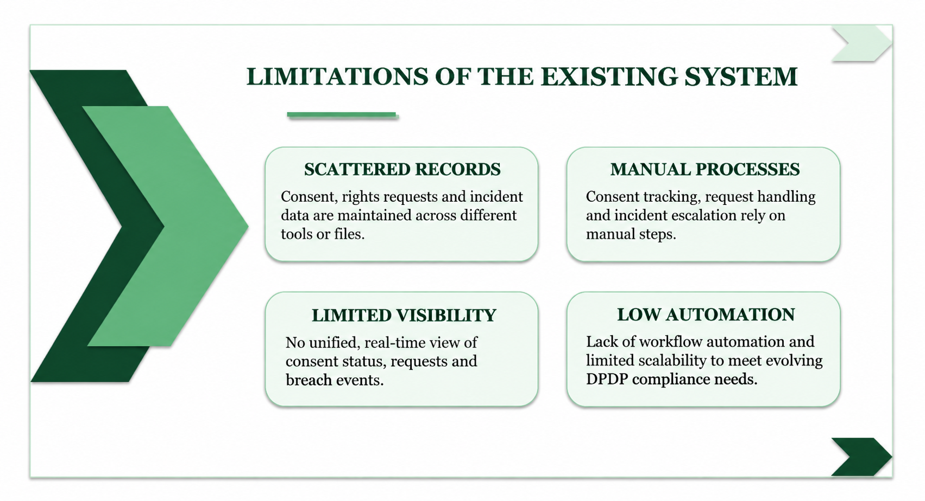

Slide 4
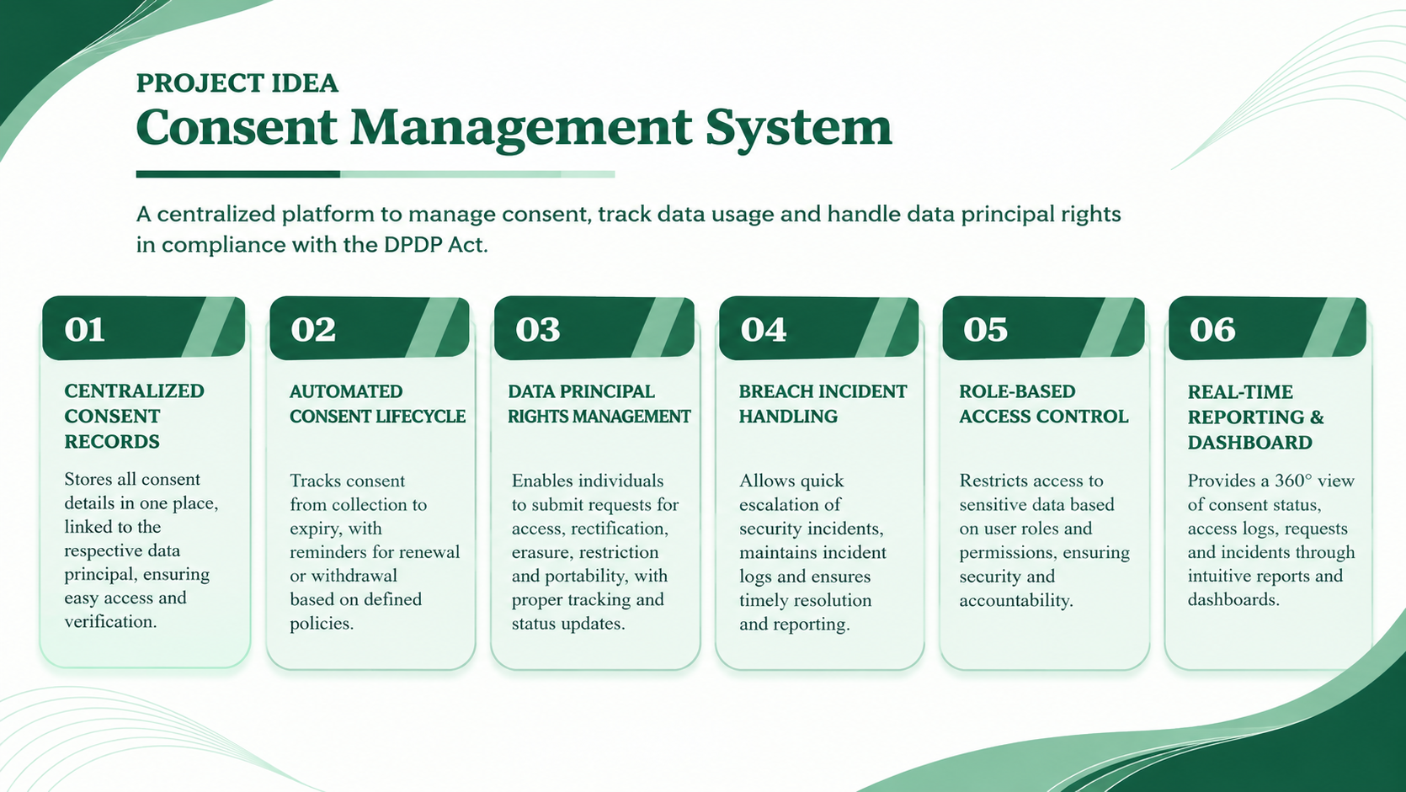

Slide 5
CONSENTLEDGER WORKFLOW
Three privacy workflows automated within Zoho Creator
01 CONSENT
Register Person
Enter data principal details in Person_Register.
Record Consent
Capture purpose, status, date and consent details.
Create Action Log
Consent creation triggers an Action_Log entry.
Review Records
View consent records through reports and dashboard.
02 RIGHTS
Submit Request
Authorised user enters request details.
Classify Request
Deluge assigns a request category.
Assess Deadline Risk
Deluge calculates deadline-risk status.
View Status
Classified request appears in reports and dashboard.
03 BREACH
Submit Incident
Enter severity, affected records and assigned officer.
Calculate Risk Score
Deluge scores severity and affected-record estimate.
Predict Risk Category
ML model assigns Low, Medium or High.
High-Risk Alert
If the prediction is High, an e-mail is sent.
HIGH → E-mail alert sent | MEDIUM / LOW → No e-mail alert
Rights requests are classified and flagged for deadline risk; they are not automatically completed or statutorily escalated.

Slide 6
ADVANTAGES OF CONSENTLEDGER
✓
Centralises privacy records
Keeps person, consent, rights request and breach details within one application.
✓
Automates request classification
Uses Deluge logic to classify submitted data principal rights requests.
✓
Highlights deadline risk
Assesses request deadline risk and reassesses it when key fields change.
✓
Standardises breach assessment
Calculates a numerical risk score using incident severity and affected-record estimates.
✓
Adds ML-based risk prediction
Predicts a risk category for submitted breach incidents using the deployed model.
✓
Enables conditional email alerts
Notifies responsible users by email when an incident is predicted as High risk.
✓
Maintains an action log
Records consent creation in Action_Log for improved traceability.
✓
Supports operational monitoring
Provides reports and dashboard KPI cards and charts for privacy operations.
A more organised, traceable and insight-driven approach to privacy operations.

Slide 7


