Slide 1
Global Banking Application
Build Data Pipeline
05-Aug-2024

Slide 2
Topics:
Overview
High Level Data Pipeline Diagram
Delta Lake Architecture
  Bronze layer
    Data Ingestion
  Silver Layer
    Cleansing and Transformation Rules
  Gold Layer
    Data Aggregation & Analysis
End to End Execution
Power-BI – Dashboards

Slide 3
Overview of the Problem Statement
Global Bank is undergoing a significant digital transformation to enhance its fraud detection capabilities, improve customer segmentation, and optimize its reporting systems. As part of this initiative, the bank requires a robust data pipeline that can efficiently handle real-time transaction data from multiple sources, including global branches and digital channels.
The key challenges include:
Scalability: Designing a system capable of ingesting and processing 100 to 500 transactions per second.
Data Management: Implementing a Delta Lake architecture that supports multiple data layers (Bronze, Silver, and Gold) for raw, cleansed, and aggregated data.
Fraud Detection: Developing a real-time fraud detection system based on rule-based flagging and transaction pattern analysis.
Customer Segmentation and Reporting: Creating a system that provides actionable insights through customer segmentation and automated reporting.

Slide 4
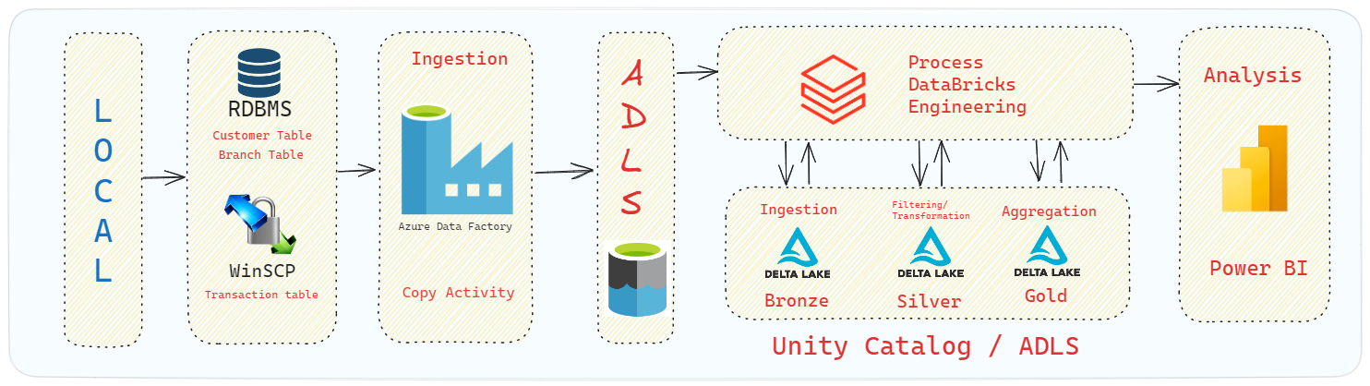
High Level Data Pipeline Diagram

Slide 5
Delta Lake Architecture- Medallion Architecture
Bronze Layer:
  Data Ingestion:
    Ingested data from Databricks File System (DBFS).
    Stored as Delta tables for raw, unprocessed data.
Reading Data:
  Customer Table
  Branches Table
Writing Data:
  Bronze Tables
Streaming Data:
  Transaction Data Processing
SQL Query:
  Max Join Date Calculation

Slide 6
Silver Layer:
• Data Cleaning & Transformation:
• Applied data cleaning rules to remove duplicates, handle missing values, etc.
• Executed transformation rules to prepare data for further processing.
Gold Layer:
  Data Aggregation & Analysis:
    Created customer_segmentation_table for customer insights.
    Created fraud_flag_table for identifying potential fraud cases.
    Performed additional aggregation for reporting

Slide 7
Phases of our data pipeline
Ingestion Phase
Transformation Phase
Analysis Phase
    Bronze layer:
    Ingested data from Databricks File System (DBFS).
    Stored as Delta tables for raw, unprocessed data.
Silver and Gold Layer:
Data Validation:
  Implement validation to identify data quality issues:
    Missing values
    Outliers
Data Cleansing and Transformation:
  Apply necessary transformations to clean and prepare data :
    Data inconsistencies
    Handle missing values with justification
    Standardize data formats
    Convert data types to match Schema (e.g., dates, null values, address verification)
Power-BI
Merge table Dashboard
Fraud Flag Dashboard
Customer Segmentation Dashboard

Slide 8
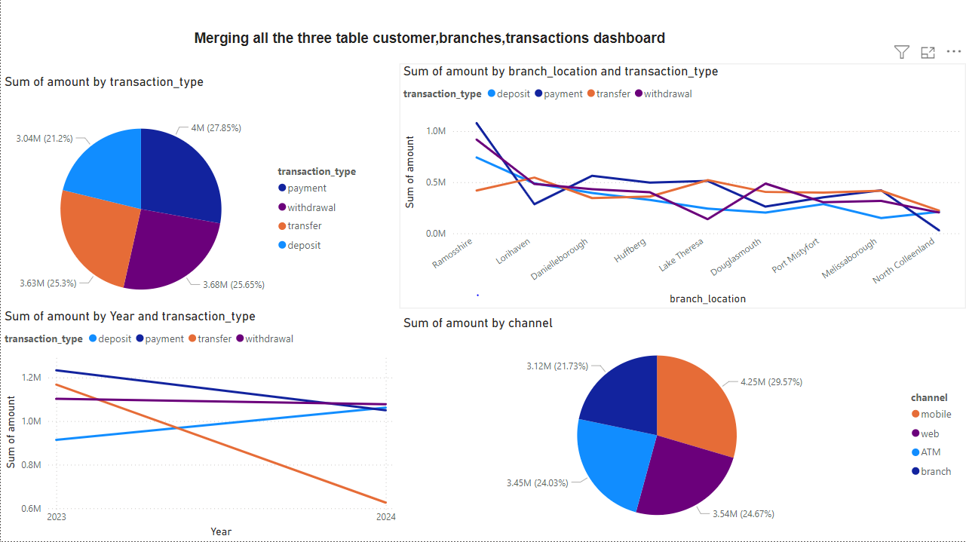
Power-BI – Dashboards

Slide 9
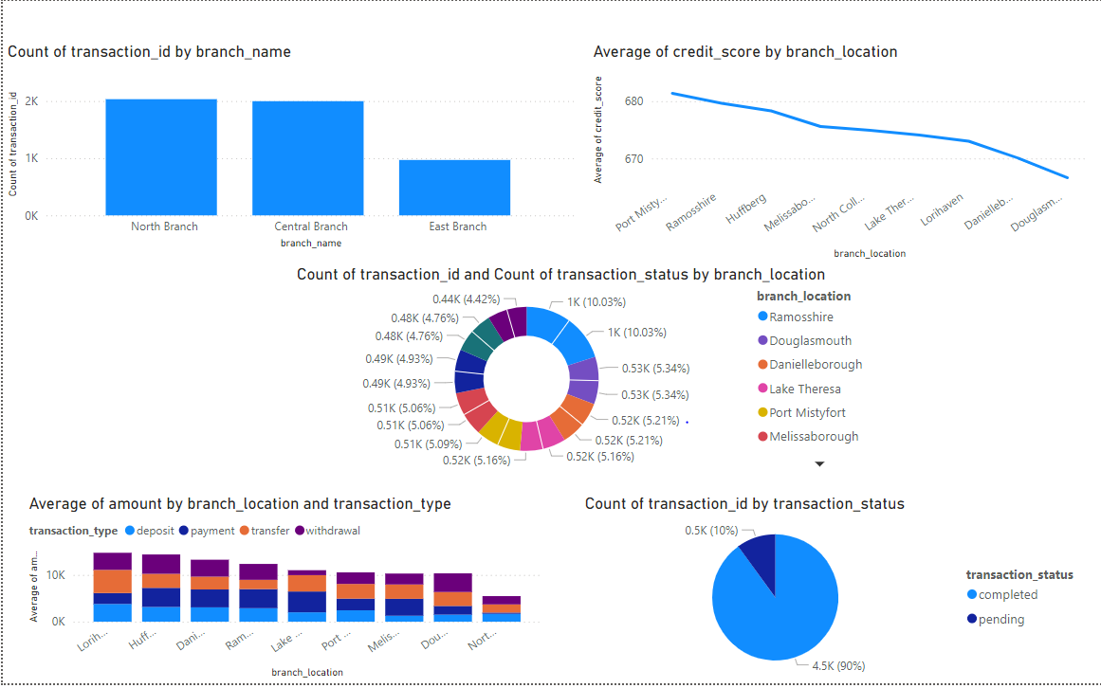

Slide 10
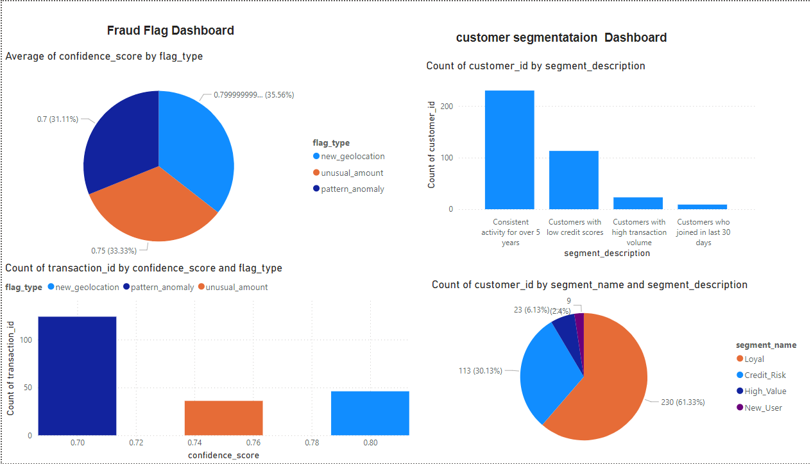

Slide 11
Thank You
Sharad Darade

