Slide 1

EV BATTERY SWAPPING STATION
A Scalable Energy-as-a-Service Model
Executive Research Report • February 2026
Prepared for Executive Leadership
⚡ < 90s Swap
🔋 ₹120/Swap
♻ 35% EBITDA
Fast • Clean • Profitable
EV Battery Swapping Station | Energy-as-a-Service • 1/14
Notes:
SPEAKER NOTES – Slide 1 (Title):
Welcome. This deck presents the investment & execution case for a Battery Swapping as a Service (BSaaS) venture in India. Duration ~35 min + Q&A.

Slide 2
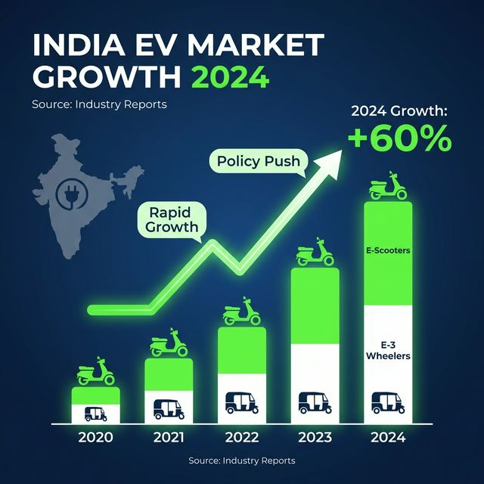
India's EV Opportunity
Massive market + infrastructure gap = the BSaaS window
1.73 M
Total EV Registrations – FY24 (VAHAN)
+43%
3W EV YoY Growth – FY24
USD 1.1B
Swapping Market Size by 2026 (IESA)
46,000
Charging Stations Needed by 2030 (BEE)
EV Battery Swapping Station | Energy-as-a-Service • 2/14
Notes:
SPEAKER NOTES – Slide 2:
India needs 34,000 more stations by 2030. The BSaaS market is validated — Battery Smart alone raised USD 65M Series B. 3W commercial vehicles are already 55%+ electrified in new sales.

Slide 3
The Four Bottlenecks Blocking EV Adoption
Charging infrastructure alone cannot solve the problem
⏱ Charging Time
💰 Battery Cost
5–8 hours Level 2 / 1 hr DC fast charge — unacceptable for 150-200 km/day riders
Batteries = 35–45% of EV price (BNEF 2023); ₹25K–₹1.2L upfront barrier
📡 Range Anxiety
⚡ Grid Impact
60–100 km real range; 15–25% productivity loss for gig workers (CEEW 2023)
Unmanaged EV charging could add 6–8 GW to peak demand by 2030 (CEA 2023)
EV Battery Swapping Station | Energy-as-a-Service • 3/14
Notes:
SPEAKER NOTES – Slide 3:
Focus on the commercial rider's pain: 2 hrs/day charging = ₹300-600 lost income. Multiply by 500K+ gig riders. Grid stress is both a risk AND an opportunity — BSaaS can be a demand-response asset.

Slide 4
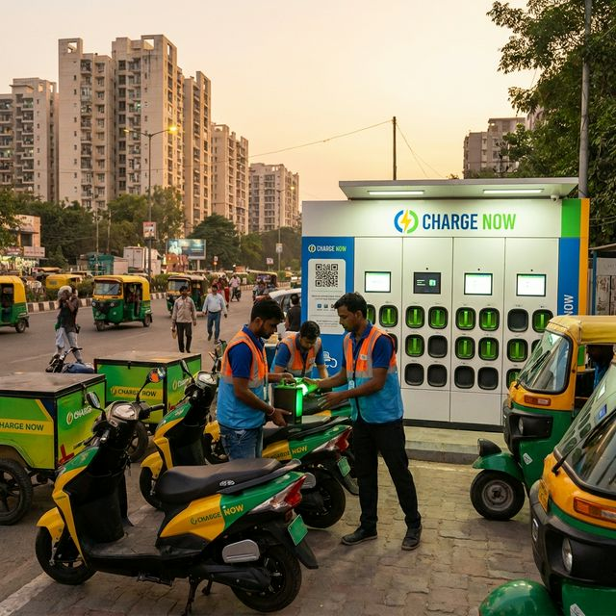
What is Battery Swapping?
From hours of waiting → 90 seconds of swapping
🔴 Traditional Charging
▸ 5–8 hours (Level 2) or 60 min DC fast
▸ Driver idle = lost income
▸ ₹50–80 Lakh installation per DC station
▸ Grid peak load spikes
🟢 Battery Swapping (BSaaS)
▸ < 90 seconds — faster than petrol pump
▸ Zero rider downtime; immediate route restart
▸ ₹20–31 Lakh total station cost
▸ Off-peak charging reduces grid stress
EV Battery Swapping Station | Energy-as-a-Service • 4/14
Notes:
SPEAKER NOTES – Slide 4:
The 90-second swap is the 'aha' moment. BSaaS is the propane-tank model applied to EVs: battery is a service, not an asset the rider owns. This lowers EV sticker price AND gives the operator a guaranteed recurring revenue stream.

Slide 5

Technical Architecture
5 integrated layers from pack to cloud
1 Battery Pack
LFP/NMC · 1.5–8 kWh · IP67 · 2,000 cycles · IS 17893
2 BMS
SoC/SoH monitoring · Thermal mgmt · Fault alerts · OTA firmware
3 Station HW
6–12 smart slots · RFID kiosk · Solar-MPPT ready · UPS buffer
4 IoT / Edge
MQTT 4G/5G telemetry · Real-time slot status · Edge compute
5 Cloud + AI
Fleet analytics · Demand forecast · Health scoring · Billing
EV Battery Swapping Station | Energy-as-a-Service • 5/14
Notes:
SPEAKER NOTES – Slide 5:
Hardware is the enabler, but the moat is in software. BMS telemetry enables AI health scoring (extends life 15-20%). Cloud analytics creates the SaaS revenue layer. Solar integration reduces energy OpEx 25-35%.

Slide 6
Market Landscape
Validated, growing, and consolidating — the time to enter is now
Total EV Market Opportunity
₹50,000+ Cr/year by 2030
NITI Aayog 2023
Swapping Addressable Market
USD 1.1 Billion by 2026
IESA 2023
Commercial Converts (2025–30)
~2 million 2W/3W EVs
CEEW 2023
Battery Cost Decline
USD 90/kWh today → $60 by 2027
BNEF 2024
Government Outlay
₹20,900 Cr (FAME II + E-DRIVE)
MHI + MoP 2024
Phase 1 Target Cities
Delhi, Bengaluru, Mumbai, Pune
Company plan
EV Battery Swapping Station | Energy-as-a-Service • 6/14
Notes:
SPEAKER NOTES – Slide 6:
USD 1.1B market validated by Battery Smart's USD 65M raise. Phase 1 targets 2 metro cities with high 3W density. Government outlay de-risks the infrastructure CapEx via subsidy programs.

Slide 7
Competitor Comparison
We lead on open standards, solar-hybrid, and AI health analytics
Parameter
Gogoro
Battery Smart
Sun Mobility
Our Venture ★
Primary Market
Taiwan / Global
India 3W / e-rick.
India 2W/3W B2B
India 2W/3W Fleet
Revenue Model
Subscription
Per-swap + fleet
B2B SaaS Energy
Swap+Sub+SaaS
Battery Standard
Proprietary ✗
Multi-OEM
Open push
IS 17893 Open ✓
Solar / Grid
Grid only ✗
Grid only ✗
Limited solar
Solar-Hybrid ✓
AI Health Mgmt
Basic
Basic
Moderate
Advanced ML ✓
Stations
2,500+ (Taiwan)
1,500+ (India)
500+ (India)
100 target Yr 1
EV Battery Swapping Station | Energy-as-a-Service • 7/14
Notes:
SPEAKER NOTES – Slide 7:
3 key advantages: (1) IS 17893 open standard — not locked to one OEM; (2) Solar-hybrid — lower energy cost/swap; (3) AI health scoring — extends battery life, reduces CapEx. Battery Smart is closest — we win on 2W segment, solar, and software.

Slide 8
Business Model
Multi-stream revenue anchored on high-frequency, recurring swaps
💳 Pay-Per-Swap
📅 Fleet Subscription
📊 Fleet SaaS
₹80–150 / swap B2C riders & fleet drivers
₹2,500–6,000 / vehicle / month Capped or unlimited
₹2,000–10,000 / fleet / month Driver score, ESG
🔋 Battery-as-a-Service
⚡ Grid Services
₹3,000–8,000 / battery / year Lifecycle managed
₹1–3 / kWh V2G demand response (future)
CapEx: ₹25L / station avg. EBITDA: ~35% at maturity Station payback: 14–17 months
EV Battery Swapping Station | Energy-as-a-Service • 8/14
Notes:
SPEAKER NOTES – Slide 8:
Pay-per-swap is the volume base. Fleet subscription adds predictability. SaaS is zero-incremental-cost to scale — highest margin stream. EBITDA of 35% matches top fuel retail economics.

Slide 9
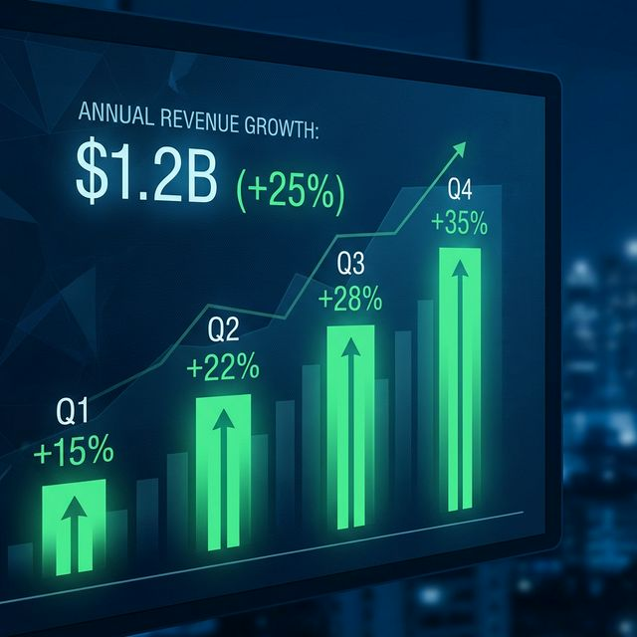
Financial Projections
100 stations × 100 swaps/day × ₹120 = ₹43.8 Cr annual revenue by Year 3
Year
Stns
Rev (₹Cr)
EBITDA
Yr 1
15
3.8
1.3
Yr 2
50
19.7
7.0
Yr 3
100
43.8
15.6
Yr 4
150
75.3
27.1
Assumptions: ₹120/swap · 100 swaps/stn/day at maturity · 65% utilisation Year 1 Station payback: 14–17 months · Network IRR: 28–35% over 5 years
Yr 5
200
105
38.1
EV Battery Swapping Station | Energy-as-a-Service • 9/14
Notes:
SPEAKER NOTES – Slide 9:
₹120 avg blended price (B2C + fleet). 65% utilisation Year 1 ramp. EBITDA ~35% at maturity. Station-level payback 14-17 months. Network IRR 28-35% over 5 years. Break-even at 35-40 active stations.

Slide 10
Battery Swapping vs. Fast Charging
Swapping wins decisively for high-utilisation commercial fleets
Parameter
🔋 Battery Swapping
⚡ DC Fast Charging
Time at station
< 90 seconds
45–60 minutes
Productivity lost
~0%
15–25% per shift
Install cost
₹20–31 Lakh
₹50–80 Lakh
Land needed
60–100 sq ft
200–400 sq ft
Battery risk owner
Operator (BSaaS)
Rider / fleet
Grid peak impact
Minimal (off-peak charge)
High (simultaneous)
Best for
Commercial 2W/3W fleet
4W + highway corridors
Revenue model
Swap fee + subscription
Per kWh / per minute
EV Battery Swapping Station | Energy-as-a-Service • 10/14
Notes:
SPEAKER NOTES – Slide 10:
90s vs 60min is the headline. But the real story is: lower install cost, no rider battery risk, off-peak charging, recurring revenue. Fast charging serves 4W/highway — not our segment.

Slide 11
Industry Trends & Tailwinds
Five converging forces building the BSaaS wave
📈 EV Penetration
3W at 55%+ electrification; 2W at 5.5% accelerating (VAHAN / SMEV 2024)
🚛 Fleet Electrification
Zomato, Swiggy, Amazon, Flipkart → 100% EV fleets by 2030
🏛 Policy Support
PM E-DRIVE ₹10,900 Cr; FAME II successor; BIS IS 17893 open standard mandate
⚙ Technology Advances
LFP at USD 90/kWh (−41% since 2022); AI health extends pack life 15–20%
🌐 Open Standards Push
NITI Aayog 2022 draft mandates interoperability; cross-OEM swapping viable
EV Battery Swapping Station | Energy-as-a-Service • 11/14
Notes:
SPEAKER NOTES – Slide 11:
Fleet electrification is most certain near-term driver. Policy is the risk-reducer. LFP cost decline improves our margin over time. IS 17893 unlocks network effect. Solid-state (2028+) is upside, not a threat within investment horizon.

Slide 12
Key Challenges & Risk Mitigations
Risk-aware execution with proactive hedges built in
Battery Std. Gap
HIGH
Adopt IS 17893 early; modular connector adapters; lobby SMEV/IESA
OEM Integration
HIGH
Open standard prevents flip; fleet SaaS contracts create switching costs
CapEx-Heavy Ramp
MEDIUM
Phase-gated: fleet LOI before station; PM E-DRIVE subsidy capture
Fast-Charge Risk
MEDIUM
Fleet focus (uptime > speed); cost advantage holds at 15-min charge
Grid Tariff Rise
MEDIUM
Solar target: 30% self-generation; time-of-use charge optimisation
Regulatory Shift
LOW
Unit economics viable without subsidy; SaaS revenue not regulated
EV Battery Swapping Station | Energy-as-a-Service • 12/14
Notes:
SPEAKER NOTES – Slide 12:
Be transparent about risks. Battery standardisation is #1 structural risk — but IS 17893 adoption is policy-mandated. CapEx risk managed by fleet-first MVP. Solar + SaaS strategy makes business viable even if subsidies sunset.

Slide 13
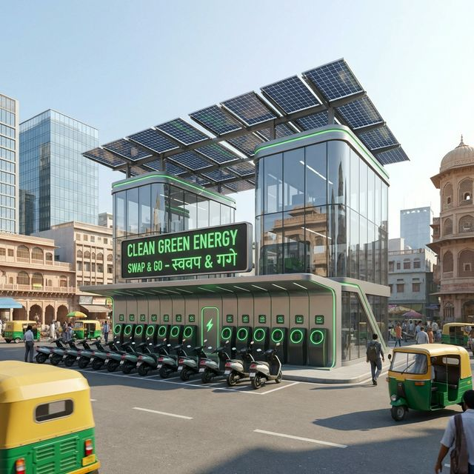
Proposed Improved Model
Five enhancements that build a defensible technology platform
🔗 Open Battery Standard
IS 17893 compliance; universal connectors; multi-OEM interoperability → network effects
🤖 AI Battery Health
ML on BMS telemetry; predict degradation 30-60 days ahead; extend life 15–20%
☀ Solar Microstations
2–4 kWp solar + 5–10 kWh BESS; 30% self-generation; saves ₹25–35K/station/year
💡 Dynamic Pricing
₹100 off-peak / ₹140 peak; smooth demand curves; fleet subscribers get flat rate
📡 Fleet Analytics SaaS
Driver scoring, ESG reports, predictive maintenance — high-margin sticky revenue
EV Battery Swapping Station | Energy-as-a-Service • 13/14
Notes:
SPEAKER NOTES – Slide 13:
These 5 enhancements transform a commodity energy dispenser into a defensible tech platform. Open standard builds network moat. AI health = CapEx savings. Solar = margin expansion. Dynamic pricing = utilisation optimisation. Fleet SaaS = near-zero churn.

Slide 14
Conclusion & Strategic Recommendation
▸ India's EV infrastructure gap is the market — BSaaS is a direct, proven solution
▸ Fleet-first MVP: 3 → 15 → 50 → 100 stations; committed volumes de-risk CapEx
▸ ₹43.8 Cr annual revenue at 100 stations · EBITDA ~35% · Payback 14–17 months
▸ Five differentiators: IS 17893 Open Standard · AI Health · Solar · Dynamic Pricing · SaaS
▸ Defensible moat: data network effects + OEM-agnostic platform + fleet contract lock-in
▸ Next steps: seed round → 3-station pilot → fleet LOI → BIS certification → tech build
Sources: VAHAN 2024 · BNEF 2024 · NITI Aayog 2022/23 · BEE 2024 · CEA 2023 · IESA 2023 · SMEV 2024 · CEEW 2023 · Gogoro AR 2024 · Battery Smart 2023 · BIS IS17893 · Zomato ESG 2024
EV Battery Swapping Station | Energy-as-a-Service • 14/14
Notes:
SPEAKER NOTES – Slide 14 (Conclusion):
Large validated market, clear differentiation, fleet-de-risked revenue, strong policy tailwinds. Call to action: approve seed funding for Phase 0 pilot (₹66–100L, 3 stations), secure fleet LOI from 1–2 delivery partners, begin IS 17893 compliance. Q&A.

