Slide 1
PROJECT MANAGEMENT SYSTEM
Team 2
July 28,2022

Slide 2
Coverage
Overview of the project
Requirement & GUIs
High Level Design
Individual contribution
Challenges faced & how it addressed
Experience gained

Slide 3
Overview
Develop an Project Management System using C
Project functionalities
Add/Delete/Edit Projects
Add/Edit/Delete Employee
Project Allocation and close project
Database : file (Admin_db, Project_db and employee_db)
Users concerned:
Admin
Employee

Slide 4
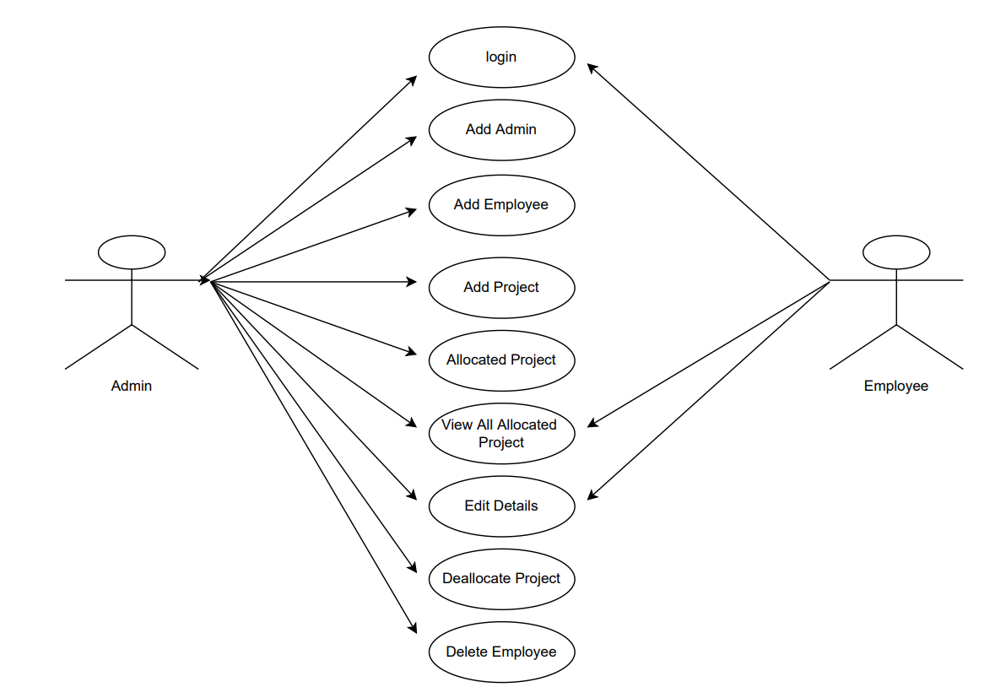
High Level Design
1.Use Case

Slide 5
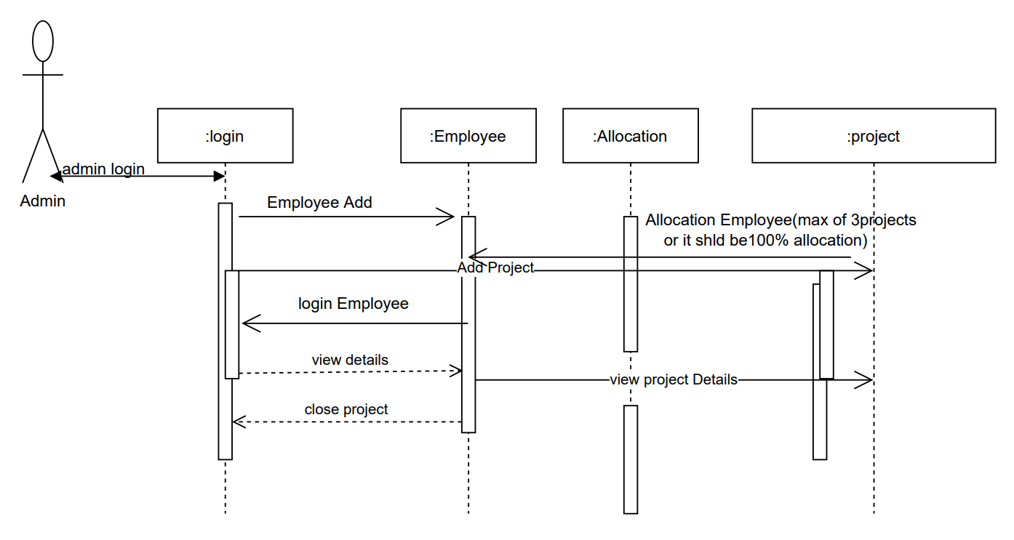
High level design
2. Sequence Diagram

Slide 6
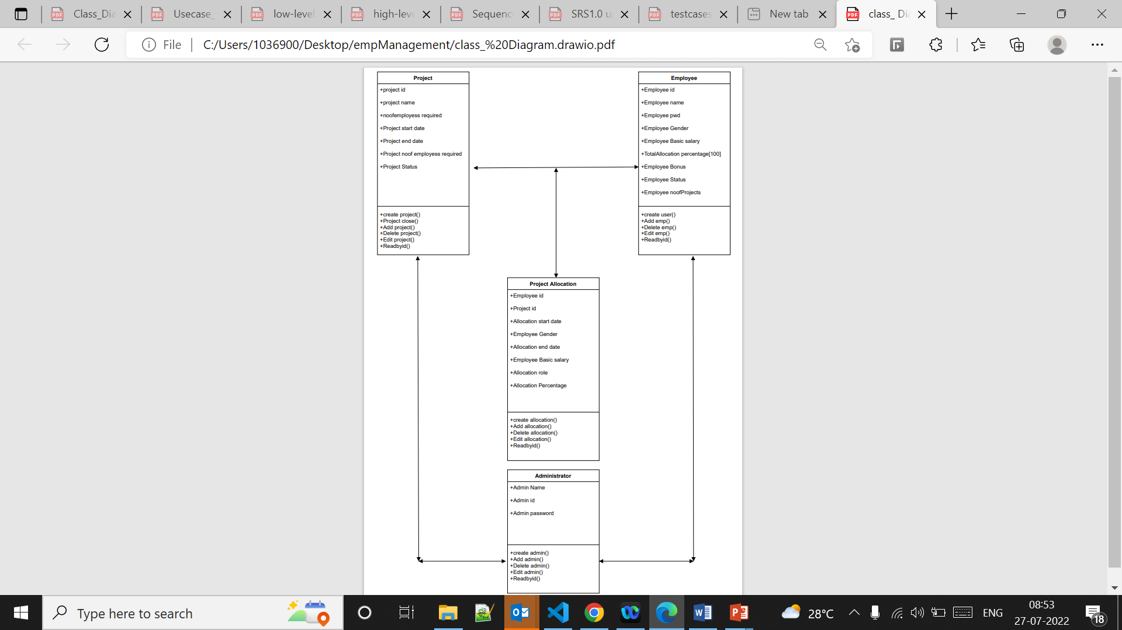
High level design
3. UML Diagram

Slide 7
High Level Design
4.Table Design

Slide 8
High level design
Class: Admin
Functionality | Description
Login and Registration | The system allows the admin to register and login to the system
Add Project | The system allows the admin to add project
Edit project | The system allows the admin to edit/update project
View all projects | The system allows the admin to view all the project details
Delete project | The system allows the admin to delete project
Add/Delete/View/Search Employee | The system allows the admin to add/delete/view search employee
Project allocation | The system allows the admin to allocate projects to employees
Project Deallocation | The system allows the admin to deallocate project
Change Password | The system allows the admin to change password
Delete Admin | The system allows the admin to delete account

Slide 9
High Level Design
Class: Employee
Functionality | Description
Login | Existing employees can login
Update details | The system allows the employee to update their details
View details | The system allows the employee to view their details

Slide 10
High level design
Functionality Table
Test Module | Test Scenario | Test Case | Expected Result | Actual result | Pass/Fail
Admin Login | Verify Login | Validate Username and Password | Admin Successfully Logged in | Admin Successfully Logged in | Pass
View project | Check project | View Available projects | View project Data | View project Data | Pass
employee Login | Verify Login | Validate Username and Password | employee Successfully Logged in | employee Successfully Logged in | Pass
Search project | Check Info | Check Available projects | projects Available | projects Available | Pass
Project allocation | Project allocation | Allocating employees to active project | Allocating employees to active project | Allocating employees to active project | Pass
Project deallocation | Project deallocation | Deallocating project | Deallocating project | Deallocating project | Pass
Delete admin | Delete admin | Delete admin | Delete admin | Delete admin | Pass

Slide 11
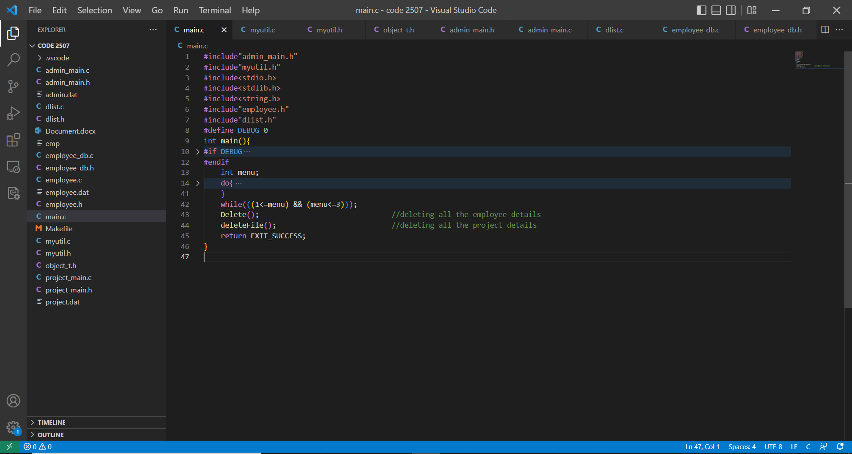
Sample Code Snippets

Slide 12
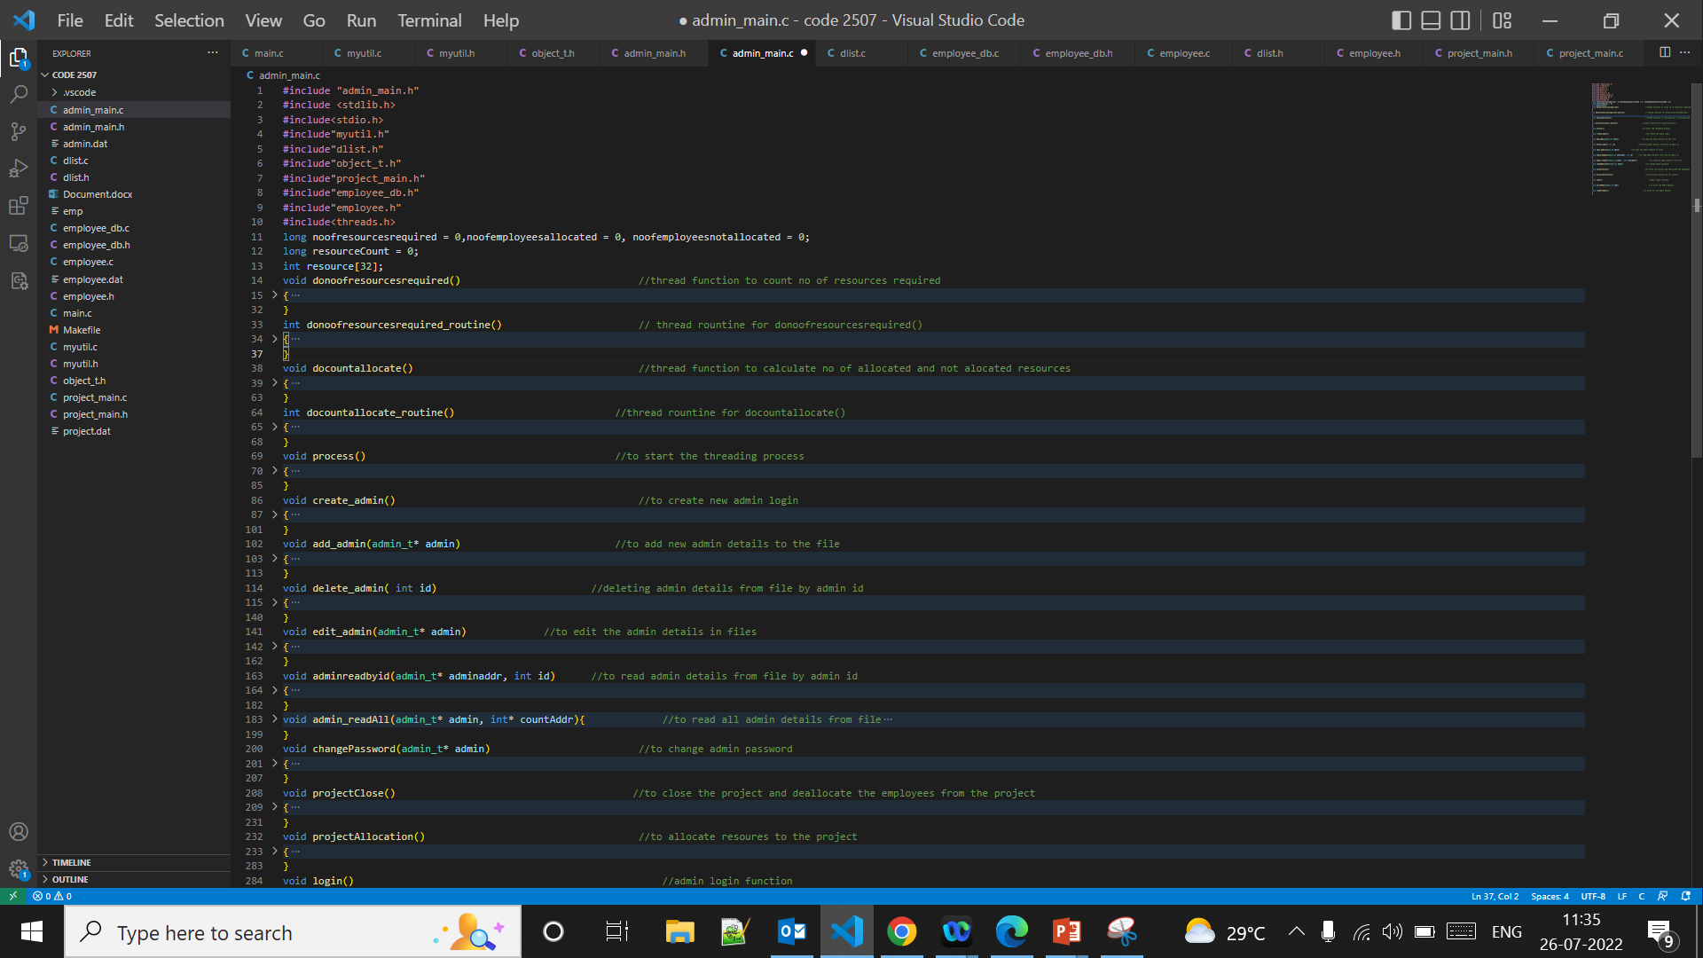
Sample Code Snippets

Slide 13
Requirement & GUIs
Visual Studio : Code
Build : GCC
Debugger : Valgrind,GDB,gprofile,splint
File Database
System Specifications :
OS :Ubuntu

Slide 14
Individual contribution
Sai Avulakunta
Employee Database and it’s functionalities
SRC doc
Mounika M
Project Database and it’s functionalities
Test case doc

Slide 15
Individual contribution
Sharanukumar Gorantli
Admin database and it’s functionalities
Thread creation
High level design doc
Narosh Shibu Mathew
Project allocation and deallocation functions
Integrating code
Low level design doc

Slide 16
Challenges faced & how it addressed
Calculating the difference between start date and end date
Integrating all the code into single code
File error while starting thread process

Slide 17
Experience gained
File system using c
Thread and Linked list
Valgrind,GDB,gprofile,splint
Memory management
Team coordination
Time management
Problem solving
Proper usage of programming conventions

Slide 18
Thank You

