Slide 1


MALLA REDDY ENGINEERING COLLEGE (A)
Face Detection Using Python
Team Members:
C.Charitha (23J41A66L1)
K.Sharanya (23J41A66M5)
P.Estheru Rani (23J41A66P2)
S.Harshitha (23J41A66Q7)
DEPT:CSM-D

Slide 2
Roles
K.Sharanya - Team Lead,Documentation
C.Charitha Reddy - Technical,References
P.Estheru Rani – Working Procedure,Requirements
S.Harshitha – Literature Survey,Abstract,Objective

Slide 3
ABSTRACT
This project proposes an enhanced face detection system utilizing deep learning techniques to accurately identify and localize faces in images.
The system employs Convolutional Neural Networks (CNNs) trained on large-scale datasets for robust face detection across various conditions including varying lighting, poses, and occlusions.
Additionally, the integration of advanced preprocessing methods enhances the system's performance by effectively handling noise and improving feature extraction.
The proposed system demonstrates superior accuracy and efficiency compared to traditional methods, making it suitable for real-world applications such as surveillance, security, and human-computer interaction.

Slide 4
INTRODUCTION
This project aims to provide a comprehensive understanding of face detection algorithms, their implementation, and real-world applications.
By leveraging cutting-edge techniques in machine learning and computer vision, we endeavor to develop a robust system capable of accurately detecting faces in images and video streams, regardless of environmental challenges or variations in appearance.
Through experimentation, analysis, and optimization, we strive to push the boundaries of face detection technology, paving the way for enhanced security measures, personalized user experiences, and innovative applications.
Join us as we delve into the fascinating world of facial recognition and unlock its potential to revolutionize how we interact with technology and each other.

Slide 5
Literature Survey
1. Traditional Methods
Viola-Jones (2001): Real-time detection using Haar features + AdaBoost. Fast but struggles with pose & lighting.
HOG + SVM: Gradient-based features with SVM classifier. More robust but still limited in complex scenes.
2. Deep Learning Methods
DeepFace (2014): Facebook’s CNN-based model; boosted accuracy.
MTCNN: Multi-task CNN; detects faces + landmarks simultaneously.
RetinaFace: Dense, accurate, handles occlusion & pose well.

Slide 6
3. Datasets
WIDER FACE, FDDB, LFW: Diverse real-world face datasets used for training & benchmarking.
4. Challenges
Occlusions, lighting variations, real-time performance on mobile devices.
5. Trends
Lightweight models (e.g., BlazeFace), attention mechanisms, video-based detection.

Slide 7
Problem Statement
Develop a robust face detection system that accurately identifies human faces in images or videos, despite challenges like lighting, pose, occlusion, and background noise, while ensuring real-time performance.

Slide 8
Objective
To design and develop a robust and efficient face detection system capable of accurately identifying human faces in images or video streams, even under challenging conditions such as varying lighting, occlusions, and facial orientations, with an emphasis on real-time performance.

Slide 9
PROPOSED METHOD
Data Collection
Preprocessing
Feature Extraction
Training
Evaluation
Deployment
Testing

Slide 10
SOFTWARE REQUIREMENTS
Python
Deep Learning Framework
Image Processing Libraries
IDE (Integrated Development Environment)
Data Collection and Management Tools
Evaluation and Visualization Tools
Deployment Tools (Optional)

Slide 11
HARDWARE REQUIREMENTS
Computer
GPU (Optional)
Memory (RAM)
Storage
Webcam (Optional)
Internet Connection

Slide 12


Slide 13


Slide 14
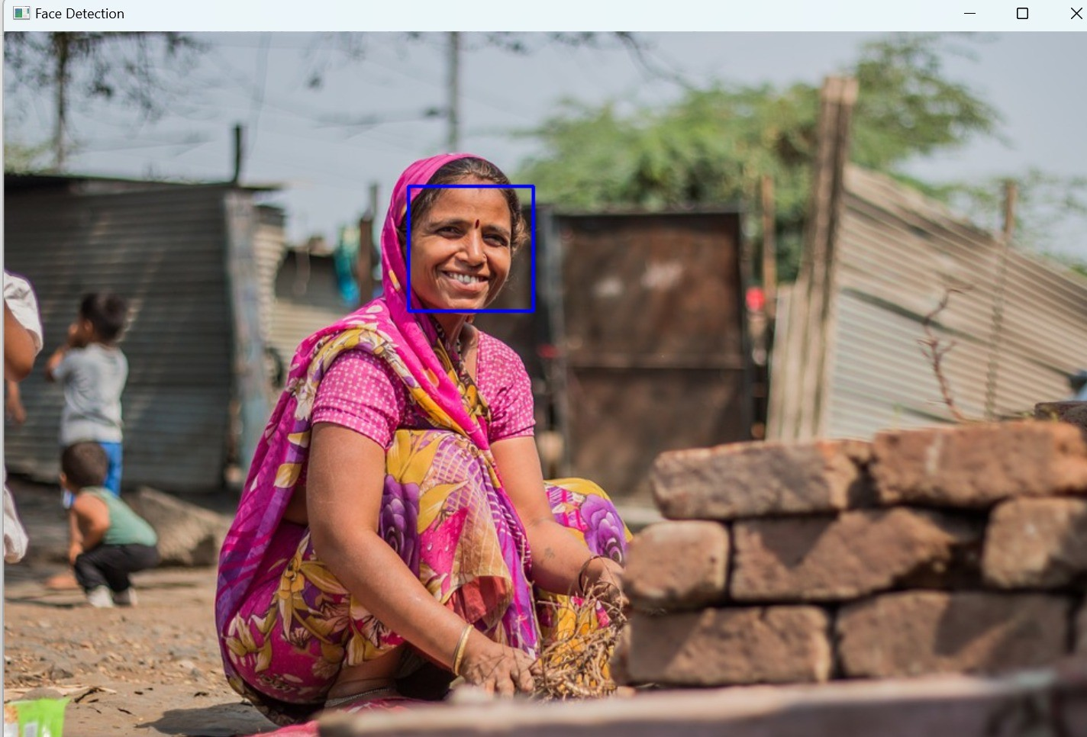
OUTPUT :

Slide 15
FUTURE SCOPE
Face detection can be used in security systems for surveillance purposes, such as identifying and tracking individuals in public spaces, airports, and other high-security areas.
Facial recognition is increasingly used for biometric authentication in smartphones, laptops, and other devices.
Face detection can play a role in healthcare applications such as patient monitoring, identifying medical conditions (like genetic disorders), and improving accessibility for individuals with disabilities.
Face detection technology can be used in educational settings for attendance tracking, monitoring student engagement, and enhancing security on school campuses.

Slide 16


