Slide 1


CGB1201 – JAVA PROGRAMMING PROJECT REVIEW-2
Department of Computer Science and Engineering
Academic Year: 2024 – 2025 (Odd Semester)
Register Number : 2303811710421143
Name : SHARARASAN S
Year : II
Semester : III
Section : C
Date : 06-Dec-2024

Slide 2
Visitor Management System

Slide 3
AGENDA
Abstract
Introduction
Java Programming – Concepts Used
Proposed Architecture
Module Description
Result and Discussion
Conclusion

Slide 4
ABSTRACT
The Visitor Management System using Java and AWT, designed to streamline visitor check-ins and check-outs. The system employs a GUI for user-friendly interaction, featuring functionalities like visitor registration, check-out, and secured visitor history access. Real-time data handling and password-protected history logs ensure efficiency and security. The application showcases the use of Java’s AWT components and event handling for GUI-based solutions.

Slide 5
INTRODUCTION
This project implements a lightweight system leveraging Java AWT for GUI design, focusing on simplicity, usability, and security. It provides key features like visitor registration, real-time status display, and administrative access to visitor history.

Slide 6
JAVA PROGRAMMING - CONCEPTS USED
AWT Components: TextFields, Buttons, Labels, and TextArea for GUI design.
Event Handling: ActionListeners for button interactions.
Date and Time API: To log and display check-in/check-out timestamps.
Object-Oriented Principles:
Encapsulation (Visitor class).
Abstraction (Core Logic encapsulated in reusable methods).

Slide 7
PROPOSED ARCHITECTURE
Vistor Management System
User input
Name-Number-Purposes
History(Visitor)
Check in & Check Out
Admin Password
Show Details
Date & Time

Slide 8
MODULE DESCRIPTION
Visitor Registration
Captures details like Name, Contact, and Purpose.
Automatically logs the check-in time.
Visitor Check-Out
Updates records with check-out timestamps.
Current Visitors Display
Lists all visitors currently checked in.
Visitor History (Password Protected)
Displays the complete log of all visitors, including check-in and check-out times.

Slide 9
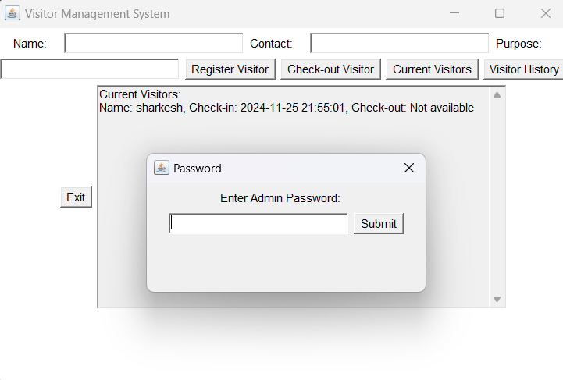
RESULTS AND DISCUSSION

Slide 10
CONCLUSION
The Visitor Management System efficiently streamlines visitor tracking with a user-friendly Java-based GUI. It ensures secure data handling, real-time updates, and password-protected access to sensitive records. With scope for future enhancements, it stands as a practical and reliable solution for visitor management needs.

Slide 11
THANK YOU

