Slide 1

Design, Fabrication & Core Loss Modelling of a High-Frequency Transformer for Dual Active Bridge Converter
Presented by: Sharath Kumar Bakam
Supervisor: Dr. Abhinav Arya
Indian Institute of Technology Bhubaneswar |2026

Slide 2
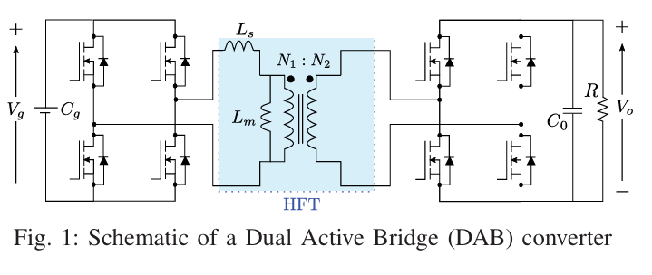
Introduction to problem statement:
The Dual Active Bridge (DAB) converter is the leading isolated DC-DC topology for EV fast-charging, microgrids, and renewable energy links — offering bidirectional power flow via phase-shift modulation and inherent Zero Voltage Switching (ZVS).
Key challenge :
Design and determination of accurate core losses for non- sinusoidal inputs for HFT
Input voltage:180-270 V
Output voltage: 300-420 V
Power = 5 kW
Switching frequency = 100kHz

Slide 3


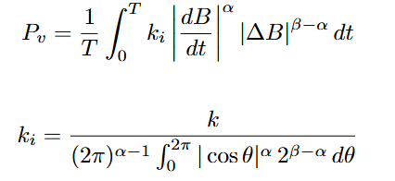
Core Loss Modelling:
Standard Steinmetz Equation (SE):
Improved Generalized SE (iGSE)
More accurate for non-sinusoidal waveforms.
As it captures the instantaneous flux changes dB/dt.
More accurate for square wave and PWM excitation and suitable for DAB and LLC (High frequency converters)
Used for sinusoidal excitations and accurate mainly for sine wave flux as it doesn’t consider varying dB/dt it would become less accurate for PWM and square wave converters.
P_{v} = k f^{α} B_{m}^{β}
Where , α , β ,k are Steinmetz parameters.

Slide 4
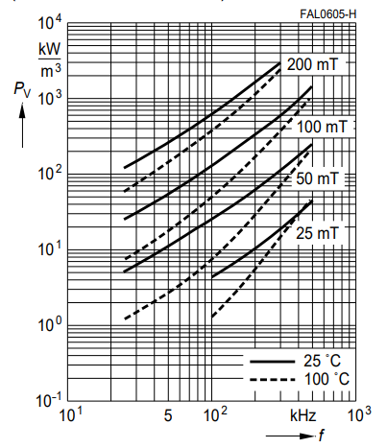
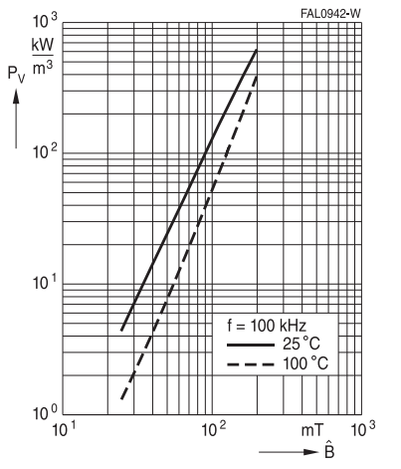
Extracting Steinmetz Parameters from Datasheets:
Frequency Exponent α:
Log-log slope of Pv vs f at B = 0.2 T, 100°C → α ≈ 1.45
Flux Density Exponent β:
Log-log slope of Pv vs B at f = 100 kHz, 100°C → β ≈ 2.8
Steinmetz Coefficient k:
Using Pv = 375 kW/m³ at 100 kHz,
B=0.2 T → k ≈ 42.774 kW/m³
keq = 0.00191 kW/m³ (in Hz)
N87 Ferrite datasheet
N87 Ferrite datasheet

Slide 5
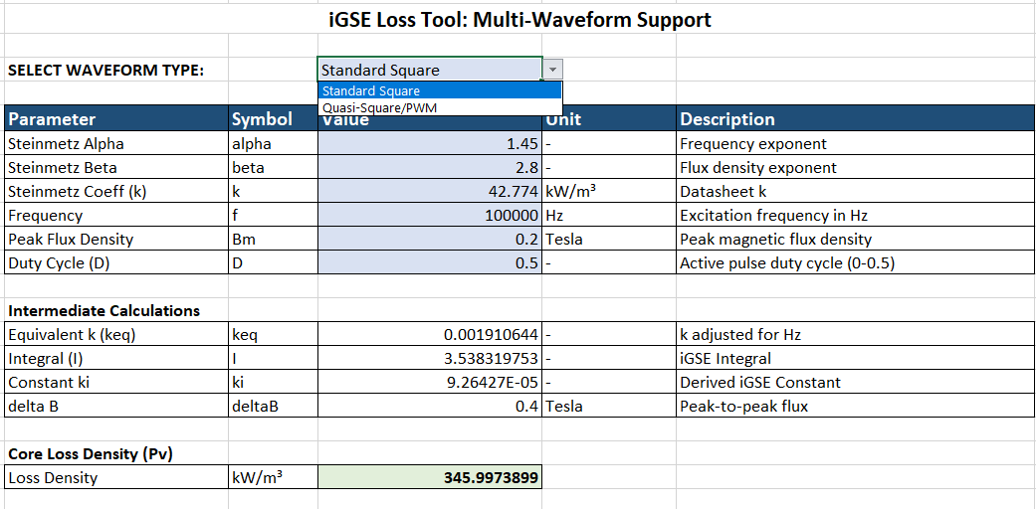
Excel Automation Tool:
An advanced iGSE core loss calculator was built in Excel supporting two waveform modes via a drop-down toggle.
At 100 kHz, 0.2 T:
Tool output = 345.99 kW/m³ — closely matching literature [8]. Frequency correction: keq = k × 1000−α
Standard Square Wave:
Quasi-Square Wave (3-Level PWM):

Slide 6
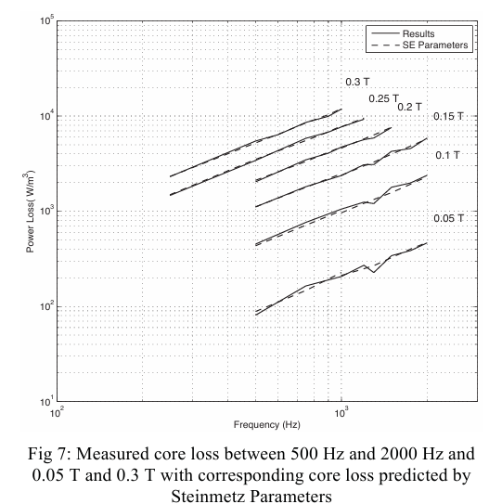
Multi wave form support:
Toggles instantly between standard square and quasi square
Core losses measured from IGSE tool, precisely matches established literature profile under 100kHz and 0.2T at 100ºC for N87 material
Core loss results of N87 material when excited with square wave with D=0.5.
At f= 100kHz and B=0.2T losses comes out around 350kW/m³

Slide 7


Core Selection & Material Optimization:
Area Product Method · MnZn Ferrite N87
▸ MnZn Ferrite (N87) selected over nanocrystalline alloys
▸ MnZn ferrite: high resistivity → eliminates macro-eddy losses; cost-effective
▸ Area Product method used for core sizing:
▸ Ap = VA / (2 × f × Bp × Kw × J)
▸ Required Ap = 12500mm⁴
▸ Selected: E-core (EE65/32/27 double-stack) with Ap ≥ 328492mm⁴— provides safety margin
Design Parameters at a Glance
Rated Power
5kW
Switching Freq.
100 kHz
Max Flux Density
0.2 T
Window Fill (Kw)
0.4
Current Density J
2.5A/mm²
Required Ap
$$125000 {mm}^{4}$$
Core Selected
EE65/32/27
Core Ap
≥ $328490{mm}^{4}$
Core Material
TDK N87 MnZn Ferrite
4

Slide 8


High-Frequency Winding Design:
Litz Wire Selection · Skin & Proximity Effect Mitigation
▸ At 100 kHz, skin depth δ = √(ρ / πfμ) ≈ 0.206 mm for copper
The radius of the selected strand should be less than $δ$
▸ Primary: RMS current = 25 A → Required area = 10 mm²
▸ Secondary: RMS current = 17A → Required area = 6.8 mm²
▸ Turns (Faraday's law, V_in,max = 270 V):
Np = 6 T, Ns = 9 T
A 6mm² braided litz wire is selected and paralleing is done for primary side
Winding Summary
Skin Depth (δ)
0.206 mm
Primary I_rms
25A
Primary Area
10mm²
Primary Turns (Np)
6
$$N_{1}=\frac{V_{1}}{4∗F_{s}∗B_{pk}∗A_{c}}$$
Secondary I_rms
17 A
Secondary Area
6.8mm²
Secondary Turns (Ns)
9
5

Slide 9
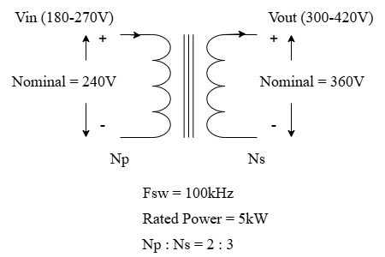
Design of 5kW Transformer:
Parameters | Value
Input Voltage Range | 180 – 270 V
Nominal Input Voltage | 240 V
Output Voltage Range | 300 – 420 V
Nominal Output Voltage | 360 V
Switching Frequency | 100 kHz
Rated Power | 5kW

Slide 10
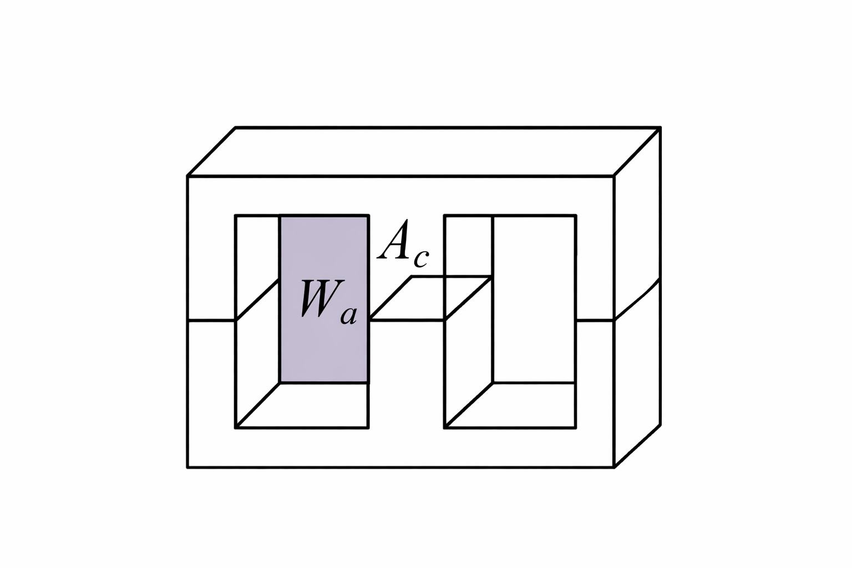
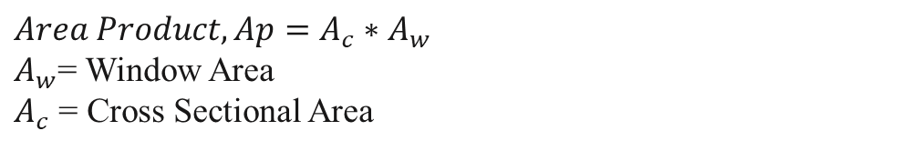
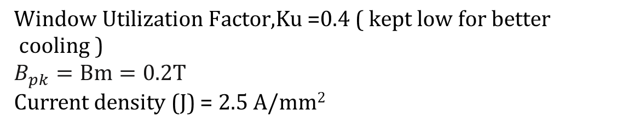


Area Product Method:
$$Area Product,Ap=A_{c}∗A_{w}$$
$A_{w}$= Window Area
$A_{c}$ = Cross Sectional Area
$A_{p}$= $\frac{V_{p}∗I_{p}+V_{s}∗I_{s}}{4Ku∗B_{pk}∗J_{m}∗F_{sw}}$
$$N_{1}=\frac{V_{1}}{4∗F_{s}∗B_{pk}∗A_{c}}$$
$$\text{Window} \text{Utilization} \text{Factor}\text{,}\text{Ku}\text{ =}\text{0}\text{.}\text{4 }\text{( }\text{kept} \text{low} \text{for} \text{better} \text{cooling}\text{ )}$$
$$B_{pk}=Bm=0.2T$$
Current density (J) = 2.5 A/mm²

Slide 11
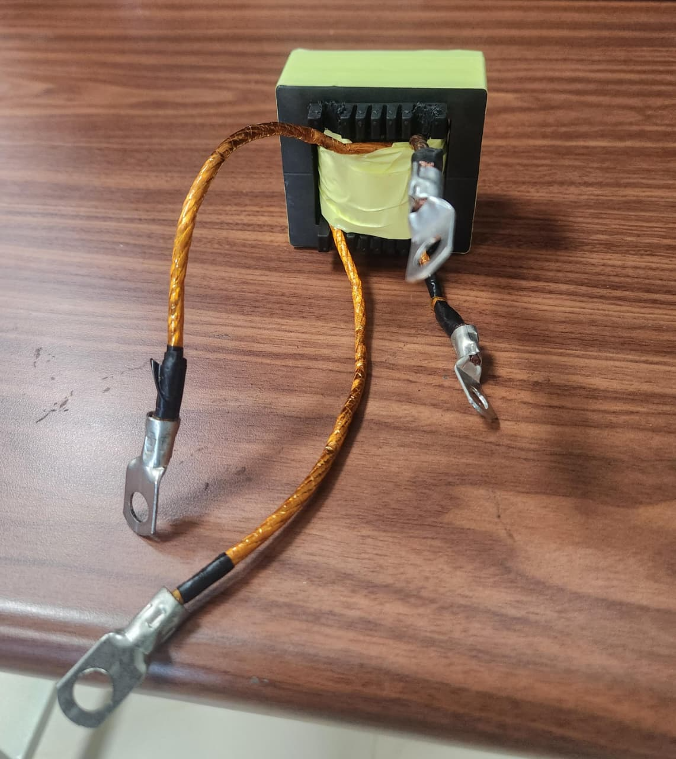
Hardware Fabrication & Assembly of HFT
Physical Prototype on EE65/32/27 Ferrite Core
Prototype Specifications
Rated Power
5 kW (scaled prototype)
Input Voltage
180–270 V (nom. 240 V)
Output Voltage
300–420 V (nom. 360 V)
Assembly Process
Switching Freq.
100 kHz
Current Density J
2.5 A/mm²
Flux Density Bm
0.2 T
Window Factor Ku
0.4
Required Ap
125,000 mm⁴
Assembly Process
▸ EE65 ferrite bobbin secured ▸ Litz wire (6 mm²) wounded. ▸ Ultra-thin insulation sheets between layers ▸ Core halves aligned to minimise air-gap variance
Core Selected
EE65/32/27 (Ap = 328,490 mm⁴)
Core Area Ac
535 mm²
Primary Turns Np
6 T
Secondary Turns Ns
9 T
10

Slide 12
Conclusion and Future Work:
Project Achievements:
Future Work:
▸ Steinmetz parameters (α, β, k) extracted from N87 datasheets via log-log slope analysis
▸ iGSE implemented for non-sinusoidal (square & quasi-square) waveforms
▸ Excel automation tool built with waveform drop-down toggle; validated vs. literature
▸ 5 kW scaled hardware prototype fabricated on EE65/32/27 core & Litz wire
▸ Open-circuit test procedure defined to isolate experimental core losses
▸ Building the transformer using ANSYS Maxwell.
▸ Visualize magnetic flux hot-spots & eddy current distribution
▸ Compare FEA results with Excel iGSE calculations.
▸ Validate against laboratory open-circuit power measurements

Slide 13
References & Bibliography:
M. Mu, 'High Frequency Magnetic Core Loss Study', PhD Dissertation, Virginia Tech, 2013.
K. Venkatachalam, C. R. Sullivan, T. Abdallah, and H. Tacca, 'Calculation of Ferrite Core Losses with Nonsinusoidal Waveforms Using Improved Steinmetz Parameters', IEEE Workshop on Computers in Power Electronics (COMPEL), 2002.
J. Li, T. Abdallah, and C. R. Sullivan, 'An Improved Generalized Steinmetz Equation for Calculating Magnetic Losses Under Non-sinusoidal Excitation', IEEE Industry Applications Society Annual Meeting, 2001.
TDK Electronics, 'N87 Ferrite Material Datasheet', EPCOS/TDK, Germany, 2022.
Ferroxcube, 'Soft Ferrites and Accessories Data Handbook', 2008.
Z. Liu, L. Zhu, Y. Dang, C. Zhan and S. Ji, "Accurate Analysis of Core Loss Considering the Non-uniform Magnetic Flux Distribution for High-Frequency-Transformer in Dual-Active-Bridge DC-DC Converter," 2023 IEEE Energy Conversion Congress and Exposition (ECCE
J. Muhlethaler, J. Biela, J. W. Kolar and A. Ecklebe, "Improved Core-Loss Calculation for Magnetic Components Employed in Power Electronic Systems," in IEEE Transactions on Power Electronics
M. Smailes et al., "Evaluation of core loss calculation methods for highly nonsinusoidal inputs," 11th IET International Conference on AC and DC Power Transmission, Birmingham, 2015

Slide 14
THANK YOU Questions and Discussions

