Slide 1
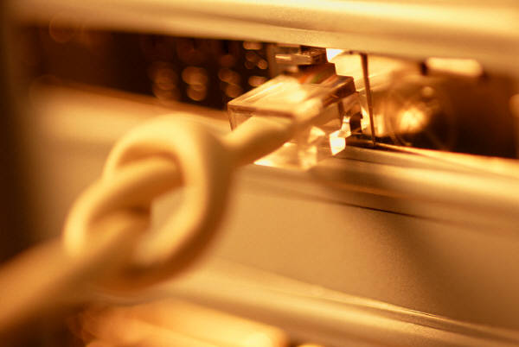
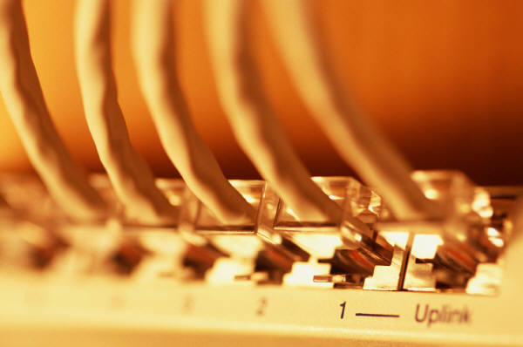
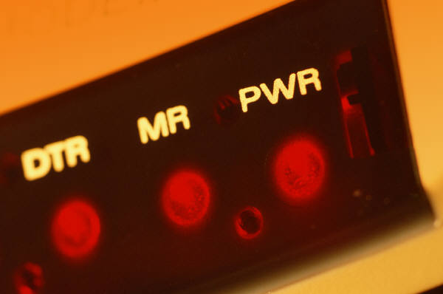
Computer Networking
By SHARATH BALAN
Notes:
I tried to keep the colors oranges, tans, and black for consistency throughout my presentation. I also felt a border throughout my project would make it stand out more. I kept the font at Arial throughout the presentation. The only change that I used was to bold it and highlight with colors here and there.

Slide 2
The Computer Network
A computer network is a group of computers/devices(Nodes) that use a set of common communication protocols over digital interconnections for the purpose of sharing resources located on or provided by the network nodes.
The nodes of a computer network may include personal computers, servers, networking hardware, or other specialised or general-purpose hosts.
The interconnections between nodes are formed from a broad spectrum of telecommunication network technologies, based on physically wired, optical, and wireless technologies.
A communication protocol is a set of rules for exchanging information over a network. physically wired, optical, and wireless

Slide 3
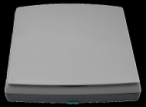




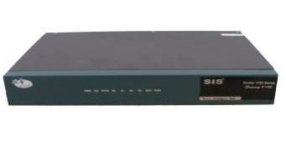
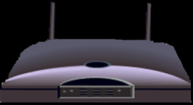
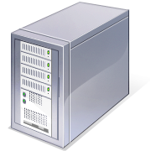

The Network Diagram
(Click on the Words Below and Learn More About Each Component)
Wired Network
PC
Firewall
The Internet
Fiber Optic Network Cable
Router
Switch
Server
Other LANS
Wireless Network
Notes:
I wanted to present this diagram to help the viewer visually understand how a computer network was set-up. I linked each component to the same text links throughout the project.

Slide 4
The Networking Devices(Nodes)
NIC Card
Repeater
Hub
Switch
Bridge
Router
Gateway
Firewall

Slide 5
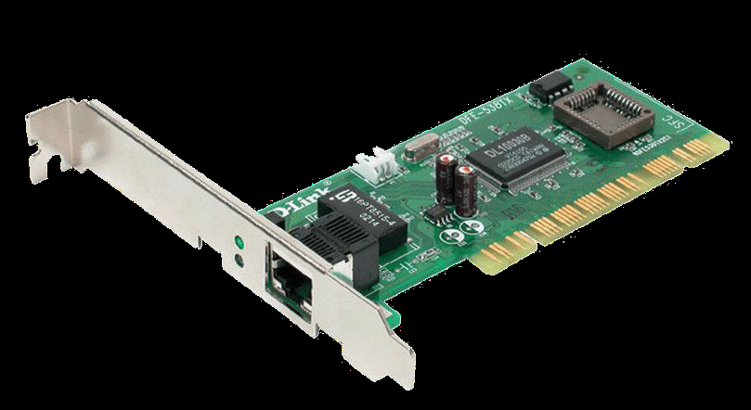
1. Network Interface Card
  NIC is used to physically connect host devices to the network media.
  A NIC is a printed circuit board that fits into the expansion slot of a bus on a computer motherboard.
  It can also be a peripheral device. NICs are sometimes called network adapters.
  Each NIC is identified by a unique code called a Media Access Control (MAC) address.
  This address is used to control data communication for the host on the network.
Notes:
Once again, I tried to pull graphics from the original network diagram. I had to alter the wireless router graphic in Photoshop to make it look better. I darken the and removed a white background to make it look consistent in relation to the standard router.

Slide 6
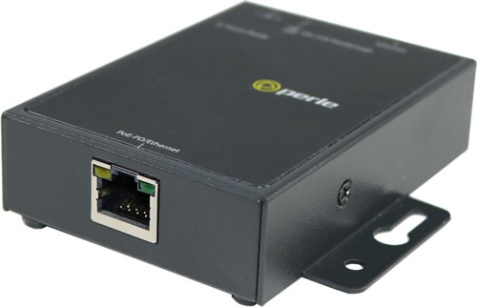
2. Repeaters
A repeater is a network device used to regenerate a signal.
Repeaters regenerate analog or digital signals that are distorted by transmission loss due to attenuation.
A repeater does not make an intelligent decision concerning forwarding packets
Notes:
Once again, I tried to pull graphics from the original network diagram. I had to alter the wireless router graphic in Photoshop to make it look better. I darken the and removed a white background to make it look consistent in relation to the standard router.

Slide 7
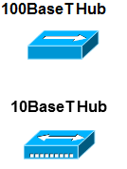
3. Hubs
Hubs concentrate on connections.
In other words, they take a group of hosts and allow the network to see them as a single unit. This is done passively, without any other effect on the data transmission.
Active hubs concentrate hosts and also regenerate signals.
Notes:
Once again, I tried to pull graphics from the original network diagram. I had to alter the wireless router graphic in Photoshop to make it look better. I darken the and removed a white background to make it look consistent in relation to the standard router.

Slide 8
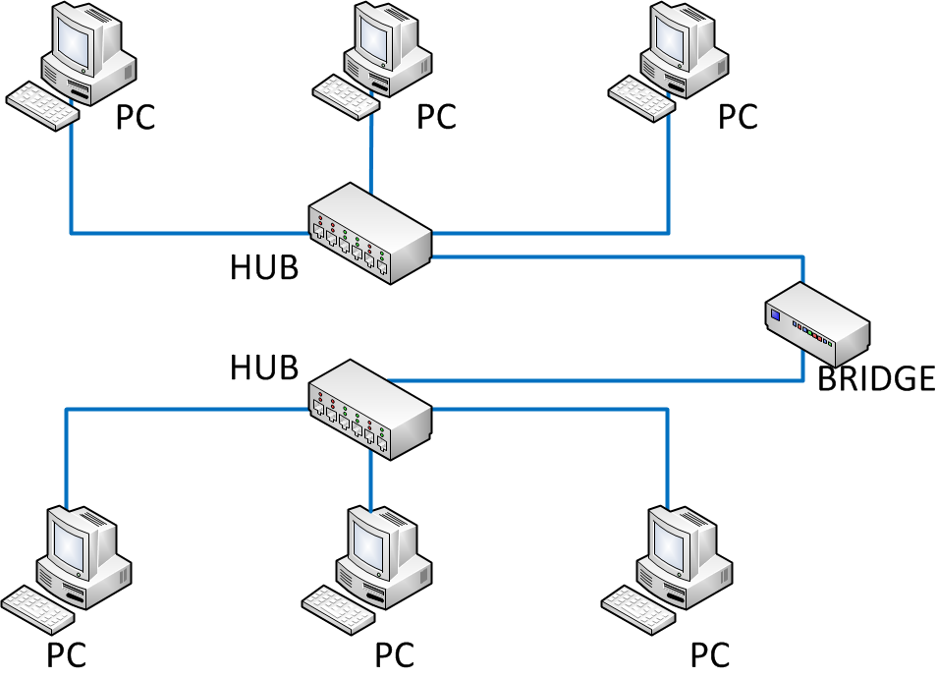
4. Bridges
Bridges convert network data formats and perform basic data transmission management.
Bridges provide connections between LANs.
They also check data to determine if it should cross the bridge. This makes each part of the network more efficient
Notes:
Once again, I tried to pull graphics from the original network diagram. I had to alter the wireless router graphic in Photoshop to make it look better. I darken the and removed a white background to make it look consistent in relation to the standard router.

Slide 9
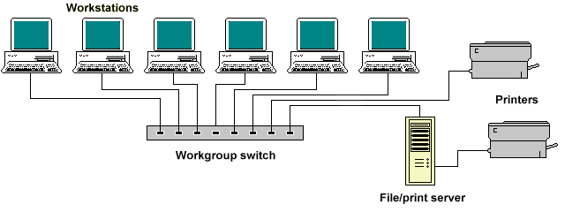
5. Switches
Switches add more intelligence to data transfer management.
They can determine if data should remain on a LAN and transfer data only to the connection that needs it.
Another difference between a bridge and switch is that a switch does not convert data transmission formats
Notes:
Once again, I tried to pull graphics from the original network diagram. I had to alter the wireless router graphic in Photoshop to make it look better. I darken the and removed a white background to make it look consistent in relation to the standard router.

Slide 10
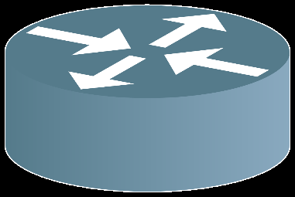
6. Routers
Routers have all the capabilities listed above.
Routers can regenerate signals, concentrate multiple connections, convert data transmission formats, and manage data transfers.
They can also connect to a WAN, which allows them to connect LANs that are separated by great distances.
Notes:
Once again, I tried to pull graphics from the original network diagram. I had to alter the wireless router graphic in Photoshop to make it look better. I darken the and removed a white background to make it look consistent in relation to the standard router.

Slide 11
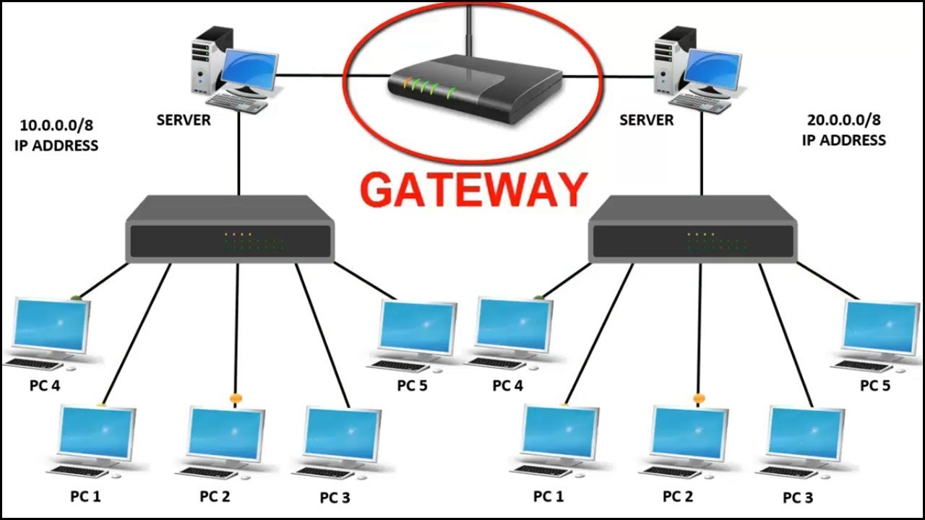
7. Gateway
A gateway is a piece of networking hardware used in telecommunications for telecommunications networks that allows data to flow from one discrete network to another.
Gateways are distinct from routers or switches in that they communicate using more than one protocol to connect a bunch of networks
Notes:
Once again, I tried to pull graphics from the original network diagram. I had to alter the wireless router graphic in Photoshop to make it look better. I darken the and removed a white background to make it look consistent in relation to the standard router.

Slide 12
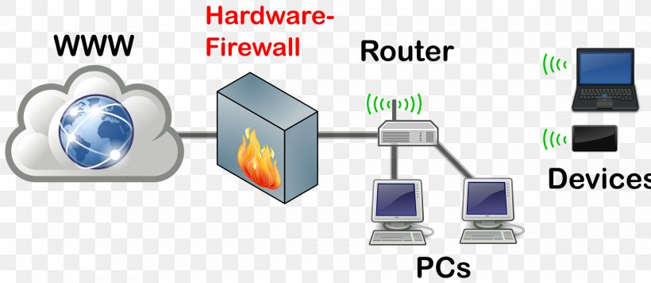
8. Firewall
A firewall is a network device or software for controlling network security and access rules.
Firewalls are inserted in connections between secure internal networks and potentially insecure external networks such as the Internet.
Firewalls are typically configured to reject access requests from unrecognized sources while allowing actions from recognized ones.
The vital role firewalls play in network security grows in parallel with the constant increase in cyber attacks.
Notes:
Once again, I tried to pull graphics from the original network diagram. I had to alter the wireless router graphic in Photoshop to make it look better. I darken the and removed a white background to make it look consistent in relation to the standard router.

