Slide 1
STUDENT NAME: SHARIFA A
REGISTER NO AND NMID: 24132090500122025 and autanm20920924213024
DEPARTMENT: BCA
COLLEGE: COLLEGE/ UNIVERSITY: RAJESWARI COLLEGE OF ARTS AND SCIENCE FOR WOMEN / ANNAMALAI UNIVERSITY

Slide 2
PROJECT TITLE:
STUDENT PORTFOLIO

Slide 3
AGENDA:
Problem Statement
Project Overview
End Users
Tools and Technologies
Portfolio design and Layout
Features and Functionality
Results and Screenshots
Conclusion
Github Link

Slide 4
Problem Statement:
In today's academic and professional environments, students are expected to showcase their skills, achievements, and academic progress in a structured and accessible format. Traditional methods such as printed resumes or static documents do not adequately reflect a student's diverse experiences, evolving skills, or creative work. Additionally, there is often no centralized system for students to collect, organize, and present their academic projects, certifications, extracurricular activities, and personal growth over time.

Slide 5
PROJECT OVERVIEW:
This project aims to develop a digital platform where students can create, manage, and showcase their academic and extracurricular achievements. The system will allow uploading of projects, certificates, and personal information in an organized format. It enhances students' ability to present their skills to educators and employers. The platform will be secure, user-friendly, and easily customizable.

Slide 6
WHO ARE THE END USERS?
End Users of the Student Portfolio System
Students – to create, update, and showcase their portfolios.
Teachers/Mentors – to review, give feedback, or endorse student work.
Recruiters/Employers – to view student portfolios during hiring or internship selection.
Academic Institutions – to track student progress and achievements over time.

Slide 7
Tools and Techniques:
HTML – to structure the portfolio content (projects, achievements, etc.)
CSS – to style the portfolio with layouts, colors, fonts, and responsiveness
JavaScript – to add interactivity (form validation, dynamic sections, image galleries, etc.)
LocalStorage / SessionStorage – to temporarily store user data within the browser
VS Code – as the code editor for development
Git + GitHub – for version control and hosting the project online

Slide 8
POTFOLIO DESIGN AND LAYOUT
Layout Structure
Header
Name, logo, and navigation menu (Home, About, Projects, Contact)
Fixed or sticky for easy access
Hero Section
A short intro with name, photo, and a tagline
Call-to-action button (e.g., “View Resume” or “Contact Me”)
About Me
Brief bio
Skills (can be shown with progress bars or icons)
Projects Section
Cards or grid layout displaying key academic or personal projects
Each card can include title, description, image, and a “View More” button

Slide 9
FEATURES AND FUNCTIONALITY:
Core Features
Responsive Design
Works smoothly on mobile, tablet, and desktop devices.
Interactive Navigation Menu
Smooth scrolling to sections
Hamburger menu for mobile view
Dynamic Project Display
Projects shown using cards or modals
“View More” buttons with toggle/show details
Skills & Progress Bars
Animated skill bars or icons to show proficiency
Contact Form
Form with fields (name, email, message)
JavaScript form validation before submission

Slide 10
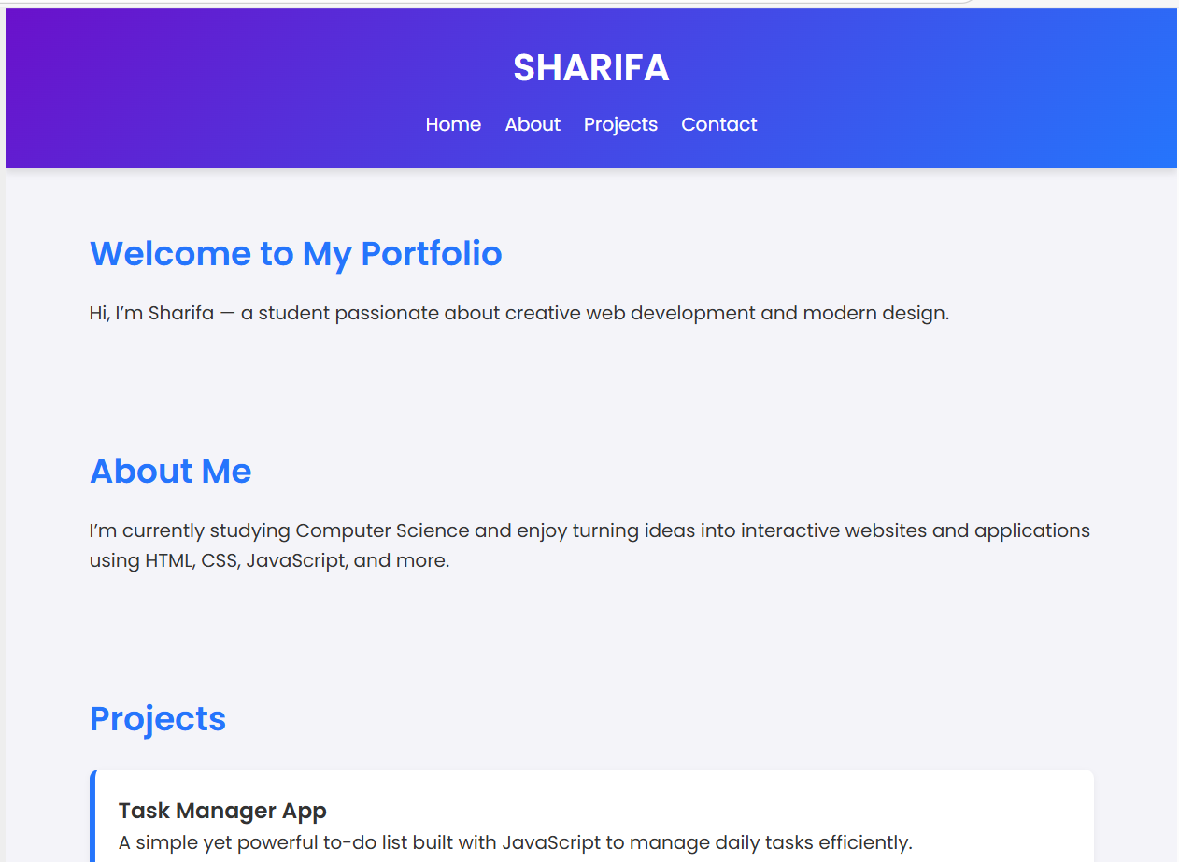
RESULTS AND SCREENSHOTS:

Slide 11
CONCLUSION:
This student portfolio project provides a simple yet effective way for students to showcase their skills, projects, and achievements online. Built using only HTML, CSS, and JavaScript, it ensures a responsive and interactive user experience. The platform enhances personal branding and helps students stand out to educators and employers.

