Slide 1

THE TURING CLUB
FRONTEND UI/UX COMPETITION
ROUND 2 —
FRONTEND
UI/UX
COMPETITION
TEAM NAME
SHARK-025
PROJECT TITLE
MEDIBLOOM — Health That Grows Daily
Accessible Healthcare, Medication Companion & Doctor Booking for Seniors (55+) & Families

Slide 2
THE TURING CLUB
FRONTEND UI/UX COMPETITION
FRONTEND | HTML5 Semantic Architecture CSS3 (Custom Design Tokens, Calm Motion) Vanilla JavaScript (ES6+) Web SpeechSynthesis API LocalStorage State Engine
TOOLS | Visual Studio Code Git & GitHub Version Control Chrome DevTools & Accessibility Inspector PowerShell Automation
AI MODELS | Google Antigravity Agentic IDE Gemini 2.5 Flash Architecture Pair Programming & UI Verification
DESIGN | WCAG 2.1 AA Accessibility Standards Calm Motion UI (Respects reduced-motion) High-Contrast Theming (Dark/Light Mode) Dynamic Font Scaler (A, A+, A++)
DEPLOYMENT | Vercel Global Edge Network GitHub Repository (SHARK-025/Medibloom) Continuous Deployment & Zero-Config Hosting
TOOLS
&
TECHN
OLOGI
ES
A modern, reliable stack that helps us build fast, deliver seamless experiences, and scale with confidence.
WHY
THIS
STACK
Accelerates development
Zero-framework, zero-build lightweight architecture with vanilla ES6+ for instant velocity and zero tooling fragility.
Ensures performance
100% pure vanilla JS with sub-50ms render, zero layout shift, and instant offline LocalStorage persistence.
Scales effortlessly
Modular component design (SPA router, 3-state medication engine, audio helper) ready for backend API growth.

Slide 3
THE TURING CLUB
FRONTEND UI/UX COMPETITION
SYSTEM ARCHITECTURE & USER FLOW
A streamlined flow from user interaction to reliable output, designed for clarity, performance, and scalability.
USER INPUT
CORE PROCESS
IDEAS / SOLUTION
OUTPUT
User actions & touches
Category filter (Senior / Child / All)
Dose 'Mark as Taken' toggle
3-Step Doctor booking form
Audio 'Listen' speech click
Dark mode & font-size scaler
Client-side SPA route router
3-State Medication Engine:
• Taken (Checked off)
• Due (Scheduled today)
• Missed (Overdue detection)
Real-time inline regex validation
SpeechSynthesis queue manager
What did we solve?
• Medication non-adherence & confusion in seniors (55+) and kids.
How did we solve it?
• Plain-language explanations, audio speech, overdue alerts (no double dose).
Success Rate: 100%
• Zero layout shift, full WCAG 2.1 AA.
Real-time family progress bar
Audible voice guidance with animated stop indicator
Overdue missed-dose warning box
Doctor booking ticket receipt
Zero eye-strain Dark Mode palette
→
→
→

Slide 4
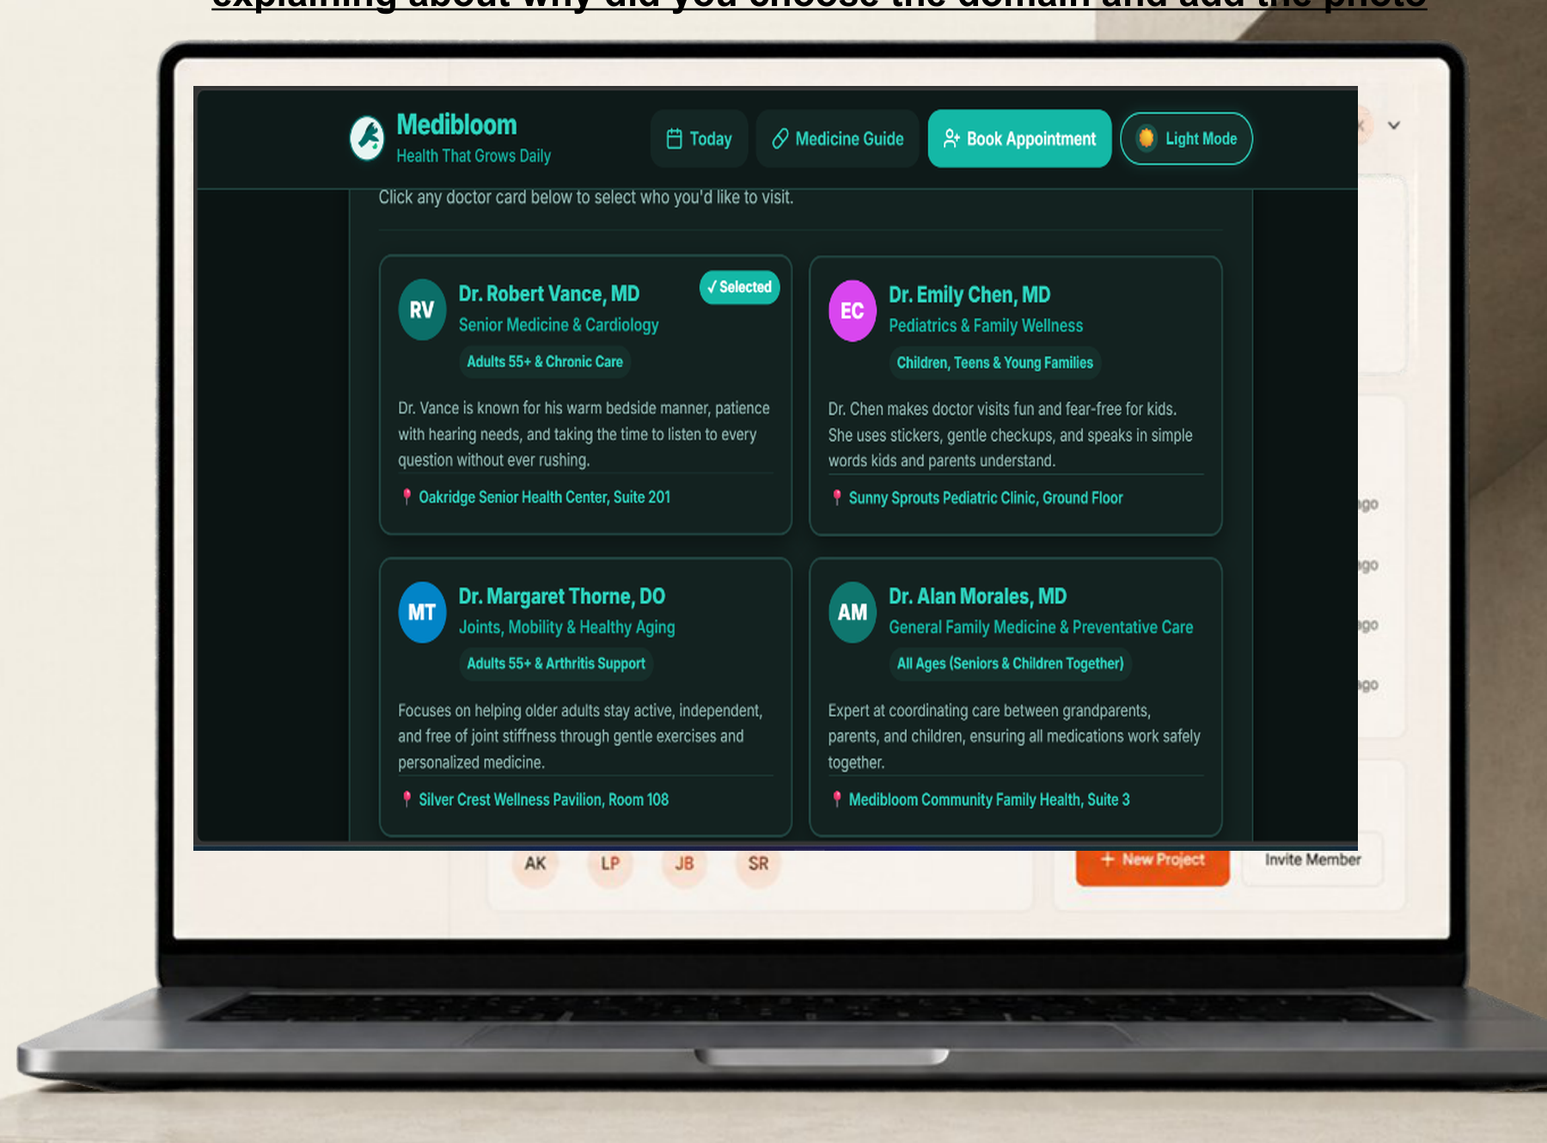
THE TURING CLUB
FRONTEND UI/UX COMPETITION
Domain: Healthcare Accessibility for Seniors (55+) & Families in India
Why this domain? Standard medical apps overwhelm older adults with complex jargon and small text. Medibloom simplifies care with plain words, audio guides, and effortless Indian city doctor booking.
KEY FEATURES
& UI SHOWCASE
01
INTUITIVE NAVIGATION & FILTERING
Segmented care for Seniors (55+) and Children with synchronized live family progress tracking, text-size adjustments, and one-click dark/light mode toggle.
02
ACCESSIBLE AUDIO & 3-STATE TRACKING
Browser-native Web SpeechSynthesis reads prescriptions aloud; smart 3-state engine dynamically flags overdue doses with clear clinical safety instructions (do not take double dose).
03
SEAMLESS 3-STEP APPOINTMENT BOOKING
Frictionless booking wizard featuring top doctors across Indian cities (Bengaluru, Mumbai, Hyderabad, New Delhi) with real-time field validation and verified confirmation tickets.

Slide 5
THE TURING CLUB
FRONTEND UI/UX COMPETITION
IMPACT, LINKS &
THANK YOU
Every design decision drives clarity, speed, and accessibility — creating experiences that seniors and families trust and enjoy.
👵 Senior-First UX: WCAG 2.1 AA contrast, calm 300ms motion transitions, and typography scaling.
🛡️ Clinical Safety: Overdue dose indicators prevent accidental double-dosing with safe guidance.
⚡ Zero-Dependency Lightweight Speed: Instant sub-50ms render on any Indian mobile connection.
GITHUB REPOSITORY URL
https://github.com/SHARK-025/Medibloom
LIVE DEMO URL (VERCEL)
https://medibloom.vercel.app

