Slide 1

IOT-BASED INTELLIGENT SOLAR TRACKING AND ENERGY PREDICTION SYSTEM USING MACHINE LEARNING
STUDENT NAME:
Sharkesh J – 234031101119
Sheik Abdullah J – 234031101121
Sree Sharan K P– 234031101123
Srinath U– 234031101124
Sriram T– 234031101125
CLASS AND SECTION
Department of Computer Applications
Dr. M.G.R. Educational and Research Institute,
PROJECT VIVA VOCE
Date: 09.04.2026
REVIEWER NAME: Dr. C. Priya
Professor
Department of Computer Applications
Dr. M.G.R. Educational and Research Institute,
GUIDE NAME: Mr. N. Surya
IBM Trainer
Department of Computer Applications
Dr. M.G.R. Educational and Research Institute,

Slide 2
CONTENTS
Abstract
Existing System
Proposed System
Architecture Diagram
Hardware and software requirements
Module descriptions
DFD/UML diagrams
Screenshot of project execution
Testing
Conclusion
Future Enhancement

Slide 3
Abstract
The rising demand for renewable energy has accelerated the adoption of solar power systems due to their sustainability and environmental benefits. Conventional solar panels are typically installed in fixed positions, limiting their ability to capture maximum solar radiation throughout the day. Since efficiency depends largely on panel orientation relative to the sun, fixed systems often result in reduced performance and energy output.
My project is an IOT-based intelligent solar tracking system with energy prediction. Traditional solar panels are fixed and lose efficiency, so our system uses sensors and a motor to automatically track the sun and maximize energy generation.
We also use a machine learning model (Linear Regression) to predict future power output based on collected data. A web dashboard displays real-time and predicted values.
This improves efficiency and enables smart energy management.

Slide 4
Existing System
Existing System
Static Installation
Reduced Efficiency
Lack of Monitoring
Solar panels are installed with a fixed tilt and orientation, unable to adapt to the sun's dynamic movement throughout the day or seasons.
This improper alignment results in a significant reduction in energy generation efficiency, missing out on optimal solar irradiance.
Most traditional systems lack real-time monitoring capabilities for critical data such as voltage, current, and power output.
No Predictive Capability
Manual Maintenance
These systems often require manual evaluation and maintenance, which increases operational costs and reduces overall reliability.
There is an absence of intelligent predictive models for estimating future power generation, leading to less efficient energy planning.

Slide 5
Proposed System
Our system integrates cutting-edge IoT technology with machine learning to revolutionize solar energy harnessing and management.
IoT-Based Tracking
Utilizes intelligent solar tracking with real-time feedback from
Light Dependent Resistors (LDRs) for optimal sun alignment.
Dynamic Alignment
An ESP32 microcontroller processes sensor data and controls servo motors, ensuring dynamic adjustment of panel orientation.
Real-time Data
Provides continuous measurement of critical parameters like voltage, current
,and power output for immediate insights.
Wireless Transmission
All collected data is transmitted wirelessly to a backend server via Wi-Fi for seamless data flow and accessibility.
ML Predictions
Machine learning regression models are employed to accurately
predict future energy generation, enabling proactive energy planning.
Interactive Dashboard
Real-time and predicted energy trends are visualized on an intuitive
and user-friendly dashboard for comprehensive monitoring.

Slide 6
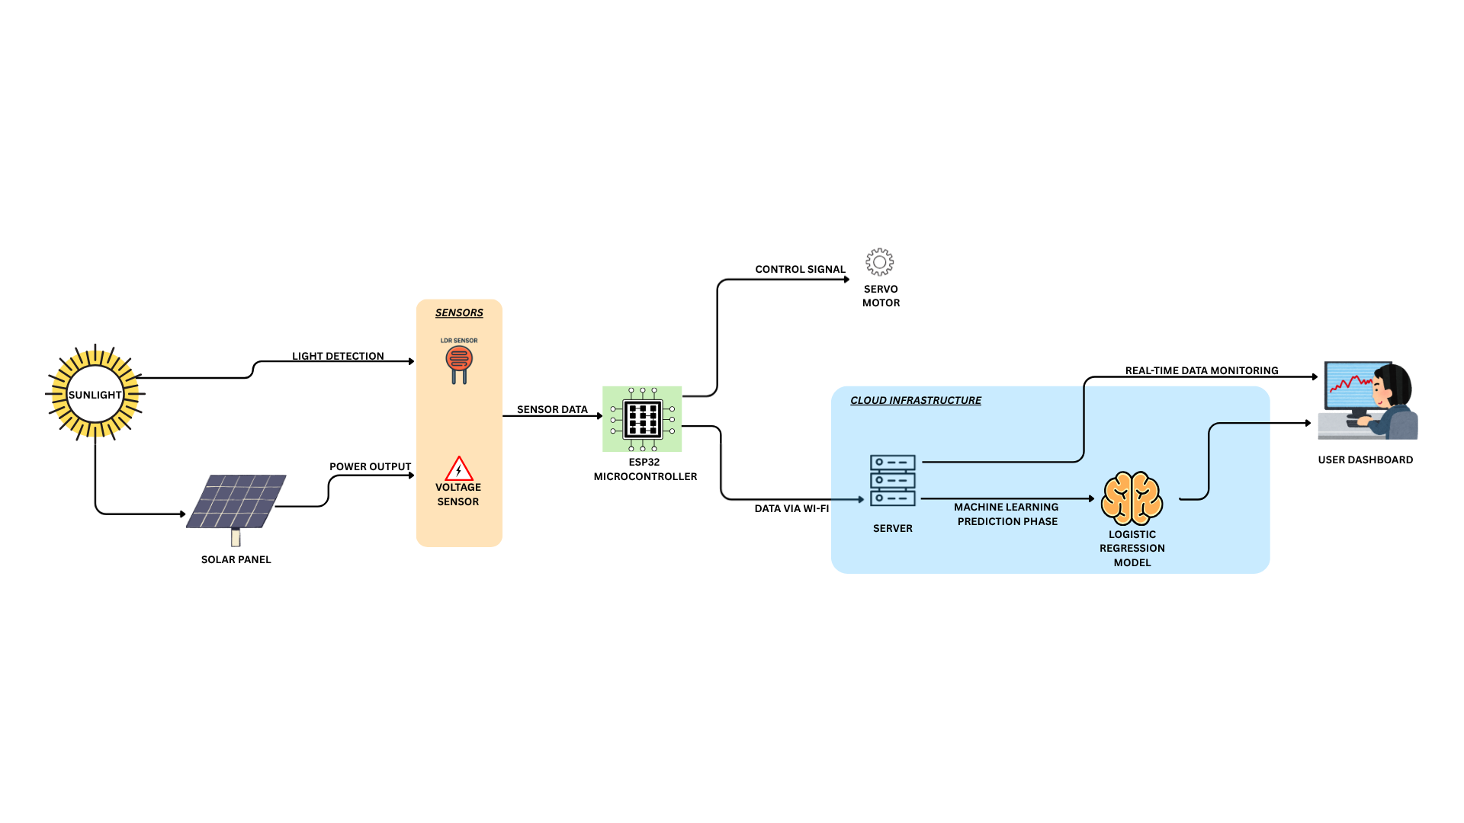
Architecture Diagram
SYSTEM ARCHITECTURE

Slide 7
SYSTEM REQUIREMENTS
Hardware | Software
Solar Panel – Efficient energy capture | Arduino IDE / ESP32 – Integrated programming environment
ESP32 Microcontroller – Central to data processing and control | Python – ML model development
LDRs (Light Dependent Resistors) – Detect sunlight intensity | ML Libraries (Scikit-learn, Pandas) – Data analysis
Servo Motor – Enables precise panel adjustment | Database (MySQL / Firebase) – Secure data storage
Sensors – Accurate voltage and current monitoring | Web Dashboard – Interactive data visualization and user interface
Buck Converter
Power Supply – Continuous system operation
Mounting Structure – Stable physical support

Slide 8
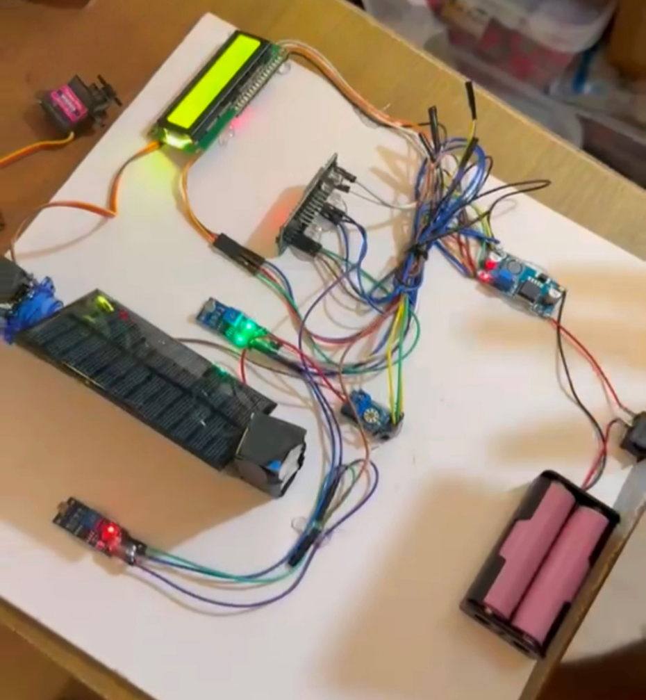
Hardware simulation
Category | Description
Key Features | • Real-time sunlight detection using LDR sensors • Automatic panel alignment using servo motor • Microcontroller-based intelligent control • Live monitoring via LCD display
Performance | • Fast and accurate light tracking • Higher efficiency than fixed panels • Stable and reliable operation
Power & Design | • Battery-backed power supply • Voltage regulation for safety • Compact and cost-effective design
Outcome | • Validates system design • Proves practical feasibility • Enhances solar energy utilization

Slide 9
Module descriptions
Module | Function
Solar Tracking Module | Uses LDR sensors and a servo motor to align the solar panel for maximum sunlight exposure.
Data Acquisition Module | Measures voltage, current, and power output from the solar panel, providing raw data.
IoT Communication Module | Transmits acquired data securely via Wi-Fi to the backend server for remote monitoring.
Machine Learning Module | Analyzes historical and real-time data with algorithms to predict future energy generation.
Visualization Module | Displays real-time data and predictive insights through an interactive dashboard.

Slide 10
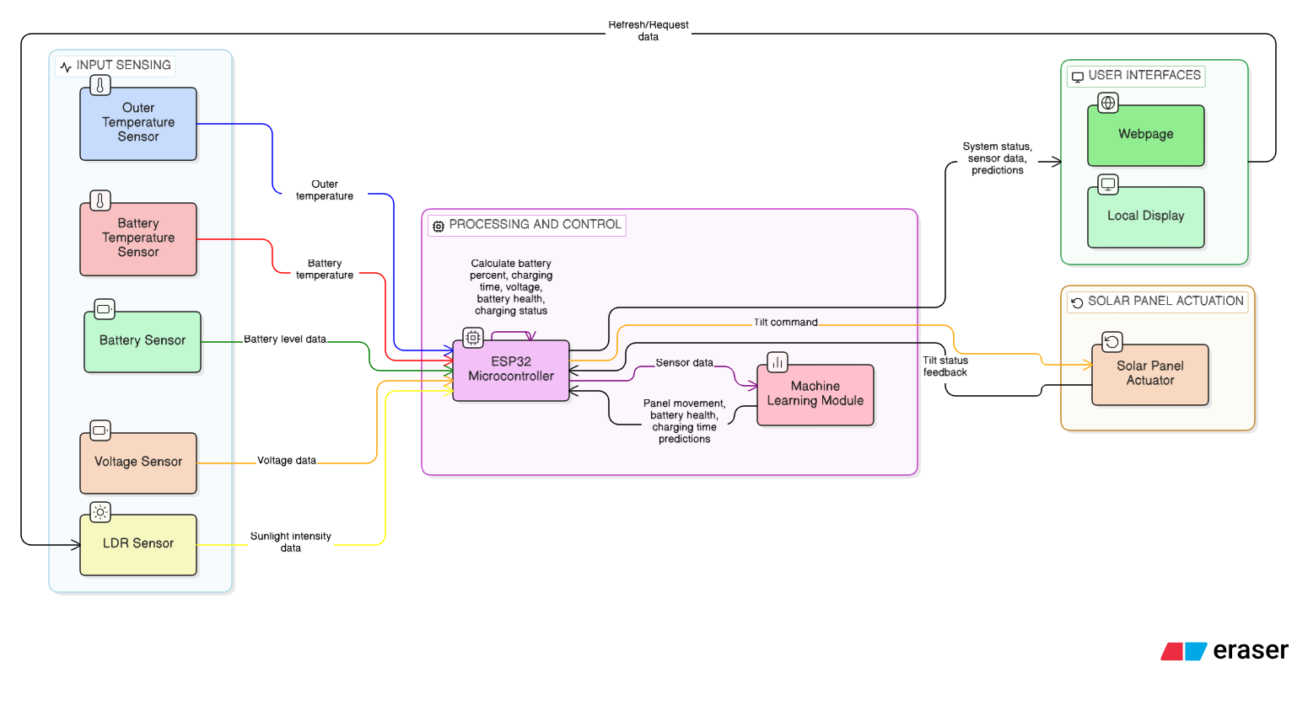

DFD DIAGRAM
SENSOR DATA ACQUISITION MODULE
Battery

Slide 11
UML diagrams
Sequence Diagram
Use Case Diagram
Flow of operations: Sensors → ESP32 → Cloud → ML → Dashboard.
Illustrates user interactions: monitor energy, track panel, view predictions.
Class Diagram
Defines system entities: LDR Sensor, Power Sensor, ESP32, Servo Motor, ML Model, Dashboard.

Slide 12
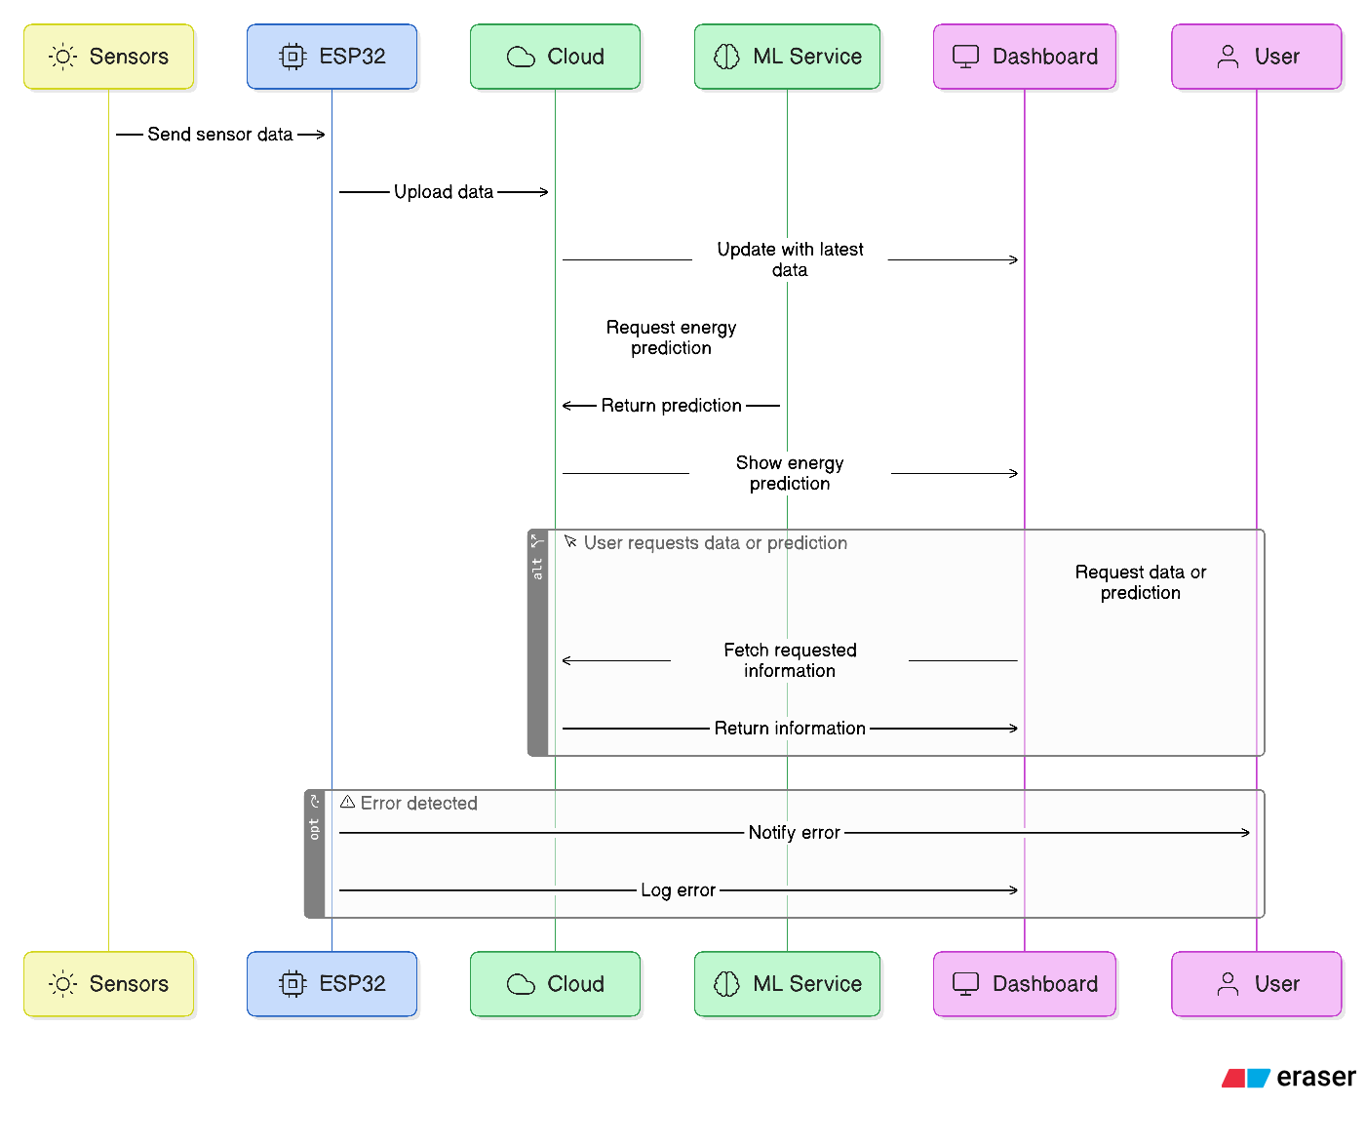


SEQUENCE DIAGRAM
System Workflow
Sensors collect sunlight and electrical data.
ESP32 processes readings and sends data to the cloud.
Cloud stores data and updates the dashboard.
Cloud requests ML service for energy prediction.
ML service returns prediction results to the cloud.
Dashboard displays real-time data and predictions to the user.
Errors are logged and user is notified.

Slide 13
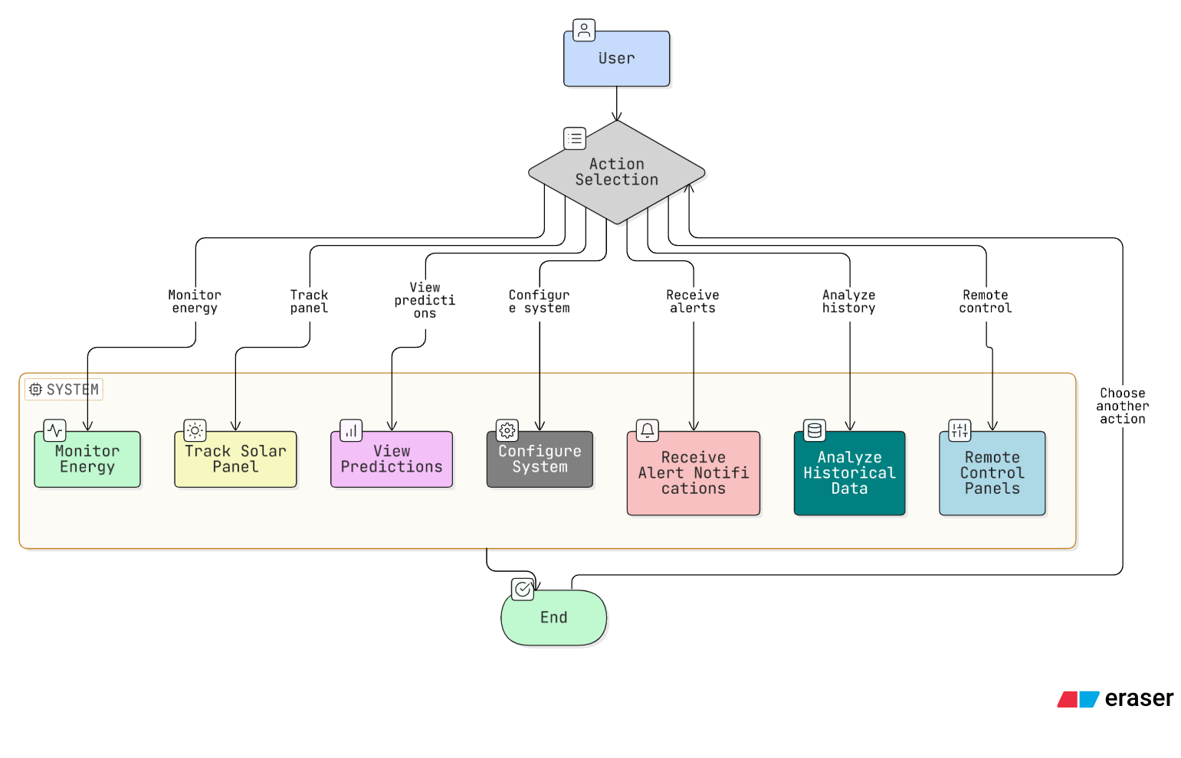

USE CASE DIAGRAM
Flow of operations: Sensors → ESP32 → Cloud → ML → Dashboard.

Slide 14
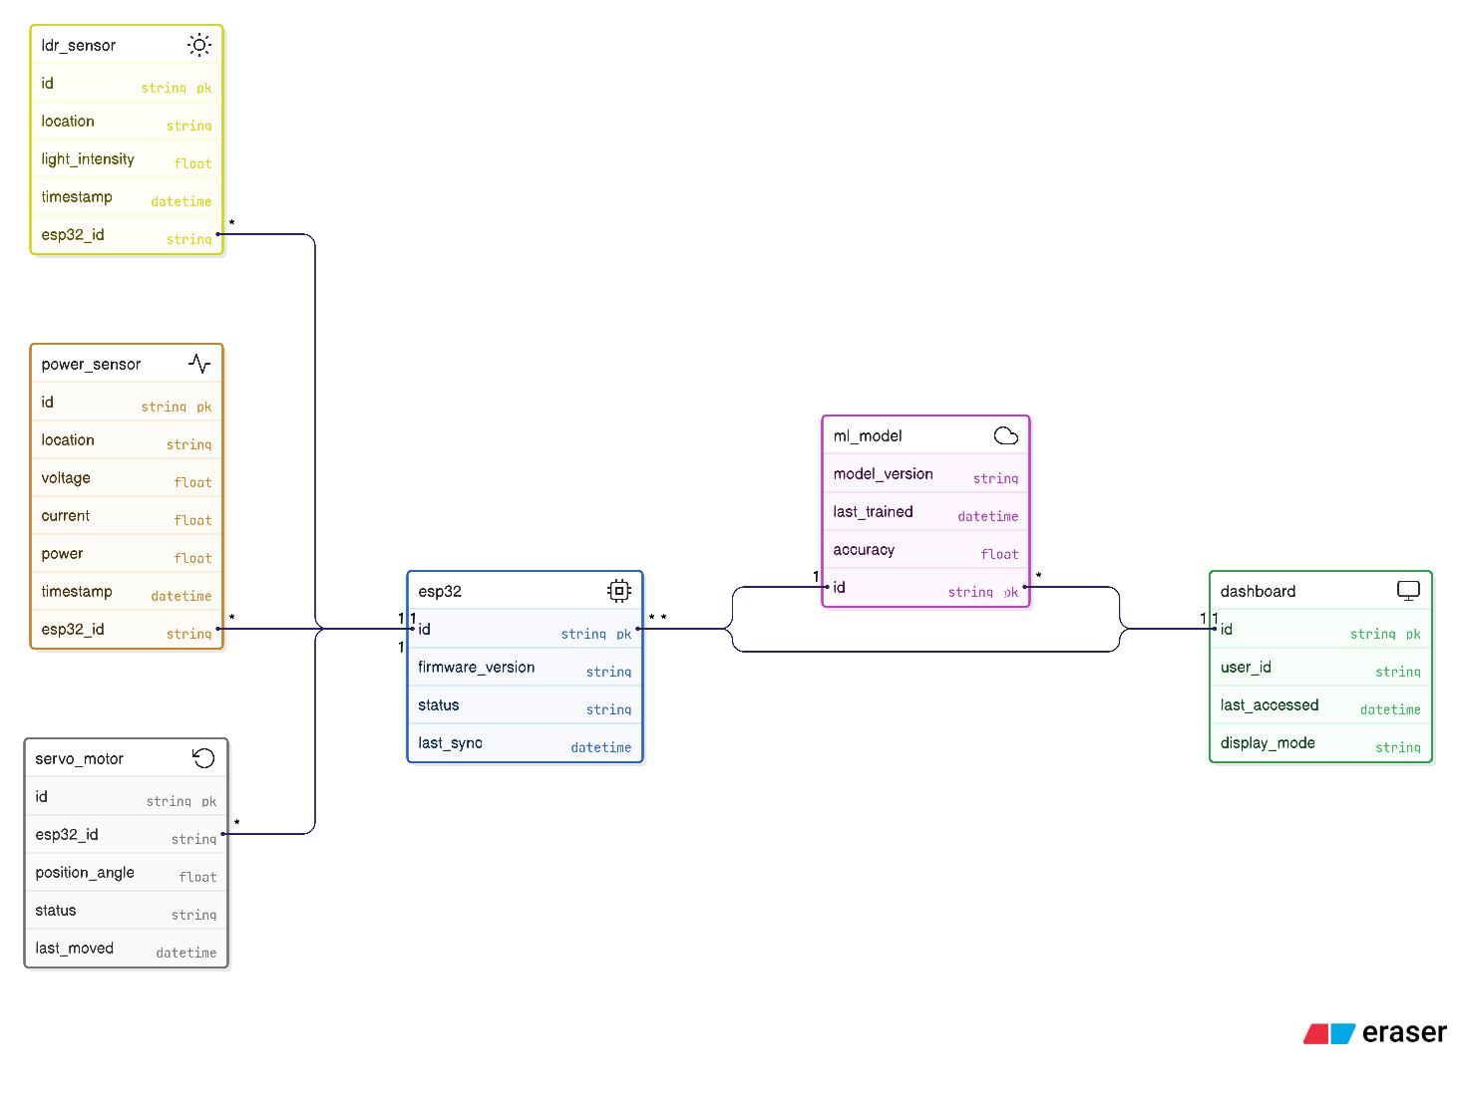
CLASS DIAGRAM
Defines system entities: LDR Sensor, Power Sensor, ESP32,
Servo Motor, ML Model, Dashboard.

Slide 15
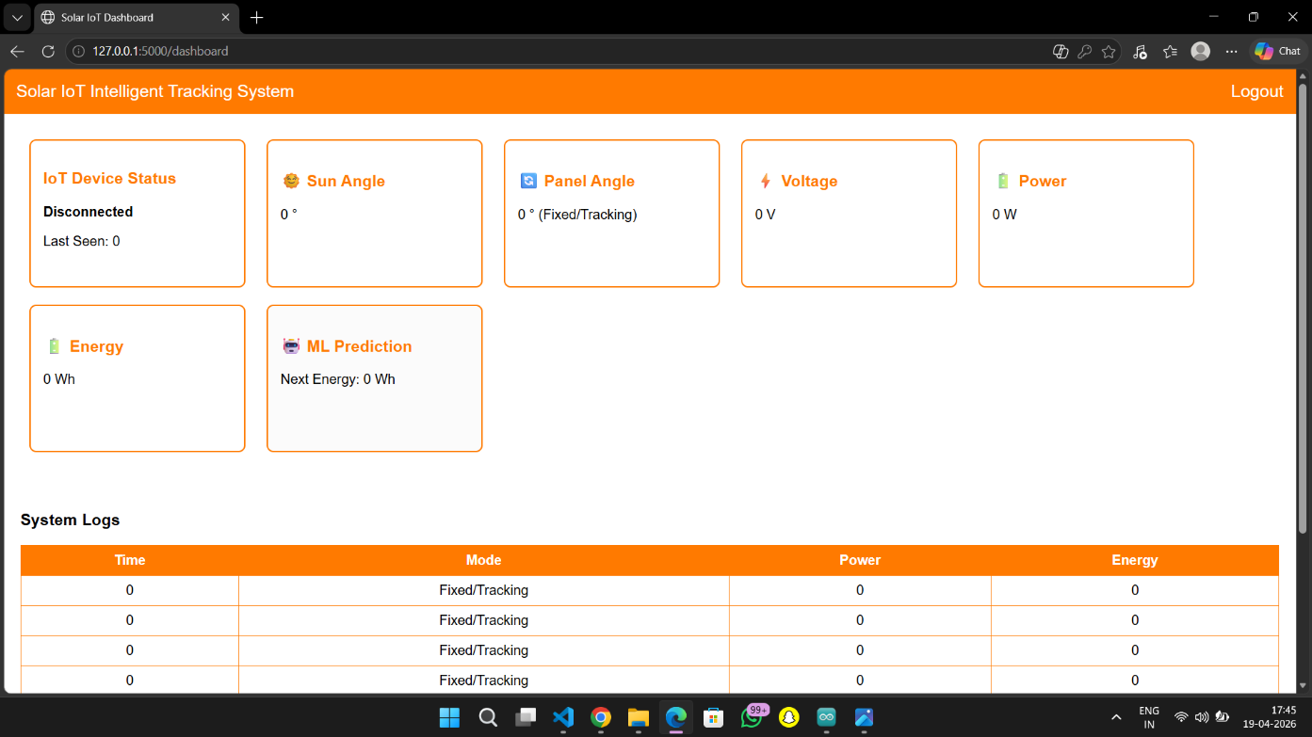
Screenshots
White and orange themed UI.
Displays real-time solar parameters.
Shows ML predicted energy.
Displays system logs

Slide 16
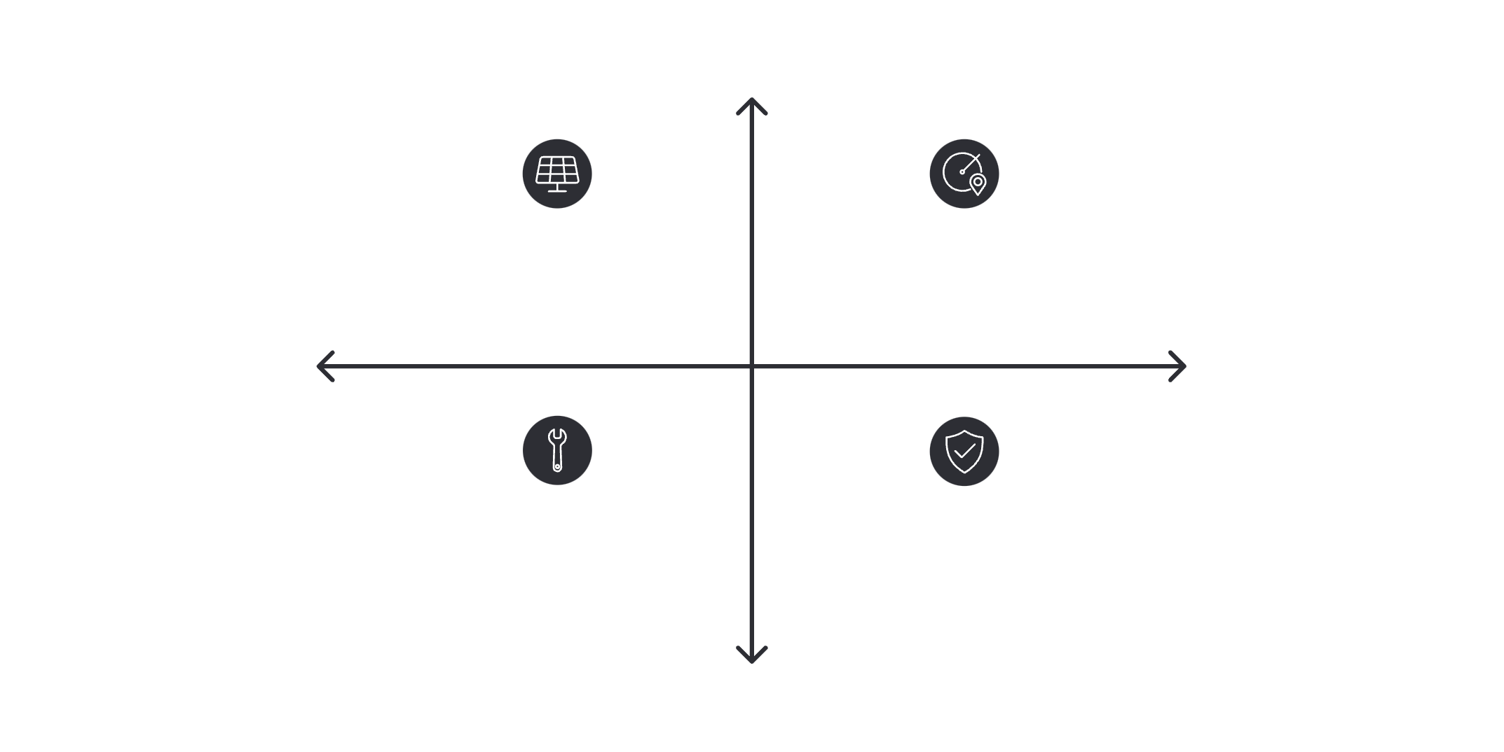
Testing
01
Higher Energy
ML Prediction Accuracy
Fixed Panel — Low Energy, Stable Output
Tracking Panel — High Energy, Variable Output
Machine Learning predictions closely align with actual trends.
Lower Cost
Higher Cost
02
Tracking Costs — Higher Installation & Maintenance
Fixed Benefits — Lower Cost, Simple Maintenance
System Performance
Overall system performs as expected .
Lower Energy
Tracking mode consistently produces higher energy output.

Slide 17
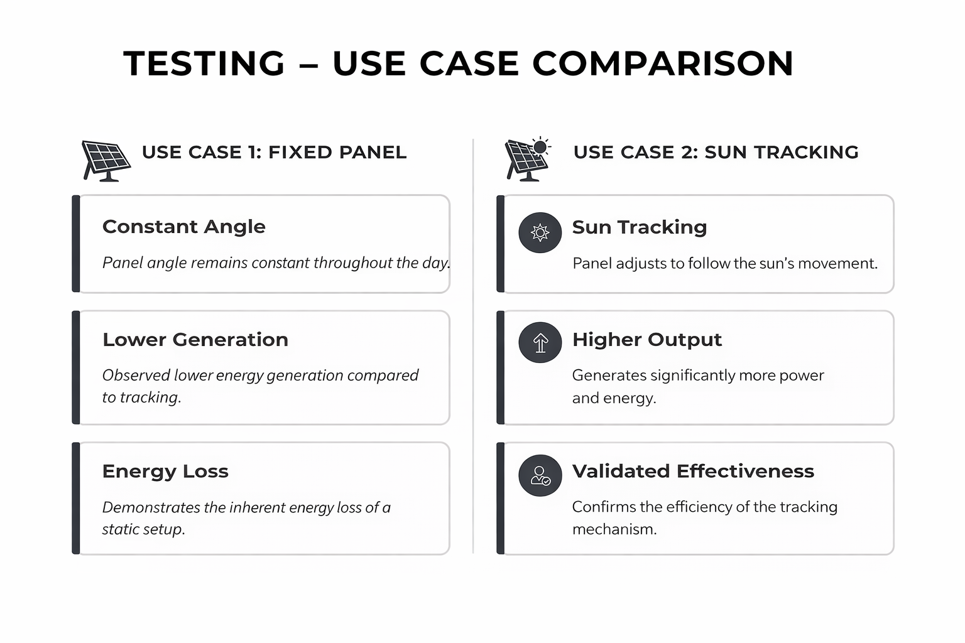
Test cases
gjslkdgj

Slide 18
Conclusion
The project successfully demonstrates an “IOT-based intelligent solar tracking system”.
Automatic tracking improves energy efficiency and power output.
IOT enables real-time monitoring and remote access.
Machine learning enhances energy prediction and planning.
The system is cost-effective, scalable, and supports renewable energy adoption.

Slide 19
Future Enhancement
Dual-axis solar tracking to maximize energy efficiency
Advanced AI/Deep Learning models for accurate energy prediction
Battery storage integration for efficient energy utilization
Mobile/Web app for real-time monitoring and control
Smart grid integration for large-scale deployment

Slide 20


