Slide 1

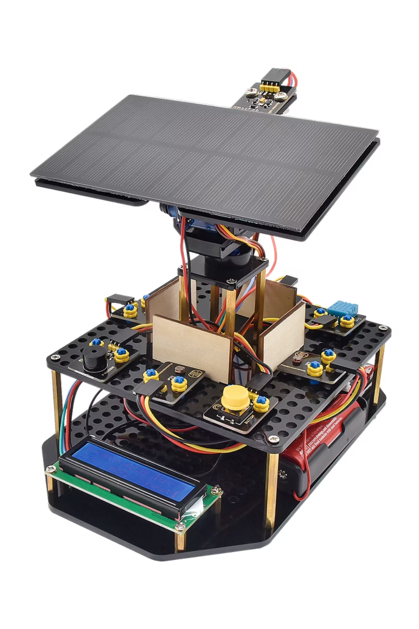

IOT-BASED INTELLIGENT SOLAR TRACKING AND ENERGY PREDICTION SYSTEM USING MACHINE LEARNING
An innovative solution integrating IoT and Machine Learning for enhanced renewable energy management.
Presented By
Sharkesh – 234031101119
Sheik Abdullah – 234031101121
Sree Sharan – 234031101123
Srinath – 234031101124
Sriram – 234031101125
Review Date: 31.12.2025 | 1st Review | Project Guide: Surya (IBM) | Project Reviewer: Dr. C. Priya

Slide 2

PROJECT ABSTRACT
The rising demand for renewable energy highlights the need for efficient solar power systems.
Fixed solar panels cannot follow the sun, leading to energy loss.
This project proposes an IoT-based intelligent solar tracking system with machine learning.
LDR sensors detect sunlight intensity in real time.
An ESP32 microcontroller controls a servo motor to align the solar panel optimally.
Real-time solar tracking improves energy generation compared to fixed panels.
The system measures voltage, current, and power output.
Data is sent to the cloud using Wi-Fi for storage and analysis.
Machine learning models predict future energy generation and performance.
The system is low-cost, scalable, and suitable for educational and small-scale use.

Slide 3
PROBLEM STATEMENT
Increasing demand for renewable energy due to high cost of conventional power sources
Solar energy is a major alternative, but efficiency is still a challenge
Traditional solar panels are fixed at one angle
Fixed panels cannot track sun movement, leading to energy loss
Conventional systems lack real-time monitoring of solar performance
No proper performance analysis to optimize energy output
Lack of predictive insights makes maintenance difficult
Need for a low-cost intelligent solar tracking system
System should provide automatic sun tracking + electrical monitoring + predictive analytics

Slide 4
OBJECTIVES
To design and develop an IoT-based intelligent solar tracking system.
To automatically align the solar panel toward maximum sunlight using LDR sensors.
To control solar panel movement using an ESP32 microcontroller and servo motor.
To improve energy generation compared to fixed-angle solar panels.
To measure key electrical parameters such as voltage, current, and power output.
To transmit real-time data to a cloud server using Wi-Fi.
To apply machine learning regression models for energy prediction and performance analysis.
To visualize real-time and predicted data through an interactive dashboard.
To compare the performance of the tracking system with a fixed solar panel.
To develop a low-cost, scalable system suitable for educational and small-scale applications.
Base Paper: IoT-Enabled Solar Tracking Systems with Machine Learning-Based Energy Prediction, IEEE Access, 2025.Focus: IoT architecture, solar monitoring, ML-based forecasting

Slide 5




LIMITATIONS OF EXISTING SOLAR SYSTEMS
Current solar energy setups face several challenges that hinder optimal performance and efficiency.
Static Installation
Reduced Efficiency
Lack of Monitoring
Solar panels are installed with a fixed tilt and orientation, unable to adapt to the sun's dynamic movement throughout the day or seasons.
This improper alignment results in a significant reduction in energy generation efficiency, missing out on optimal solar irradiance.
Most traditional systems lack real-time monitoring capabilities for critical data such as voltage, current, and power output.
No Predictive Capability
Manual Maintenance
These systems often require manual evaluation and maintenance, which increases operational costs and reduces overall reliability.
There is an absence of intelligent predictive models for estimating future power generation, leading to less efficient energy planning.

Slide 6
INTRODUCING OUR INTELLIGENT SOLAR SOLUTION
Our system integrates cutting-edge IoT technology with machine learning to revolutionize solar energy harnessing and management.
IoT-Based Tracking
Utilizes intelligent solar tracking with real-time feedback from Light Dependent Resistors (LDRs) for optimal sun alignment.
Dynamic Alignment
An ESP32 microcontroller processes sensor data and controls servo motors, ensuring dynamic adjustment of panel orientation.
Real-time Data
Provides continuous measurement of critical parameters like voltage, current, and power output for immediate insights.
Wireless Transmission
All collected data is transmitted wirelessly to a backend server via Wi-Fi for seamless data flow and accessibility.
ML Predictions
Machine learning regression models are employed to accurately predict future energy generation, enabling proactive energy planning.
Interactive Dashboard
Real-time and predicted energy trends are visualized on an intuitive and user-friendly dashboard for comprehensive monitoring.

Slide 7
SYSTEM REQUIREMENTS
To implement our intelligent solar tracking and energy prediction system, specific hardware and software components are essential.
1
2
Hardware
Software
Solar Panel: For efficient energy capture.
ESP32 Microcontroller: Central to data processing and control.
LDRs (Light Dependent Resistors): Detects sunlight intensity.
Servo Motor: Enables precise panel adjustment.
Sensors: For accurate voltage and current monitoring.
Wi-Fi Connectivity: Facilitates seamless data transmission.
Power Supply: Ensures continuous system operation.
Mounting Structure: Provides stable physical support for the system.
Arduino IDE / ESP32: Integrated programming environment.
Python: Utilized for ML model development.
ML Libraries: Includes Scikit-learn and Pandas for data analysis.
Database: MySQL / Firebase for secure data storage.
Web Dashboard: For interactive data visualization and user interface.

Slide 8
IOT-BASED INTELLIGENT SOLAR TRACKING AND ENERGY PREDICTION SYSTEM USING MACHINE LEARNING
An innovative solution integrating IoT and Machine Learning for enhanced renewable energy management.
Presented By
Sharkesh – 234031101119
Sheik Abdullah – 234031101121
Sree Sharan – 234031101123
Srinath – 234031101124
Sriram – 234031101125
Review Date: 12.01.2026 | 2nd Review |Project Guide: Surya (IBM) | Project Reviewer: Dr. C. Priya

Slide 9

SYSTEM ARCHITECTURE: INTEGRATING INTELLIGENCE INTO SOLAR ENERGY
Our system meticulously integrates several components to achieve optimal solar energy capture and prediction. From physical tracking to advanced analytics, each element plays a crucial role in enhancing efficiency.
Ⅱ
Ⅰ
Ⅲ
Solar Panel with Servo Motor
LDR Sensors for Sunlight Detection
ESP32 Microcontroller
Dynamic positioning for maximum sunlight absorption.
Real-time light intensity measurement for precise tracking.
The brains of the operation, coordinating data and movement.
Ⅳ
Ⅴ
Ⅵ
Wi-Fi Communication
Backend Server & Database
Machine Learning Prediction Engine
Seamless data transmission to the backend infrastructure.
Secure storage and processing of collected energy data.
Predictive analytics for future energy generation forecasts.
Ⅶ
Visualization Dashboard
Intuitive display of real-time and predicted energy insights.

Slide 10





CORE MODULES: DRIVING SOLAR EFFICIENCY AND INTELLIGENCE
Our system is compartmentalized into distinct modules, each responsible for a specific function, ensuring robust performance and scalability.
1. Solar Tracking Module
Utilizes LDR sensors and a servo motor to dynamically align the solar panel, ensuring optimal exposure to sunlight throughout the day.
2. Data Acquisition Module
Measures critical parameters such as voltage, current, and power generated by the solar panel, providing raw data for analysis.
3. IoT Communication Module
Facilitates secure and efficient transmission of acquired data to the central backend server via Wi-Fi, enabling remote monitoring.
4. Machine Learning Module
Employs advanced algorithms to analyze historical and real-time data, predicting future energy generation patterns with high accuracy.
5. Visualization Module
Presents real-time operational data and predictive insights through an interactive dashboard, offering a clear overview of system performance.

Slide 11
FEASIBILITY STUDY: A COMPREHENSIVE ASSESSMENT
We studied whether this project is practical and worth doing.
Technical Feasibility
Economic Feasibility
Uses affordable, easy-to-find parts like the ESP32 chip and light sensors, plus tested machine learning tools.
Uses cheap, ready-made parts and free software, so the project won't cost much.
Operational Feasibility
Schedule Feasibility
Easy to use and monitor with a simple dashboard that shows clear, useful information.
The project is clear and can be finished in one semester.

Slide 12
IOT-BASED INTELLIGENT SOLAR TRACKING AND ENERGY PREDICTION SYSTEM USING MACHINE LEARNING
An innovative solution integrating IoT and Machine Learning for enhanced renewable energy management.
Presented By
Sharkesh – 234031101119
Sheik Abdullah – 234031101121
Sree Sharan – 234031101123
Srinath – 234031101124
Sriram – 234031101125
Review Date: 29.01.2026 | 3rd Review |Project Guide: Surya (IBM) | Project Reviewer: Dr. C. Priya

Slide 13
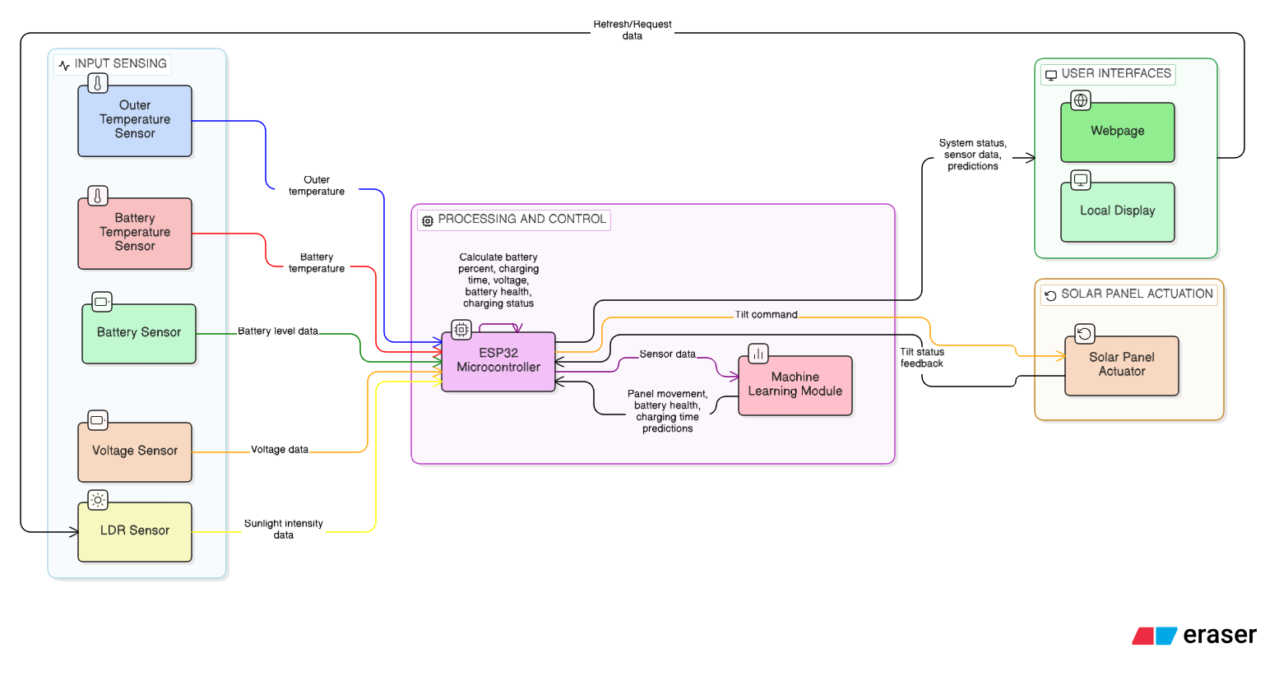
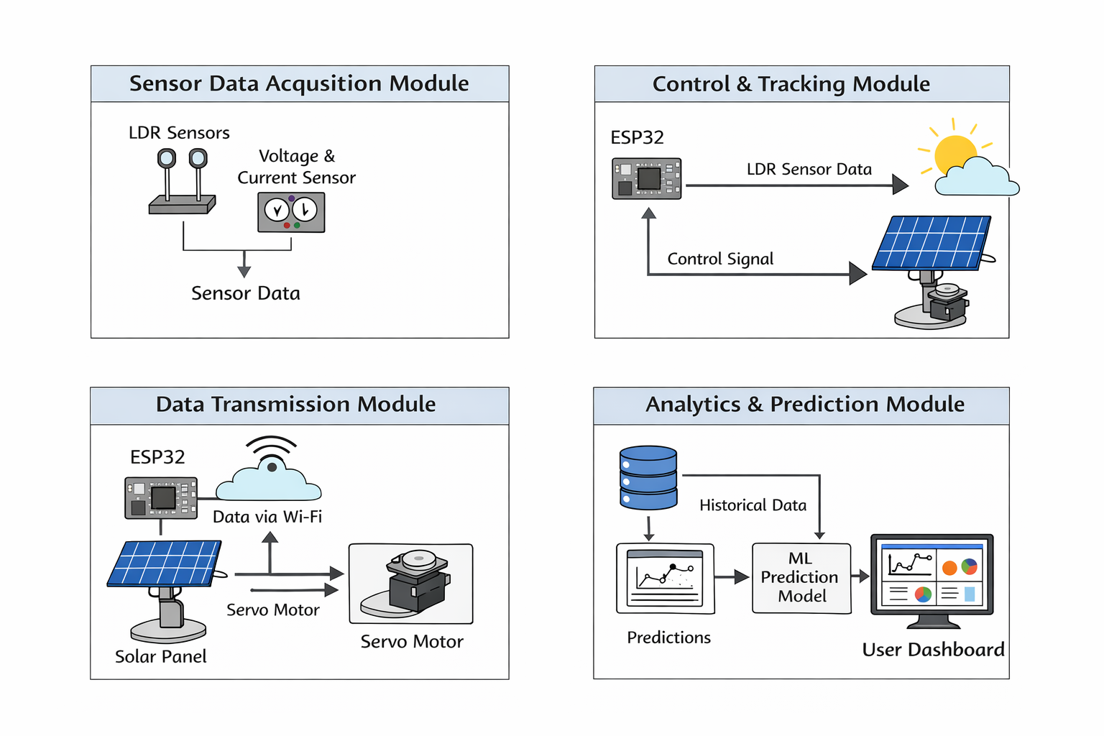



DFD LEVEL 0
SENSOR DATA ACQUISITION MODULE
Battery
Sunlight illuminates the solar panel
LDR sensors detect light intensity changes
Voltage and measure power output
All sensor values collected as raw input data

Slide 14
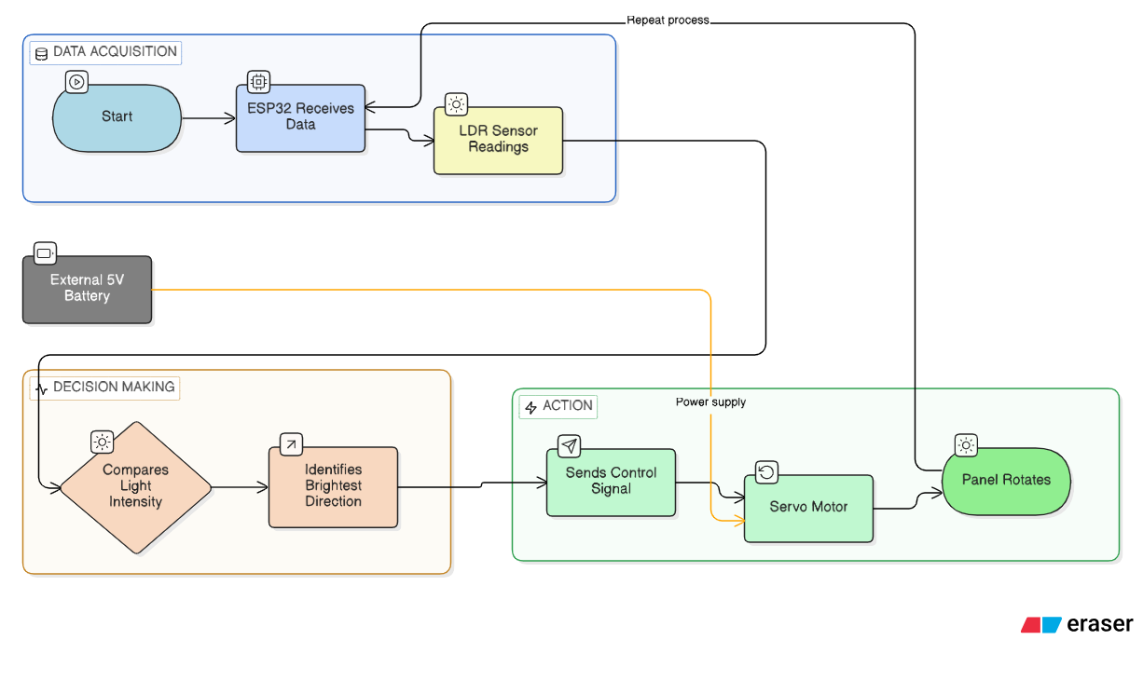
DFD LEVEL 1
CONTROL & TRACKING MODULE
ESP32 Receives Data
Compares Light Intensity
Sends Control Signal
Panel Rotates
Aligns towards maximum sunlight exposure
Processes LDR sensor readings
Identifies direction of brightest sunlight
Sends Control Signal

Slide 15
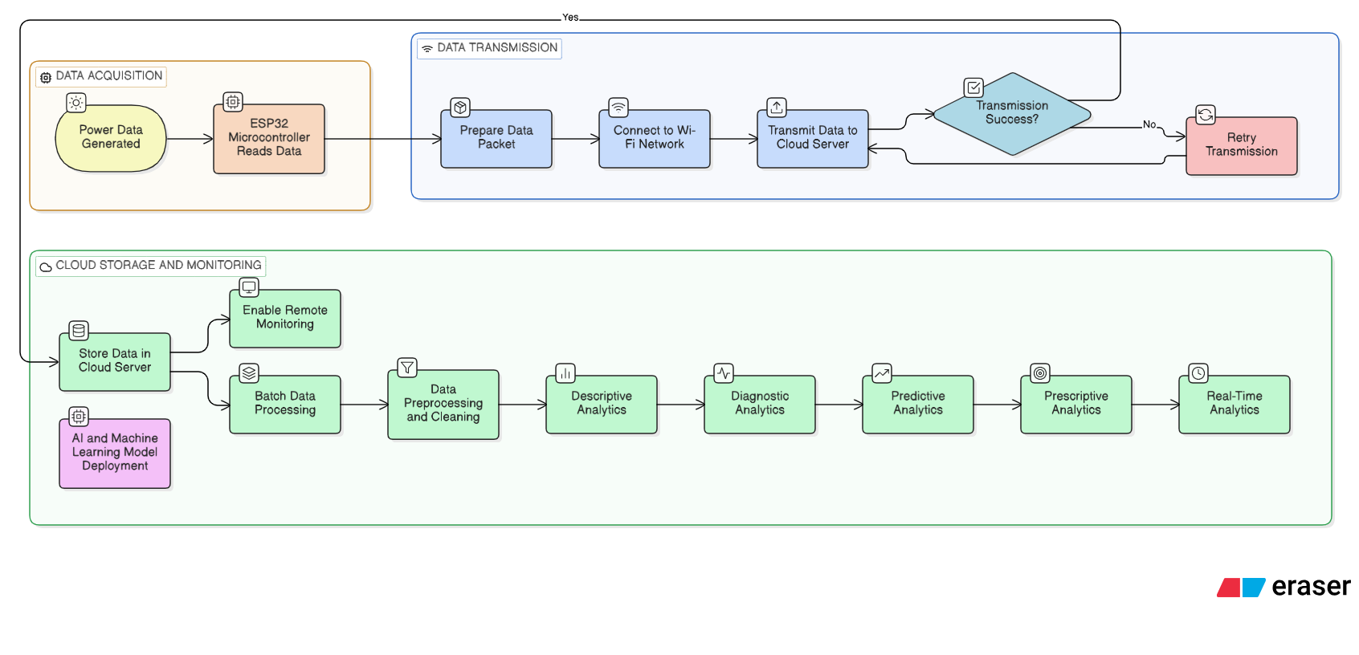


DFD LEVEL 2
DATA TRANSMISSION MODULE
ESP32 gathers sensor & power data
Data transmitted to cloud server via Wi-Fi
Enables continuous remote monitoring
Data archived for historical analysis

Slide 16
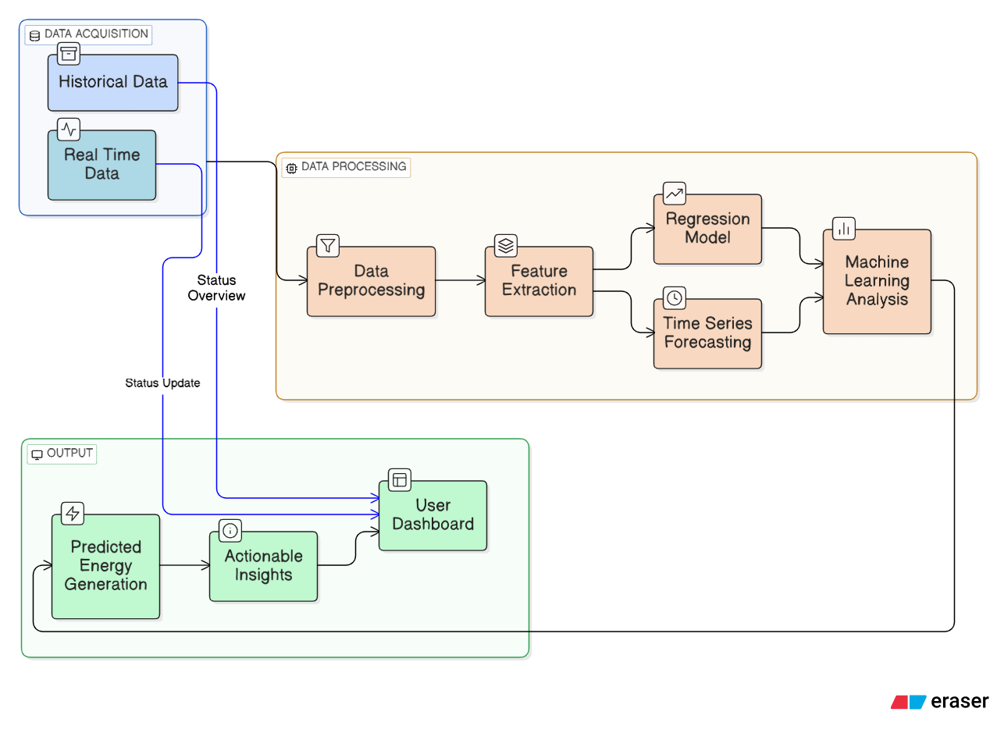
DFD LEVEL 3
ANALYTICS & PREDICTION MODULE

Slide 17
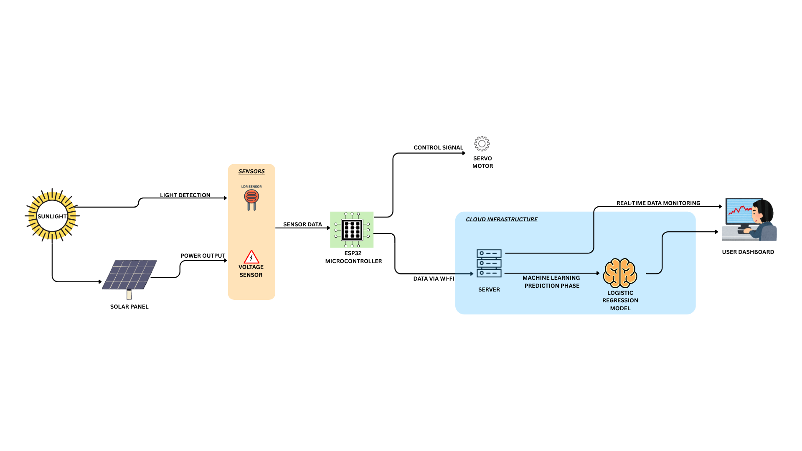


SYSTEM ARCHITECTURE
This diagram illustrates the interconnected components for seamless operation and data flow within the intelligent solar tracking system.

Slide 18
UML DIAGRAM – SYSTEM OVERVIEW
1
2
3
Sequence Diagram
Use Case Diagram
Class Diagram
Flow of operations: Sensors → ESP32 → Cloud → ML → Dashboard.
Illustrates user interactions: monitor energy, track panel, view predictions.
Defines system entities: LDR Sensor, Power Sensor, ESP32, Servo Motor, ML Model, Dashboard.
UML diagrams provide clear insights into system behavior and structural relationships.

Slide 19
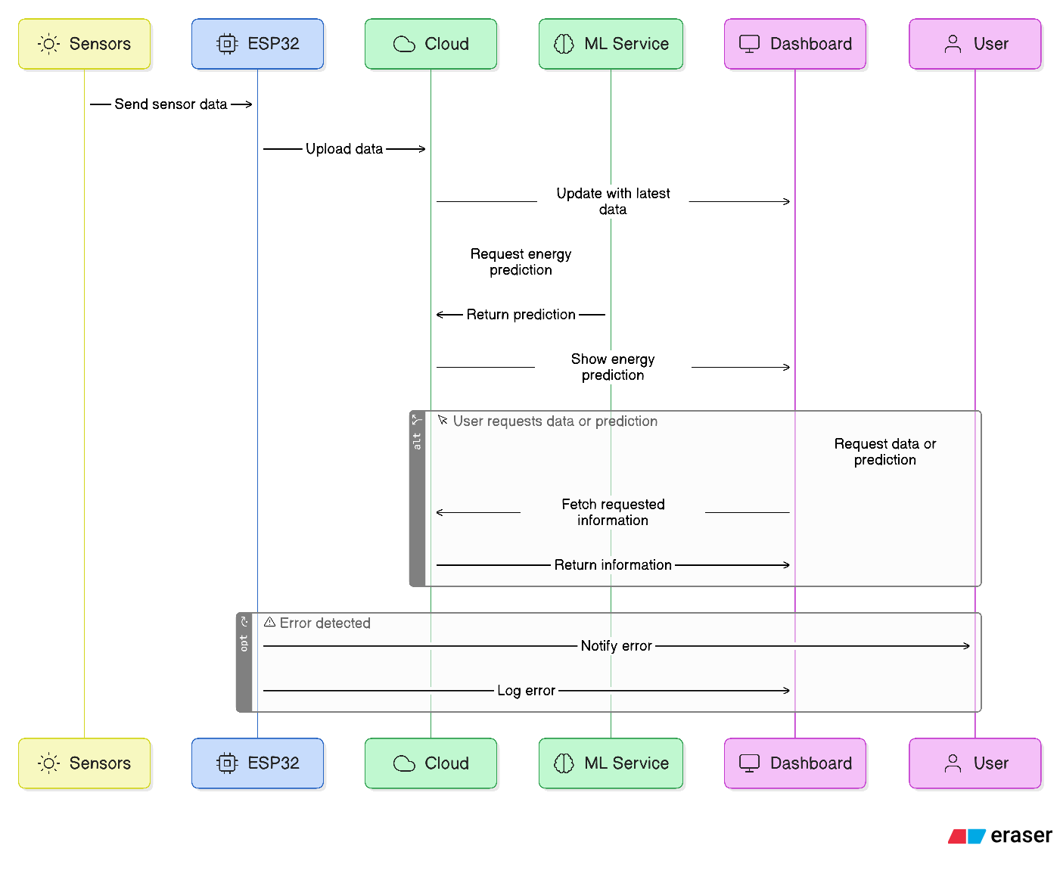

SEQUENCE DIAGRAM
System Workflow
Sensors collect sunlight and electrical data.
ESP32 processes readings and sends data to the cloud.
Cloud stores data and updates the dashboard.
Cloud requests ML service for energy prediction.
ML service returns prediction results to the cloud.
Dashboard displays real-time data and predictions to the user.
Errors are logged and user is notified.

Slide 20
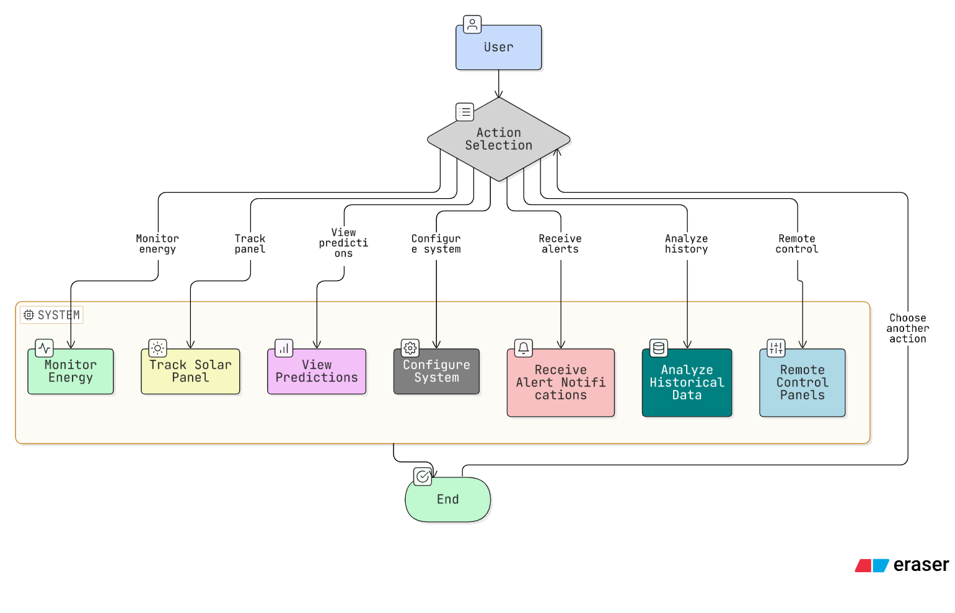


USE CASE DIAGRAM
Flow of operations: Sensors → ESP32 → Cloud → ML → Dashboard.

Slide 21
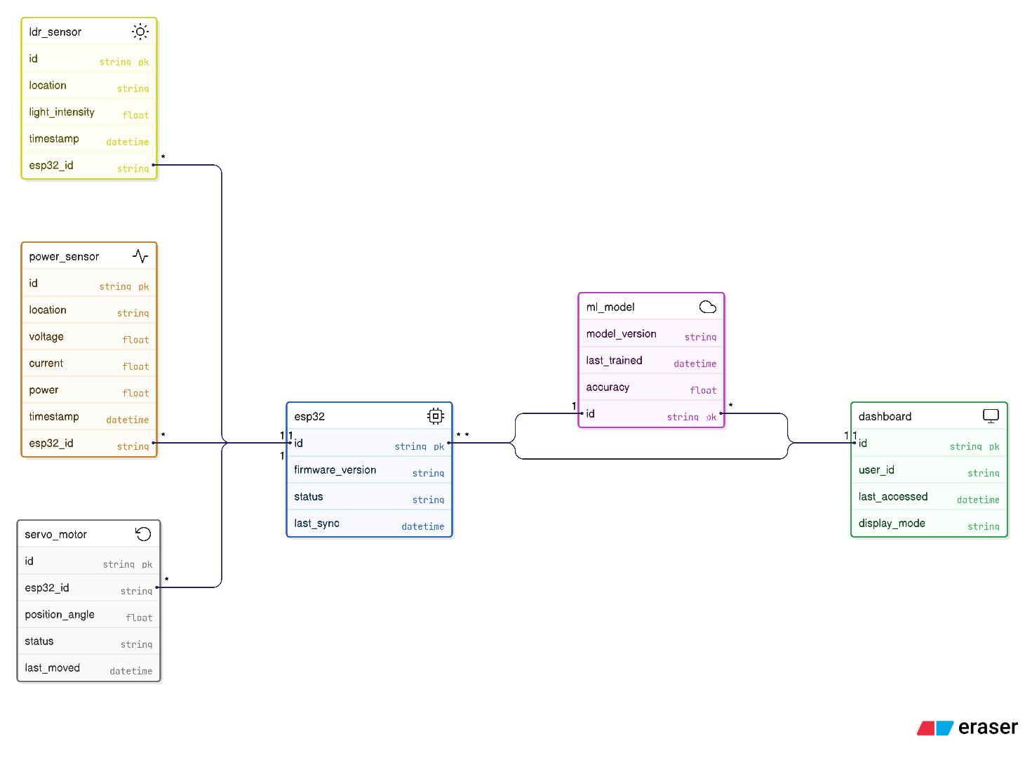
CLASS DIAGRAM
Defines system entities: LDR Sensor, Power Sensor, ESP32, Servo Motor, ML Model, Dashboard.

Slide 22
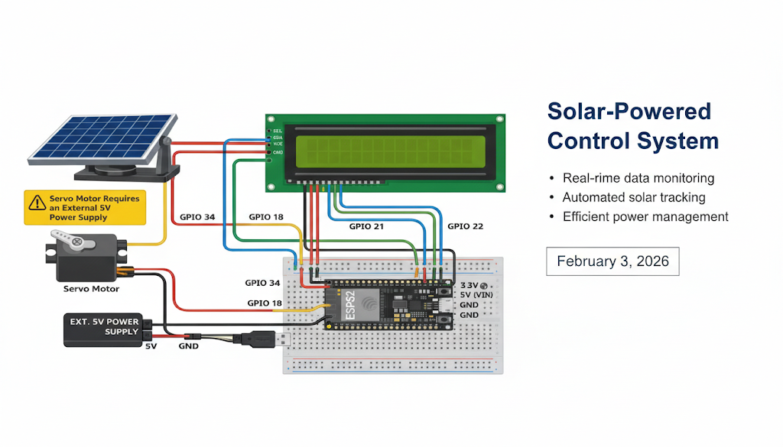

Real – time data monitoring.
Automated Solar tracking.
Efficient power management

Slide 23
IOT-BASED INTELLIGENT SOLAR TRACKING AND ENERGY PREDICTION SYSTEM USING MACHINE LEARNING
An innovative solution integrating IoT and Machine Learning for enhanced renewable energy management.
Presented By
Sharkesh – 234031101119
Sheik Abdullah – 234031101121
Sree Sharan – 234031101123
Srinath – 234031101124
Sriram – 234031101125
Review Date: 12.12.2025 | 4th Review | Project Guide: Surya (IBM) | Project Reviewer: Dr. C. Priya

Slide 24
MODULE 1: IOT SIMULATION
Simulates ESP32, LDR sensors, and servo motor.
Simulates ESP32 controller, LDR sensor readings,
and servo motor tracking logic for testing.
Detects Sun and panel angle.
Detects sunlight direction using LDR sensors and adjusts panel angle for maximum exposure.
Computes voltage, power, and energy.
Calculates voltage, power output, and total
energy generated for performance analysis.
Sends data to backend via HTTP POST.
Uploads sensor and energy data to backend server
using HTTP POST for storage and monitoring.

Slide 25
IOT SIMULATION: SAMPLE CODE
sun_angle = 1.56 panel_angle = 90 if mode == 'Sun' else sun_angle energy = -abs(math.cos(math.radians(panel_angle)) panel_angle)) requests.post('api', json=data)
Key logic for angle calculation and data transmission.

Slide 26
MODULE 2: BACKEND IMPLEMENTATION
Flask-based RESTful API.
Receives IoT data.
Developed backend using Flask REST API to enable
communication between IoT device and web application.
Sensor readings are stored in SQLite database for
historical tracking, reports, and analytics.
Handles user login and dashboard functions.
Stores data in SQLite database.
Backend receives real-time IoT sensor data,
validates it and processes it for monitoring and storage.
Implements user authentication and supports
dashboard features like live data display and
performance visualization.

Slide 27
BACKEND API: SAMPLE CODE
@app.route('/api', methods=['POST']) def api(): data = request.json cursor.execute( INSERT INTO solar_data VALUES (...) )
API endpoint for receiving and storing solar data.

Slide 28
MODULE 3 & 4: DATABASE & ML
Database Module
Machine Learning Module
SQLite for lightweight storage.
Logistic Regression-based energy prediction.
Stores timestamp, angles, power, energy.
Uses historical energy data.
Supports dashboard and ML queries.
Predicts future energy generation.
Evaluated with MAE and RMSE.

Slide 29
ML TRAINING: SAMPLE CODE
X = df[['sun_angle','panel_angle','power']] y = df['energy'] model.fit(X, y)
Code snippet for training the energy prediction model.

Slide 30
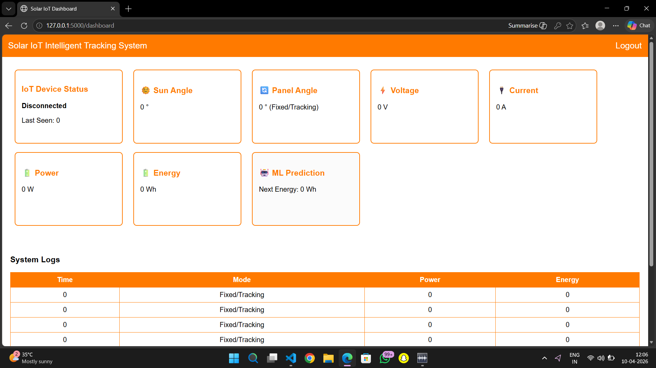
MODULE 5: WEB DASHBOARD
White and orange themed UI.
Displays real-time solar parameters.
Shows ML predicted energy.
Displays system logs.

Slide 31
TESTING – USE CASE 1: FIXED PANEL
Constant Angle
Panel angle remains constant throughout the day.
Lower Generation
Observed lower energy generation compared to tracking.
Energy Loss
Demonstrates the inherent energy loss of a static setup.

Slide 32
TESTING – USE CASE 2: TRACKING PANEL
Sun Tracking
Higher Output
Panel adjusts to follow the sun's movement.
Generates significantly more power and energy.
Validated Effectiveness
Confirms the efficiency of the tracking mechanism.

Slide 33
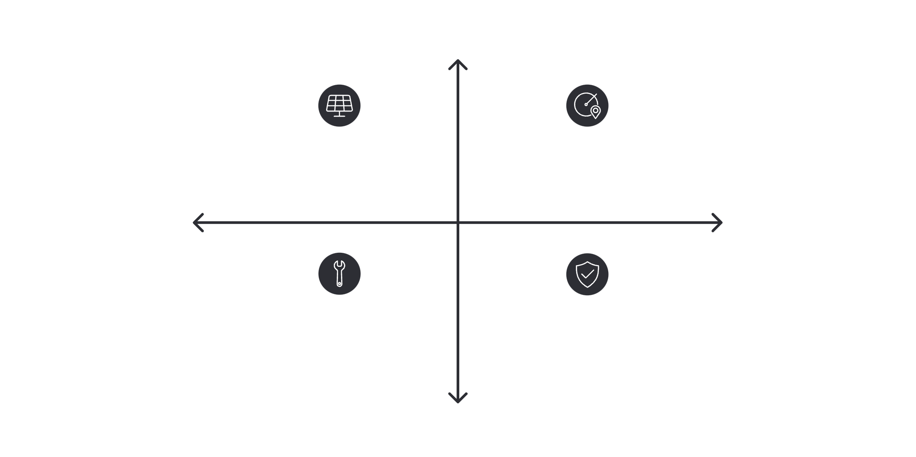
TESTING RESULTS SUMMARY
Higher Energy
01
ML Prediction Accuracy
Fixed Panel — Low Energy, Stable Output
Tracking Panel — High Energy, Variable Output
Machine Learning predictions closely align with actual trends.
Lower Cost
Higher Cost
Tracking Costs — Higher Installation & Maintenance
Fixed Benefits — Lower Cost, Simple Maintenance
02
System Performance
Lower Energy
Overall system performs as expected .
Tracking mode consistently produces higher energy output.

Slide 34
CONCLUSION
1
2
Integrated System
Hardware-Independent
Successfully implemented an end-to-end IoT + ML system.
Simulation validated without reliance on physical hardware.
3
Scalable Implementation
System can be easily extended to real hardware for practical use.

Slide 35
IOT-BASED INTELLIGENT SOLAR TRACKING AND ENERGY PREDICTION SYSTEM USING MACHINE LEARNING
An innovative solution integrating IoT and Machine Learning for enhanced renewable energy management.
Presented By
Sharkesh – 234031101119
Sheik Abdullah – 234031101121
Sree Sharan – 234031101123
Srinath – 234031101124
Sriram – 234031101125
Review Date: 26.02.2026 | 5th Review | Project Guide: Surya (IBM) | Project Reviewer: Dr. C. Priya

Slide 36

IOT-BASED INTELLIGENT SOLAR TRACKING AND ENERGY PREDICTION SYSTEM USING MACHINE LEARNING
STUDENT NAME:
Sharkesh – 234031101119
Sheik Abdullah – 234031101121
Sree Sharan – 234031101123
Srinath – 234031101124
Sriram – 234031101125
CLASS AND SECTION
Department of Computer Applications
Dr. M.G.R. Educational and Research Institute,
PROJECT VIVA VOCE
Date: 26.02.2026
REVIEWER NAME: Dr. C. PRIYA
Designation
Department of Computer Applications
Dr.M.G.R. Educational and Research Institute,
GUIDE NAME: Mr. SURYA (IBM)
Designation
Department of Computer Applications
Dr. M.G.R. Educational and Research Institute,

Slide 37

The Dawn of Smarter Solar: Enhancing Efficiency with IoT and ML
Renewable energy demand is rapidly increasing worldwide.
Solar panel efficiency depends on proper alignment with the sun.
Traditional fixed panels reduce power output due to
limited sun exposure.
IoT enables real-time monitoring and automatic panel control.
Machine Learning predicts sun movement and optimizes
panel angle.
Smart tracking system increases energy efficiency and
power generation.

Slide 38

The Inefficiency of Static Solar
1
2
Suboptimal Positioning
Energy Generation Loss
Fixed solar panels cannot adjust their angle, leading to reduced energy capture as the sun moves across the sky.
This static approach results in significant energy generation losses, impacting overall system output and ROI.
3
4
Manual Oversight Burden
Lack of Predictive Insight
Manually adjusting panels for optimal sun exposure is impractical, labor-intensive, and prone to human error.
Without dynamic data and analytical tools, predicting future energy output remains a significant challenge.

Slide 39
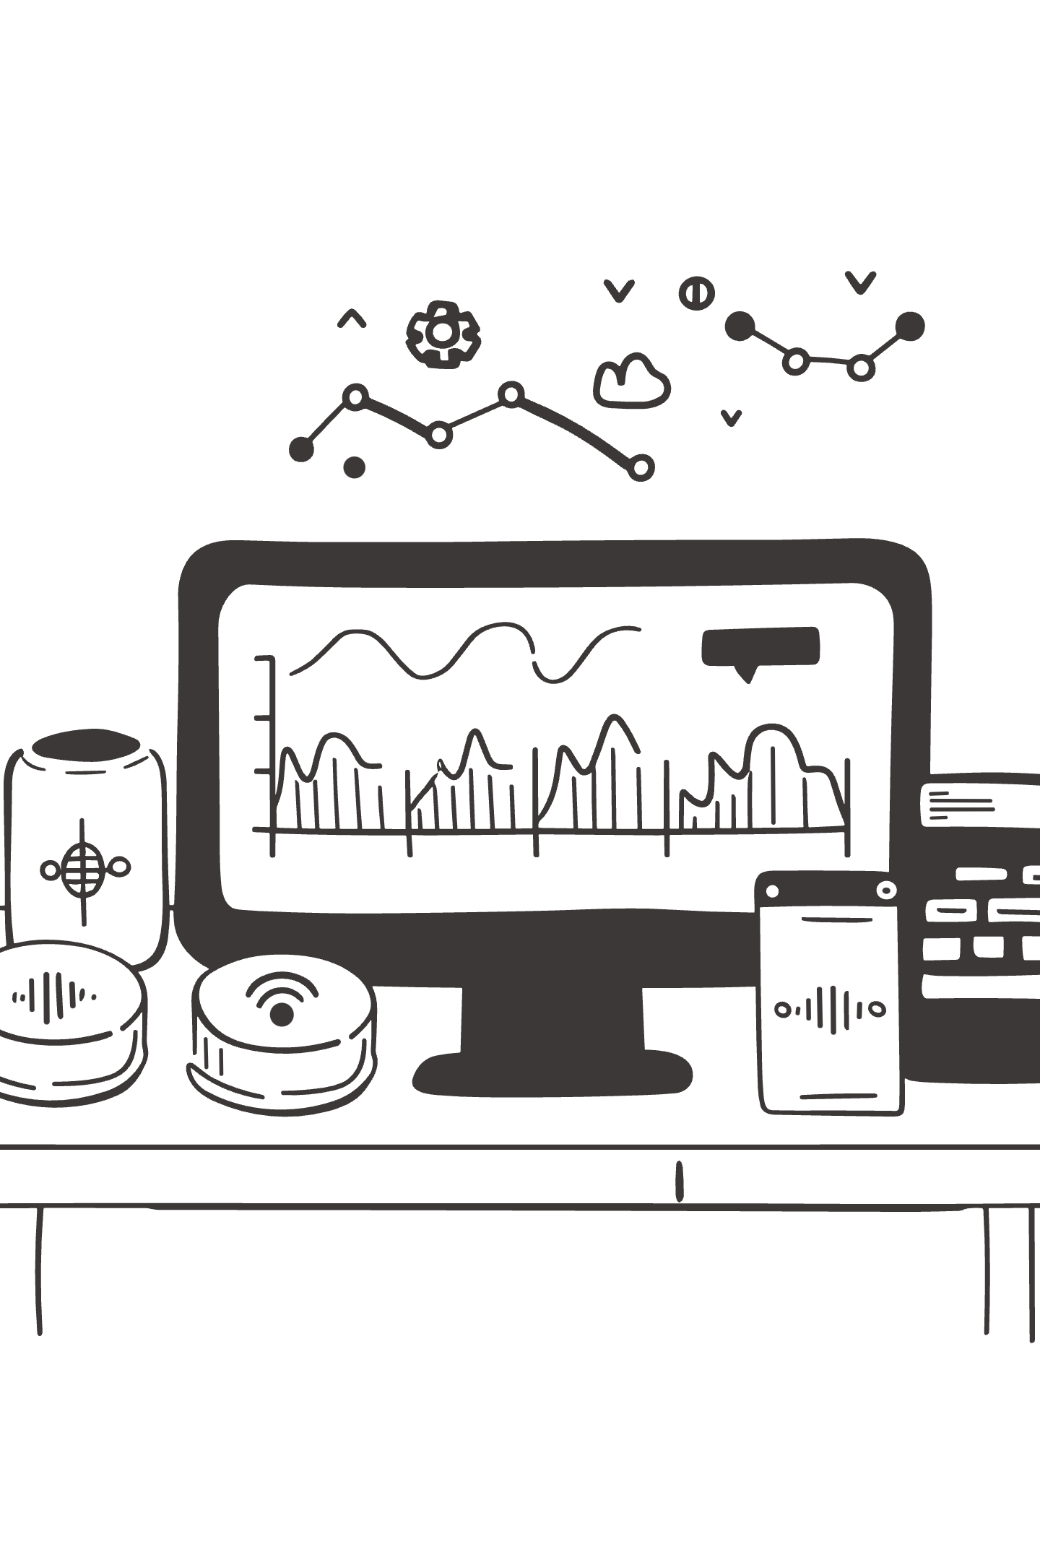
Our Vision: Intelligent Solar Tracking
Automated Solar Tracking: Develop a dynamic system that continuously adjusts panel orientation for maximum sunlight absorption.
Real-time IoT Data Collection: Implement IoT sensors to gather crucial environmental and performance data in real time
.
Machine Learning Prediction: Leverage ML algorithms to forecast future energy generation based on historical data.
Enhanced Efficiency: Significantly improve solar panel efficiency, leading to higher energy output and greater cost savings.

Slide 40
Limitations of Current Solar Installations
Fixed Panel Orientation
Inefficient Energy Capture
Traditional systems rely on stationary panels, limiting their ability to adapt to changing sun positions.
This fixed setup often means panels are not optimally angled, especially during peak sunlight hours.
Lack of Real-time Insights
Absence of Predictive Analytics
Existing systems typically lack real-time data collection, hindering performance analysis and proactive maintenance.
Without data-driven predictions, optimizing energy distribution and grid integration becomes more challenging.

Slide 41
Introducing Our Smart Solar Solution
Automated Solar Tracking
IoT-Based Monitoring
Machine Learning Prediction
Web Dashboard Visualization
Intelligent actuators constantly adjust the solar panel's angle to follow the sun's path, maximizing direct exposure.
A network of sensors collects real-time data on irradiance, voltage, and current, providing comprehensive insights.
Advanced ML models analyze collected data to predict future energy generation, optimizing resource allocation and efficiency.
A user-friendly web interface provides intuitive visualization of real-time data, historical trends, and predictive analytics.

Slide 42
System Architecture Overview
Solar Tracker
IoT Monitor
ML Processor
Dashboard
Collects panel position and environmental data.
Aggregates sensor data and forwards securely.
Analyzes patterns and predicts optimal angles.
Visualizes insights and supports operator decisions.
Our system is designed with a modular architecture, ensuring scalability and robust performance across all operational phases. This structure allows for seamless integration and efficient data flow from physical tracking to intelligent insights.

Slide 43
Key Hardware Components
Solar Panel
Servo Motor
Microcontroller
Converts sunlight into usable electrical energy.
Precisely controls the panel's rotational movement.
The brains of the system, processing data and executing commands.
LDR Sensors
Voltage Sensor
Detects light intensity to guide panel orientation.
Monitors electrical output for performance analysis.

Slide 44
System Architecture Overview
Our system is designed with a modular architecture, ensuring scalability and robust performance across all operational phases. This structure allows for seamless integration and efficient data flow from physical tracking to intelligent insights.
Solar Tracker
IoT Monitor
ML Processor
Dashboard
Collects panel position and environmental data.
Aggregates sensor data and forwards securely.
Analyzes patterns and predicts optimal angles.
Visualizes insights and supports operator decisions.

Slide 45
LDR Sensors: Eyes on the Sun
Light Dependent Resistors (LDRs) serve as the crucial "eyes" of our solar tracking system. These simple yet effective components play a vital role in sensing the direction and intensity of sunlight.
Precise Light Detection:
Real-time Input:
Optimal Orientation:
LDRs accurately measure the varying light levels across the panel's surface.
Provides immediate feedback to the microcontroller, enabling rapid adjustments.
By comparing readings from multiple LDRs, the system determines the optimal angle for maximum light absorption.

Slide 46
LDR Sensors: Eyes on the Sun
Precise Light Detection:
Real-time Input:
Optimal Orientation:
LDRs accurately measure the varying light levels across the panel's surface.
Provides immediate feedback to the microcontroller, enabling rapid adjustments.
By comparing readings from multiple LDRs, the system determines the optimal angle for maximum light absorption.
Light Dependent Resistors (LDRs) serve as the crucial "eyes" of our solar tracking system. These simple yet effective components play a vital role in sensing the direction and intensity of sunlight.

Slide 47


Microcontroller: The Brain of Our System
At the core of our smart solar tracking system lies a powerful microcontroller. This tiny yet mighty component acts as the central processing unit, orchestrating the collection of vital data and precise control over mechanical movements.
Processes Sensor Data
Controls Servo Motor
Transmits Data to IoT Module
Intakes and interprets environmental readings from various sensors.
Commands the servo motors to adjust the solar panel's orientation for optimal sun exposure.
Securely sends processed data to the integrated IoT module for further analysis and communication.

Slide 48
IoT Module: Connecting to the Cloud
The IoT Module serves as the communication hub, bridging the physical solar tracking hardware with the digital world. It enables seamless data flow and remote management capabilities.
Key Functions
Collects real-time data from the microcontroller, ensuring up-to-the-minute information.
Facilitates wireless communication (Wi-Fi, Cellular, LoRa) to send data to cloud servers.
Enables remote monitoring and control of the solar panel from anywhere in the world.
Supports over-the-air (OTA) updates for continuous improvement and feature additions.

Slide 49
Comprehensive Data Collection
Our system meticulously collects a range of environmental and performance data points to ensure peak operational efficiency and accurate energy prediction.
Sun Angle
Precise measurement of the sun's azimuth and altitude for optimal panel positioning.
Panel Angle
Real-time tracking of the physical orientation of the solar panel.
Voltage
Continuous monitoring of the electrical potential generated by the panel.
Current
Measurement of the flow of electrical charge from the solar array.
Power Output
Calculation of the total power generated, a key performance indicator.

Slide 50
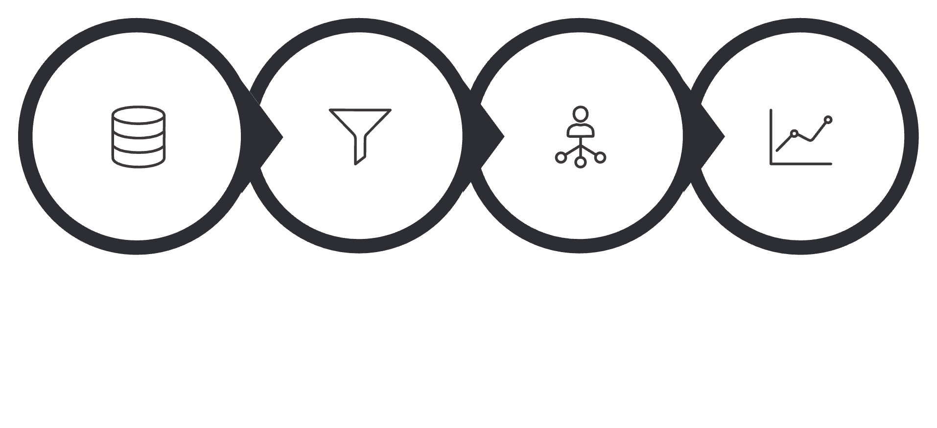
Machine Learning for Predictive Intelligence
Leveraging machine learning, our system moves beyond reactive adjustments to proactive optimization. This intelligence drives better energy management.
ML's Role in Solar Optimization
Energy Prediction: Our models forecast future energy output based on current conditions and historical patterns.
Analyzes Historical Data: Continuously learns from past performance and environmental data to refine its predictions.
Improves Decision Making: Provides insights that allow for smarter panel adjustments and energy distribution strategies.
Data Input
Preprocessing
Model Training
Prediction Output

Slide 51
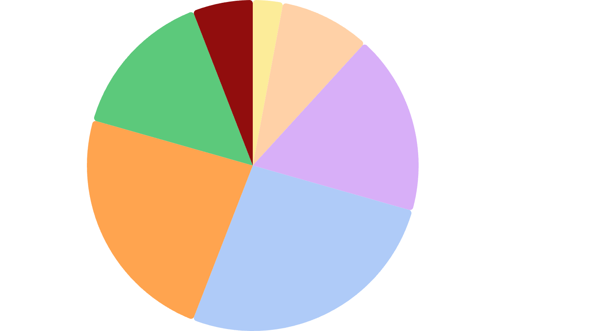
Logistic Regression: Predicting Power Output
Logistic Regression, a robust statistical model, is employed to accurately predict solar power generation. Its simplicity and effectiveness make it ideal for this application.
ML-Based Power Prediction Model
Model uses multiple input parameters:
Sun angle
Panel angle
Temperature
Cloud cover
Analyse relationships between environmental and system variables.
Estimates expected solar power output accurately.
Provides reliable energy production forecasts.
Helps optimize panel positioning and system performance.
6 AM 2.94%
8 AM 8.82%
10 AM 17.65%
12 PM 26.47%
·
2 PM 23.53%
4 PM 14.71%
6 PM 5.88%

Slide 52
Intuitive Web Dashboard
Our user-friendly web dashboard provides a centralized interface for monitoring and managing the solar tracking system, accessible from any internet-connected device.
Real-time Data Visualization: Instantly view live sensor data, panel angles, and current power output through interactive graphs and charts.
Predicted Output Display: See forecasts for energy generation, helping users anticipate and plan their energy consumption.
Remote Accessibility: Access the dashboard securely from a desktop, tablet, or smartphone, enabling monitoring on the go.
Alerts and Notifications: Receive automated alerts for critical system events or performance anomalies.

Slide 53
Tangible Results and Benefits
Our smart solar tracking system delivers significant improvements in solar energy harvesting and operational visibility.
Improved Solar Tracking
Higher Power Output
Real-time Monitoring
Dynamic adjustments based on sun position and weather conditions ensure panels always face the sun.
Optimized positioning leads to a substantial increase in daily energy generation, maximizing ROI.
Continuous data streaming provides immediate insights into system performance and health.

Slide 54
Performance Metrics: Validating Our Model
To ensure the accuracy and reliability of our machine learning model, we rigorously evaluate its performance using industry-standard metrics.
Mean Absolute Error (MAE)
Root Mean Squared Error (RMSE)
R² Score (Coefficient of Determination)
Measures the average magnitude of the errors in a set of predictions, without considering their direction. A lower MAE indicates higher accuracy.
Quantifies the square root of the average of the squared errors, giving more weight to larger errors. It's particularly useful for model comparison.
Represents the proportion of the variance in the dependent variable that is predictable from the independent variables. An R² close to 1 indicates a model that explains a large portion of the variance.

Slide 55
Key Advantages of Our System
Our smart solar tracking solution offers a compelling set of advantages, setting a new standard for solar energy efficiency and management.
Automated System
Improved Efficiency
Eliminates the need for manual adjustments, reducing operational overhead.
Maximizes solar energy capture, leading to higher power generation throughout the day.
Energy Prediction
Reduced Manual Effort
Provides valuable insights into future energy output for better planning and resource allocation.
Frees up time and resources, allowing for focus on other critical tasks.

Slide 56
Conclusion & Future Scope
Our smart solar tracking system represents a significant step forward in renewable energy technology, combining efficient tracking with reliable prediction.
Current Achievements
Future Enhancements
Achieves efficient solar tracking through dynamic panel adjustments.
Provides reliable prediction of energy output using machine learning.
Offers real-time monitoring via an intuitive web dashboard.
Integration with cloud storage solutions for long-term data archival and advanced analytics.
Development of mobile application support for enhanced accessibility and control.
Exploration of adaptive learning algorithms to further refine predictive accuracy.

