Slide 1



Threshold-Based Secure File Communication System
A modern cryptographic system combining AES-GCM encryption with multi-user threshold authorization to protect sensitive files in enterprise environments. No single user can access encrypted content independently — approvals from multiple authorized users are required before decryption.
SECURITY
CRYPTOGRAPHY
REST API
REACT.JS + FASTAPI
Notes:
1

Slide 2
Introduction & Objectives
Secure communication is a critical requirement as organizations continuously exchange confidential information. Traditional systems relying only on basic authentication and encryption may not protect against unauthorized access, tampering, or insider attacks. This project demonstrates secure file transfer, REST API communication, encryption/decryption, multi-user authorization, access control, and integrity protection — simulating real-world enterprise secure communication workflows.
The Challenge
Project Objectives
Traditional systems lack adequate protection against unauthorized access, tampering, and insider threats. This project implements encrypted file transfer combined with threshold-based authorization — files remain encrypted until approvals from multiple users are received.
Implement secure encrypted communication using cryptographic techniques
Design a threshold-based authorization system
Ensure sensitive files remain inaccessible until approvals are completed
Preserve integrity and confidentiality during transmission
Implement secure backend communication via REST APIs
Provide a modern frontend for communication and approvals
Simulate a secure enterprise-style communication system
Notes:
2

Slide 3
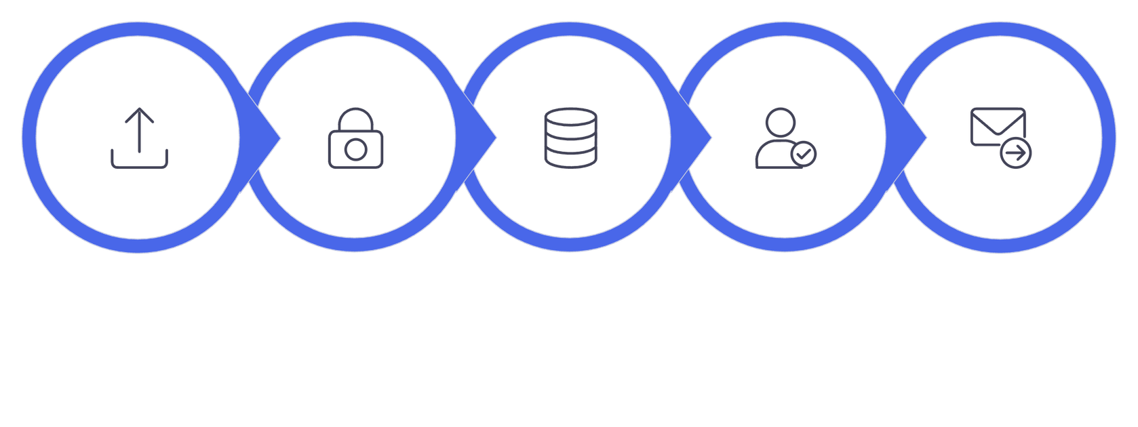





System Architecture
The project follows a client-server architecture with two major modules communicating via REST APIs. The backend acts as the central secure communication server, handling all cryptographic operations and approval logic.
Sender Upload
Encrypt AES‑GCM
Secure Storage
Dual Approval
Decrypt & Deliver
The backend acts as the central secure communication server, managing encryption, storage, approval verification, and decryption.
Frontend Module (React.js)
Backend Module (FastAPI)
Login functionality
File upload via drag-and-drop
Inbox viewing
Approval management dashboard
Secure file download
AES-GCM encryption and decryption
Approval verification logic
Access control enforcement
File management in secure memory
REST API implementation
Communicates with backend through HTTP requests using Axios.
Processes all cryptographic operations and returns JSON or file responses.
Notes:
3

Slide 4
Technologies Used
The project leverages modern, well-established technologies to deliver both performance and security across the full stack.
React.js
Frontend user interface development
FastAPI
Backend REST API framework
Python
Backend programming language
Axios
Frontend-backend HTTP communication
AES-GCM
Encryption and integrity verification
PyCryptodome
Cryptographic operations
Framer Motion
Frontend animations
React Dropzone
Drag-and-drop file upload
Notes:
4

Slide 5
REST API Design
The backend exposes REST APIs for all frontend-backend communication. REST architecture is used because it is lightweight, scalable, and easy to integrate with modern frontend applications. The frontend sends HTTP requests to the FastAPI backend, which processes each request, performs any required cryptographic operations, and returns responses in JSON or file format — enabling clean separation of frontend and backend logic.
Endpoint
Method
Purpose
/login
POST
User authentication
/send
POST
Upload encrypted file
/inbox
GET
Fetch receiver inbox
/pending
GET
Fetch pending approvals
/approve
POST
Approve encrypted message
/read
GET
Decrypt and download file
All API responses are returned in JSON or file format, enabling clean separation of frontend and backend logic.
Notes:
5

Slide 6

Encryption Methodology: AES-GCM
AES (Advanced Encryption Standard) with GCM (Galois Counter Mode) is the core encryption standard used. GCM is a secure block cipher mode providing confidentiality, integrity, and authentication — widely adopted in modern secure communication systems.
Encryption Process
Decryption Process
Sender uploads a file
Backend generates a random AES key
File is encrypted using AES-GCM
Nonce and authentication tag are generated
Encrypted file is stored in secure memory
Receiver requests file access
Approval status is verified
AES-GCM verifies integrity using authentication tag
Original file is decrypted
Exact original file is returned to receiver
AES-GCM ensures the original file name, type, and content are fully preserved — PDF remains PDF, PNG remains PNG, DOCX remains DOCX.
Notes:
6

Slide 7

Threshold-Based Authorization
The system implements a multi-user approval mechanism ensuring no single user can independently access sensitive information. Two distinct authorized users must approve a file before the receiver can decrypt it.
1
2
Sender Uploads
Receiver Sees Inbox
Sender uploads an encrypted file targeting a specific receiver.
Receiver sees the encrypted message but cannot access it yet.
3
4
Two Users Approve
File Unlocked
Two separate authorized users (neither sender nor receiver) approve the message.
System marks file as approved; receiver gains access to the decrypted file.
🚫 Sender Cannot Self-Approve
🚫 Receiver Cannot Approve
🚫 No Duplicate Approvals
✅ Two Distinct Users Required
Notes:
7

Slide 8
Frontend Design & System Workflow
The frontend provides an interactive, user-friendly interface with glassmorphism UI, drag-and-drop upload, dynamic inbox, approval dashboard, notification system, and responsive design. Animations via Framer Motion enhance the user experience.
1
User1 uploads file for User2
2
Backend encrypts with AES-GCM
3
User2 sees encrypted file in inbox
4
User3 approves the message
5
User4 approves the message
6
System unlocks the file
7
User2 downloads original file
All file actions — sending, approving, downloading — are performed through API calls to the backend. The system preserves original file name, type, and content throughout the workflow.
Notes:
8

Slide 9








Applications & Advantages
This system has direct applications across multiple high-security domains where controlled, multi-party authorization is essential.
Banking Systems
Military Communication
Medical Systems
Enterprise & Cloud Storage
Sensitive financial documents require multi-level authorization before access.
Confidential mission files protected using threshold authorization.
Patient records accessed only after approvals from authorized staff.
Corporate files securely shared via encrypted approval workflows; concepts similar to secure cloud document vaults.
Strong Encryption
Multi-User Authorization
Integrity Verification
Controlled Decryption
Notes:
9

Slide 10

Limitations, Future Enhancements & Conclusion
Current Limitations
Conclusion
No database persistence — data lost on server restart
No JWT authentication
No cloud deployment
Uses in-memory storage only
The system successfully demonstrates secure communication using AES-GCM encryption, REST API communication, multi-user authorization, and controlled decryption. It provides practical exposure to secure communication design and establishes a strong foundation for future improvements involving hybrid cryptography, digital signatures, and distributed secure communication systems.
Future Enhancements
RSA-based hybrid cryptography
JWT authentication & database integration
Cloud deployment & WebSocket real-time updates
Digital signatures & Shamir Secret Sharing
References: FastAPI Documentation (fastapi.tiangolo.com), React.js Documentation (react.dev), PyCryptodome Documentation (pycryptodome.readthedocs.io), NIST AES Standard Documentation, OWASP Secure Communication Guidelines.
Notes:
10

