Slide 1


INVESTIGATE THE QUALITY OF SURFACE
ROUGHNESS USING VARIOUS 3D PRINTING
TECHNOLOGIES
By
SELVAGANESH A 211420114106
Batch No: 39
Under the Supervision
Of
Mr. P. SENTHIL KUMAR M.E.,
Assistant Professor,
Department of Mechanical Engineering,
Panimalar Engineering College.

Slide 2
INTRODUCTION
Additive manufacturing (AM) is the industrial term for the group of manufacturing technologies commonly known as 3D printing. AM can generally be described as the manufacturing of components via a layer-by-layer material addition process.
“Process of joining materials to make parts … from 3D model data, usually layer … upon layer, as opposed to subtractive manufacturing and formative manufacturing methodologies.”
- (ISO/ASTM, 2021)

Slide 3
Types of Additive Manufacturing:
Vat photopolymerization
Material jetting
Binder jetting
Material extrusion
Sheet lamination
Powder bed fusion
Directed energy deposition

Slide 4
LITRATURE SURVEY
The history of AM can be traced as far back as the 1890s, with the majority of AM development occurring from the 1960s alongside the development of rapid prototyping technologies such as stereolithography, the process of solidifying light- sensitive liquid polymer. CH. Venu Madhav et al,3D printing is one of the most important technological advancements in Additive manufacturing which has been Implemented and recognized as a part of modern industry. Development of various components ranging from simple structures used in everyday life to complicated Components in aerospace applications, 3D printing Provides many advantages few are Simplicity, Reliability and Precision etc this makes it one of the most widely used for making components which can be used as concept. Components.3D printing is the most widely used additive manufacturing processes in the current industry not only limited to Engineering.

Slide 5
OBJECTIVE
Fused Deposition Modelling (FDM) is one of the preferred technologies, as it requires a simple operation with affordable equipment setup and major advantage of FDM technology is the quantity of available materials. To successfully produce parts using the FDM machine, a slicing software is required to provide instructions to the machine. Currently, numerous slicing softwares are available in the market that can be integrated to the FDM machine. Each slicing software has a slightly different performance compared with others. In this work, five slicing softwares namely, Ultimaker Cura, Astroprint, Icesl, Fusion360 and PrusaSlicer have been chosen to investigate their effect on the surface finish of 3D printed parts. The parameters which involved in affecting surface finish of printed parts were layer thickness, infill density, building temperature, printing speed.

Slide 6
PRINCIPLES USED
Material Extrusion :
Material extrusion is an additive manufacturing technique in which thermoplastic material is pushed through a heated extrusion nozzle and deposited layer by layer to build an object. Fused filament fabrication (FFF), also referred to as fused deposition modelling (FDM), is the most commonly used additive material extrusion process.
Fused Deposition Modelling (FDM):
In FDM process, thermoplastic material in the form of filament is unwound from a spool and is fed into a extruder assembly where it is melted in liquefier and this semi-liquid material is laid down on the build platform by extrusion process through a nozzle according to computer-controlled paths, where it cools and solidifies.

Slide 7
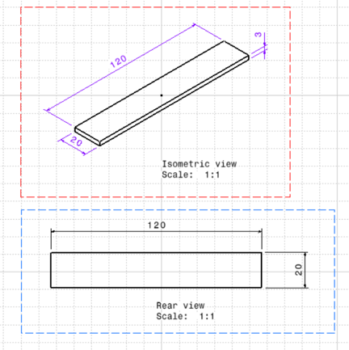
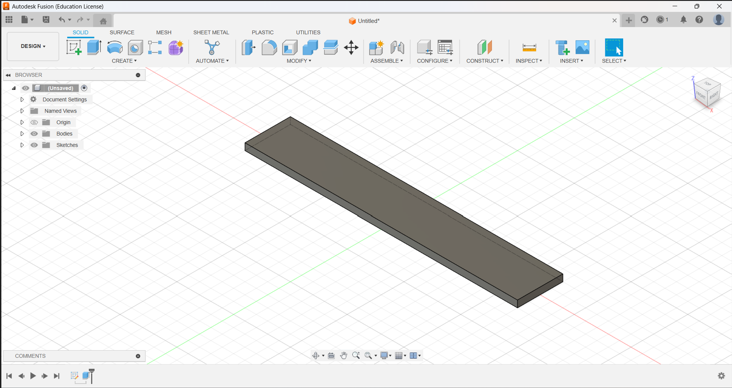
PREPARATION OF SPECIMEN
Description of the 3D Part:
The 3D part selected for this study is a representative rectangular component. The part possesses intricate geometrical features and dimensions of 120 mm x 20 mm x 3 mm. The part is designed using Fusion 360 software.

Slide 8
Slicing Softwares:
Five slicing software programs, namely Ultimaker Cura, Astroprint, Prusaslicer, Fusion 360 and Icesl were employed for slicing the 3D part.
Printing Parameters:
Printer : Creality Ender 3
Material : PLA
Nozzle Diameter : 0.4 mm
Layer Height : 0.2 mm
Infill Density : 50%
Infill Pattern : Grid
Print Speed : 100 mm/s
Printing Temperature : 200°C
Build Plate Temperature : 60°C

Slide 9
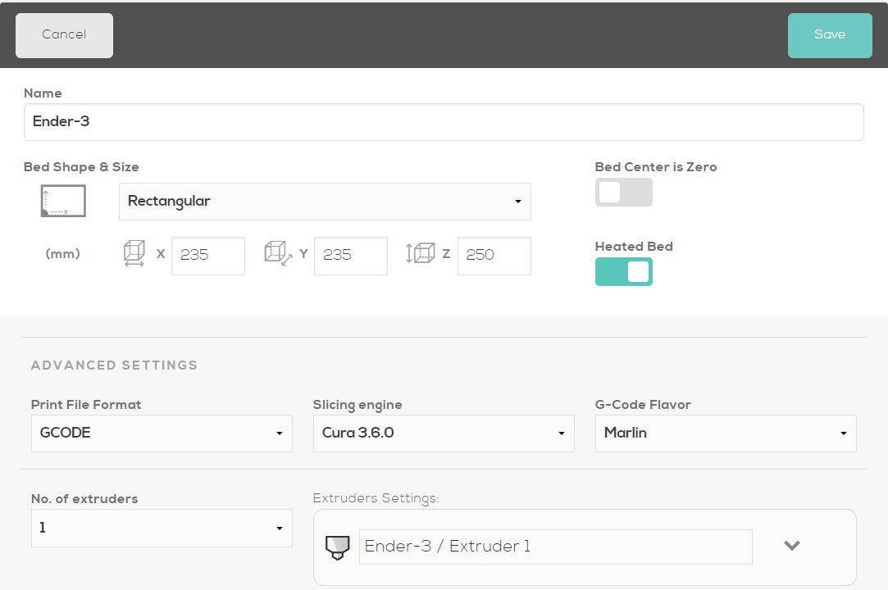
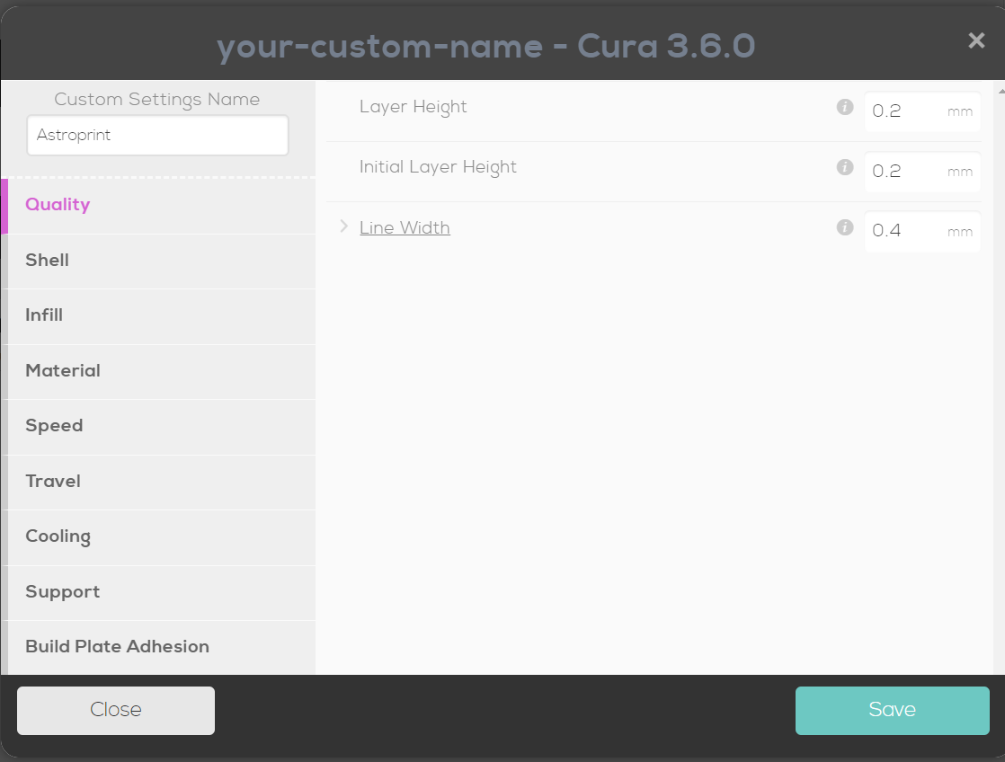
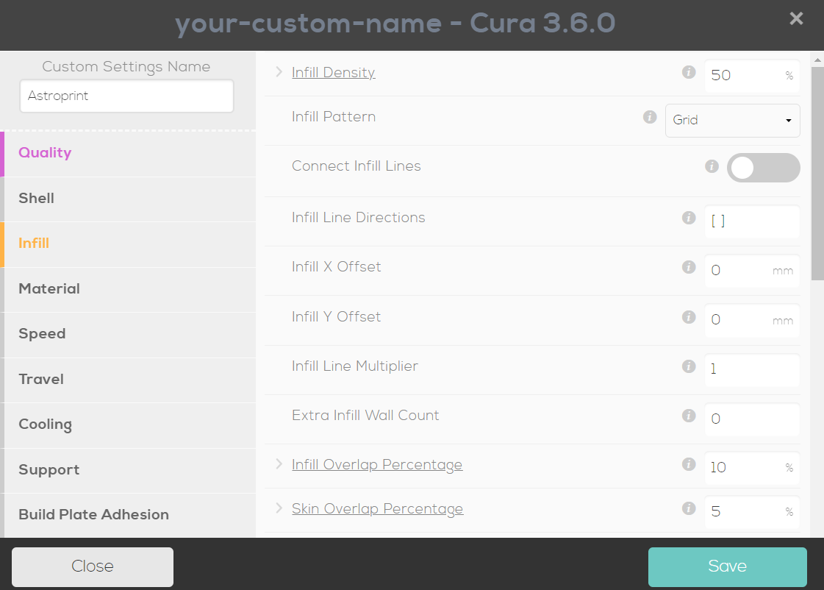
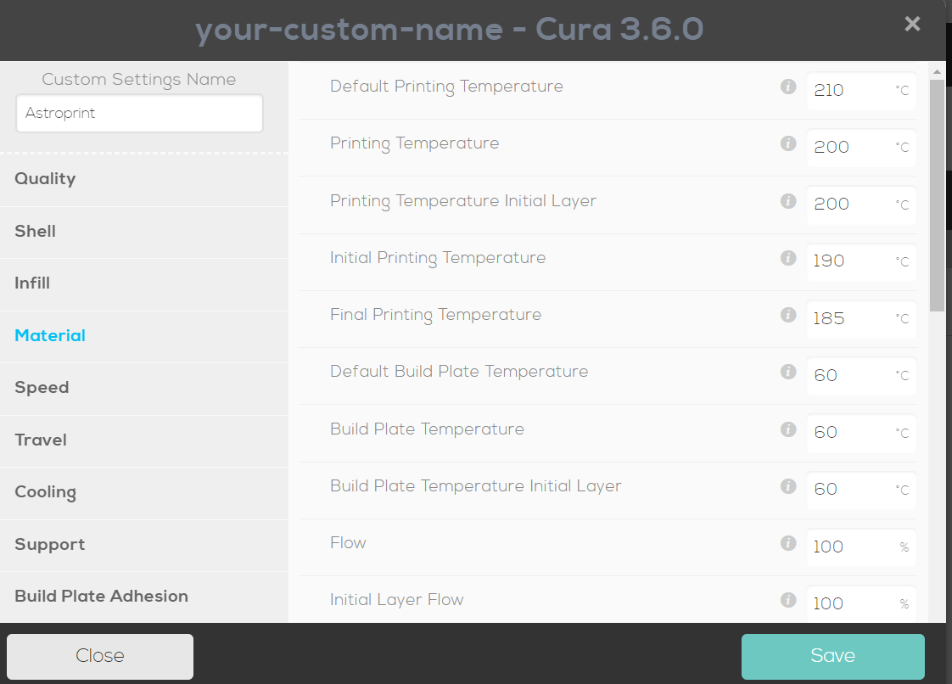
ASTROPRINT - PRINTING PARAMETERS

Slide 10
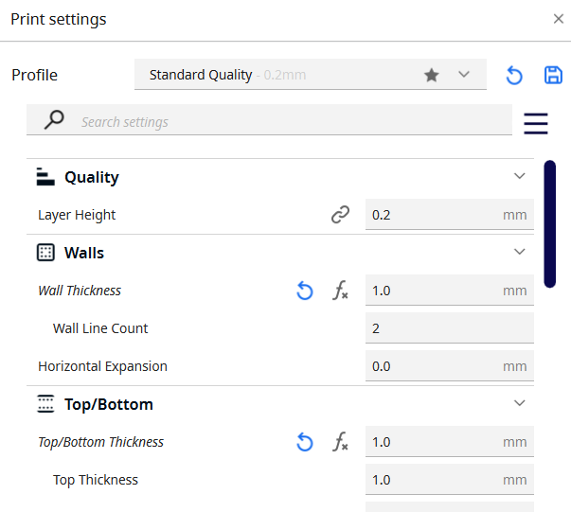
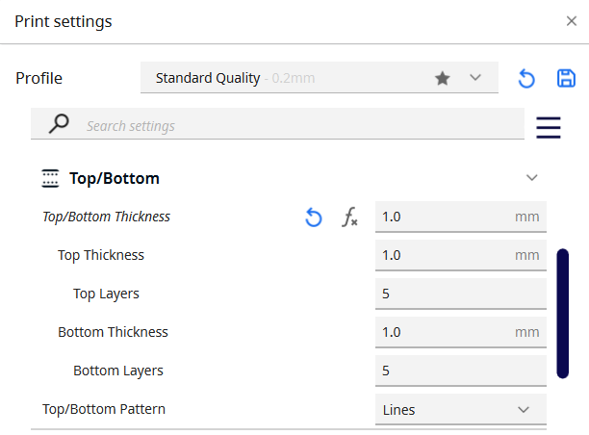
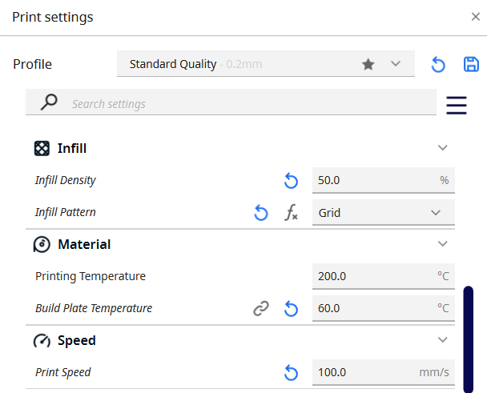
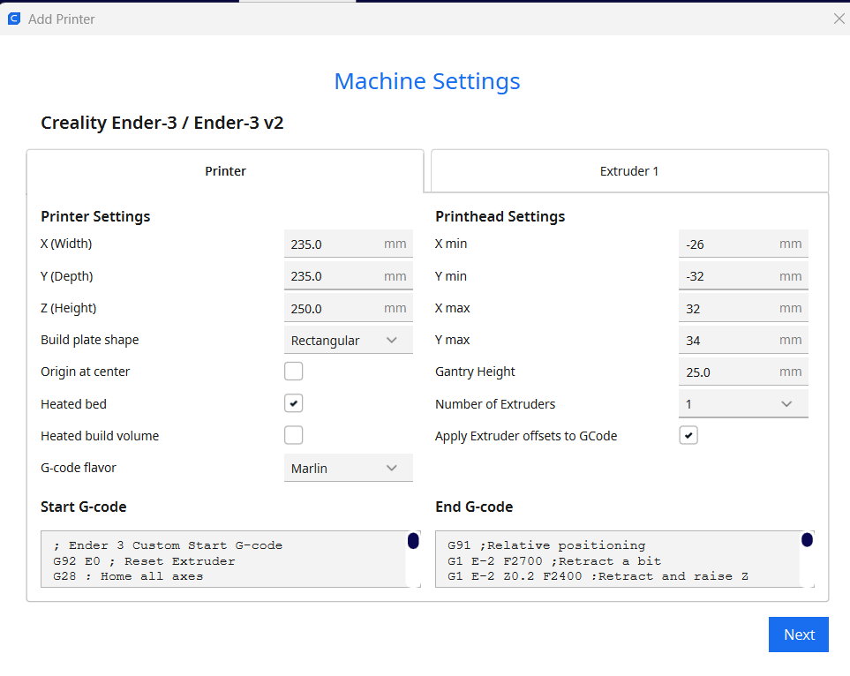
ULTIMAKER CURA - PRINTING PARAMETERS

Slide 11
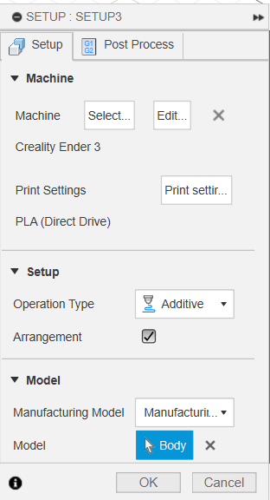
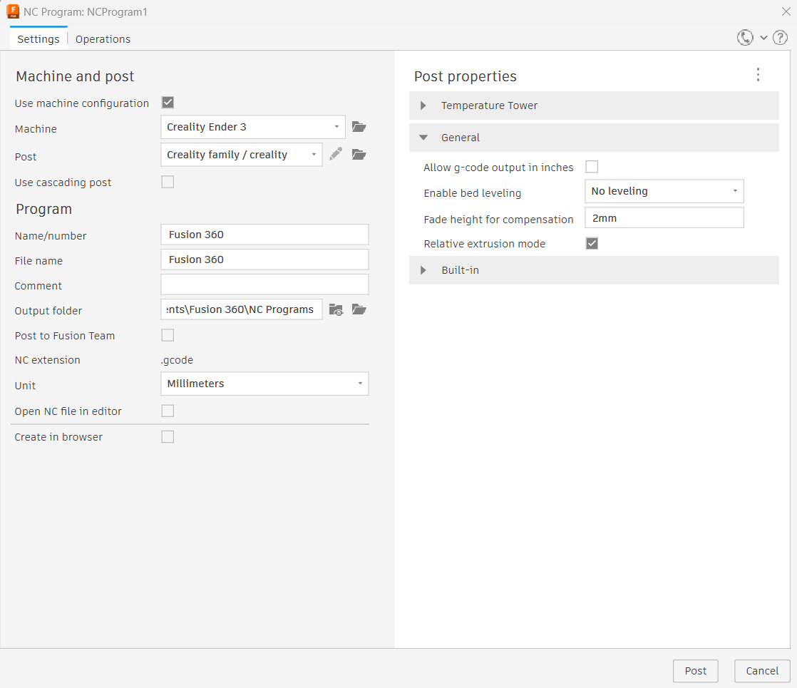
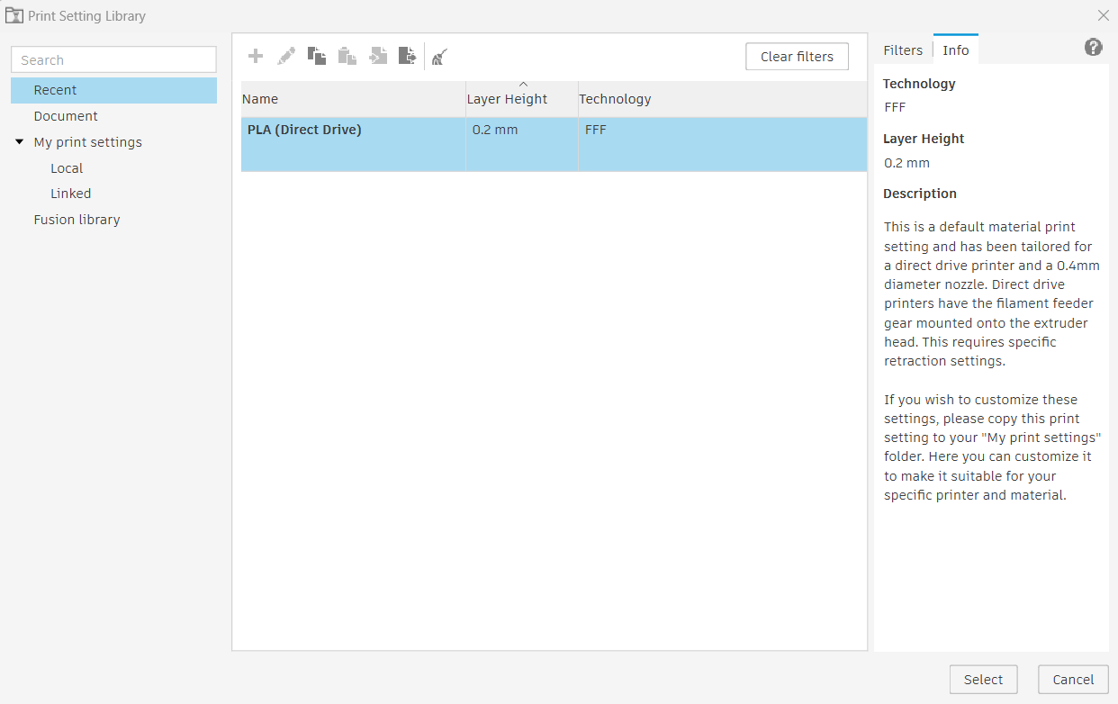
FUSION 360 - PRINTING PARAMETERS

Slide 12
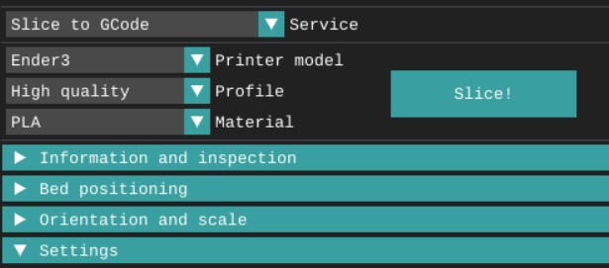
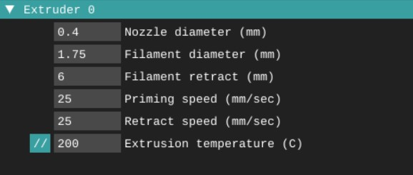
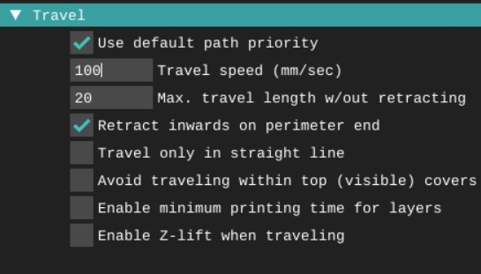
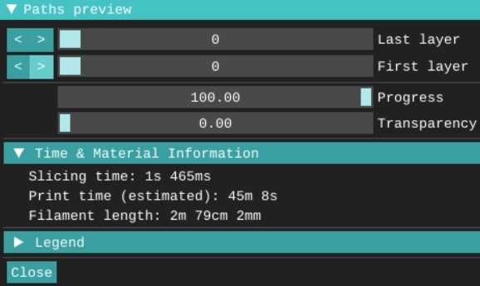
ICESL – PRINTING PARAMETERS

Slide 13
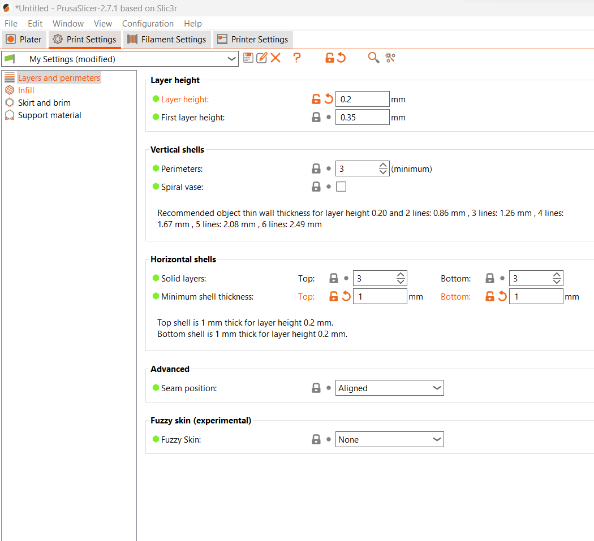
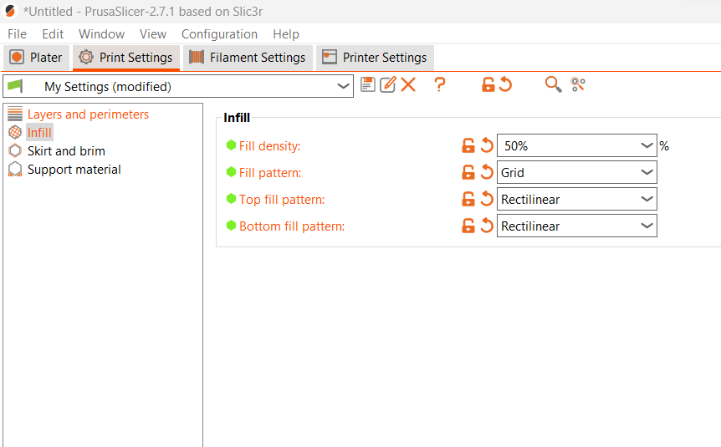
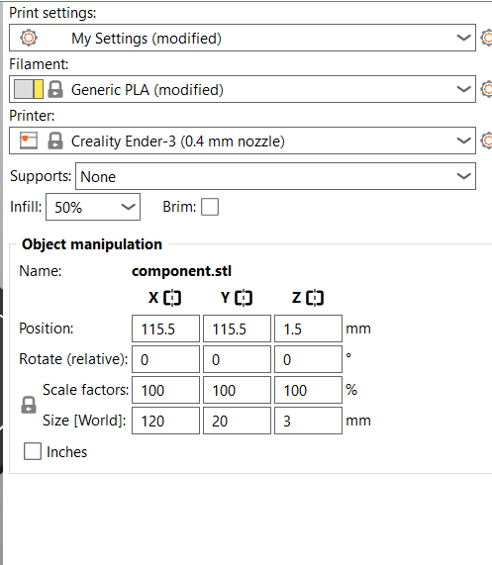
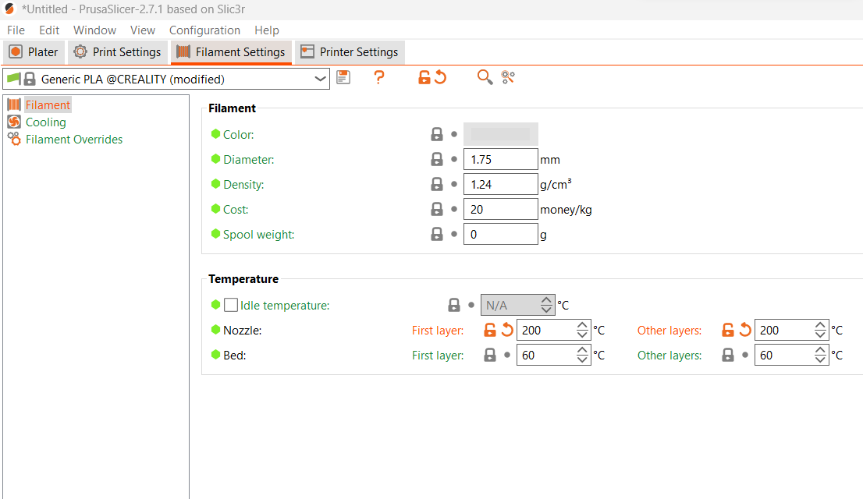
PRUSA SLICER – PRINTING PARAMETERS

Slide 14
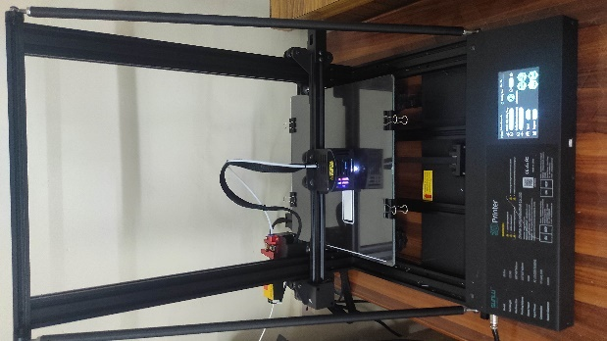
EXPERIMENTAL SETUP
4.1 3D Printer:
A Creality Ender 3 Pro FDM printer was utilized for the experiment. This printer is known for its reliability, affordability, and widespread use in the 3D printing community. It offers a build volume of 310 mm x 310 mm x 400 mm and is capable of printing with various filament materials.

Slide 15
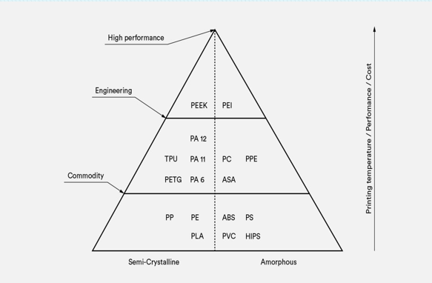
Common materials for FDM 3d printing:

Slide 16
POLYLACTIC ACID (PLA):
Biodegradability: PLA is biodegradable under certain conditions, making it an environmentally friendly choice compared to petroleum-based plastics.
Ease of Printing: PLA has excellent printability, with low nozzle clogging and minimal odor during printing. It adheres well to print surfaces, requiring minimal to no heated bed for successful prints.
Low Warping: PLA exhibits minimal warping and shrinkage during printing, making it suitable for printing large, flat objects without the need for a heated enclosure.

Slide 17
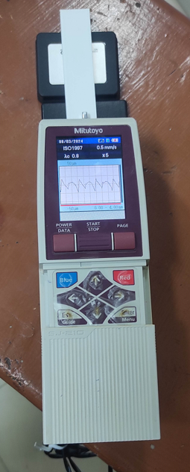
Surface Roughness Measurement:
Surface roughness measuring instruments are tools used to quantify the texture and irregularities of a surface. Some common types of surface roughness measuring instruments are Profilometer, 3D Scanning and Laser Profiling Interferometry.
Profilometer:
A profilometer is a precision instrument used to measure surface roughness by tracing a stylus or probe along the surface profile of the object. The stylus moves vertically in response to variations in the surface, and the resulting displacement is converted into measurements of roughness parameters.

Slide 18
RESULTS & DISCUSSION
Comparison of Surface Roughness Measurements:
Component | Ra Value (µm) | Rq Value (µm) | Rz Value (µm)
Astroprint | 7.268 | 8.463 | 34.204
Icesl | 5.989 | 8.133 | 32.971
Fusion 360 | 7.439 | 9.631 | 40.944
Prusa slicer | 3.815 | 4.404 | 19.871
Ultimaker Cura | 6.931 | 8.393 | 34.215

Slide 19
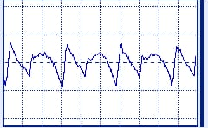
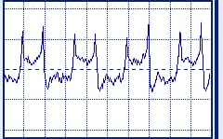
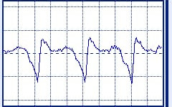
Surface roughness of various softwares
ultimaker cura software
Prusaslicer software
Fusion 360 software

Slide 20
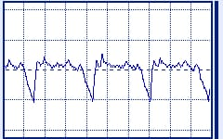
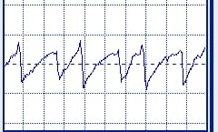
IceSL software
Astroprint software

Slide 21
Conclusion:
PrusaSlicer consistently produced the smoothest surface textures, exhibiting the lowest Ra, Rq, and Rz values among the slicing software tested. This suggests that PrusaSlicer's toolpath generation algorithms and material settings are effective in minimizing surface irregularities and optimizing surface finish.
Icesl and Ultimaker Cura also yielded relatively low surface roughness values compared to Astroprint and Fusion 360, indicating smoother surface textures. While not as smooth as PrusaSlicer, Icesl and Ultimaker Cura demonstrated good performance in achieving acceptable surface finish standards for various applications.
Astroprint and Fusion 360 exhibited higher surface roughness values compared to the other slicing software tested.

Slide 22
FUTURE SCOPE:
The importance of surface roughness in the final product is recognized by both conventional and advanced manufacturing methods, especially for critical and small products. To increase the applicability of AM processes, it is necessary to assess the surface finish of as-printed polymers and to provide guidance on AM process windows and limitations.
The techniques mentioned in this study can also provide insight into other advanced materials, such as nanoparticle and their suspensions with functional properties, surface treatment, and liquid metals to use in AM technology. Furthermore, fiber reinforcement and composition can be incorporated into almost all AM methods.

Slide 23
THANK YOU

