Slide 1
Clinical Trials -
Knowledge Graph
Clinical applications
Drug Intelligence
Disease Analytics
Sponsor Intelligence
Network & Graph
Geo & Temporal

Slide 3
What I built
01
Drug Intelligence
Evidence · Competition · Geography · Multi-hop paths
02
Disease Analytics
Landscape · Design · Phase · Enrollment · Sponsor diversity
03
Sponsor Intelligence
Portfolio · Geo reach · Pipeline · Drugs · Collaborators
05
Network & Graph
Centrality · Communities · Repurposing signals

Slide 4
01 / DRUG INTELLIGENCE
Evidence Profile
Geographic Footprint
WHAT IT DOES
Aggregates every trial ever run for a drug by phase, status, condition and geography in a single query. Replaces weeks of manual registry work.
WHAT IT DOES
Maps the countries actively conducting trials for a drug, exposing regional concentration risk and untapped recruitment markets.
WHO USES IT
Drug developers, BD teams assessing clinical maturity before in-licensing, and medical affairs preparing HCP evidence summaries.
WHO USES IT
Clinical operations optimizing site selection; market access teams forecasting country by country launch readiness.
Competitive Landscape
Multi-hop Paths
WHAT IT DOES
Finds every drug that shares a condition with the target compound, ranked by trial volume, also every sponsor investing in the drug.
WHAT IT DOES
Constructs the Drug → Study → Condition → Sponsor subgraph, the structured context chunk fed to the LLM in the GraphRAG pipeline.
WHO USES IT
Portfolio strategy and white space mapping; medical affairs competitive dossiers; licensing analysts sizing the field.
WHO USES IT
AI/ML teams building grounded clinical Q&A agents; regulatory writers who need citation ready evidence chains.

Slide 5
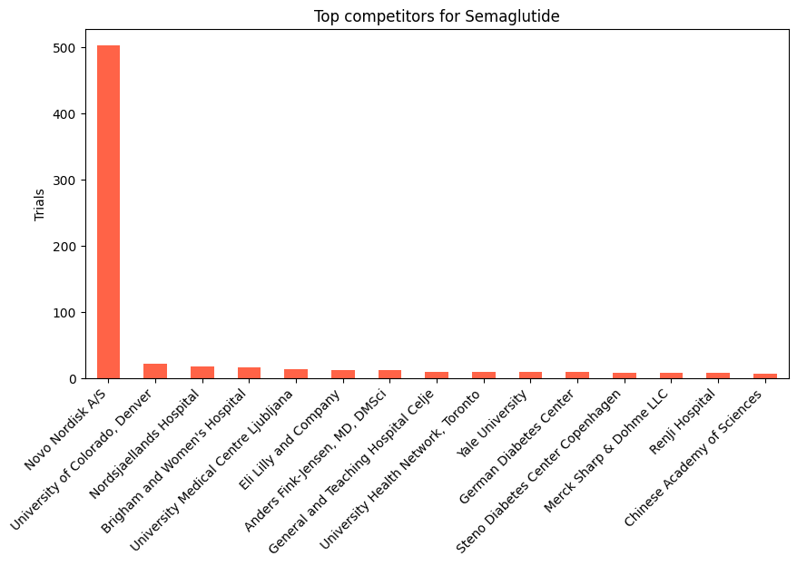
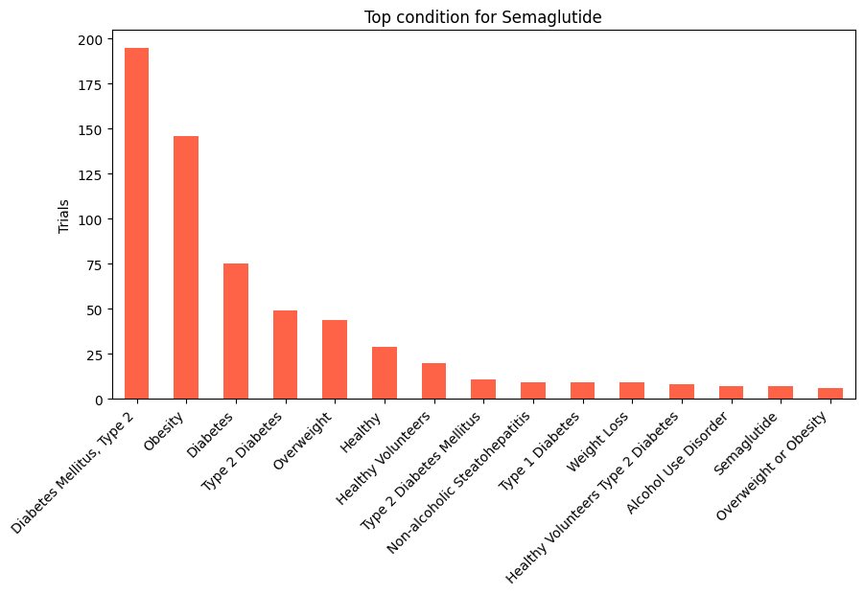
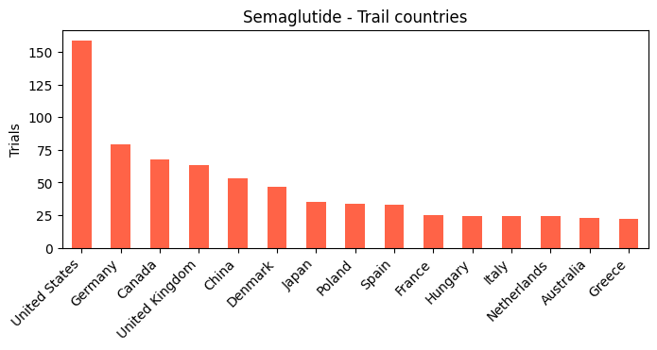
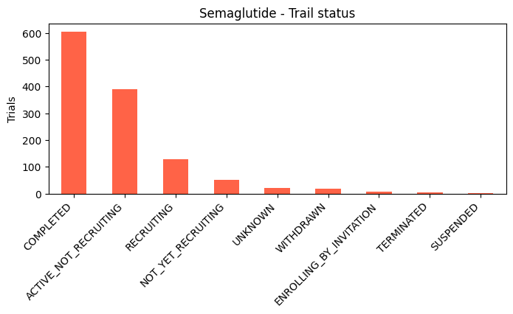
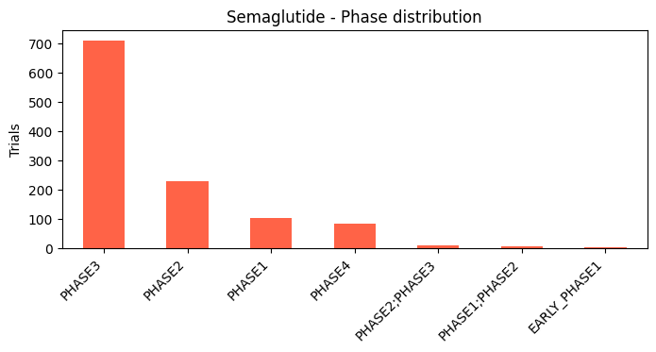
01 / DRUG INTELLIGENCE - Semaglutide
Top competitors to Semaglutide
Metformin | Clopidogrel | Ritonavir
Zidovudine | Pioglitazone | Rosuvastatin
Sitagliptin | Aspirin | Atorvastatin
Dapagliflozin | Insulin | Itraconazole
Midazolam | Liraglutide | Lamivudine
Propofol | Insulin aspart | Prednisone
Insulin detemir

Slide 6
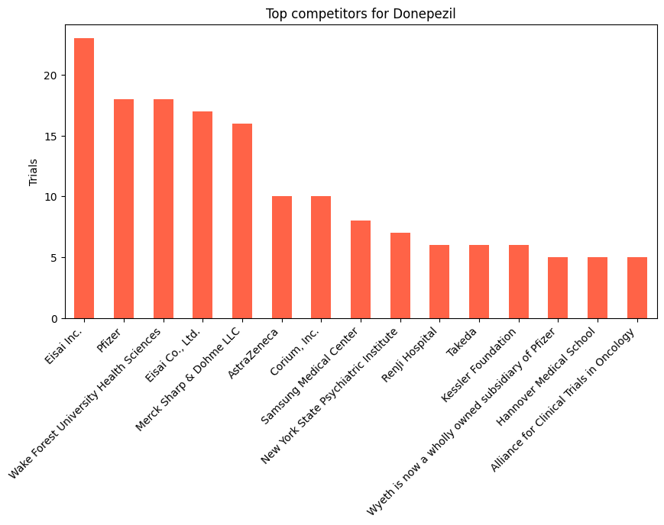
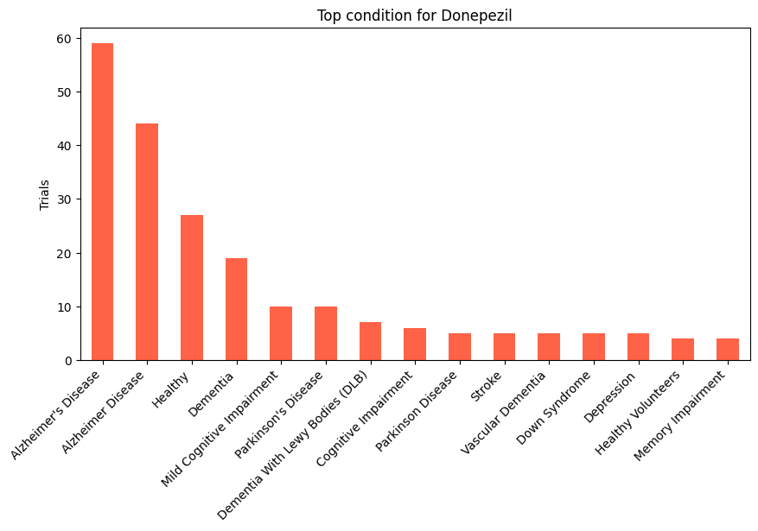
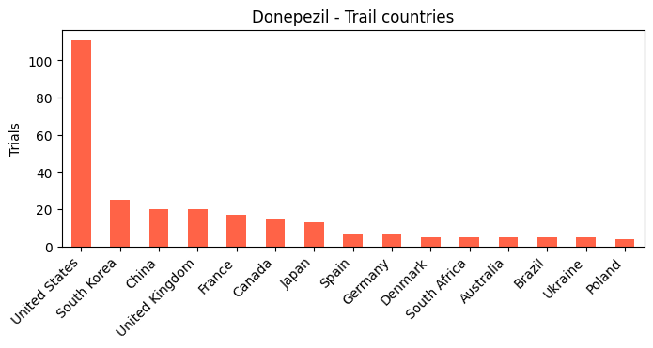
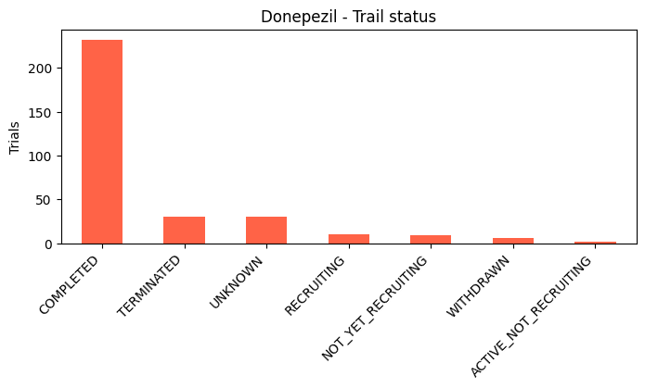
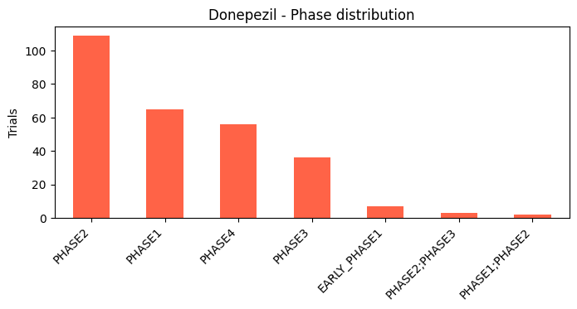
01 / DRUG INTELLIGENCE - Donepezil
Top competitors to Donepezil
Radiation therapy | Metformin | Paclitaxel
Carboplatin | Cyclophosphamide | Trastuzumab
Docetaxel | Methotrexate | Cisplatin
Midazolam | Aripiprazole | Olanzapine
Conventional surgery | Risperidone | Capecitabine

Slide 7
02 / DISEASE ANALYTICS
Treatment Landscape
Enrollment Analysis
WHAT IT DOES
Ranks every active drug by trial count for a condition. Shows who dominates and who is an emerging challenger.
WHAT IT DOES
Histogram + phase-stratified median charts. Exposes underpowered trials and mega-trials that skew cost estimates.
WHO USES IT
Competitive intelligence analysts; payers building formulary evidence; investors assessing therapeutic crowding.
WHO USES IT
Biostatisticians planning sample sizes; regulatory reviewers; health economists modelling trial cost distributions.
Trial Design Patterns
Sponsor Diversity
WHAT IT DOES
Breaks down allocation, blinding and arm type across all trials in a disease, shows whether the field relies on RCTs or observational evidence.
WHAT IT DOES
Classifies sponsors as Industry, Academic or Government and maps trial volumes. High academic share signals exploratory science.
WHO USES IT
Protocol designers benchmarking against field norms; HTA bodies assessing evidence quality, meta analysts planning systematic reviews.
WHO USES IT
Licensing managers identifying partners; grant writers mapping funding; investors gauging commercial momentum in a disease area.
Phase Progression
WHAT IT DOES
Plots trial counts by phase for the entire disease area. A healthy funnel shows I >> II >> III. Inversion signals high attrition.
WHO USES IT
R&D strategy leads prioritizing areas; VCs screening categories; BD teams timing in-licensing to the pipeline cycle.

Slide 8
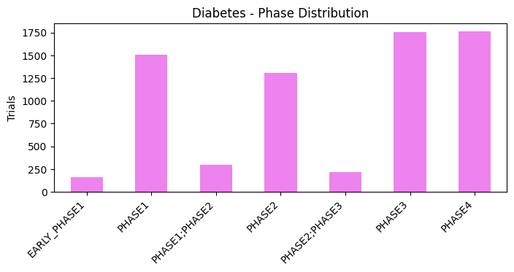
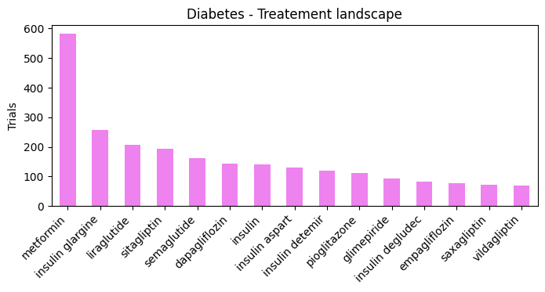
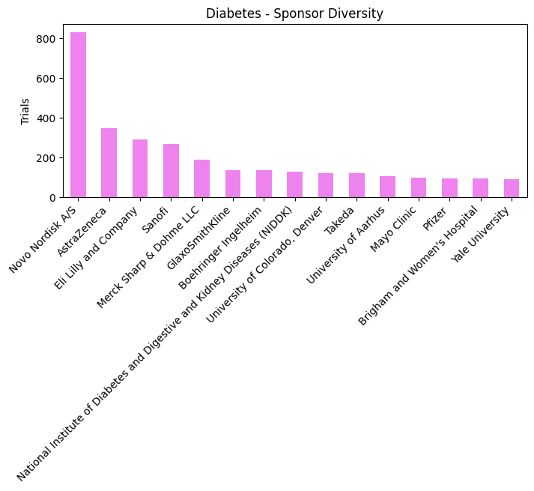
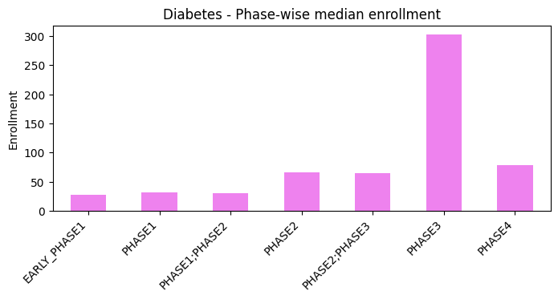
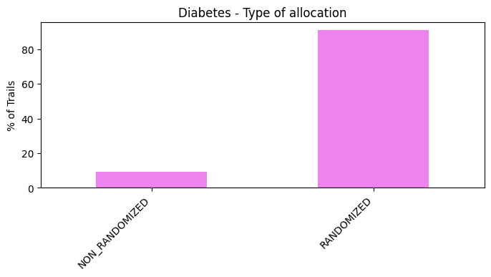
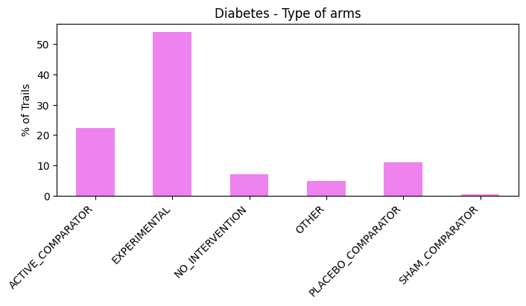
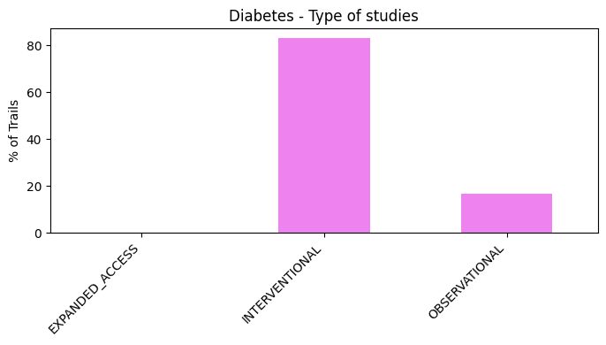
02 / DISEASE ANALYTICS - Diabetes

Slide 9
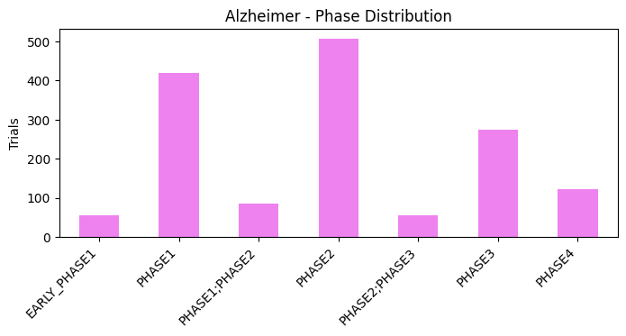
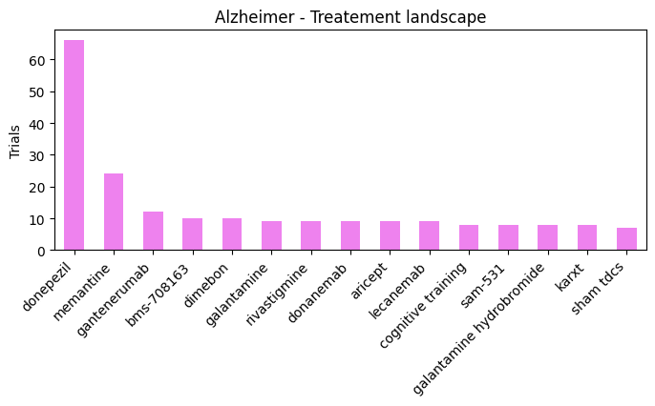
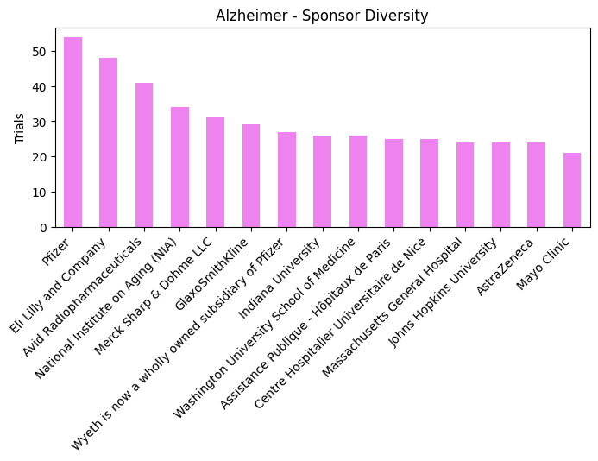
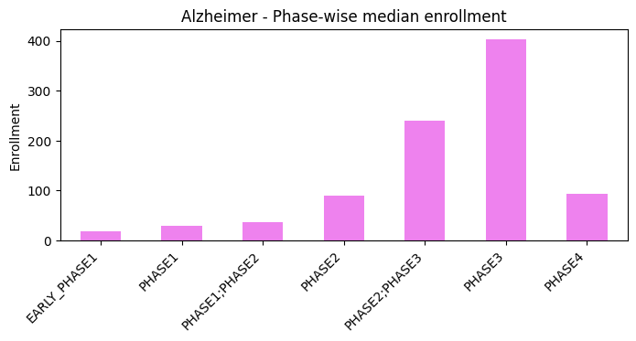
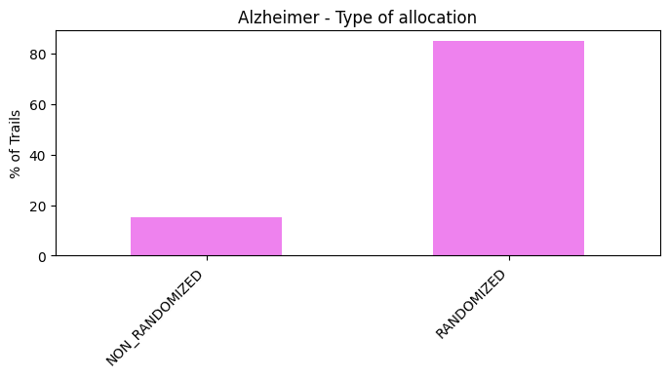
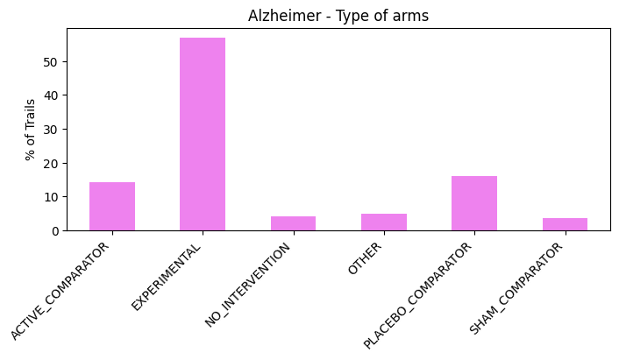
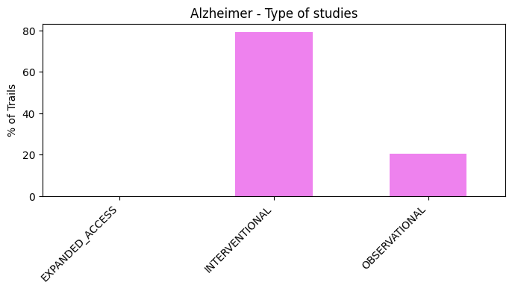
02 / DISEASE ANALYTICS - Alzheimer

Slide 10
03 / SPONSOR INTELLIGENCE
Condition Portfolio
Drug Inventory
WHAT IT DOES
Ranks every disease area a sponsor runs trials in. Reveals true therapeutic focus.
WHAT IT DOES
Lists every distinct intervention a sponsor trials, ranked by volume. Exposes flagship compounds vs. one offs.
WHO USES IT
BD teams mapping a counterpart's priorities before a deal; investors stress testing pipeline concentration risk.
WHO USES IT
Portfolio strategists prioritizing investment; CMC teams forecasting manufacturing complexity; regulatory leads anticipating submission workload.
Geographic Reach
Collaborator Network
WHAT IT DOES
Maps countries where a sponsor conducts trials. Reveals regional over-reliance, regulatory arbitrage strategies, and site network maturity.
WHAT IT DOES
Identifies other sponsors appearing in the same trials, exposing co-development deals, consortia and academic partnerships not always announced.
WHO USES IT
Clinical operations choosing sites; market access teams predicting first-launch markets; regulators assessing data generalizability
WHO USES IT
BD analysts mapping partnership ecosystems; due diligence teams verifying collaborations; academic institutions identifying industry partners.
Pipeline Mix
WHAT IT DOES
Cross tabulates trial phase against status in a stacked bar. A mature sponsor shows many COMPLETED Phase III; an early-stage one shows RECRUITING Phase I.
WHO USES IT
Analysts building competitive pipeline maps; investors calculating probability of success.

Slide 11
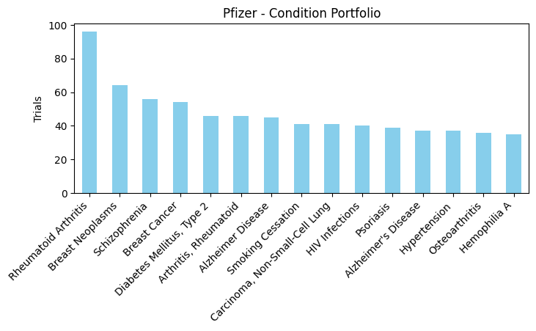
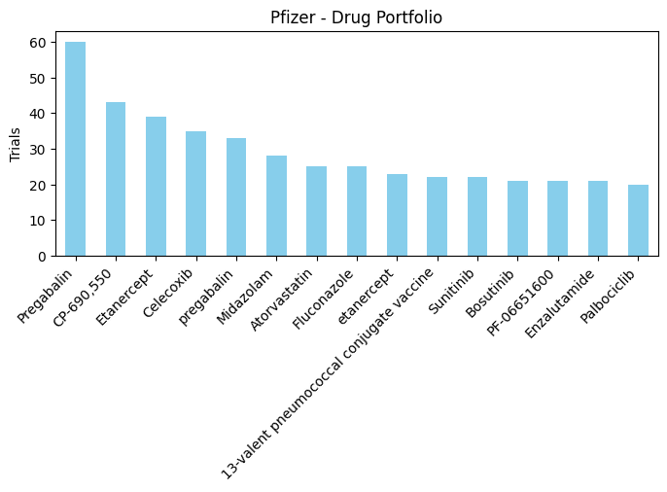
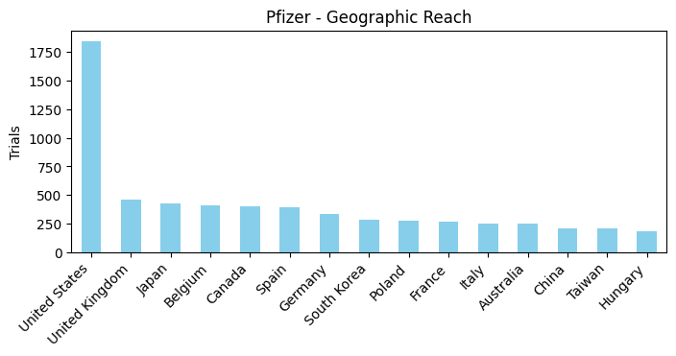
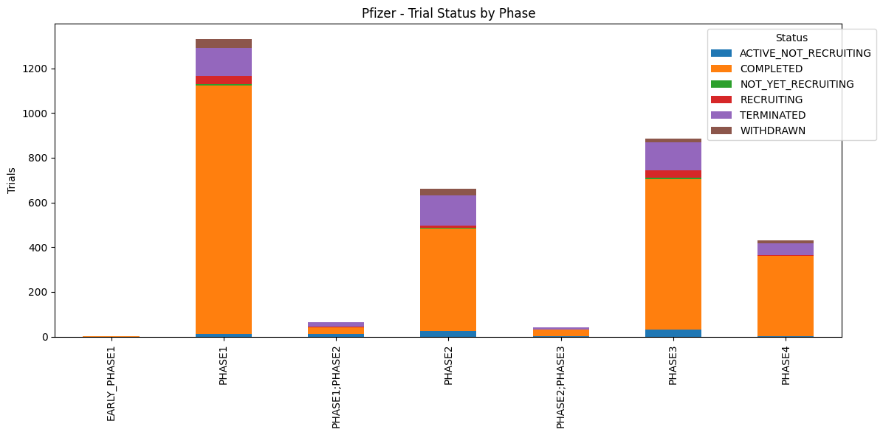
03 / SPONSOR INTELLIGENCE - Pfizer

Slide 12
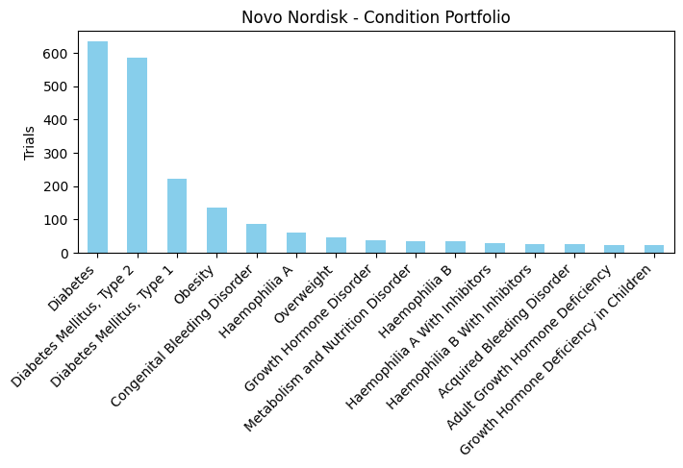
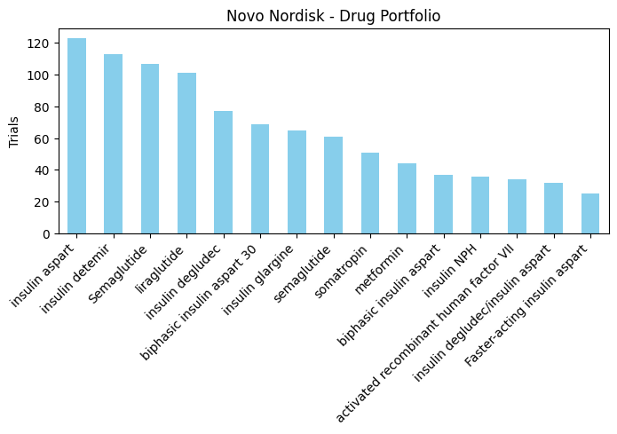
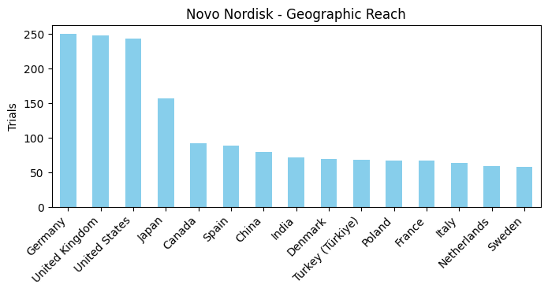
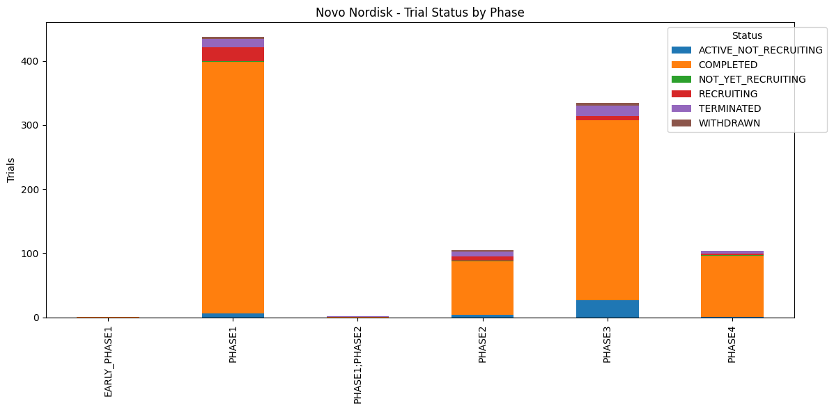
03 / SPONSOR INTELLIGENCE - Novo Nordisk

Slide 13
04 / NETWORK & GRAPH — APPLICATION DEEP-DIVE
Graph structure reveals what tabular data cannot
Centrality Scoring
Drug Repurposing Signals
WHAT IT DOES
WHAT IT DOES
Computes degree centrality (unique connections) and betweenness centrality (bridge importance) across the drug–condition graph. High-degree nodes are therapeutically broad; high-betweenness nodes are structural bridges.
Identifies drugs studied across the greatest number of distinct conditions relative to trial volume. High condition-breadth at moderate trial count = a drug explored beyond its label — the core repurposing signal.
WHO USES IT
Pipeline prioritisation teams; drug-repositioning researchers finding anchor conditions with maximum cross-indication reach.
KEY INSIGHT
Obesity is the highest-degree condition — connected to more distinct drugs than any other disease, reflecting its role as a comorbidity driver across cardio, diabetes and oncology.
WHO USES IT
Drug repositioning researchers; biotech startups seeking off-patent compounds; AI drug-discovery teams building training datasets; rare-disease researchers needing established safety profiles.
Community Detection
WHAT IT DOES
Applies the Louvain algorithm to partition the graph into dense clusters where drugs and diseases are tightly co-studied. Each community is a self-organised therapeutic area.
KEY INSIGHT
WHO USES IT
Cyclophosphamide spans 2,340 conditions across ~1,900 trials — a 70-year-old chemotherapy still actively studied in autoimmune, transplantation and rare conditions far beyond its original oncology label.
GraphRAG pipeline builders feeding disease-cluster summaries to an LLM; biomedical ontologists validating disease taxonomy.
KEY INSIGHT
15,585 communities detected. The largest (59,883 nodes) is an oncology mega-cluster spanning solid tumours, haematology and targeted therapies — ideal for LLM synthesis.

Slide 14
04 / NETWORK & GRAPH ANALYTICS

Slide 15
Why it matters: The GraphRAG Pipeline
These 20 validated outputs become structured context for a language model.
01 Query
User asks a natural language question about a drug, disease, or sponsor
02 Retrieve
Graph query fetches the relevant subgraph — validated, structured, real
03 Augment
LLM receives the subgraph as grounded context with no hallucination risk
04 Generate
Model summarizes evidence, compares pipelines, surfaces repurposing leads
05 Hypothesize
Cross-condition and cross-sponsor patterns suggest novel research directions

Slide 16
The stack behind this
Data source
ClinicalTrials.gov — full registry, 640K+ trial records
Graph DB
Neo4j — 6 node types, 5 relationship types, Cypher queries
Extraction
Python · pandas · networkx · python-louvain
Visualization
matplotlib · seaborn · plotly-ready
Next stage
GraphRAG pipeline → LLM summarization + hypothesis generation
Interested in applying this to your therapeutic area? Let's connect →

