Slide 1
Clinical Trials -
Knowledge Graph
Clinical applications
Drug Intelligence
Disease Analytics
Sponsor Intelligence
Network & Graph analysis

Slide 2
What I built
01
Drug Intelligence
Evidence · Competition · Geography · Multi-hop paths
02
Disease Analytics
Landscape · Design · Phase · Enrollment · Sponsor diversity
03
Sponsor Intelligence
Portfolio · Geo reach · Pipeline · Drugs · Collaborators
04
Network & Graph
Centrality · Communities · Repurposing signals

Slide 3
01 / DRUG INTELLIGENCE
Evidence Profile
Geographic Footprint
WHAT IT DOES
Aggregates every trial ever run for a drug by phase, status, condition and geography in a single query. Replaces weeks of manual registry work.
WHAT IT DOES
Maps the countries actively conducting trials for a drug, exposing regional concentration risk and untapped recruitment markets.
WHO USES IT
Drug developers, BD teams assessing clinical maturity before in-licensing, and medical affairs preparing HCP evidence summaries.
WHO USES IT
Clinical operations optimizing site selection; market access teams forecasting country by country launch readiness.
Competitive Landscape
Multi-hop Paths
WHAT IT DOES
Finds every drug that shares a condition with the target compound, ranked by trial volume, also every sponsor investing in the drug.
WHAT IT DOES
Constructs the Drug → Study → Condition → Sponsor subgraph, the structured context chunk fed to the LLM in the GraphRAG pipeline.
WHO USES IT
Portfolio strategy and white space mapping; medical affairs competitive dossiers; licensing analysts sizing the field.
WHO USES IT
AI/ML teams building grounded clinical Q&A agents; regulatory writers who need citation ready evidence chains.

Slide 4
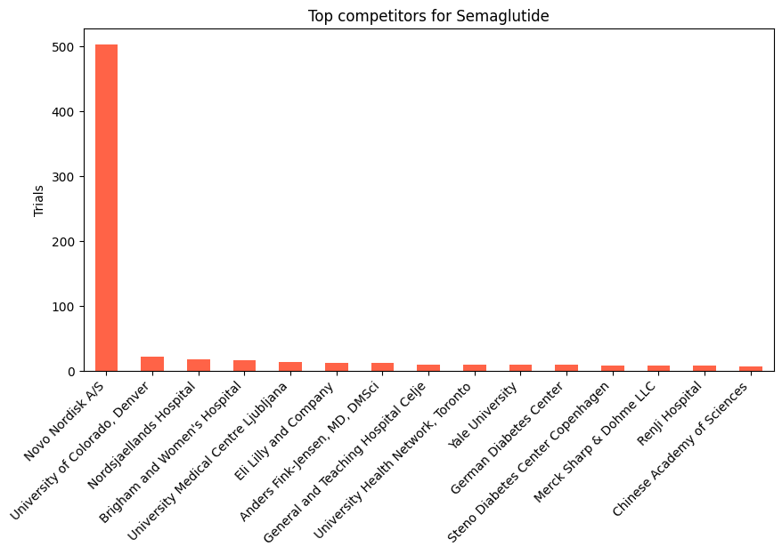
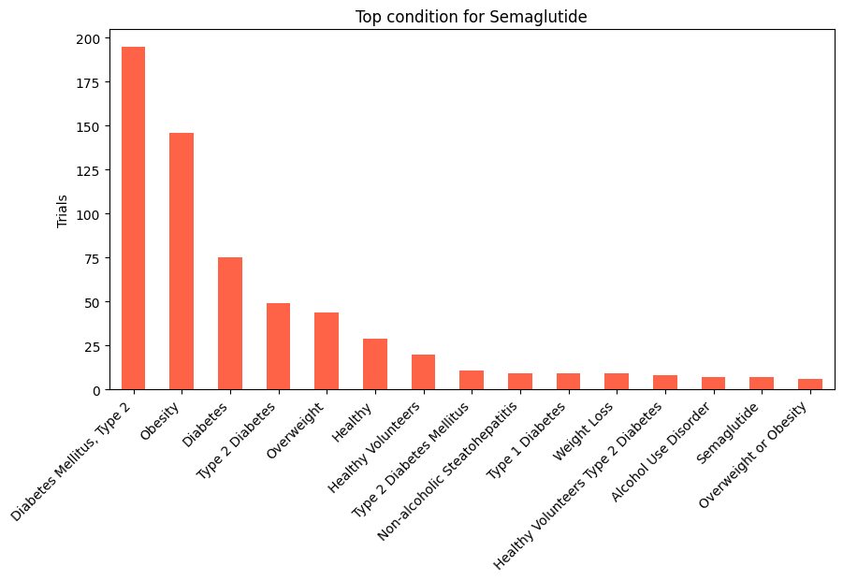
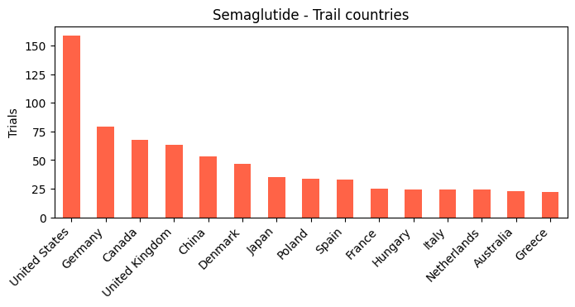
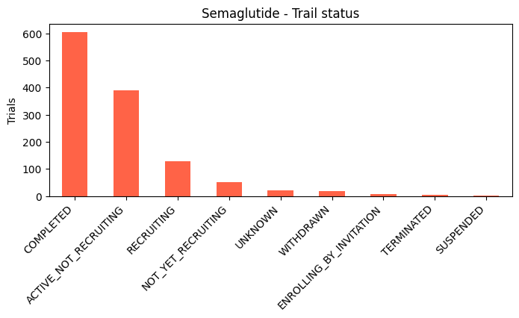
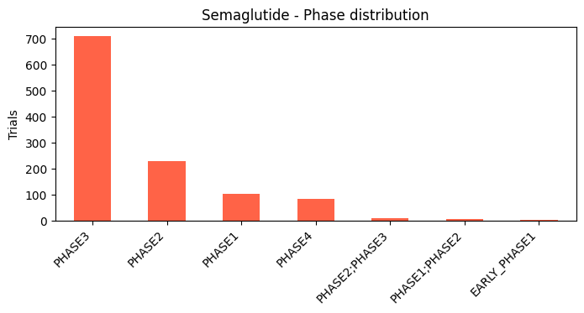
01 / DRUG INTELLIGENCE - Semaglutide
Top competitors to Semaglutide
Metformin | Clopidogrel | Ritonavir
Zidovudine | Pioglitazone | Rosuvastatin
Sitagliptin | Aspirin | Atorvastatin
Dapagliflozin | Insulin | Itraconazole
Midazolam | Liraglutide | Lamivudine
Propofol | Insulin aspart | Prednisone
Insulin detemir
Semaglutide's trials are mostly across metabolic conditions, it is Phase 3 heavy and it has US centric geography with Novo Nordisk as main sponsor.

Slide 5
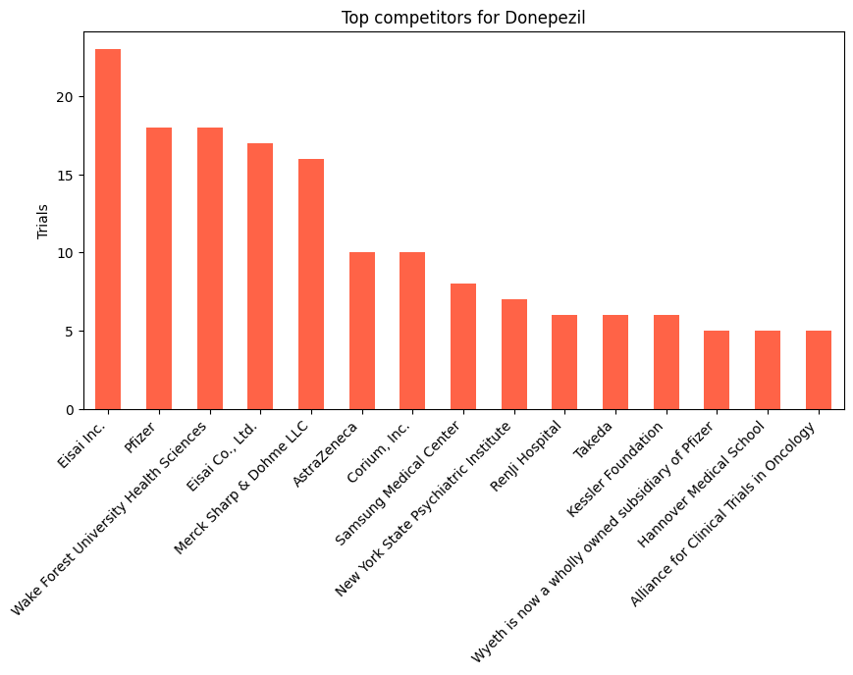
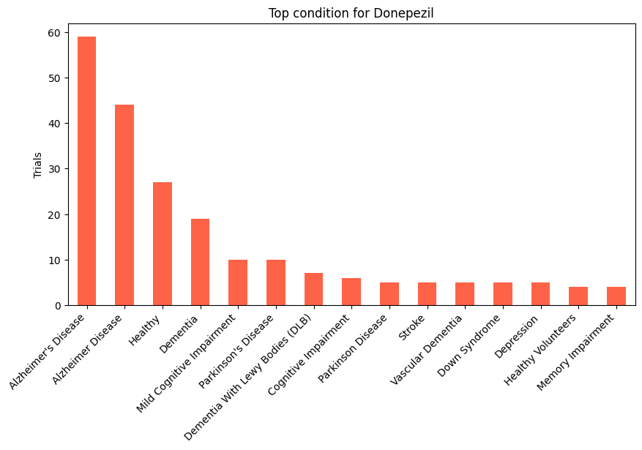
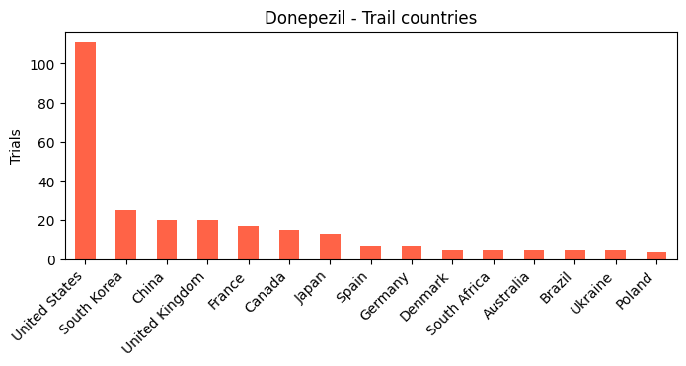
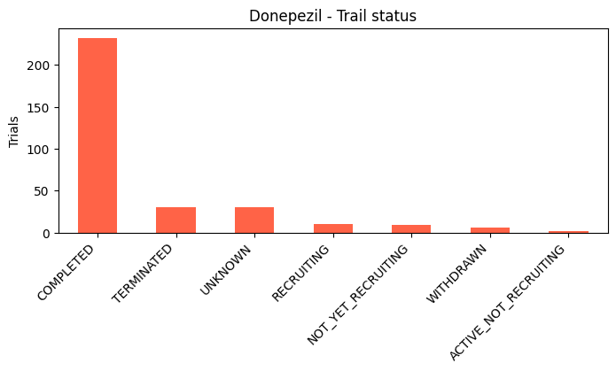
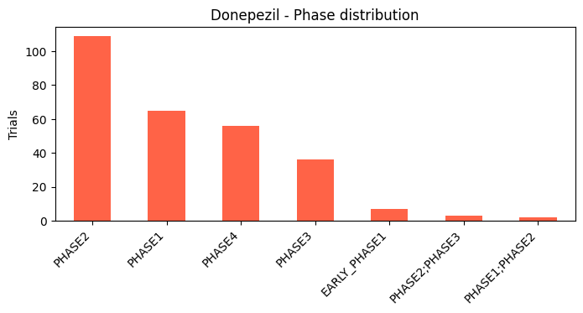
01 / DRUG INTELLIGENCE - Donepezil
Top competitors to Donepezil
Radiation therapy | Metformin | Paclitaxel
Carboplatin | Cyclophosphamide | Trastuzumab
Docetaxel | Methotrexate | Cisplatin
Midazolam | Aripiprazole | Olanzapine
Conventional surgery | Risperidone | Capecitabine
Donepezil's competitor list spans across oncology and antipsychotics which reveals the shared comorbidity landscape of Alzheimer's trials. The Phase 2 peak signals a disease area still seeking its breakthrough, with academic centers driving most trial activity.

Slide 6
01 / DRUG INTELLIGENCE – Key Findings
1
2
Semaglutide dominates its disease space
Donepezil reveals unexpected competitors
Semaglutide has a lot of Phase 3 trials confirming it as the most clinically validated GLP1 agonist. The US leads site concentration with most of the trials, followed by Germany and Canada. Novo Nordisk and the University of Colorado are the dominant sponsors, with Diabetes Mellitus Type 2 and Obesity as the primary conditions.
Donepezil’s top competitors include oncology drugs (Paclitaxel, Carboplatin) and antipsychotics (Aripiprazole, Risperidone), reflecting the shared Alzheimer’s + comorbidity trial landscape. Phase 2 trials dominate, signalling a pipeline still searching for breakthrough efficacy. The US and South Korea are the leading countries.
3
Geographic concentration is a risk signal
Both drugs are heavily US centric in their trial geography, revealing recruitment concentration risk. For a drug like Semaglutide with global obesity relevance, the under representation of Asia and Africa is a meaningful gap for generalizability of trial evidence.

Slide 7
02 / DISEASE ANALYTICS
Treatment Landscape
Enrollment Analysis
WHAT IT DOES
Ranks every active drug by trial count for a condition. Shows who dominates and who is an emerging challenger.
WHAT IT DOES
Histogram + phase-stratified median charts. Exposes underpowered trials and mega-trials that skew cost estimates.
WHO USES IT
Competitive intelligence analysts; payers building formulary evidence; investors assessing therapeutic crowding.
WHO USES IT
Biostatisticians planning sample sizes; regulatory reviewers; health economists modelling trial cost distributions.
Trial Design Patterns
Sponsor Diversity
WHAT IT DOES
Breaks down allocation, blinding and arm type across all trials in a disease, shows whether the field relies on RCTs or observational evidence.
WHAT IT DOES
Classifies sponsors as Industry, Academic or Government and maps trial volumes. High academic share signals exploratory science.
WHO USES IT
Protocol designers benchmarking against field norms; HTA bodies assessing evidence quality, meta analysts planning systematic reviews.
WHO USES IT
Licensing managers identifying partners; grant writers mapping funding; investors gauging commercial momentum in a disease area.
Phase Progression
WHAT IT DOES
Plots trial counts by phase for the entire disease area. A healthy funnel shows I >> II >> III. Inversion signals high attrition.
WHO USES IT
R&D strategy leads prioritizing areas; VCs screening categories; BD teams timing in-licensing to the pipeline cycle.

Slide 8
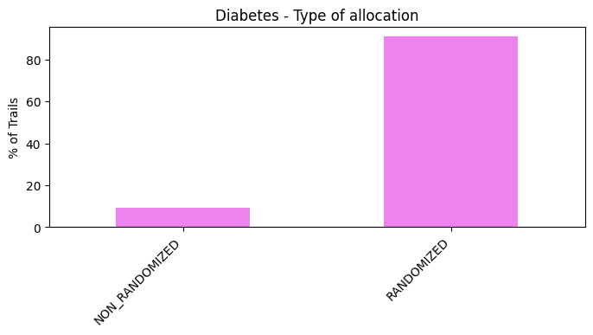
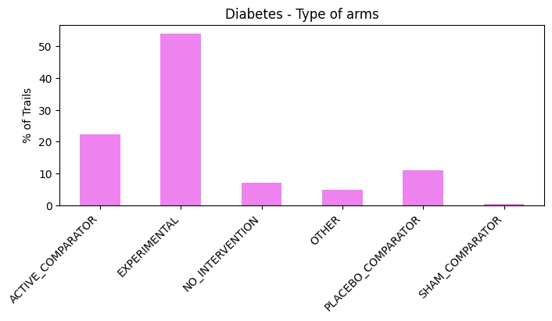
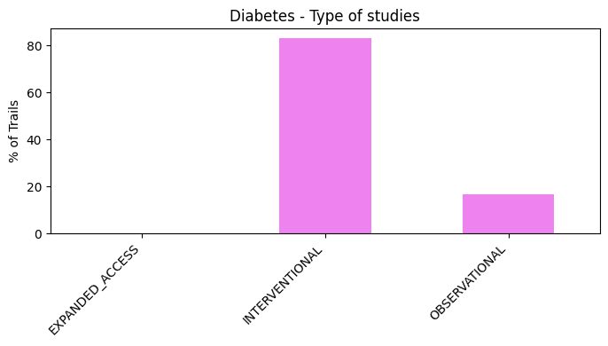
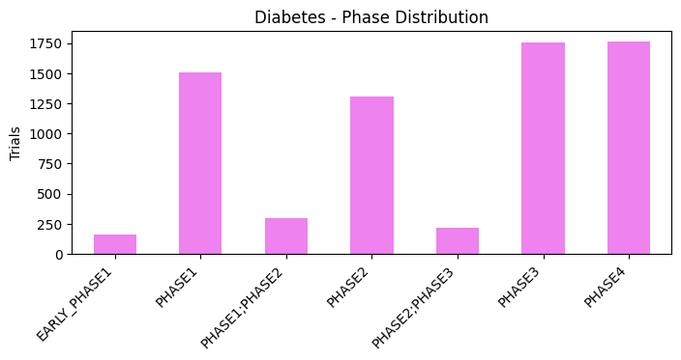
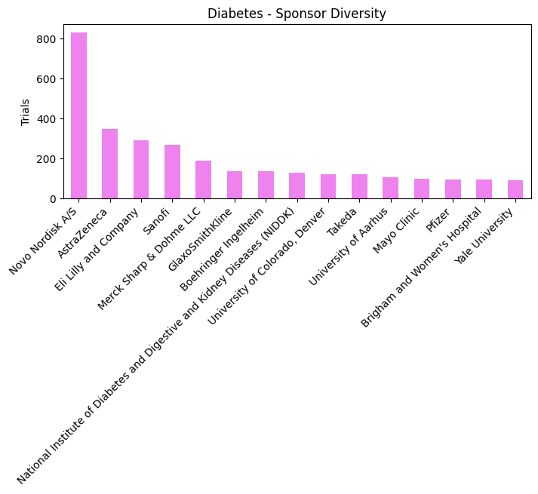
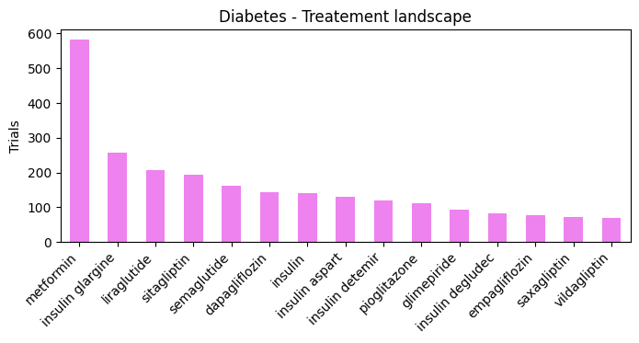
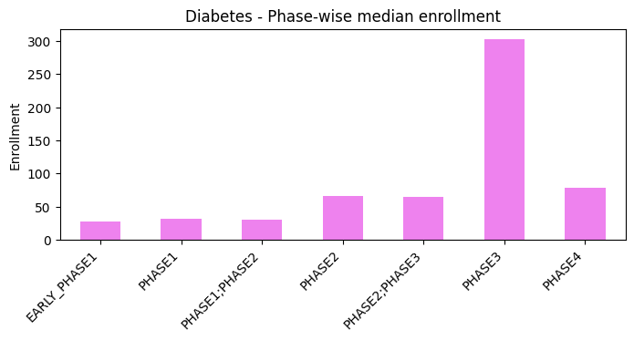
02 / DISEASE ANALYTICS - Diabetes
Diabetes trials represent one of the most mature, industry funded, and RCT saturated disease landscapes. The large Phase 3 enrollment medians and 85%+ randomization rate confirm this as a benchmark disease for trial design standards.

Slide 9
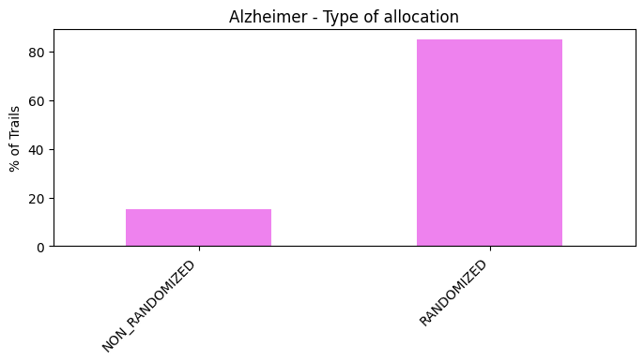
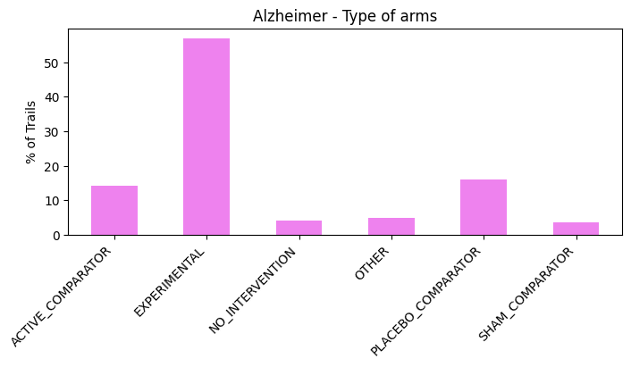
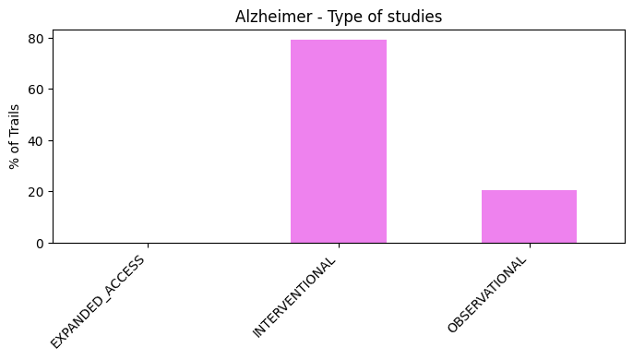
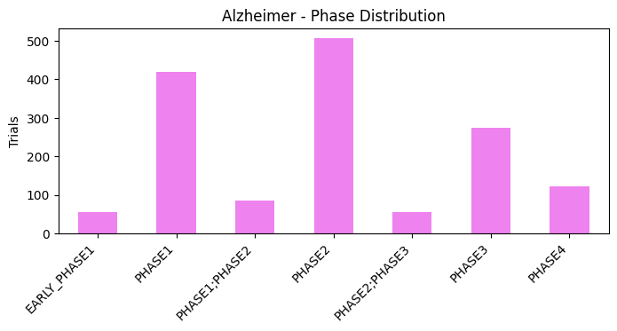
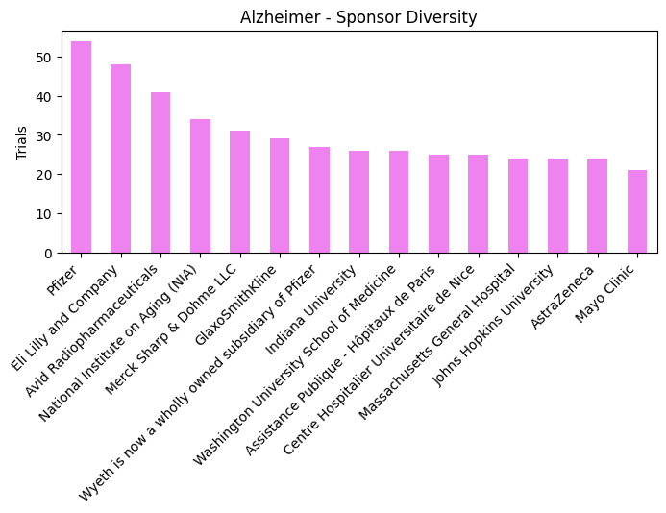
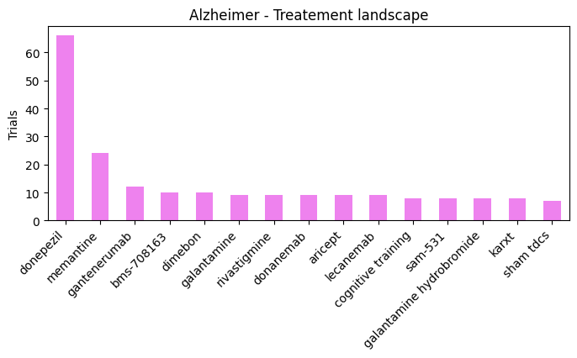
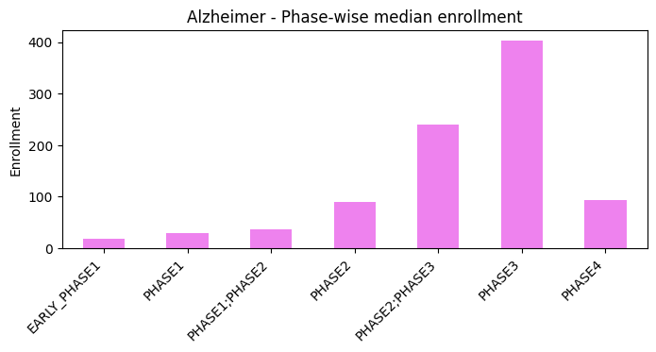
02 / DISEASE ANALYTICS - Alzheimer
Alzheimer's trials show an inverted funnel i.e., peaking at Phase 2 with large Phase 3 enrollment requirements signaling high cost and risk. Higher academic/government sponsorship vs Diabetes reflects a disease still in the discovery phase of its clinical journey.

Slide 10
02 / DISEASE ANALYTICS – Key Findings
1
2
Diabetes: mature, industry led, RCT dominated
Alzheimer’s: early stage, fragmented, academic heavy
Diabetes trials show a healthy Phase 3 > Phase 2 funnel, with Phase 3 enrollment medians exceeding 300 participants. Over 85% of trials are randomized and predominantly interventional. Novo Nordisk and Eli Lilly dominate sponsor share, with Metformin and insulin glargine leading the treatment landscape.
Alzheimer’s trials peak at Phase 2, suggesting a pipeline still searching for breakout efficacy. Enrollment medians spike dramatically at Phase 3, reflecting large, expensive confirmation trials. NIH, Pfizer, and Eli Lilly co-lead, with Donepezil and Memantine as the established treatment anchors.
3
4
RCT evidence quality varies sharply by disease
Sponsor diversity signals innovation stage
Diabetes has ~85% randomized allocation vs Alzheimer’s ~80%, but both use predominantly experimental arms. Diabetes’ higher interventional share confirms stronger commercial investment and regulatory maturity. Alzheimer’s higher observational share signals the field still building disease understanding.
Diabetes is industry dominated (Novo Nordisk, Lilly) confirming commercial viability. Alzheimer’s shows higher academic/government share (NIH, academic hospitals), reflecting that the disease is still in an exploratory, grant funded phase which might be a key signal for investors and licensing teams.

Slide 11
03 / SPONSOR INTELLIGENCE
Condition Portfolio
Drug Inventory
WHAT IT DOES
Ranks every disease area a sponsor runs trials in. Reveals true therapeutic focus.
WHAT IT DOES
Lists every distinct intervention a sponsor trials, ranked by volume. Exposes flagship compounds vs. one offs.
WHO USES IT
BD teams mapping a counterpart's priorities before a deal; investors stress testing pipeline concentration risk.
WHO USES IT
Portfolio strategists prioritizing investment; CMC teams forecasting manufacturing complexity; regulatory leads anticipating submission workload.
Geographic Reach
Collaborator Network
WHAT IT DOES
Maps countries where a sponsor conducts trials. Reveals regional over-reliance, regulatory arbitrage strategies, and site network maturity.
WHAT IT DOES
Identifies other sponsors appearing in the same trials, exposing co-development deals, consortia and academic partnerships not always announced.
WHO USES IT
Clinical operations choosing sites; market access teams predicting first-launch markets; regulators assessing data generalizability
WHO USES IT
BD analysts mapping partnership ecosystems; due diligence teams verifying collaborations; academic institutions identifying industry partners.
Pipeline Mix
WHAT IT DOES
Cross tabulates trial phase against status in a stacked bar. A mature sponsor shows many COMPLETED Phase III; an early-stage one shows RECRUITING Phase I.
WHO USES IT
Analysts building competitive pipeline maps; investors calculating probability of success.

Slide 12
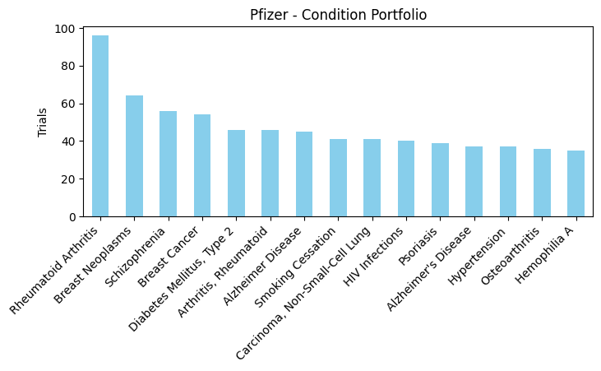
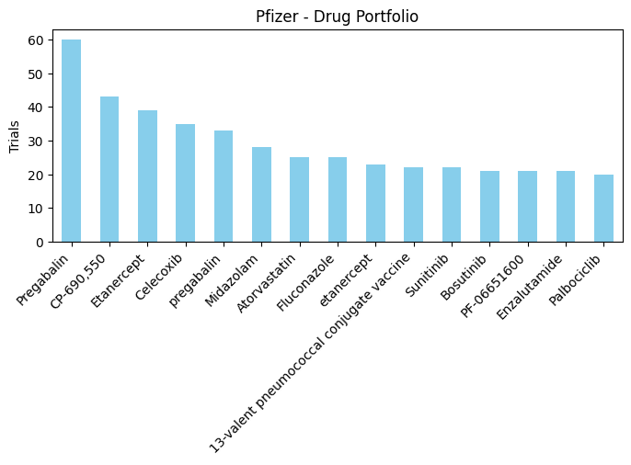
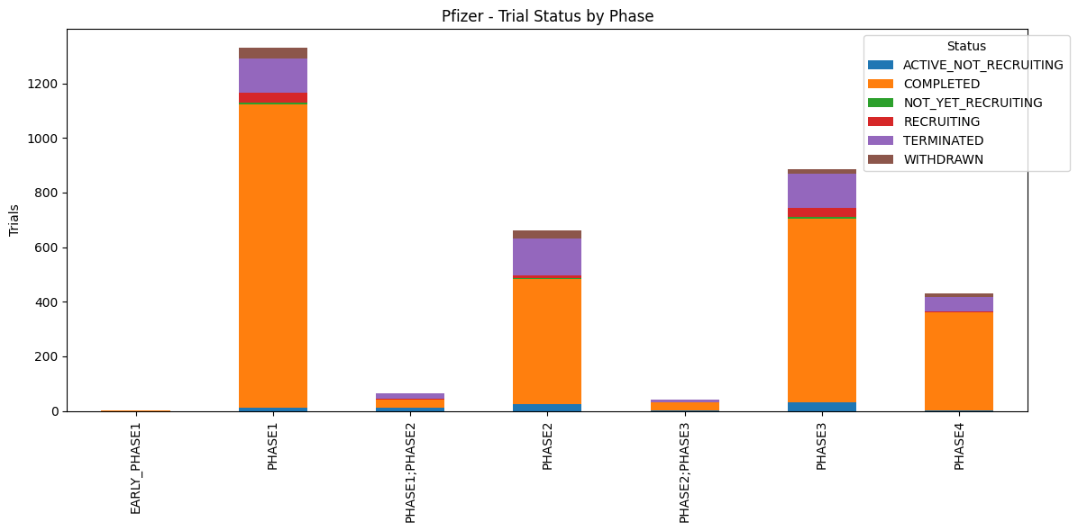
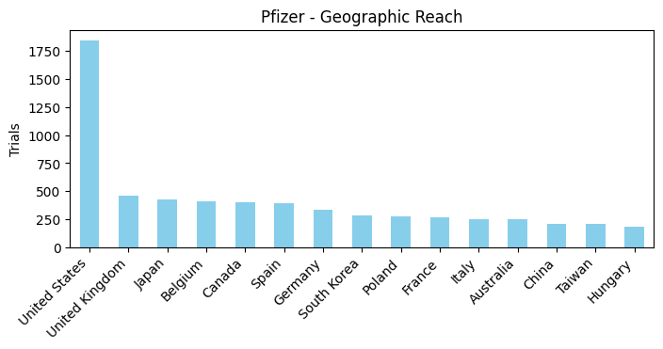
03 / SPONSOR INTELLIGENCE - Pfizer

Slide 13
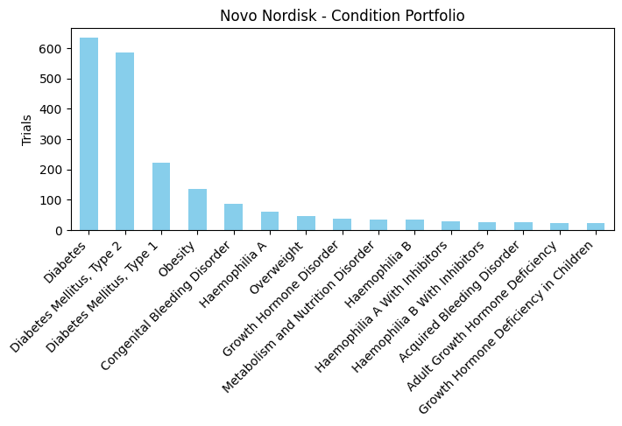
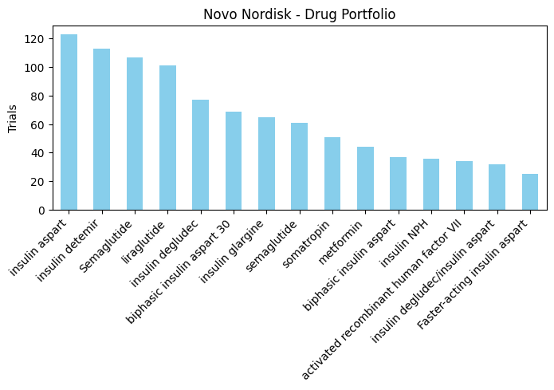
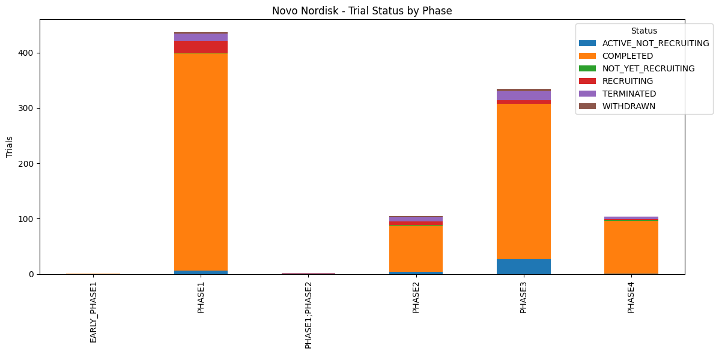
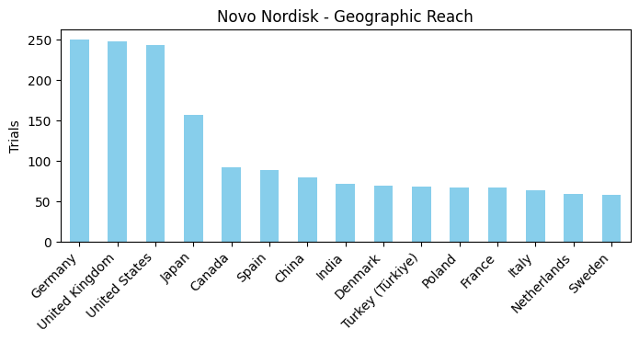
03 / SPONSOR INTELLIGENCE - Novo Nordisk

Slide 14
03 / SPONSOR INTELLIGENCE – Key Findings
1
2
Pfizer: broad portfolio, late stage mature
Novo Nordisk: focused on metabolic disease
Pfizer trials span 15+ therapeutic areas with Rheumatoid Arthritis, Breast Cancer, and Schizophrenia at the top. Its Phase 2 and Phase 3 completed bars dominate the pipeline mix, confirming a sponsor with proven commercial delivery. US and UK lead geographic reach.
Novo Nordisk’s condition portfolio is dominated by Diabetes and Obesity. Semaglutide and insulin analogues lead drug inventory. Germany tops geographic reach, reflecting European HQ. Active Phase 3 recruiting signals the next wave beyond GLP1 dominance.

Slide 15
04 / NETWORK & GRAPH ANALYTICS
Centrality Scoring
WHAT IT DOES
Computes degree centrality (unique connections) and betweenness centrality (bridge importance) across the drug condition graph. High degree nodes are therapeutically broad; high betweenness nodes are structural bridges.
Drug Repurposing Signals
WHO USES IT
Pipeline prioritization teams; drug repositioning researchers finding anchor conditions with maximum cross indication reach.
WHAT IT DOES
Identifies drugs studied across the greatest number of distinct conditions relative to trial volume. High condition breadth at moderate trial count = a drug explored beyond its label, the core repurposing signal.
WHO USES IT
Drug repositioning researchers; biotech startups seeking off patent compounds; AI drug discovery teams building training datasets; rare disease researchers needing established safety profiles.
Community Detection
WHAT IT DOES
Applies the Louvain algorithm to partition the graph into dense clusters where drugs and diseases are tightly co-studied. Each community is a self organised therapeutic area.
WHO USES IT
GraphRAG pipeline builders feeding disease cluster summaries to an LLM

Slide 16
04 / NETWORK & GRAPH ANALYTICS – Centrality scoring
Obesity
Highest degree: GLP-1 agonists, SGLT2 inhibitors, bariatric, dietary, and behavioral trials all converge on this node. Reflects the global obesity epidemic driving massive trial investment.
Degree centrality
Betweenness centrality
Breast Cancer
Tested with the widest variety of drugs/chemotherapy backbones, targeted therapies (CDK4/6, HER2), immunotherapy, and hormonal agents all connect here.
Pain & Heart Failure
Despite appearing in middle of the list in degree, both score very high in betweenness, they act as bridges between analgesic, surgical, and cardiovascular clusters.
Dexamethasone (Only Drug)
The sole pharmaceutical agent in the betweenness top 25. Used in oncology premedication, COVID19 (RECOVERY trial), surgical anaesthesia, sepsis, and haematology, spanning ALL major disease communities simultaneously.
All top nodes are DISEASE CONDITIONS — confirming the graph's condition centric structure driven by trial volume per disease area

Slide 17
04 / NETWORK & GRAPH ANALYTICS – Community detection
15,585
Total Communities
59.3%
Singleton or
Pair Clusters
28
Mega clusters
(>1,000 nodes)
The extreme skew (59% singletons) is expected in large bipartite trial graphs as rare drug condition pairs from small trials form isolated nodes, while the core knowledge concentrates in ~28 bigger communities representing major therapeutic areas.
Community
#9
Metabolic & Behavioral Health
Community #68
Perioperative & Anaesthesia Care
Largest cluster. Centers on Type 2 Diabetes + Depression + Obesity co-comorbidity. Dominated by behavioral interventions (CBT, motivational interviewing, mindfulness), antidepressants (Escitalopram), and lifestyle programs.
Surgical drug trials: laparoscopic/bariatric surgery, cardiac and orthopaedic procedures. Key agents: Dexmedetomidine, Remifentanil, Lidocaine, Midazolam. Glucose monitoring devices link back to metabolic domain.
T2D · Depression · CBT · Gastric Bypass · Sleep
Dexmedetomidine · Remifentanil · Bariatric Surgery · PEEP
Community
#6
Oncology + Hepatic/Metabolic Overlap
Community
#15
Neurological & Musculoskeletal Rehab
HCC and colorectal cancer trials co-occurring with metabolic agents (Metformin, Glipizide) and PD-1 inhibitors (Nivolumab, Sintilimab). Reflects trials optimizing metabolic health during cancer treatment.
Neurodegenerative and musculoskeletal conditions with rehabilitation focus. MRI based diagnostics, exercise programs, stem cell therapies, hyperbaric oxygen. Parkinson's, cognitive decline, diabetic neuropathy.
Liver Cancer · Nivolumab · Metformin · PegIFN · Tamoxifen
Parkinson · Cognitive Decline · Hyperbaric O₂ · fMRI · Stem Cells
The Louvain algorithm independently recovered clinically meaningful therapeutic clusters without any expert labeling. Community boundaries align precisely with real biomedical domains, validating the KG.

Slide 18
04 / NETWORK & GRAPH ANALYTICS – Community detection
Community
#82
Diabetes Pharmacotherapy
Community
#13
Cardiovascular Disease & Prevention
Tightly focused T2D drug trials. Contains every major class: SGLT2i (Dapagliflozin, Empagliflozin), GLP-1 (Dulaglutide), DPP-4i (Sitagliptin), sulfonylureas, and insulin variants plus NASH-related interventions.
Coronary artery disease, atrial fibrillation, heart failure. Atorvastatin, Aspirin (multiple doses), Evolocumab, Valsartan, Warfarin. Coronary stent comparisons (TAXUS vs Xience). SGLT2i (Dapagliflozin) entering cardiology.
Dapagliflozin · Empagliflozin · Sitagliptin · Insulin · NASH
Atorvastatin · Aspirin · Evolocumab · Cardiac MRI · Dapagliflozin
Community
#0
Hepatitis B Virology
Community
#10
Immunology, Autoimmune & Gout
Almost entirely devoted to Chronic Hepatitis B (CHB). All antiviral classes: TAF/TDF, Entecavir, Lamivudine, PegIFN. Therapeutic vaccines and novel investigational agents (VIR-2218, Bepirovirsen (siRNA based)). Reflects the global HBV cure effort.
Rheumatoid arthritis, gout, GvHD, and autoimmune conditions. Abatacept, Hydroxychloroquine, Rituximab, Anakinra, Allopurinol, Rasburicase, antifungals. Mix of immunosuppressants and natural anti-inflammatory compounds.
TAF/TDF · Entecavir · PegIFN · HBV Vaccine · Bepirovirsen
RA · Gout · Abatacept · Hydroxychloroquine · Rituximab · GvHD
Community
#41
Sleep Apnea, Obesity & Pulmonary
Community
#3
Infectious Disease & Respiratory
Obstructive sleep apnea (active vs sham CPAP), polysomnography endpoints, obesity interventions, asthma. Pirfenidone (IPF), Bosentan (PAH), Roflumilast (COPD). Hyperpolarized Xe-129 MRI, cutting edge pulmonary imaging.
Respiratory infections, COVID19, sepsis, influenza, critical care. Antibiotics (Vancomycin, Clindamycin), Oseltamivir, mechanical ventilation protocols, FMT, high flow nasal cannula. Nitazoxanide repurposing for COVID19.
CPAP · Sleep Apnea · Pirfenidone · Bosentan · Xe-129 MRI
COVID19 · Sepsis · Vancomycin · FMT · Mechanical Ventilation

Slide 19
04 / NETWORK & GRAPH ANALYTICS – Drug Repurposing
Communities 6–10: Cardiovascular, Immunology, Infectious Disease & Beyond
Checkpoint Inhibitors
Cytotoxic Drugs
Cyclophosphamide, Carboplatin, Cisplatin, Paclitaxel, Gemcitabine, appear in combination regimens across virtually all solid and haematological cancers. High condition breadth is partly combinatorial (many tumor subtypes tested) but also reflects genuine mechanistic versatility via DNA damage and immune modulation.
Pembrolizumab, Nivolumab, Ipilimumab, Durvalumab, Atezolizumab, expanded from melanoma/NSCLC into dozens of tumor types. Nivolumab appears in HBV and COVID19 trials, signaling cross disease immune axis potential via PD1 blockade beyond oncology.
Corticosteroid
Dexamethasone, the sole non oncology drug in the top tier. Spans inflammation, surgery, sepsis, respiratory distress (ARDS), haematology. Its inclusion in the COVID19 RECOVERY trial is an example of repurposing success.

Slide 20
04 / NETWORK & GRAPH ANALYTICS – Key Findings
1
2
Disease burden drives graph structure
Betweenness reveals hidden cross domain connectors
Degree centrality is dominated by conditions , reflecting that disease prevalence and funding priority determine how many drugs get tested against a given condition. Obesity, Breast Cancer, Stroke, and Pain are the most contested disease nodes in the entire trial network.
Knee Osteoarthritis, Infertility, and Epilepsy act as structural bridges despite moderate trial volume. Dexamethasone is the only drug with this bridging role, its cross indication presence in every major disease domain makes it irreplaceable to the network's connectivity.
3
4
Louvain communities map to real biomedical domains
Repurposing signals: three distinct archetypes
All 10 largest communities correspond to coherent therapeutic areas: metabolic disease, oncology, cardiovascular, infectious disease, and virology. The HBV community (#0) is the most specific community almost exclusively devoted to one pathogen's eradication.
Cytotoxic backbone drugs (broad oncology use), checkpoint inhibitors (tumor agnostic expansion), and corticosteroid. The KG correctly surfaces Nivolumab's HBV and COVID19 appearances as biological signals.

Slide 21
The GraphRAG Pipeline

