Slide 1
Merck molecular activity
Developing a framework that can be used to build a model to predict activity of the compounds with the help of their descriptors only

Slide 2
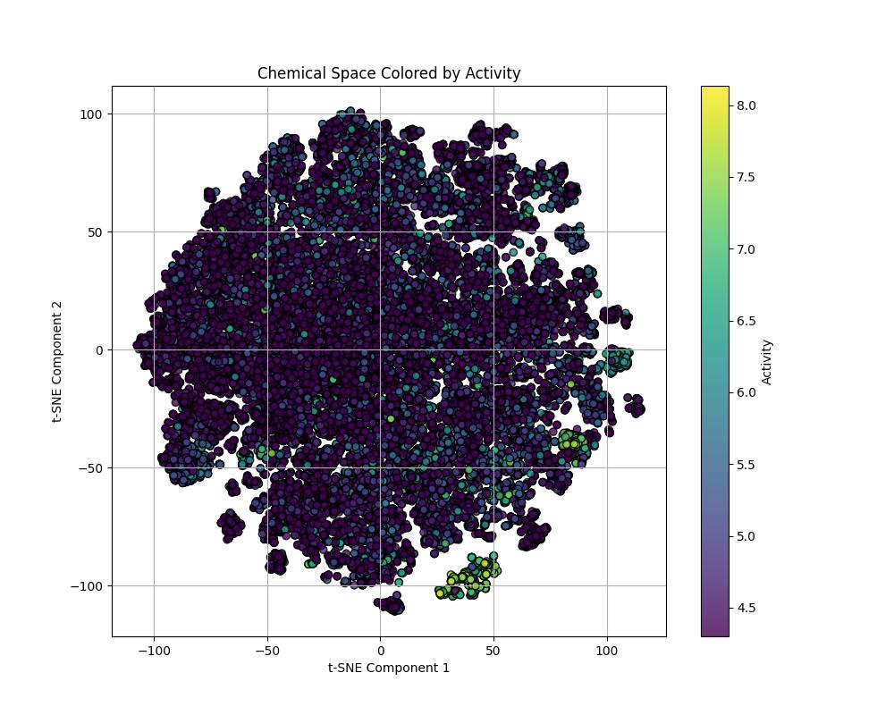
ACT1

Slide 3
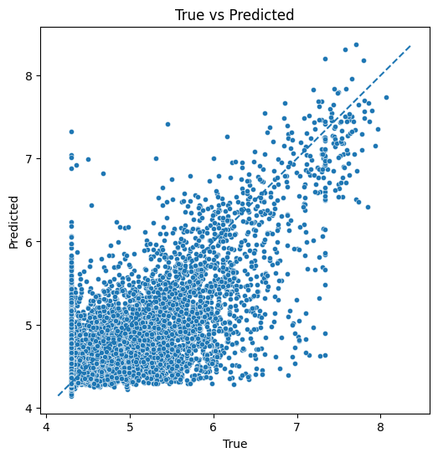
ACT1
NN model 2
 | R squere
Test | 0.5758

Slide 4
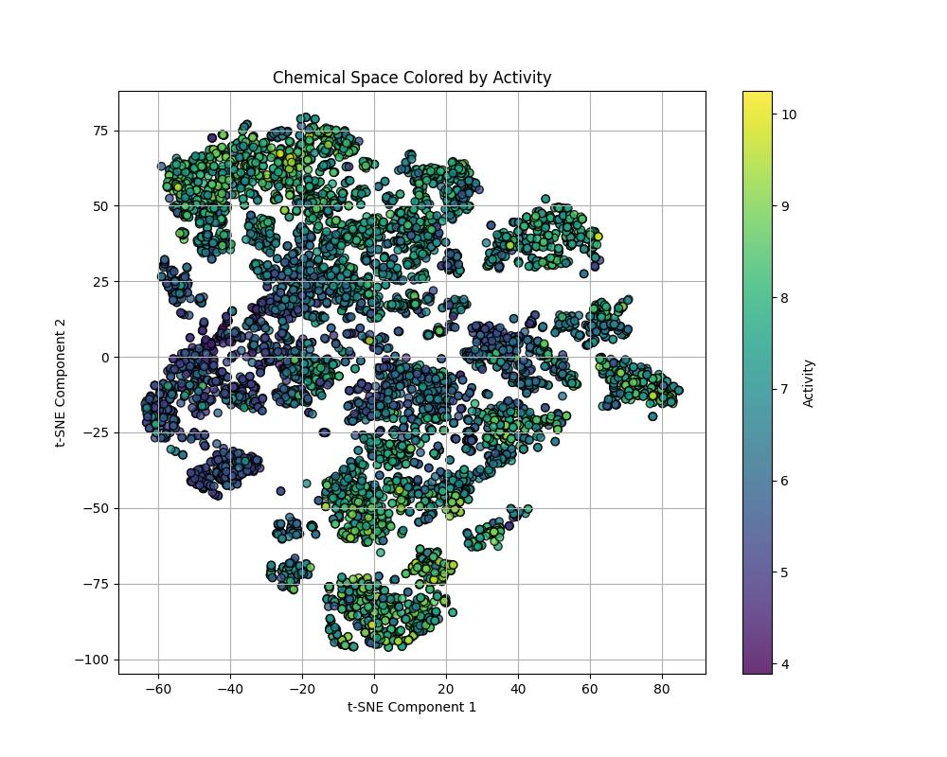
ACT2

Slide 5
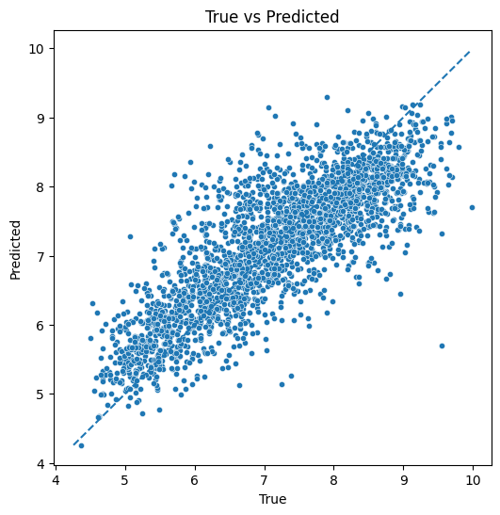
ACT2
Ensemble model
SVR + KernelRidge + GaussianProcessRegressor
 | R squere
Test | 0.6759

Slide 6
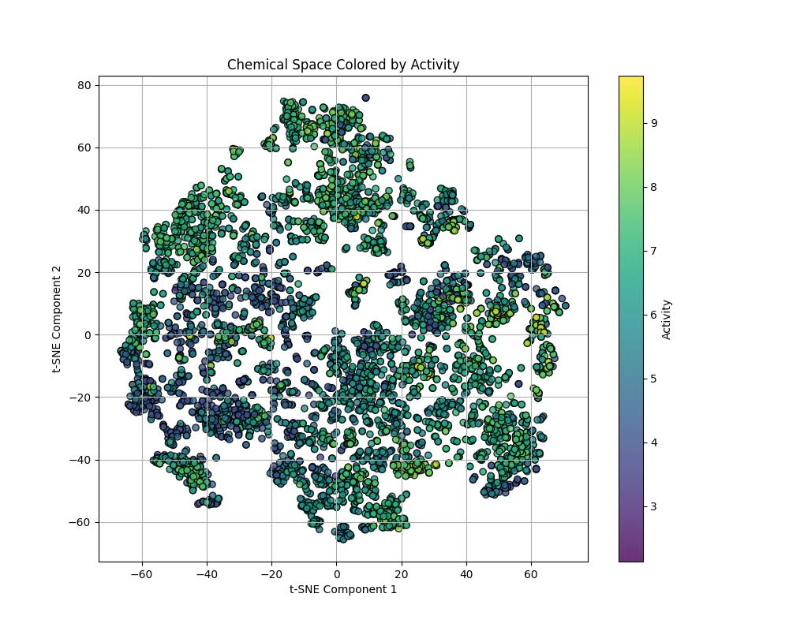
ACT3

Slide 7
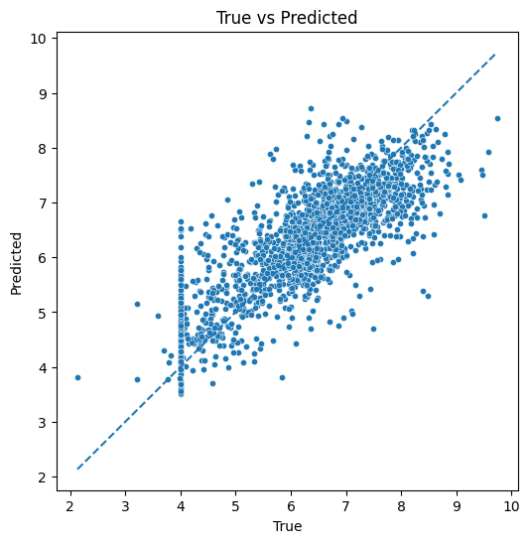
ACT3
Ensemble model
SVR + KernelRidge + GaussianProcessRegressor
 | R squere
Test | 0.6643

Slide 8
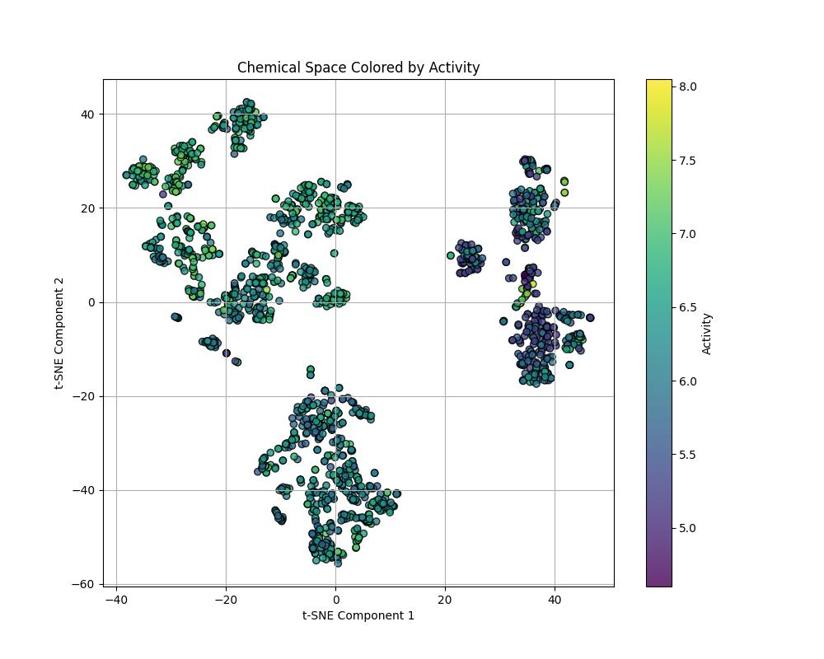
ACT4

Slide 9
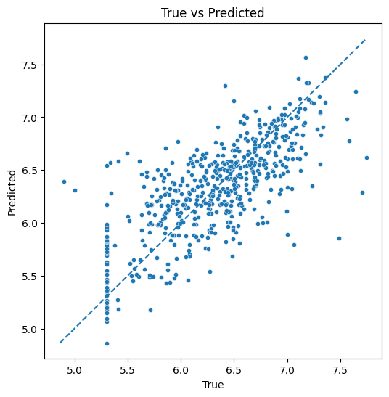
ACT4
Ensemble model
SVR + KernelRidge + GaussianProcessRegressor
 | R squere
Test | 0.5163

Slide 10
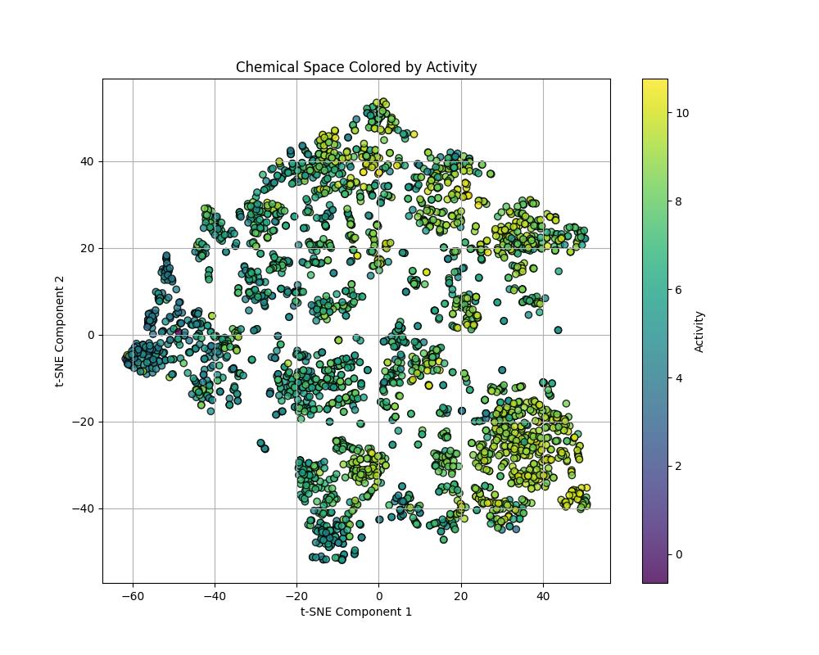
ACT5

Slide 11
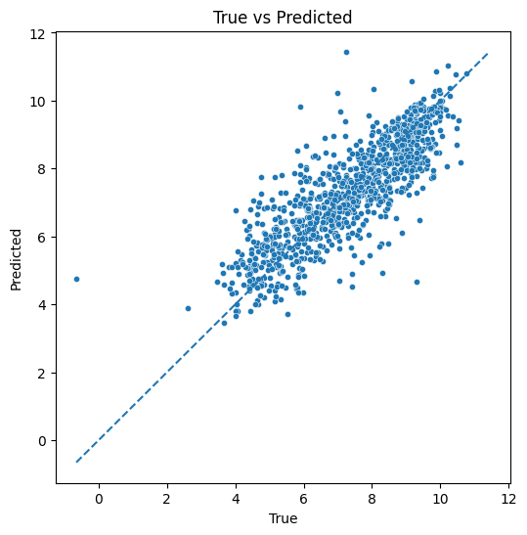
ACT5
Ensemble model
SVR + KernelRidge + GaussianProcessRegressor
 | R squere
Test | 0.6824

Slide 12
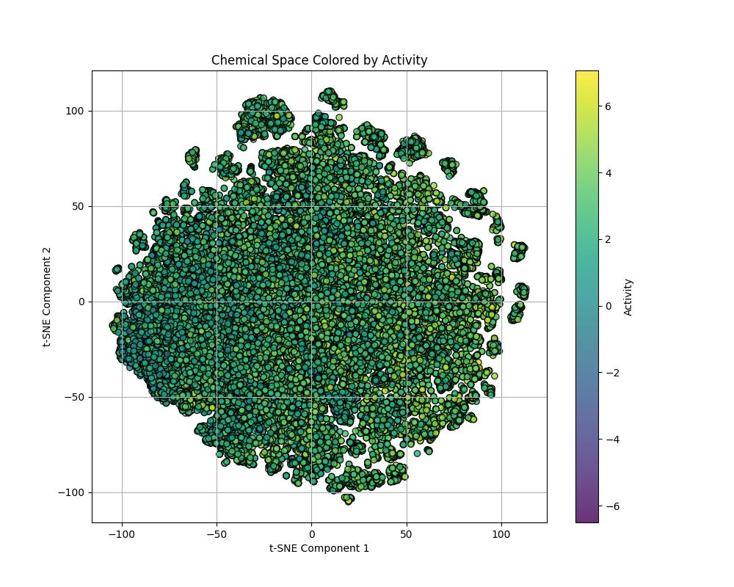
ACT6

Slide 13
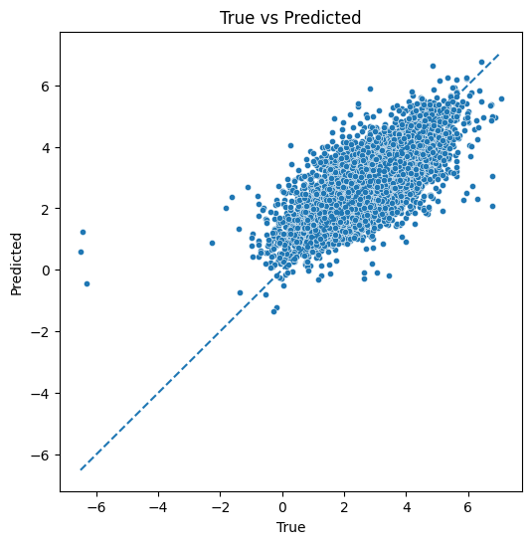
ACT6
NN model 4
 | R squere
Test | 0.6165

Slide 14
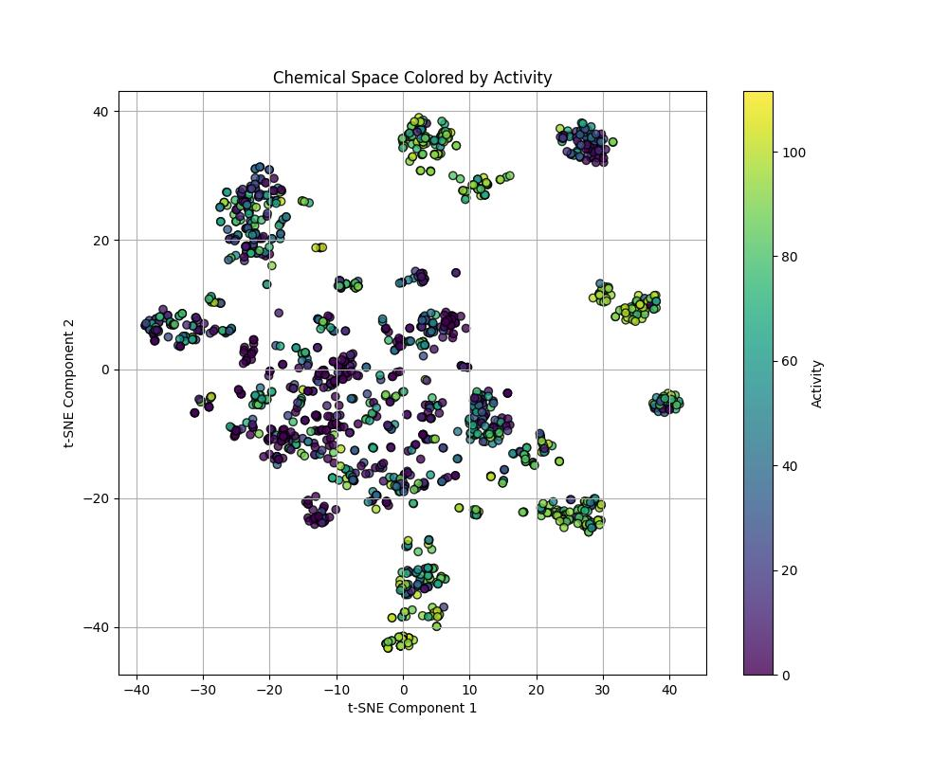
ACT7

Slide 15
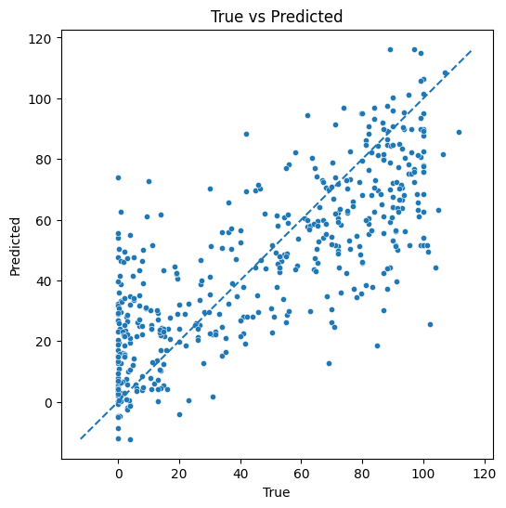
ACT7
Ensemble model
SVR + KernelRidge + GaussianProcessRegressor
 | R squere
Test | 0.6087

Slide 16
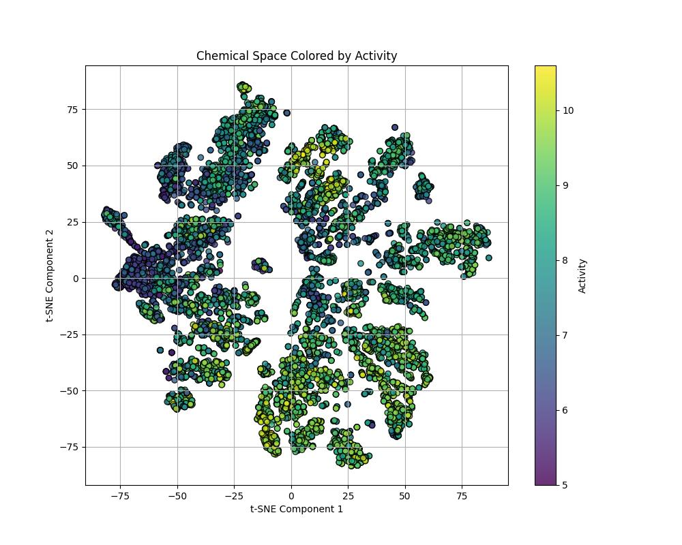
ACT8

Slide 17
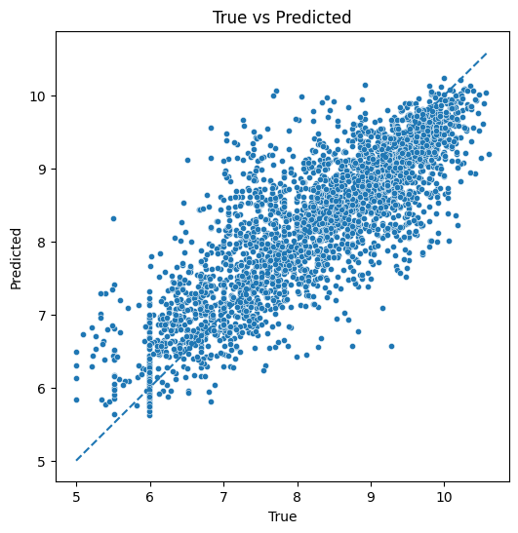
ACT8
Ensemble model
SVR + KernelRidge + GaussianProcessRegressor
 | R squere
Test | 0.6979

Slide 18
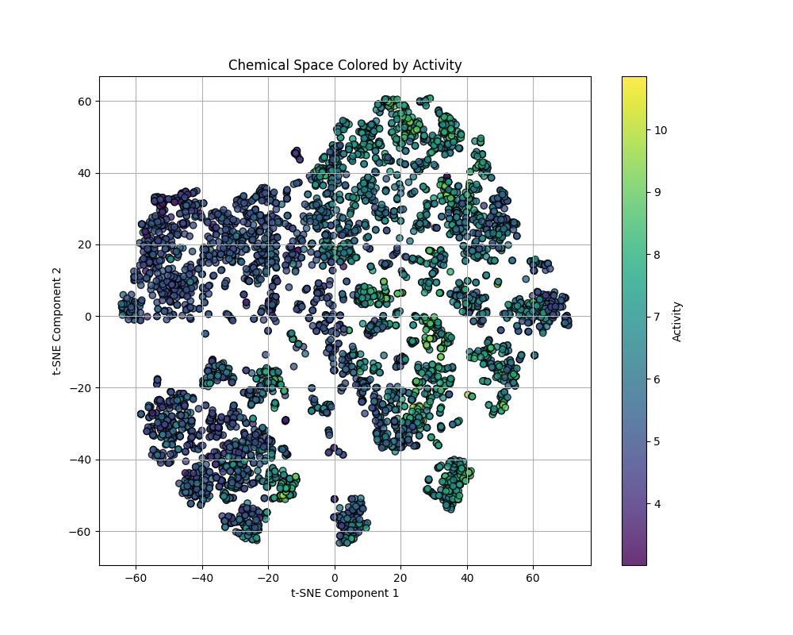
ACT9

Slide 19
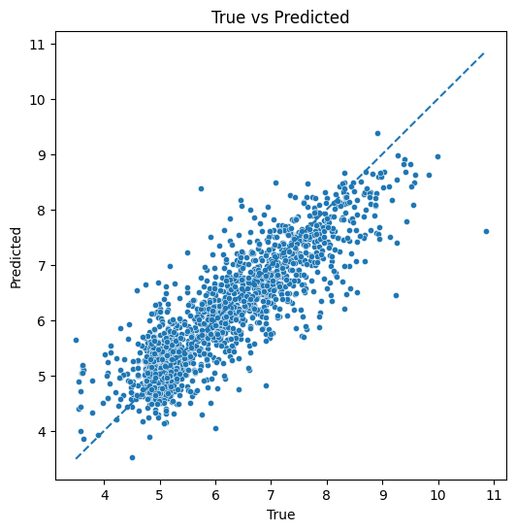
ACT9
Ensemble model
SVR + KernelRidge + GaussianProcessRegressor
 | R squere
Test | 0.7531

Slide 20
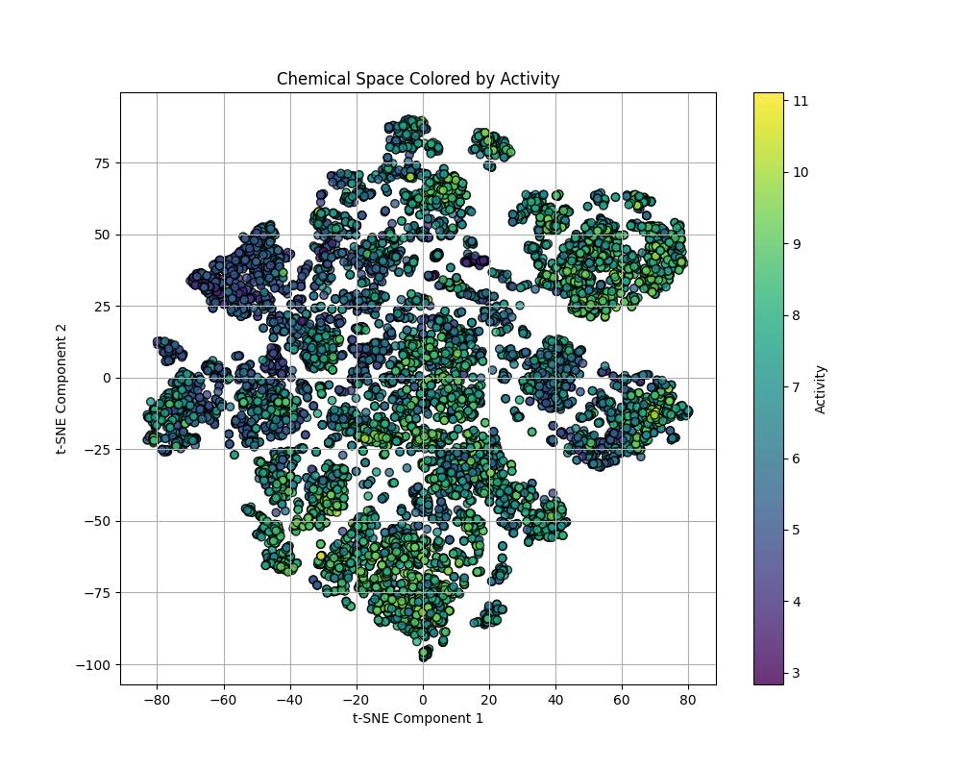
ACT10

Slide 21
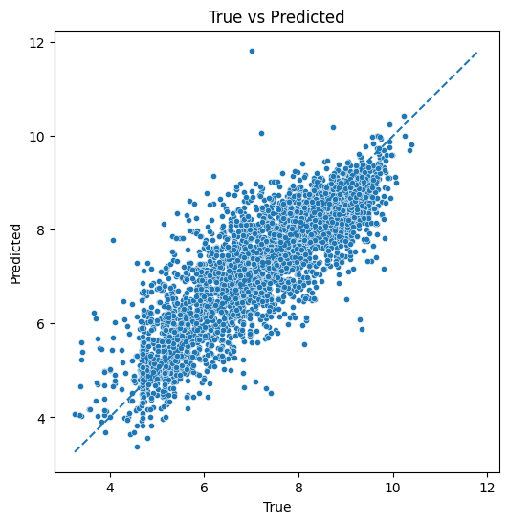
ACT10
NN model 1
 | R squere
Test | 0.7101

Slide 22
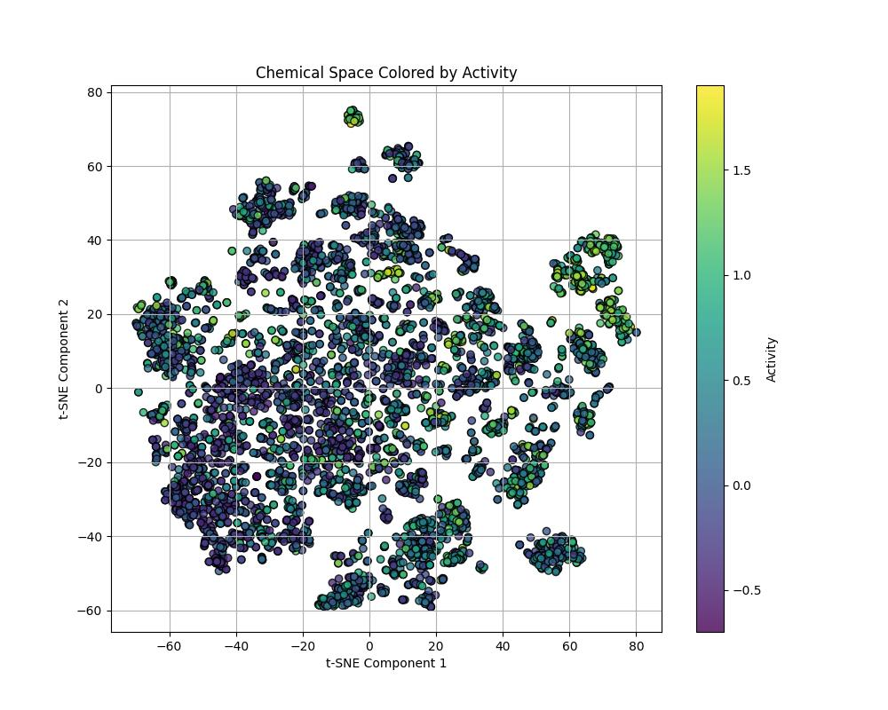
ACT11

Slide 23
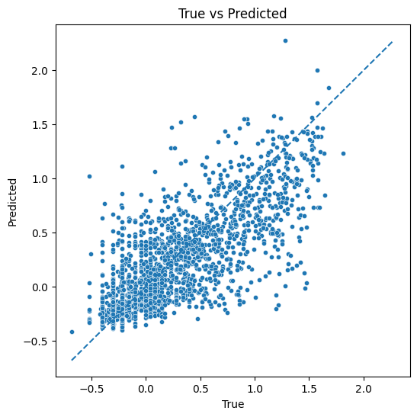
ACT11
NN model 1
 | R squere
Test | 0.5758

Slide 24
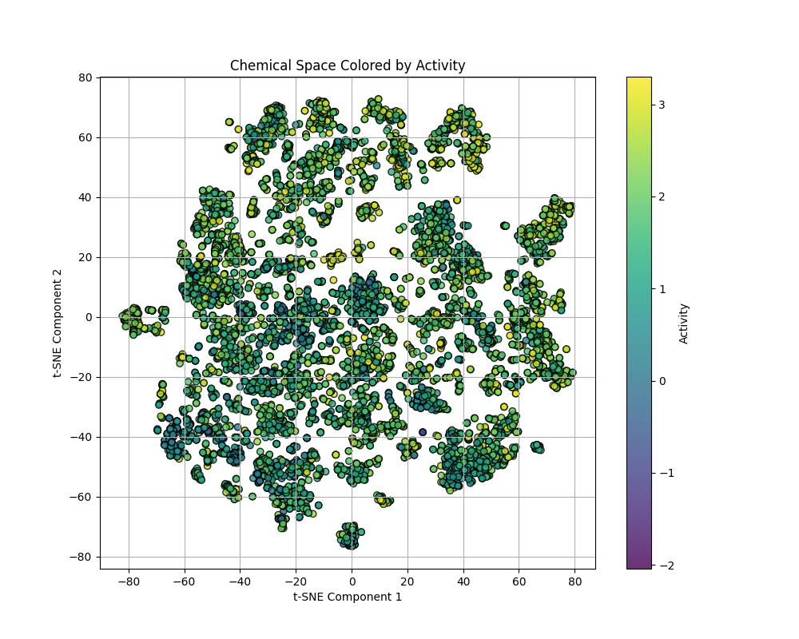
ACT12

Slide 25
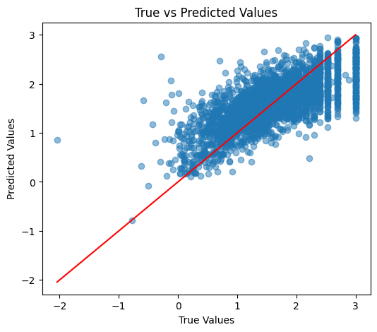
ACT12
XGBoost
 | R squere
Test | 0.5274

Slide 26
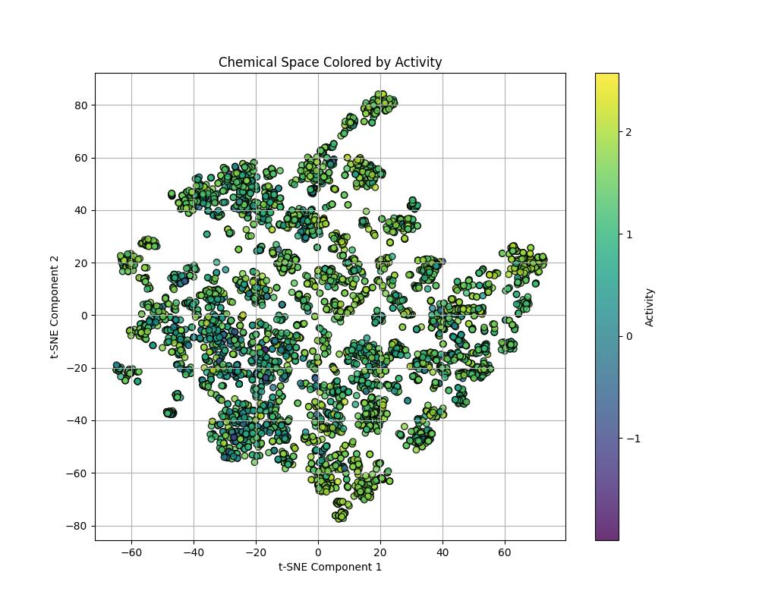
ACT13

Slide 27
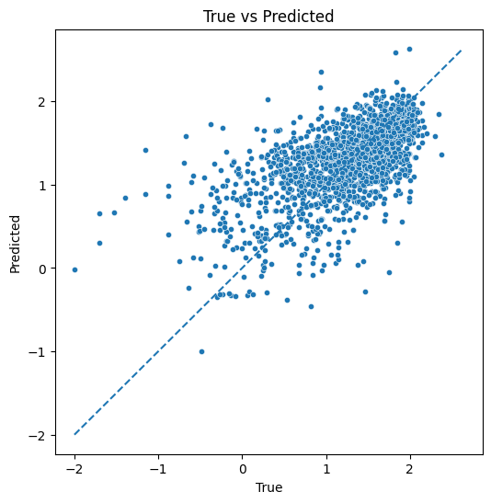
ACT13
NN model 4
 | R squere
Test | 0.3632

Slide 28
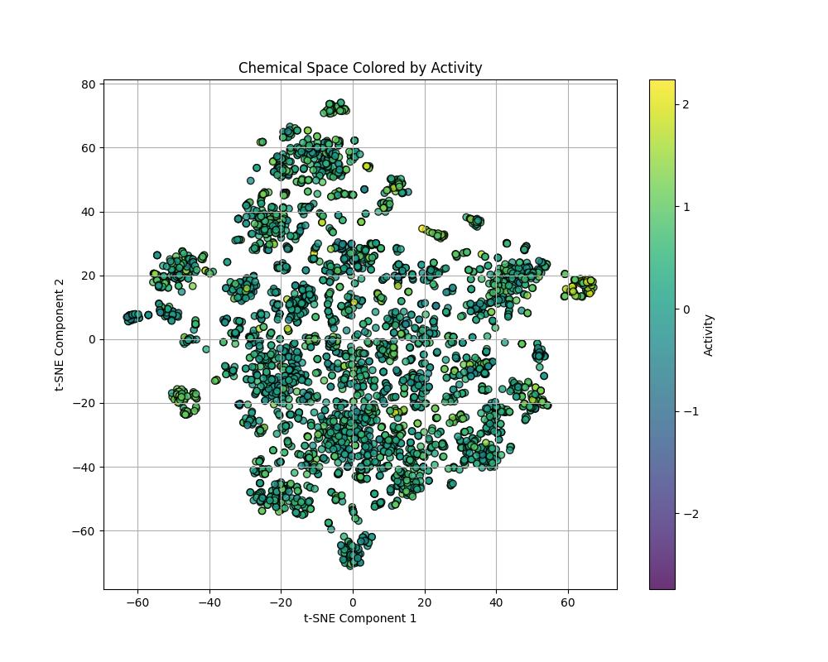
ACT14

Slide 29
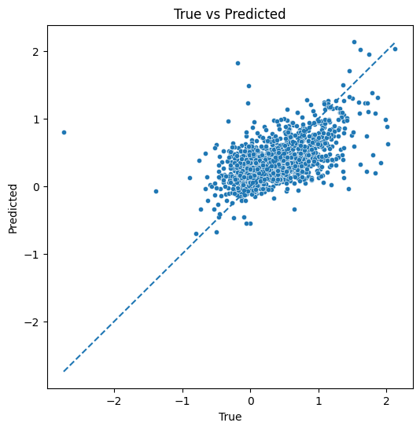
ACT14
Ensemble model
SVR + KernelRidge + GaussianProcessRegressor
 | R squere
Test | 0.3296

Slide 30
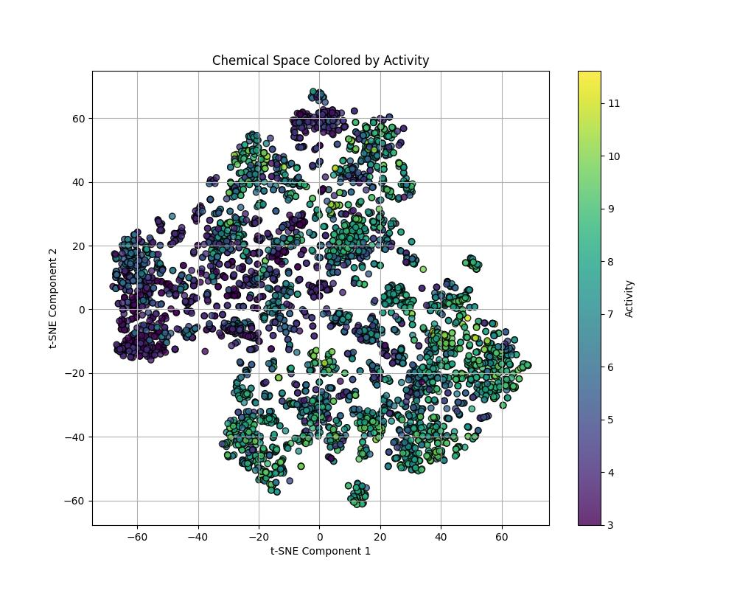
ACT15

Slide 31
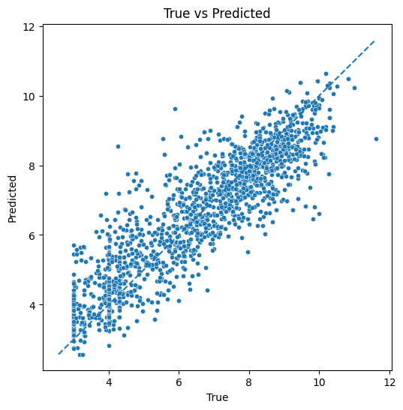
ACT15
Ensemble model
SVR + KernelRidge + GaussianProcessRegressor
 | R squere
Test | 0.796

Slide 32
Summary
Model | XGBoost | Ensemble | Architecture1 | Architecture2 | Architecture3 | Architecture4 | Best
ACT1 | 0.5451 | NA | 0.5321 | 0.5787 | 0.5567 | 0.5712 | 0.5787
ACT2 | 0.5889 | 0.6759 | 0.6062 | 0.6227 | 0.4644 | 0.6188 | 0.6759
ACT3 | 0.5578 | 0.6643 | 0.6431 | 0.6406 | 0.5374 | 0.6392 | 0.6643
ACT4 | 0.5157 | 0.5163 | 0.2074 | 0.2307 | 0 | 0.1155 | 0.5163
ACT5 | 0.6292 | 0.6824 | 0.5934 | 0.66 | 0.6604 | 0.5906 | 0.6824
ACT6 | 0.5053 | NA | 0.6062 | 0.6053 | 0.5902 | 0.6165 | 0.6165
ACT7 | 0.537 | 0.6087 | 0.5789 | 0.5876 | 0.5867 | 0.5931 | 0.6087
ACT8 | 0.6506 | 0.6979 | 0.6333 | 0.6225 | 0.6288 | 0.6261 | 0.6979
ACT9 | 0.6969 | 0.7531 | 0.7044 | 0.7248 | 0.6703 | 0.6648 | 0.7531
ACT10 | 0.6851 | NA | 0.7101 | 0.7052 | 0.6831 | 0.7001 | 0.7101
ACT11 | 0.5013 | 0.5623 | 0.5758 | 0.5464 | 0.5233 | 0.5516 | 0.5758
ACT12 | 0.5274 | 0.5617 | 0.5668 | 0.5703 | 0.5257 | 0.5611 | 0.5703
ACT13 | 0.3405 | 0.3536 | 0.3117 | 0.3459 | 0.3266 | 0.3632 | 0.3632
ACT14 | 0.3086 | 0.3296 | 0.3062 | 0.2793 | 0.2864 | 0.2891 | 0.3296
ACT15 | 0.7196 | 0.7959 | 0.7346 | 0.6839 | 0.7228 | 0.7051 | 0.7959

